Slide 1
Straw electronics
Straw Readout Board (SRB)

Slide 2
Full SRB - IO
Handling 16 covers
  Input 16*2 400(320eff) Mbits/s
Control
  TTC
  LEMO
  VME
Output
  to PC farm – 2*1Gb/s ethernet
  VME to SBC
  L0 trigger

Slide 3
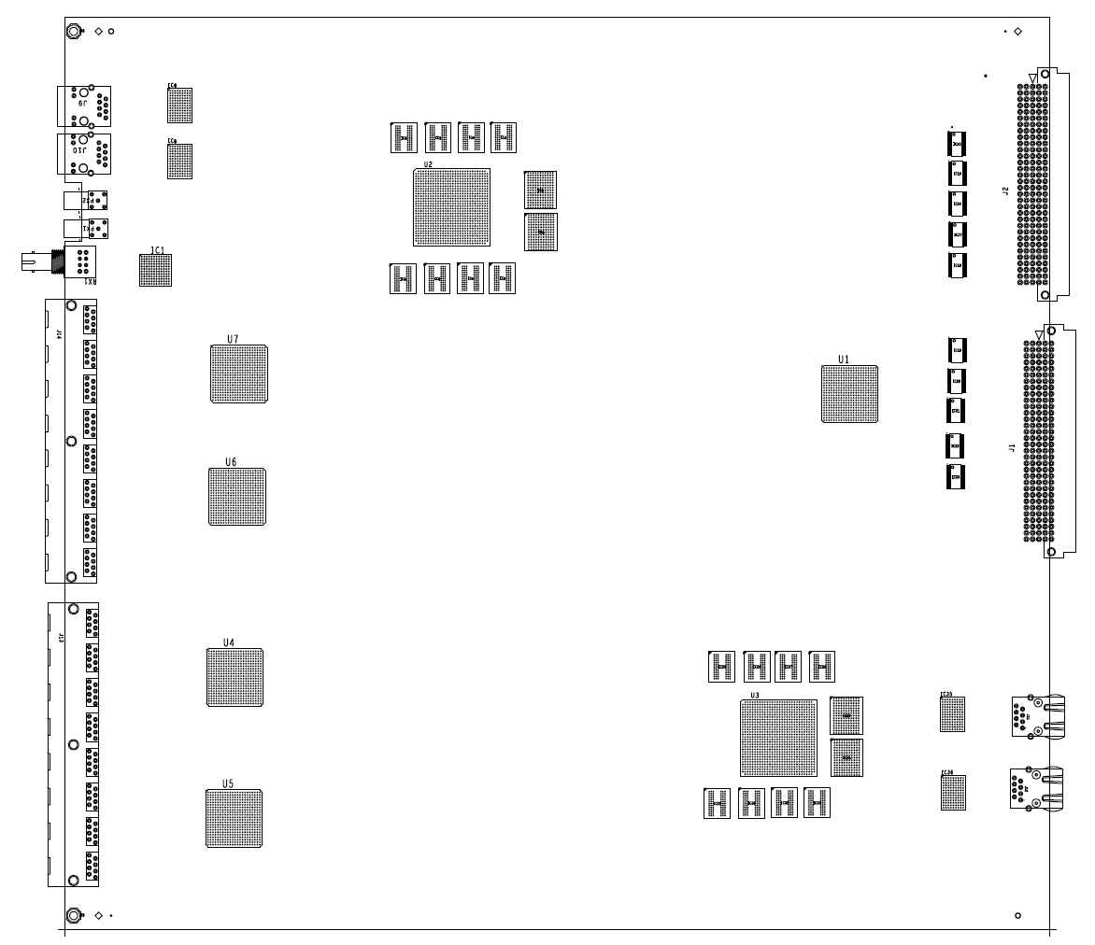
SRB – components
L0 PROCESSOR
L0 LOOK_UP
TABLE
L0 OUT
LEMO
VME INTF
ON-LINE
MONITOR
TTC
TTCRx
COVERS
TIME
REMAP
DATA TO PC FARM
COVER CONTROL, DATA, SYNCH
EVENT PROCESSOR
2(4)GB DDR3

Slide 4
SRB – control flow
VME to
- Setup
- Control,
- On-line monitoring
- Data
Selectable control
TTC
LEMO
VME
Clock delay to compensate time of flight

Slide 5
SRB – data flow
VME
2.5Gbit/s
16x2x320Mbit/s
~10Gbit/s
2x Gbit ethernet

Slide 6
SRB – trigger data flow
L0 PRIMITIVES
VME
2.5Gbit/s
16x2x320Mbit/s
~10Gbit/s
2x Gbit ethernet

Slide 7
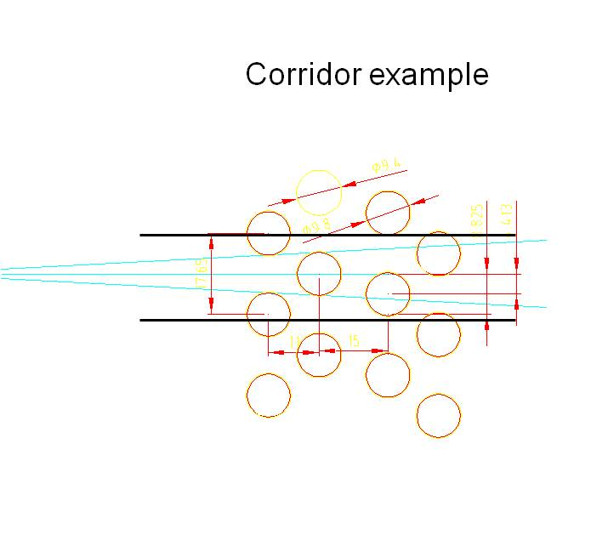
Trigger
First mentioned in TD
Possibility to use Straw detector for L0 if proved to be useful
View is split to corridors
  6 straws
Corridors overlap on each side by 2 straws
2 or more trailing edges in a corridor in a defined time window qualify a track
Can be already used as a coarse position ~13mm

Slide 8
Trigger
Position can be improved using leading edges
Leading edges from 6 straws put into the time pipeline corresponding to the full drift time in straw, step 25ns
Trailing edge track signal starts pattern recognition
Leading edges are run though look-up table and output position code
Time-corresponding position codes from all views are combined
To look-up table
6 straws leading edges

Slide 9
Trigger
1 SRB with modified firmware collects primitives from 8 SRBs serving 1 chamber
  Left/right ambiguity solved using 3 views
4 SRBs from 4 chambers send L0 primitives to L0 processor
Time estimate
  Event to Cover to SRB – <500ns
  Time-reordering of hits - 10us
  Track finding - <1us
  Collection of hits and combination < 10us
  Sending L0 primitives in < 22us

Slide 10
SRB
Design started
  Schematics
  Big part of prototype board firmware could be reused
  New parts
    Time reordering
    Event buffer management
    data format for pc-farm
    Online monitoring
    L0 trigger
Ready for PCB layout in October
Prototype December
Price estimate
  Components < 1 kCHF
  PCB + assembly < 1 kCHF
  Total < 2 kCHF

