Slide 1
Report from the straw working group
H. Danielsson

Slide 2
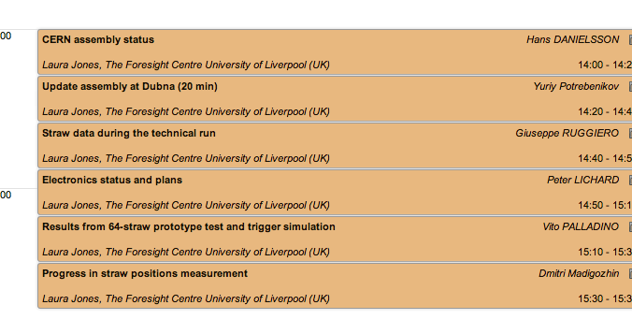
Content

Slide 3
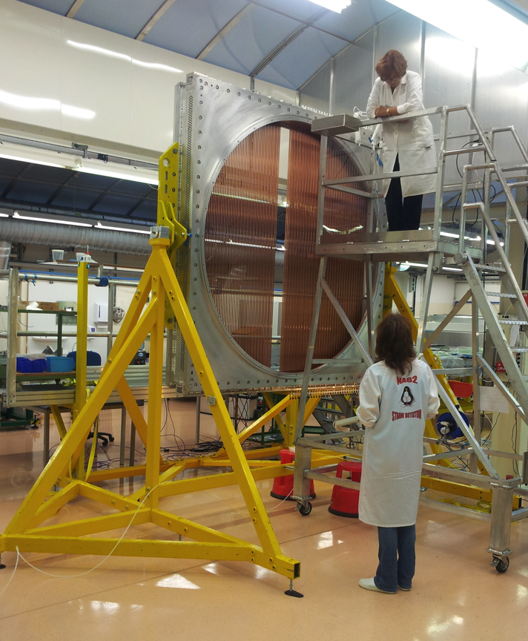
Assembly and testing
Three out of four modules completed in terms of straw gluing and wiring
All four modules (Ch1 and Ch3) completed by the end of the year (straws, wires and testing)
Module #6 on 26/8/2013

Slide 4
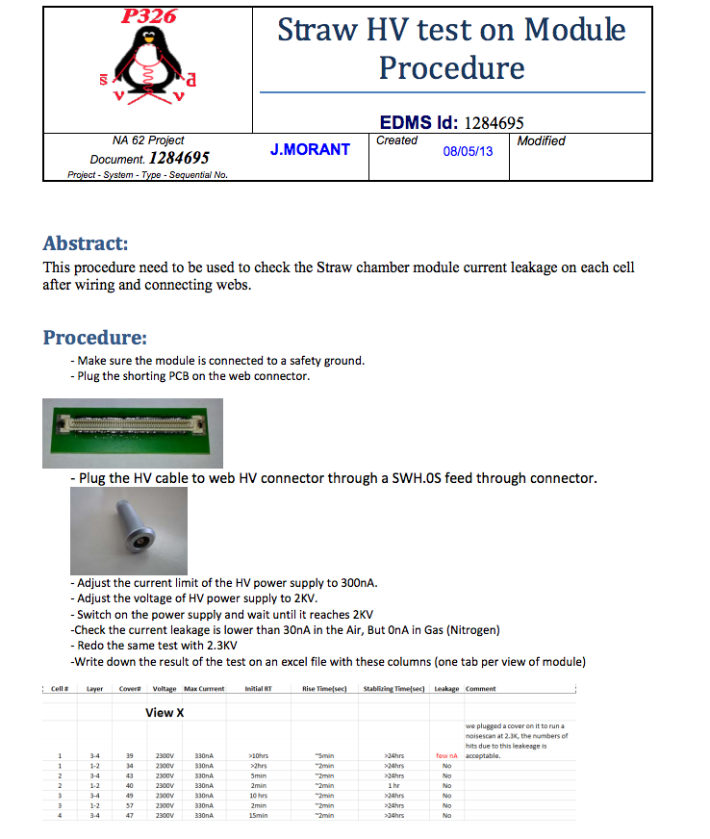
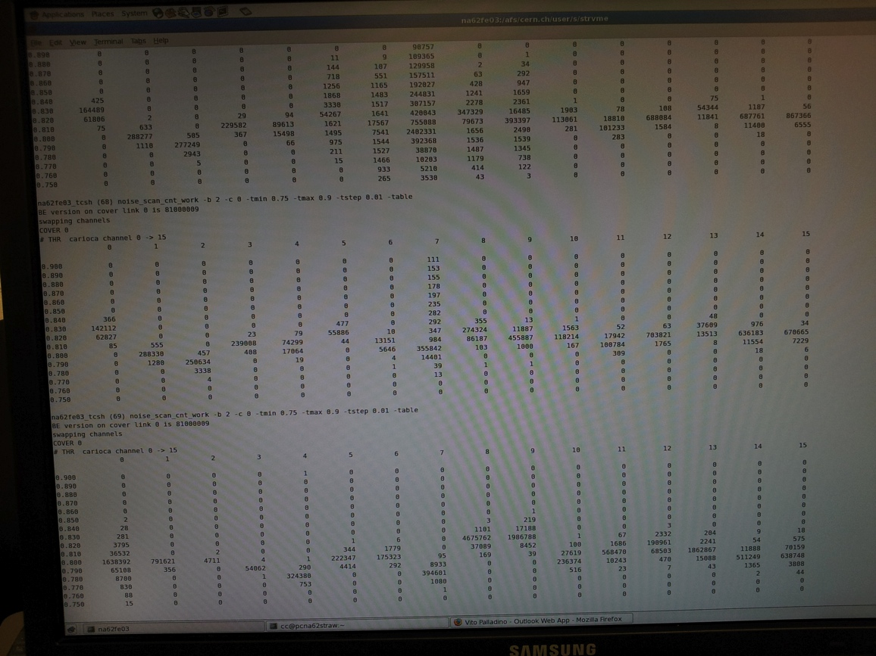
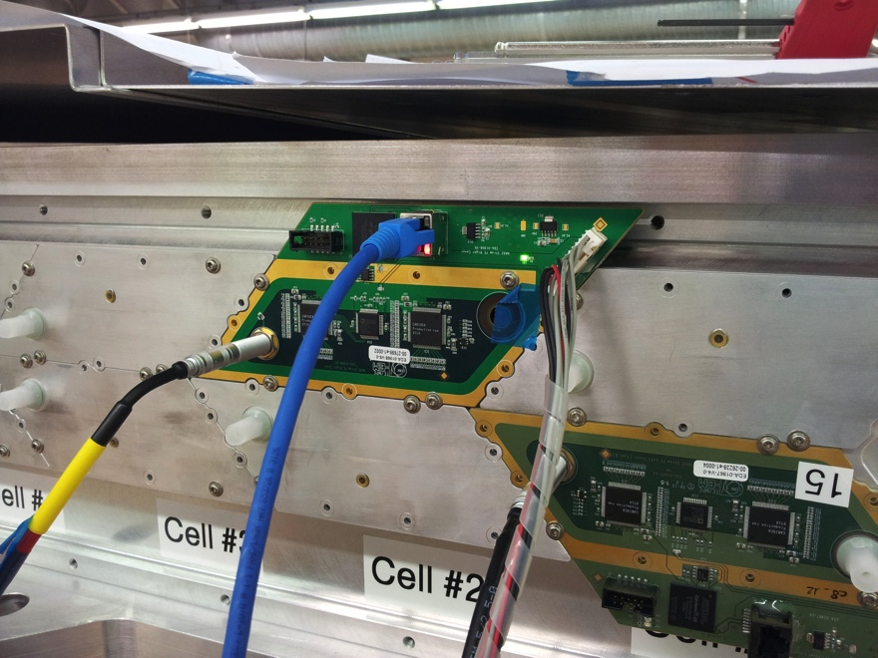
Example HV test
HV test by monitoring the current (1nA resolution) at 2.2kV. If current too high we need to identify the wire.
HV test by Threshold scan (see below). Typically we have ~10 wires /view to change.
New cover! ☺

Slide 5
Gas Load
From theory:
From experiment:
Component | Pressure increase rate
Vacuum Tank | 1.27 x 10⁻²mBar l/s (27%)
LAV Detectors | 2.2 x 10⁻²mBar l/s (47%)
STRAW Tracker | 1.25 x 10⁻²mBar l/s (26%)
Total | 4.72 x 10⁻²mBar l/s (100%)
‘NA62 Vacuum requirements specification’ EDMS:1143879
Limit for an individual straw
Total pressure increase (March ‘13 test)
STRAW Tracker | 53% (1E-11/1.88E-11)
Outgassing | 37% (7E-12/1.88E-11)
Air Leak | 10% (1.8E-12/1.88E-11)
Leak test 05-07/03/2012
← !!
%s from Mass Sweep

Slide 6
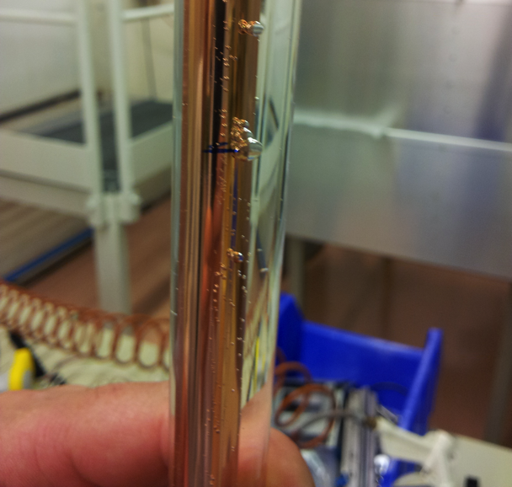
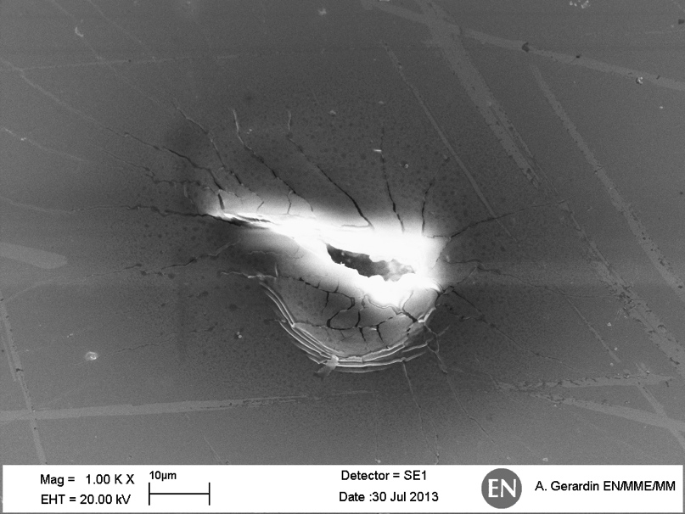
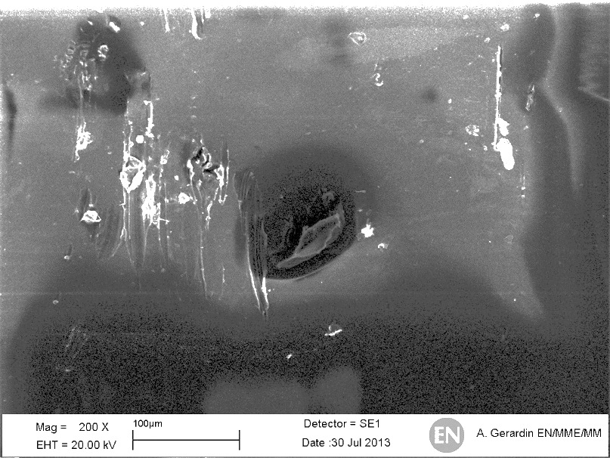
Straw leak in the technical run
Three straws were leaking and replaced. One straw had a leak of ~10 mbar x cm³/min. Two straws had a leak of ~100 mbar x cm³/min. The big leaks could be found with a leak detector, but not the small leak.
It is possible that we did not see the leaks during the assembly
The smallest leak was not visible
in a simple bubble test (water) and not possible to
detect with the leak detector….with
Helium it was possible as can be seen →
Future action: pressurize the chambers (1 bar)
before installation
SEM images
(inner surface)
(outer surface)

Slide 7
Status of straw production
and
straw module assembling in Dubna
S.Movchan, Yu.Potrebenikov
28 August 2013

Slide 8
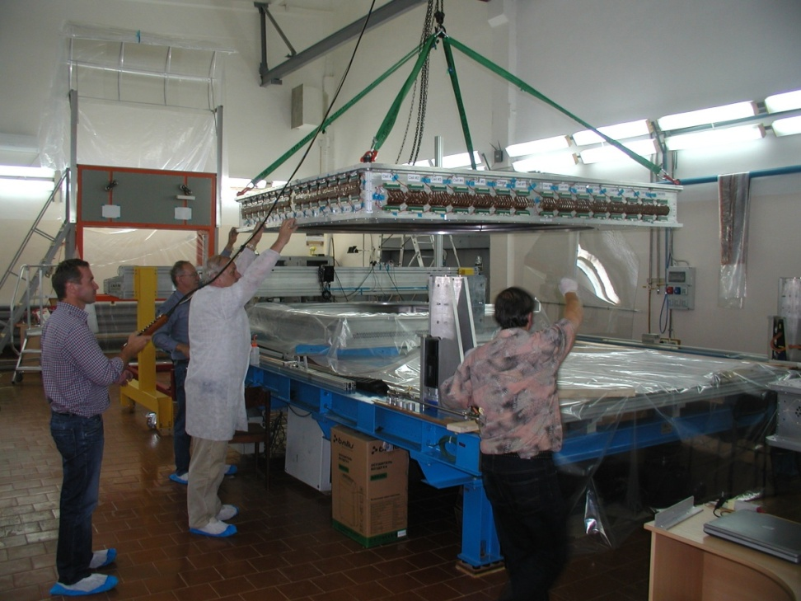
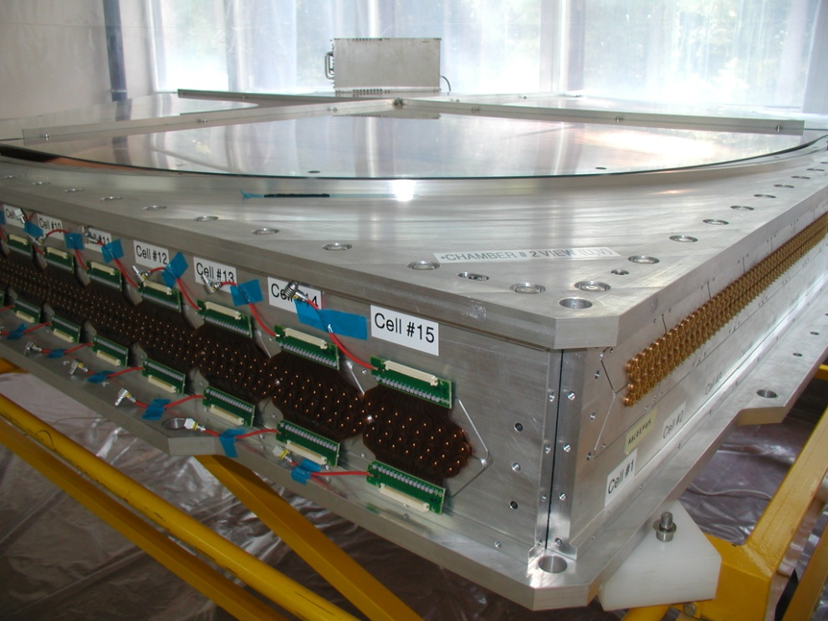
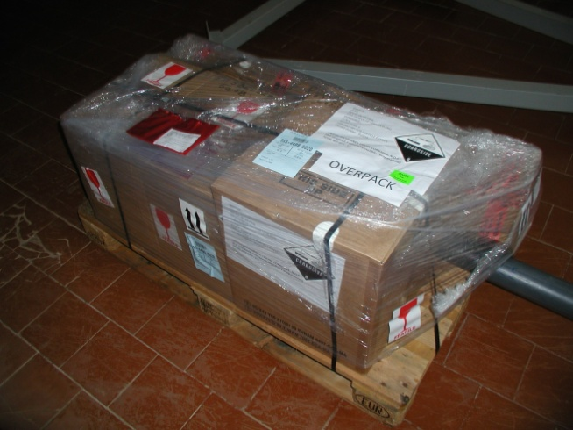
Module removed from the assembly tooling
(June 2013)
CH2 M1 in
“dry” room
ready for HV test
A set of materials and components
for finish assembly CH2 M1
and for assembly CH2 M2 (X-Y) is received from CERN August 15, 2013

Slide 9
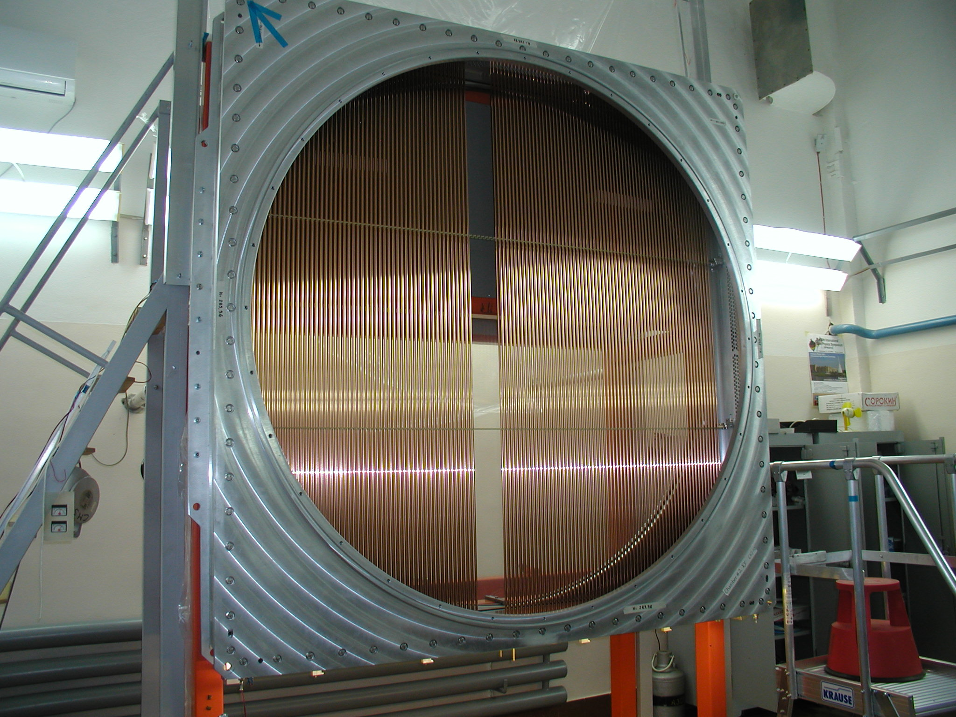
Straw gluing
2 layers have been glued

Slide 10
Conclusion and planes
Straw manufacture:
  there are all necessary straws for module 2 of CH2
  and for module 1 of CH4
  straw manufacture is in progress for module 2 of CH4
  Straw manufacture will be finished in October 2013
CH2 Module 1 (U-V):
  straw gluing and wiring – done
  final assembly – started
  tests (HV, gas leak) – September 2013
  delivery to CERN – September 2013
CH2 Module 2 (X-Y):
  straw gluing – 2 layers glued + Sept
  wiring – October 2013
  final assembly – November 2013
  tests (HV, gas leak) – December 2013
  delivery to CERN – January 2014
  CH2 installation – Feb-March 2014
instead Feb, 2014 (new Fredi schedule)

Slide 11
CH4 M1 U-V:
  vacuum test – in progress
  straw gluing – Nov-Dec 2013
  wiring - Jan-Feb 2014
  final assembly – April 2014
  tests (HV, gas leak) – May 2014
  delivery to CERN – July 2014
CH4 M2 X-Y:
  frame gluing – Autumn 2013
  vacuum test – Autumn 2013
  straw gluing – Feb-March 2014
  wiring - April 2014
  final assembly – May 2014
  tests (HV, gas leak) – June 2014
  delivery to CERN – July 2014
  CH4 installation - Aug-Sept 2014 instead July-Aug (new Fredi schedule)

Slide 12
Straw Data during the Technical Run
Giuseppe Ruggiero (CERN)
Straw WG Meeting
Liverpool, 28/08/2013

Slide 13
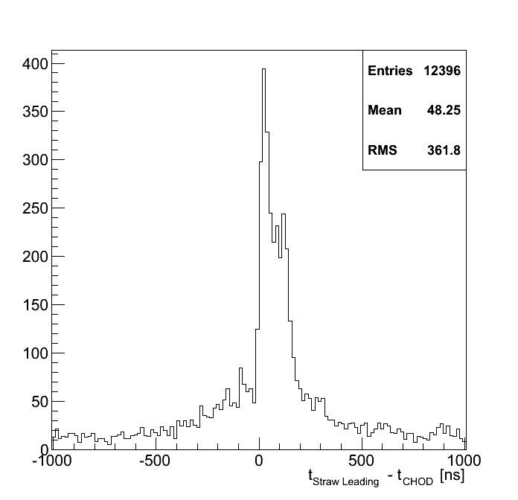
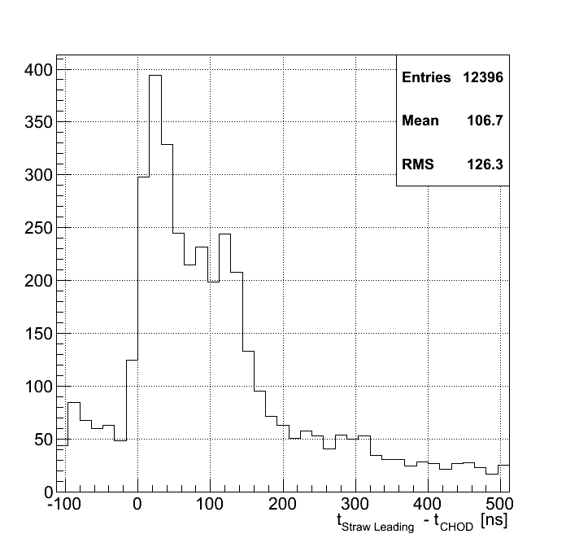
Straw – CHOD Timing
Drift time structure in time with CHOD clearly visible (< 200 ns).
Out-of-time structure within +-500 ns from the drift time not understood

Slide 14
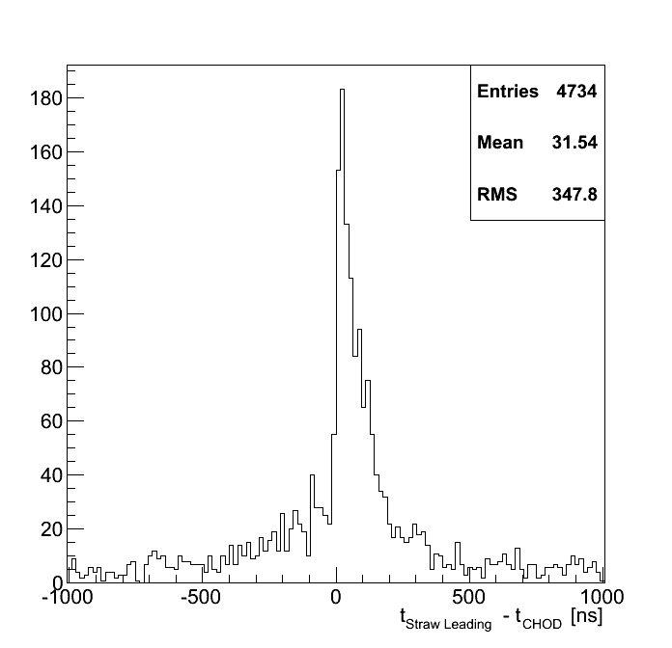
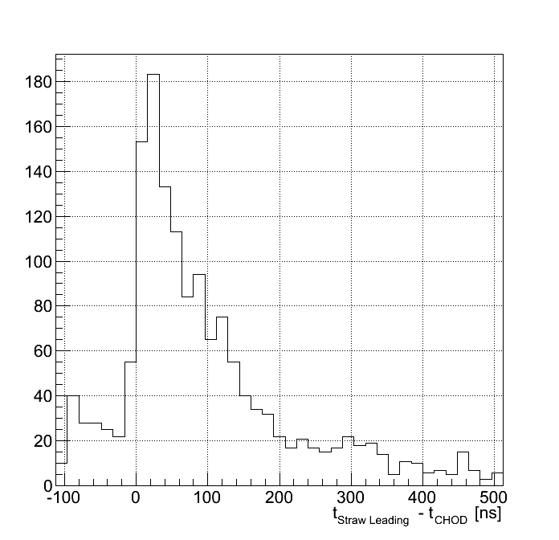
First Straw hit Timing
If >1 leading in the same straw within 200 ps the hit with the minimum time is considered.
No more shoulder in the second half of the drift time

Slide 15
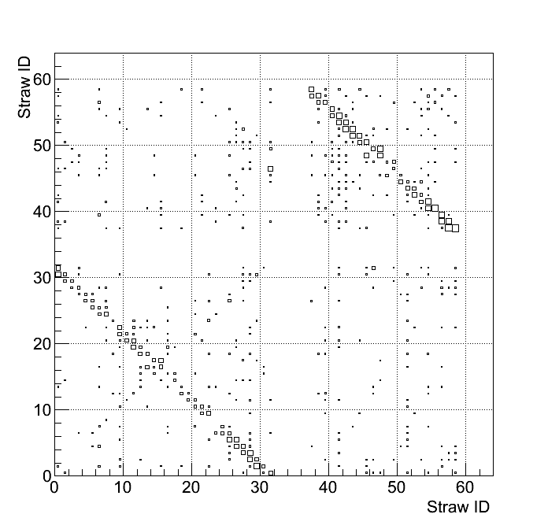
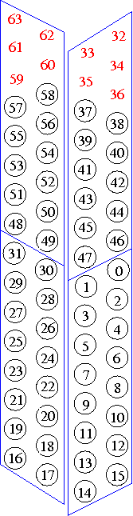
Plane correlations
Relative position of the hits belonging to different straws and within 200 ns
Pattern compatible with hits from one particle going straight

Slide 16
Straw L0 Trigger Studies
Vito Palladino
NA62 Collaboration Meeting - Liverpool
Idea: implement capacity in the new SRB
(see presentation by Peter)

Slide 17
Tracking
In order to track charged particles the detector is divided in corridors (group of 6 straws) two neighbor corridors have 2 common straws.
Corridor shape has been defined in order to maximize the number of straws in one corridor.
First two chambers are considered for tracking.
No drift time is considered. One coordinate (XYUV) is measured doing the mean of the position of the hit straws.

Slide 18
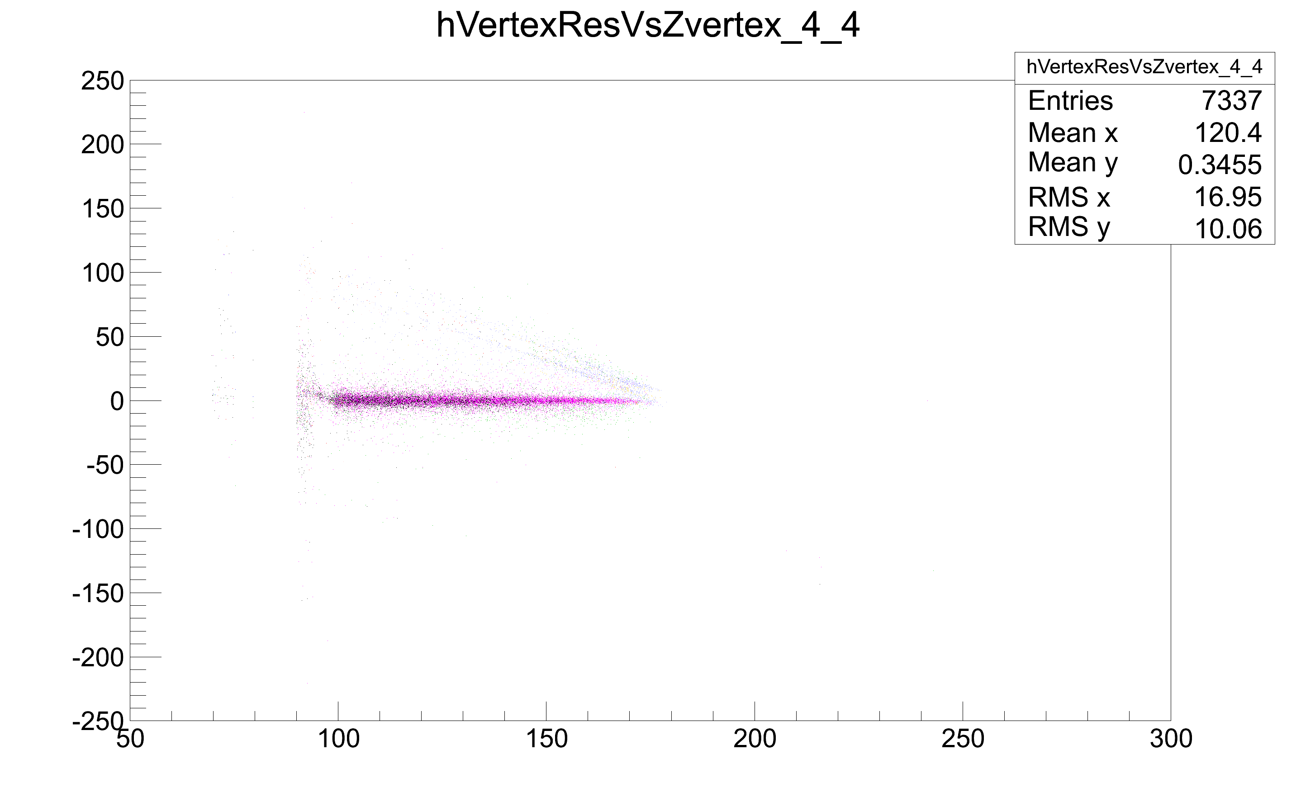
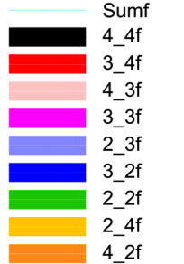
Vertex Resolution Z Dependence
Straw0
MCT vertex – Reco Vertex (m)
GTK3
MCT vertex (m)

Slide 19
Full SRB – IO (P. Lichard)
Handling 16 covers
  Input 16*2 400(320eff) Mbits/s
Control
  TTC
  LEMO
  VME
Output
  to PC farm – 2*1Gb/s ethernet
  VME to SBC
  L0 trigger

Slide 20
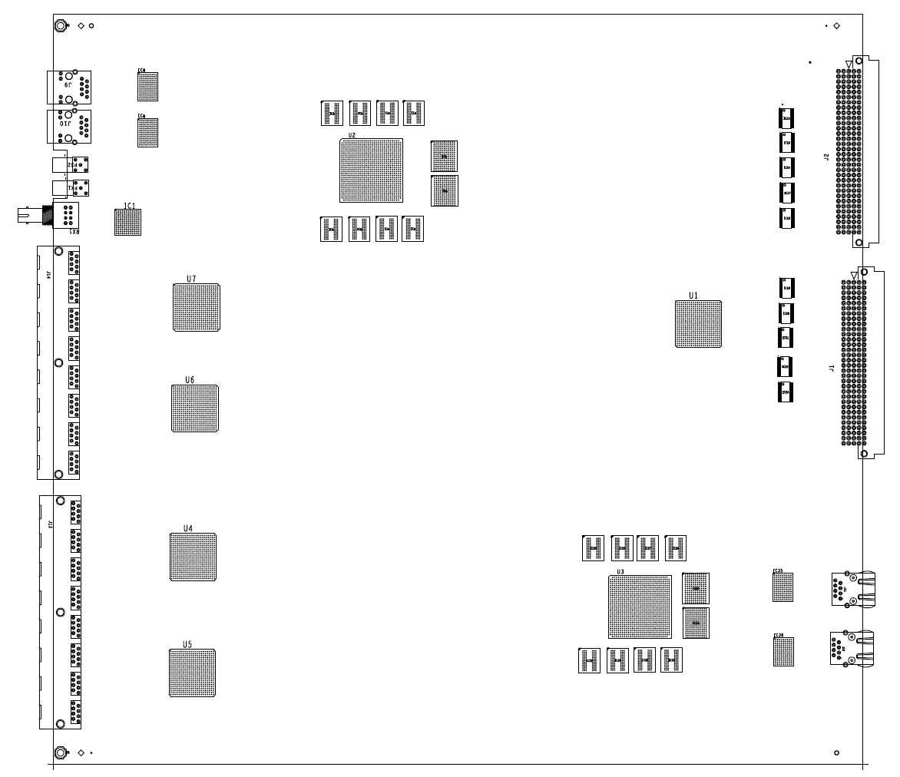
SRB – data flow
VME to
- Setup
- Control,
- On-line monitoring
- Data
2.5Gbit/s
16x2x320Mbit/s
~10Gbit/s
2x Gbit ethernet

Slide 21
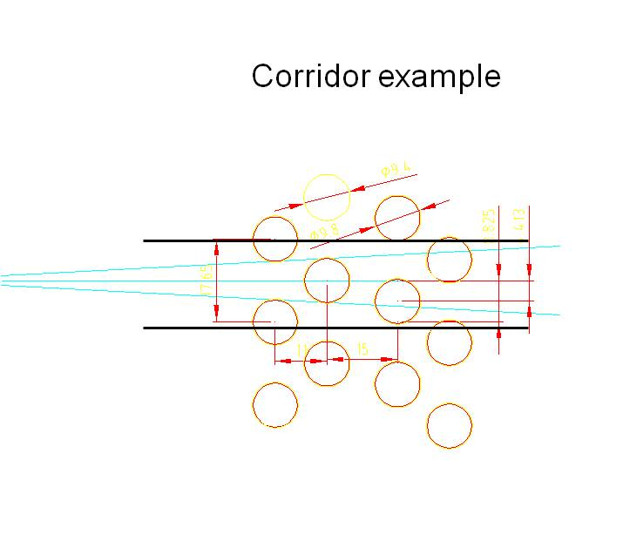
Trigger
First mentioned in TD
Possibility to use Straw detector for L0 if proved to be useful
View is split to corridors
  6 straws
Corridors overlap on each side by 2 straws
2 or more trailing edges in a corridor in a defined time window qualify a track
Can be already used as a coarse position ~13mm

Slide 22
Trigger
Position can be improved using leading edges
Leading edges from 6 straws put into the time pipeline corresponding to the full drift time in straw, step 25ns
Trailing edge track signal starts pattern recognition
Leading edges are run through look-up table and output position code
Time-corresponding position codes from all views are combined
To look-up table
6 straws leading edges

Slide 23
Conclusions and Plans
Production is progressing in Dubna and at CERN
  Chamber 1, 2 and 3 will be completed by the end of the year (straw installation, wiring and testing).
  Chamber 4 will be completed in the beginning of 2014
However, we see that the schedule is tight. In particular for Chamber 4. We need to find a way to complete the assembly earlier. We will have meeting in Dubna in October to discuss this and the preparation for the installation in 2014.
Leak in TR: We found 3 leaking straws and they have been replaced. The exact cause for these defects is not yet known.
Front-end cover board and SRB:
  Cover should be available in October which will allow us to complete the modules and start testing (including taking some data with cosmics)
  Straw Readout Board: The design is well advanced and it will include the possibility for a L0 trigger. Prototype expected in December

Slide 24
Spares

Slide 25
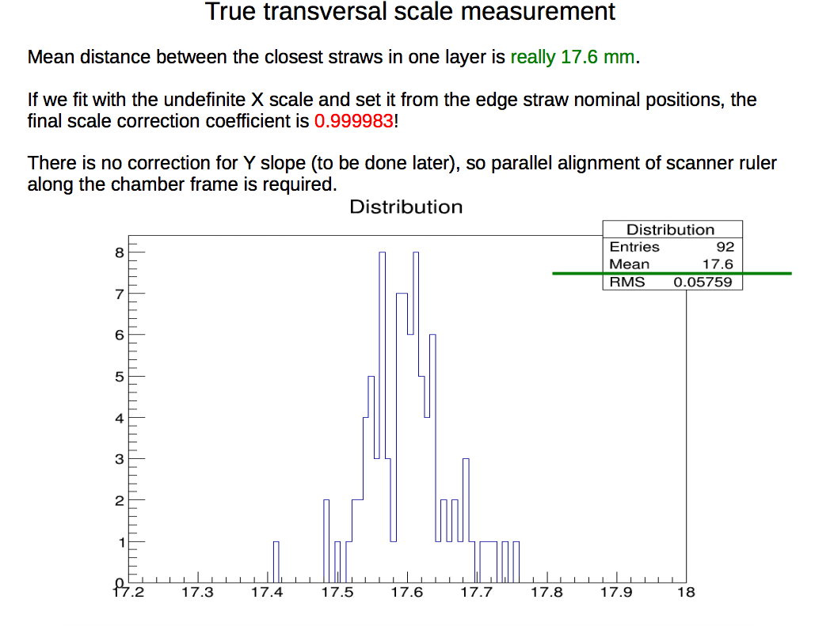
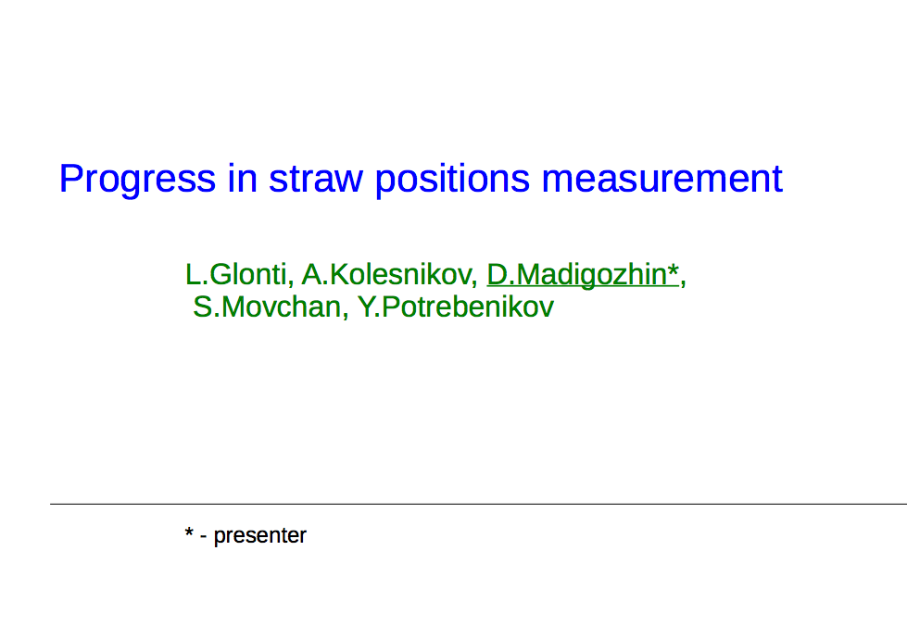
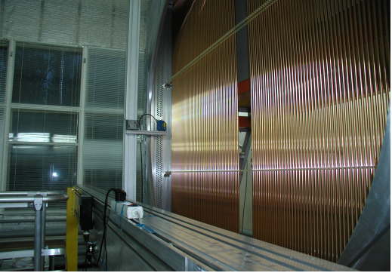
Conclusions
Method to handle triggerless data developed.
Timing correlation between Straws and other detectors evident.
View-planes correlation clearly visible.
Structure of the straw drift time to be investigated in detail.
Structure of the out-of-time event to be studied.
Straw multiple hit structure to be further investagated.

Slide 26
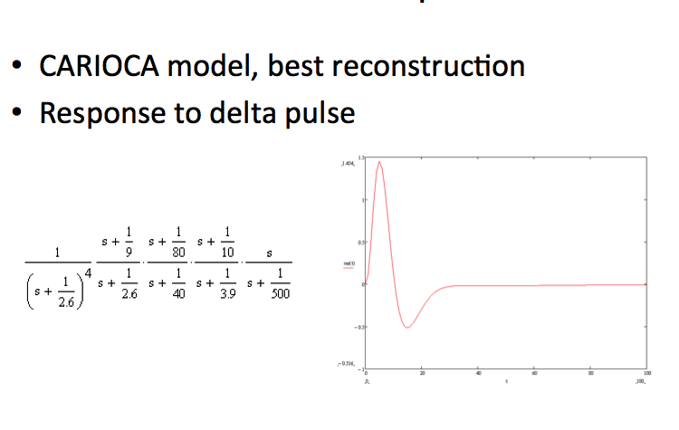
Signal

Slide 27
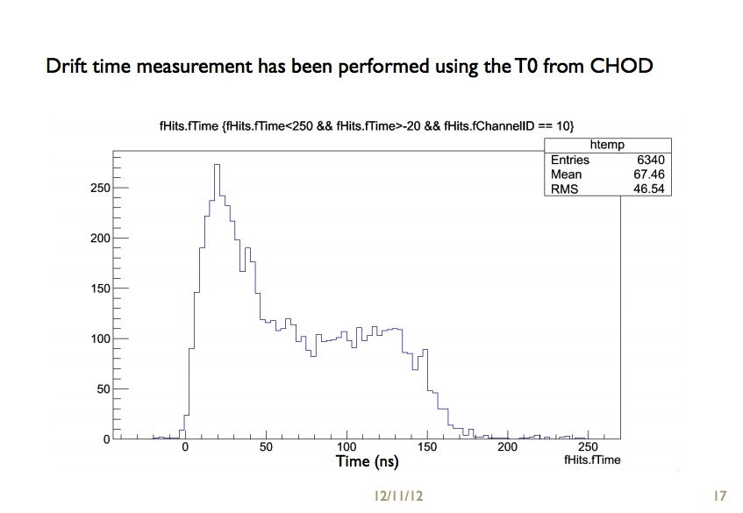
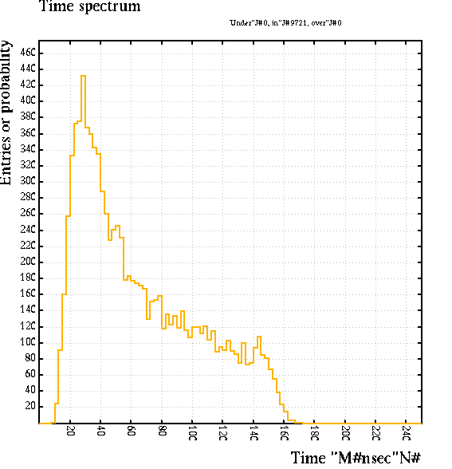
Time spectrum
TR
(From Tonino’s presentation)
Garfield (first th. crossing)

Slide 28
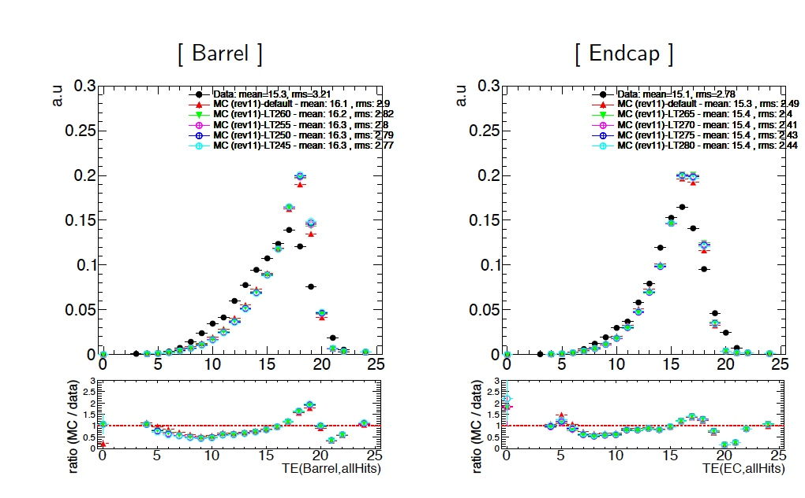
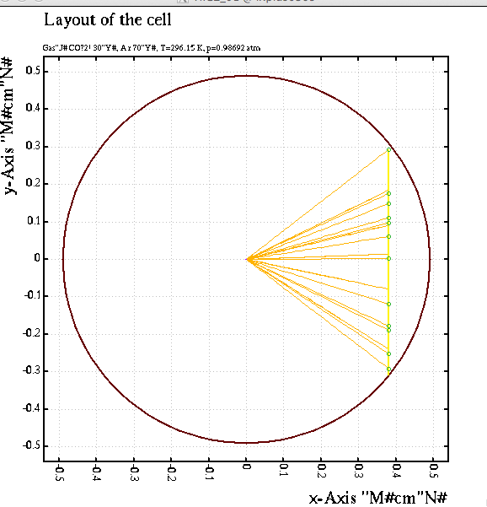
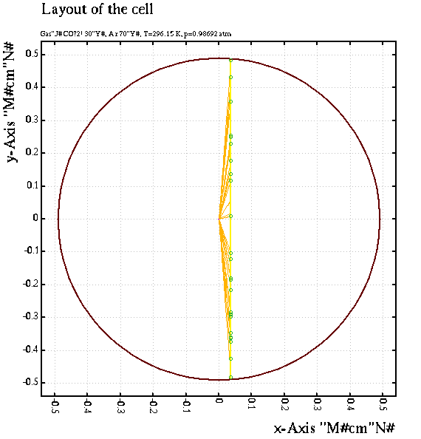
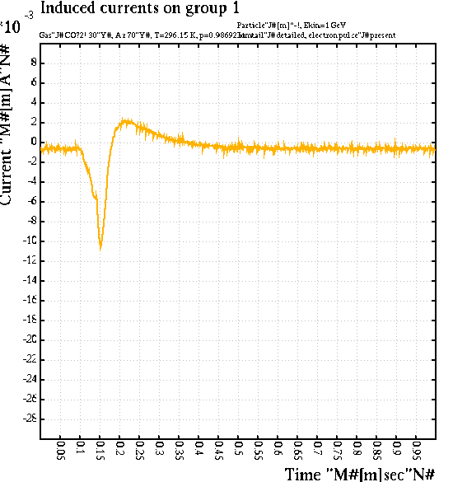
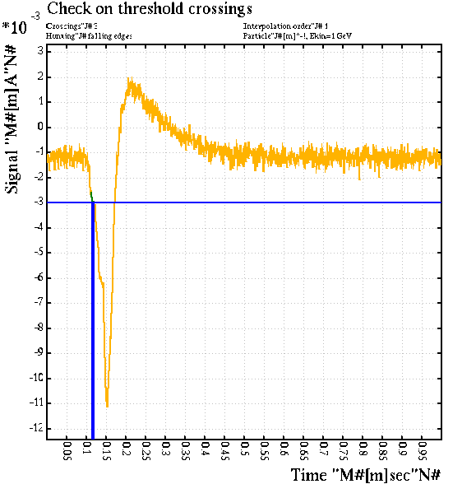
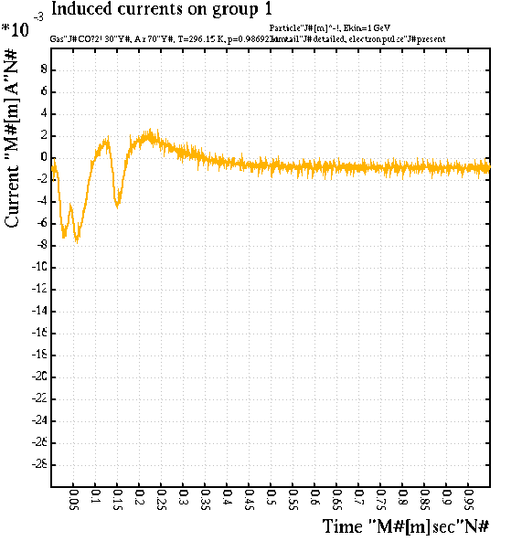
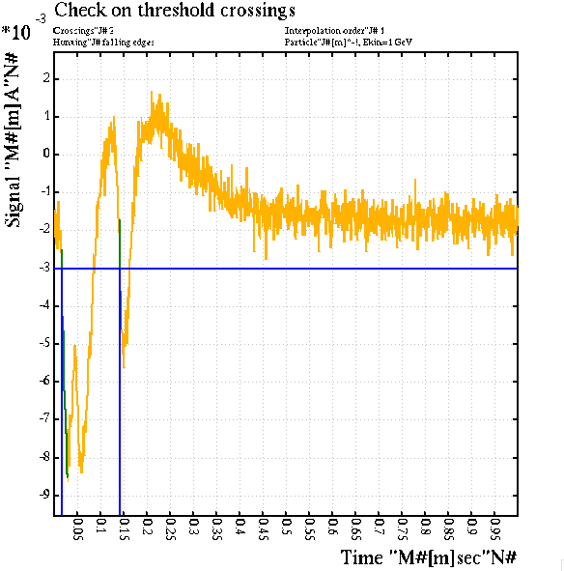
Trailing edge
Will in principle give the time of the track but is difficult to implement in particular with fast electronics like the CARIOCA
ATLAS TRT shows similar results. (They don’t use the trailing edge)

Slide 29
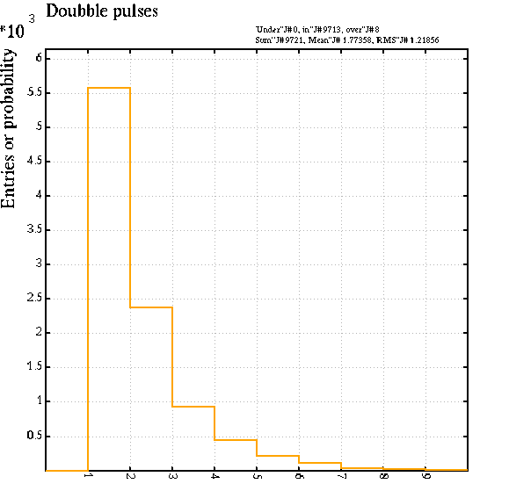
Double pulses

