Slide 1
Challenges and Overview
Augusto Ceccucci
NA62 Collaboration Meeting
Liverpool, UK, August 27, 2013

Slide 2

NA62 Collaboration Meeting
Thank you to the Liverpool Team for the hospitality!
We are delighted to be here
Liverpool has outstanding tradition is particle physics
Nice memories of John Dainton (JD) and John Fry (JF)
JD: We met on a taxi from Heathrow to RAL
in 1999; Shared LHCC experience (same side);
SPSC experience (opposite side…)
JF: John F. (CPLEAR, Babar) was SPSC referee
of NA48; We spoke during the same session
of the Lepton Photon Symposium in 2003…

Slide 3
Overview: Particle Physics
Higgs Boson → Found
SUSY → Not Found
We are told that New Physics must exist
The 100 TeV scale at Colliders is unlikely to be addressed directly before 2035
(see next slide)
We seem to be left for a long time with:
LHC@14 TeV (from 2015)
Rare Processes: B, K, μ ,ν
NA62 is timely and important

Slide 4
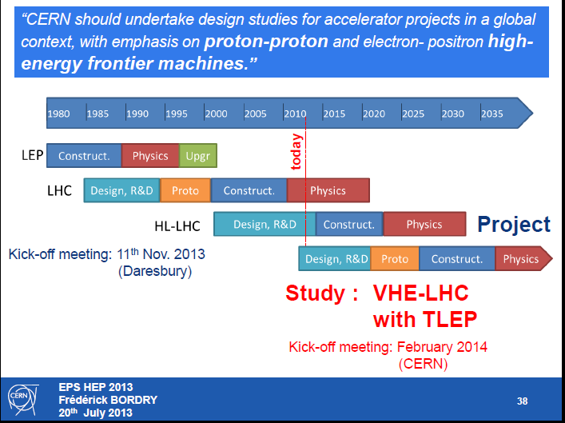

Slide 5
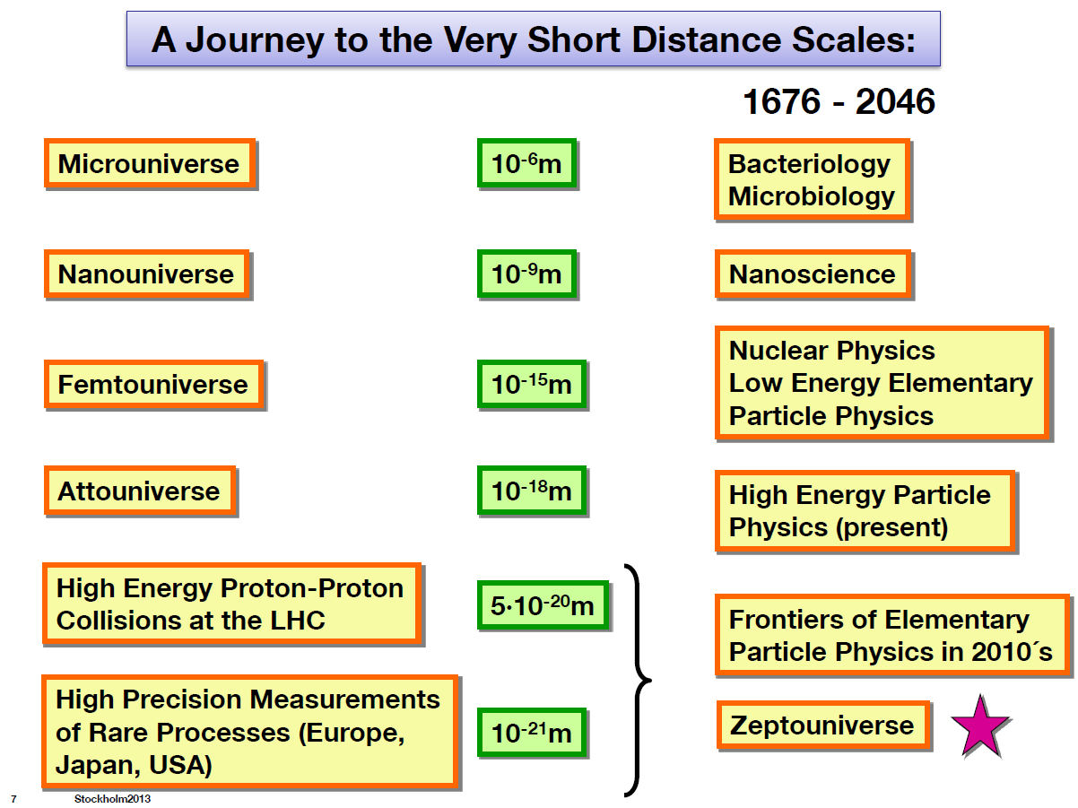
Following A. Buras at EPS HEP

Slide 6
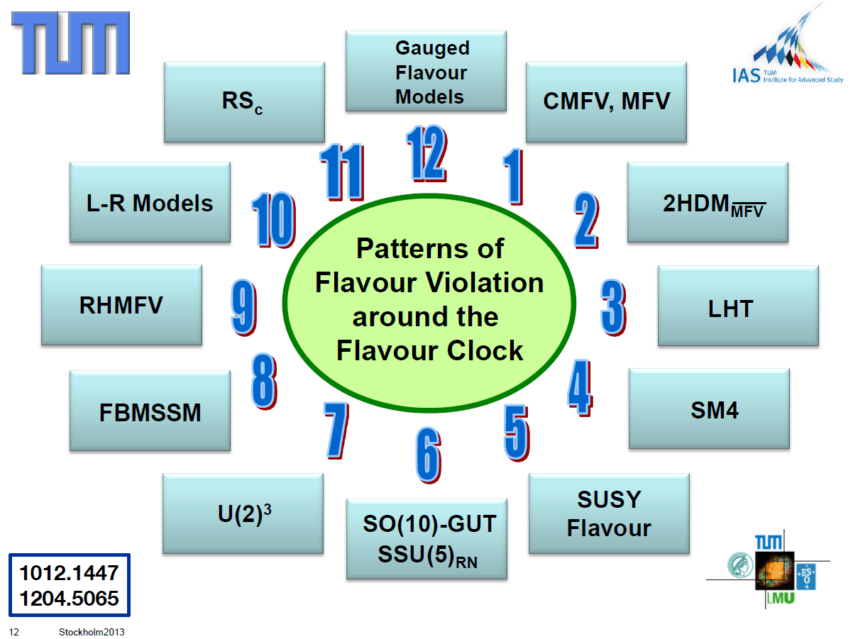
A. Buras @EPS HEP
No lack of possibilities….

Slide 7
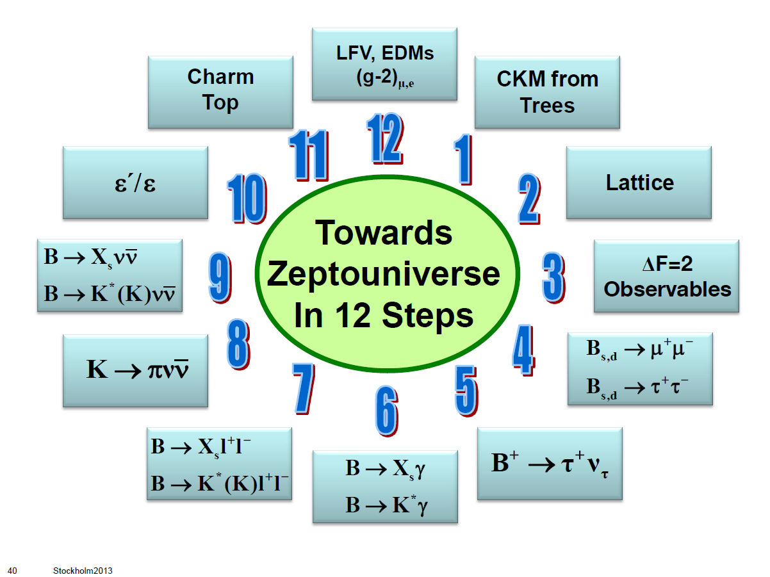
A. Buras EPS HEP

Slide 8

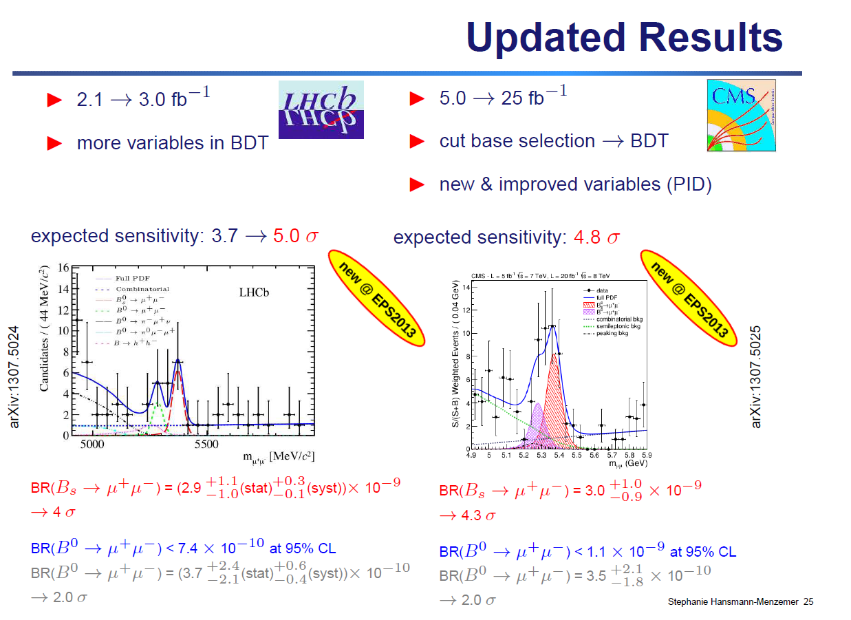
Overview, new results: B_{(s,d)} →μ⁺μ⁻
SM Predictions: FCNC and helicity suppression:
B rare decays are
now where K rare decays
used to be 15 years ago
…large errors but catching up!

Slide 9
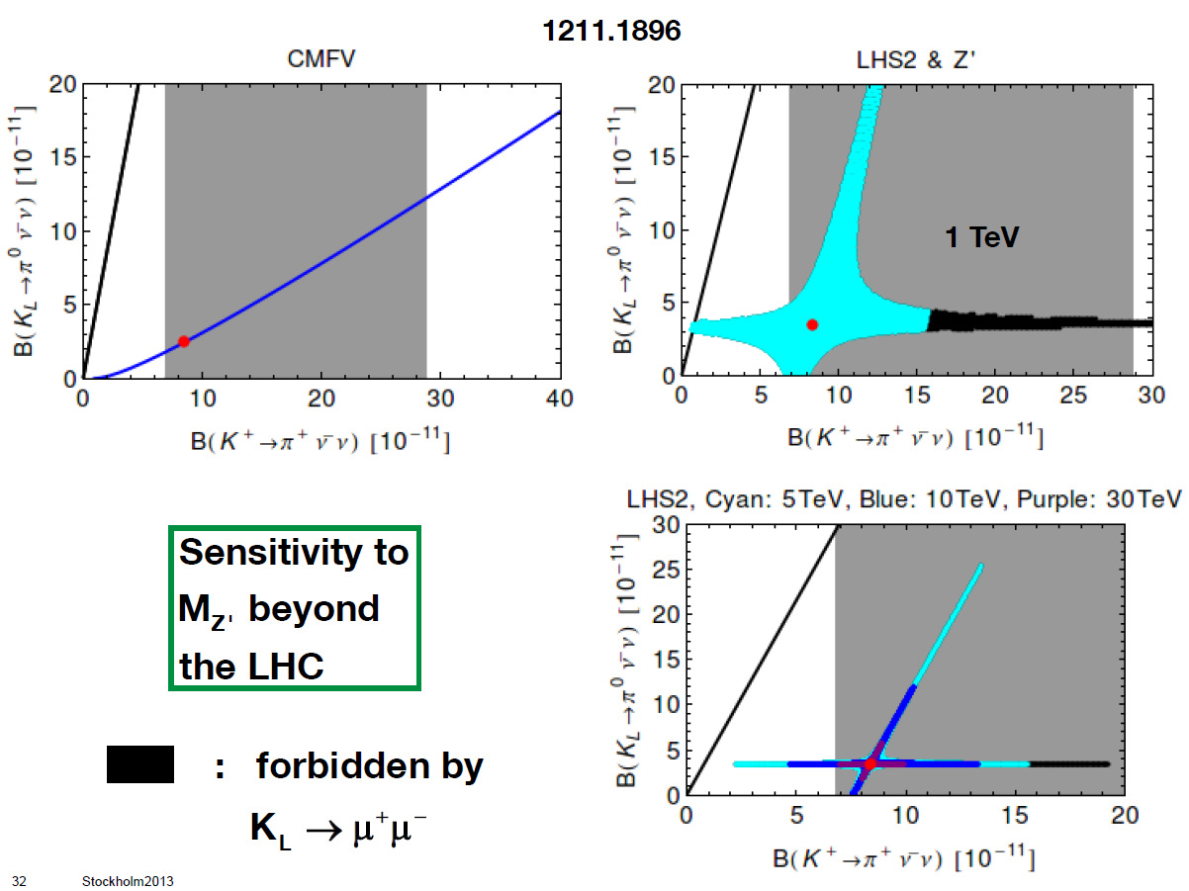
A. Buras at EPS HEP, examples

Slide 10
Overview: K Experiments
Europe:
  NA62, in flight decay @ CERN SPS: <10% precision on BR(K⁺→π⁺ ν ν ); rare and forbidden decays; K_{l3};K_{l4}; LU;LFV; CHPT;…
  LNF DAΦNE ϕ factory: KLOE2; QM interferometry; V_{us} to 0.1 %; low energy hadron physics
JPARC:
  KOTO (K⁰→π⁰ ν ν), Stage I: expect SM SES; Stage II: ~100 SM events
  TREK (Kμ3γ transverse polarization)
FNAL:
  ORKA at the 8 GeV Booster: stopped K⁺ à la BNL ; aims for “1000 K⁺→π⁺ ν ν events” in 5 years of DAQ
  Status: “Stage I Approval”. In the Strategic Fermilab Agenda FY 2013 – FY 2018 is written ”Develop concepts for future experiments: ORKA, nuSTORM and pEDM”.
  ProjectX (KOPIO-type experiment? )
IHEP Protvino:
  OKA (data taking);
  KLOD (concept for K⁰→π⁰ ν ν )

Slide 11
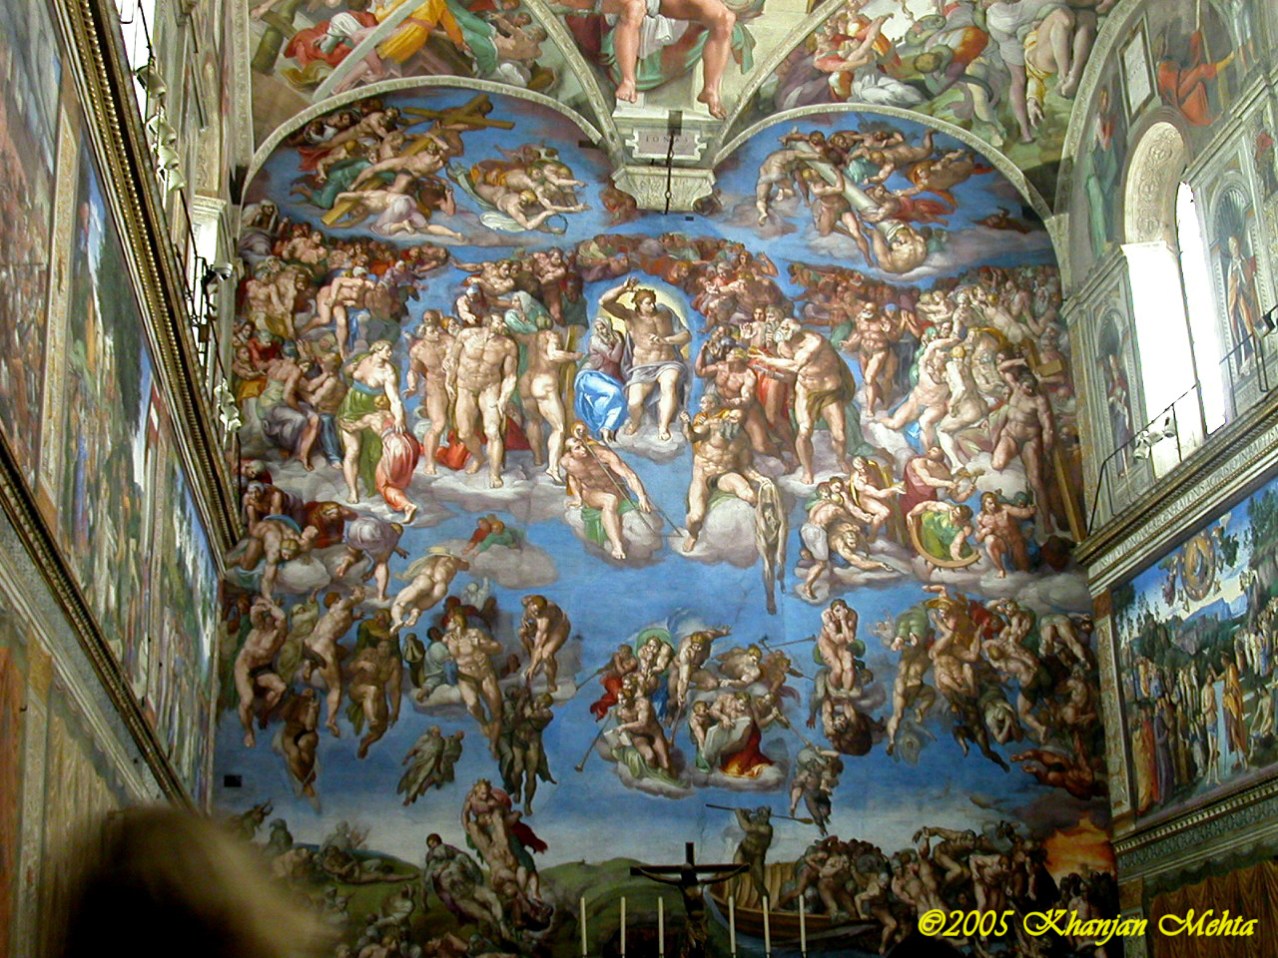
Overall Challenge (I)
“The greater danger for most of us lies not in setting our aim too high and falling short; but in setting our aim too low, and achieving our mark.”
Michelangelo Buonarroti

Slide 12
Overall Challenge (II)
From the minutes of the CERN Research Board (March 3, 2013):
“A proton run to the North Area will then take place between 13 October and 15 December 2014”
Assume:
  60 days of NA62 data taking in 2014
  ~10% of the nominal intensity×efficiency (average)
Aim: challenge the K⁺→π⁺ ν ν Standard Model (SM) sensitivity
Reminder:
  SM: ~ 8 10⁻¹¹
  BNL E787/E949:(17±11) 10⁻¹¹

Slide 13
Physics
Beam commissioning
Shutdown
Tests
LS1
from 16th February 2013 to end December 2014
16th Feb. 2013
20th July
2013
2014
2015
F
M
A
M
J
J
A
S
O
N
D
J
F
M
A
M
J
J
A
S
O
N
D
J
F
M
A
LHC
beam to beam
SPS
PS
PS Booster
available for works
Slide by Frédérick Bordry presented by Mike Lamont at EPS-HEP

Slide 14

Happy Birthday Italo!
Please accept this little gift from NA62 on the occasion of your 80th anniversary
We look forward to collaborate with you and to learn from you for many years to come!

