Slide 1
Trigger simulation update
Bruno Angelucci
INFN & University of Pisa
NA62 Physics WG meeting – Liverpool, 28/08/2013

Slide 2
Outline
Update on “classical” L0 rates and changes wrt my last table (10/04/13 Physics WG)
  CHOD and MUV3 digitizations
  CHOD primitive generation
  LKr L0 first simulation
  LAV (was missing)
First attempt to simulate a L0TP matching primitives from different subdetectors
Preliminary rate for a rare process trigger

Slide 3
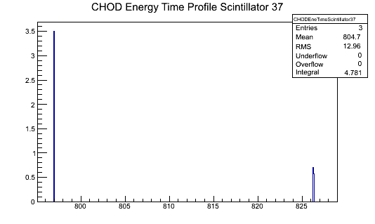
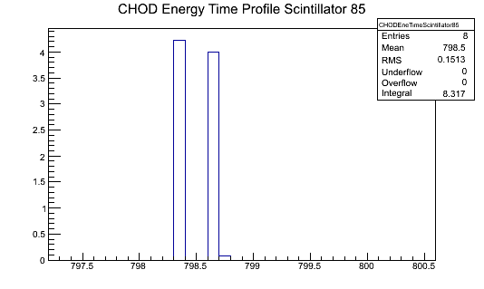
Timing and digitization – CHOD and MUV3
As already explained in my last talk (Physics WG 05/06/13) I modified the present naive digitization to take into account the correct time of the hit inside the MC event and the possibility to have more then one hit on the same channel.
However this is not a “real” digitization! (no PMTs, no dead time, no time propagation inside CHOD slabs)
This implementation is based on the study of the time profile of each scintillator.
Energy(MeV)
/bin
Energy(MeV)
/bin
Time(ns)
Time(ns)

Slide 4
Primitive generation
Time information is used for the primitive generation. The output of each trigger routine is a timestamp+fine time sent to L0TP.
CHOD: coincidence is made in space (hit in correspondent quadrants) and now also in time: I use 2 ns.
One primitive for coincidences within 1 ns.
RICH: multiplicity (between 4 and 32) evaluated in time bins of 1 ns.
MUV3: one primitive for one or more hits in time within 1 ns.

Slide 5
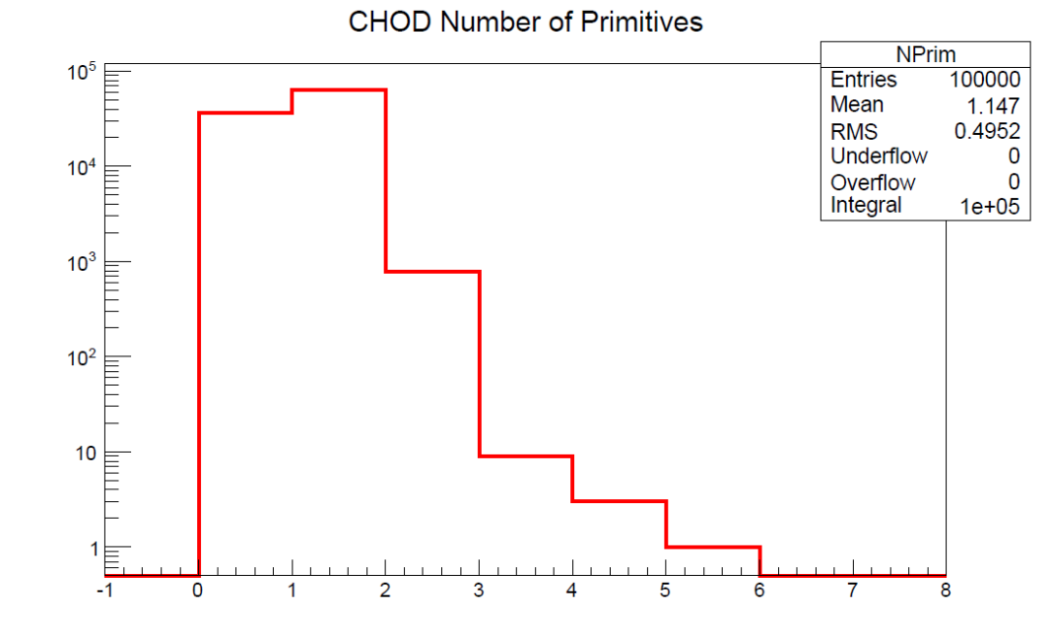
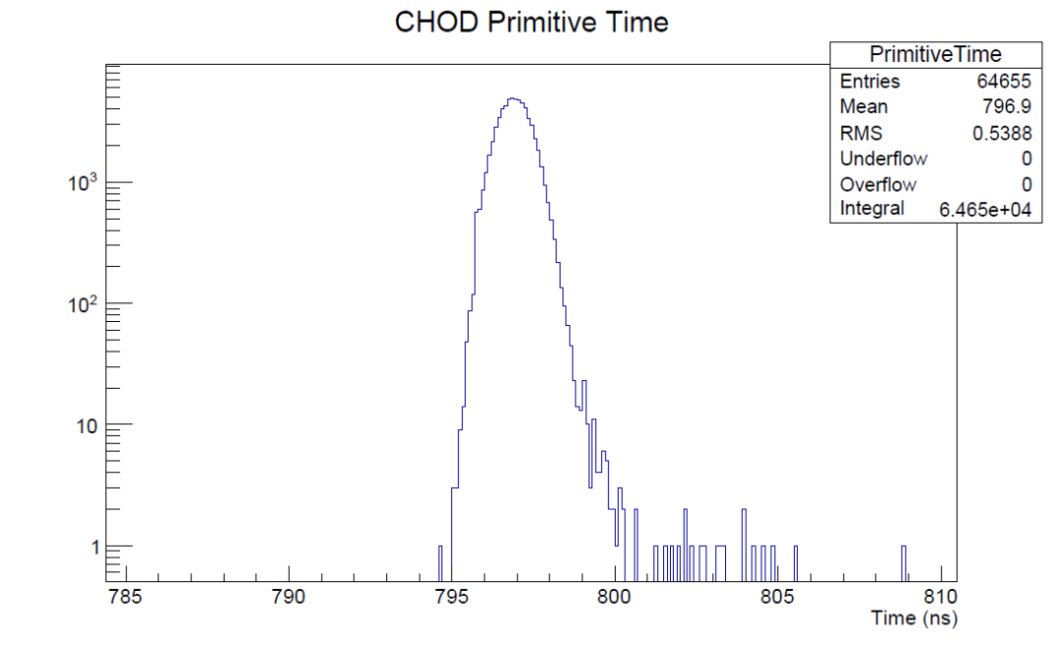
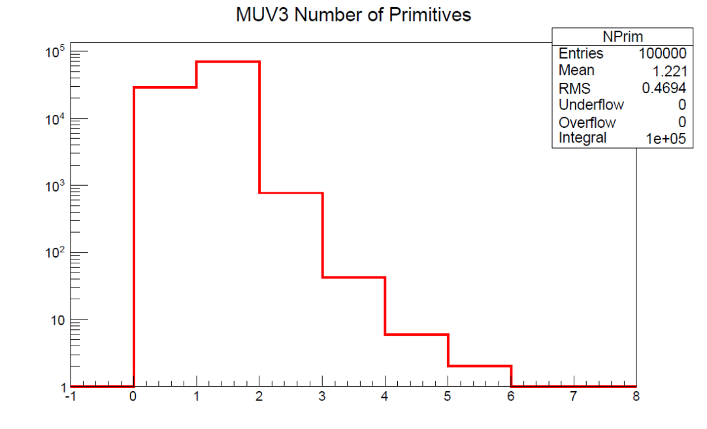
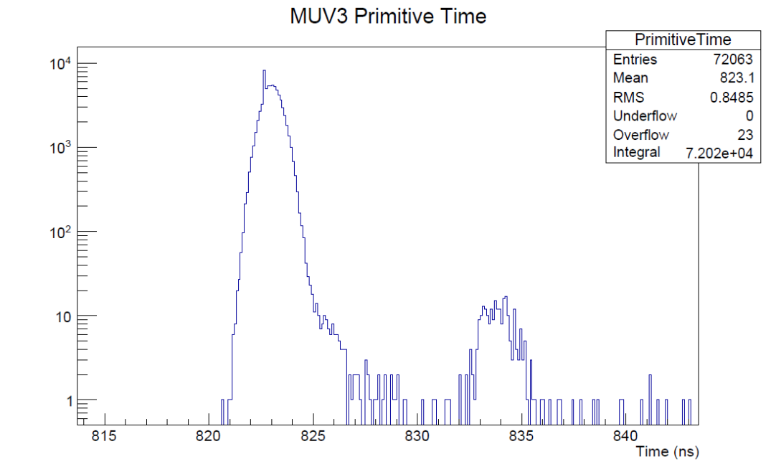
Primitive example – Kµ2

Slide 6
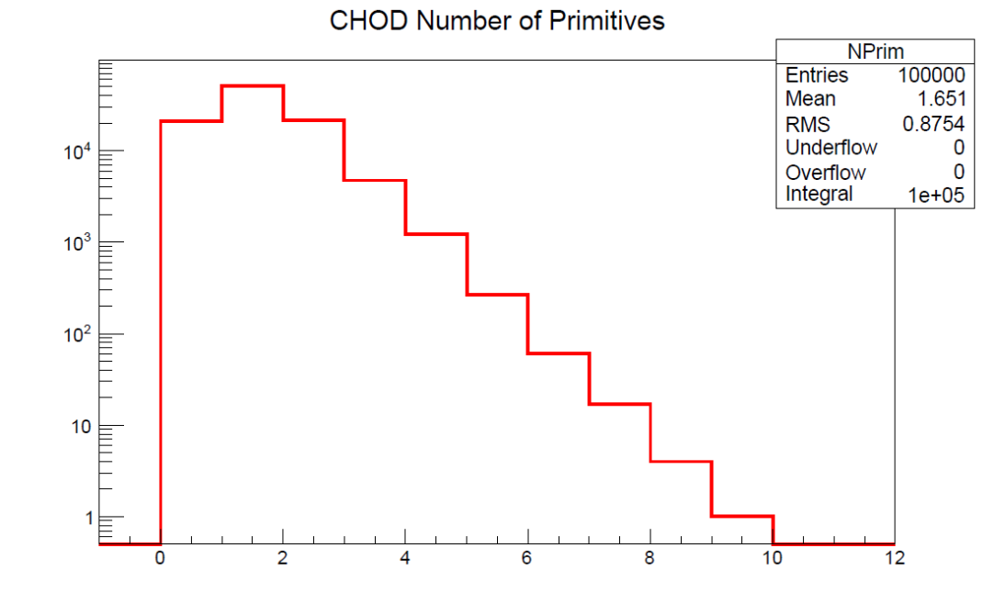
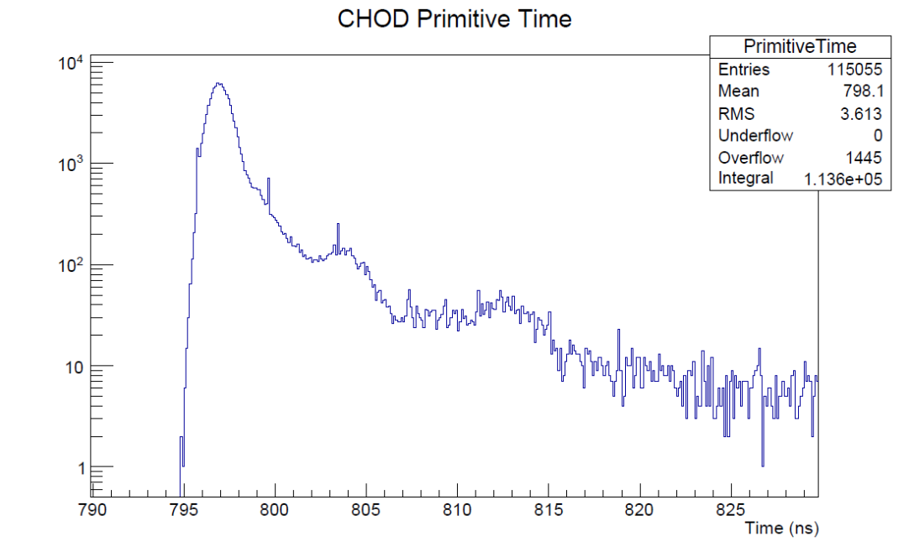
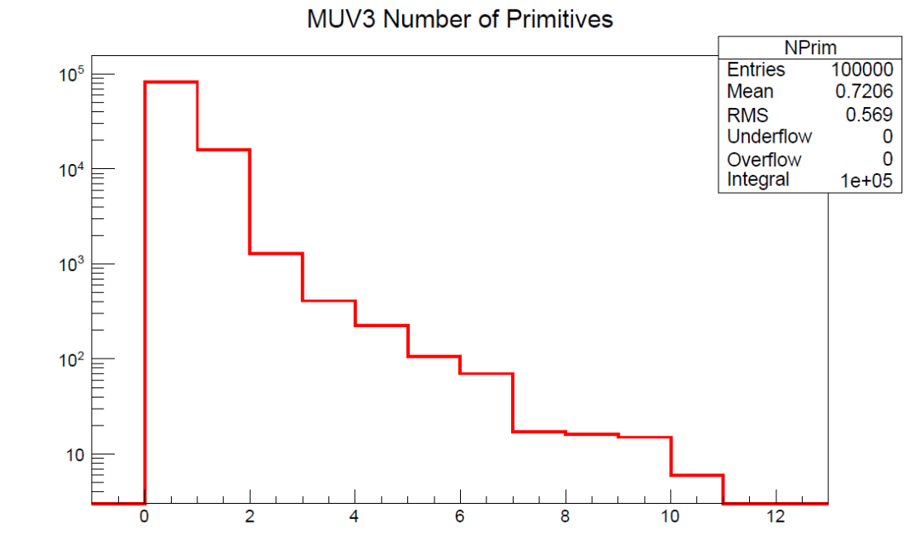
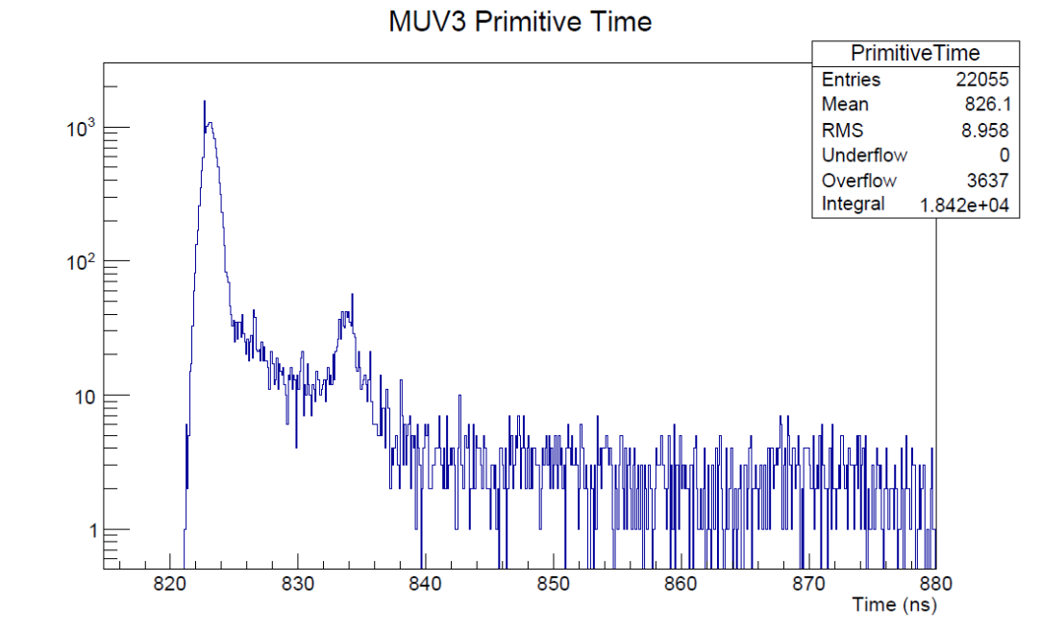
Primitive example – K→π+π+π-

Slide 7
Lkr L0 simulation
The idea is to implement at a certain approximation what will be the LKr L0 from RomaTV.
Main guidelines for this first simulation:
  SuperCells of 4x4 channels grouped in 28 TEL62s, first stage with horizontal check.
  Up to now, 25ns sample structure from digitization is not significant: peak energy has been used without time
  Second stage of 7 TEL62 for vertical check.
  Final primitive production: up to know, no time but only a trigger information concerning the number of “clusters”.

Slide 8
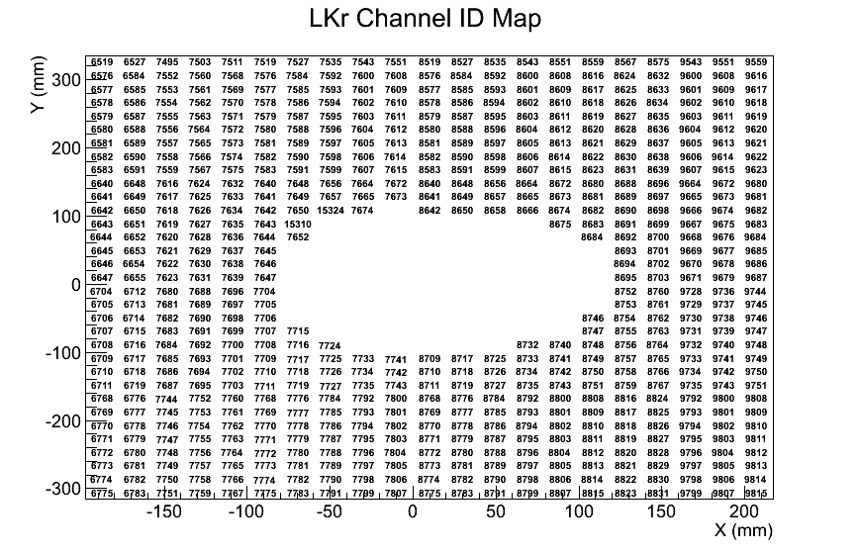
Mapping from channels …

Slide 9
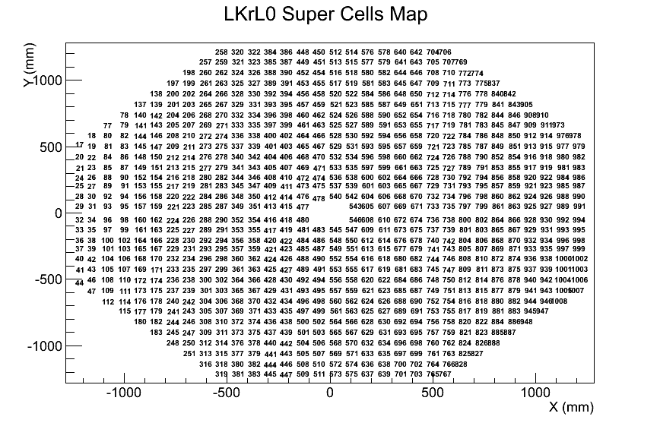
… to Super Cells

Slide 10
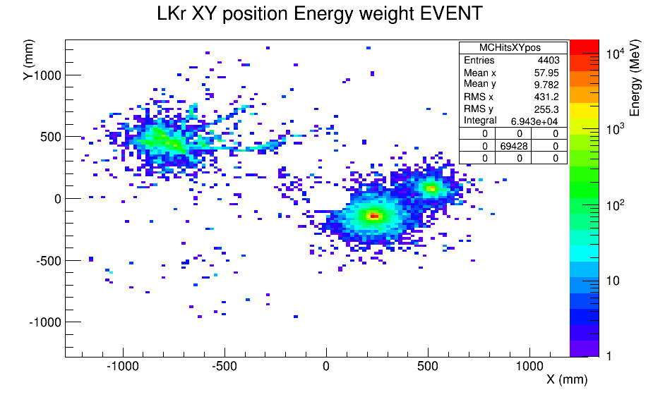
Issues with digitized data
Here a event is represented in energy release from MC

Slide 11
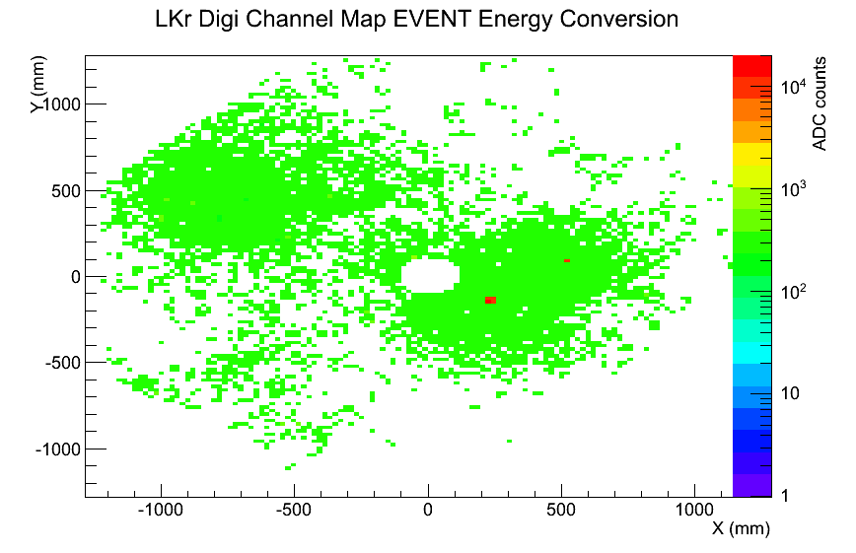
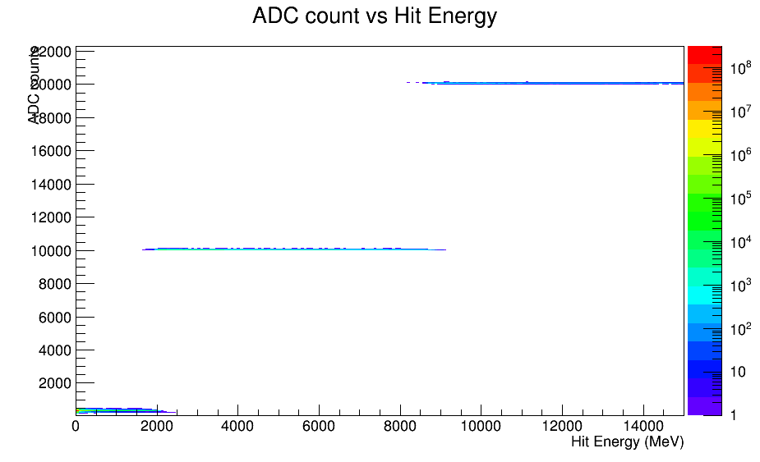
Issues with digitized data - 2
First attempt to use just the ADC counts of the peak
High inefficiency for pions and low energy photons due to the gain vs cell energy release and the difficulty to choose a threshold

Slide 12
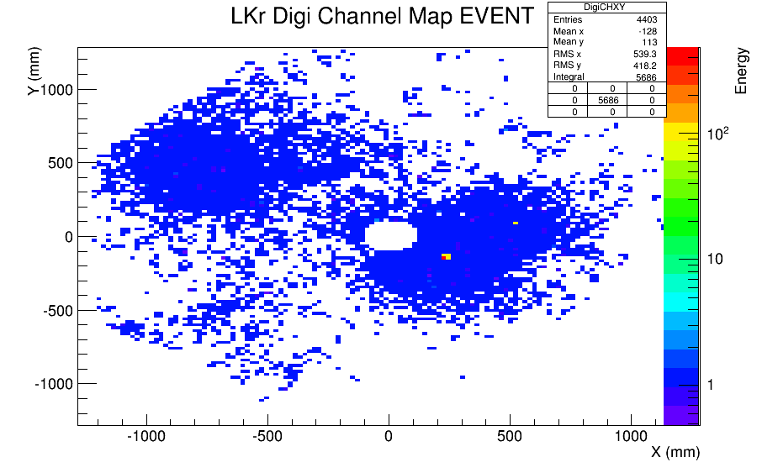
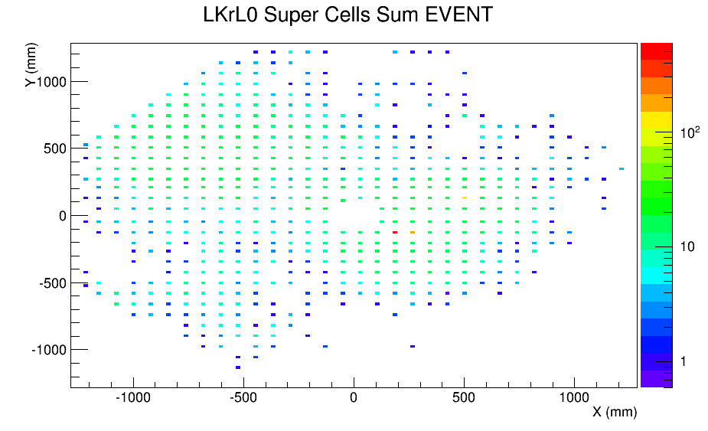
Issues with digitized data - 3
The routine to convert from ADC counts to energy has been used
Still some difficulties to choose a threshold and to distinguish between noise and low energy cells: most probably due to my lack of knowledge concerning the calorimeter data handling

Slide 13
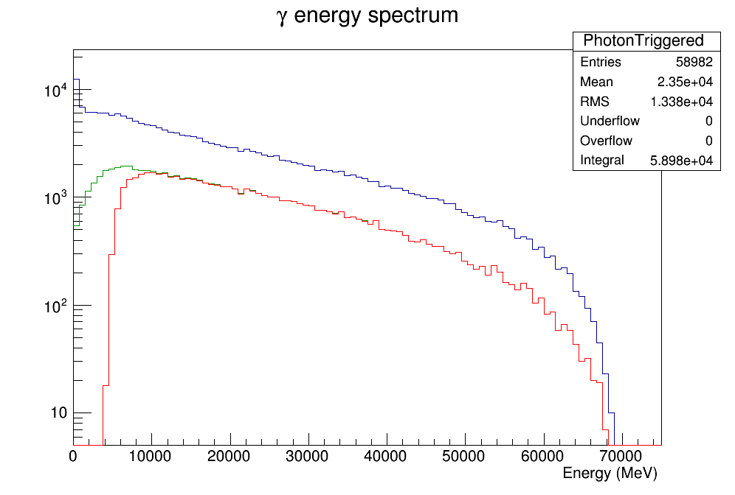
Current trigger efficiency - photons
all γ
γ hit LKr
γ triggered

Slide 14
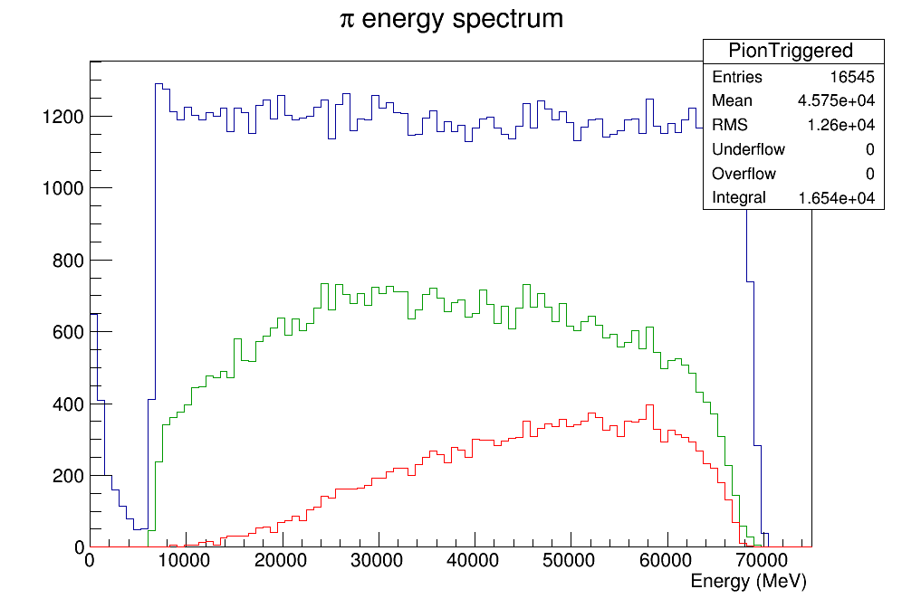
Current trigger efficiency - pions
all π
π hit LKr
π triggered

Slide 15
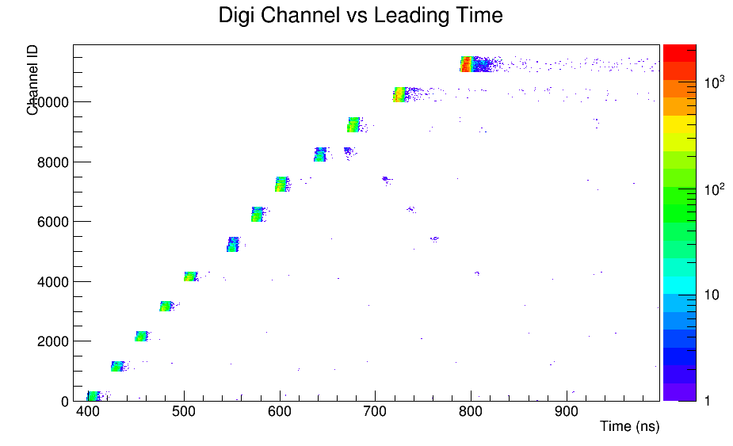
LAV in L0
All LAV station have been included in primitive generation
Time offsets between station have been evaluated
In single station, time spread of about 10 ns: slewing correction not implemented, low threshold and only leading used, offset between layers not computed…other suggestions from LAV people?

Slide 16
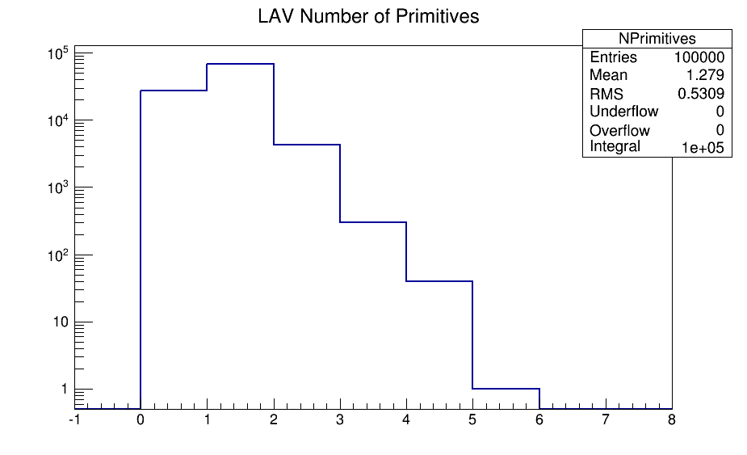
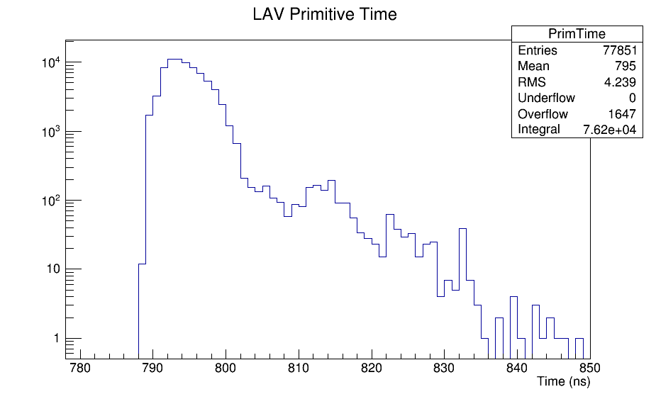
LAV primitive generation
All time are expressed in the LAV12 time using station offsets
Due to the 10 ns uncertainty, primitive are now coming from hits within 10 ns, obviously unacceptable for a veto!

Slide 17
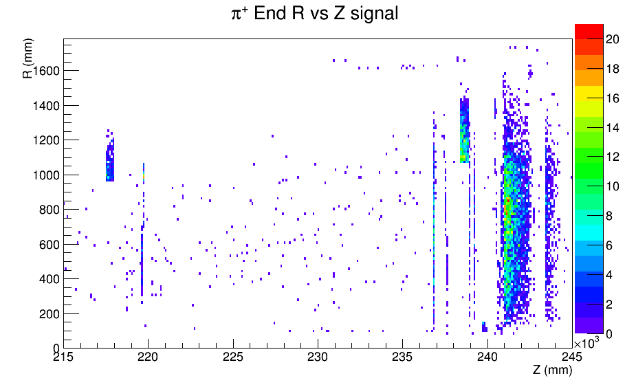
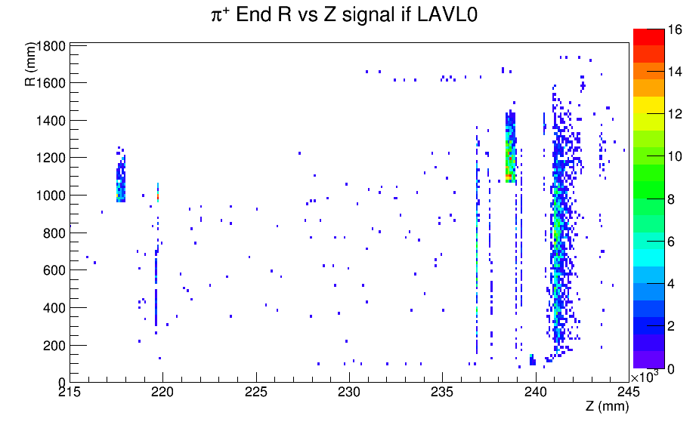
LAV in pinunu
After the signal selection, half of the events have a primitive from LAVs, mainly LAV11 and LAV12
Primitive are both in time and not in time, and the situation can be better understood looking at the position where the pion stops
Combining this with the 10 ns primitive matching leads to a big loss of trigger efficiency for the signal

Slide 18
L0 rate table – no primitives matching
CHOD: 1 or more quadrants
RICH: between 4 and 32 hit
MUV3: at least one hit
LKr: 2 or more clusters
LAV: at least one hit in a station
Component | Initial | CHOD | RICH | x !MUV3 | x !LKr | X !LAV
 | 2140 | 1732 | 1179 | 1089 | 539 | 60
 | 6585 | 4204 | 3817 | 29 | 29 | 10
 | 579 | 458 | 225 | 180 | 171 | 32
 | 182 | 156 | 98 | 89 | 18 | 1
 | 525 | 403 | 253 | 248 | 84 | 6
 | 347 | 272 | 194 | 17 | 14 | 3
 |  | 7226 | 5765 | 1651 | 854 | 111
Signal effic. |  | 91.2% | 88.2% | 82.1% | 82.0% | 47.9%
rate with 1 or more cluster in LKr drops to 128kHz after !LKr and 8kHz after !LAV, but efficency also drops to 68% and 39%

Slide 19
L0 rate table – primitives matching
CHOD: 500ps resolution
RICH: 100ps resolution
MUV3: 500ps resolution
No LKr
LAV: 1.5ns resolution
Rates suffer from LKr missing in this chain
Efficiency would probably be better improving LAV timing
Roughly same results with same chain without time matching
Component | Initial | CHOD X RICH X !MUV3 X !LAV
 | 2140 | 304
 | 6585 | 17
 | 579 | 41
 | 525 | 74
 | 347 | 4
 |  | 440
Signal effic. |  | 49.6%

Slide 20
Possible trigger for process
CHOD: 2 or more quadrants
MUV3: at least one hit
LKr: 2 or more clusters
Could be feasible with a reduced intensity or downscaled
Component | Initial | Q2 X !MUV3 X LKr
 | 2140 | 327
 | 6585 | 0
 | 579 | 19
 | 182 | 65
 | 525 | 100
 | 347 | 2
 |  | 513

Slide 21
Future plans
L0 simulation, main trigger
  Add MUV3 new digitization from Riccardo and Luigi
  Try something more than total multiplicity in RICH
  LAV timing: slewing, offsets, thresholds
  LKr timing and calibration
  Add halo with timing
  Try different resolutions and matching times in L0TP simulation
L1 and L2 software algorithms
Trigger rates for other rare K+ and π0 decays looking at the first data taking of 2014

