Slide 1
Straw L0 Trigger Studies
Vito Palladino
NA62 Collaboration Meeting - Liverpool

Slide 2
The Idea
We would like to study the feasibility of Straw detector as a L0 trigger detector.
Our read-out board (SRB) will be designed to collect the data and produce the L0 trigger primitives as well.
  We will have 2 SRB per view => 8 per station => 32 in total
One possible way to use the Straw as a trigger detector is to fast identify the vertex. The present talk presents the results we had for simulated Kp -> Pip nu nubar events.
NO time simulation has been introduced.
Drift time will not be considered and Leading-Trailing matching is not foreseen.
No straw efficiency curve is simulated.

Slide 3
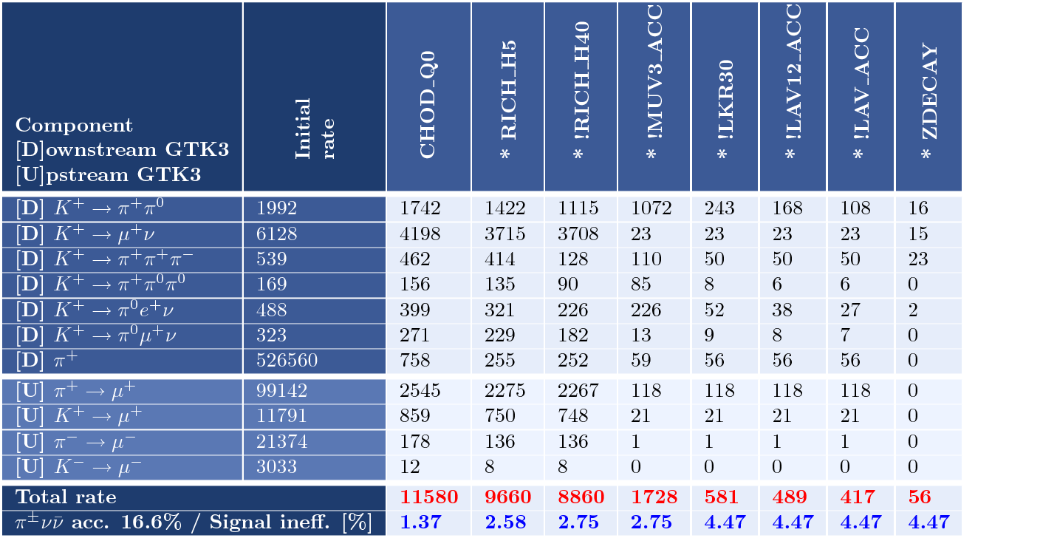
Why?
From Spasimir table

Slide 4
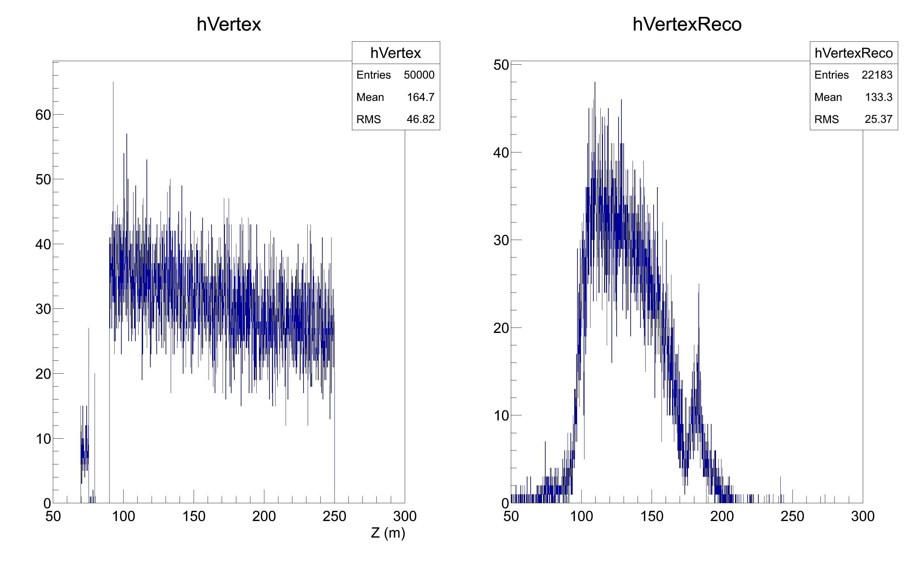
Dataset
50k events of Kp -> Pip nu nubar have been simulated with GTK, CEDAR and Straw on.
The decay region allowed is 90m -> 250m.
No pile-up simulated.

Slide 5
Tracking
In order to track charged particles the detector is divided in corridors (group of 6 straws) two neighbor corridors have 2 common straws.
Corridor shape has been defined in order to maximize the number of straws in one corridor.
First two chambers are considered for tracking.
No drift time is considered. One coordinate (XYUV) is measured doing the mean of the position of the hit straws.

Slide 6
Tracking
In order to track charged particles the detector is divided in corridors (group of 6 straws) two neighbor corridors have 2 common straws.
Corridor shape has been defined in order to maximize the number of straws in one corridor.
First two chambers are considered for tracking.
No drift time is considered. One coordinate (XYUV) is measured doing the mean of the position of the hit straws.

Slide 7
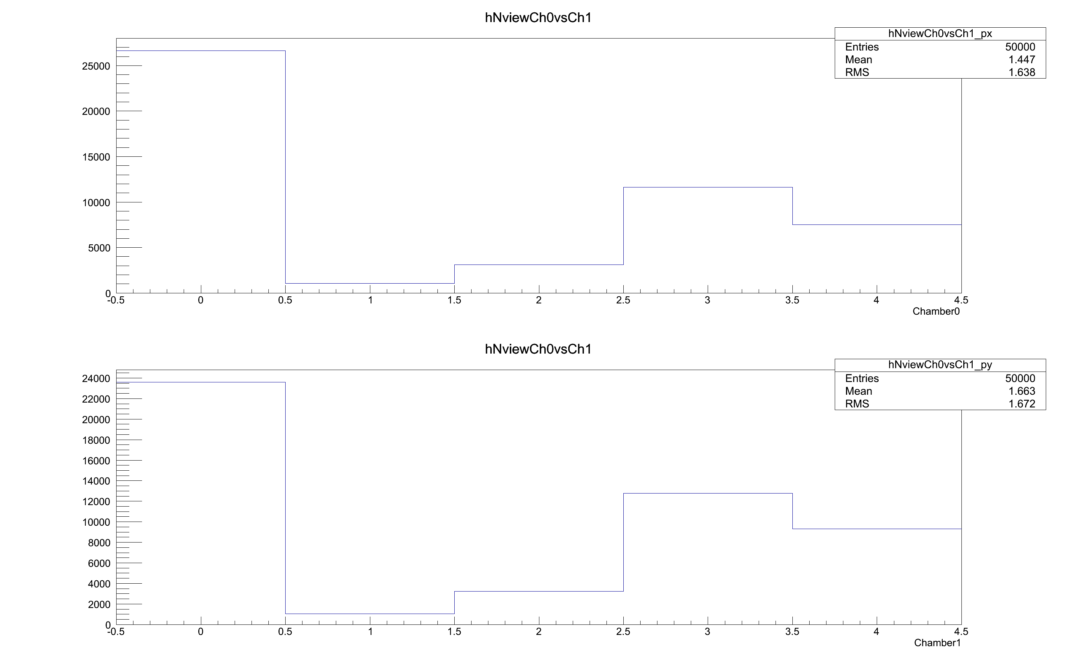
Occupancy
The number of views hit.

Slide 8
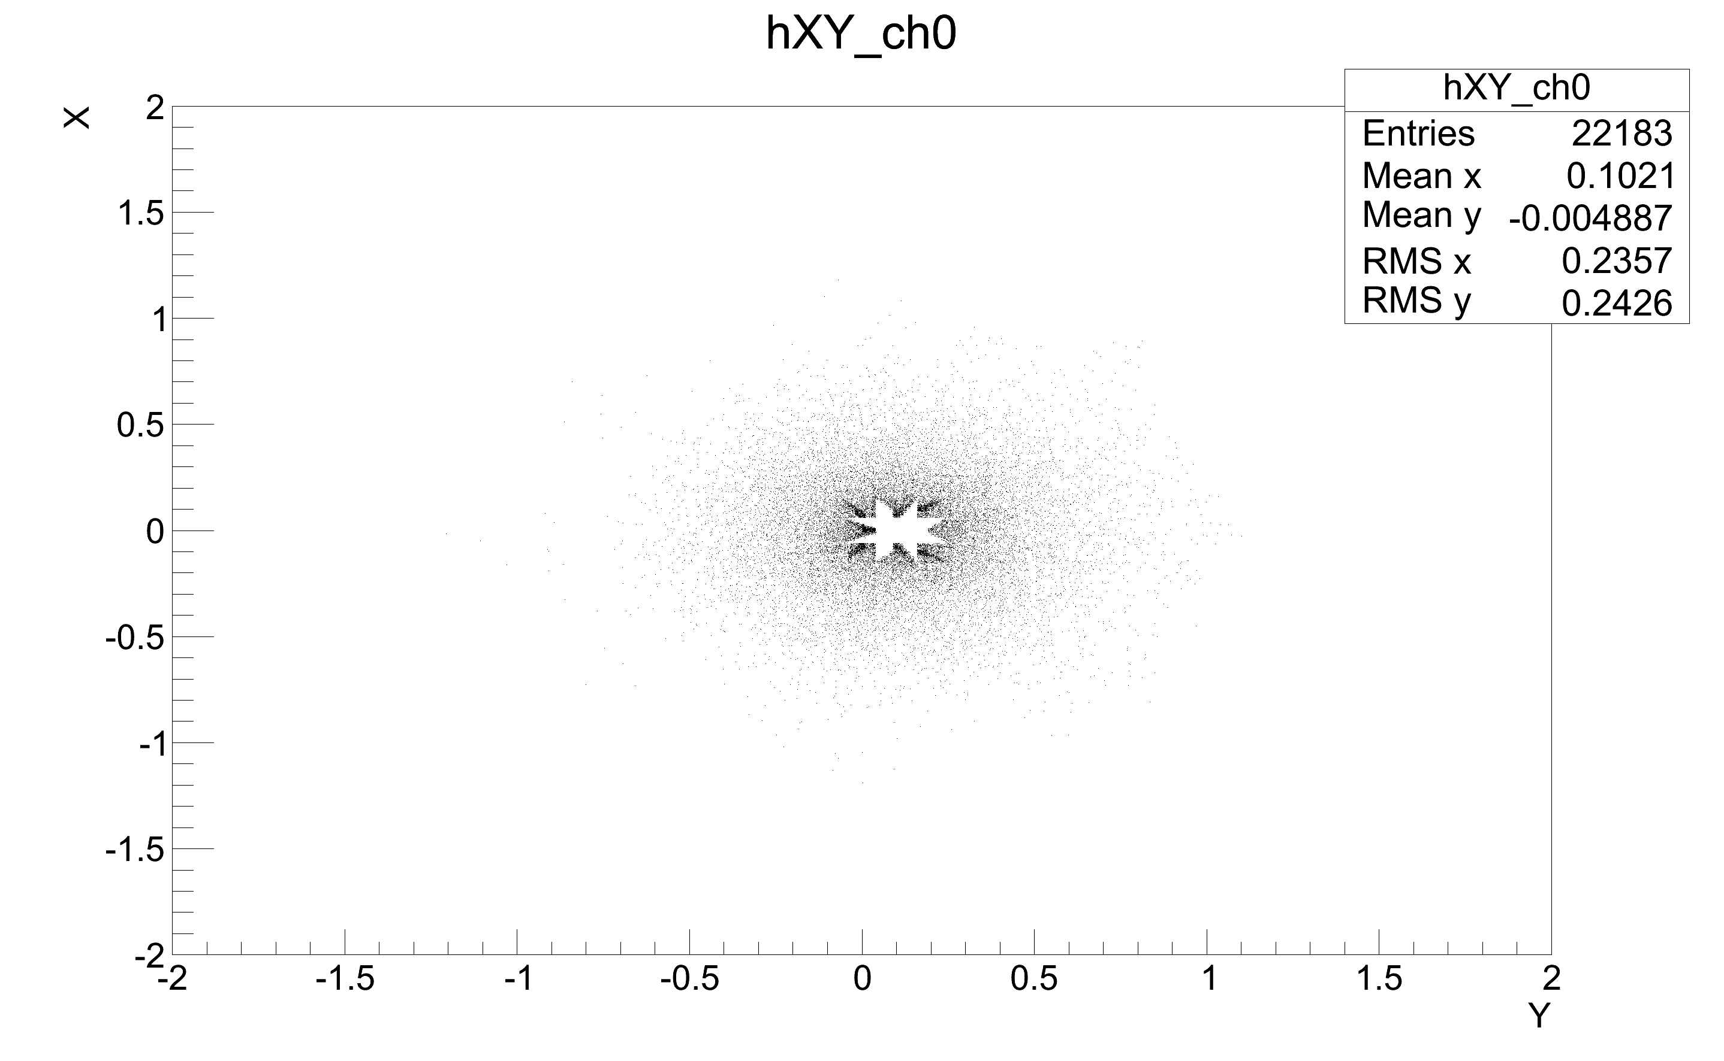

Occupancy
Reconstructed coordinates.

Slide 9
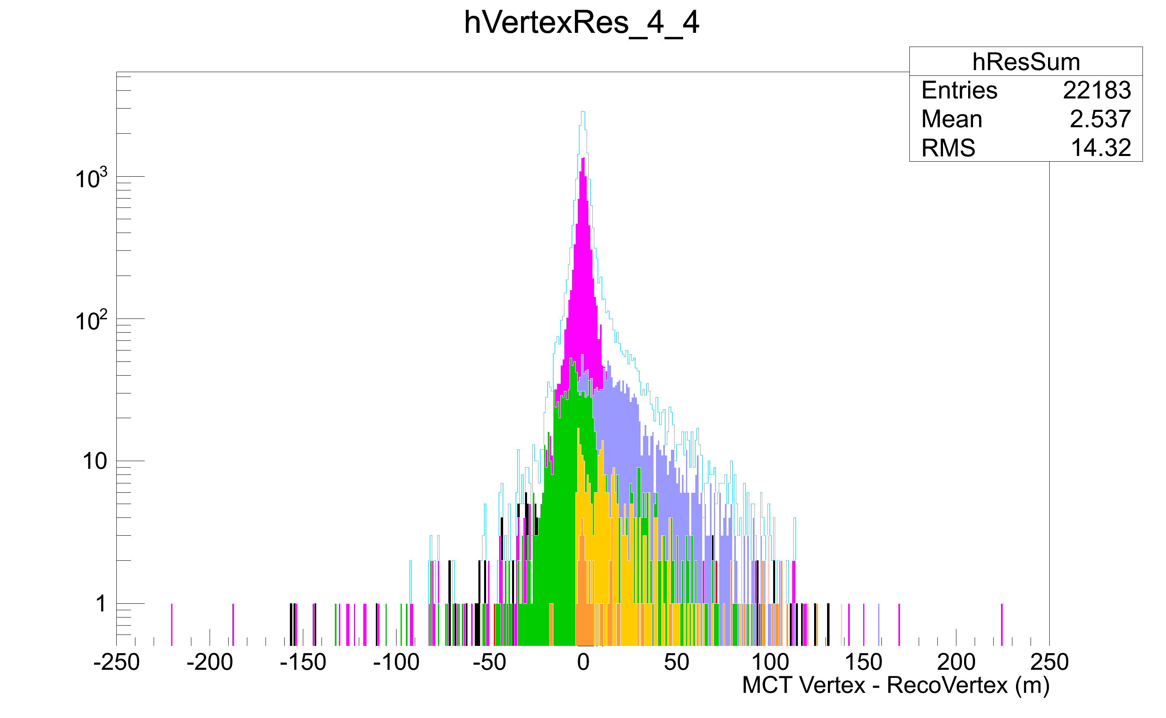
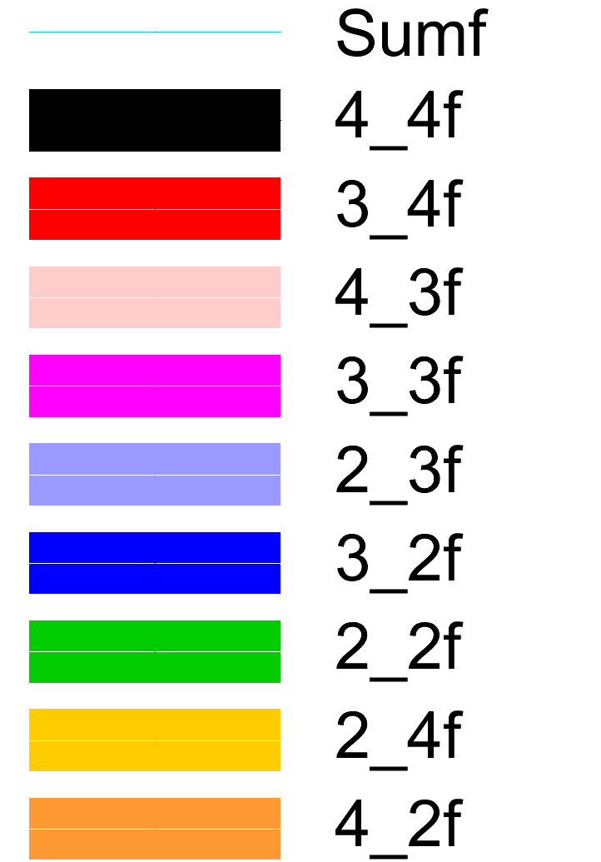
Vertex Resolution
Reconstructed vertex using the nominal beam position has been performed. Vertex reconstructed contributions using different number of views have been highlighted.

Slide 10
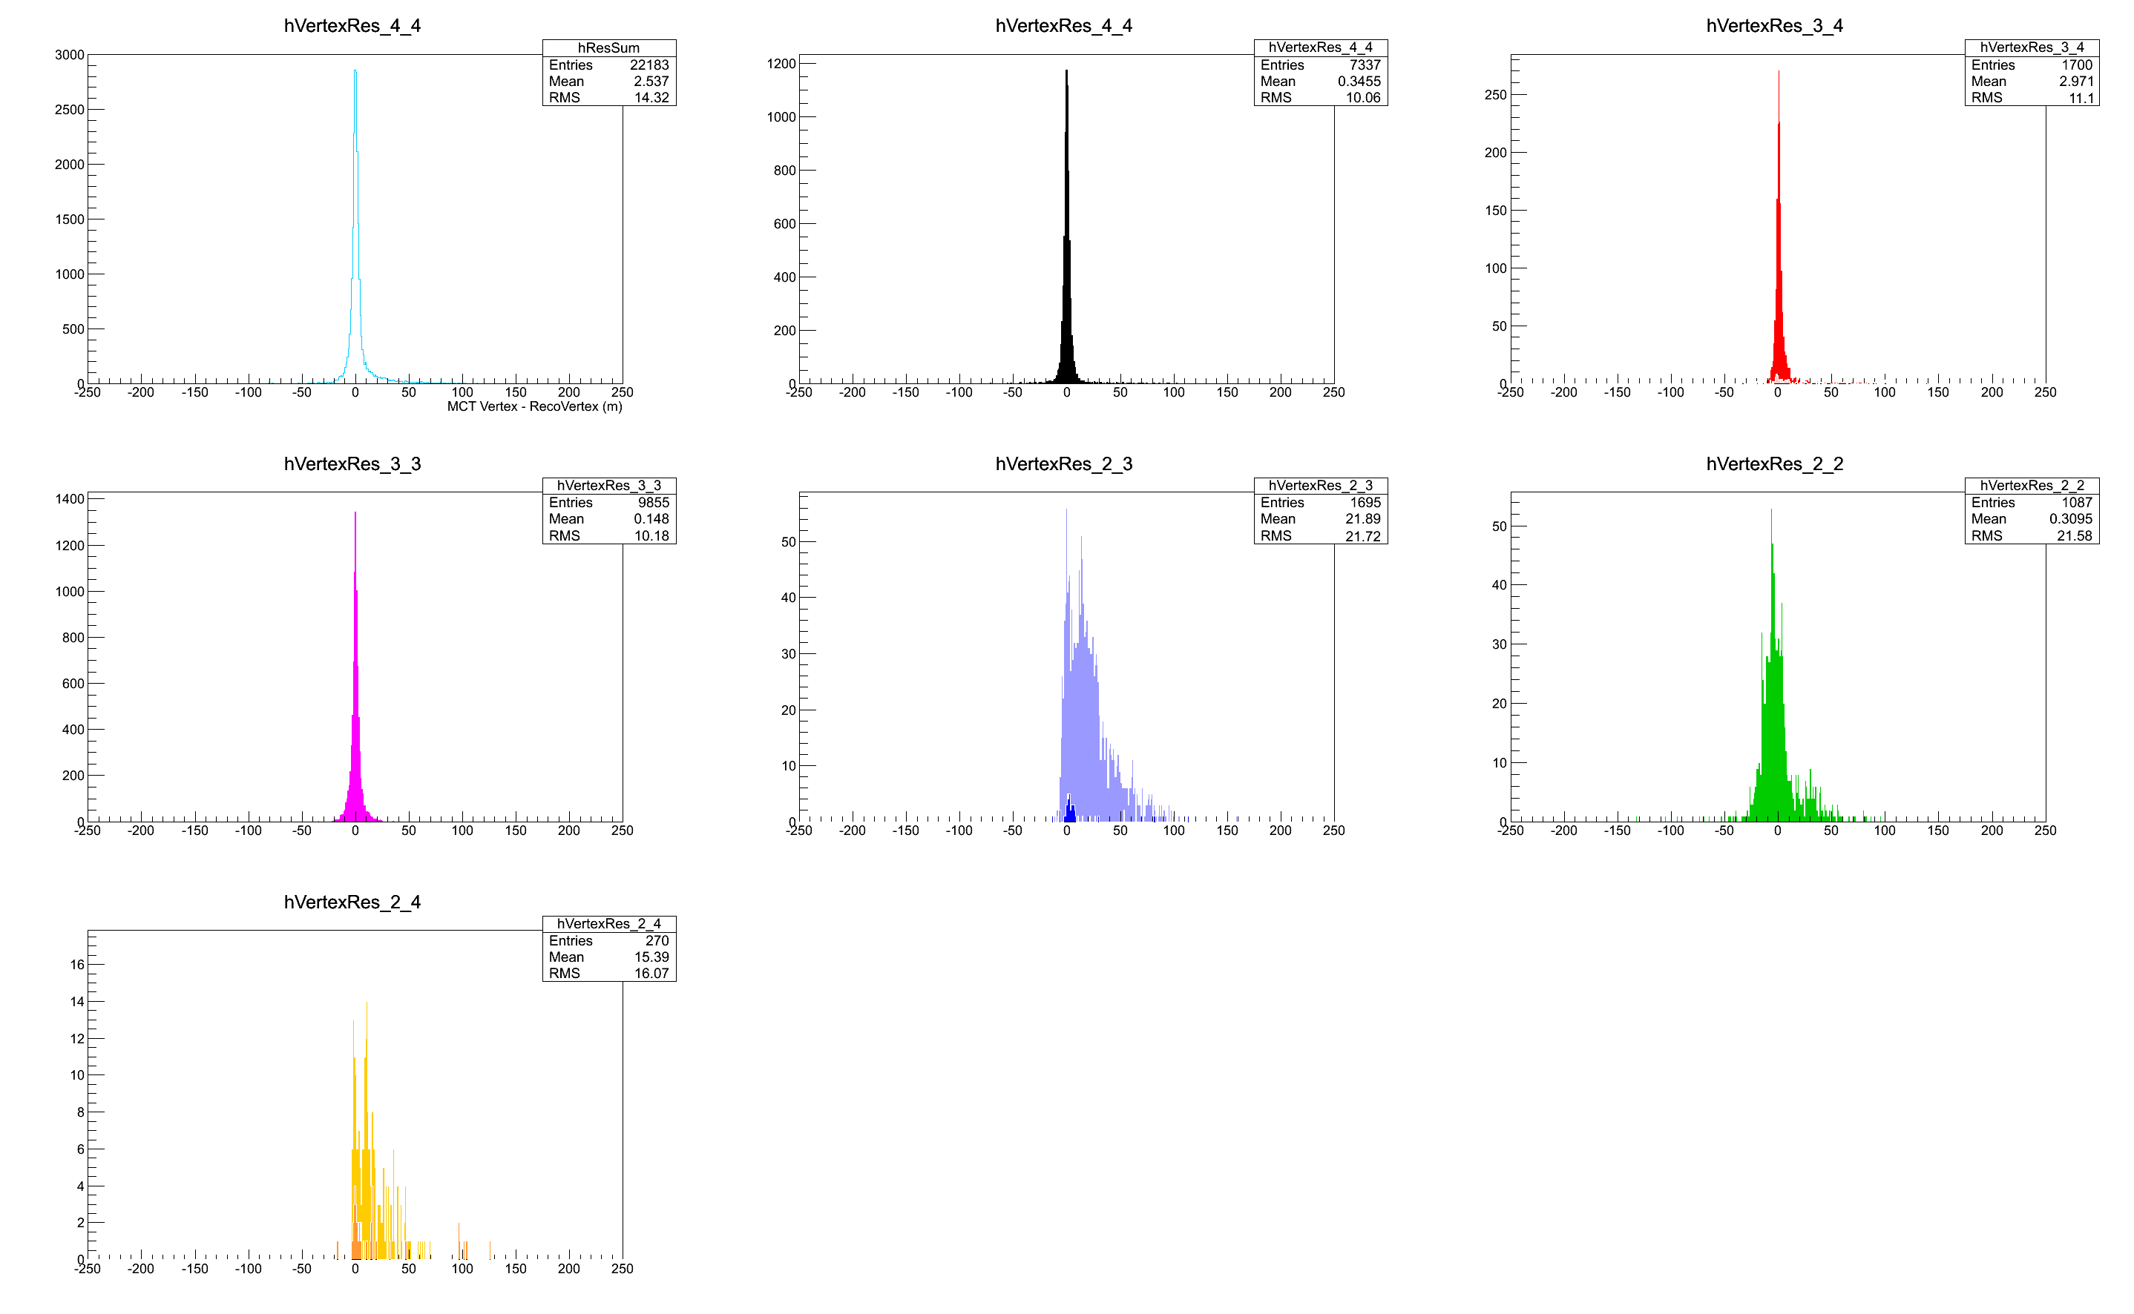
Vertex Resolution
Single contributions to the resolution.

Slide 11
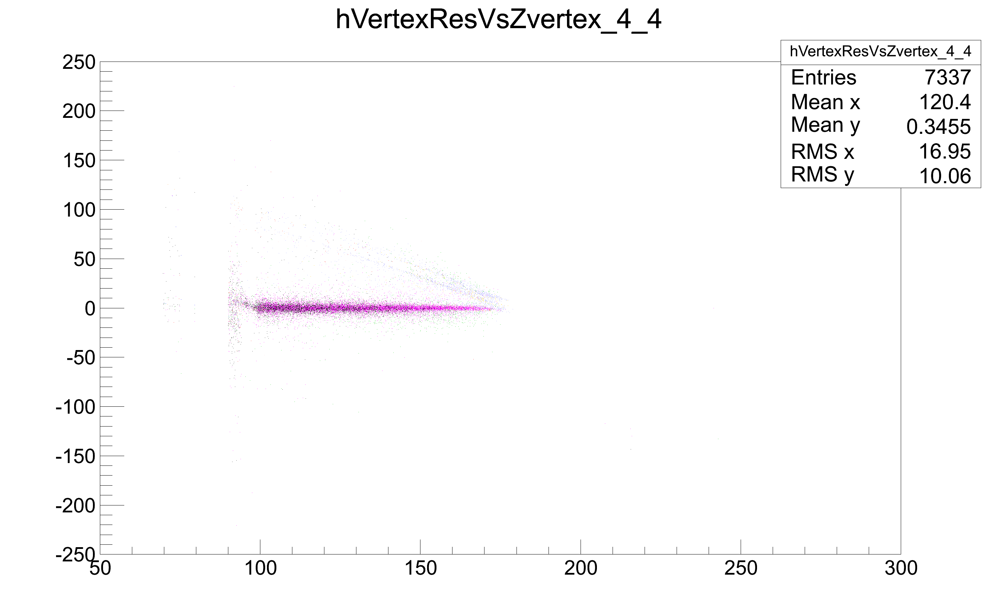
Vertex Resolution Z Dependence
Straw0
MCT vetex – Reco Vertex (m)
GTK3
MCT vetex (m)

Slide 12
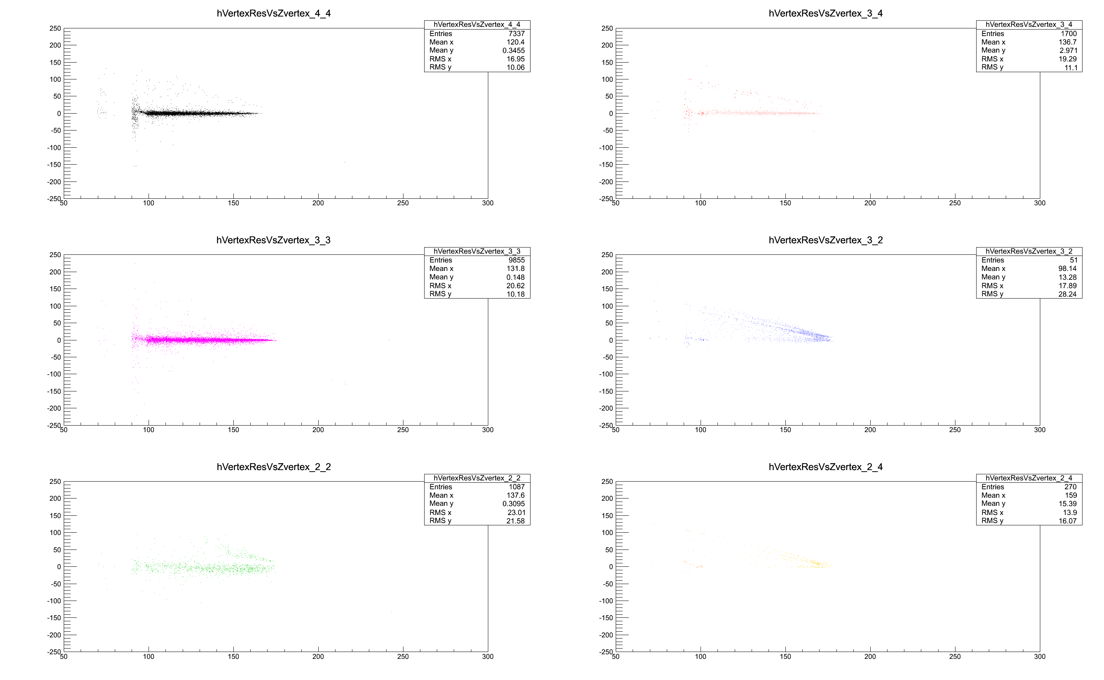
Vertex Resolution Z Dependence

Slide 13
Signal Acceptance
The signal acceptance has been estimated as the ratio of the total number of events with the triggered events with the real vertex in the fiducial region (105 >165) and the total number of events in the FR (17770).
Reco Vertex Cut | # ev MCT | # “Triggers” | Acceptance
105 > 165 | 15925 | 16847 | 0.896173
102 > 175 | 16436 | 18605 | 0.92493
102 > 180 | 16649 | 19024 | 0.936916

Slide 14
Conclusions and Plans
Any contribution/suggestion from collaboration are very welcome.
Preliminary results are encouraging us to go further in our studies.
We have some inputs to finalize the SRB design.
We have many things to add to the simulation:
  Timing (fundamental to understand our capability to disentangle events with many tracks)
  Pile-up simulation
  Corridor clustering

Slide 15
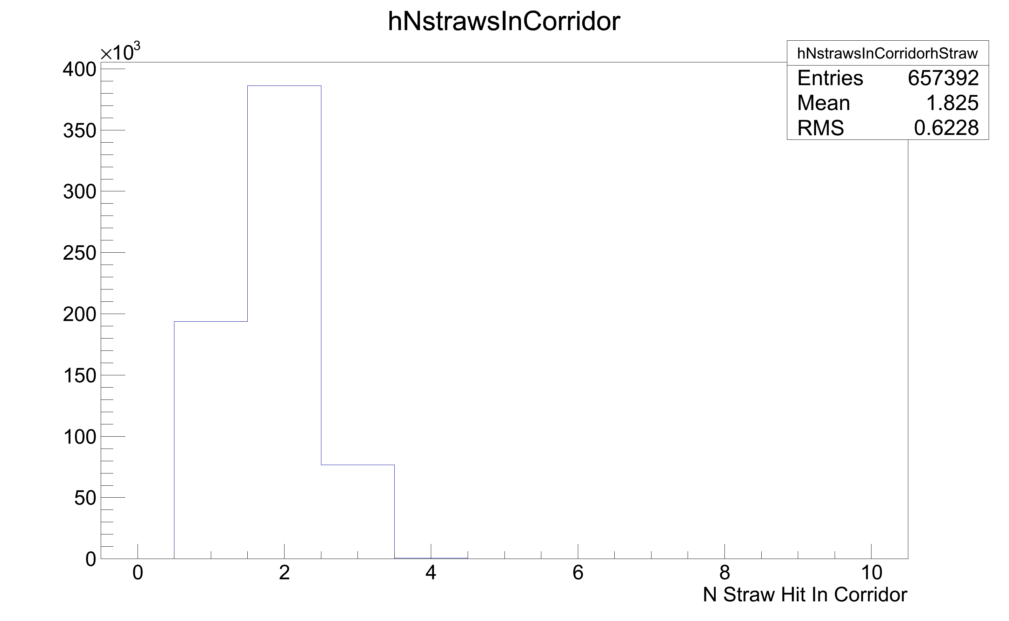
Corridor Occupancy
The number Straw Hit per Corridor

Slide 16
How to
In order to recognize events with at least 2 straws the idea is to push data in a 40MHz buffer and wait for 2 leadings in a corridor. The data from each SRB are than collected by an other SRB who will provide the L0 primitive.
For details see Peter’s talk.
Straw 0
Straw 1
Straw 2
Data Pushing
Straw 3
Straw 4
Straw 5
25ns

