Slide 1
PM installation status
M.Lenti

Slide 2
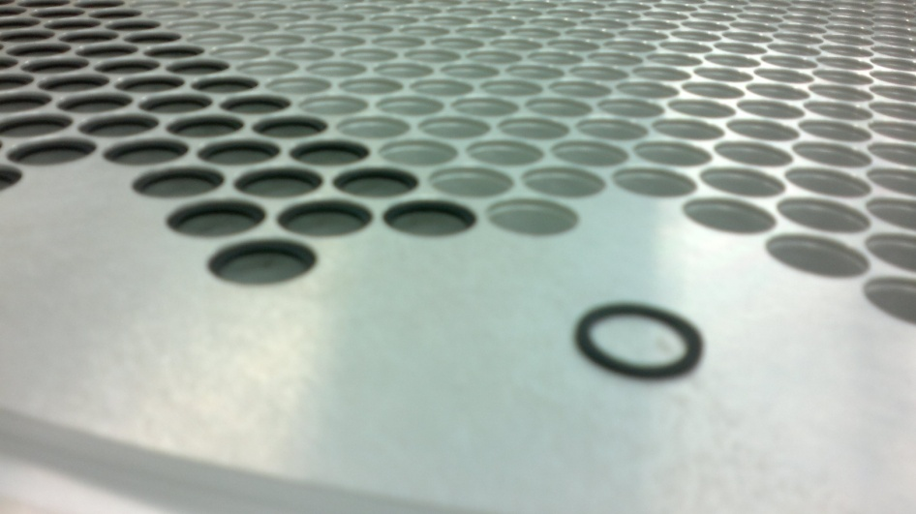
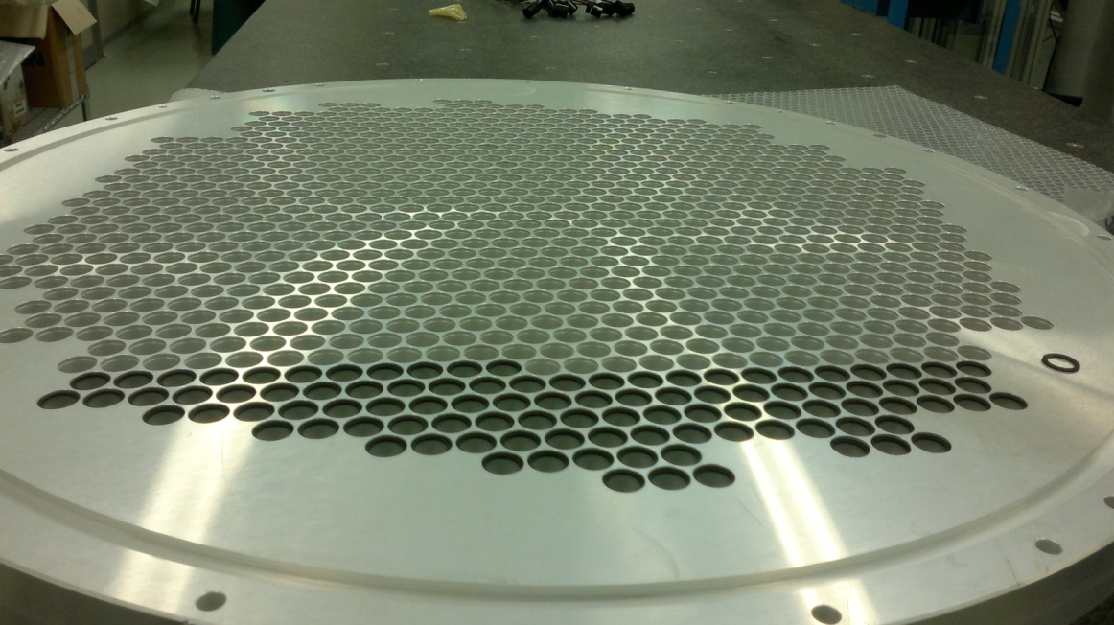
PM Lodging disks
Each disk has 976 holes; there are two lodging disks
In each hole a thin o-ring 1 mm thick (13.5-17.5 mm Ø) is inserted in a gorge at the downstream end
It is the arrest of the PM (and protection against ambient light from the back)

Slide 3
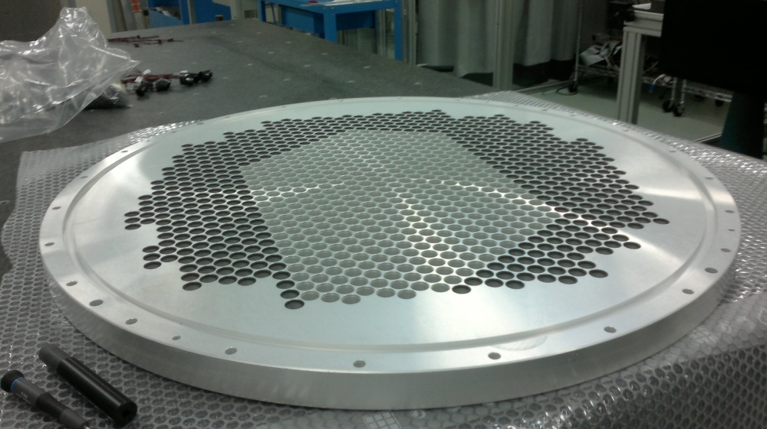
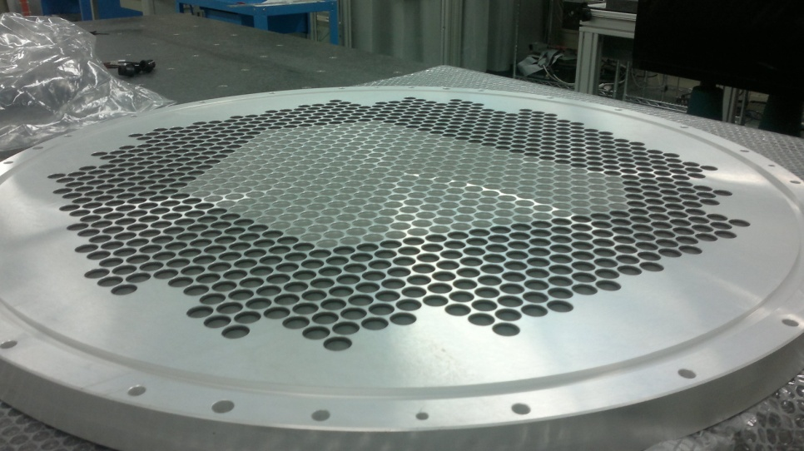
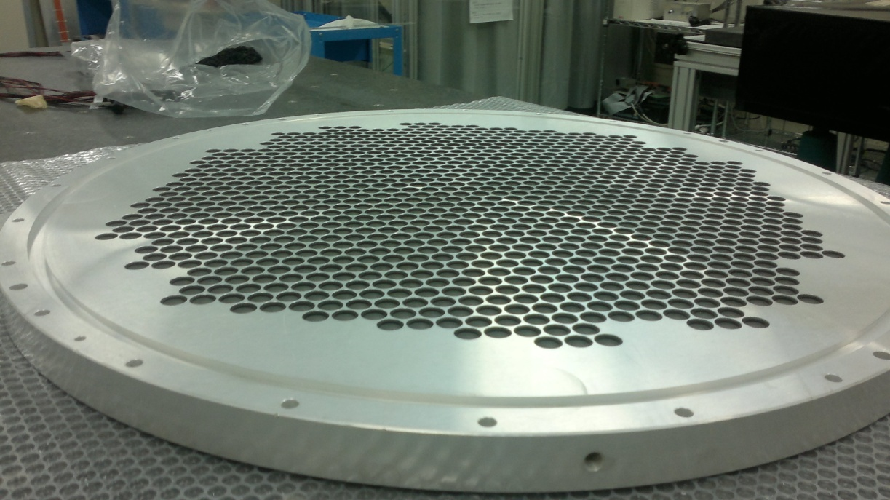
Progress in the o-rings…
First disk completed
Downstream view of the disk

Slide 4
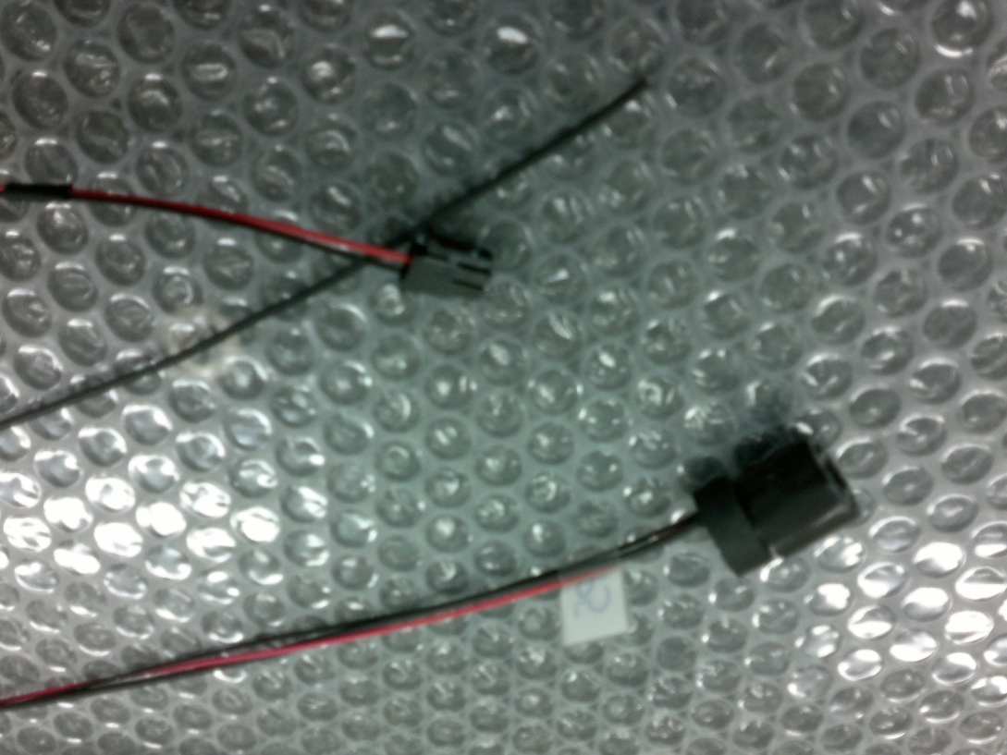
New sockets (test sample)
Signal cable
without connector
HV connector
New socket
Thick o-ring
(6 mm thick)
A thick o-ring is inserted upstream of each socket+PM to keep it in position, protect from
ambient light and provide a good thermal contact

Slide 5
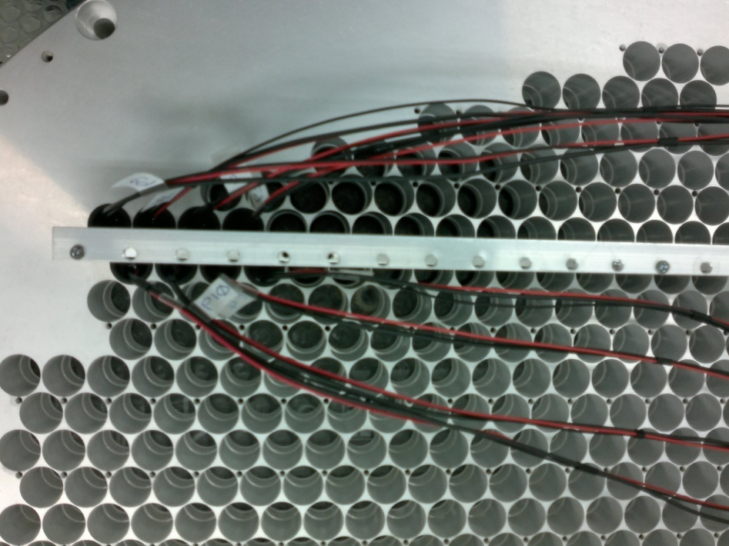
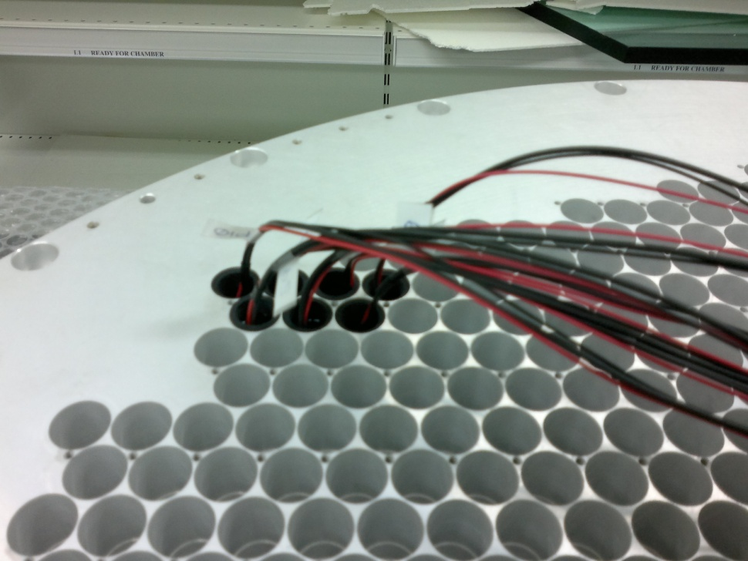
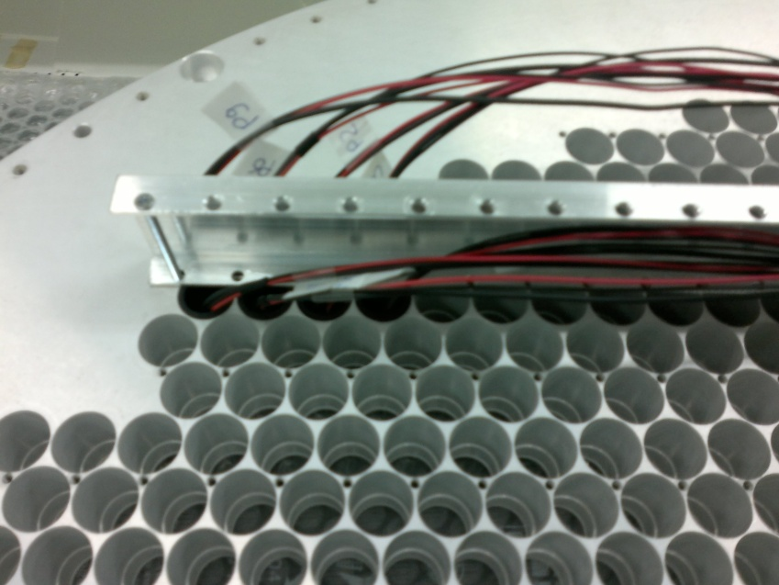
PM+socket insertion
Upstream view of the disk
Fixation bar inserted
A fixation bar in inserted every two rows of PMs
to keep them in position and facilitate the dissipation
of the residual heat produced by the sockets

Slide 6
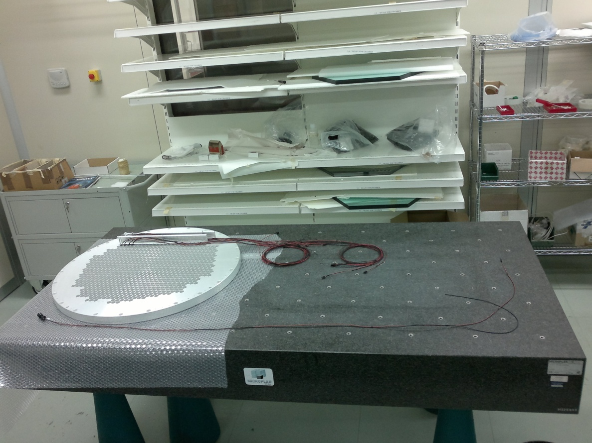
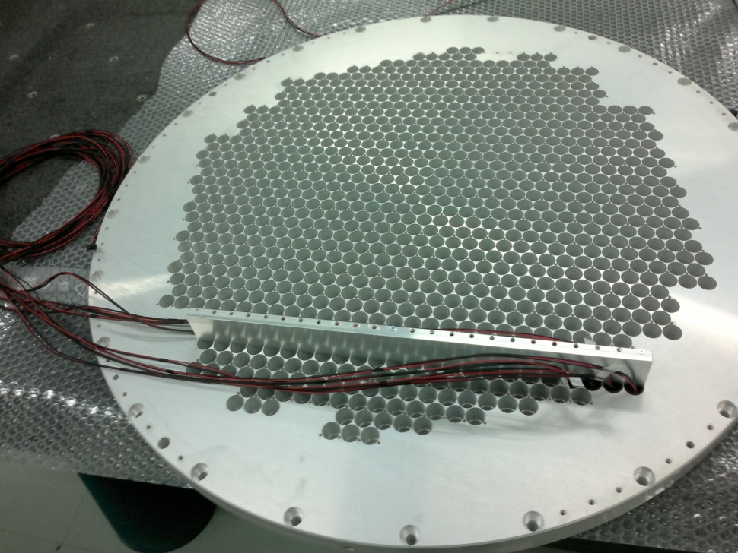
Work in clean room
Ready to install all the PM+sockets

Slide 7
Supercell
L
R
PMs are grouped in Supercells of 8 PM each (to be used in multiplicity trigger)
Two HV channels (L and R) feed one Supercell

Slide 8
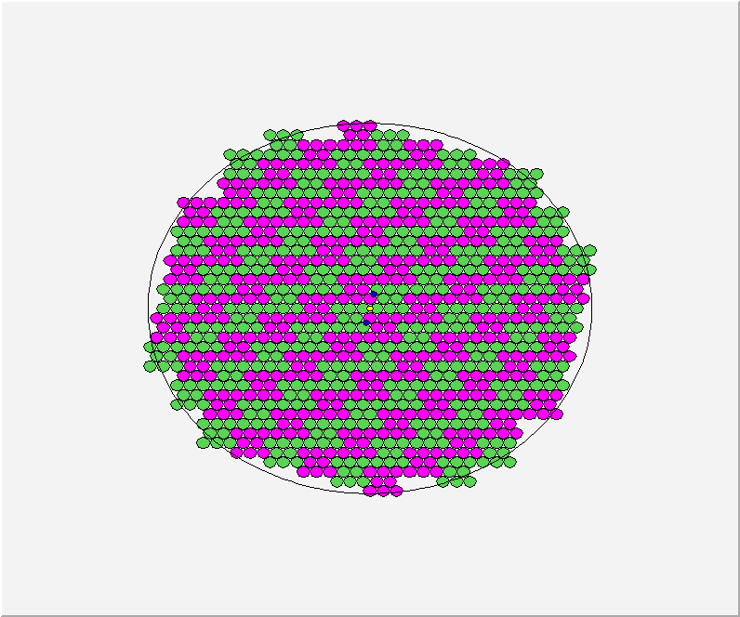
Super-Cells Numbering
JURA side
RACK
I: 28 super-cells
7 up-boards
224 channels
II: 33 super-cells
8+1/4 up-boards
264 channels
I
I I
16 FE up-boards
(32 ch each)
512 ch total
16
4
8
20
28
32
0
5
12
17
21
29
40
1
18
33
41
44
2
6
9
13
24
30
36
45
10
19
42
52
3
7
14
25
31
37
48
53
11
15
22
26
34
43
49
60
I I I
I V
61
65
23
27
38
46
54
62
66
69
73
35
50
56
70
77
81
93
39
47
55
57
63
67
82
94
97
51
58
16 FE down-boards
(32 ch each)
512 ch total
64
71
78
85
95
105
109
59
68
74
83
89
101
106
113
121
72
79
96
102
110
117
75
80
86
90
98
107
114
118
76
87
91
103
111
119
84
88
99
104
115
120
92
112
100
116
108
III: 33 super-cells
8+1/4 down-boards
264 channels
IV: 28 super-cells
7 down-boards
224 channels
Numbering is chosen to optimize cable lenght and PM-Crate distance
Saleve side is equal (not specular) with rack on the right

Slide 9
Conclusions
Ready for installation of PM+sockets in the two lodging disks
HV distribution boards ready
HV power supply: two mainframe at CERN, 1 in Perugia, 1 in Firenze
FE boards to arrive in fall this year
All the stuff (PM+sockets, HV, FE) will be checked in Lab with Laser before shipping to CERN

