Slide 1
RICH WG
M.Lenti

Slide 2
Outlook
Mirror Support Vidyo meeting on June 12, 20, 27 and on July 4 and 11
RICH WG meeting on august 27
Vessel status (see Ferdi’s presentation last Tuesday)
Mirror Support Status (V.Carassiti)
Mirror Support Prototypes (G.Anzivino)
PM installation (M.Lenti)
RICH TDAQ status (M.Piccini, reported in the TDAQ summary)

Slide 3
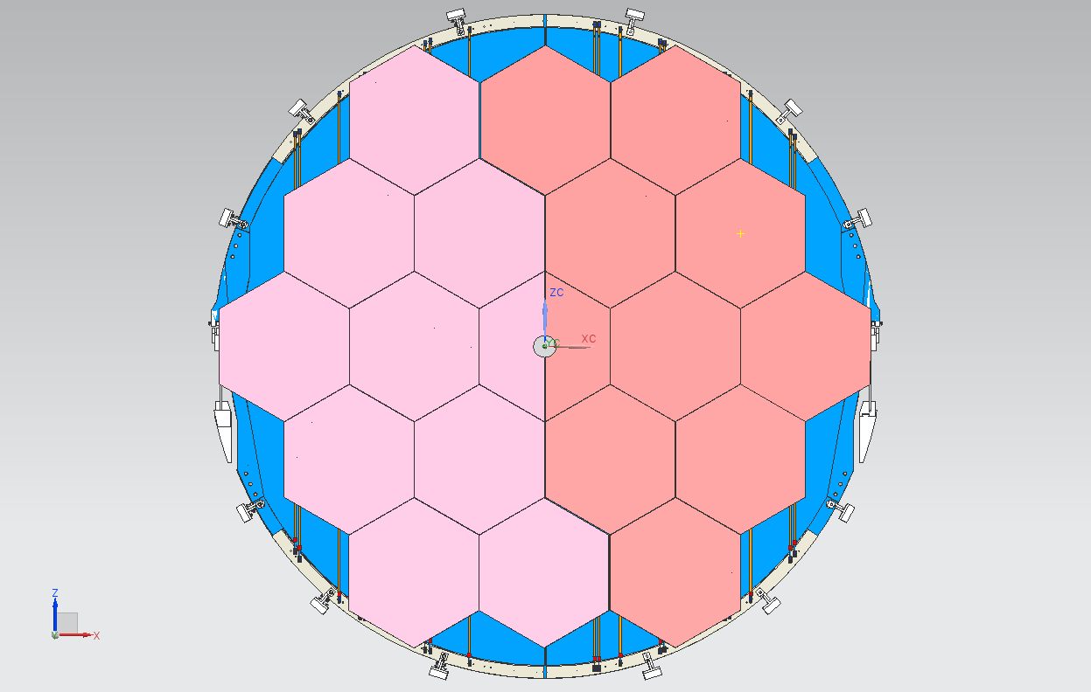
THE MIRRORS– FRONT VIEW

Slide 4
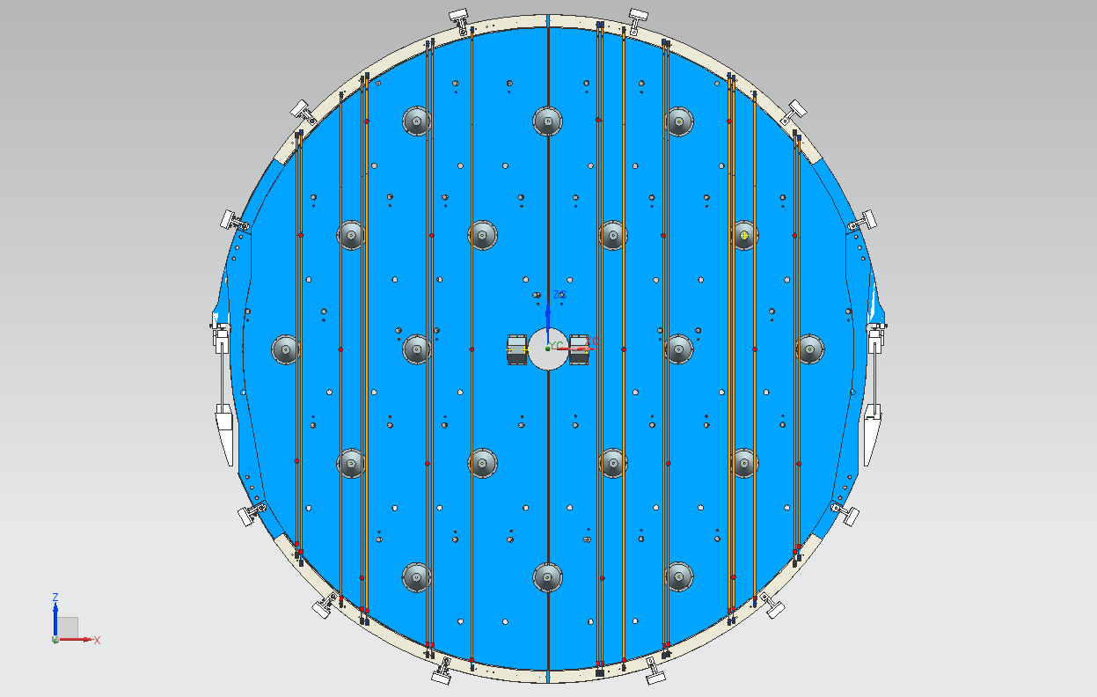
STABILIZING RIBBONS & MIRROR SUPPORTS

Slide 5
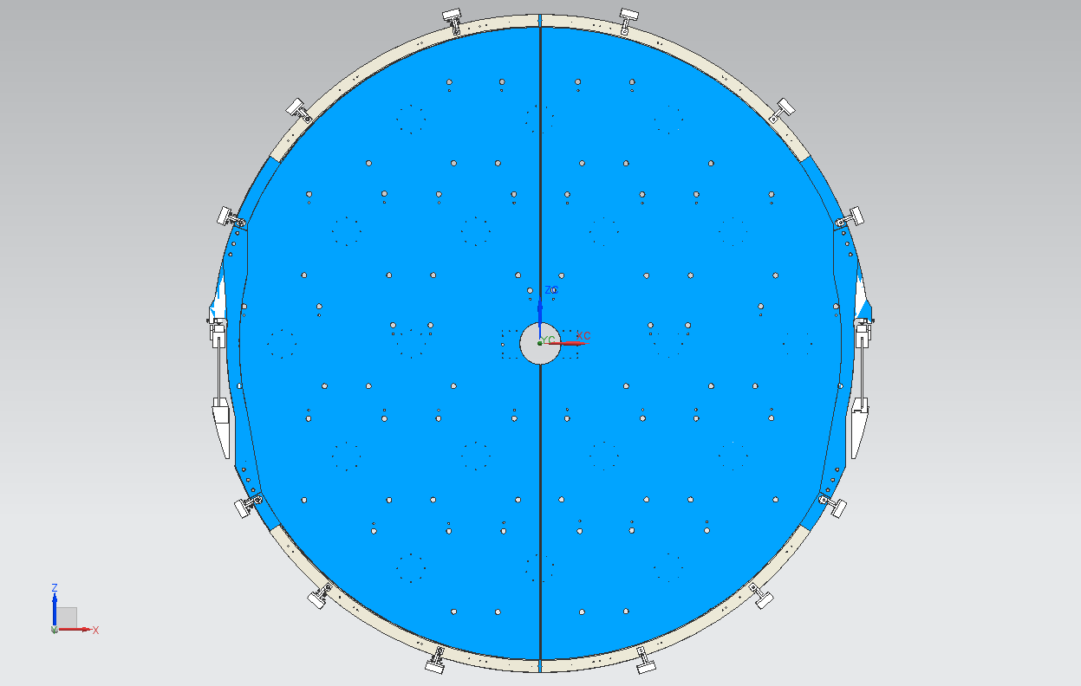
THE HOLES ON THE SUPPORTING PANELS

Slide 6

THE HOLES ON THE SUPPORTING PANELS - DETAIL
TENSIONING RIBBON
TRANSMISSION SUPPORT
MIRROR SUPPORT (CONE)
PLANE B

Slide 7
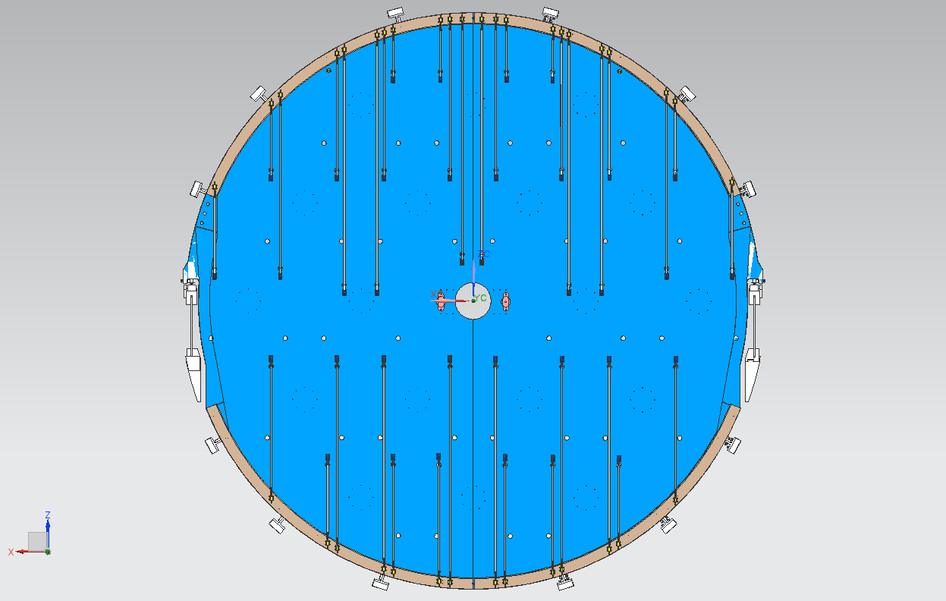
THE TENSIONING RIBBONS

Slide 8
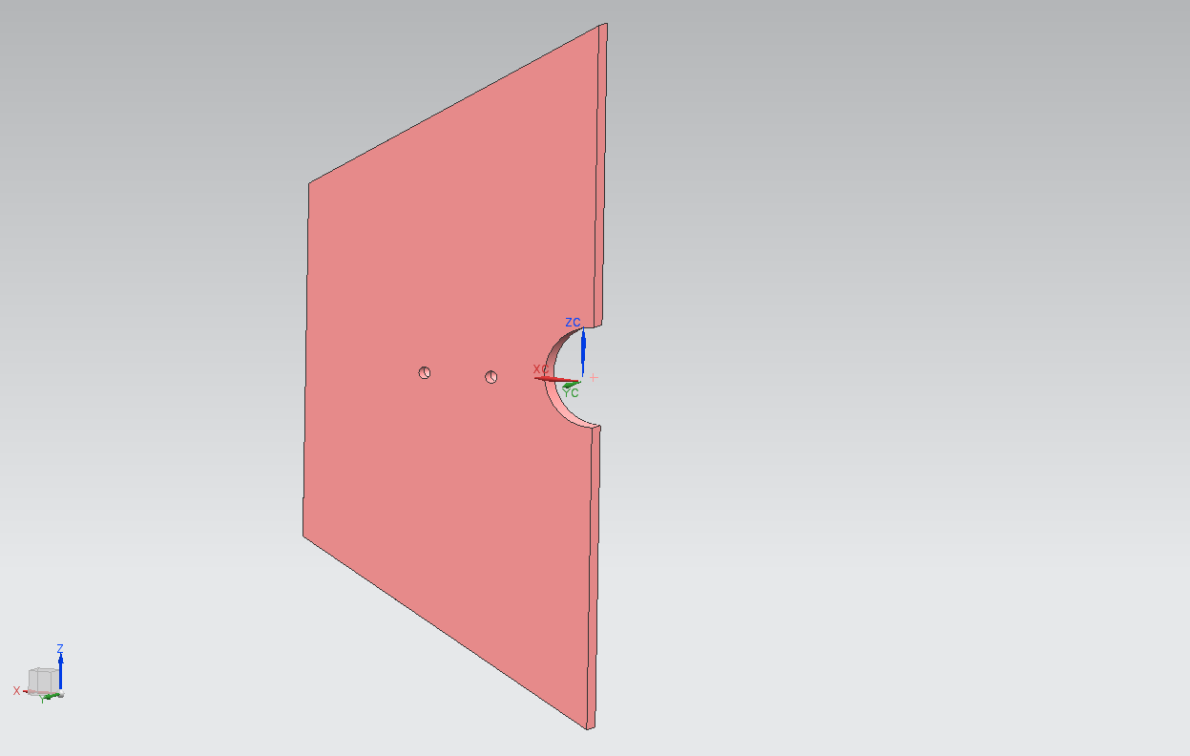
THE HALF CENTRAL MIRROR
TWO DOWELS

Slide 9
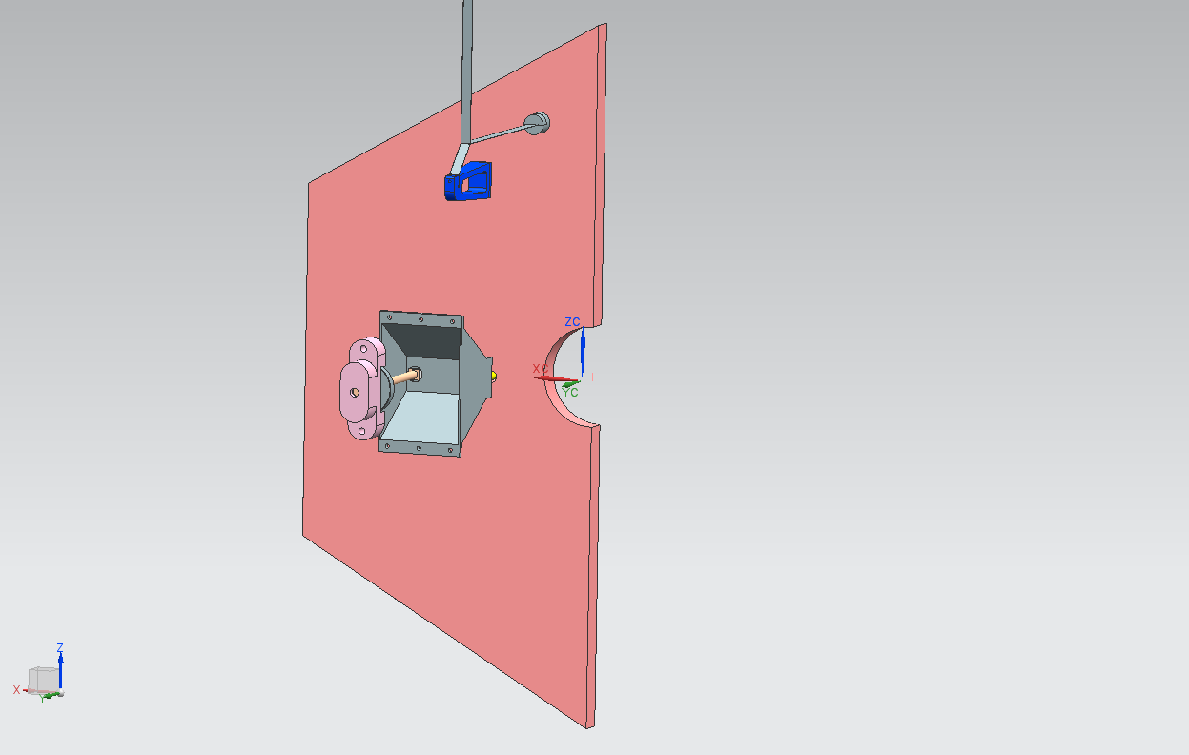
THE HALF CENTRAL MIRROR
TENSIONING RIBBON
(HORIZONTAL AXIS ROTATION)
SLIDING DOWEL SYSTEM
(VERTICAL AXIS ROTATION)
MIRROR SUPPORT

Slide 10
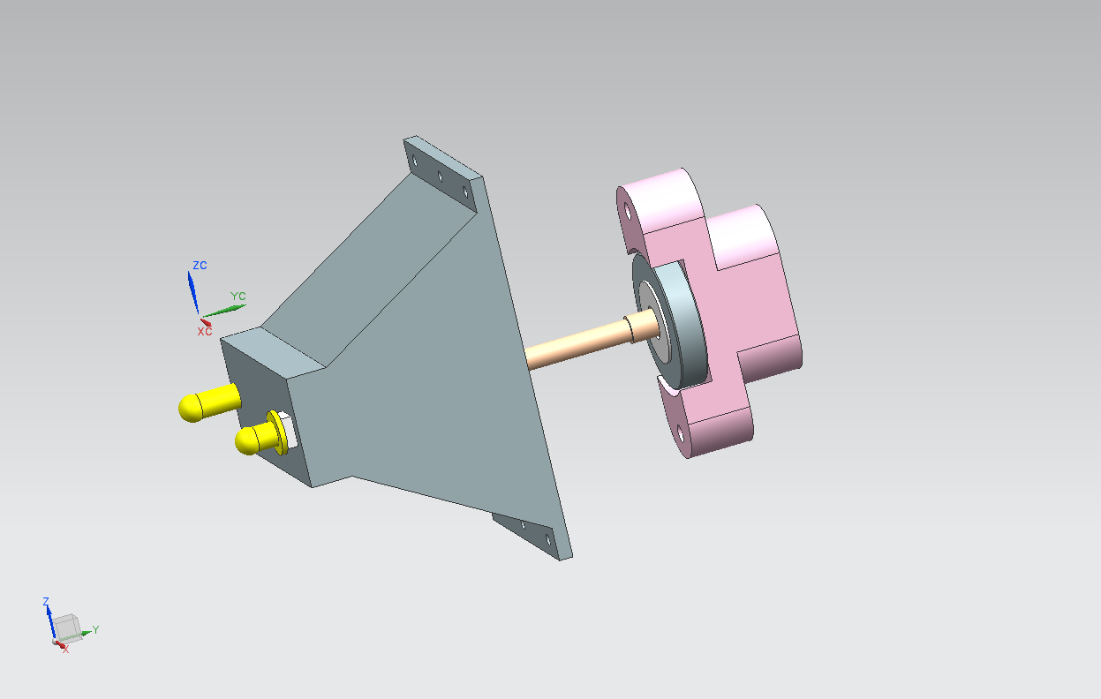
THE SLIDING DOWEL SYSTEM - DETAIL
KNOB SUPPORT
FIXED DOWEL
ACTUATING BAR
KNOB
SLIDING DOWEL
MIRROR SUPPORT

Slide 11
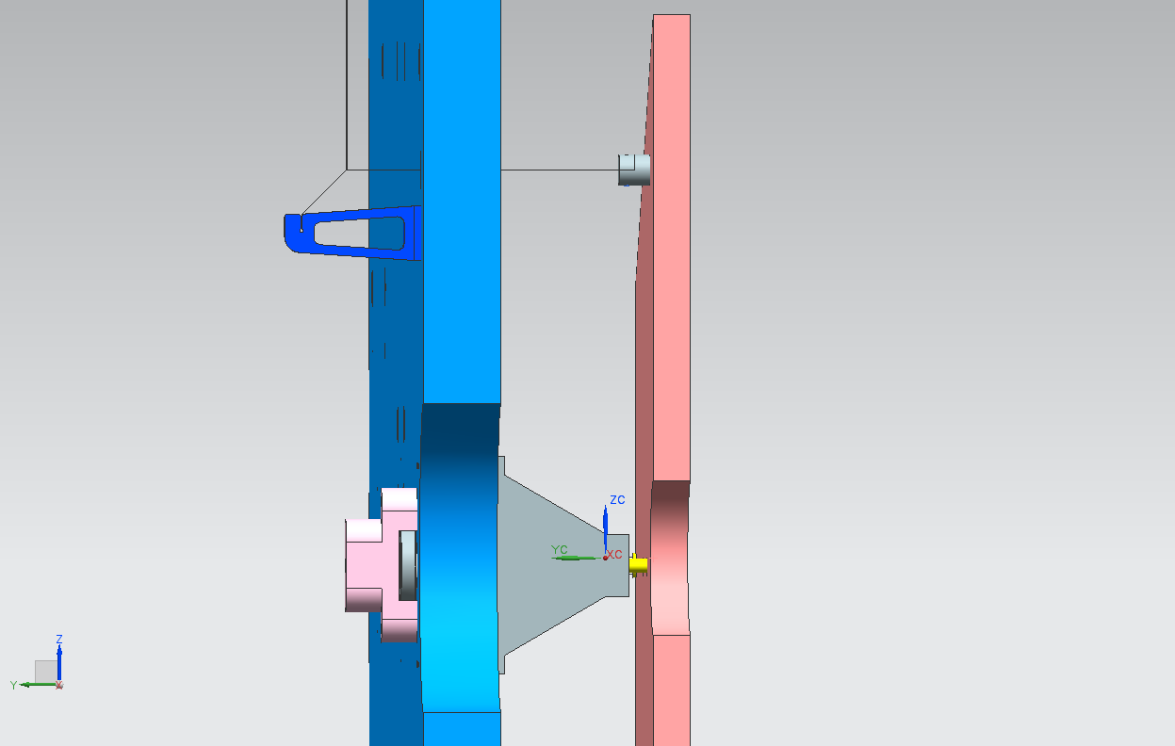
THE HALF MIRROR IN PLACE

Slide 12
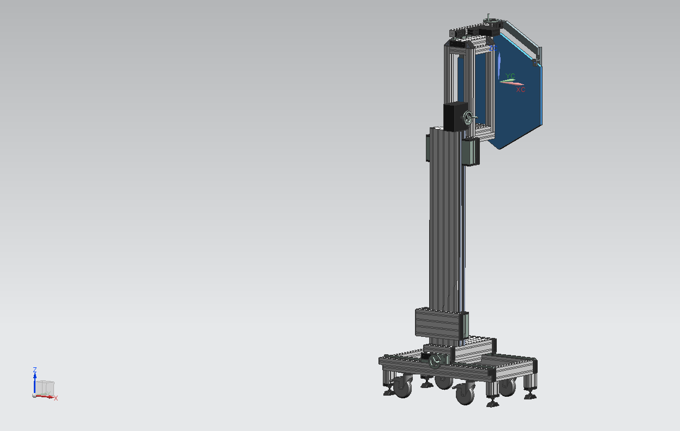
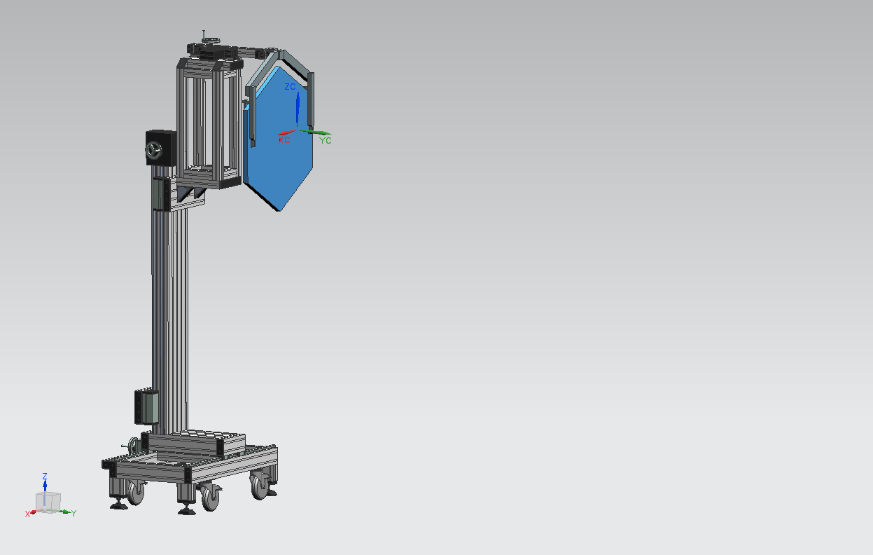
THE TOOLING ASSEMBLING THE MIRROR – FINAL UPGRADE

Slide 13
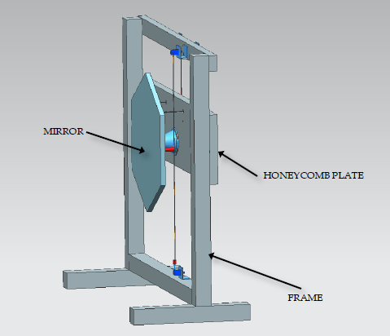
Prototype 2.0 (1 mirror)

Slide 14
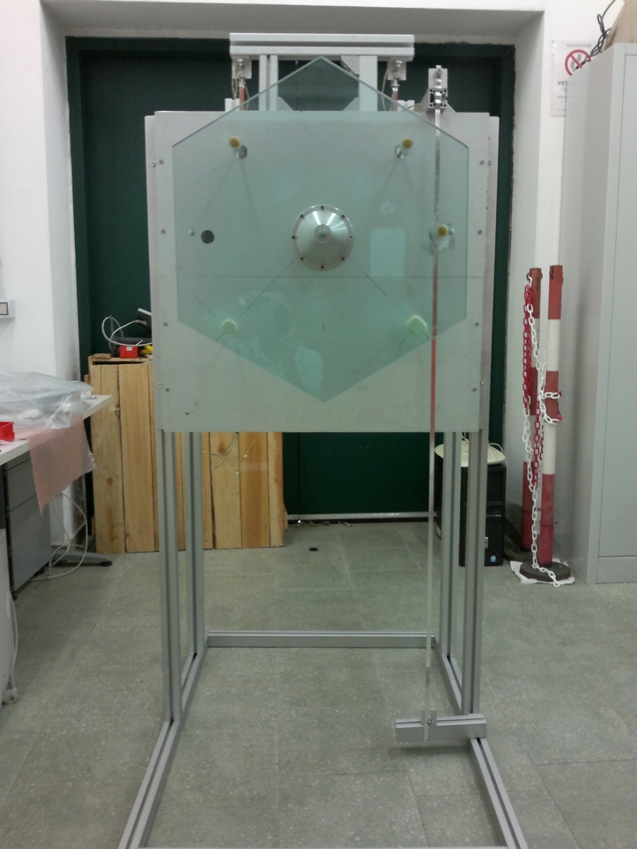
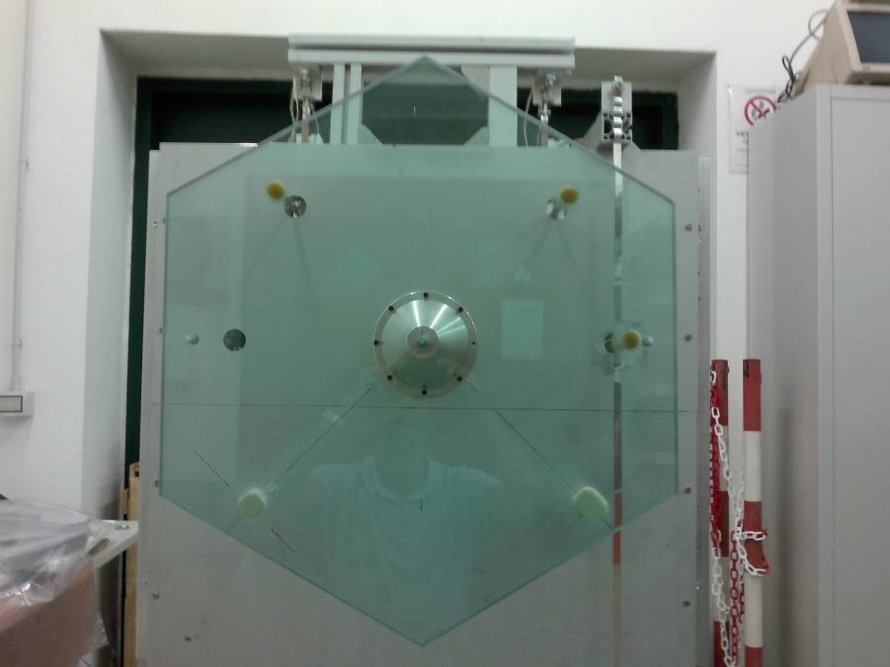
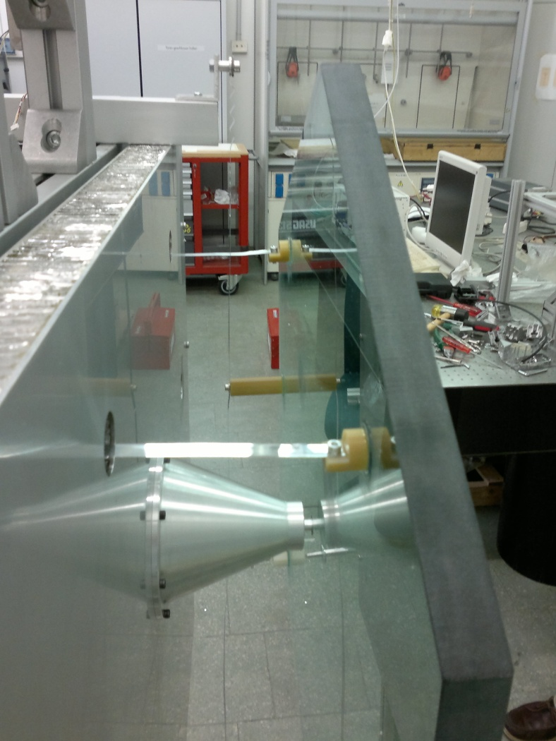
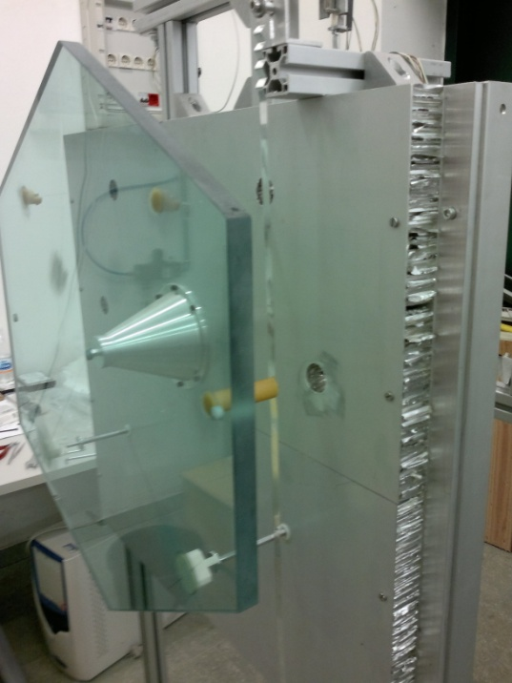
Prototype 2.0: done
Stabilizer Ribbon added

Slide 15
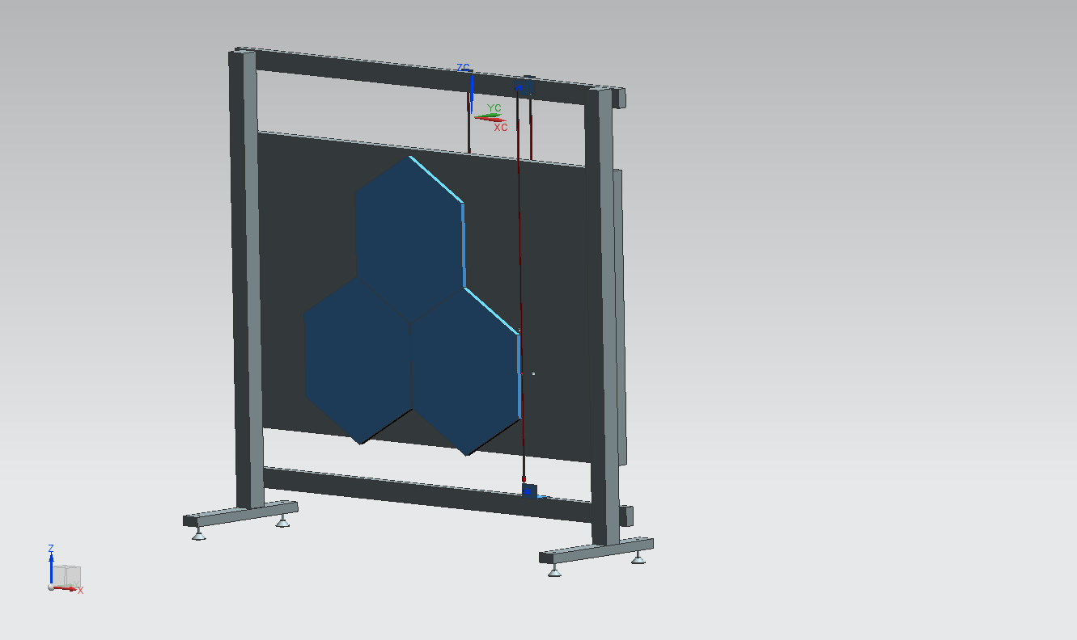
Prototype 3.0 (3 mirrors) in preparation in Perugia
MIRROR
HONEYCOMB PLATE
FRAME

Slide 16
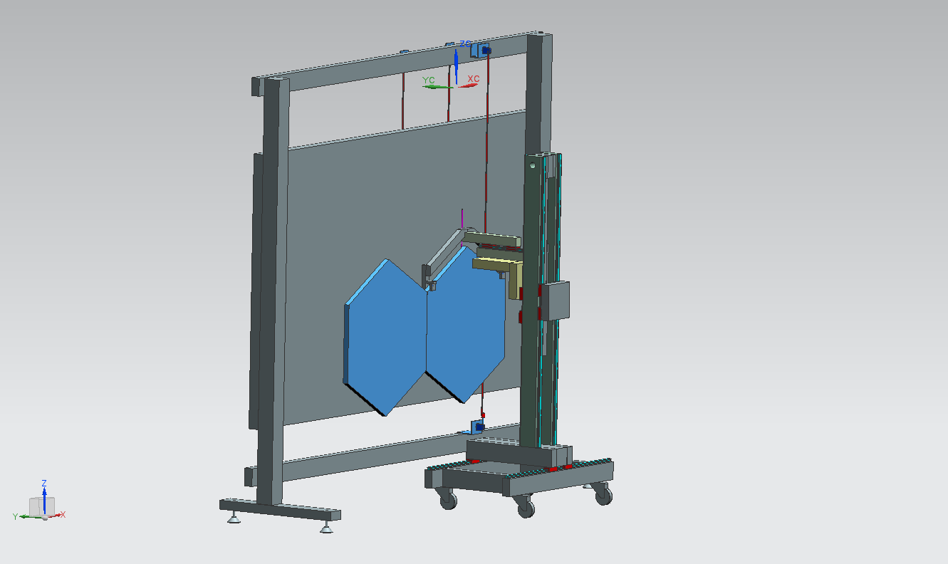
MIRRORS ASSEMBLY – PUT THE MIRROR IN PLACE -1
INSERTION SYSTEM – UPDATED DESIGN
THE INSERTION OF THE DOWEL INTO THE
MIRROR’S HOLE HAS TO BE DONE CAREFULLY
AFTER THE CONNECTION OF THE
RIBBONS THE LIFTING FRAME IS
DISMOUNTED AND THE INSERION
SYSTEM CAN MOVE TO THE NEXT
MIRROR
THE INSERTION SYSTEM DOES
HAVE 3 AXES MOTION
THE MIRROR CAN’T BE HELD BY HAND DURING
THE CONECCTION AND THE TENSIONING OF THE
RIBBONS

Slide 17
Material procurement in Perugia
Giuseppina Anzivino
Honeycomb panel
  order placed beginning of August
  delivery expected mid september
Frame to host the panel
  same as the panel
Insertion tool
  in production, same delivery time
Order for aluminium for the whole production of cones and additional pieces for the mirror support
  a little bit delayed, but
  we have in the workshop the material necessary for the production of the pieces for the prototype

Slide 18
Front view of RICH PM and electronics
16 X 32 CH
HV FILTER
HV
HV
SIG
SIG
PMT
PMT
SIG
SIG
HV
HV
SUPPORT
SUPPORT
5x TEL62

Slide 19
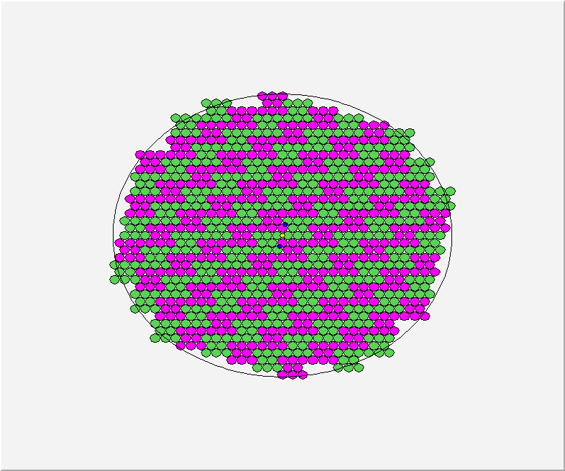
Super-Cells Numbering
JURA side
RACK
I: 28 super-cells
7 up-boards
224 channels
II: 33 super-cells
8+1/4 up-boards
264 channels
I
I I
16 FE up-boards
(32 ch each)
512 ch total
16
4
8
20
28
32
0
5
12
17
21
29
40
1
18
33
41
44
2
6
9
13
24
30
36
45
10
19
42
52
3
7
14
25
31
37
48
53
11
15
22
26
34
43
49
60
I I I
I V
61
65
23
27
38
46
54
62
66
69
73
35
50
56
70
77
81
93
39
47
55
57
63
67
82
94
97
51
58
16 FE down-boards
(32 ch each)
512 ch total
64
71
78
85
95
105
109
59
68
74
83
89
101
106
113
121
72
79
96
102
110
117
75
80
86
90
98
107
114
118
76
87
91
103
111
119
84
88
99
104
115
120
92
112
100
116
108
III: 33 super-cells
8+1/4 down-boards
264 channels
IV: 28 super-cells
7 down-boards
224 channels
Numbering is chosen to optimize cable lenght and PM-Crate distance
Saleve side is equal (not specular) with rack on the right

Slide 20
Supercell
L
R
PMs are grouped in Supercells of 8 PM each (to be used in multiplicity trigger)
Two HV channels (L and R) feed one Supercell

Slide 21
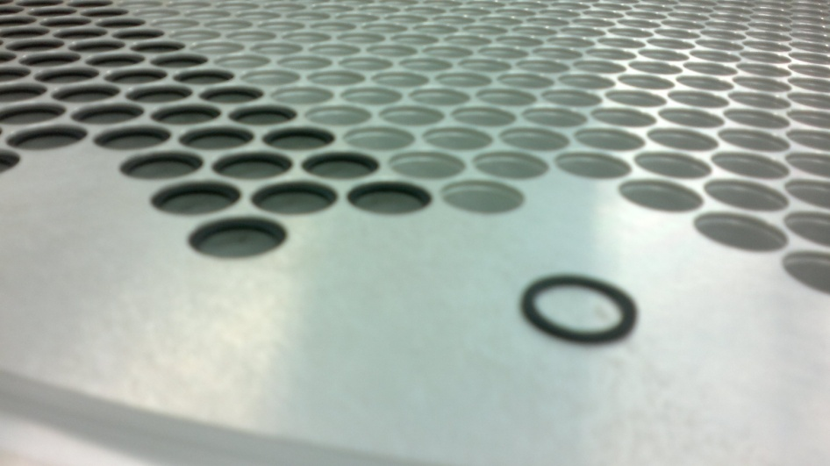
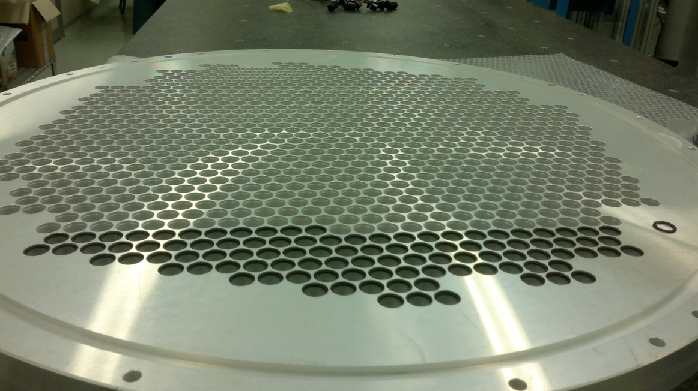
PM Lodging disks
Each disk has 976 holes; there are two lodging disks
In each hole a thin o-ring 1 mm thick (13.5-17.5 mm Ø) is inserted in a gorge at the downstream end
It is the arrest of the PM (and protection against ambient light from the back)

Slide 22
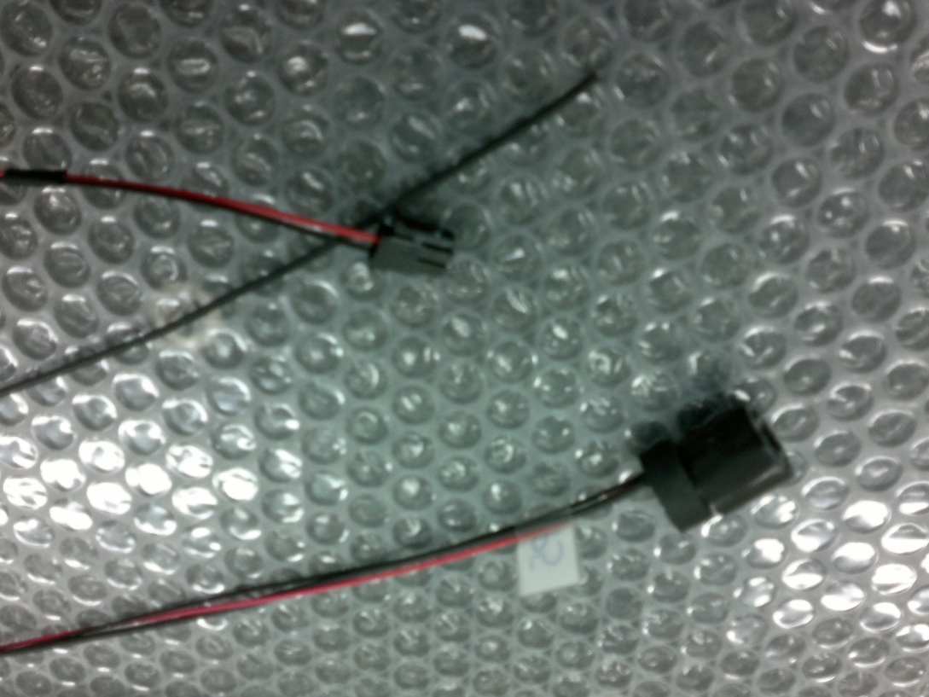
New sockets (test sample)
Signal cable
without connector
HV connector
New socket
Thick o-ring
(6 mm thick)
A thick o-ring is inserted upstream of each socket+PM to keep it in position, protect from
ambient light and provide a good thermal contact

Slide 23
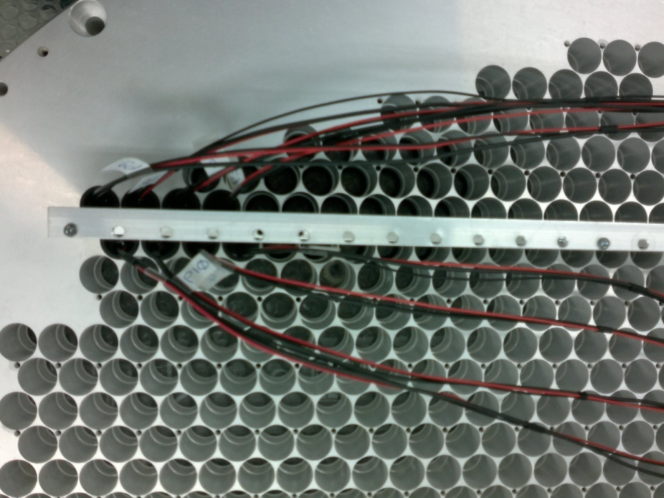
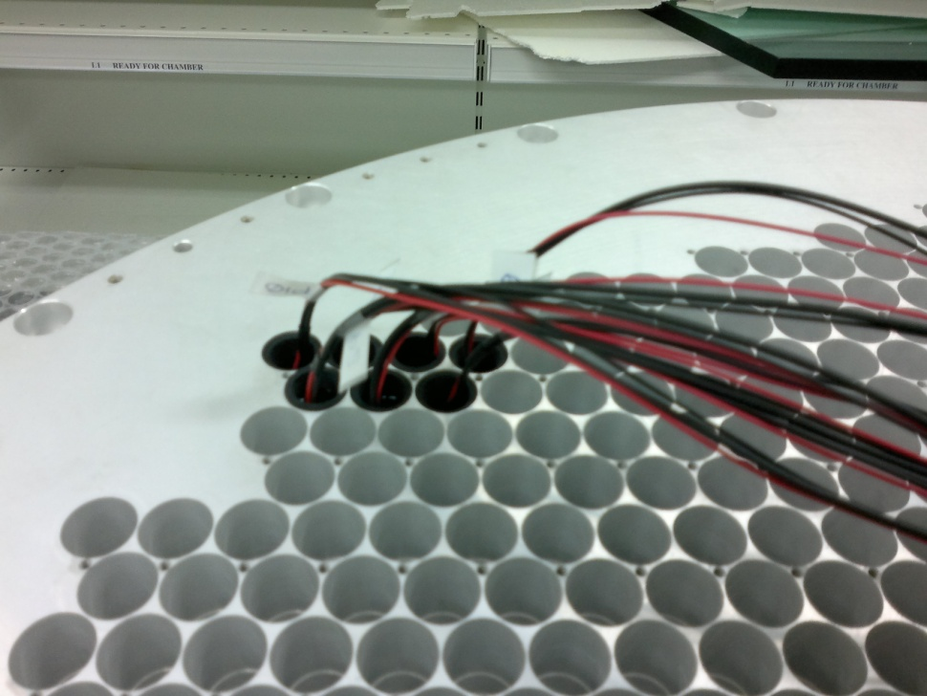
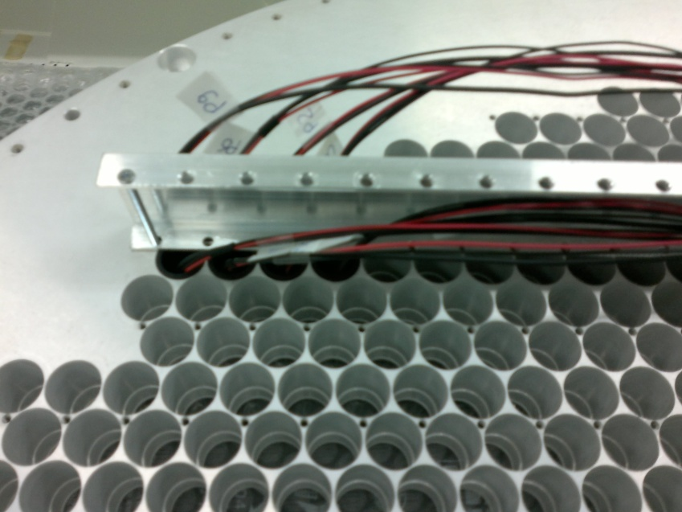
PM+socket insertion
Upstream view of the disk
Fixation bar inserted
A fixation bar in inserted every two rows of PMs
to keep them in position and facilitate the dissipation
of the residual heat produced by the sockets

Slide 24
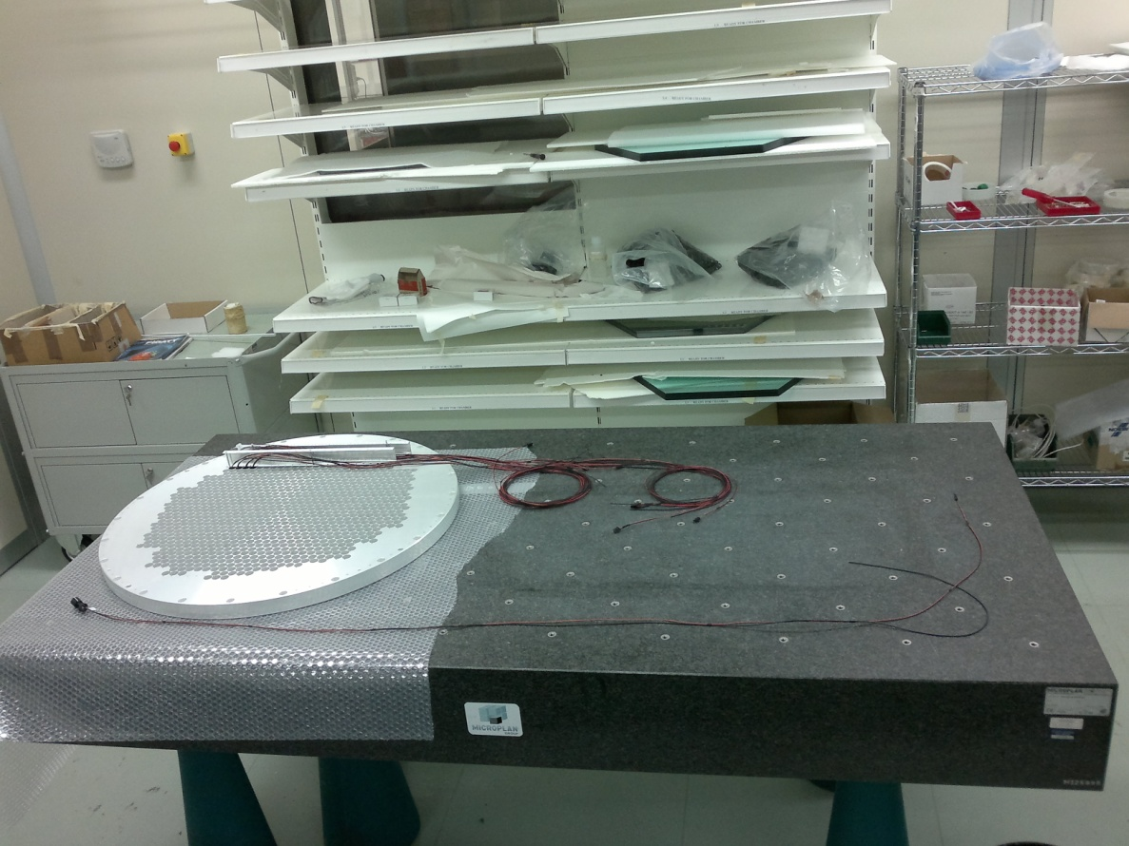
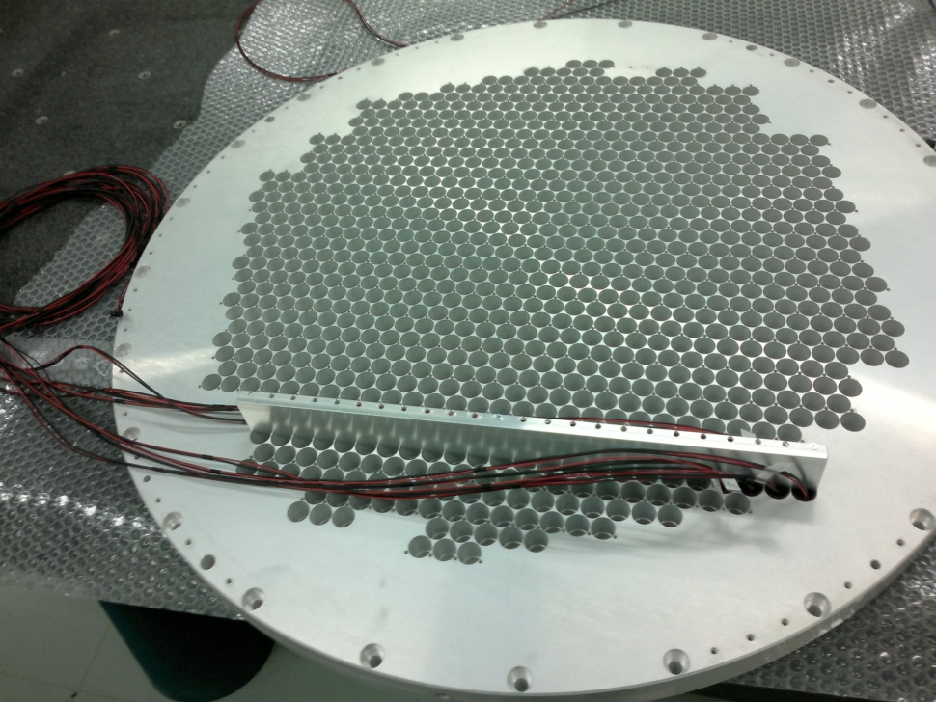
Work in clean room
Ready to install all the PM+sockets

Slide 25
Conclusions
Approaching final design of the mirror support system
Intense prototyping ongoing on the mirror support: people training, details checking, etc
PM installation on the lodging disks started: first step of a full (laser) test of all the electronics chain before installation at CERN
Some delay in RICH vessel construction

