Slide 1
Computing status
Paolo Valente – INFN Roma

Slide 2
Evolution of computing model: starting points
Start from clear requirements
  Add appropriate safety factors when some information is missing/not final
Make clear choices:
  e.g. CERN-based vs. maximize outside data processing
Keep it simple
Mandatory to get ready for running in 2014

Slide 3
Data flow: open questions
Question on filtering with a L3 trigger
  Foresee in any case the possibility of filtering/selecting events in streams
  Whether or not really throw away events will be a compromise between physics and resources
How many formats? (RAW, RECO, THIN, …)
  Start from a “standard set”
  Make educated guess on size
Calibration data
Metadata, catalog(s)
How many/which DB?
  All these issues connected. Dedicated discussion on offline database
Where to store, reconstruct and analyze data

Slide 4



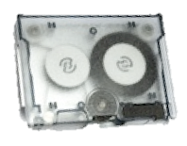
First step: data transfer from NA62 farm
From ECN
NA62
CERN data center
L1/L2 farm
Institutes
Disk pool
Tapes
Farm storage

Slide 5
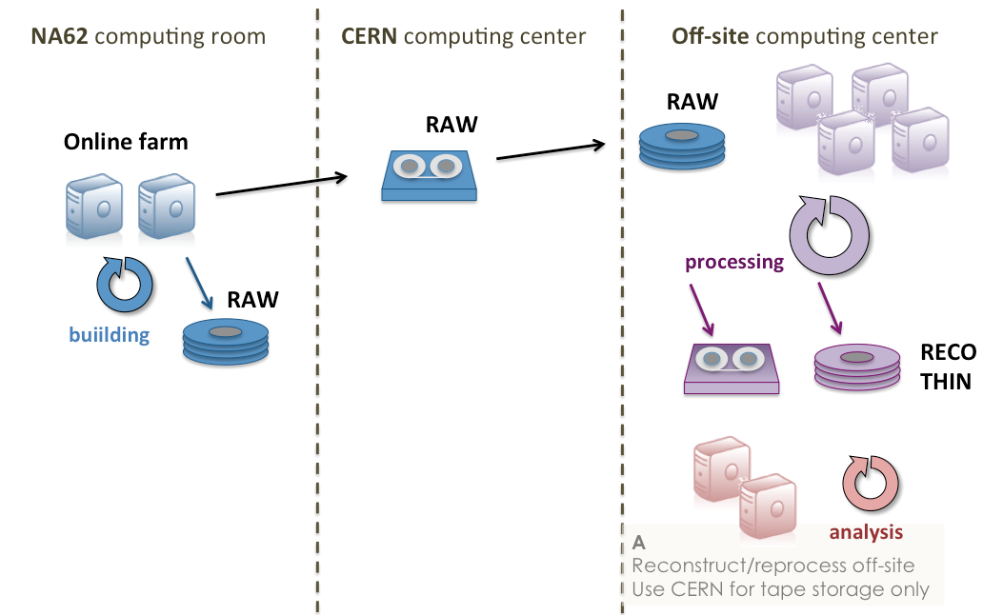
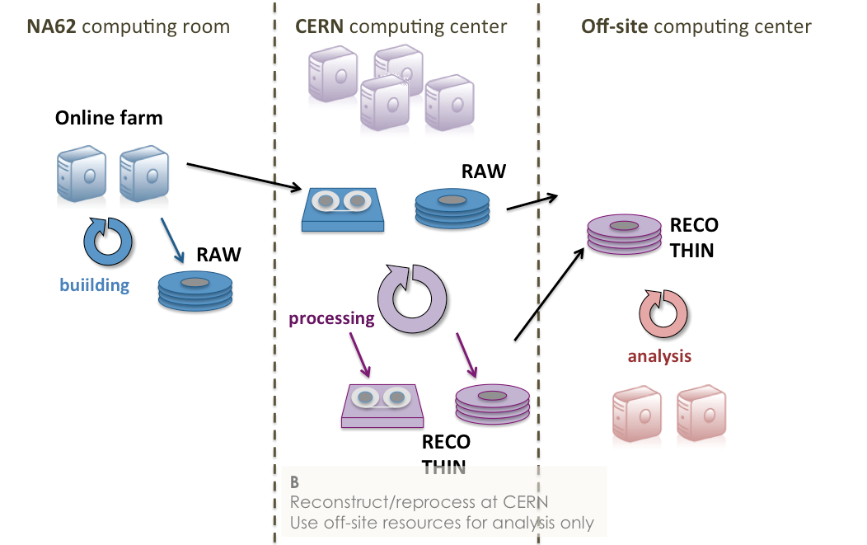
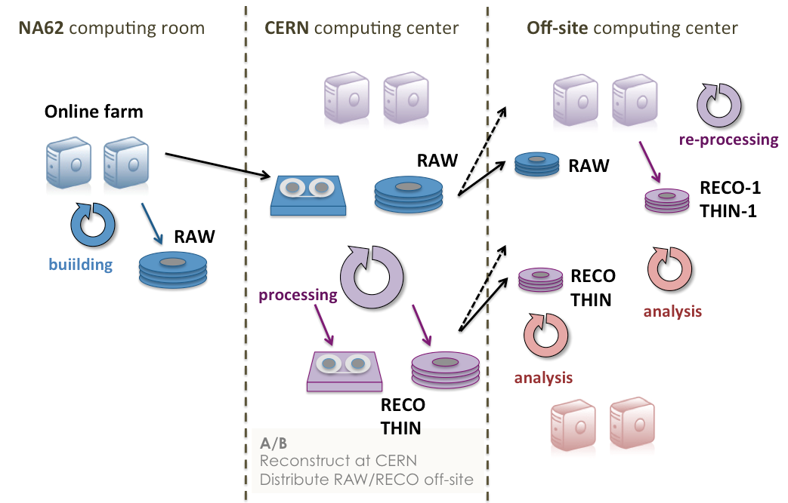
Computing model
Main choice:
one of these 3 options

Slide 6
Computing model

Slide 7
Resources and cost

Slide 8
EOS testing

Slide 9
Open questions in random order/1
Online farm:
  We have a single merger-pc model now, how much has to be changed in order to distribute among at least 3 machines? (2+1 hot spare?)
  Accounts and password policy: currently everybody running root user. EOS but also the new CDR will need Kerberos (AFS) authentication
  How many machines of the different “kind” can we arrange in the main switch/router?
    L1/L2 nodes
    storage elements
    merger/event-building
    service machines
    …

Slide 10
Online farm status

Slide 11
Open questions in random order/2
new CDR
  NA48/NA62₂₀₀₇ CDR is no longer usable
    too many legacy and unsupported databases/languages
    too many patches
    not all the knowledge still available
  During the technical run we reused a set of scripts from the Compass CDR
  What to do for the future?
    Write [at least] the basic requirements for the new system
    Start as soon as possible a prototype

Slide 12
Proposal for a new CDR

Slide 13
Offline database

Slide 14
General issues
Time is becoming strict, computing close to the critical path
The technical run has demonstrated that CDR is just the next step [we are now able to write data on the farm]
Asking for/negotiating computing resources needs a considerable time in advance
Since remote resources are involved, organization and coordination is needed
All computing related persons are busy with one or more other tasks
Data processing and analysis is at the very end of the chain: many details not yet fixed
Complex systems, not easy to simulate and test

Slide 15
Next steps
Concerning model, resources, planning:
Write a “Computing technical document” by end of september 2013
Open for discussion and elaboration until end of november 2013
Send out request for resources to CERN: approval by Steering Committee in december 2013
On the technical side, in the meanwhile:
Continue working on design of CDH
Build a prototype, test it
Continue with EOS testing
Work out a solution for high-speed dedicated connection from NA62 farm to CERN-IT

Slide 16
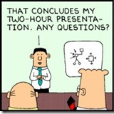

Discussion

Slide 17


FroNTier access to DB
FroNTier launchpad
Tier-0 squid
DB server
FroNTier servlet
squid
squid
squid
squid
squid
Tier-1/2 squid
squid
squid
FroNTier provides translation of database connection and SQL statements into HTTP protocol
Squid provides HTTP data caching
Farm squid
Tier-1/2 squid
squid
squid
squid
squid
FroNTier client API
User code

Slide 18
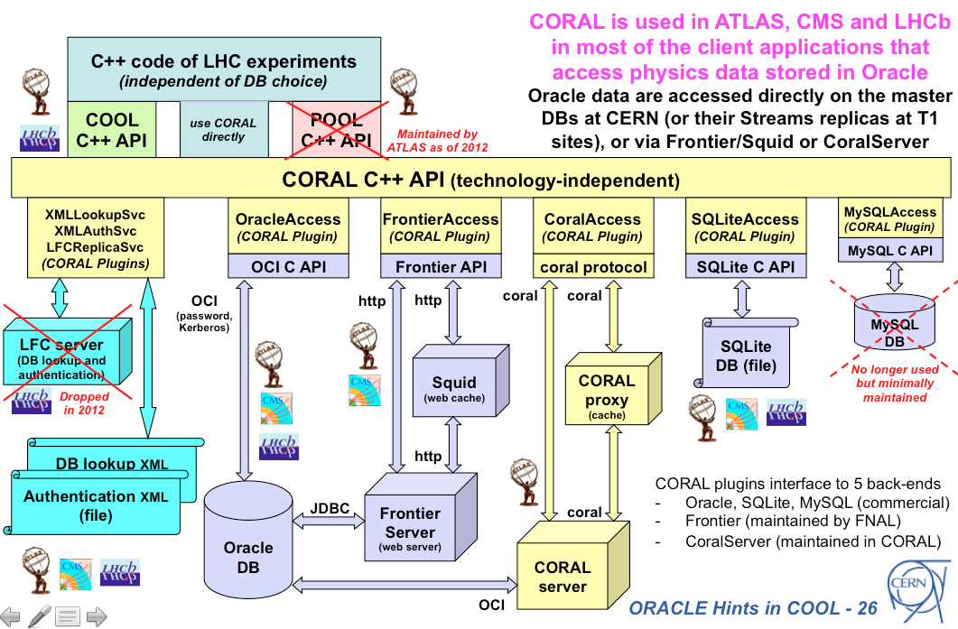
A. Valassi

