Slide 1
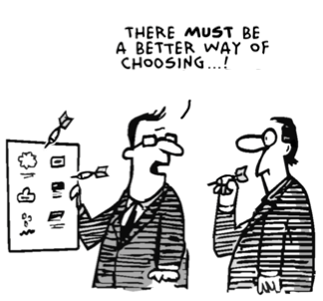
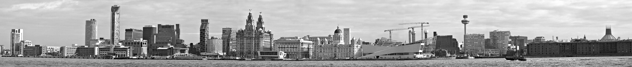
NA62 computing model update
Paolo Valente – INFN Roma
[Acknowledgements to B. Panzer-Steindel, M. Lamanna, A. Di Girolamo]

Slide 2
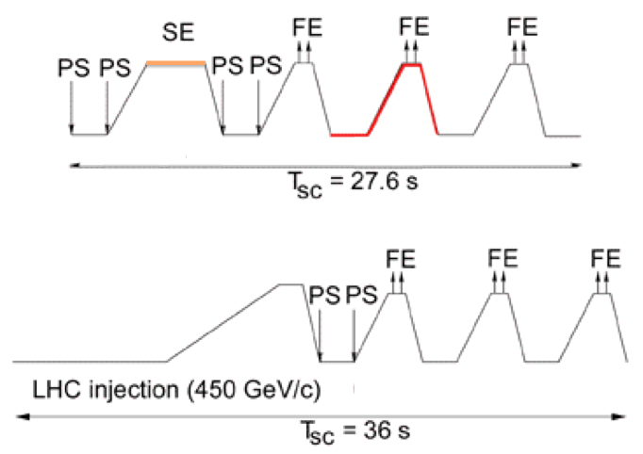
Requirements: data volume/1
SPS duty-cycle: 9.6 s flat top/27.6 s
Trigger rates/latencies:
  L0: 1 MHz/0.1 ms
  L1: 100 kHz/1 s
  L2: 15 kHz/27.6 s
Event size: 30 kB
  Zero-suppressed LKr (13000→1000 cells, 185 kB/13=14 kB)
  All other detectors: 15 kB
RAW data: 13.5 TB/day
Band-width to storage: 150 MB/s
  150k events/burst=4GB/burst

Slide 3
Requirements: data volume/2
L3
  The (possible) filtering of events after L2 trigger and reconstruction and before permanent storage
  A single parameter in the estimates: f=reduction fraction, 0<f≤1
Running time: 100 full days (100% efficiency), i.e. 300k bursts
RAW data: f×13 TB/day×100 days=f×1.2 PB/year
RECOnstructed data assumed to have approximately the same size of RAW data (in the end they could be even larger)
THIN ?
As a comparison, in 2007:
    120 days of data taking, 450k bursts of 14,4 s → 60% live-time
    55k events/burst, 11 kB/event → 600 MB/burst, 40 MB/s band-width
    300 TB unfiltered total RAW data
    f=0.3 → 90 TB after L3 filtering

Slide 4
Computing resources: summary
Tapes
  1.2 PB/year RAW + reconstructed data (RECO)
  RECO size can be optimized, but expect at least same size as RAW
    Deletion policy (How many versions? Where to keep them?)
  Difficult to expect less than 2 PB/year
Disk
  Essentially driven by processing/reprocessing needs
  Depends on the computing model
  If one full data-set to be kept on disk, 1-2 PB
CPU
  Full reconstruction: O(1) HS06⋅s/event, 5kevents/s = 5kHS06 = O(500) cores ×(safety factor=2) = 10 kHS06
    Really need to check this number

Slide 5
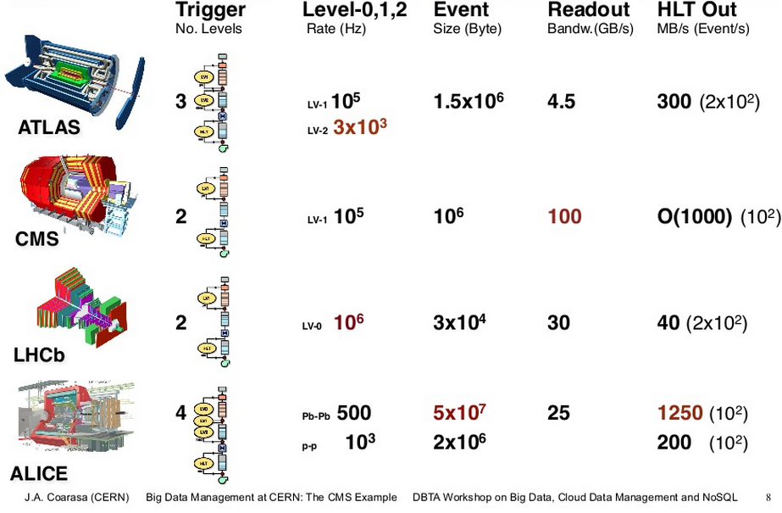
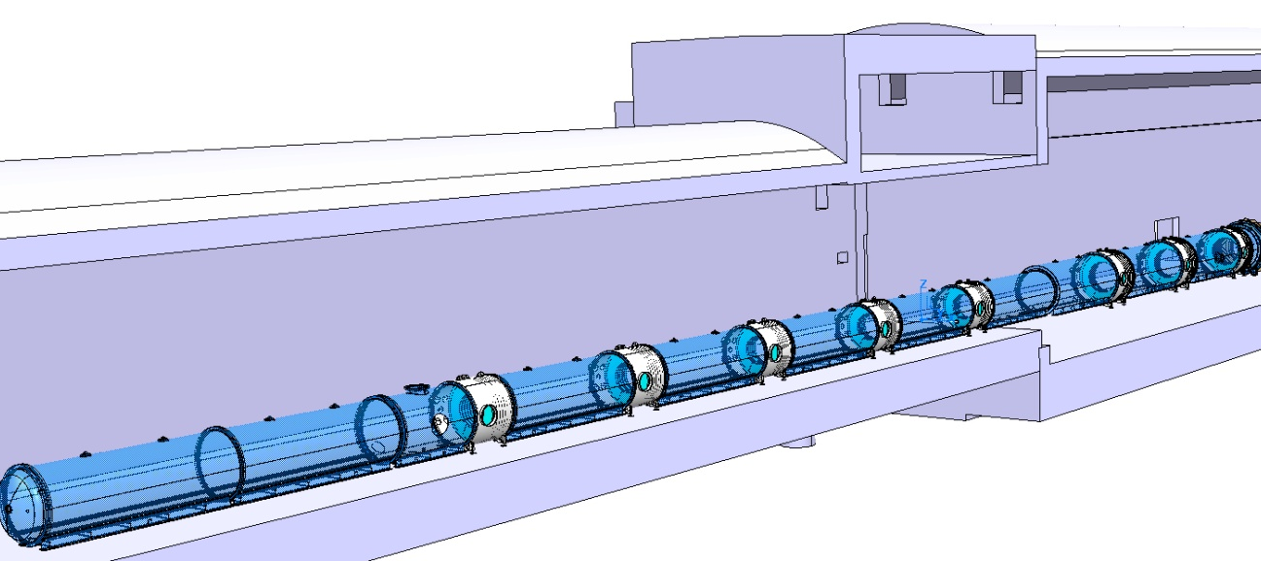
Comparison with LHC experiments
2
LV-0 10⁶
LV-1 10⁵
3x10⁴
5
(without LKr)
150 (5×10³)
NA62

Slide 6
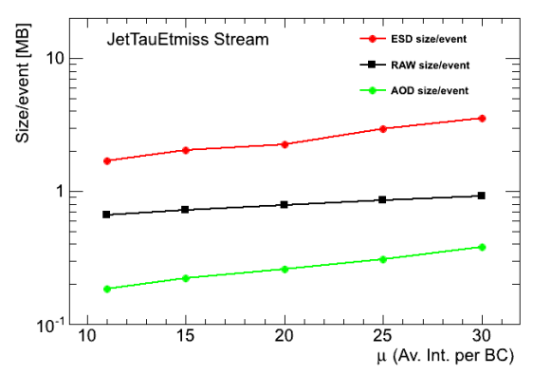
Comparison with LHC experiments
NA62
L2 output rate = 5 kHz (averaged over the spill)
  30 machines = 720 cores
Event size ≅ 30 kB
RAW volume/year = 1.2 PB
LHCb
L2 output rate = 3 kHz (design) → 5 kHz
  25 k processes
Event size ≅ 50 kB
RAW volume/year = 1 PB
AOD = 750 kB/event (200 Hz)
DST = 150 kB/event
μDST = 10 kB/event
ATLAS/CMS
L2 output rate = 0.5/0.35 kHz
Event size ≅ 0.5 MB/1.5 MB
RAW volume/year = 5 PB
  ESD = 2 MB/1 MB
  AOD = 300 kB
ATLAS

Slide 7
LHC computing models
Tier-0
  Primary computing infrastructure at CERN (CPU + Disk + Mass Storage)
  State of the art networking
    connectivity to the experiments
    connectivity to the Tier-1 centers
  Requirements for custodial storage of datasets
    RAW data archive
    Archive of reconstructed data and AOD
  Service level: 24×7 service
  Tasks: Prompt Reconstruction, data archiving, prompt alignment and calibration, transfer of RAW/RECO to Tier-1’s
  at CERN
Tier-1
  Computing infrastructure (CPU + Disk Storage + Mass Storage) on the Grid
  State of the art networking
    10 Gb/s connectivity to CERN on OPN, connectivity to other Tier-1’s
    Connectivity to Tier-2’s on LCHONE
  Requirements for custodial storage of datasets
    RAW data must remain accessible throughout the lifetime of the LHC
    Long-term access to RECO/SIMU and analysis datasets
  National (regional) support role including training and user support
  Service level: 24×7 service
  Tasks: Reprocessing, analysis skims, archiving
  At national labs, main universities
Tier-2
  Simulation
  User analysis
(Original definitions of LHC experiments computing models)
MONARC model
Dedicated networks
LHCOPN
  Dedicated to T0 to T1 and T1 to T1
LHCONE
  Dedicated to T2’s connection

Slide 8
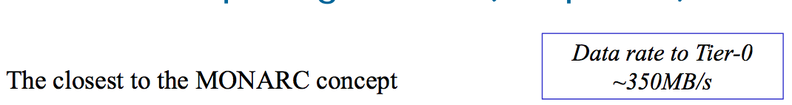
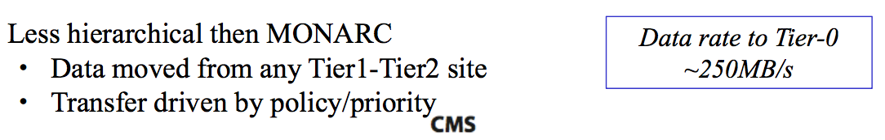
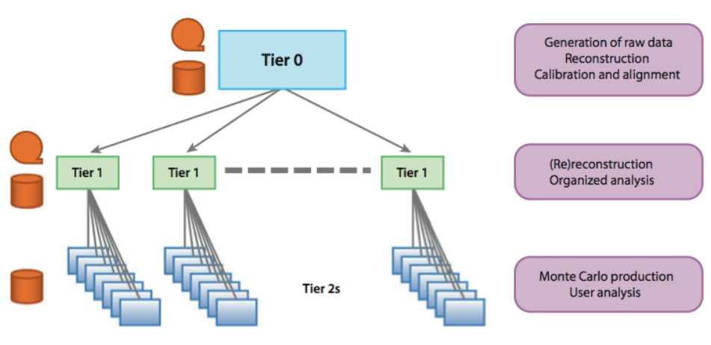
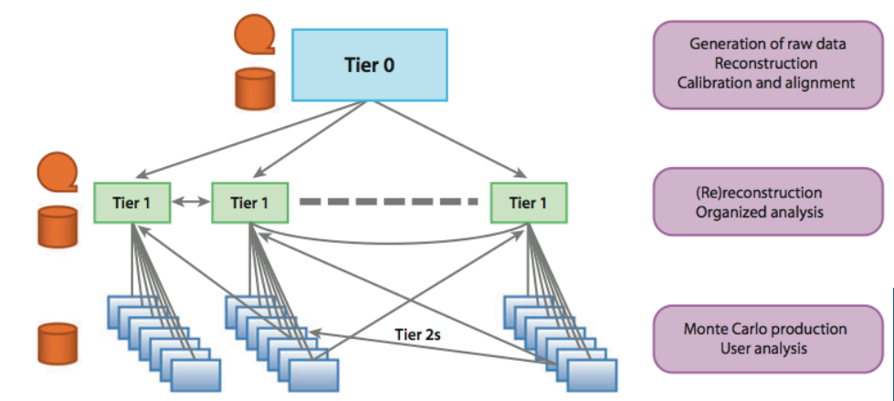
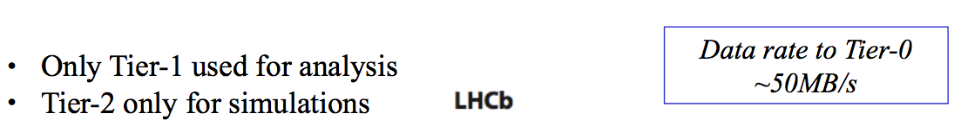
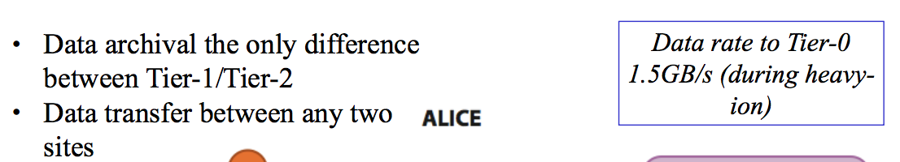
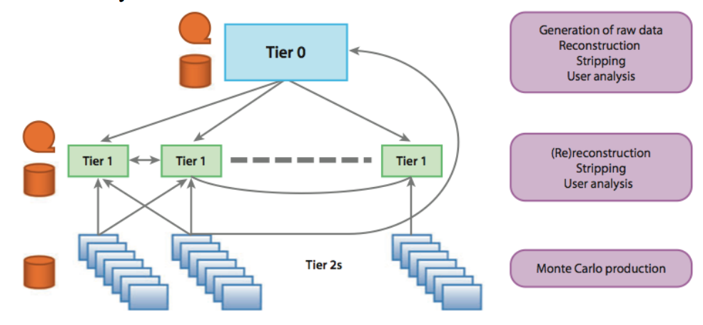
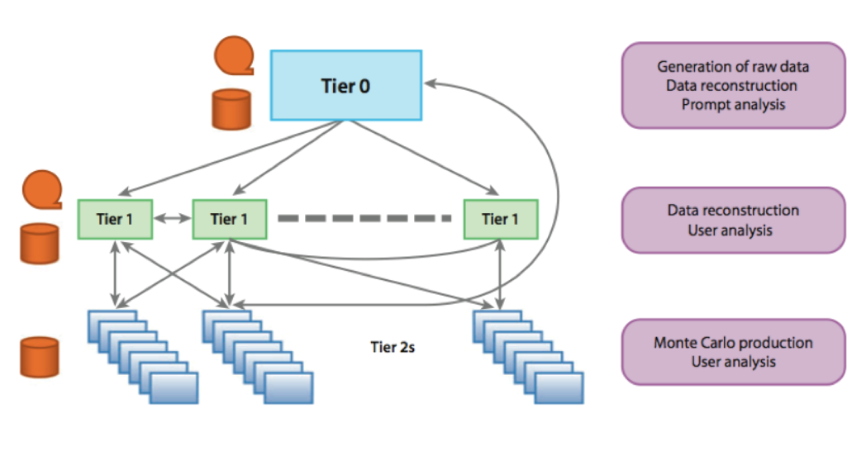
LHC experiments
ATLAS
[original]
CMS
LHCb
ALICE

Slide 9
Evolution of LHC computing models
[Some] motivations for original MONARC model
The network was a very limited resource, potentially a bottleneck
Need a hierarchical mass storage, cannot keep everything in a local disk space
Disk/Tape hierarchy
Job runs “close” to data, achieving efficient CPU utilization
Need a structured and predictable data utilization
What happened as soon as LHC started?
Data transfers between sites demonstrated to be more reliable than predicted
The WAN bandwidth is comparable with the backbone available at LAN level
Some Tier-2 sites are larger then some Tier-1 sites
Geographically distributed job submission and resource usage are working well
Hierarchical mass storage system is complex to manage and requires effort
Regional transfer of data is basically broken
Evolution of LHC computing models from a hierarchical mass storage system to a full mesh/peer-to-peer
Reduced latency in data transfers
Increased working efficiency
Possibility to remotely read data when needed without dramatic impact on CPU efficiency
Hiding local data issues/failures to the users

Slide 10
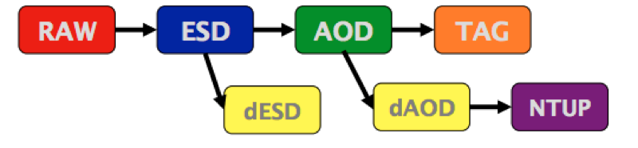
LHC experiments data types
(Original definitions of LHC experiments computing models)
RAW: data from the detector
  Input into the reconstruction at the Tier-0
RECO: primary output of the reconstruction from RAW data
AOD: reduced event data for analysis
TAG: event-level metadata
SIMU: Simulated data that has been reconstructed
  Also contains generator information and MC-truth

Slide 11
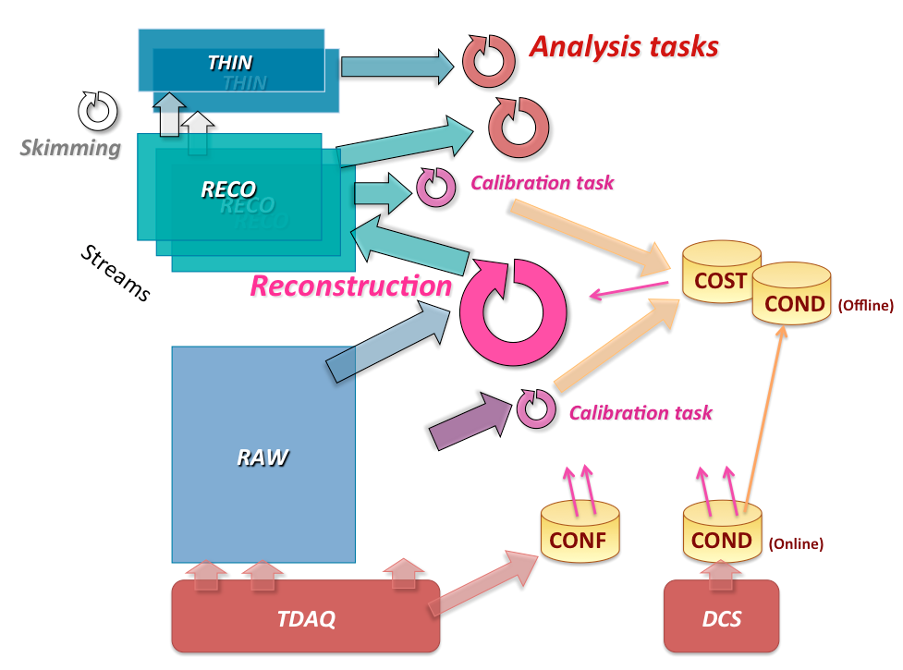

NA62 data flow and types
RAW
RECO
THIN
?
More formats?...
?
NTUP

Slide 12
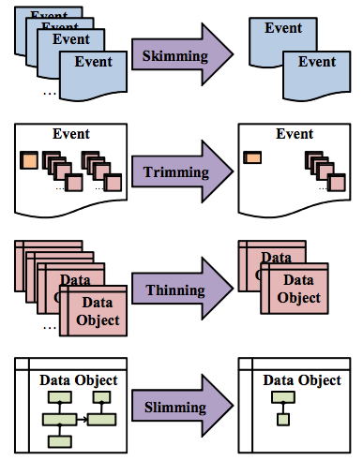
Data stripping
Different types of RECO data reduction:
Filtering/Skimming
  Only events that are interesting for the specific types of calibration/analysis are kept.
Trimming
  Removal of entire containers or top-level data objects from all events. For example, one might remove the calorimeter cells for performance studies of track reconstruction
Thinning
  Removal of individual objects from a container. For example, to study efficiencies for electron and photon reconstruction one needs to keep only calorimeter cells associated to a track.
Slimming
  Removal of parts of an object. For example, one might remove an error matrix from tracking algorithms, when this particular piece of information is not needed for the specific analysis/task
≈ Compact → SuperCompact

Slide 13
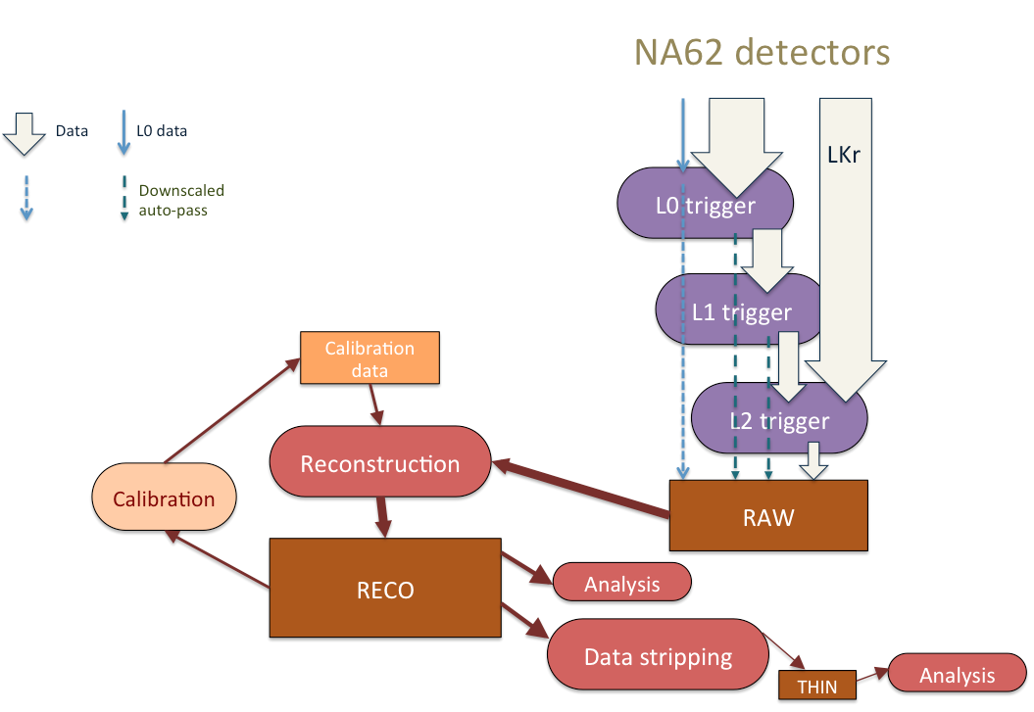
NA62 data processing

Slide 14
Event building and storage
NA62 farm
CERN
Tier-0
Tapes
Event building
Disk pool
Farm storage
1. Events are built in the PC farm after L2 selection, the RAW data files are recorded on the farm disk server(s)
2. RAW files are copied to a large disk pool in the CERN data center
3. RAW files are migrated to tape (custodial copy) and marked for deletion on the farm disks
- The farm storage should be capable of holding at least 48h of continuous data taking (>27 TB), but of course it will be needed also for services, and for holding calibration or dedicated data.
- The link to the CERN data center should not generate back-log: the present connection at 1 Gb/s should be upgraded
RAW

Slide 15
Reconstruction
NA62 farm
CERN
Tier-0
Tapes
Disk pool
Reconstruction
4. Reconstruction is started taking as input the RAW files on the disk pool, RECOnstructed files are stored on the disk pool
5. RECO files are also migrated to tape
- In principle, once successfully reconstructed and migrated to tape, the RAW files could be deleted also from the disk pool, but we want to keep/distribute RAW files for subsequent re-processing
RAW
RECO-1

Slide 16
Data distribution
NA62 farm
CERN
Institutes
Tier-0
Tier-1 A
Tapes
x_{A}%
Disk pool
Disk
x₀%
x_{B}%
Tier-1 B
Disk
6. The RAW data-set is partially transferred to the Tier-1’s and partially kept at the Tier-0
7. RECO files are also distributed (for analysis)
- The entire data-set is shared between the Tier-0 (x0%) and the Tier-1’s.
- The share between sites can be adjusted, while ensuring: x₀ + x_{A} + x_{B} + … = 100%
The details of RECO files distribution will depend on the requests of the analysis groups
8. RECO files are THINned for analysis
RAW
RECO-1

Slide 17
Re-processing
NA62 farm
CERN
Institutes
Tier-0
Tier-1 A
Tapes
Reco
Disk pool
x_{A}%
Disk
x₀%
Thinning
Thinning
Tier-1 B
Reconstruction
Reco
x_{B}%
Disk
9. Re-processing is started from the RAW (of current year) on disk at the Tier-0 and at Tier-1’s
10. RECO-2,3… files are migrated to tape
11. RECO files THINning
Thinning
RAW
As an option, the Tier-1’s can take part to the first pass of the reconstruction, of course as soon as the files are successful copied.
In this case, the reconstruction starts immediately at Tier-0 only on a fraction x₀% of the RAW, while each of the RAW files of the remaining 100%-x₀% will be reconstructed upon successful transfer to the remote site, RECO files can be transferred back to CASTOR, if necessary
RECO-2, …

Slide 18
Analysis
NA62 farm
CERN
Institutes
Tier-0
Tier-1 A
Tapes
Disk pool
x_{A}%
Disk
x₀%
Tier-1 B
x_{B}%
Disk
- Analysis is performed at the Tier-2’s
Tier-2
Tier-2
Tier-2
Tier-2
Analysis
Analysis
Analysis
Analysis
THIN-1, …, THIN-n
Analysis
Analysis

Slide 19
NA62 farm
CERN
Institutes
Tier-0
Tier-1 A
Tapes
Event building
Reco
Disk pool
x_{A}%
Disk
Farm storage
x₀%
Thinning
Thinning
Tier-1 B
Reconstruction
x_{B}%
Not shown possible exchanges of:
THIN between T1’s
THIN to T2 from different T1’s
Analysis output to T1’s
Disk
Thinning
Tier-2
Tier-2
RAW
Tier-2
Tier-2
RECO-1
Tier-2
RECO-2, …
THIN-1, …, THIN-n
Analysis
Analysis

Slide 20
General comments (in random order)/1
“Tapes” [today] is CASTOR
“Disk pool” could be EOS
The migration to “tapes” is performed through a disk-cache in front of the tape drives, so it is from disk to disk. Deletion policy should be decided by the data handler, upon successful completion of the subsequent steps:
  e.g. a file can be marked for deletion on the farm disks once successfully copied to the disk-cache of CASTOR and kept on the EOS disk until migrated to tape AND the RECO is produced by the reconstruction
Tapes drives are currently O(100) at CERN… the assigned drives are adjusted automatically, we need to make sure that the drives for NA62 can scale with the need of data taking
The solid lines representing file “transfer” to Tier-1 and Tier-2 data center from analysis tasks or processing/reprocessing can be interpreted in two alternative/interchangeable ways:
  The files are actually transferred (via gridftp /srm/xrdcp/http copy)
  Remote I/O also possible (e.g. a THIN file on a Tier-1 can be accessed by an analysis task running in a Tier-2 WN without copying the file)
Analysis tasks output is not represented: it is probably ok to keep the output files where they are produced.
An user quota on the EOS big disk pool is foreseen, but the main purpose of the EOS space should be:
  to ensure that the processing of data is performed from disk
  to allow efficient reprocessing
The size of the main disk pool should be such to keep a consistent fraction of one-year data-taking available. The share between sites x₀, x_{1A}, x_{1B}, … should be adjusted in order to guarantee that at least an entire data-set (= 1 year) is available on disk.

Slide 21
General comments (in random order)/2
In the model with immediate distribution of RAW files to the off-CERN sites, the off-site data centers de facto will share part of the Tier-0 task (first-pass reconstruction) and, in the subsequent stages, CERN will participate to re-processing as one of the Tier-1’s.
Each of the Tier-0/1 centers will have a given fraction of RAW data to process or re-process.
  This should make the use of resources for reconstruction more efficient, and processing and following re-processing productions more similar, the only difference being the need of restaging from tape to the disk pool if one wants to re-process a data-set different from the current year
  The data-quality and physics monitoring can be performed on the x₀% of the entire data, on the freshly reconstructed data at CERN. In this case, the fraction x₀ of CERN-resident RAW should take into account the need for a prompt monitoring of data
In the scheme, RECO files are stored to tape. This has to be carefully tuned. ATLAS e.g. deletes all ESD files (apart ExpressStream for monitoring) and only saves AOD.
  First of all, a deletion policy can be defined, e.g. we can keep on tape only version n and n-1, until reprocessing n+1 is completed
Another possibility is to avoid copying back to CERN CASTOR the RECO files produced at the other Tier-1 centers, using local tape systems.
In general, avoid cross-distribution of RECO files

Slide 22
General comments (in random order)/3
Assume 1 burst  1 RAW file  1 RECO file  1 THIN file
  Files up to 4 GB, at least for RAW and RECO
  THIN files hopefully smaller, but probably 1 burst  1 file still OK
Calibrations
  Performed typically from RECO
  Calibration tasks could run automatically once a given amount of data is reached
  To be performed at the T0 and/or T1’s
In order to optimize resources, consider the possibility of:
  Perform prompt reconstruction only the fraction of data needed for Data Quality/Physics monitoring at pass-1
  Run full data-set reconstruction only at pass-2+, once calibrations are OK
  Convenient only if we feel that at least 1 re-processing is needed
  Probably not OK for 2014 run

Slide 23
Summarizing
Baseline design:
RAW stored and reconstructed (pass-1) at CERN Tier-0, copied to Tier-1 centers
RECO distributed at Tier-1’s and thinned
Re-processing for pass-2+ at Tier-1’s
Thinned data distributed to Tier-2 centers for user analysis, also used for Monte Carlo production
Modified in order to:
Distribute immediately RAW files to Tier-1’s keeping a fraction at the CERN disk pool. All RAW files are in any case kept on tape at CERN (custodial copy).
Use CERN+Tier-1 centers on the same footing for pass-1 processing and re-processing and for THIN production
Avoid cross-distribution of RECO files between the Tier-1’s
We end up with the following scheme…

Slide 24
NA62 farm
CERN
Institutes
Tier-0
Tier-1 A
Tapes
Reco
Event building
x_{A}%
Disk pool
x_{A}%
Disk
Farm storage
Tapes
x₀%
Thinning
Thinning
x_{B}%
Tier-1 B
Reconstruction
Reco
x_{B}%
Not shown possible exchanges of:
RECO/THIN between T1’s
THIN to T2 from different T1’s
Analysis output to T1’s
Disk
Tapes
Thinning
Tier-2
Tier-2
Tier-2
RAW
Tier-2
Tier-2
Tier-2
RECO-1, …, RECO-n
Tier-2
THIN-1, …, THIN-n
Analysis
Analysis
Analysis
Analysis
Analysis
Analysis
Analysis

Slide 25
Ok, let’s try to put some labels…
NA62-FARM
CERN-PROD
RAL-LCG2
Tapes
Reco
Event building
x_{A}%
Disk pool
x_{A}%
Disk
Farm storage
Tapes
x₀%
Thinning
Thinning
x_{B}%
INFN-T1
Reconstruction
Reco
x_{B}%
Not shown possible exchanges of:
RECO/THIN between T1’s
THIN to T2 from different T1’s
Analysis output to T1’s
Disk
Tapes
Thinning
BelGrid-UCL
INFN-PISA
… more sites
RAW
INFN-FRASCATI
RECO-1, …, RECO-n
UKI-NORTHGRID-…
THIN-1, …, THIN-n
Analysis
Analysis
Analysis
Analysis

Slide 27
