Slide 1
EOS test
P. Valente, L. Mascetti

Slide 2
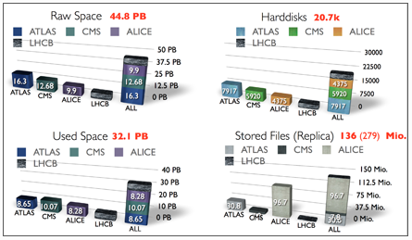
EOS technology/1
A project from CERN IT-DSS group
Fast, highly scalable and reliable technology for providing large disk storage
Hierarchical namespace
Inherently lossy (similar to CASTOR diskonly)
Built on top of FTS (gLite File Transfer Service)

Slide 3
EOS technology/2
Pools exploiting the EOS technology usually can be accessed directly by the users.
They can be accessed through the eos<exp>.cern.ch xrootd redirector using the xrootd tools and commands.
Test pool created on EOSPUBLIC instance: eosna62
Group vl accounts assigned to eosna62
EOS uses quotas to handle the pool space, with user/group/project levels similar to filesystems like EXT4, AFS
More details on eos.cern.ch
  Interfaces:
    eos cp, import and export files using XRootD, http, gsiftp, and s3 protocols
    eos transfer, scheduled transfers: I/O is bridged via dedicated gateways
  Gateways, Quotas, …

Slide 4
Example file access under EOS
xrdcp filename root://eosna62.cern.ch//eos/na62/…
TFile *file = TFile::Open("root://eosna62//eos/na62/.../filename");

Slide 5
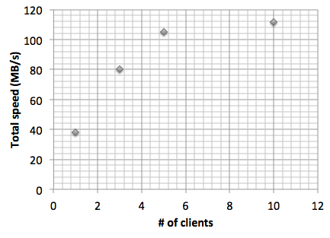
Speed vs. number of clients
From na62merger-in to eosna62 using xrootd (xrdcp)
Limited most probably due to 1 Gb/s connection to GPN

Slide 6
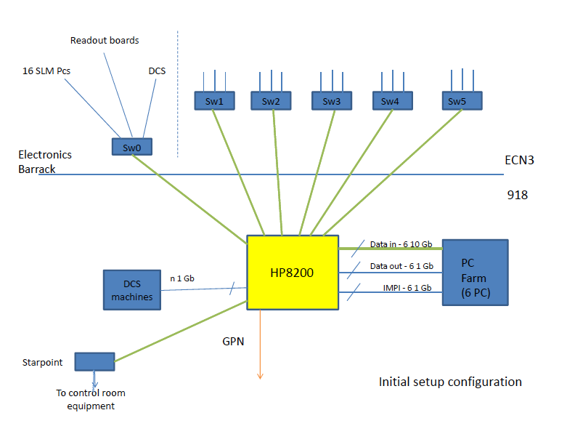
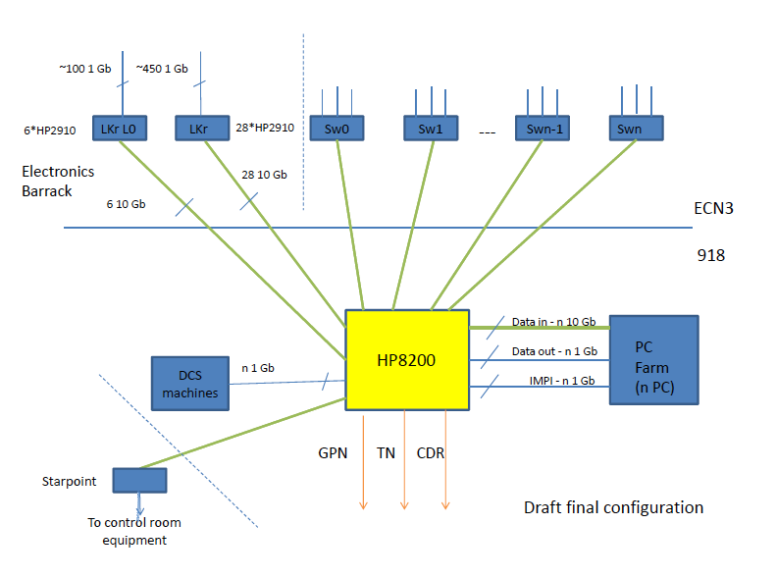
Present situation

