Slide 1

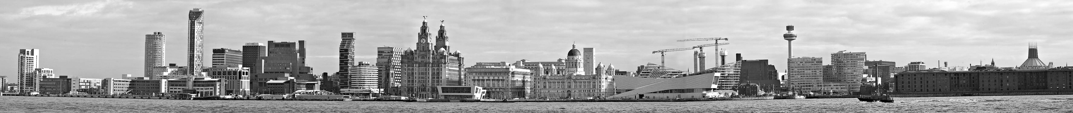
NA62 computing resources update
Paolo Valente – INFN Roma

Slide 2
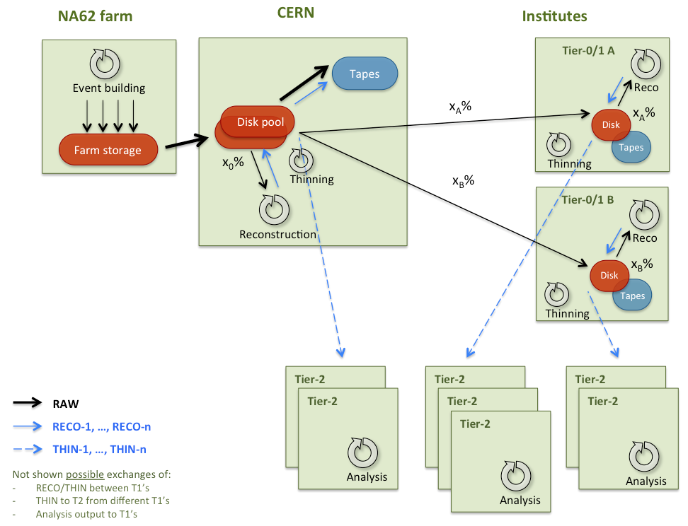
Resources for the running
Data center
Tapes
Disk
CPU
Define requirements for each data center of:
Connection speed (in-bound, out-bound)
CPU power
Tape space and reading/writing speed
Disk space (and speed)

Slide 3



NA62-FARM resources
From ECN3
CERN-IT
L1/L2 farm
150 MB/s
NA62
Disk
48h cache for RAW [30 TB]
Calibration streams
Services for the online
Databases
CPU
At present, limited by:
Network ports
Racks power limit: 10 kW
Farm storage

Slide 4
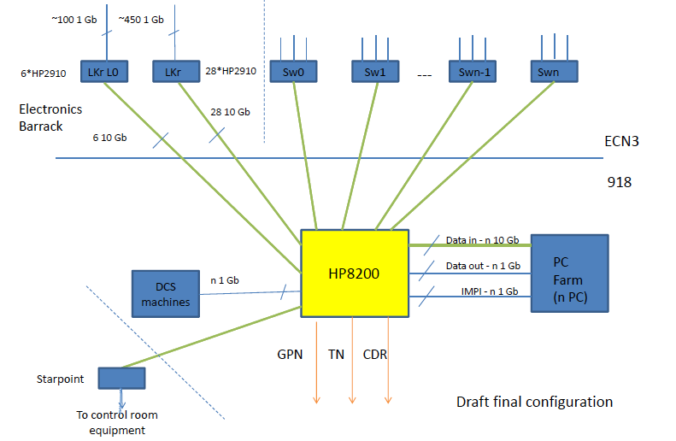
NA62-FARM networking

Slide 5
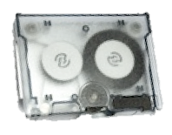
CERN-PROD resources
Requirements depends essentially on a single set of parameters: share between CERN and the other Tier-1’s in terms of RAW and RECO:
LHC original model:
  CERN:outside = 1:2
  CERN:ΣT1:T2 = 1:1:1
Proposal is to keep in any case 100% of RAW at CERN (custodial)
Assume 2 Tier-1 centers
NA62
CERN-IT
Institutes
150 MB/s
Tapes
100% of RAW + ⅓×(RECO+THIN) = 2 PB
Disk pool
Disk cache for file distribution
Reprocessing on 33% of RAW
Physics monitoring/Data quality/Fast analysis
Calibrations
Total = 1 PB
CPU = 10 kHS06
Disk pool
Tapes

Slide 6
Tier-1 resources
Requirements depends essentially on a single set of parameters: share between CERN and the other Tier-1’s in terms of RAW and RECO:
LHC original model:
  CERN:outside = 1:2
  CERN:ΣT1:T2 = 1:1:1
Proposal is to keep in any case 100% of RAW at CERN (custodial)
Assume 2 Tier-1 centers
  RAW=CERN:T1A:T1B=100%:33%:33%
  RECO/THIN=CERN:T1A:T1B=33%:33%:33%
T1 center
Tapes
33%×(RAW+RECO+THIN) = 1 PB
Disk
Reprocessing on 33% of RAW = 500 TB
CPU = 5 kHS06
Slightly more to speed up reprocessing

Slide 7
Tier-2’s resources
Used for analysis and Monte Carlo production
  Analysis
    Requirements vary according to analysis to be performed
    Total size of THIN files for one dataset (one year of data taking)
      Disk: of order 100-200 TB + ntuples, output, etc.
      CPU: assume at least a factor :50 with respect to reconstruction but assuming 50 jobs for each file
  Monte Carlo:
    Take 10⁹ events/year, scaling last production:
      112M events (mixed)
      30 TB
      0.250 kHS06
ΣT2 centers
Disk
Analysis = 250 TB
Monte Carlo = 250 TB
CPU
Analysis = 10 kHS06
Monte Carlo = 2 kHS06

Slide 8
Full cost estimates
Costs for 2013, to be scaled to the day of purchase and to be negotiated
Excluding NA62-FARM resources
Tapes
  0.04 Euro/GB: price down by a factor 2.5 in 3 years…
  50kEuro/year for RAW data only + approximately the same amount for RECO files
  Total 100 kEuro/year for custodial copy of RAW
  +100% amount for T1’s
Disks
  1 PB ≈ 300 kEuro
  EOS option to be considered for CERN-PROD
  +100% for T1’s
  + T2’s resources
CPU
  Many choices: INTEL multi-core platform, GPU, “micro-servers”, Integrated CPU+GPU, …
  Assume 10k Euro/kHS06, 100 kEuro for processing
  + 50% for T1’s reprocessing
  Add 100% for T2’s analysis and Monte Carlo
Coarse estimate of computing costs/year during running: 300 kEuro/year × 3 years only for T0
  Add 50% for T1 resources
  Add cost for T2 resources: dominated by CPU [Analysis and Monte Carlo] + some disk
Possibilities to reduce this cost:
  Tapes can be reduced only with L3 filtering (f-factor) and/or deletion of RECO versions
  Disks can be reduced with slower reprocessing/harder data access
  CPU power seems to be hardly reducible, and CPU power estimate is the less solid

Slide 10
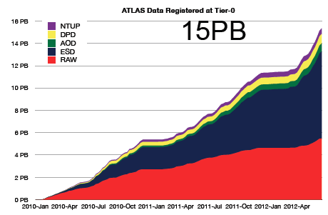
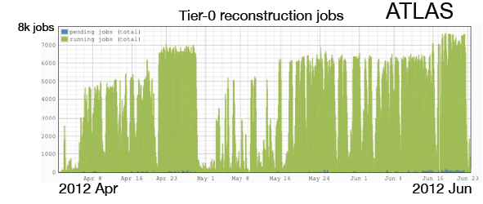
Is it resonable? [Compare to ATLAS]/1
ATLAS 2012
×5 wrt to what we expect
ESD getting larger than RAW
AOD, DPD ≈ 1/10
ATLAS 2012
≈8000 jobs
If we have one job per burst, expect ≈3000 jobs/day for crunching 1/5 of the data [OK, different data structure, different reconstruction…]
Very roughly, need ½ of CPU

Slide 11
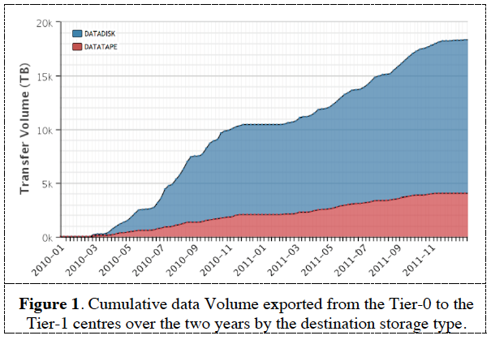
Is it resonable? [Compare to ATLAS]/2
ATLAS 2012
More or less the same data to T1’s by storage type:
  4 PB to disk/13 PB to tape

