Slide 1
B-Field Mapping
Liverpool 28-08-2013

Slide 2
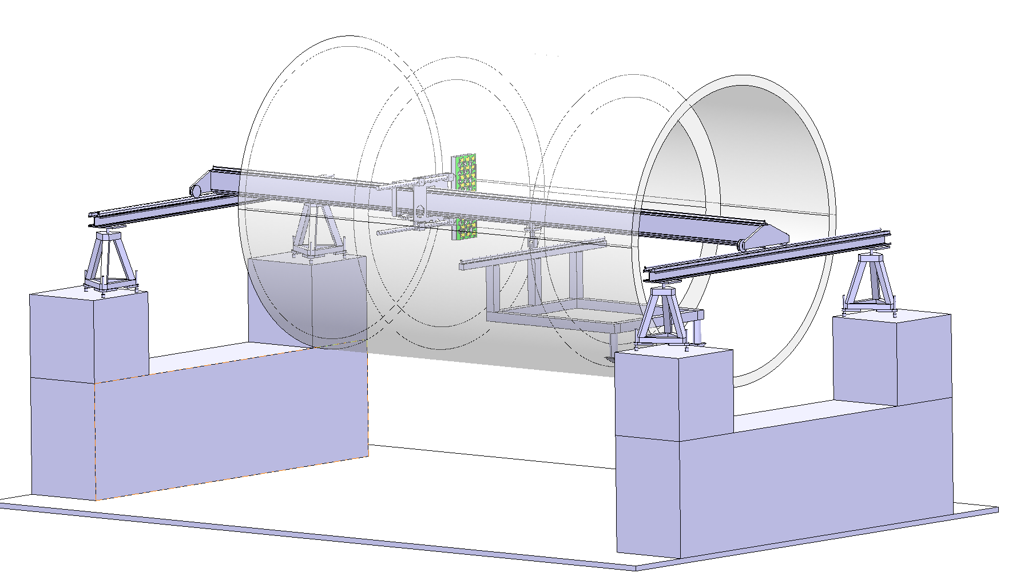
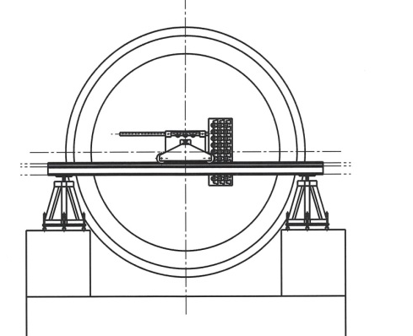
Magnet Mapping Bench
Two measurement series (upstream/downstream side
Outside tube
Inside tube
1.5m
3.0m
Felix Bergsma, Francois Garnier + Piere-Ange Giudici,

Slide 3
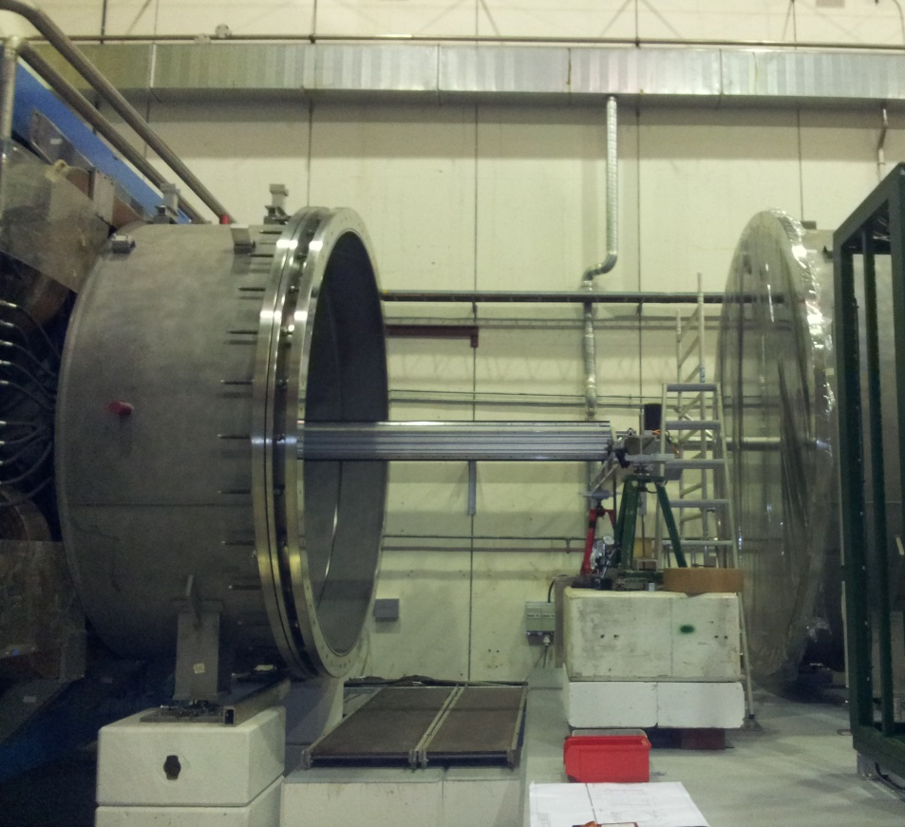
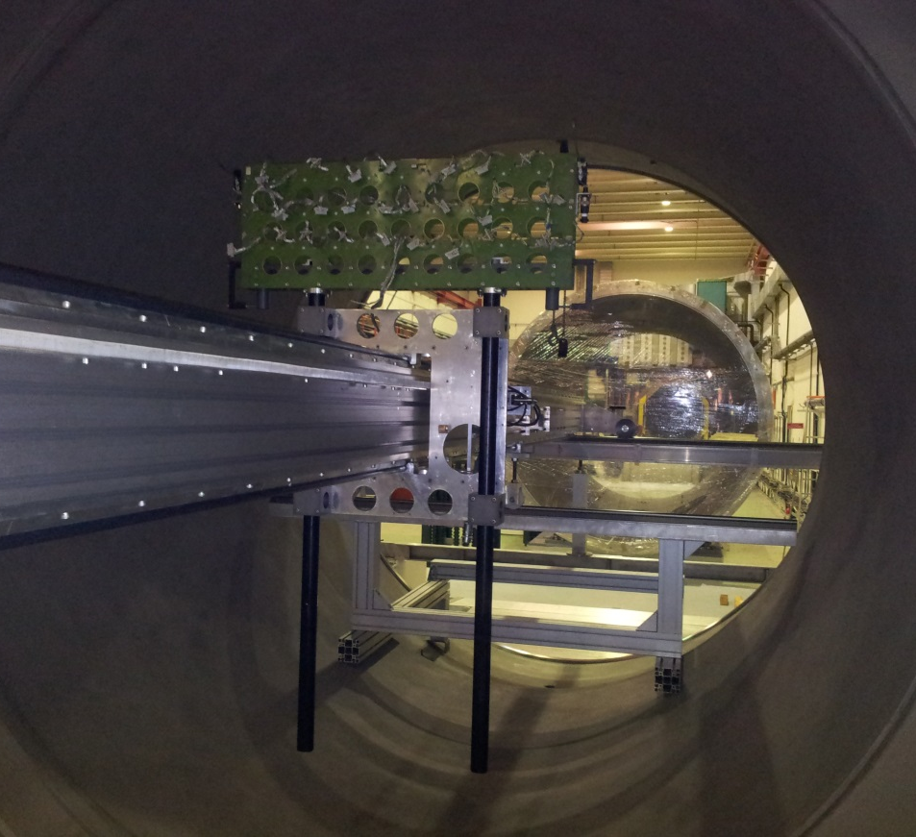
Mapping Bench
Installed and aligned on upstream side

Slide 4
Sensor Panel
80
2 sensor layers in Z
80
80
295
800
60 3D Hall probes (3 x 10 per plane)

Slide 5
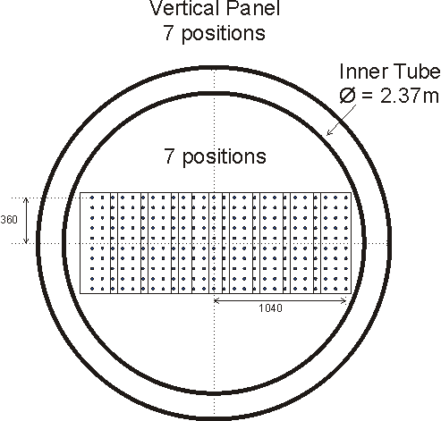
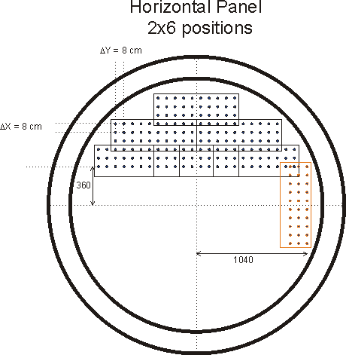
Measurement Grid
Foresee: 100 measurement positions in z (every 8 cm => ΔZ=4cm)
No. of points 60x100x19 = 114’000
(Z position can be multiples of 4cm)

Slide 6
Planning
The measurement starts on Sept. 9th and must be finished by Sept. 26th (before open-day WE)

