Slide 1


Report from Physics WG
Giuseppe Ruggiero (CERN)
NA62 Collaboration Meeting
Liverpool, 29/08/2013

Slide 2

2014 Run: Physics Goal
Assumptions:
  60 days of data taking (vs nominal run 100 days)
  10% of the nominal Intensity x data taking efficiency
$$N_{K}=0.06∙4.5×{10}^{12}=2.7×{10}^{11}$$
$$N_{πνν}^{selected}=N_{K}∙BR\left(πνν\right)∙𝓐_{πνν}=\left(2.7×{10}^{11}\right)∙\left(0.8×{10}^{−10}\right)∙0.1$$
$$N_{πνν}^{selected}≈2.2 (SM)$$
We can reach the SM sensitivity.
  We can provide a BR measurement competitive with the existing one (if everything goes as expected);
  otherwise we can spot what is missing to reach the goal.

Slide 3
Conclusions from “Overview & Challenges”
Overview:
We are on track.
Challenges:
Trigger strategy
Program of the analysis
Analysis program(s)

Slide 4
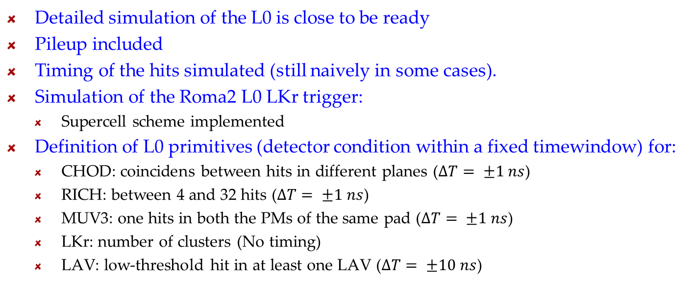
L0 Trigger Simulation (B. Angelucci)
Detailed simulation of the L0 is close to be ready
Pileup included
Timing of the hits simulated (still naively in some cases).
Simulation of the Roma2 L0 LKr trigger:
  Supercell scheme implemented
Definition of L0 primitives (detector condition within a fixed timewindow) for:
  CHOD: coincidens between hits in different planes ($∆T= ±1 ns$)
  RICH: between 4 and 32 hits ($∆T= ±1 ns$)
  MUV3: one hits in both the PMs of the same pad ($∆T= ±1 ns$)
  LKr: number of clusters (No timing)
  LAV: low-threshold hit in at least one LAV ($∆T= ±10 ns$)

Slide 5
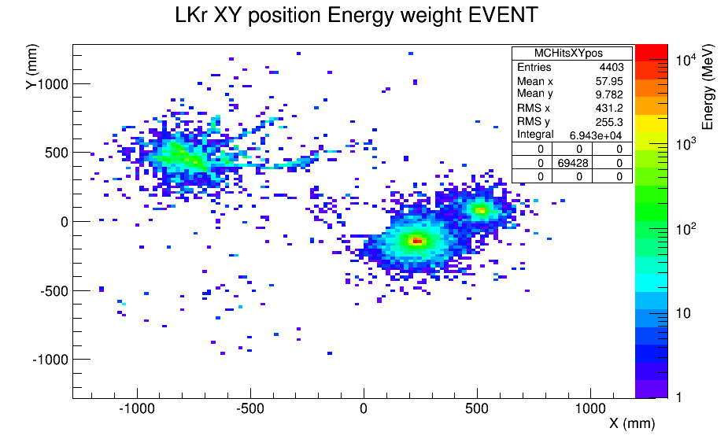
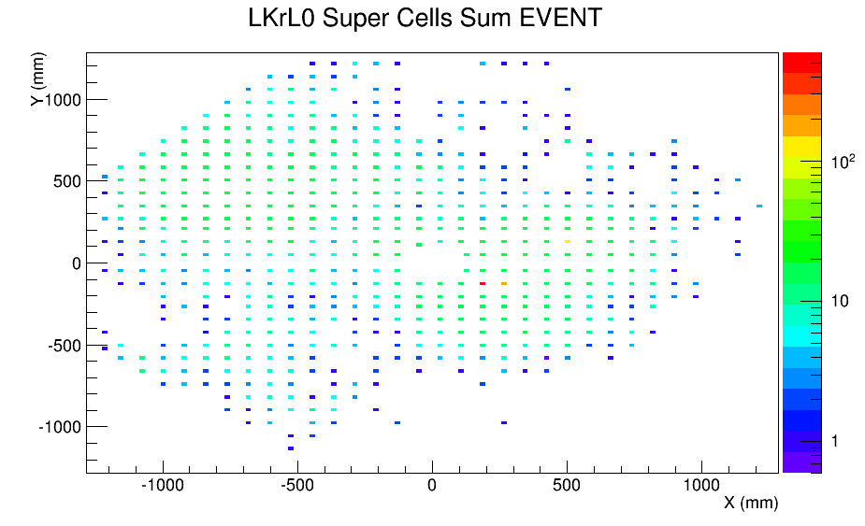
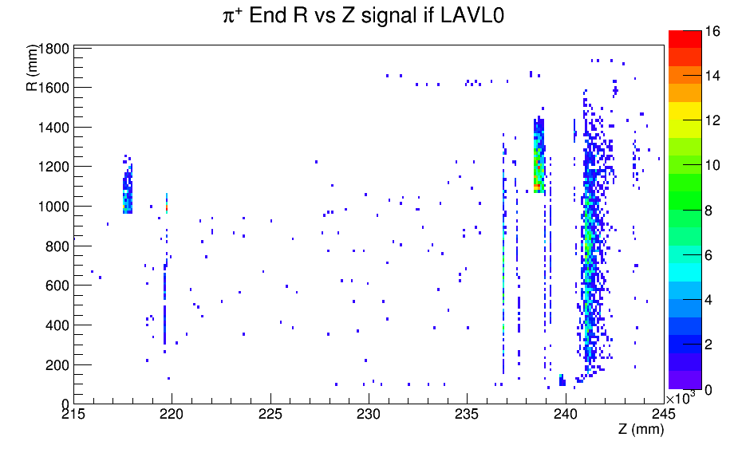
L0 Trigger Simulation (B. Angelucci)
LKr Primitive
  Work just started
  Some issue to be solved
LAV Primitive
  Half of the signal events have a LAV primitive
  Work just started.

Slide 6
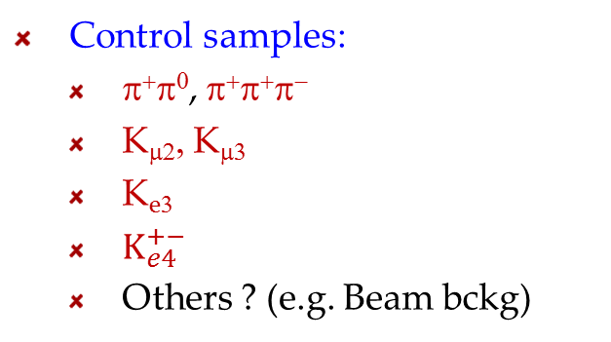
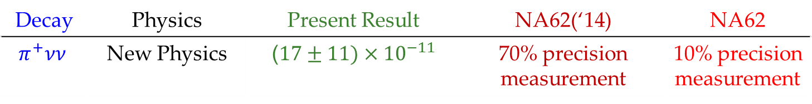
Proposals for 2014 Run: πνν
E. Goudzovsky
G. Lamanna
T. Spadaro
G.R.
Decay | Physics | Present Result | NA62(‘14) | NA62
$$π^{+}νν$$ | New Physics | ($17±11)×{10}^{−11}$ | 70% precision measurement | 10% precision measurement
Two main triggers: expected L0 rate (or) 400 KHz at nominal intensity
  Q1 × RICH × !LAV × !LKr × !MUV3
  Q1 × RICH × Energy in MUV12 × !LAV × !LKr
Control samples:
  π⁺π⁰, π⁺π⁺π⁻
  K_{μ2}, K_{μ3}
  K_{e3}
  $K_{e4}^{+−}$
  Others ? (e.g. Beam bckg)
Triggers:
CHOD, RICH, LAV, LKr, MUV1,2,3 primitives allow different L0 combinations according to the effect to be studied.
Downscaling to be decided.

Slide 7
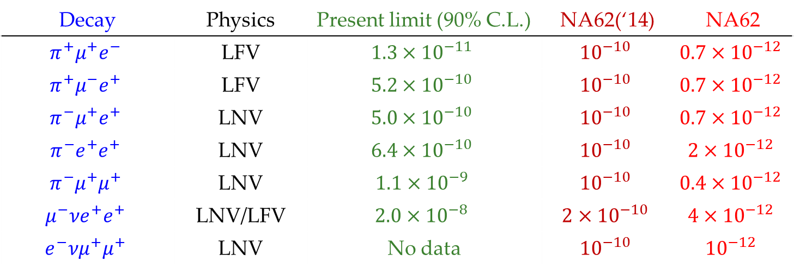
Proposals for 2014 Run: LFV
E. Goudzovsky
G. Lamanna
T. Spadaro
G.R.
Decay | Physics | Present limit (90% C.L.) | NA62(‘14) | NA62
$$π^{+}μ^{+}e^{−}$$ | LFV | $$1.3×{10}^{−11}$$ | $${10}^{−10}$$ | $${0.7×10}^{−12}$$
$$π^{+}μ^{−}e^{+}$$ | LFV | $$5.2×{10}^{−10}$$ | $${10}^{−10}$$ | $${0.7×10}^{−12}$$
$$π^{−}μ^{+}e^{+}$$ | LNV | $$5.0×{10}^{−10}$$ | $${10}^{−10}$$ | $${0.7×10}^{−12}$$
$$π^{−}e^{+}e^{+}$$ | LNV | $$6.4×{10}^{−10}$$ | $${10}^{−10}$$ | $${2×10}^{−12}$$
$$π^{−}μ^{+}μ^{+}$$ | LNV | $$1.1×{10}^{−9}$$ | $${10}^{−10}$$ | $${0.4×10}^{−12}$$
$$μ^{−}νe^{+}e^{+}$$ | LNV/LFV | $$2.0×{10}^{−8}$$ | $${2×10}^{−10}$$ | $${4×10}^{−12}$$
$$e^{−}νμ^{+}μ^{+}$$ | LNV | No data | $${10}^{−10}$$ | $${10}^{−12}$$
Di-lepton trigger (3-trk type): rate 50 KHz at nominal intensity
 | Trigger | rate
ee | Q2 × ELKr(2 clust) | 10 KHz
μe | Q2 × ELKr(1 clust) × 1μ | 20 KHz
μμ | Q2 × 2μ | 10 KHz

Slide 8
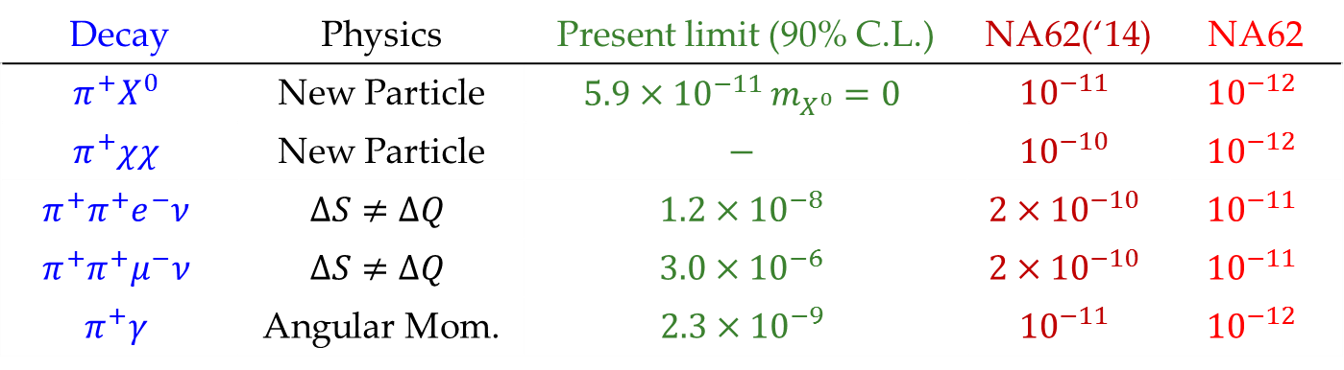
Proposals for 2014 Run: Forbidden
Decay | Physics | Present limit (90% C.L.) | NA62(‘14) | NA62
$$π^{+}X^{0}$$ | New Particle | $$5.9×{10}^{−11 }m_{X^{0}}=0$$ | $${10}^{−11}$$ | $${10}^{−12}$$
$$π^{+}χχ$$ | New Particle | $$−$$ | $${10}^{−10}$$ | $${10}^{−12}$$
$$π^{+}π^{+}e^{−}ν$$ | $$ΔS≠ΔQ$$ | $$1.2×{10}^{−8}$$ | $${2×10}^{−10}$$ | $${10}^{−11}$$
$$π^{+}π^{+}μ^{−}ν$$ | $$ΔS≠ΔQ$$ | $$3.0×{10}^{−6}$$ | $${2×10}^{−10}$$ | $${10}^{−11}$$
$$π^{+}γ$$ | Angular Mom. | $$2.3×{10}^{−9}$$ | $${10}^{−11}$$ | $${10}^{−12}$$
Signal trigger
Dedicated triggers: rate 100 KHz at nominal intensity
Type | Trigger | Rate
1trk | Q1×RICH<32×ETOT×!LAV×… | 50 KHz
3trk | Qn×RICH>20×!LAV×topology in calorimeters | 50 KHz
E. Goudzovsky
G. Lamanna
T. Spadaro
G.R.

Slide 9
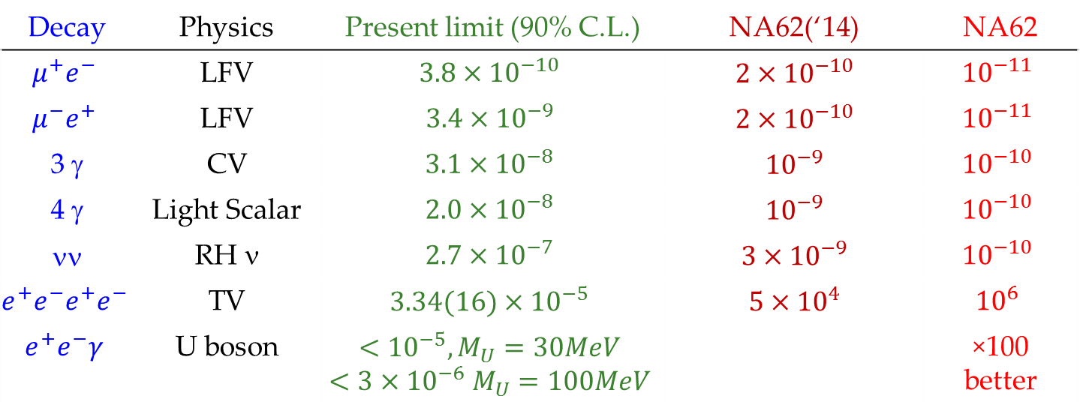
Proposals for 2014 Run: π⁰
E. Goudzovsky
G. Lamanna
T. Spadaro
G.R.
Decay | Physics | Present limit (90% C.L.) | NA62(‘14) | NA62
$$μ^{+}e^{−}$$ | LFV | $$3.8×{10}^{−10}$$ | $${2×10}^{−10}$$ | $${10}^{−11}$$
$$μ^{−}e^{+}$$ | LFV | $$3.4×{10}^{−9}$$ | $${2×10}^{−10}$$ | $${10}^{−11}$$
3 γ | CV | $$3.1×{10}^{−8}$$ | $${10}^{−9}$$ | $${10}^{−10}$$
4 γ | Light Scalar | $$2.0×{10}^{−8}$$ | $${10}^{−9}$$ | $${10}^{−10}$$
νν | RH ν | $$2.7×{10}^{−7}$$ | $${3×10}^{−9}$$ | $${10}^{−10}$$
$$e^{+}e^{−}e^{+}e^{−}$$ | TV | $$3.34(16)×{10}^{−5}$$ | $${5×10}^{4}$$ | $${10}^{6}$$
$$e^{+}e^{−}γ$$ | U boson | $$<{10}^{−5}, M_{U}=30MeV$$ $$<3×{10}^{−6} M_{U}=100MeV$$ |  | ×100 better
Signal trigger
Dedicated triggers: 1trk, 3trk (di-lepton type)

Slide 10
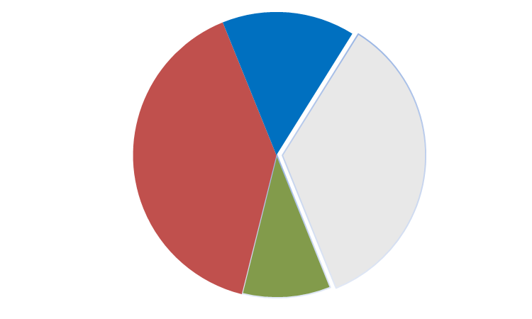
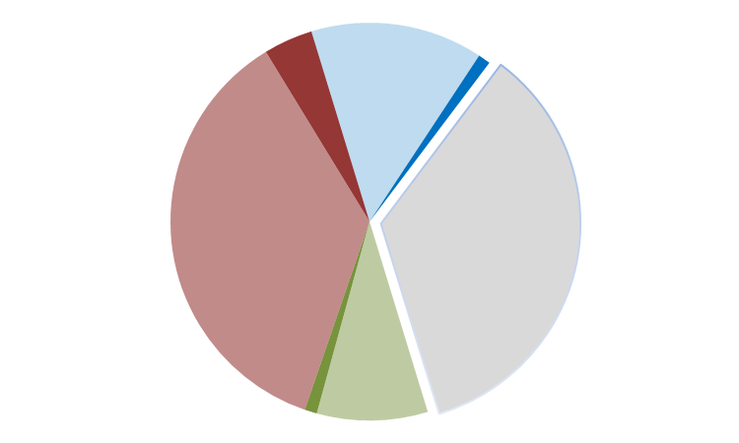
Trigger Proposals
E. Goudzovsky
G. Lamanna
T. Spadaro
G.R.
Trigger occupancy (assumption: max L0 rate 1 MHz):
  Signal: 400 KHz
  Control samples: 400 KHz (downscaling mandatory)
  Rare/Forbidden: 1trk-type, 3trk-type: 100 KHz (downscaling probable)
  Others: multitracks, Q1/D1, NHOD/D2, Random, Calibration: 100 KHz
Nominal Intensity
10% Nominal Intensity
Q1/50
Q1/50
πνν
πνν
F1/3TRK
F1/3TRK

Slide 11
K⁺→π⁺γγ (S. Padolski)
Bckg for 1 signal event
Trigger conditions may allow a collection of >10⁵ πγγ
Investigation of the offline signal/background separation
  Important background at low z coming from the tails of ππ⁰
Impossible to generate 10¹⁰ ππ⁰ with the full simulation.
Two steps simulation implemented:
  Complete ππ⁰ sample generated with a partial simulation (only trackers and MUV3)
  Cut on m_{γγ} implemented to reject the π⁰ peak saving the dangerous tails
  Response of all the detectors simulated only for the selected ππ⁰ events

Slide 12
K⁺→π⁺γγ (S. Padolski)
Mgg vs mmiss is a good plane to suppress the ππ⁰ background.
Still S/B = 1/1000 if we keep the low z spectrum.
  Source: tails from kinematic reconstruction of the ππ⁰.
  Further studies needed.

Slide 13
Analysis: Missing Items For October 2014
Improvements in MUV1,2 reconstruction.
Improvements in RICH reconstruction
Development of realistic particle ID technique/algorithms using the calorimeters.
Development of realistic particle ID technique/algorithms using the RICH.
Methods to measure the LAV, IRC, SAC photon detection efficiencies.
Methods to measure the muon ID inefficiency.
Methods to investigate the beam related background (accidentals).
Methods to measure the random losses.
Detector calibration/alignement methods.
...
Definition of the trigger strategy.
Definition of the analysis strategy (signal and control regions ...).

Slide 14
GTK Mis-alignment (B. Velghe)
1 mm misalignment of station 1 and 2 vs station 3 simulated (4 config.)
Impact of the GTK on kinematics

Slide 15
Conclusions
Overview:
We are on track
  Still true after 2 days.
Challenges:
Trigger strategy
  Simulation tool for detailed trigger studies close to be ready.
  Ideas about the trigger strategy already from 2014 on the market.
Program of the analysis
  Effort started.
Analysis program(s)

