Slide 1
Summary of the LKr WG
R. Fantechi

Slide 2
CREAM status
S. Venditti

Slide 3
OUTLOOK
Report to CAEN on CREAM analog properties
Report on dry run activities
Other firmware enhancements
Plans for the November dry-run

Slide 4
CREAM ANALOG PROPERTIES
Report on the outcome of the tests on analog properties of the CREAM board sent to CAEN on July 22nd
All specifications required in the tender were tested:
Effective Number of Bits (ENOB) > 10
Cross-talk < -70 dB
Integral non-linearity(INL) < 5 LSB, differential non-linearity(DNL) < 2 LSB
Coherent noise below 1 LSB and 10% of the non-coherent noise
Pedestal width
Noise level/channel < 2 LSB rms
Analog signal: rise time 40 ns, 70±10 ns FWHM, 1 ns uniformity
Gain uniformity ±1%

Slide 5
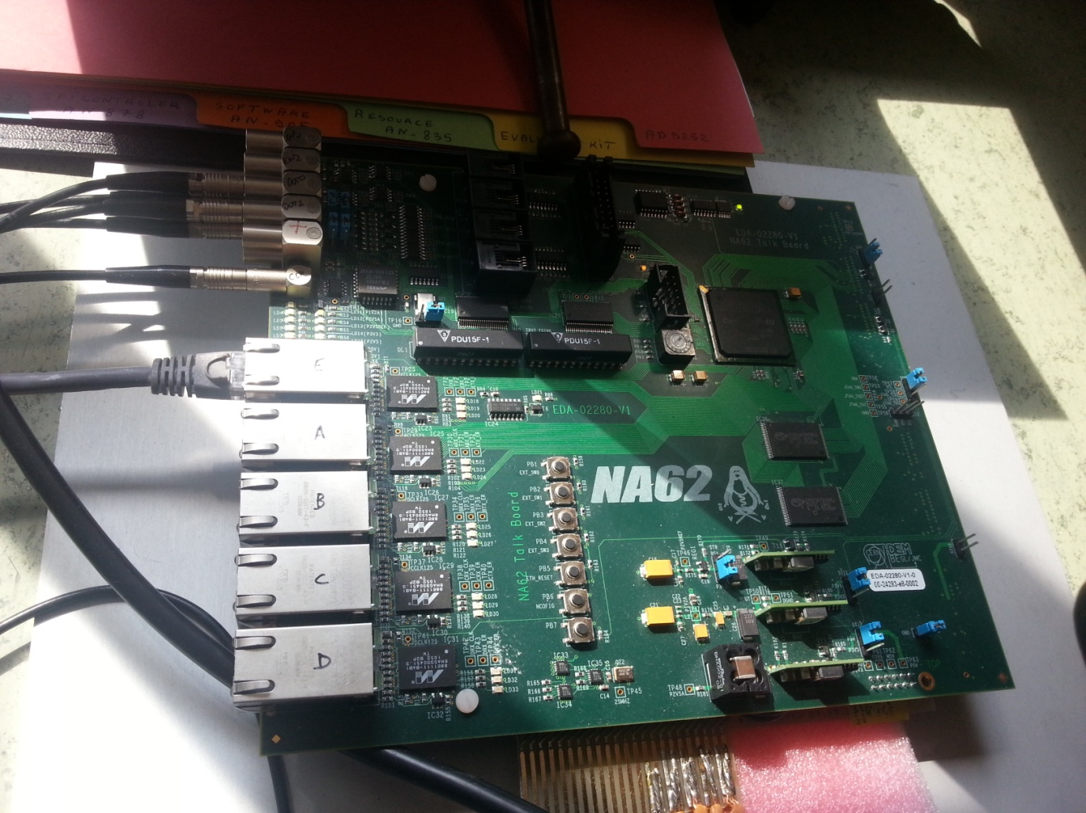
DATA COLLECTION,DECODING AND STORING
Two CREAM data acquisition modes used:
CONTINUOUS MODE: 65536 consecutive samples are collected
TRIGGERED MODE: a configurable number of samples is sent by the CREAM for each L1 request
Data is finally decoded into ROOT files to be analyzed
TALK BOARD
L0 signals into the P0 backplane;
L0 time-stamps to the acquisition PC to form the MRP (Multiple Request Packet) to CREAM
triggers a LKr-like signal from pulse generator (earlier than the CREAM L0 signal by the CREAM L0 trigger latency)
reset signal to CREAM

Slide 6
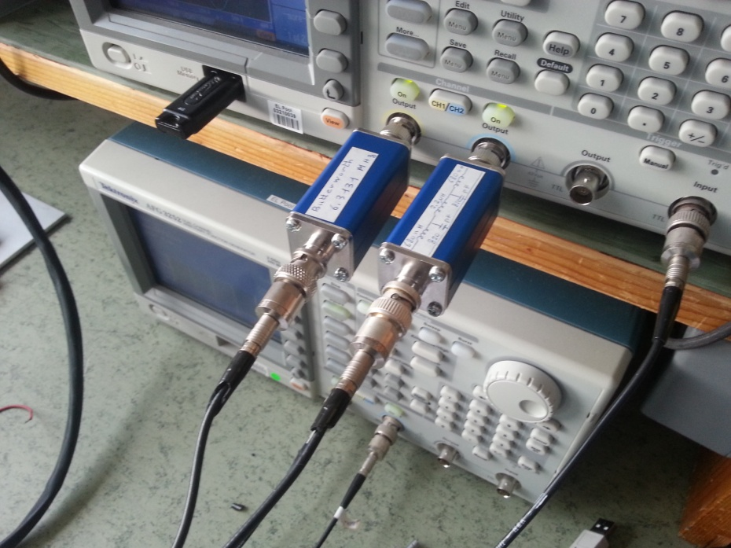
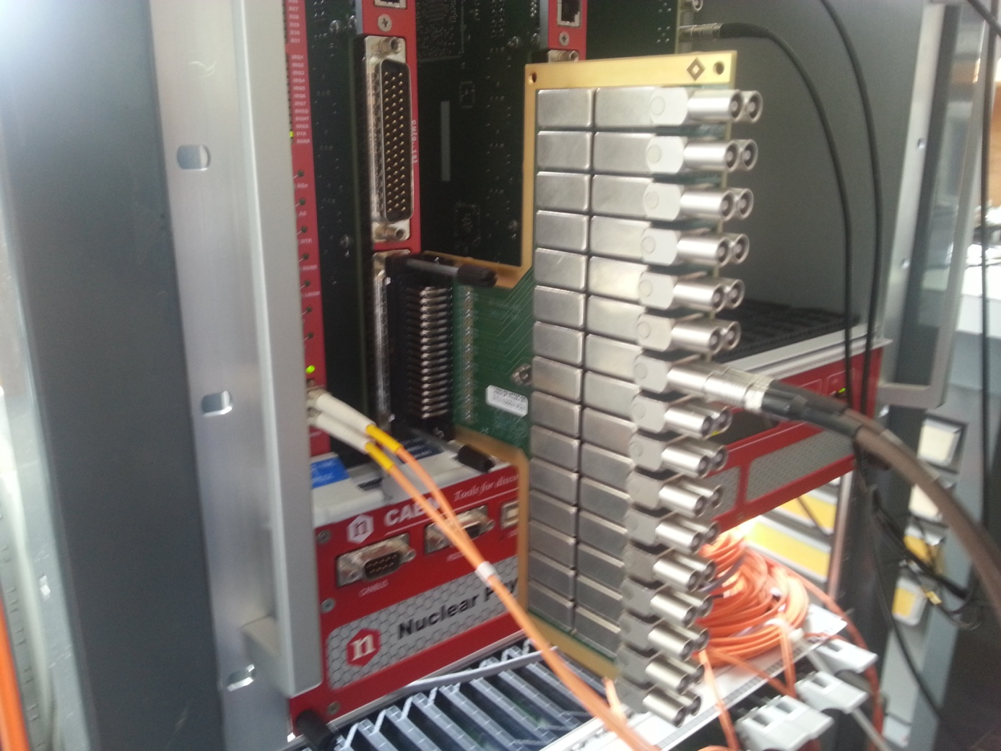
EXPERIMENTAL SETUP
The 4 CREAMs delivered by CAEN at the end of March
A TALK board (see previous slide)
2 Tektronix AFG 3252 function generators, used to generate the clocks and the required signals used in the tests The two generators are phase-locked
A board (11th VME slot) distributing the clock, reset and L0 signals on the custom P0 backplane (LKr-TTC not yet ready)
A patch panel mounting 5 MHz narrow band-pass filters
Two 6.313 MHz low pass filters
An acquisition PC, whose tasks are:
- to configure and control the CREAM through a CAEN A3818 PCIe card controlling the CAEN VX2718 VME bridge
- to acquire L0 time-stamps produced by the TALK board
- to perform data requests to the CREAM through Ethernet
- to collect and analyze data out of the CREAM
TEKTRONIX AFG 3252 AND LOW-PASS FILTERS
ALL ACQUISITION AND ANALYSIS ROUTINES (EXCEPT CAEN LIBRARIES) WERE WRITTEN AT CERN
CREAM BOARD CONNECTED TO THE 5 MHz FILTERS

Slide 7


ENOB MEASUREMENT
FW MODE: continuous
SIGNAL USED: sinusoidal 5MHz, amplitude close to ADC full dynamic range
FILTERS: 5 MHz narrow band-pass
PROCEDURE
5 MHz sine wave fed in the 5 MHz narrow band-pass filters and then into the CREAM
Baseline set at half the ADC dynamic range through the DAC offset
Amplitude is such that the maximum (minimum) value is ~10 ADC counts from minimum (maximum) range value
Tektronix producing sine phase-locked with that producing the external reference for the CREAM (40 MHz) → COHERENT SAMPLING (65536/8=8192 sines sampled)
A FFT is performed, the SINAD (SIgnal to Noise And Distortion ratio) is computed as:
P_{SIG}: signal power
P_{NOISE}: noise power
P_{DIST}: distortion power
From the SINAD the ENOB can be computed as:
RESULTS
All the channels within the specifications (ENOB > 10 LSB)

Slide 8
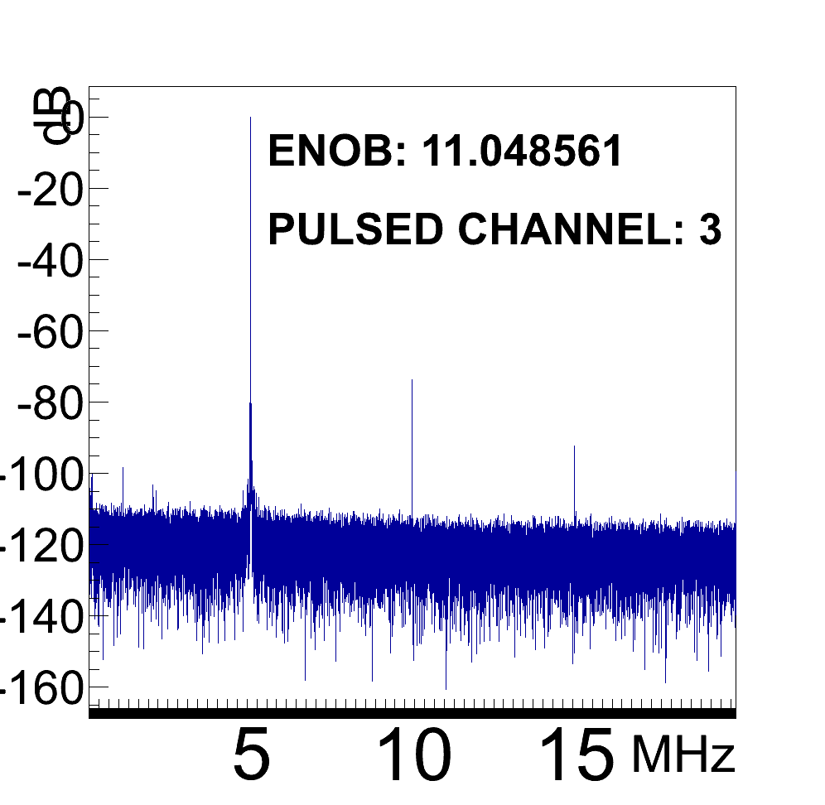
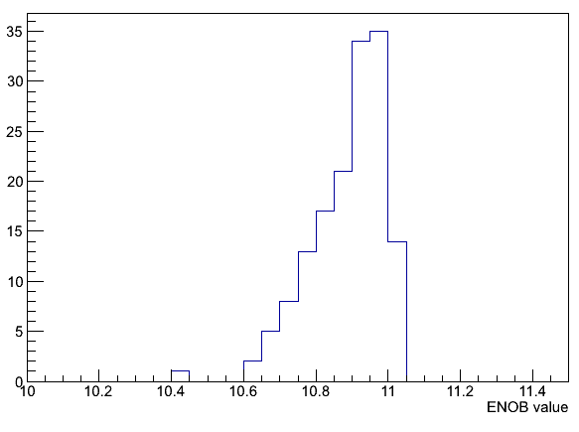
ENOB MEASUREMENT
CHANNEL 3 (FIRST CONNECTOR)
5 10 15 MHz
FFT EXAMPLE – 5 MHz SINE SIGNAL + FILTERS
ENOB DISTRIBUTION (150 EVENTS)

Slide 9
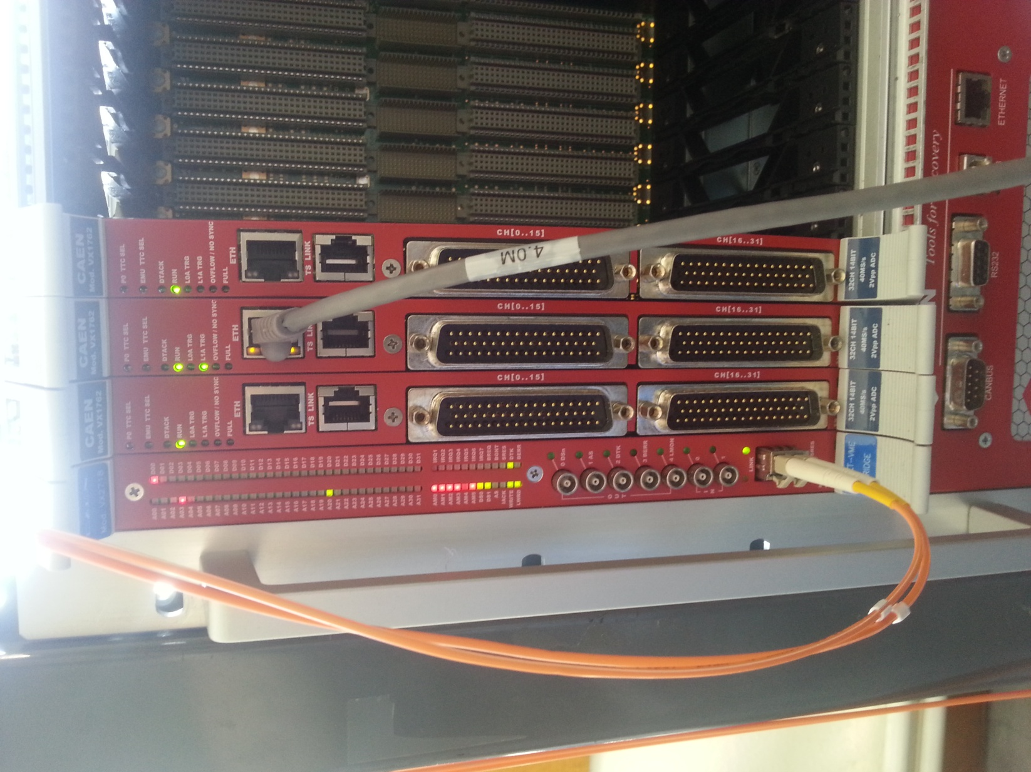
CROSS-TALK
FW MODE: continuous
SIGNAL USED: sinusoidal 5 MHz, two amplitudes tested: 450 and 900 mV
FILTERS: 6.313 MHz low-pass
PROCEDURE
Single differential pair+low-pass filters used as the panel used for the ENOB induced a sizable cross-talk.
FFT of all channels computed
5 MHz harmonic amplitude from not pulsed channels compared to that from the pulsed channel
RESULT
Cross-talk slightly above specifications (<-70 dB)for channels closest to the pulsed one
Amount of cross-talk constant over different acquisitions
Cross-talk not dependent on the amplitude of the input sine (450 and 900 mV tested)
Tests on possible cross-talk/noise induced by the presence of nearby working board were negative
CENTRAL BOARD TESTED WHILE OTHER TWO WERE PULSED AND WORKING

Slide 10
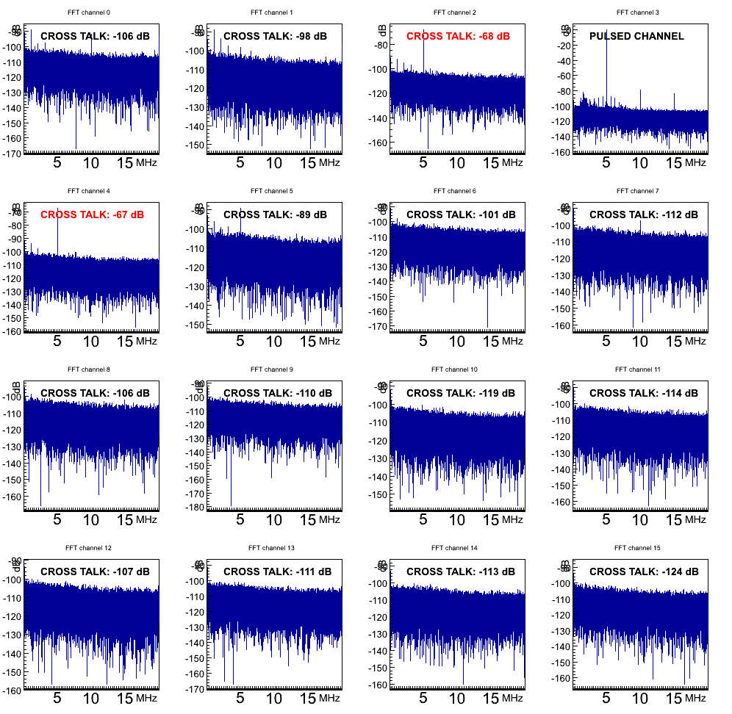
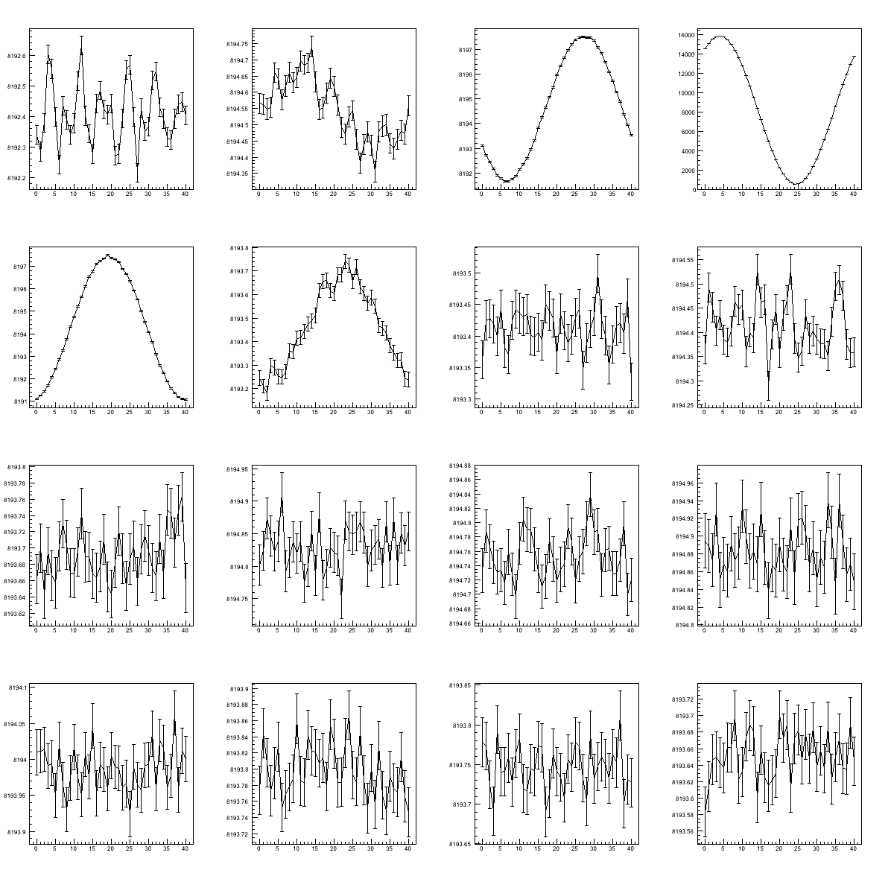
CROSS-TALK
FIRST CONNECTOR CHANNEL 3 PULSED
NOISE SHAPE
PULSED CHANNEL
0.5 CNTS
6 CNTS
16K CNTS
6 CNTS
0.5 CNTS
FFT AND CROSS-TALK

Slide 11
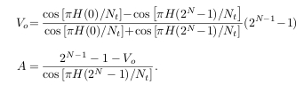



NON-LINEARITIES
DIFFERENTIAL NON-LINEARITY: measures how much the range of a single digital value differs from [dynamic range]/2^N.
INTEGRAL NON-LINEARITY: is the sum of differential non-linearities up to the n-th ADC value. It measures how localised nonlinearities are.
FW MODE: continuous
SIGNAL USED: sinusoidal, frequency slightly lower than 5 MHz, amplitude 1.2 V
FILTERS: 5 MHz narrow-band
PROCEDURE: non-linearities measured through a SINE-WAVE HISTOGRAM test:
(Ting,Liu, IEEE Tr. On Instr. & Meas., Vol. 57,N.2)
A sine signal fed into a CREAM channel, amplitude > dynamic range
The offset and amplitude, and hence the theoretical distribution of a pure sine wave can be computed
The differential and integral non-linearities can be extracted as in formulas
AMPLITUDE & OFFSET
THEORETICAL DISTRIBUTION
DNL & INL FORMULAS
RESULTS: non-linearities of all channels within specifications (|DNL|<2LSB, |INL|<5 LSB)

Slide 12
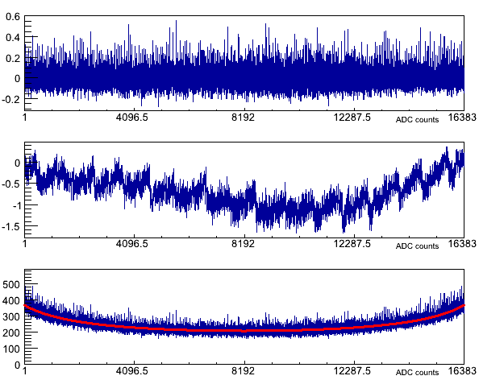
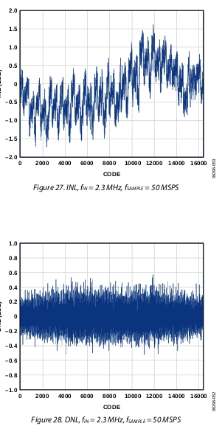
NON-LINEARITIES
CHANNEL 3 (FIRST CONNECTOR)
NON-LINEARITIES FROM ADC MANUAL
1) INTEGRAL NL
2) DIFFERENTIAL NL
1) DIFFERENTIAL NL 2) INTEGRAL NL 3) DATA/THEORY COMPARISON

Slide 13
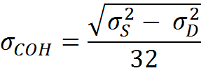

PEDESTALS AND COHERENT/UNCOHERENT NOISE
FW MODE: continuous
SIGNAL USED: none (pedestals)
FILTERS: none
PROCEDURE
Channels of a CREAM divided in two groups, even and odd channels respectively
Pedestals acquired, plotted and fitted
The sigma of the pedestal sums of the 32 channels (σ_{S}) and of the difference between pedestal sums of even and odd channels (σ_{D}) is computed
Coherent (σ_{COH}) and non-coherent (σ_{NCOH}) noise is computed as:
RESULTS
All pedestal sigmas < 1.3 ADC counts
Coherent and uncoherent noise within specifications

Slide 14
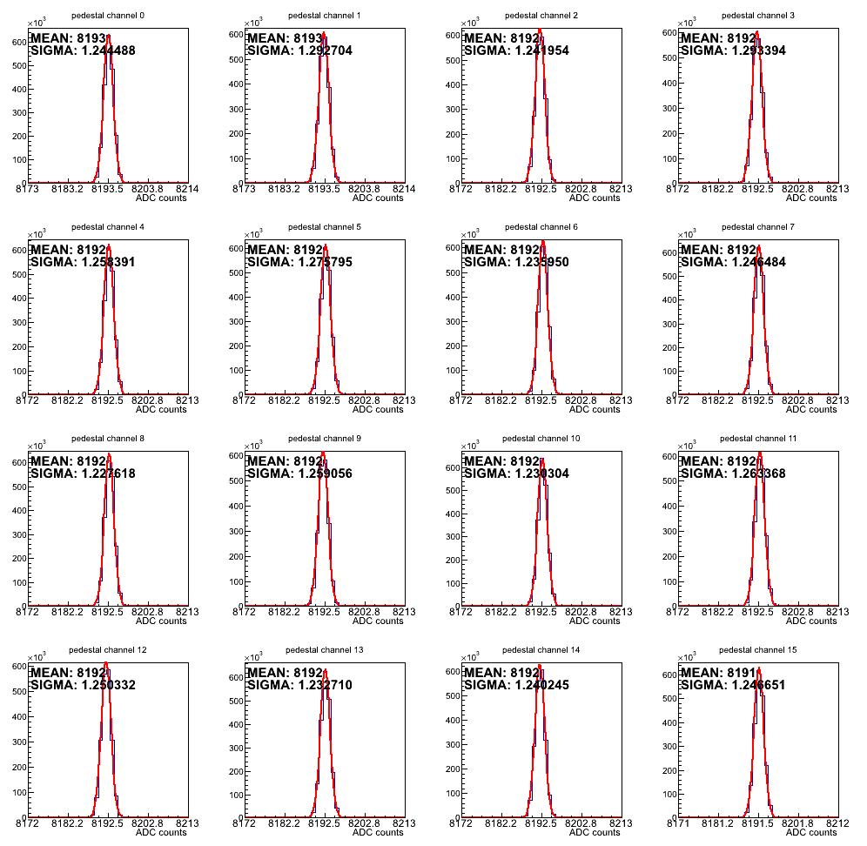
PEDESTALS AND COHERENT/UNCOHERENT NOISE
PEDESTALS FROM FIRST CONNECTOR

Slide 15
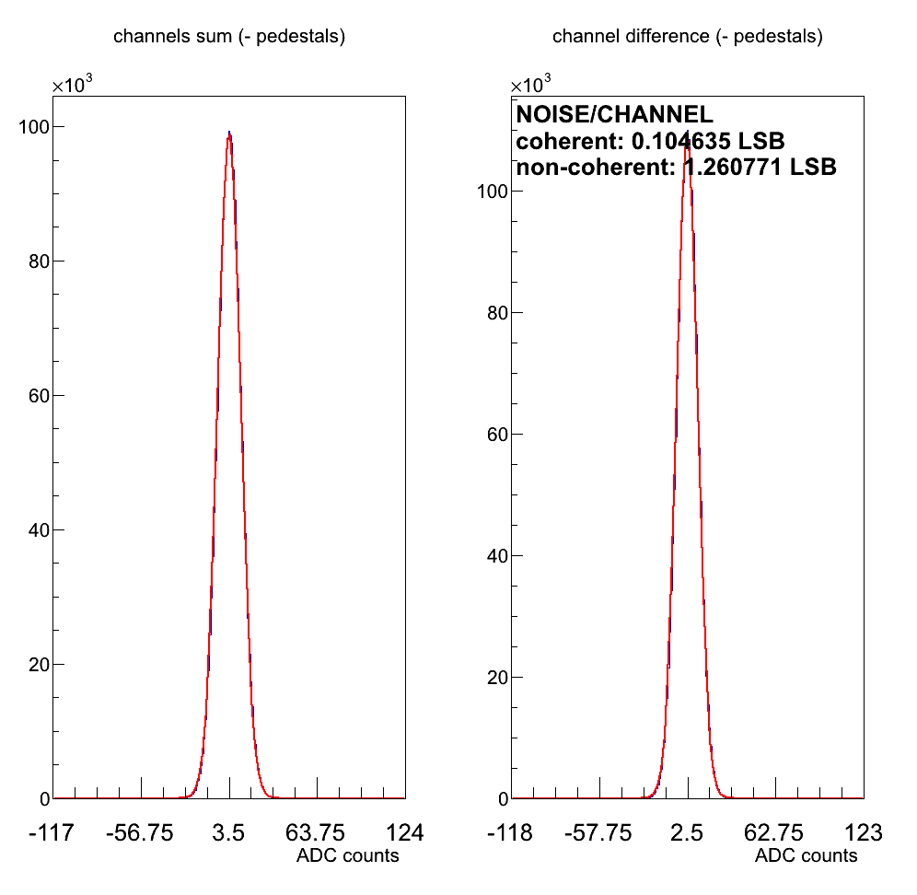
PEDESTALS AND COHERENT/UNCOHERENT NOISE
LEFT: SUM OF ALL CHANNELS
RIGHT: DIFFERENCE BETWEEN EVEN AND ODD CHANNELS
EACH ADC SAMPLE IS SUBTRACTED BY THE MEAN VALUE OF ITS PEDESTAL

Slide 16
NOISE LEVEL PER CHANNEL, FWHM AND ITS UNIFORMITY
FW MODE: triggered
SIGNAL USED: LKr-like generated through the AFG3252
FILTERS: none
PROCEDURE
LKr-like signal (20 ns RT, 2.7 µs FT) triggered by the TALK
L0 signal from the TALK to the CREAM after a time equal to the CREAM latency (to have the LKr-like signal within the acquired samples)
Distributions for each of the 8 samples plotted and their sigma computed
FWHM of the LKr-like signal and its uniformity. The LKr-like signals are fitted with a gaussian to compute FWHM ≈ 2.355 σ.A FWHM distribution was plotted, and its σ computed.
RESULTS
FWHM within 70 ns ± 10%, FWHM uniformity within 1%
Sigmas of triggered samples is out of the specifications (~4LSB, whereas the requirement is < 2) for samples at higher signal slopes. This effect is probably due in part to the clock jitter
In the sample distributions smaller peak are visible. This effect is due to the jitter of the TALK signal triggering the pulse generator, that results in a slightly delayed start of the pattern and hence in a differently centered signal within the 8 samples. The effect doesn’t affect the measurement presented here.

Slide 17
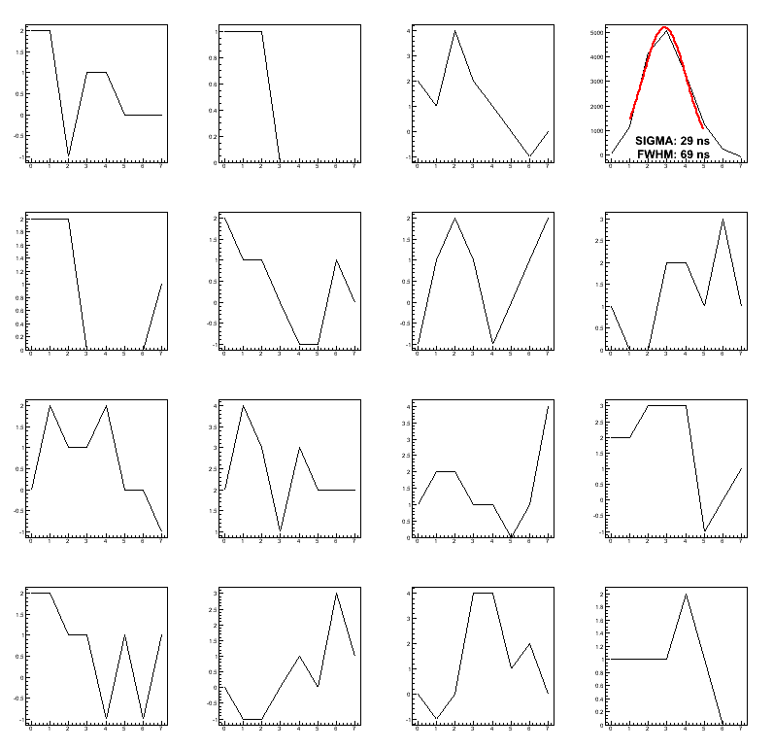
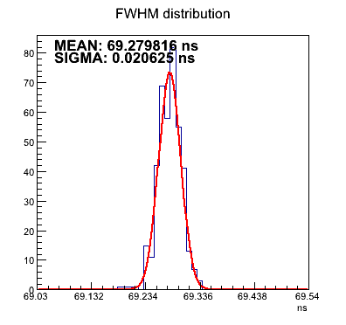
NOISE LEVEL PER CHANNEL, FWHM AND ITS UNIFORMITY
CHANNEL 3
(FIRST CONNECTOR)
EXAMPLE OF TRIGGERED SAMPLES (8) – CHANNEL 3 PULSED
FWHM DISTRIBUTION

Slide 18
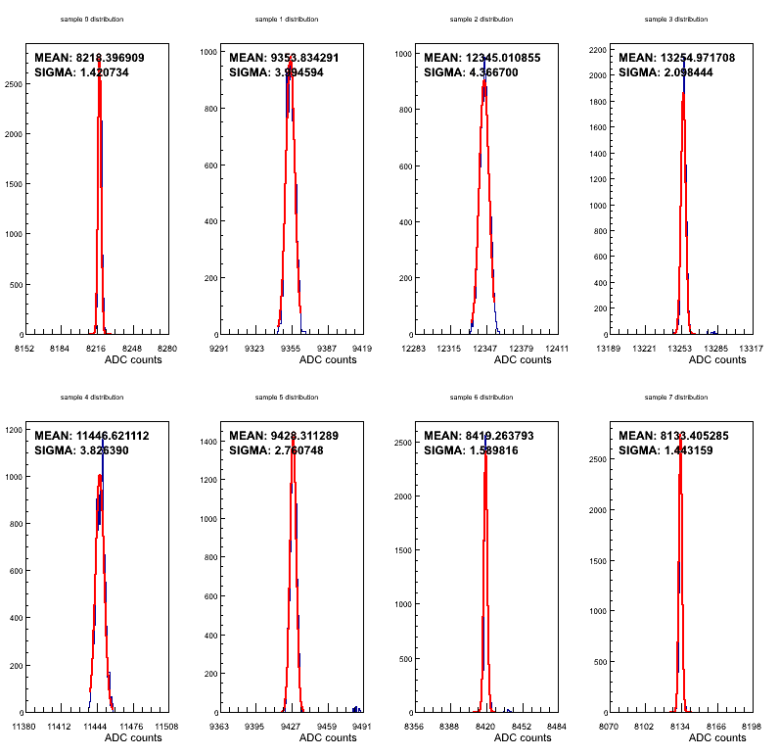
NOISE LEVEL PER CHANNEL, FWHM AND ITS UNIFORMITY
CHANNEL 3
(FIRST CONNECTOR)
DISTRIBUTIONS OFTHE 8 TRIGGERED SAMPLES FROM CHANNEL 3

Slide 19
GAIN UNIFORMITY
FW MODE: continuous
SIGNAL USED: sinusoidal, period=205 ns, amplitude 950 mV
FILTERS: 6.313 MHz low-band
Gain uniformity within ±1% between channels required
PROCEDURE
205 ns period sine fed into the CREAM
In a continuous acquisition @ 40 MHz (65536 samples) the sine is sampled in 41 different points, each point being sampled 65536/41 ≈ 1598 times
All samples referring to one point are averaged, the 41 averages obtained are fitted with a sine with amplitude, fase, frequency and baseline as free parameters
Sine amplitudes from all the channels are extracted and compared; the difference wrt their average is the gain uniformity
RESULTS
The gain varies up to ~2% between channels. The main responsible for this effect is the ADC chip (AD 9257-40, Gain matching between -1% and 5%)

Slide 20
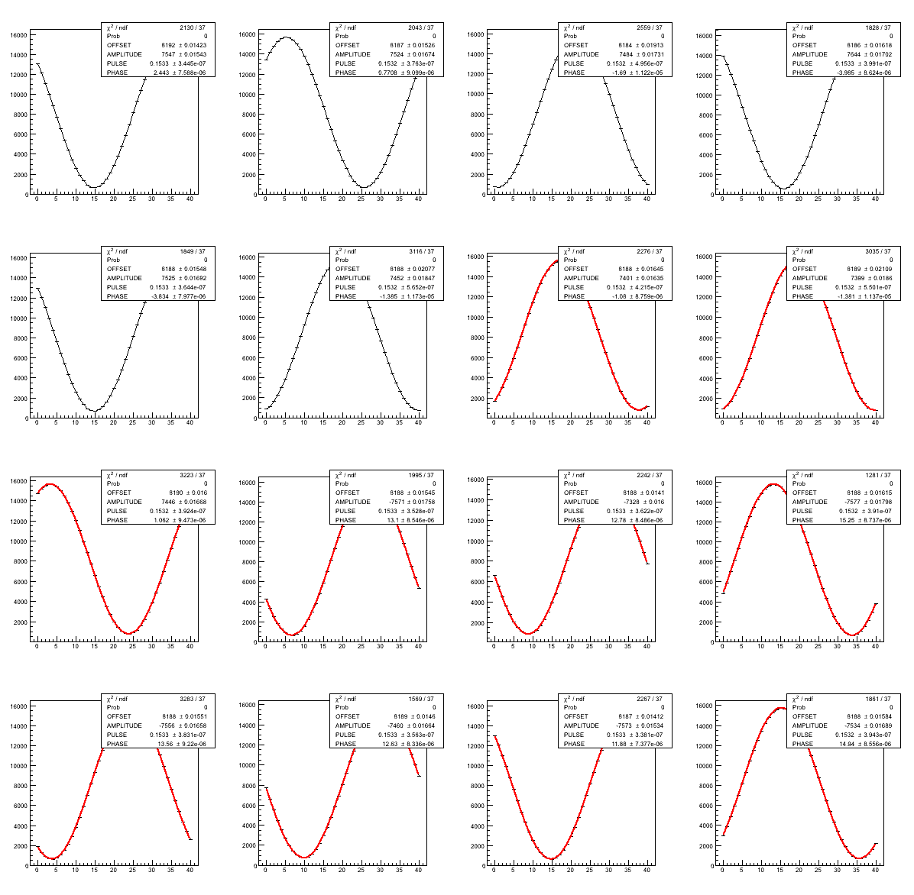
GAIN UNIFORMITY
CHAN | AMPLITUDE (COUNTS) | %DEVIATION FROM AVERAGE
0 | 7547 | 0.61
1 | 7524 | 0.30
2 | 7484 | -0.23
3 | 7644 | 1.9
4 | 7525 | 0.32
5 | 7452 | -0.66
6 | 7401 | -1.34
7 | 7399 | -1.36
8 | 7446 | -0.74
9 | 7571 | 0.92
10 | 7328 | -2.32
11 | 7577 | 1.00
12 | 7556 | 0.73
13 | 7460 | -0.55
14 | 7573 | 0.96
15 | 7534 | 0.43
FITS ON SINE WAVE – FIRST CONNECTOR CHANNELS

Slide 21
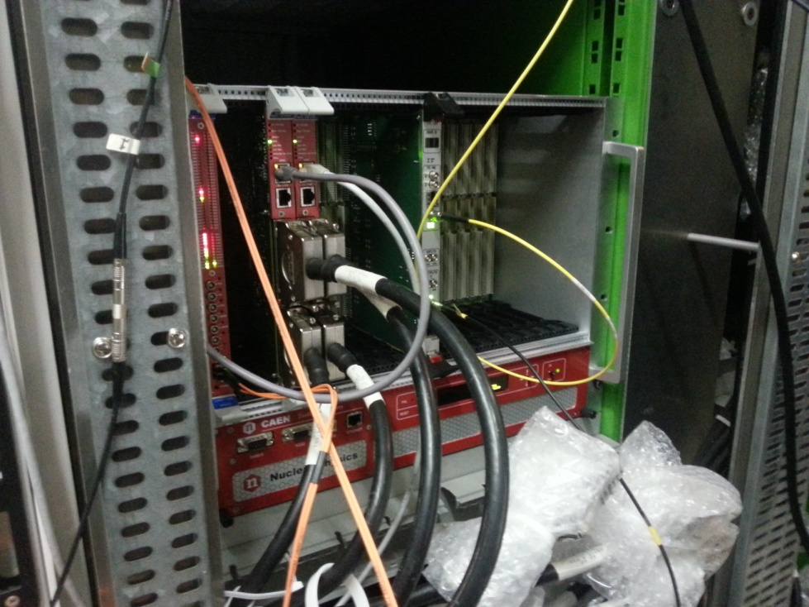
DRY-RUN OUTCOME
DRY RUN: July 1st-14th
MAIN OBJECTIVE: test the acquisition chain to be used during normal data-taking
ACQUISITION FOR CREAM TESTS
slow control done by the same PC that sends L1 requests
direct connection between PC and CREAM
Timestamps downloaded from the TALK board and used to perform L1 requests
L1 request addressed in unicast mode
STANDARD ACQUISITION
Requests performed by L1PC, slow control done by a PC placed in the LKr barrack
CREAM(s) connected to a switch, CREAMs and L1PC on different network segments
Timestamps received by the L1PC and used to perform L1 requests
L1 requests addressed in multicast mode
PREPARATORY WORK
Get rid of the old electronics in the LKr barrack (CPDs, SLMs, cables…) MAY-JUNE
Configure the slow control PC: A3818 PCIe card installation, library config, communication tests
Install the required electronics and make it work:
1 CAEN VME crate equipped with the P0 panel
1 VX2718 bridge
2 CREAMs
1 Switch (all 16 CREAMs of a crate will be connected to it)
The new LKr-TTC board (clock,reset,L0 signals)
CREAMS IN THE LKr BARRACK DURING THE DRY RUN

Slide 22
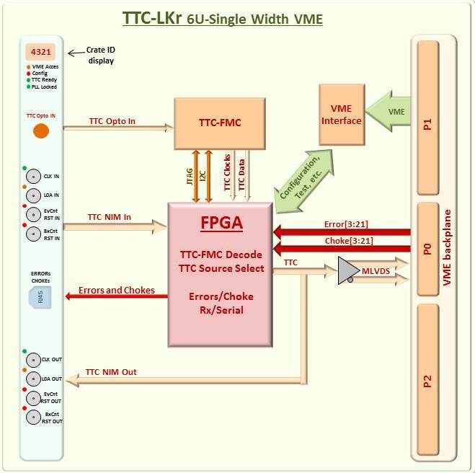
LKr Timing, Trigger and Control interface module (TTC-LKr)
Single-width 6U VME64x unit
Board control is implemented within Xilinx Spartan-6 FPGA
TTC-FMC receiver mezzanine based on commercial off-the-shelf components and the ADN2814 clock-data recovery receiver from Analog Devices
Main functions:
40 MHz clock
L0 trigger information
Start/End of burst
broadcasts commands
Selectable TTC sources:
optical 160 Mbps BPM encoded bit-stream
electrical front-panel inputs
internal rate-programmable TTC signal generator
generated by a specific VME access
Once selected, relevant TTC source is converted, decoded and made available on the VME P0 backplane (custom).
One TTC-LKr can serve up to 19 CREAMs in the same crate.
All TTC signals on the backplane are synchronised with the 40 MHz clock which is delivered via the P0 backplane as well.

Slide 23
DRY-RUN OUTCOME
Several problems fixed on the spot, also thanks to Jonas and CAEN people:
Major effort on the network side (both software and firmware):
Endianity of request packets inverted (firmware to be modified after summer holidays)
Multicast issues (subscription to the group and its renovation) dealt with
Time to live (TTL) of data packets increased in the fw to let them reach the L1PC
Jumbo frame implemented (under Jonas request, very fast feedback from CAEN)
Correct addressing (IPs, MACs) in request and data packets
Problem with the event number in request packets solved (linked to wrong endianity)
Decoding adapted to read LKr data inside L2 data packets produced by the farm
RESULTS AND PROBLEMS DETECTED
Pedestal events collected, required by sending regular L0 triggers from the TALK board and L1 requests from the L1PC through the router and the switch (not related to L0)
Calibration signals in triggering mode not acquired due to some issues with the TALK
CREAM fw instability observed when L1 requests/packet increased

Slide 24
OTHER FIRMWARE ENHANCEMENTS
ZERO SUPPRESSION: first ZS implementation from CAEN tested(data not suppressed if at least one sample is above a programmable threshold), some problems detected:
While ZS can presently be activated through a VME register, it should rather be L1-trigger specific, i.e. a bit of the L1 trigger type in the request header should be used to specify whether the L1 request is ZS or not.
A line in the ZS data packet is missing
Firmware seems to easily get stuck in ZS mode
Interaction with CAEN over the next weeks to solve these problems
TSL: Sums already available, to be tested. Upon Andrea’s request, the code required to test TSL data transmission from the CREAM to the receiving board (under production in Perugia) will be implemented in the CREAM’s firmware
FIRMWARE UPLOAD THROUGH VME: fundamental when dealing with all CREAMs (fw to be uploaded on one board at a time otherwise),should be ready for the dry run.
HANDLING OF L0 BRCST,CHOKE/ERROR SIGNALS: The fw does not presently handle the Broadcast signal (notifying the CREAMs about the L0 trigger type, choke, error, enable/disable data-taking), as well as the choke and error signals. Their implementation should be ready by the dry run

Slide 25
GOALS FOR THE NEXT DRY-RUN
TRIGGER CALIBRATIONS: produce a L0 trigger by feeding the calibration start signal into the TALK, and use it to extract calibrations from the CREAMs
TEST A WHOLE CRATE: the CREAM preproduction (14 units) will be available in September. This will allow to test a crate with 16 CREAMS during the dry run (i.e. the final configuration) and perform the following tests:
- Network occupancy
- Simultaneous configuration of 16 CREAMs through the VME backplane
- Electrical and mechanical stability
TEST THE ZS SCHEME: after the problems in the firmware will be solved, the ZS mechanism can be tested at the experiment
- modifications required on the L1PC side
- Use calibrations to simulate signals. When ZS is on, only data from pulsed signals should be on disk.
TEST THE TSL: the receiver board (to be plugged on a TEL62) should be ready in November. First goal is to test data transmission, but, depending on the L0 LKr fw status, part of the L0 LKr algorithm could also be tested

Slide 26
Cream installation work
R. Fantechi

Slide 27
Cooling and power distribution
Decision taken to go to new heat exchangers
  New exchangers to be bought now
  Installation will follow
  The old circuit has been already emptied
After the exchanger installation
  Complete the installation of power plugs
  2 long plug bars on each rack
    4 crates + 4 switches
    Not overload one single bar
    Many power slots unaccessible because of equipment on the back/ exchangers

Slide 28
VME crates
All the ordered crates are at CERN
  Connected to power
  Keep them running to spot problems
  Indeed:
    A couple of fan trays had problems (fan failure) in the last delivery
  To be reported to CAEN after their holidays
  All the others on without failures for few months

Slide 29
Optical fibers
Installation completed
Fiber patch panels (both network and clock) will be on top of the racks EB01 and EB08 on the front face
Already being used by the CREAM setup in the dry run
Already discussed:
  The path of the network fibers from the front panel to the internal back part of the racks 2-7
  It is foreseen to install a complete crate (with all the services) to test the routing of cables and fibers

Slide 30
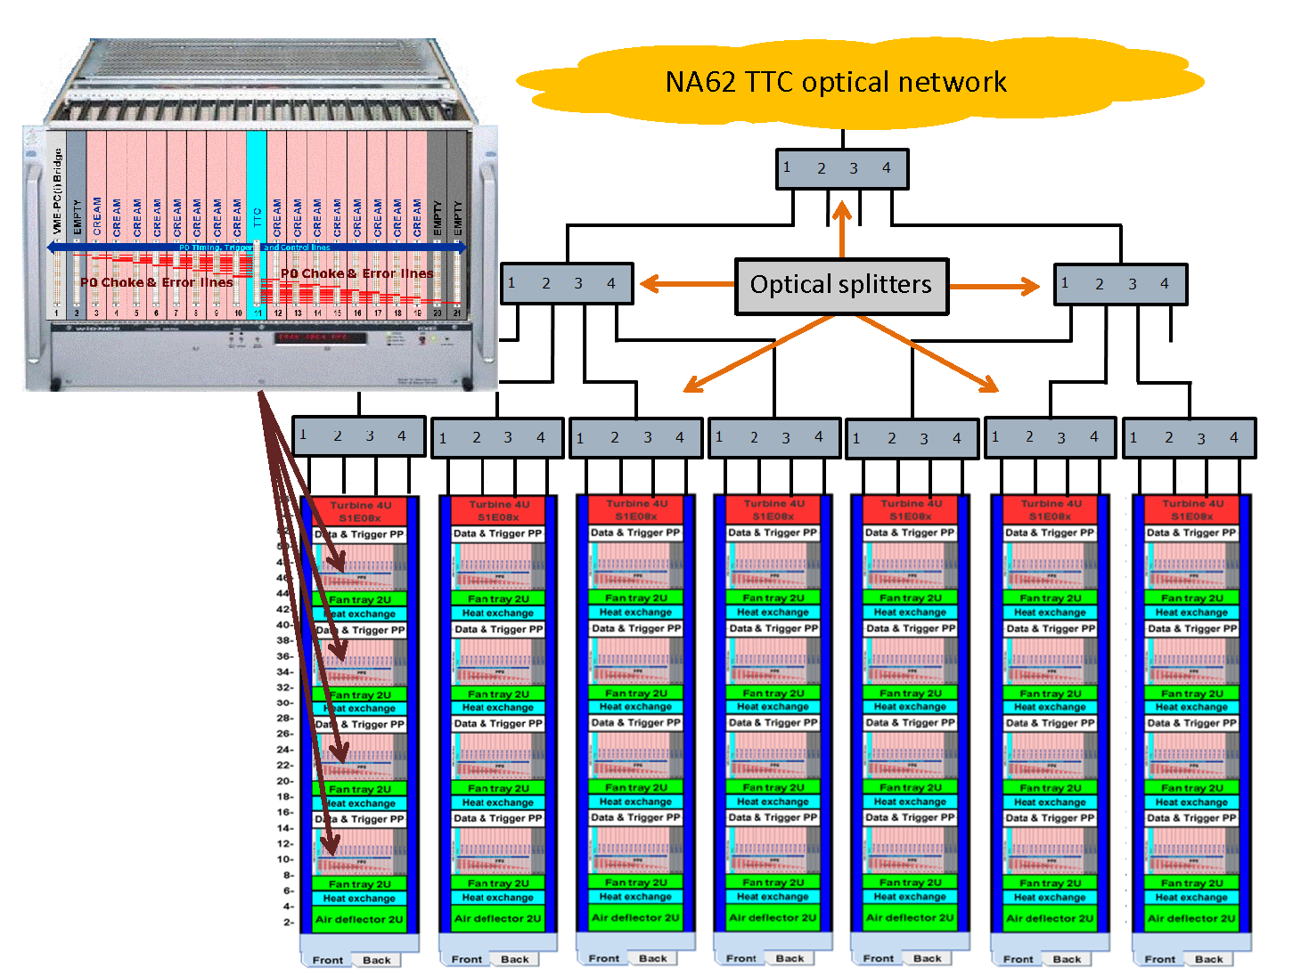

Slide 31
Broken regulator card
Reminder: during the control of the channels, a regulator board with a short circuit in input was found
Its removal with the standard procedure was failing, because one of the two screws was turning around
Eventually removed and a spare unit prepared for the substitution
For the removal, all the neighbouring cards where removed as well
Conservative approach to remount everything
  Install the regulators one at the time
  Check some of the corresponding channels to be sure the card is correctly installed
  Go to the next one
  During the tests, another board found faulty and replaced
Mechanical problem:
  The initially faulty board was not fitting exactly in its position, because the hole in the brass box to the flange is too small
  The board had to be grinded on one side to fit in

Slide 32
Channel checks
We have to complete the channel checks using calibration and scope.
  About 3000 channels
Work started after the board repair
  As of today, 1100 channels done
  8 hours still needed
A refined investigation will be needed
  To understand specific problems

Slide 33
Calibration driver hw/sw
Planned to upgrade the driver to new hardware
  VME I/O registers instead of CAMAC
  The TALK board to configure the pulse sequence
  A patch panel PCB to match the old cables to the new connectors
New software as well
  C++ code to handle the new hardware, run control and burst timing
  Prototype setup by Christina Hughes (G. Mason Univ.)
  TALK commands to be added
I plan to smoothly shift from the old system to the new one in the next months
In this way we can dismiss the last pieces of the NA48 LKr system

