Slide 1
DCS WG : achievements and challenges

Slide 2
DCS strategy and plans
Concentration on basic control of whole detector without closing possibility of future upgrade (horizontal base)
  Test and integration of all available middleware
  Integration of all available hardware
  Migration to final network and DB set-up
  Simplified User Interface and functions
Implementation of advanced control in case of availability of extra manpower
Installation of final DCS hardware – beginning of spring of 2014
Commissioning - April / May 2014

Slide 3
S
T
A
T
E
2
MON
T
H
S
AGO
Ready
Main DCS hard- and middleware
IT: ORACLE DB
In progress
Win CC OA 3.11
External systems
LKr LV control
WIENER FE crates
GTK RO card control
KTAG Env. monitor
OPC servers and
other middleware
CAEN HV
CAEN FE crates
RICH FE control
MPOD
STRAW HV & LV
LAV FE control
CHANTI PS
KTAG FE control
Hardware
Env. monitor
FE control
LV control
FE control
LV control
FE control: 12
RO card control
FE control
WIENER FE crate
CAEN FE crates: 32
WIENER FE crate
WIENER FE crates: 5
WIENER FE crates: 4
WIENER FE crates: 12
WIENER FE crate
WIENER FE crate: 4
WIENER FE crate
CAEN HV: 1,2
CAEN HV
CAEN HV
CAEN HV: 4
MPOD: 4
CAEN HV: 12
PS (?)
CAEN EASY
CAEN HV
IRC/
SAC
MUV
LKr
CHOD
RICH
STRAW
LAV
CHANTI
GTK
KTAG

Slide 4
Common for all sub-detectors tasks
Last achievements:
  Migration to WinCC OA 3.11 SP1 + JCOP 5.01 + UNICOS 6.1 :
    Operational version for 2014
    Validation of component base approach
    Clean-up
  Integration of second VAISALA Combined Pressure, Humidity and Temperature Transmitter
  Another iteration with CAEN OPC server. A test of a new version is near completed.
Challenges (till run 2014):
  Stable and reliable common middleware
  Adaptation of DCS to final set-up of NA62 network
  Procurement and installation of final DCS hardware
    SYSTEC box(s) for LAV FE control
    New front-end computer(s) in pc-farm area
    New back-end server(s) in CCC
    Cabling and arrangement of DCS rack in pc-farm area
  Integration of information provided by external systems
  Further cleaning and unification of internal DCS structure

Slide 5
Sub-detectors : KTAG/CEDAR
IRC/SAC
MUV
LKr
CHOD
RICH
STRAW
LAV
CHANTI
GTK
CEDAR
Last achievements:
  FE control of two fully populated FE boards installed in KTAG d uring July dry run
  Successful test of DIM server for LV power supplies control
Challenges:
  Finalization of control of HV system
  Implementation of FE control for full detector
  Integration of LV power supplies
  Development of control program for CEDAR pressure scan
  Improvement of CEDAR alignment tools
  Final tuning of Temperature & pressure measurement

Slide 6
Sub-detectors : GTK
IRC/SAC
MUV
LKr
CHOD
RICH
STRAW
LAV
CHANTI
GTK
CEDAR
Last achievements:
  A preliminary version of User Requirements + first meeting + mails exchange
    4 WIENER VME crates – integration should be straightforward
    Custom control of RO cards
      6 parameters x 30 cards
      A DIM server should be developed by GTK team
    CAEN-EASY 3000 LV system
      3 crates x 12channels = 36 channels in total
      Doubts about reliability of long CAN bus line between branch controller and EASY crate (should be <150m according to CAEN spec)
    CAEN HV system – 3 channels, integration should be straightforward
Challenges:
  Detailed User Requirement document (naming, mapping, UI panels, etc - “a la” KTAG)
  Decision on CAEN-EASY mainframe location (central team recommends to install it in TCC8)
  Development of RO cards control
  Kick-off meeting is scheduled in mid September

Slide 7
Sub-detectors: LAV
IRC/SAC
MUV
LKr
CHOD
RICH
STRAW
LAV
CHANTI
GTK
CEDAR
Last achievements:
  Integration of FE control for 3 stations in central DCS
  Stress test of new FE board FW shown that after a few days of correct operation 2 boards from 5 started to drop frames and finally stopped to send them completely.
Challenges
  Reliable and stable FE board FW
  “KTAG like” LAV DCS user requirement document available on EDMS, in particular for LAV12
  Development of FE control for whole detector
  Finalization for HV and WIENER control – pending on hardware availability

Slide 8
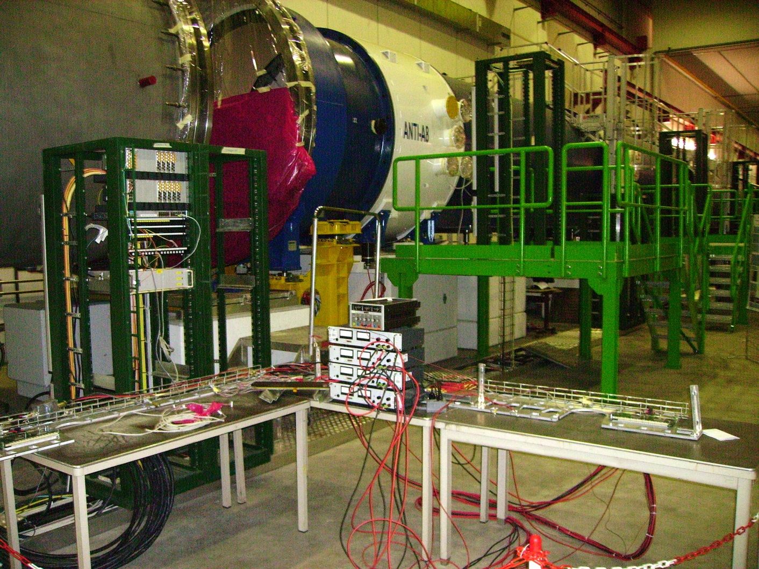
Sub-detectors: Straw Tracker
IRC/SAC
MUV
LKr
CHOD
RICH
STRAW
LAV
CHANTI
GTK
CEDAR
Last achievements:
  Simulator of monitoring system (LV, temperatures, etc) based on ELMBs for ½ chamber (Straw team).
Challenges:
  Full monitoring system (> 2000 channels !)
  WIENER crates
  Integration of MPOD power supplies (by STRAW team)

Slide 9
Sub-detectors: RICH
IRC/SAC
MUV
LKr
CHOD
RICH
STRAW
LAV
CHANTI
GTK
CEDAR
Last achievements:
  Partial test of HV system (2 crates)
Challenges:
  Full test of HV system (waiting for hardware)
  WIENER crates (waiting for hardware)
  Front-end control - “terra incognito” – no progress yet

Slide 10
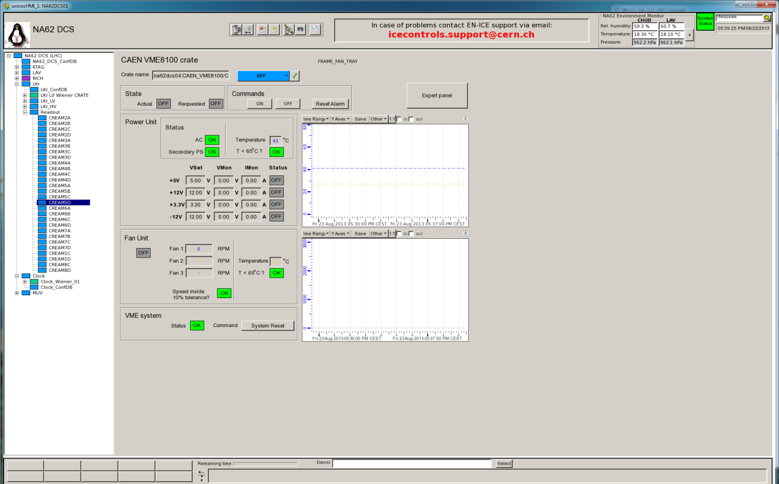
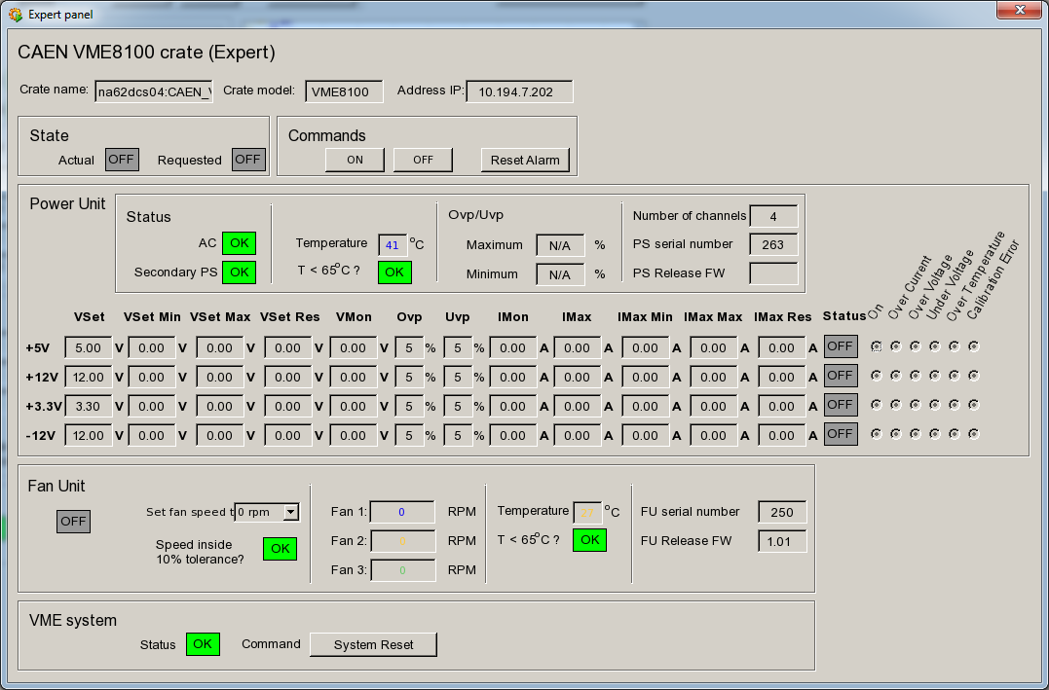
Sub-detectors: LKr
IRC/SAC
MUV
LKr
CHOD
RICH
STRAW
LAV
CHANTI
GTK
CEDAR
Last achievements:
  Full integration of CAEN 8100 crates

Slide 11
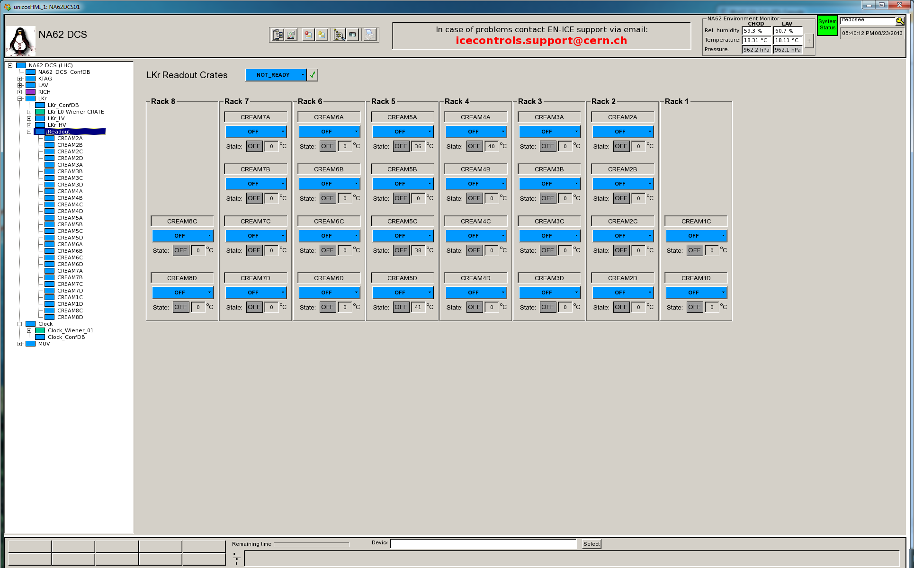
Sub-detectors: LKr
IRC/SAC
MUV
LKr
CHOD
RICH
STRAW
LAV
CHANTI
GTK
CEDAR
Challenges:
  Final debugging and cleaning

Slide 12
Sub-detectors: MUV
IRC/SAC
MUV
LKr
CHOD
RICH
STRAW
LAV
CHANTI
GTK
CEDAR
?
?
?
HV system and WIENER crate are ready
Challenges:
  HV system for MUV1. Waiting for URD and hardware
  Front end control - “Terra incognito” – no progress yet
“Terra incognito”: IRC/SAC, CHANTI, HAC

Slide 13
Main DCS hard- and middleware
IT: ORACLE DB
Ready
In progress
Operational version for 2014
Win CC OA 3.11 SP1
External systems
LKr LV control
WIENER FE crates
GTK RO card control
KTAG Env. monitor
OPC servers and
other middleware
CAEN HV
CAEN FE crates
RICH FE control
MPOD
STRAW HV & LV
LAV FE control
CHANTI PS
KTAG FE control
Hardware
Env. monitor
FE control
LV control
FE control
LV control
FE control: 12
RO card control
FE control
WIENER FE crate
CAEN FE crates: 32
WIENER FE crate
WIENER FE crates: 5
WIENER FE crates: 4
WIENER FE crates: 12
WIENER FE crate
WIENER FE crate: 4
WIENER FE crate
CAEN HV: 1,2
CAEN HV
CAEN HV
CAEN HV: 4
MPOD: 4
CAEN HV: 12
PS (?)
CAEN EASY
CAEN HV
IRC/
SAC
MUV
LKr
CHOD
RICH
STRAW
LAV
CHANTI
GTK
KTAG

Slide 14
DCS tasks and resources needed (in days)
 | HV | LV | FE control | Crates | Specific tasks | Total
KTAG | 10 | 50 | 10 |  | 60 | 130
Central DCS – sub-detectors
 | HV | LV | FE control | Crates | Specific tasks | Total
GTK | 2 | 5 |  | 5 | 15 | 27
LAV | 2 |  | 15 | 1 |  | 18
STRAW |  | 15 |  | 5 |  | 20
RICH | 5 |  | 30 (?) | 5 |  | 40
LKr |  |  |  |  | 5 | 5
MUV | 10 |  | 30 (?) |  |  | 40
Total |  |  |  |  |  | 150

Slide 15
DCS tasks and resources needed (in days)
Central DCS – common tasks
Task | Resources needed (in days)
Integration of external information | 10
System management, operation and maintenance | 20
Test of common middleware | 10
Total | 40
Summary
 | Resources needed (in days) | Developer | End of contract
KTAG | 130 | Ryan Page | September 2014
Central DCS | 190 | Roman Fedoseev | May 2014

Slide 16
DCS tasks and resources
Conclusion
In current situation the Central DCS team doesn’t have resources neither for consideration of new requirements nor for implementation of advanced control

