Slide 1

A11 cosmic test results
Francesco Gonnella, Matthew Moulson
Photo Veto Working Group
NA62 Collaboration Meeting - Liverpool UK

Slide 2
Test summary
We tested a subset of 32 lead-glass blocks of LAV station A11
We connected the LG blocks to a LAV-FEE board obtaining 64 output channels
A11 vessel is in ECN3 and it is properly rotated for a cosmic ray test
We used HV power supply system connected with new HV cables
We performed our measurements with one LAV-FEE motherboard (LAV 3, board 1)
We tested both mezzanines with gain-3 and gain-5 amplifier

Slide 3
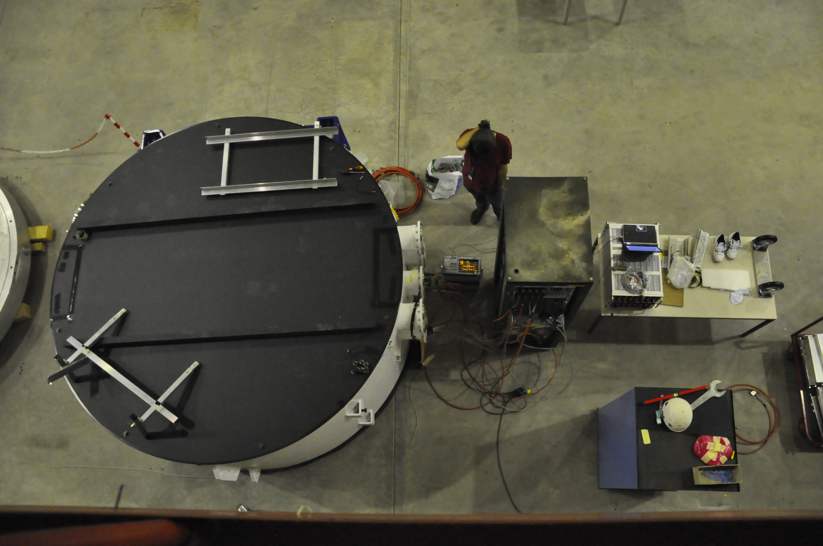
A11 at ECN3
Matt
Acq
PC
Daq
system
a pair of
shoes
rotated A11

Slide 4
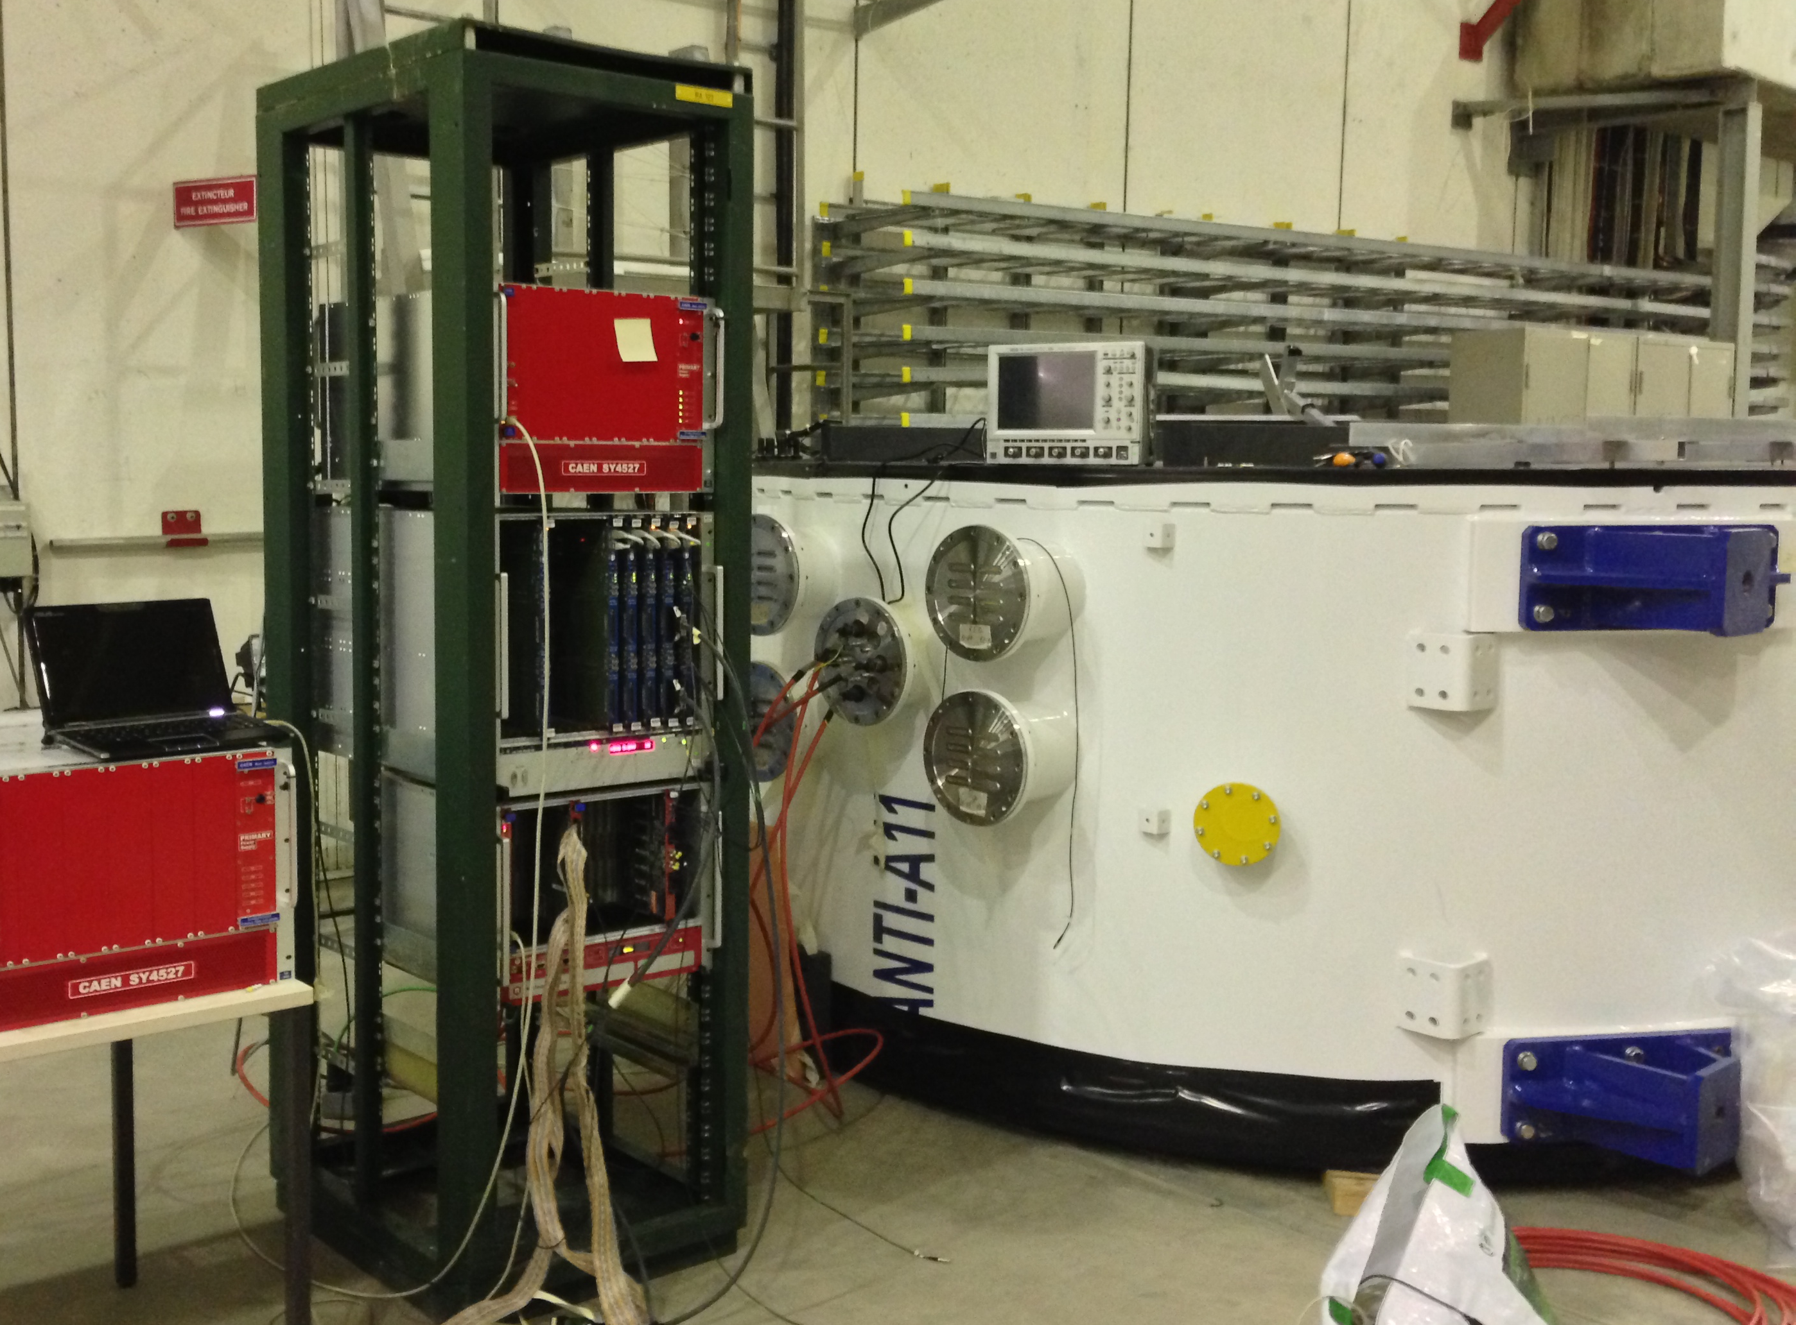
Experimental setup
Special “D1” cables were build to connect bananas in columns to one LAV-FEE board
D1 cables are made of Teflon like the internal ones and are 2 m long
The mapping of LG blocks is:
top-left
top-right
0
1
2
3
4
5
6
7
8
9
10
11
12
13
14
15
Blocks were powered with HV value equalized by the “oven” at 4.5 pC with10% accuracy
Only blocks in the first and last rows were used in the trigger logic
Efficiency was measured for internal blocks only
16
17
18
19
20
21
22
23
24
25
26
27
28
29
30
31
bottom-left
bottom-right

Slide 5
Data acquisition setup
LAV-FEE
On CAEN LT discriminator, Thresholds were set to 2 mV, on the sum of 4 which has an attenuation factor of 0.5.
Effective thresholds are 1 mV
LG block
TL sum
CAEN
LT Discriminator
TR sum
2 or more
LG block
BL sum
LG block
BR sum
LG block
usb
32 blocks
CAEN – TDC 64 ch
trigger
LVDS out
32
VME-bridge
PC
LVDS out
32
VME
usb
Trigger logic: coincidence of at least two signals above 1 mV among Top-Left, Top-Right, Bottom-Left, Bottom-Right bananas.

Slide 6
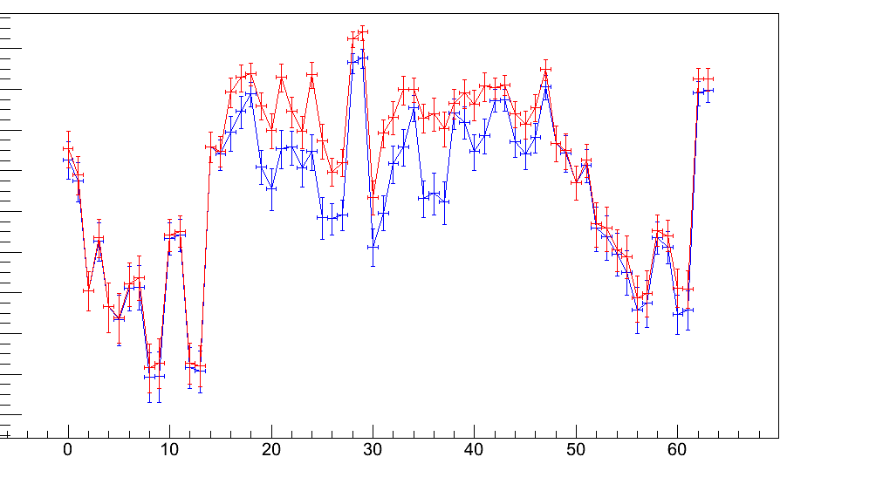
Efficiency evaluation
For the calculation of the efficiency we evaluated the ratio between: hit in a channel and hit in the “column” of that channel
The column of the n^{th} channel is defined as all the blocks on its same vertical except the n^{th} block n itself
For geometrical reason, efficiency measurements are reliable only on the internal rows
Top blocks
Bottom blocks
n^{th}
n^{th}
column

Slide 7
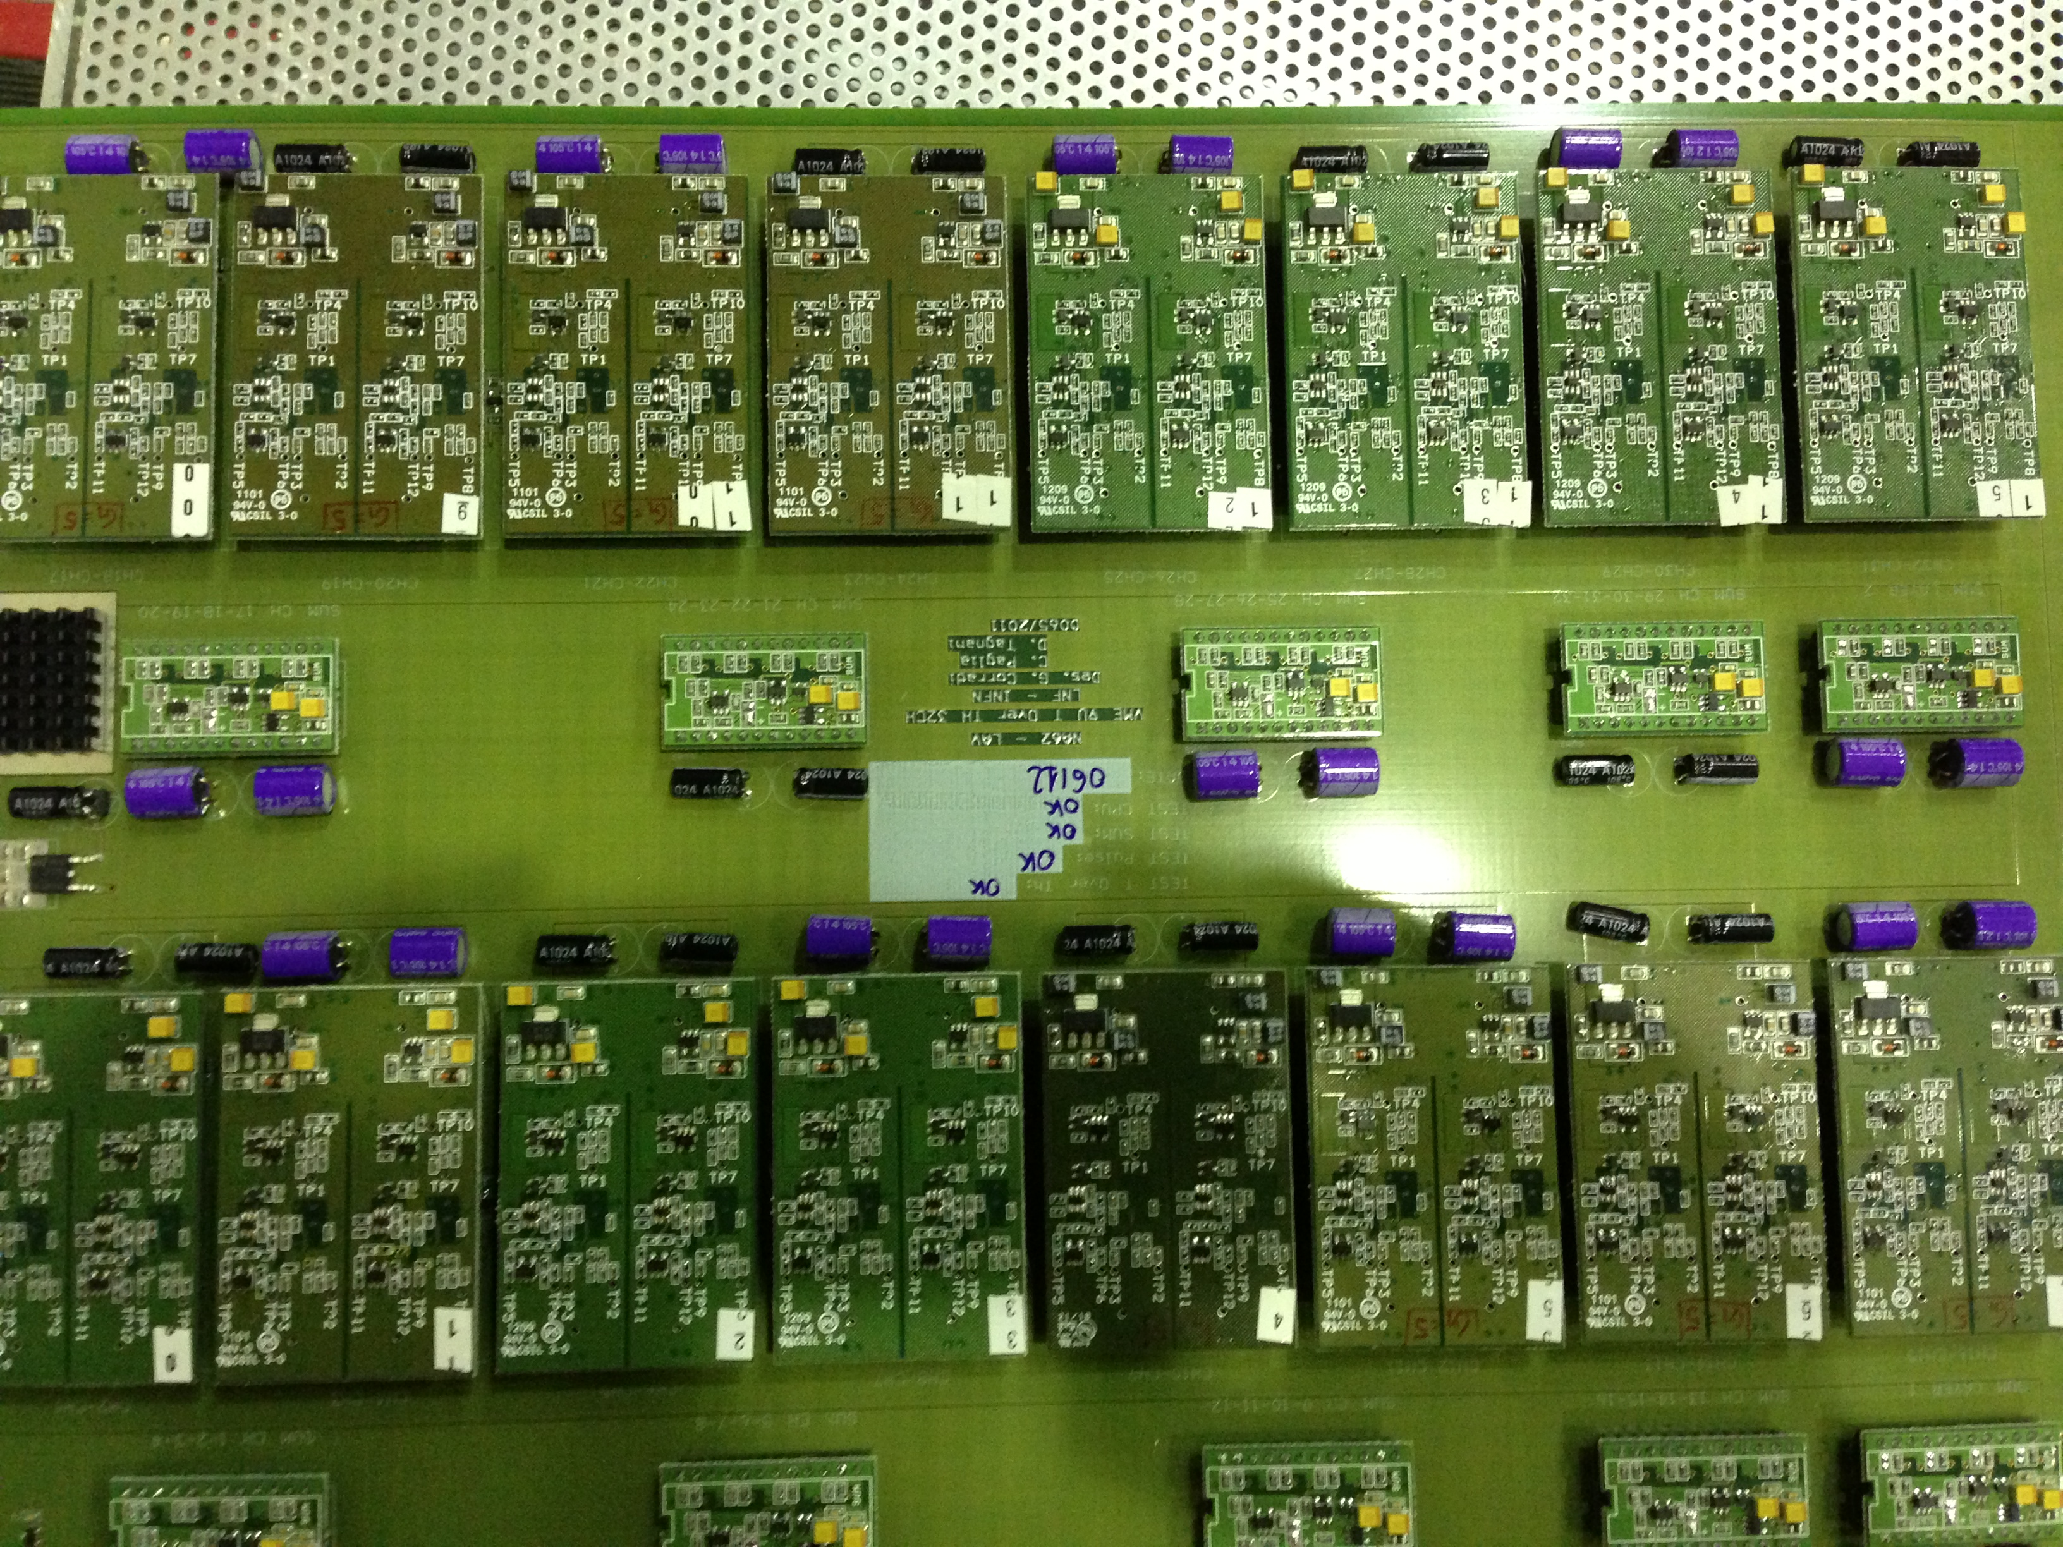
Testing gain-5 mezzanines
For testing g=5 boards we used the same motherboard and replaced only the mezzanines connected to central blocks (channels 16-47)
The remaining mezzanines are used for trigger purpose with 11 mV equalized thresholds
0
1
2
3
4
5
6
7
G = 3, Thr fixed at 11mV
8
9
10
11
12
13
14
15
G = 5
16
17
18
19
20
21
22
23
24
25
26
27
28
29
30
31
G = 3, Thr fixed at 11mV

Slide 8
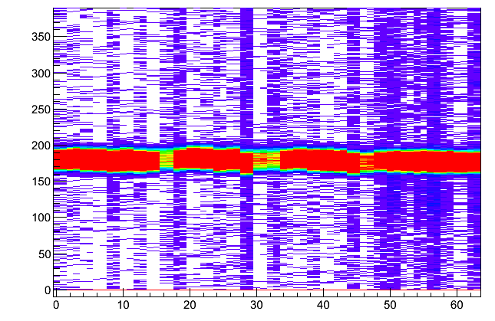
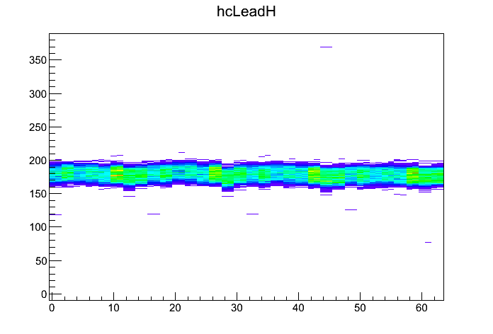
Noise hits with G=3, 11 mV equalized threshold
Leading time distribution for all the hits and for hits selected by the column
The known problem on last channels is clearly visible
time (ns)
channel
The column completely cuts off out-of-time hits
The 25 ns band is due to CAEN TDC trigger precision
time (ns)
channel

Slide 9
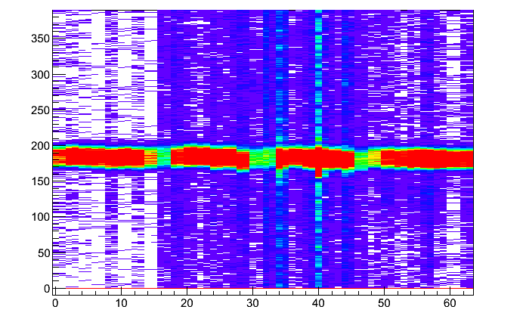
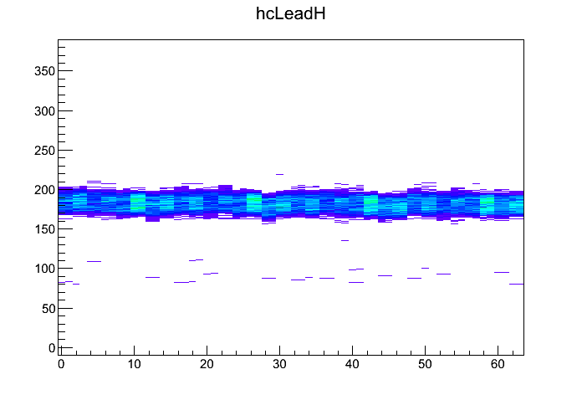
Noise hits with G=5, 2 mV nominal threshold
Leading time distribution for all the hits and for hits selected by the column
The low threshold channels are only from 16 to 47
time (ns)
channel
time (ns)
Also in this very noisy case the column cut works greatly
channel

Slide 10
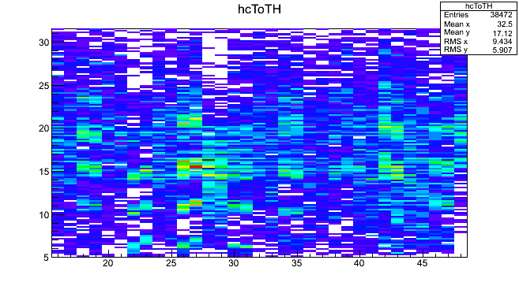
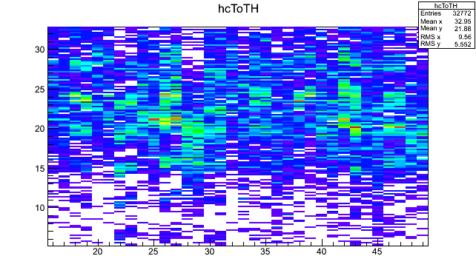
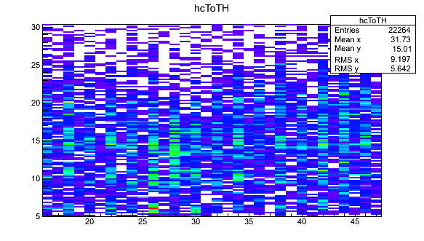
Time over threshold
ToT distribution for channels from 16 to 47.
The typical noise-induced comb structure is present in some channels
A clear positive trend is visible with the decreasing of the threshold
G=5, 7 mV threshold
time (ns)
channel
G=5, 3 mV threshold
G=3, 13 and 15 mV threshold
time (ns)
time (ns)
channel
channel

Slide 11
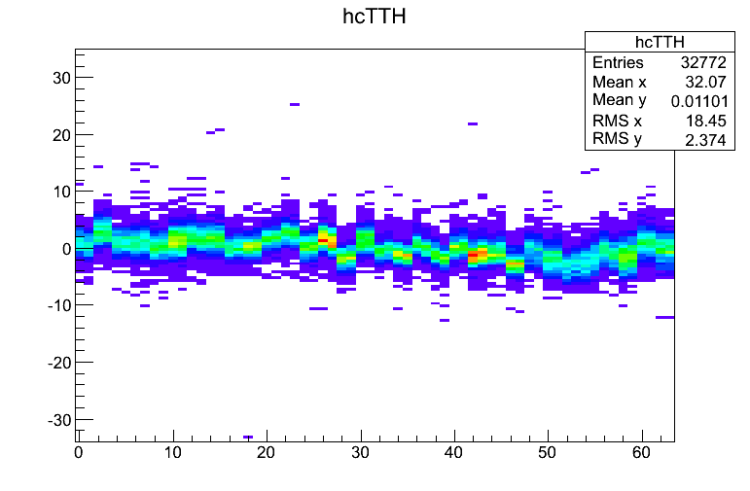
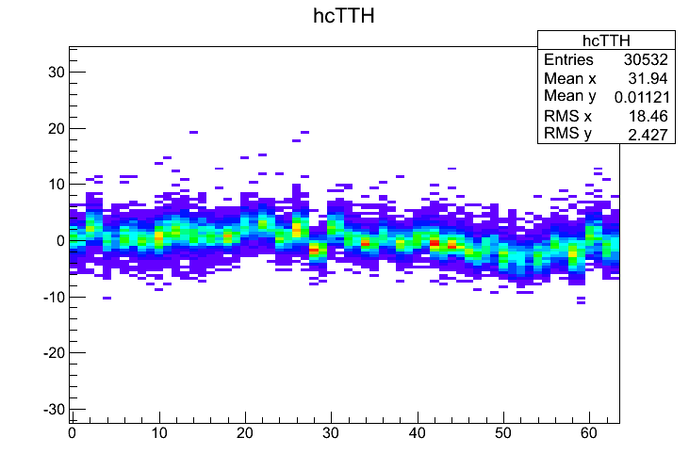
Time measurements
G=5, 3 mV threshold
Distributions of time difference between the hit and the average column time for every channel
Individual time offset are clearly visible in plots.
time (ns)
G=3, 10 and 12 mV threshold
time (ns)
channel
Offsets are mainly due to cable length differences inside the LAV vessel.
channel

Slide 12
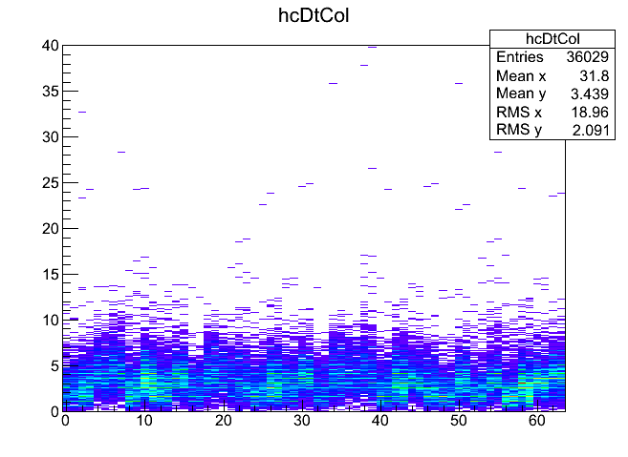
Hit time in a column
G=3, 10 and 12 mV threshold
Distribution of time difference between the first and last hit in a column for every channel
time (ns)
G=5, 3 mV threshold
time (ns)
channel
Most of the hits occur in less than 10 ns, that is compatible with a MIP signal taking into account all time offsets.
A cut on this variable didn’t seem to be necessary
channel

Slide 13
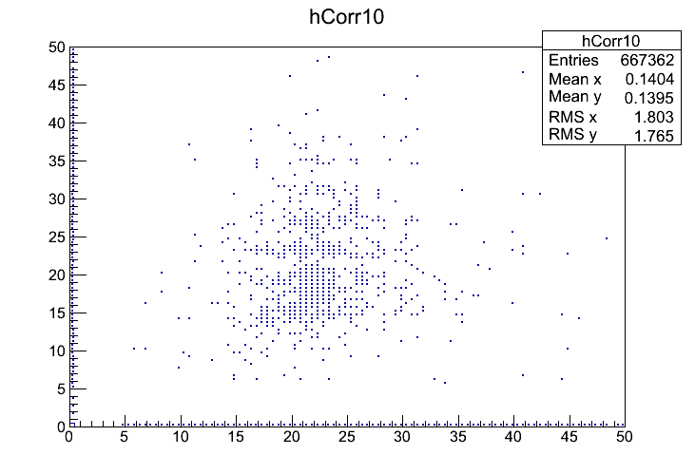
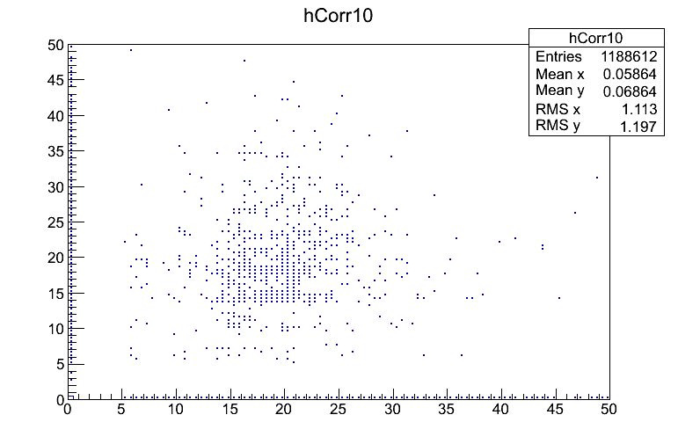
Bias on large angle cosmics?
G=3, 10 and 12 mV threshold
In a given column, we looked for correlation between ToT on first and last block
time (ns)
G=5, 3 mV threshold
time (ns)
time (ns)
No correlation was observed, thus the variation in ToT (and in amplitude of the MIP signal) is mainly due to stochastic processes.
time (ns)

Slide 14
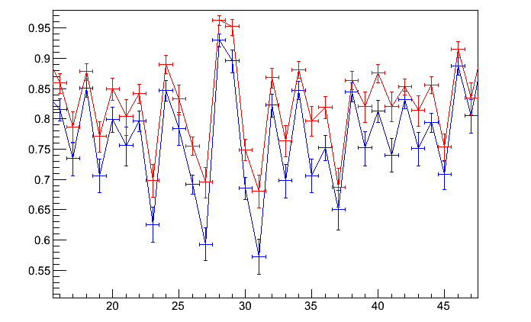
Efficiency on G=3 boards 13, 15 mV
Leading only
Leading and Trailing
Channel
15 mV threshold: LT Efficiency = 73.11%
13 mV threshold: LT Efficiency = 82.69%

Slide 15
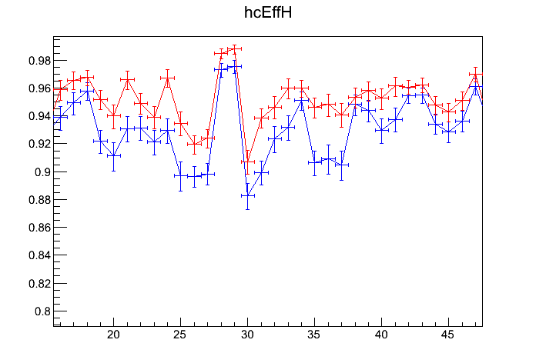
Efficiency on G=3 boards 11 mV
Leading only
Leading and Trailing
Channel
11 mV threshold Efficiency LT = 93.92%

Slide 16
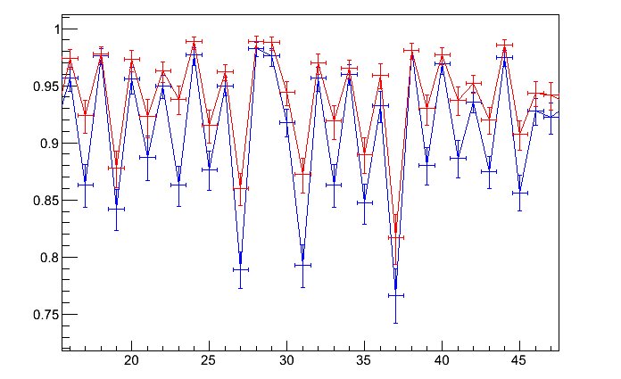
Efficiency on G=3 boards 10, 12 mV
Leading only
Leading and Trailing
Channel
12 mV threshold: LT Efficiency = 88.72%
10 mV threshold: LT Efficiency = 94.51%

Slide 17
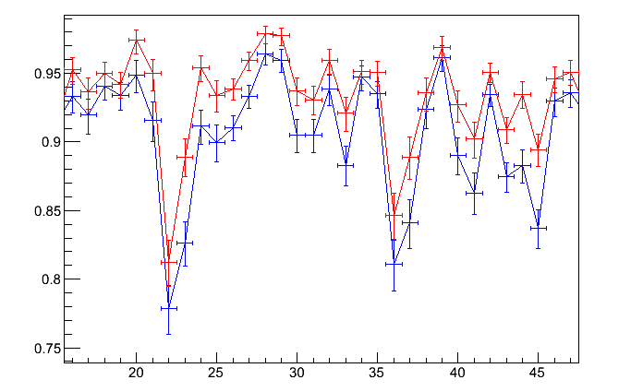
Efficiency on G=5 boards 7 mV (nom)
Leading only
Leading and Trailing
Channel
7 mV nominal threshold (~10mV real signal): Efficiency LT = 92.08%

Slide 18
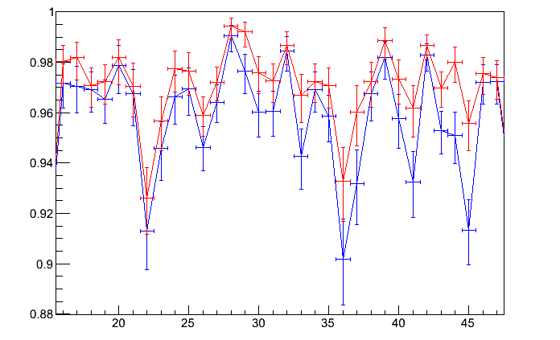
Efficiency on G=5 boards 5 mV (nom)
Leading only
Leading and Trailing
Channel
5 mV nominal threshold (~8mV real signal): Efficiency LT = 96.73%

Slide 19
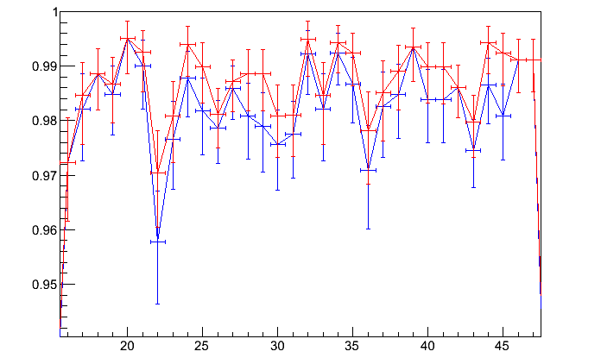
Efficiency on G=5 boards 3 mV (nom)
Leading only
Leading and Trailing
Channel
3 mV nominal threshold (~6mV real signal): Efficiency LT = 98.54%

Slide 20
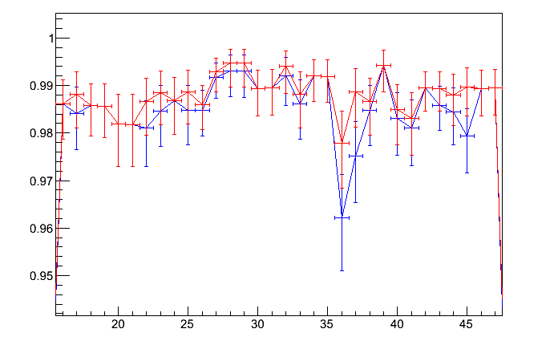
Efficiency on G=5 boards 2 mV (nom)
Leading only
Leading and Trailing
Channel
2 mV nominal threshold (~5mV real signal): Efficiency LT = 98.78%

Slide 21
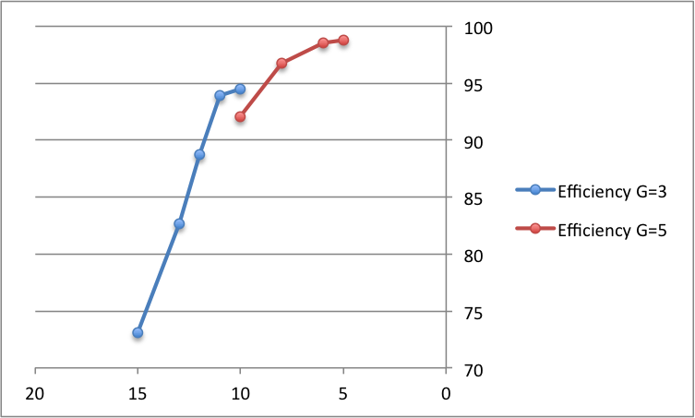
Efficiency summary
threshold (mV)
G=5 threshold values are just an estimation: boards not equalized

Slide 22
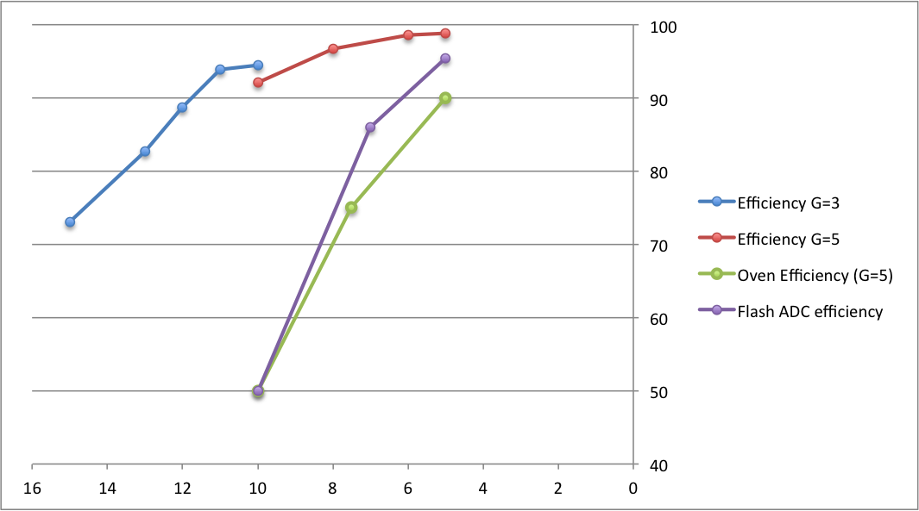
Efficiency comparisons
Previous efficiency measurements and simulations are deeply inconsistent with A11 cosmic-ray test results

Slide 23
Conclusions
With gain-5 mezzanines we reach an efficiency greater than 97% for MIPs with a nominal threshold of 3 mV (meaning a signal amplitude of about 6 or 7 mV)
Gain-5 amplifiers canbe a good choice for all mezzanines on LAV front-end boards but are a little bit at the limit for MIPs,
maybe gain 6 could be a safe choice.
To do:
Explain inconsistency with other efficiency measurements
Perform same tests on A9 at Frascati
Perform noise study to verify if 3 mV threshold is safe to use
Solve problems on some HV channels found on A11

Slide 24
Thank you for your attention
francesco.gonnella@lnf.infnf.it

Slide 25
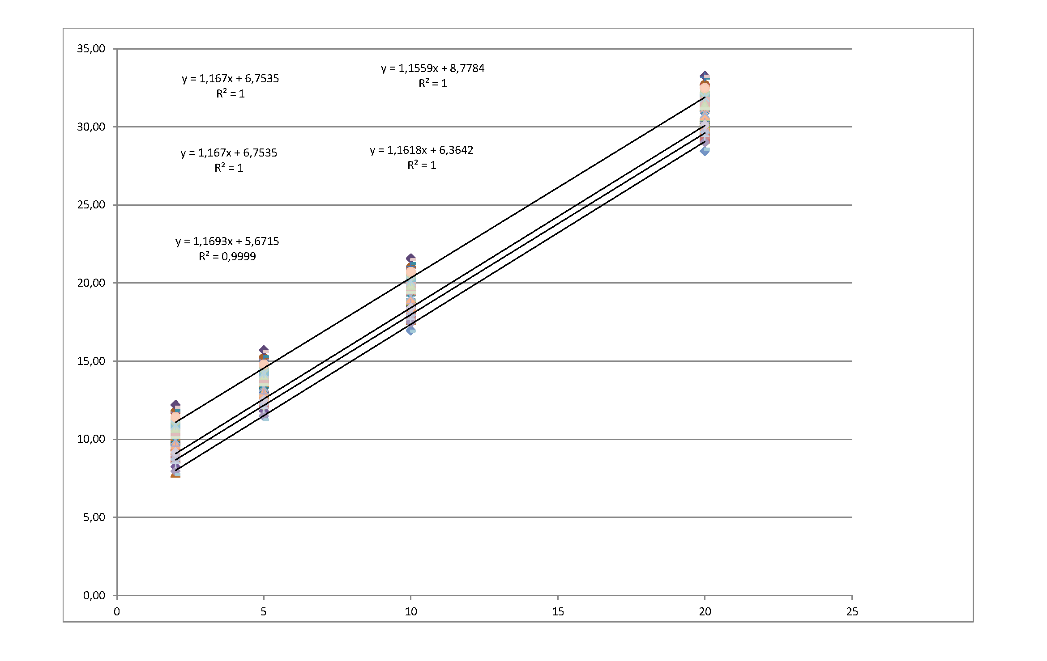
Amplification 3 calibration
Signal amplitude @ 95% efficiency (mV)
nominal threshold (mV or 10 daq unit)

Slide 26
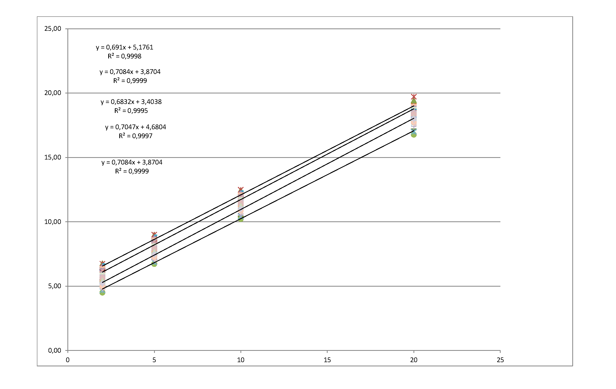
Amplification 5 calibration
Signal amplitude @ 95% efficiency (mV)
nominal threshold (mV or 10 daq unit)

Slide 27
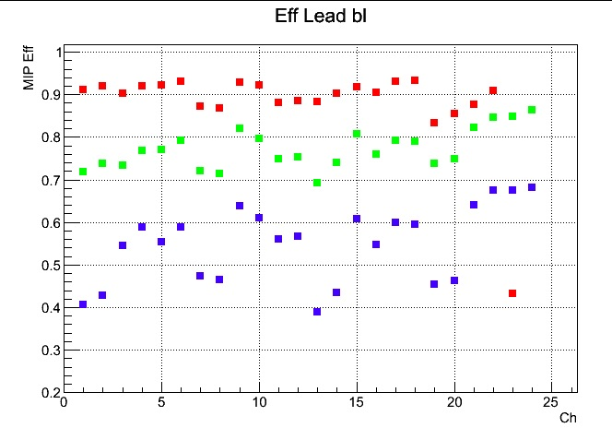
Oven tests results
Thr = 5mV
Thr = 7.5mV
Thr = 10mV

Slide 28
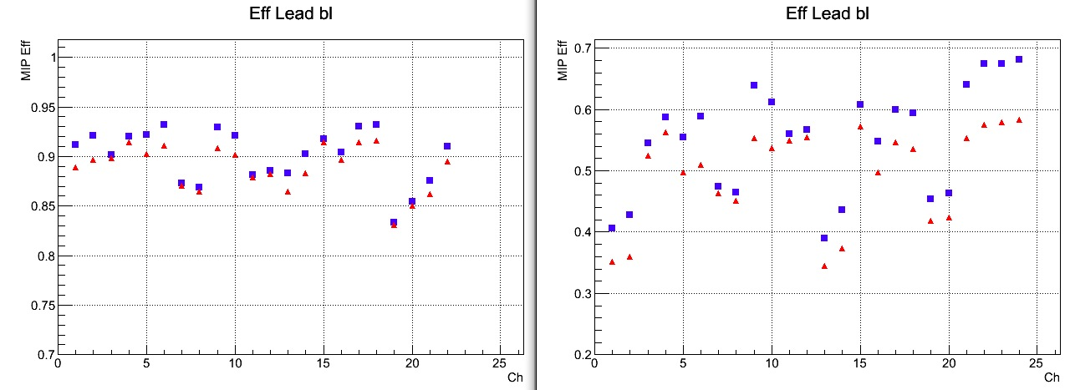
Oven: Lead vs. Lead-Trail efficiencies
Leading and trailing
Leading only
5mV
10mV
The leading and trailing difference seems not so big as we could expect! Investigating…

