Slide 1
PH-DT
Seasonal meeting 7/5/13
Group, projects update and general news > M.Capeans
Recruitment in PH > L.Mapelli
Safety > A.Catinaccio, M.Hatch

Slide 2
DT Group Mandate
The mandate of the PH-DT group comprises development, construction, operation and maintenance of particle detectors for the experiments at CERN. The group also offers a range of services and infrastructure for experiments and detector R&D
R&D on Strategic Fields
Detector Projects
Detector and Infrastructure Services
Gas systems
Detector cooling systems
Magnet control and support
Instrumentation and controls
B-field mapping
Thin film & glass Lab
Silicon facility, Bond
Wire-bonding & QART Lab
PH irradiation facilities
Specialized labs
Silicon detectors
Gaseous detectors
Scintillating fibre detectors
Novel on-detector cooling
LHC experiments
Aegis, CAST, CLOUD, NA62
Linear Collider Detectors

Slide 3
74 Staff members
FSU of 14 people
11 Fellows
12 Tech/Doct Students
6 Trainees
Coming soon: 12 summer std & +3 trainees
DT FSU
A.Kerhli, M.Carrichon, J.Dumollard, G.Lacroix, B.Marichy, A.Laassiri, G.Crepet, H.Sabba, H.Martinati
Notes:
Matrix organization (most projects extend over several sections)
DI > Services (gas, cooling, magnet operation & controls) are fully committed to LHC operational support and are therefore joined in a new section. Cooling in DT consists of two main activities: plant construction and operation, and R&D for future detectors and cooling concepts. The first team joined the SERVICES section
PH-DT DD > To boost detector R&D and upgrading infrastructures for future detector projects
PH-DT TP
PH-DT Technical Sector: PO, EM1 & 2 Need larger flexibility and increased follow up to cope with new demands

Slide 4
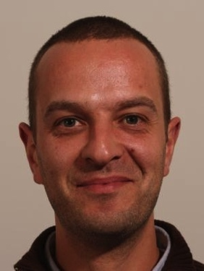
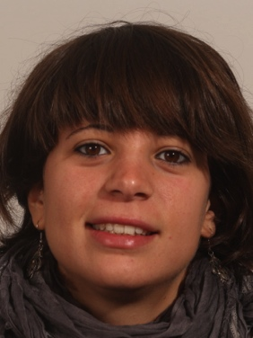
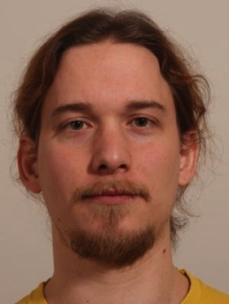
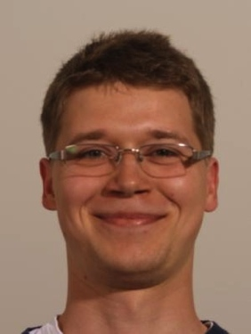
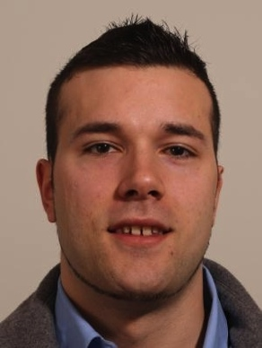
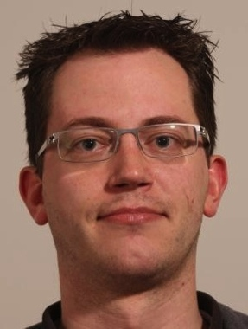
Arrivals since Jan 2013
Name | Supervisor | Topic | Program | Arrival
Pedro Miguel LIMA | A.Onnela | ATLAS IBL & electro-mech. support to irradiation facilities | TTS | 1.1.13
Giulia ROMAGNOLI | P.Petagna | Development of silicon μ-structured cooling plates for NA62 GTK | Doctoral | 1.2.13
Patrik THUINER | L.Ropelewski | MPGD | Doctoral | 1.2.13
Piotr DZIURDZIA | R.Dumps | LHCb VELO & cooling | Technical | 1.3.13
Andreas KRUGER | M.Davenport | CAST | Technical | 1.3.13
Christian GALLRAPP | M.Moll | Silicon detectors | Fellow | 1.3.13
Pedro Miguel Giulia Patrik Piotr Andreas Christian

Slide 5
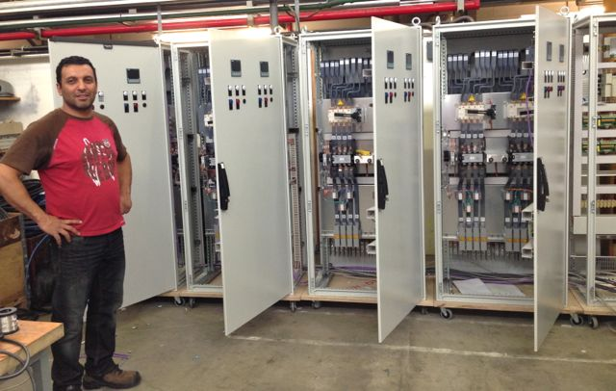
Field Support Unit PH-02
A.Kerhli, M.Carrichon, G.Crepet, H.Sabba
J.Dumollard, B.Marichy, A.Laassiri, H.Martinati
C.Landraud, G.Lacroix
R.Camus, S.Florent, S. Rambaud, F.Raviel
F.Merlet
COORDINATOR
X.Pons
Electrical
F.Merlet
Mechanics (Fluids)
S.Ravat
Software
CERN 3/5/13
FSU COORDINATION in DT
Please, always contact F.Merlet for job requests

Slide 6
Current Use of Resources
(only staff ~ 74 FTE)
45% Projects (contributions to experiments)
35% Services (common LHC M&O included)
5% R&D activities
15% is shared between administrative and technical management:
  Some examples (FTE): Group management (2.4), EU projects management (1.5), Workshops and Labs supervision, Safety, Support to PH travelling exhibitions (0.6), Committees, Detachments…

Slide 7
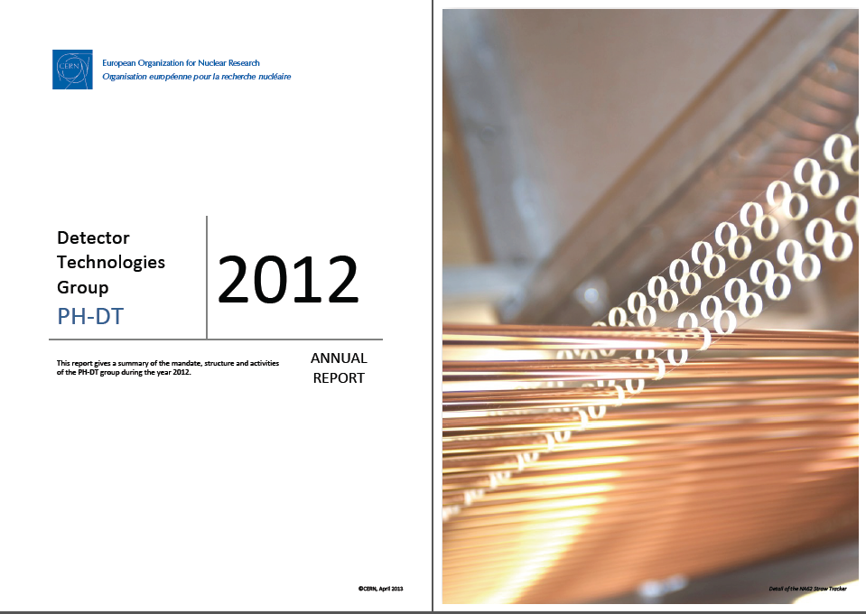
DT Annual Report
http://ph-dep-dt.web.cern.ch/ph-dep-dt/Documents/AnnualReports/DT_AnnualReport_2012v2.pdf

Slide 8
Contributions to LHC experiments
Completed projects in red, New projects in green
Experiment | FTE 2013 | Operation | LS1 Deliverables | LS2 | LS3
ALICE | 7.75 | General mechanical support: structures, movements, assembly areas, system support (TPC, HMPID, …) Engineering (Project engineer & design support) |  | ITS
ATLAS | 7.2 | ID cooling coordination and expert support Mechanical support ATLAS-ALFA | IBL and Pixel nSQP CO₂ and thermo-siphon cooling plants ID opening, TRT leaks | NSW μ-megas for muon system | TK Engineering
CMS | 3.2 | Cooling coordination and expert support Ecal cooling controls Preshower det. support | Pixel Luminosity telescope CO₂ plants for TIF, Pix Tracker drier & colder | CO₂ cooling plants for new Pix det. operational | TK: Module design, Integration, support structures
LHCb | 5.1 | Engineering, design support VELO support, test beams RICH operation, HPD repairs | Shielding behind muon system Detector movements Mechanical support | Sci-Fi studies (det & cooling) RICH, TORCH studies
TOTEM | 1.5 | Mechanics of RP (Si-det), controls RP movement & secondary vacuum Support for T2 stations (GEM) | Dismantling RP at 147m and 220m RP extension Controls

Slide 9
Projects
Non-LHC
Experiment | FTE (2013) | Activities
NA62 | 6.7 | TC (F.Hahn) & technical support (mechanics, infrastructure, beam pipe…) Straw tracker construction RICH vessel design GTK module cooling and integration
AEGIS | 1.3 | TC (S.Haider) & Mechanical support Control/safety systems 1- 5 T magnets
CLOUD | 0.8 | TC (A.Onnela) & Mechanical support
CAST | 1 | TC (M.Davenport) & Mechanical support
LCD | 1.4 | Tungsten HCAL Test beam support Tungsten/Scintillator ECAL Pixel detector
 | 11.1

Slide 10
PH-DT Services
Clusters of expertise for the experiments
DT Service | Entry Point | FTE 2013 | Operations | LS1 Deliverables
Gas systems project | R.Guida | 5.6 (4 FSU) | Construction of gas systems CERN wide LHC: M&O gas systems, 24h On-call | Consolidation LHC New systems (e.g. ALICE MTR close-loop, ATLAS IBL, CMS GEM, LHCb RICH2 CF4-recup)
Magnet Control Project | X.Pons (HW) S.Ravat (SW) | 4 (4 FSU) | LHC experimental magnets M&O, 24h On-call | Consolidation LHC Development new MSS2 (Safety systems for M1, Compass)
Cooling Project (CO2 plants) | P.Petagna | 4 (0.5 FSU) | Prototypes, Lab and Test-beam setup units | CO2 Plants for CMS Pix and ATLAS IBL
Magnet support B-field meas. | F.Bergsma | 2.2 | On-request | East-hall renovation B-field MICE, NA62, LHCb

Slide 11
PH-DT Services
Clusters of expertise for Detector R&D
DT Service | Entry Point | FTE 2013 | Commitments
Thin film/Glass Lab | T.Schneider | 2.5 | E.g. NA62 RICH and CEDAR
Bond Lab, DSF and QART Lab | A.Honma | 3.1 | E.g. ATLAS IBL, CMS Pix R&D projects (~40/y) …New Bonding machine being purchased
Irradiation Facilities | M.Glaser/F.Ravotti | 1.1 | Construction GIF++ in the North Area and new PS Irradiation facilities in the East Hall

Slide 12
PH-DT R&D WPs
Clusters of expertise, equipment and infrastructure for all experiments
Launch pads for Upgrade projects
R&D | Entry Point | FTE 2013* | 2013 Commitments
RadHard Silicon Det. (WP4) | M.Moll | 0.6 staff 1 Fell 1 Doct | Infrastructure CMS Tracker sensor characterization RD50 (rad hard aspects) + Spokesperson
Micro-Pattern Gas Detectors (WP5) | L.Ropelewski | 1 staff 1 Fell 1 Doct | Infrastructure Support to upgrade projects (e.g. large area MPGD for LHC: ATLAS, CMS, ALICE) RD51 activities + Spokesperson
Detector Cooling (WP11) | P.Petagna | 1 staff 1 Fell 2 Doct | Third generation of CO₂ plants On-detector cooling: Silicon μ-channel (ALICE ITS, LHCb VELO, ATLAS IBL-II) New detector concepts via μ-fabrication techniques
* Resources externally funded not accounted

Slide 13
Reinforcement Areas
 | Posts open or in the pipeline 2013 | Status
Micro-system engineering will be potentiated, and supported in the design, calculation and integration phases. It will exploit synergies with existing DT silicon facilities/services | Staff Engineer on micro-systems (E) | ✔ Recruited
Engineering: calculations & competency and facilities for rapid prototyping, bonding, composite materials design and prototyping… for all projects! | Staff Applied physicist/Engineer (E) | ✔ Board takes place end of May
Gas Project team at the limit of capacity | TTS | ✔ Candidate selected, post shared with Cooling project
MCP team suddenly lost 1 FTE at the end of 2012 | Internal reorganization | ✔
PH Irradiation Facilities: construction/commissioning projects for the next 2 y and later operational responsibility | Staff Tech (C) for irrad. facilities and generic electro-mech support 50-50 | ✔ Vacancy under preparation
Mech Tech (CP C) retirement | Staff Tech (C) ~Autumn | ✔ To be prepared
1 tech leaves end’13 due to internal mobility | New post for Mech. Tech | ✔ To be prepared
1 tech detached & 1 engineer moving to new responsibilities | t.b.d.

Slide 14
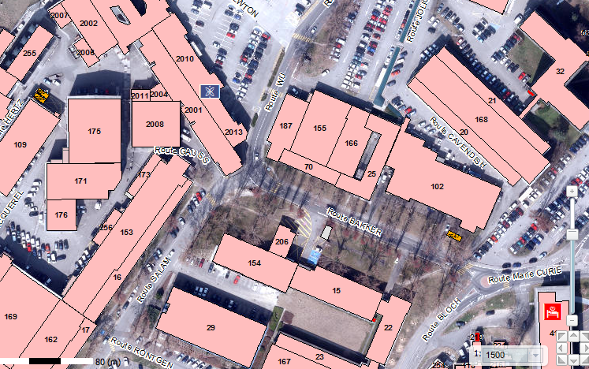
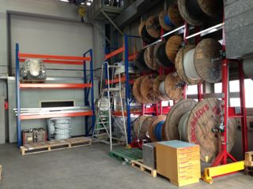
  DT News: Buildings
New DT Headquarters project not moving
Ongoing improvements:
Renovation facade
168/R Recuperated fully the crystal palace for Cooling Activities (J.Daguin)
21/1-67 Recuperated old UK Liason Office for Detector (Scint) R&D Lab (C.Joram)
21/R-65 Setting up an Instrumentation & Controls Lab (S.Ravat)
Saleve Side: arranged storage place (R.Kristic/X.Pons)
New shower room!
154/R: Renovation of air conditioning system and extension of GDD Lab (Gas Detectors)

Slide 15
DT Budgets
Group Budget 2013
Cars
  A.Onnela has agreed to chair a working group to evaluate the use of DT cars
2013 Investments (PH funds) for ~ 220 k
  1 new wire bonding machine (150k) & several equipment for Gas Project, Engineering SW for EO, and 3D printer for rapid prototyping (40K)
Activity |  | ~ Budget (kCHF)
DT operation | Cars, WS, training, trainees, PCs, consumables… WS conformity (Special budget line in 2013) | 424 150
SERVICES | MCP, GAS, Irrad. Facilities, TFG, QART, Scintillator, Si-facility | 323
DT R&D | Gas detectors, Silicon lab, Hybrid photon det. | 67
R&D WPs | Silicon (RD50), MPDG (RD51) & Cooling R&D | 362

Slide 16
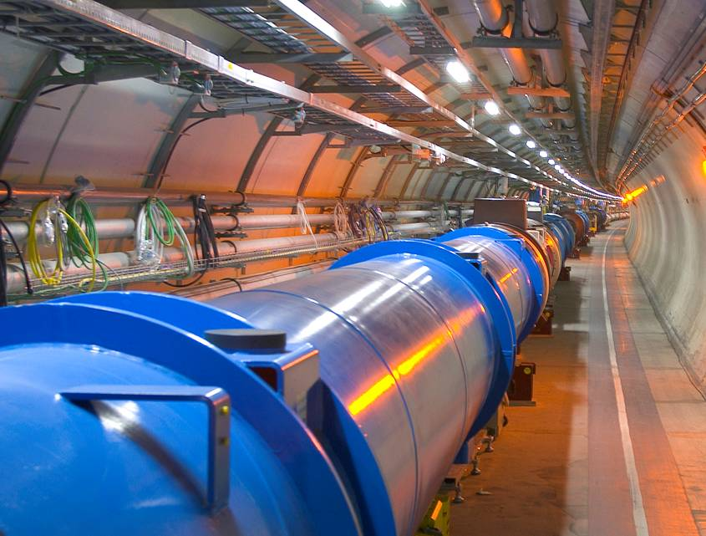
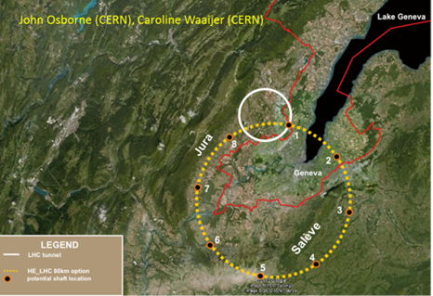
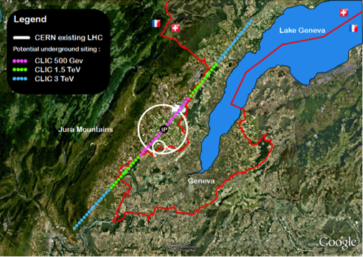
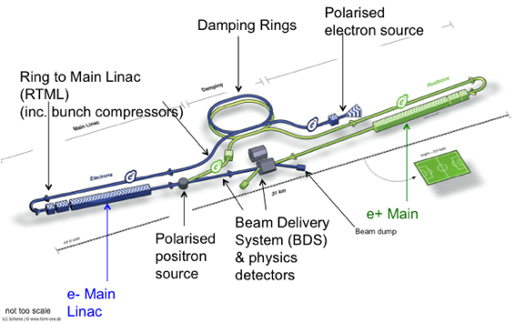
European Particle Physics Strategy https://indico.cern.ch/getFile.py/access?resId=0&materialId=0&confId=217656
Priority projects:
Europe’s top priority should be the exploitation of the full potential of the LHC, including the high-luminosity upgrade of the machine and detectors with a view to collecting ten times more data than in the initial design, by around 2030.
To stay at the forefront of particle physics, Europe needs to be in a position to propose an ambitious post-LHC accelerator project at CERN. CERN should undertake design studies for accelerator projects in a global context, with emphasis on proton-proton and electron-positron high-energy frontier machines (refers High Energy LHC and CLIC)
There is a strong scientific case for an electron-positron collider, complementary to the LHC that can study the properties of the Higgs boson and other particles with unprecedented precision and whose energy can be upgraded (refers to ILC in Japan)
CERN should develop a neutrino programme to pave the way for a substantial European role in future long-baseline experiments. Europe should explore the possibility of major participation in leading neutrino projects in the US and Japan
General statement about detector R&D
The success of particle physics experiments, such as those required for the high-luminosity LHC, relies on innovative instrumentation, state-of-the-art infrastructures and large-scale data-intensive computing. Detector R&D programmes should be supported strongly at CERN, national institutes, laboratories and universities. Infrastructure and engineering capabilities for the R&D programme and construction of large detectors, as well as infrastructures for data analysis, data preservation and distributed data-intensive computing should be maintained and further developed.

Slide 17

CERN
Open days September
2013
Friday 27th industry and VIPs.
Saturday 28th, Sunday 29th, General Public.
from 09:00 to 20:00.

Slide 18
Opportunity to showcase CERN and
PH/DT detector know-how.
(DT= Detector technologies)
Where: Bat 154
What: Micropattern gas detectors,
scintillating fibres, NA 62 straws…
Who: PH/DT Volunteers.

Slide 19
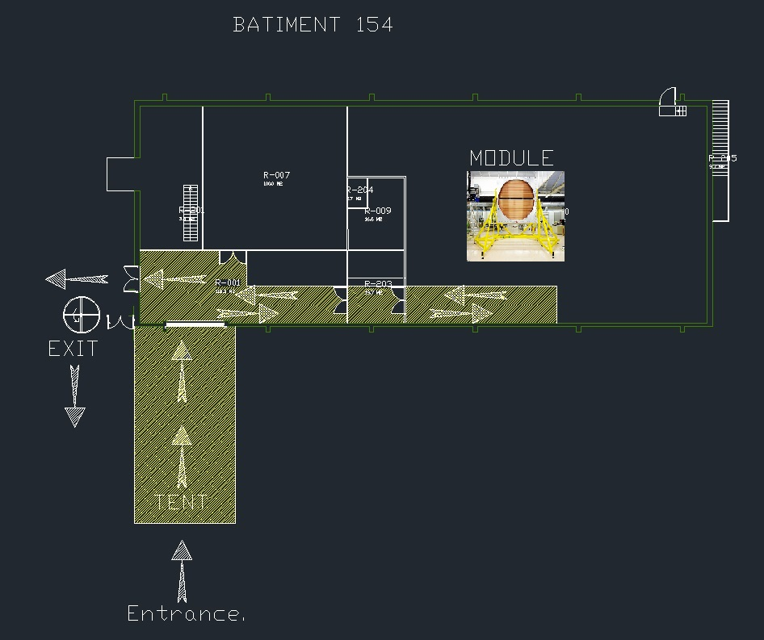
Building 154

Slide 20
Participation:
Main theme: Detector design and construction stages;
and their applications.
To be as interactive as possible.
Expect public, from children to detector experts.
Call to section leaders, for participation with their teams.
http://opendays2013.web.cern.ch/

Slide 21
BACKUP

Slide 22
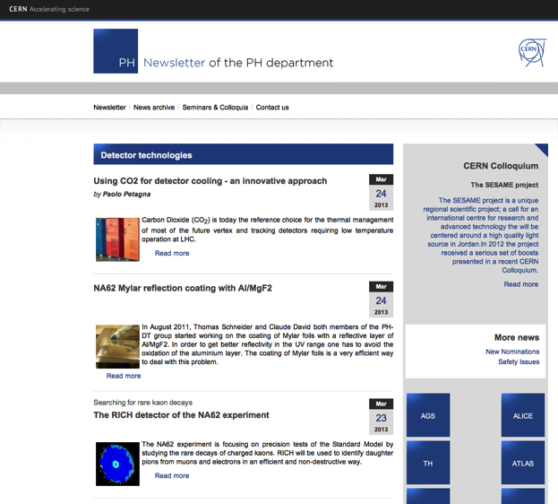
News
Cash position or Organisation still acceptable. Most countries paid (or will soon have paid) ≥ 50% of 2013 Contribution
Candidates for Accession: Rumania, Associate Members: Israel and Serbia
Good performance of Pension Fund in 2012 (6.8%, well above 3%+inflation target)
LD2IC
  Last year statistics, 61 proposed, 58 granted, 57 went to job holder
  This year: Boards mid October – End November, Exercise finished by Xmas
New PH E-newsletter: http://ph-news.web.cern.ch

Slide 23
Resources Breakdown
Projects
2013
1 FTE Designer detached to ATLAS, no DT supervision
4.2 FTE Techs + 1 FTE Engineer detached to ALICE, no DT supervision
Staff directly allocated (above 5% level) to projects in experiments: 35 FTE
LHC VS non-LHC experiments: 24 / 11 and LHC operation VS LHC upgrades: 18 / 6

Slide 24
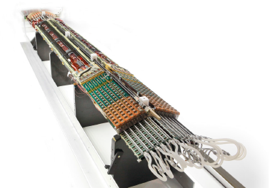
Projects
ATLAS
ECP: M.Capeans
2012 | FTE | 2013 | FTE
Operations ID cooling coordination and expert support Generic mechanical support ATLAS-ALFA | 2.7 | Installation and commissioning of control SW/HW for cooling plants (thermo-siphon and CO₂) Generic mechanical support ATLAS-ALFA Pixel extraction/installation (nSQP related) IBL assembly/commissioning Support to TRT leak finding Technical support to Micro-megas project HL-LHC TK upgrade engineering | 7.2
Upgrade LS1 Pixel nSQP and IBL CO₂ cooling and ID thermo-siphon Upgrade LS2, LS3 Technical support for Micro-megas HL-LHC TK upgrade engineering | 3.9
Example: Pixel nSQP project in 2012
0.5 FTE Project management
0.4 FTE Electrical QA
2 FTE Mechanical support (tools, infrastructure…)
< Picture: nSQP panel fully completed ready for installation

Slide 25
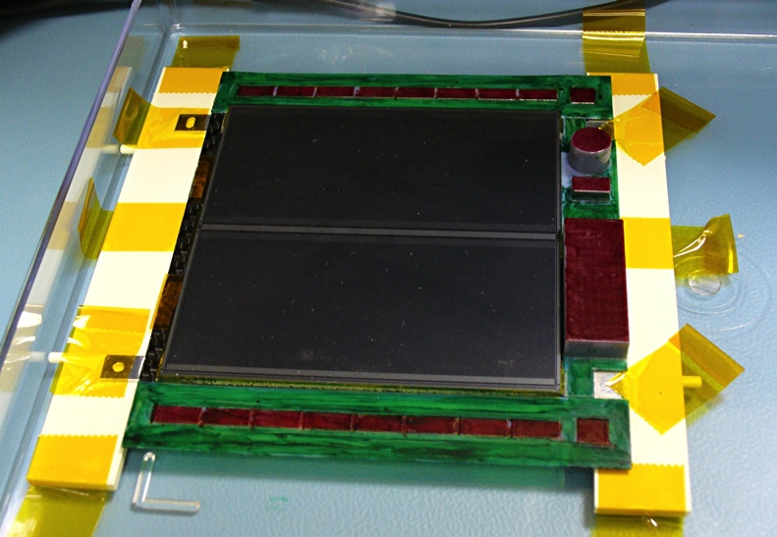
Projects
CMS
ECP: P.Petagna
2012 | FTE | 2013 | FTE
Operations Cooling coordination and expert support Ecal cooling controls Preshower detector support | 0.9 | TK Humidity lowering and cold oper. SW Upgrade Ecal cooling PLT installation CO₂ cooling plants installation & commissioning HL-LHC TK upgrade | 3.2
Upgrade LS1 Pixel Lumi. Telescope (PLT) prod. CO₂ cooling plants Upgrade LS3 HL-LHC TK upgrade Module design + mechanics Integration, support structures | 1.9
Example: CMS Tracker Upgrade ~ 1.2 FTE
Tracker upgrade module design and front-end hybrid R&D, and integration studies
< Picture (A.Honma): CMS tracker upgrade module mock-up made with 3D printed dummy hybrid

Slide 26
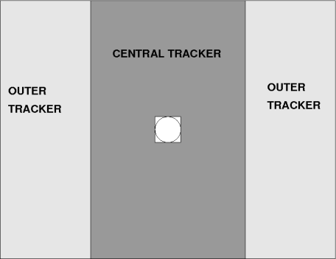
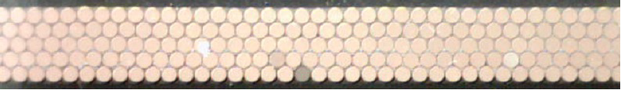
Projects
LHCb
ECP: B.Schmidt
2012 | FTE | 2013 | FTE
Operations Shifts, run-chief Engineering support (design) VELO support, test beams RICH: operation and HPD repairs | 3.3 | Shielding behind muon system Detector movements (Calo, Muon) Mechanical support VELO (new cooling concepts) RICH upgrade studies, incl. TORCH Assessment of Sci-Fibers for tracking | 5.1
Upgrade LS2 Assessment of Sci-Fibers for tracking | 0.7
Example: SciFi for Tracker Upgrade option for LS2
~ 0.6 FTE
Large area scintillating fibre tracker
(500k channels, 30 kGy radhard)
< Picture Baseline technology: 0.25 mm Ø multi-cladded sci. fibres read out by SiPM arrays (0.25 × 1.3 mm2)
2 x 2.5 m

Slide 27
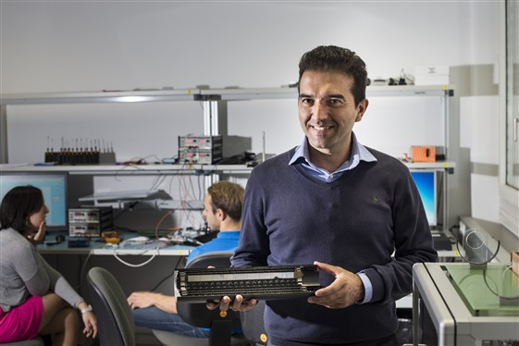
Projects
ALICE
ECP: P.Martinengo
Most of the PH-DT team for ALICE is detached and supervised by ALICE TC & PE
2012 | FTE | 2013 | FTE
Operations General mechanical support: structures, movements, assembly areas, system support (TPC, HMPID, …) Engineering (Project engineer & design support) Upgrade LS2 PE for the upgrade of the Inner Tracking System (ITS) | 7.6 | Intense technical work in all fronts | 7.8
Example: ITS
ITS will consist of 7 layers of silicon sensors supported by an ultra-light carbon fibre structure
Picture (CERN) Prototype of half ITS, with the 3 innermost Si-sensor layers

Slide 28
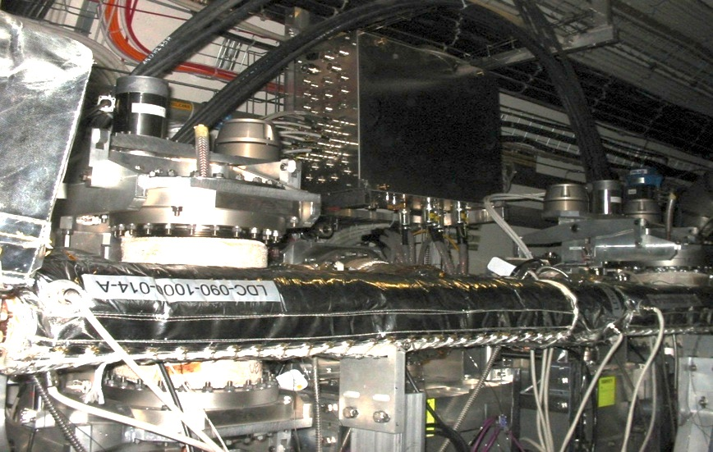
Projects
TOTEM
ECP: C.Joram
2012 | FTE | 2013 | FTE
Operations: Roman Pots (Si-detectors) Mechanical support Controls RP movement system Controls and support for RP secondary vacuum system T2 stations (GEM detectors) Mechanical support | 1 | Intense technical work and update of control systems software (need a new WP, currently under preparation, and to update committed FTE) Secondary Vacuum System Upgrade 147 m station dismounting operation Detector package protection cover for 220m RP 220m stations bake put operation RP anti-collision range adjustment Integration stepper motor resolver FESA class and DIM communication SW upgrade Final calibration and commissioning 220 m RP extension from removed 147m | 1
Example: Dismantling of RP station at 147m
This task is complex and involves several aspects: mechanics, vacuum, control, detectors, services … & radio-protection issues
< Picture (X.Pons): Roma Pot at 147m

Slide 29
Resources Breakdown
Services
2013
Staff directly allocated (above 5% level) to SERVICES for experiments: 25 FTE
~75% of the allocated resources provide direct services to LHC projects (~19 FTE)

