Slide 1
Electronic Systems for Experiments
Visit of CSEM
23 May 2013
Philippe.Farthouat@cern.ch

Slide 2
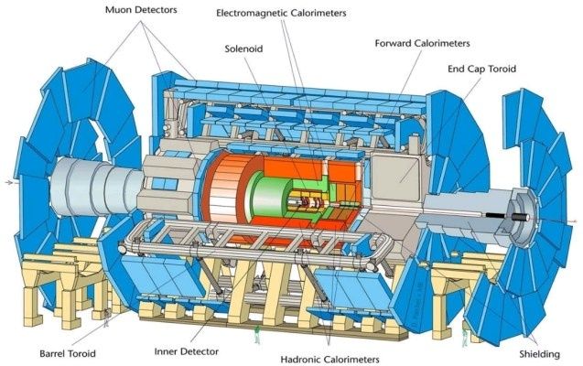
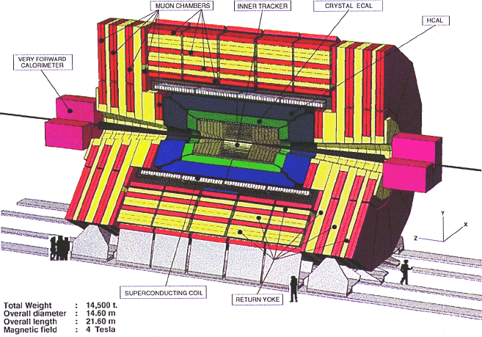
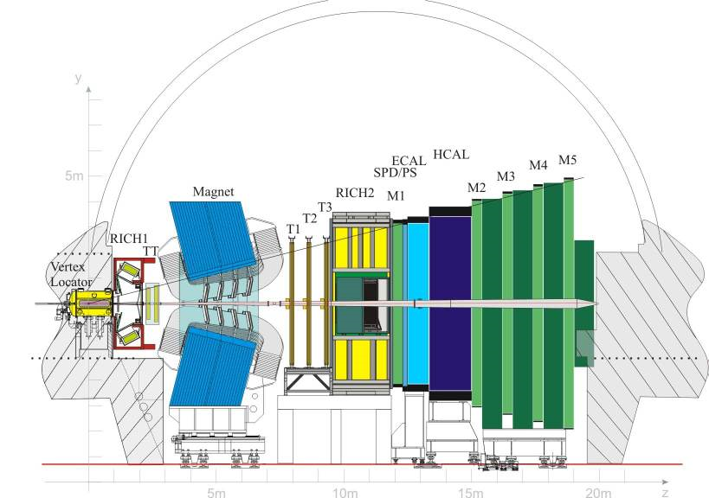
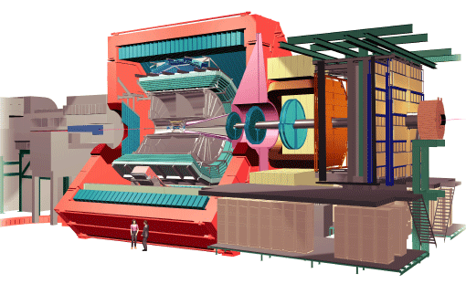
The LHC Experiments

Slide 3
The ESE Group: mandate
Development/qualification of specific technologies required for experiments
  Radiation hard IC Technologies: 250nm, 130nm, 65nm CMOS
  Common building blocks: Optical links, Power conversion, Control/monitoring
  Readout electronics of detectors: from sensors to data storage
  Infrastructure: Crates, Racks, Power supplies
Contribute to specific experiment systems
  E.g. CMS tracker upgrade, ATLAS Central Trigger, ALICE Inner Tracker, LHCb Velo, NA62 Gigatracker, ...
Make general instrumentation available to CERN users and experiments
  Electronics pool
  Procurement and maintenance contracts for crates and power supplies
Electronics coordination
  “Management” in experiments
CERN contributes ~20% to the electronics of the experiments. However more orders can go through CERN

Slide 4
The ESE Group: composition
55 CERN staffs
  36 engineers or applied physicists
15 Post Docs
7 Doctoral Students
3 Technical Students (undergraduate)

Slide 5
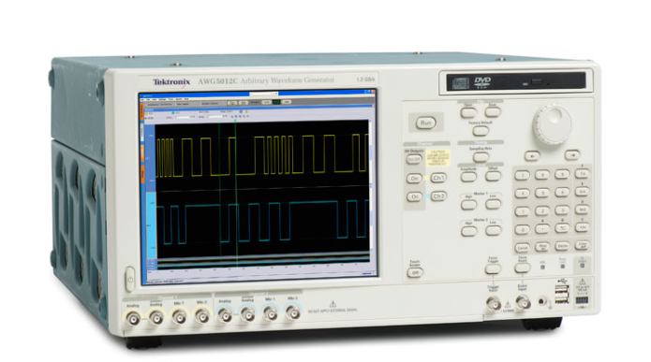
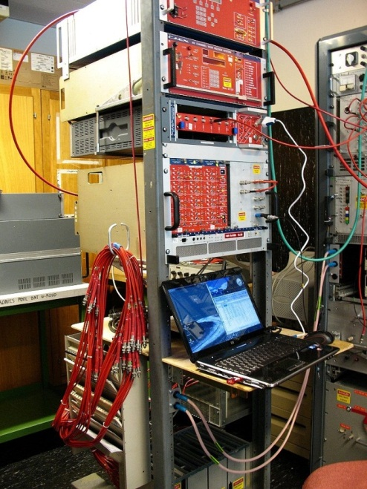
CERN Electronics Pool
Rental of instrumentation, modular electronics, LV and HV power supplies, crates
  Technical Support
    Systematic verification
    Test benches for each equipment type
  Database (18000 items)
  Logistics (4400 movements in 2011)
  Procurement
    6 Frame contracts
CAEN HV test bench

Slide 6
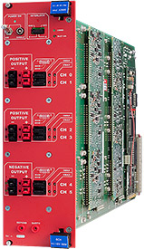
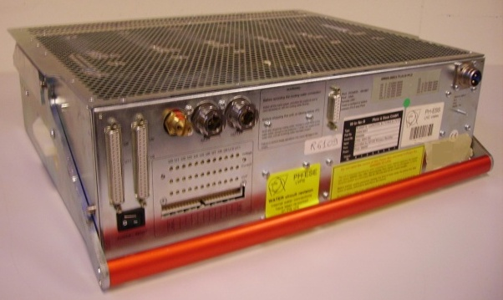
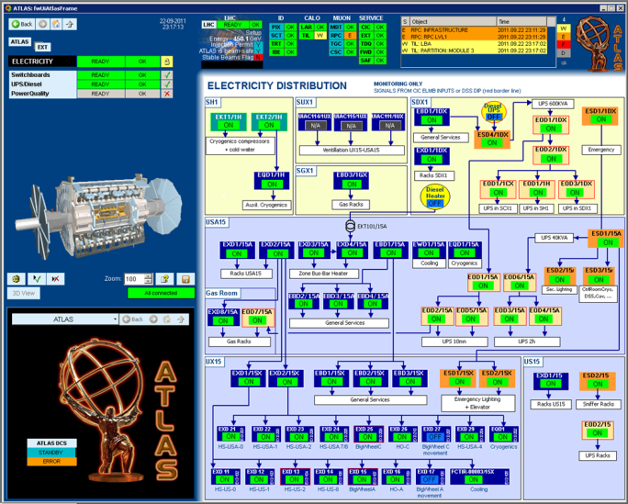
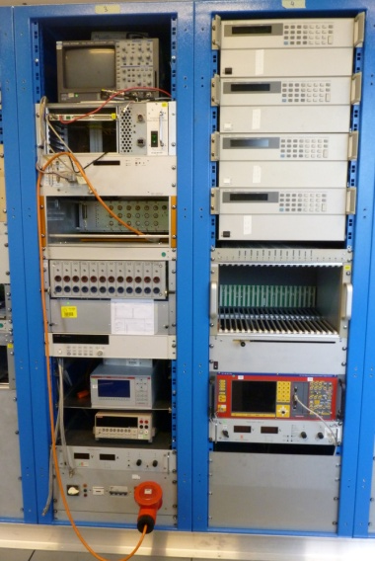
Power and Crates (1)
CAEN & Wiener equipment under contract
LHC Power supplies and crates, procurement and maintenance
  Frame Contracts (7)
  Database (13k items)
  Logistics (20-30 repairs/month)
  Technical Support
    Verification
    Preventive maintenance
    Test benches
Power distribution
to Experiments
LVPS Test system

Slide 7
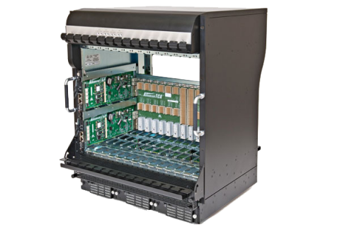
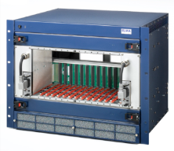
Power and Crates (2)
xTCA evaluation project
  Crates and power supplies
    Test system
    MMC controller
    Load boards
Future bulk power supplies developments
  More radiation tolerance

Slide 8
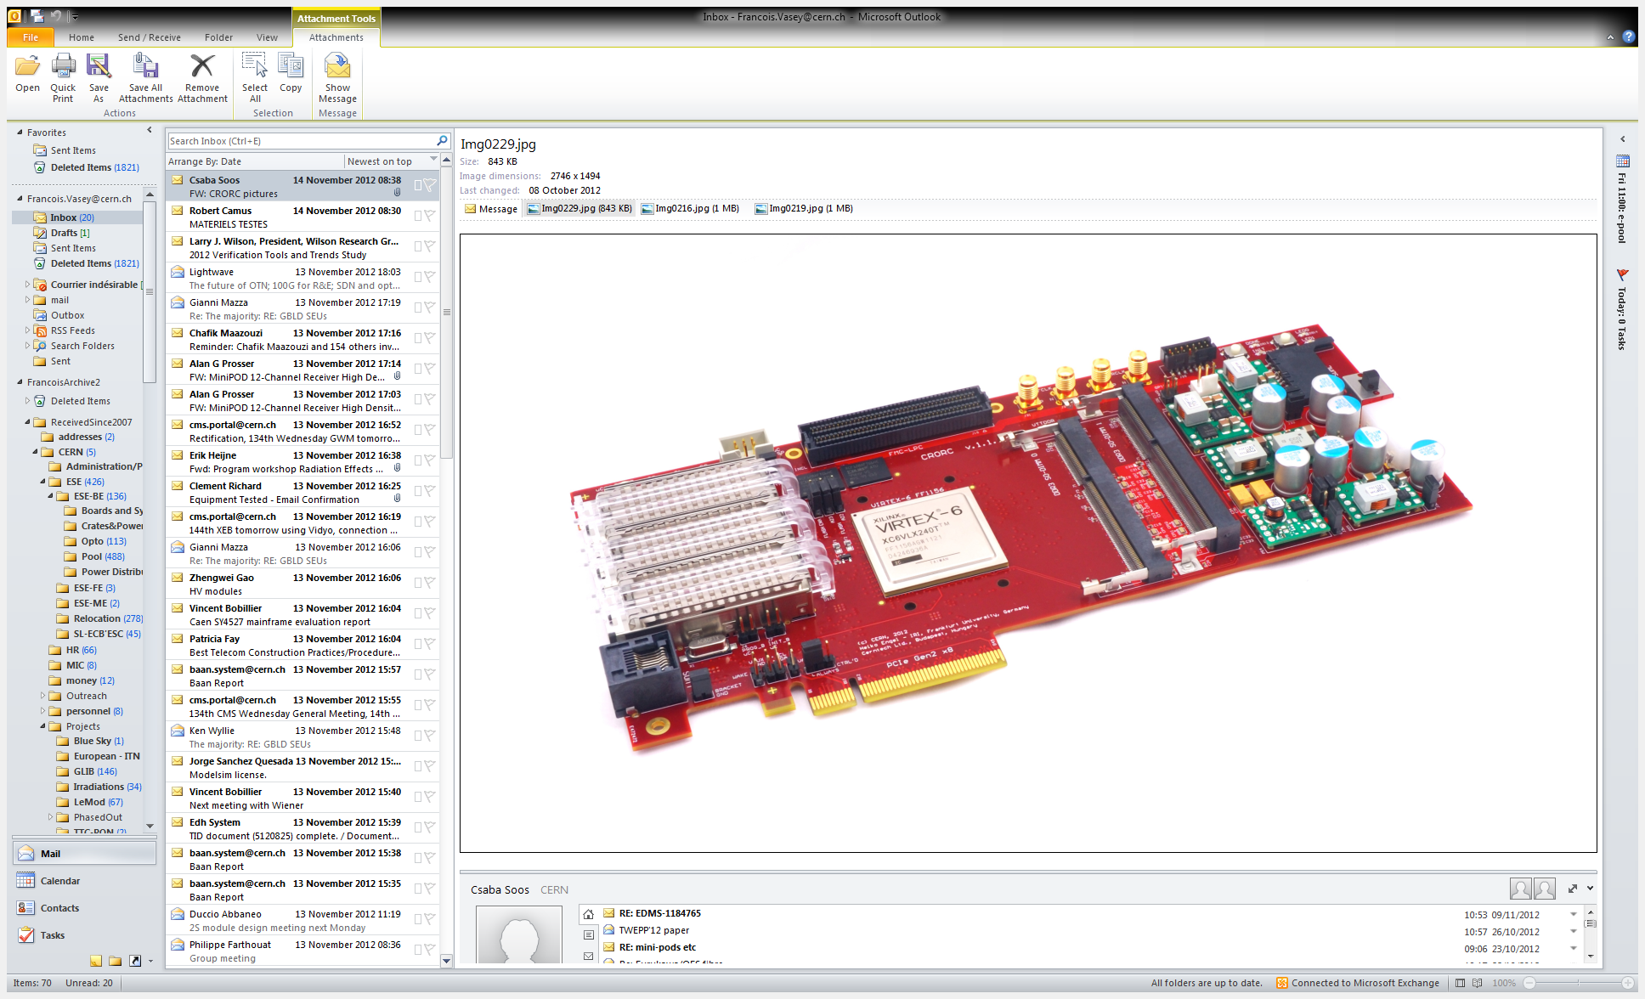
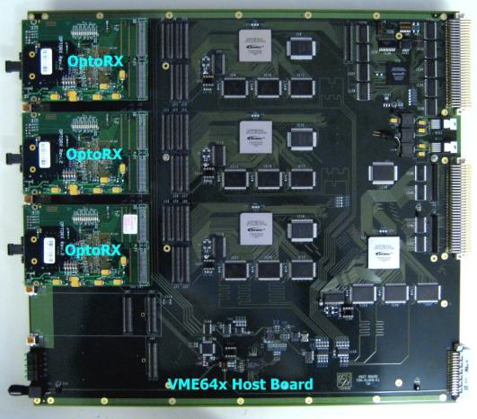
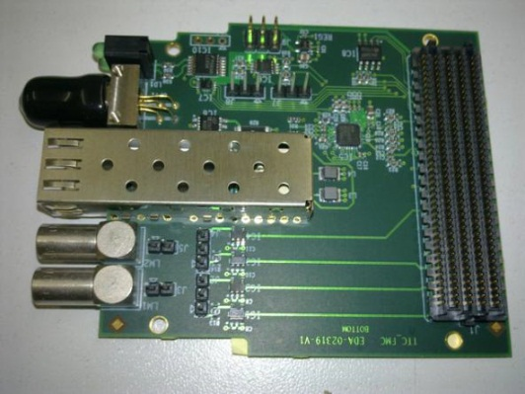
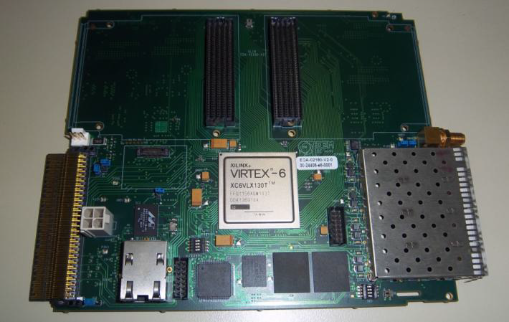
System Designs (back-end)
ALICE C-RORC
Heavily involved in readout system
  VME or xTCA or PCIxx based designs
  Large use of FPGAs
  Commercial digital optical links
CMS-Preshower DCC
TTC FMC
GLIB

Slide 9
System Designs (front-end)
Front-end systems for several detectors and experiments
  NA62: Gigatracker, Straws, LKr Calorimeter
  ATLAS luminosity detector (ALFA)
  ALICE TPC and Pixel
  ...
Front-end development for LHC upgrades
  CMS tracker readout hybrid
  LHCb Velo upgrade
  ...
Developments for future experiments
  E.g. power pulsing for a linear collider experiment

Slide 10
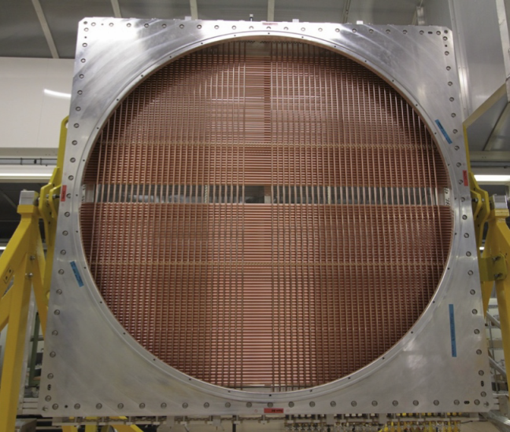
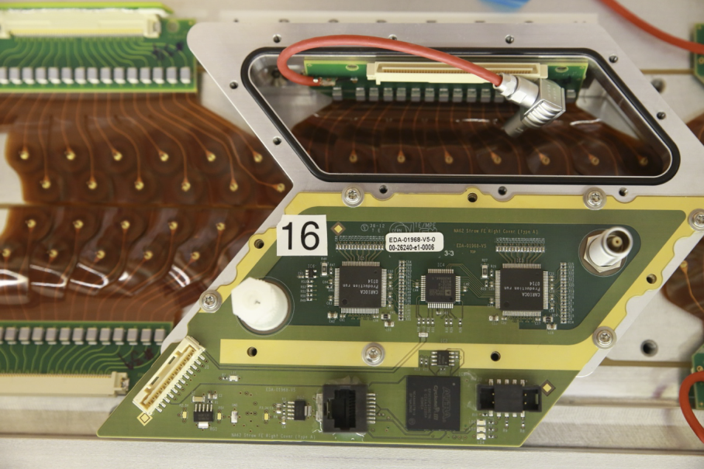
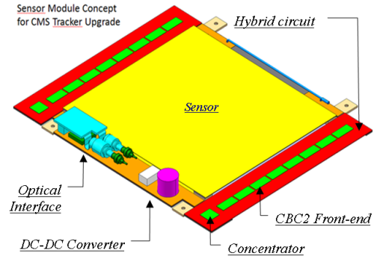
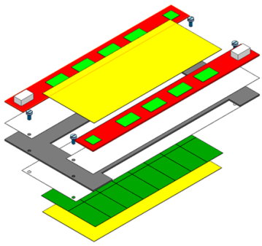
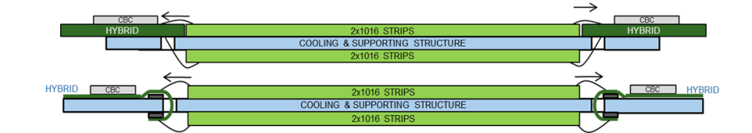
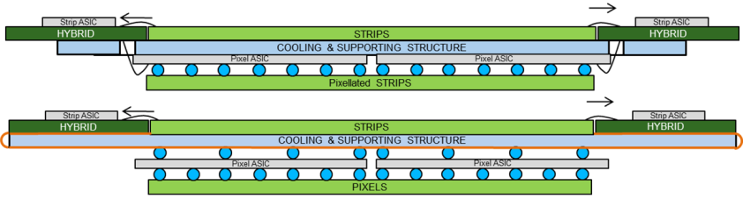
Two examples of front-end systems
NA62 straw detector
CMS tracker upgrade readout hybrids

Slide 11
Microelectronics: Technologies
CMOS 6SF
Legacy designs
CMOS 8RF-LM
Low cost technology for
Large Digital designs
CMOS 8RF-DM
Low cost technology for
Analog & RF designs
BiCMOS 8WL
Cost effective technology for Low Power RF designs
BiCMOS 8HP
High Performance technology for demanding
RF designs
250nm CMOS
130nm CMOS
Legacy technology IBM CMOS6SF (250nm)
  Re-fabrication of old designs
  Small number of new designs
Mainstream technology IBM CMOS8RF-DM (130nm)
  Technical support: CERN compiled Mixed-Signal design kit
  Frequent MPW and Engineering runs
Advance technology IBM CMOS9LP/RF (90nm)
  Limited support: Project specific
Future technology (65nm)
  For LHC upgrade applications
CMOS 9SF LP/RF
High performance technology for dense designs
CMOS 65nm
High performance technology for dense Low Power designs.
90nm CMOS
65nm CMOS

Slide 12
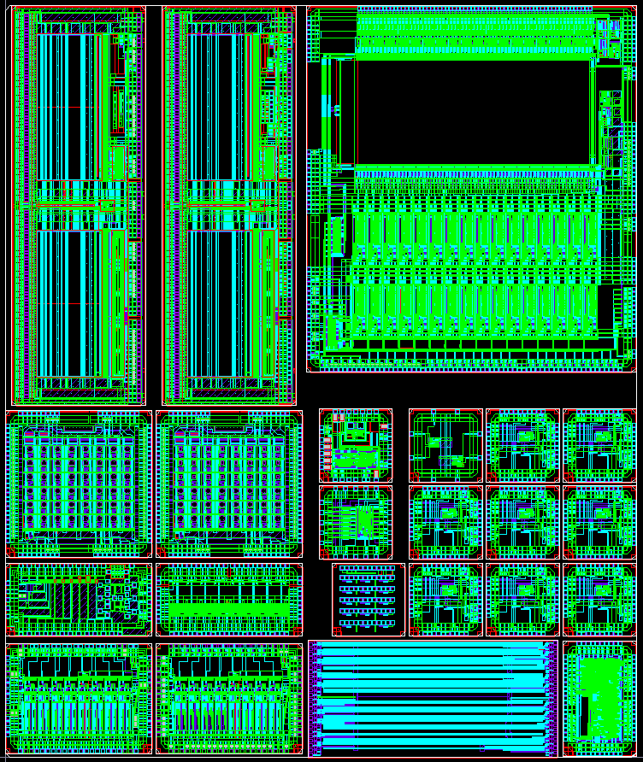
130 nm MPW Activity
CERN participates on all MOSIS MPW runs (4 runs/year) and organizes ad-hoc MPWs with the foundry for high volume and/or area demanding prototyping.
CMOS8RF-DM (3-2-3) is the dominant metal stack option.
Prototyping and Engineering run costs are kept the same for the last 2 years.
Evolution of the Prototyping activity on CMOS8RF for the last 5 years

Slide 13
Future Working Model for 65 nm
TSMC
Transfer of most support activities to IMEC
  PDK co-development
  PDK distribution and maintenance
  User support MPW organization
  Training
IMEC
Cadence VCAD
design services
CERN
Physics institutes

Slide 14
Microelectronics: common projects
Evaluation of new technologies
Radiation-hard and magnetic tolerant (up to 4 T) POL DC-DC converters
GigaBit Transceiver (GBT) and the Versatile Link

Slide 15
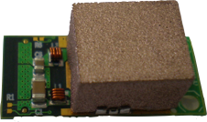
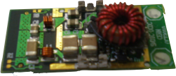
DC-DC Converter
28.5mm
13.5mm
Converter ASIC under the inductor
Covering shield
Plastic shields with Cu plating and clips: OK for Phase1 applications. Better options are explored for the future
“optimized” PCB
Custom inductor
To be optimized on final application (customization depends on assembly technology, inductor, overall needs in mass and size
Radiation hard ASIC developed
Output voltage 1.2, 1.8, 2.5, 3.3V or selectable
Output current: up to 3A
Input Voltage: nominal 5-10V
Air-core inductor

Slide 16
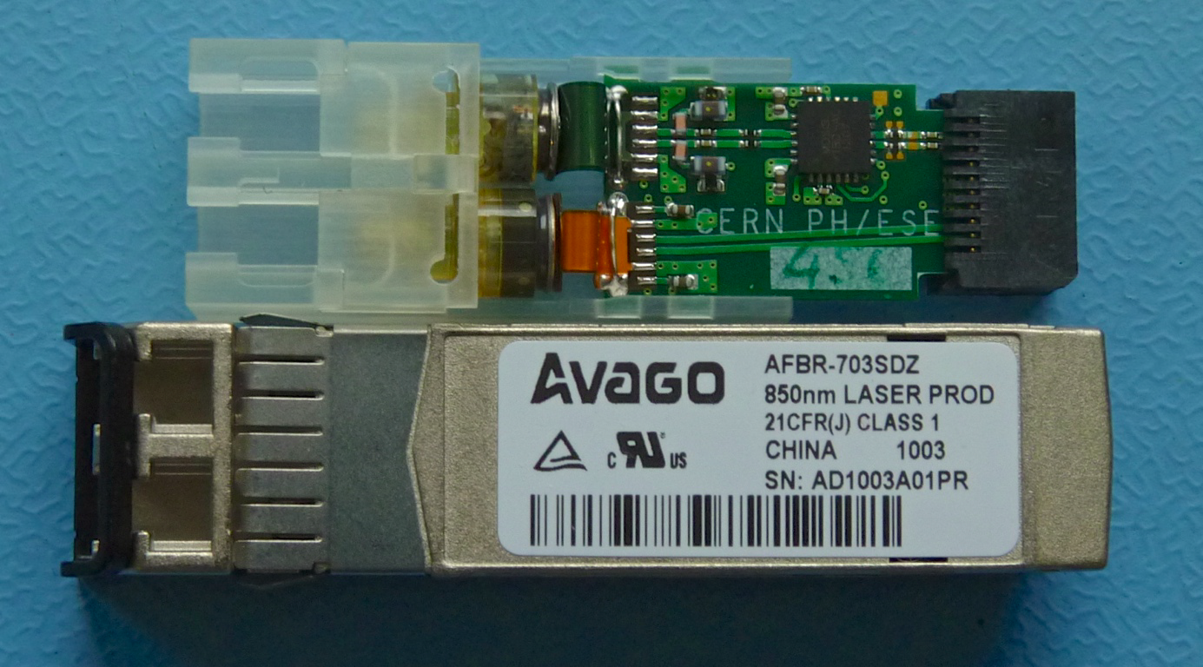
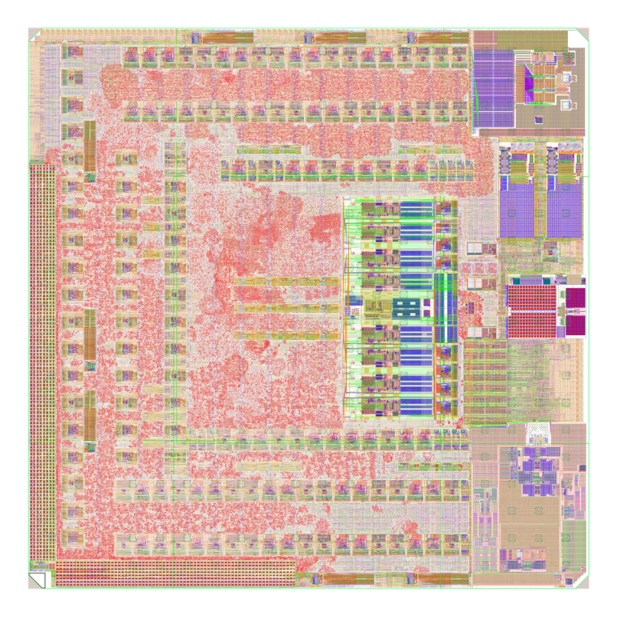
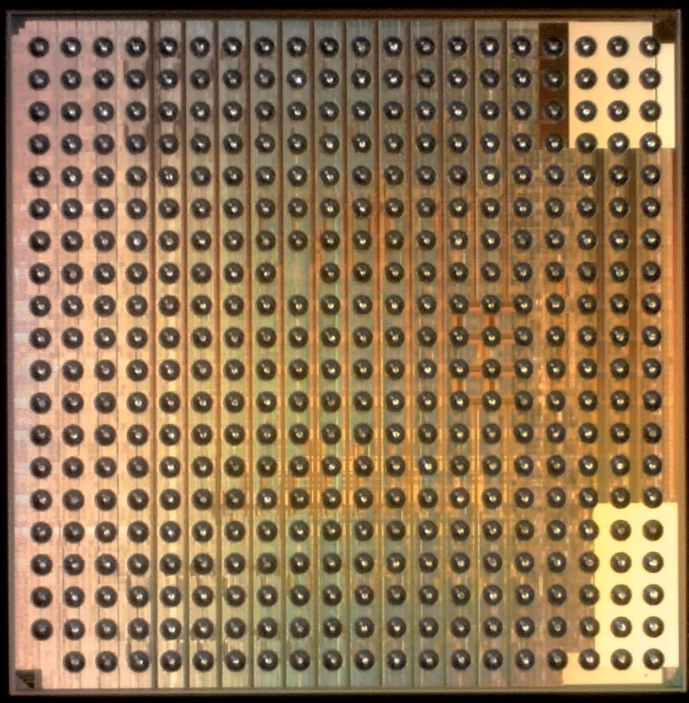
GBT and Versatile Link
4.8 Gbps bidirectional link
GBT
GBT
Versatile Link
FPGA
Timing & Trigger
GBTX
PD
Timing & Trigger
GBTIA
DAQ
DAQ
GBLD
LD
Slow Control
Slow Control
Custom ASICs
On-Detector
Radiation Hard Electronics
Off-Detector
Commercial Off-The-Shelf (COTS)

Slide 17
Microelectronics: specific designs
Several chips for Medipix applications (medical imaging)
Readout chip for the ATLAS upgrade silicon strip (ABC130)
NA62 GigaTracker TDCPIX
ALICE monolithic pixel
And several others

Slide 18
Medipix Chips development
 | Timepix3 | Smallpix | CLICpix prototype
Technology | 130nm | 130nm | 65nm
Pixel size | 55x55μm² | ~40x40μm² | 25x25μm²
Analog/digital | 730/2300μm² |  | 350/275μm²
Chip area | 210mm² | ~400mm² | 5.4mm² (pixel array 2.56mm²)
#pixels/chip | 256x256 (65k) | ~250k | 64x64 (4k)
Functionality | TOT 10bit, ToA 14+4bit or ITOT 14bit, PC 10bit | ToA+TOT or PC+ITOT | ToA 4bit, TOT 4bit or PC 4bit (only for calibration)
Clock frequency | 40MHz |  | 100MHz
Readout clock | 160MHz |  | 320MHz
Readout mode | Data Driven or Sequential | Sequential | Sequential
Power pulsing | YES | YES | YES
Data Compression | Per pixel (sparse readout) | Per pixel, per column | Per pixel, per cluster, per column

Slide 19
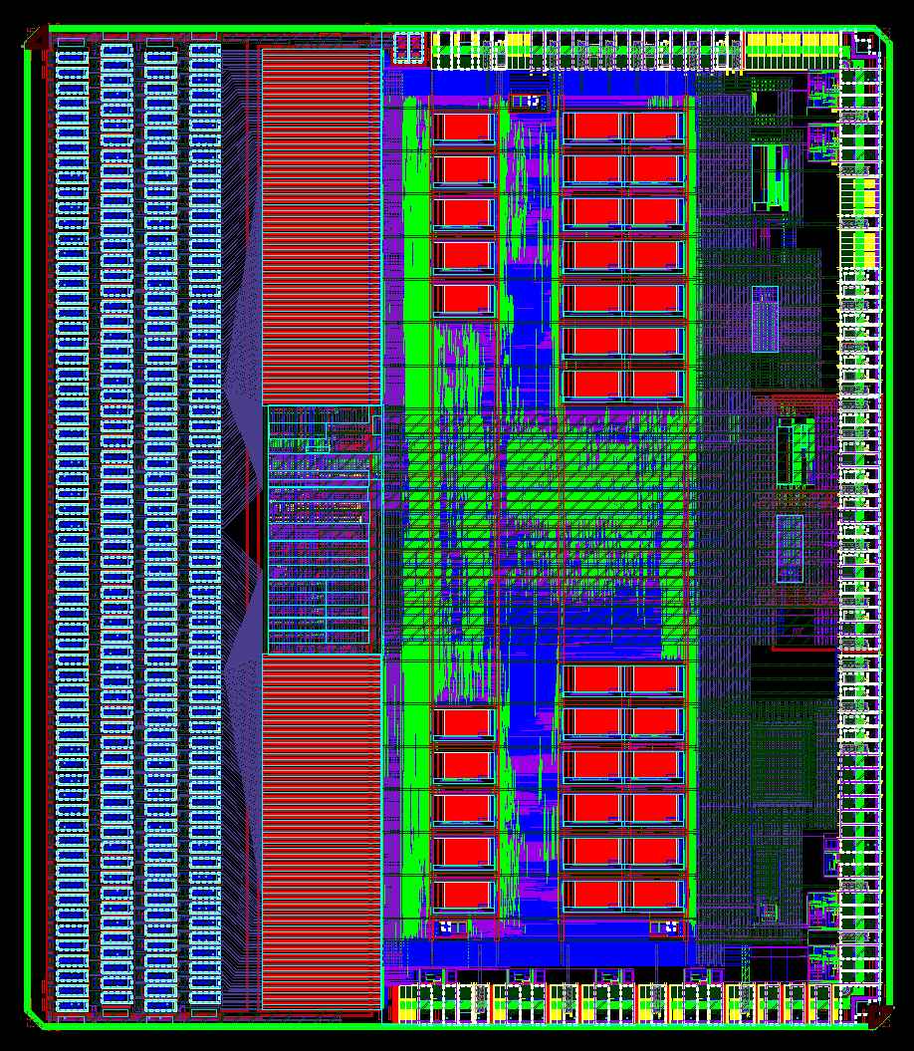
ATLAS ABC130
CMOS 130 nm
256 channels
Preamplifier, shaper, discriminator
Complex buffering schemes
Readout at 160 Mbps

Slide 20
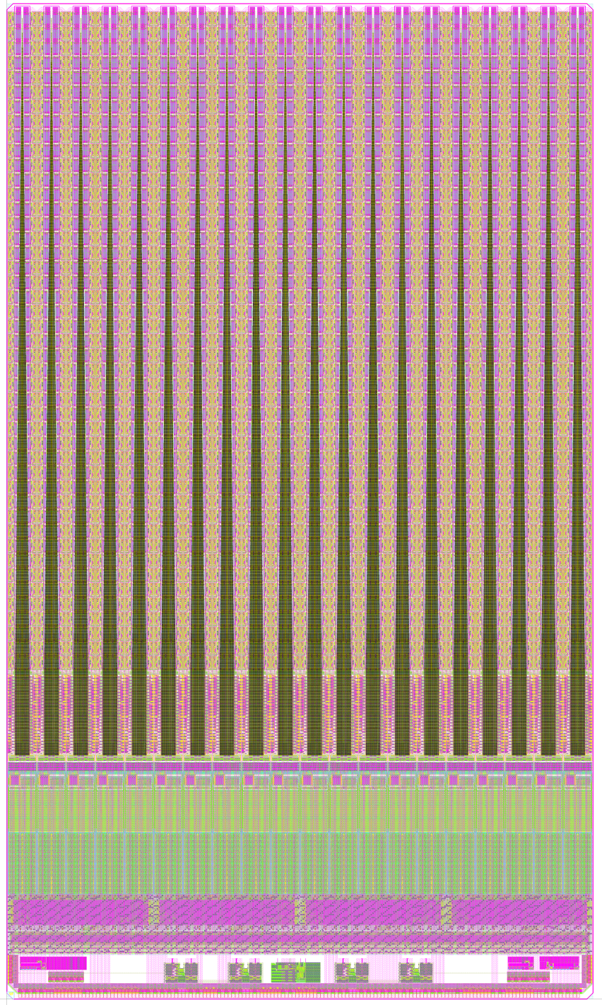
NA62 GTK TDCPIX
Pixel matrix
CMOS 130nm
Pixel matrix (300x300um); 1800 pixel cells
Hit time measurement
  ~100 ps resolution
“South bank”

Slide 21
ALICE Monolithic Pixels
Nwell
Collection
Electrode
Pwell
Nwell
Pwell
Nwell
Deep Pwell
18 micron
P-epitaxial layer
P-substrate
Technology offers high resistivity epitaxial layer of up to 18 micron thick and a deep Pwell, allowing integration of PMOS and NMOS in the pixel
Can be used to implement a monolithic detector integrating a detector matrix and its readout in one piece of silicon

Slide 22
Other Developments
Readout chips for GEM detectors
Amplifier for diamond beam condition monitor detector
Pixel prototype for a linear collider pixel detector (65 nm)

Slide 23
THANK YOU FOR YOUR ATTENTION

