Slide 1

Low Power Wireless Systems
CSEM/CERN workshop
23rd May 2013

Slide 2
Agenda
  Wireless at CSEM
  RFIC & SOC
  RF protocols (standard and proprietary)
  Antennas and systems
  Wireless sensor networks
Notes:
(previously discussed with CERN: Francois Vasey)

Slide 3
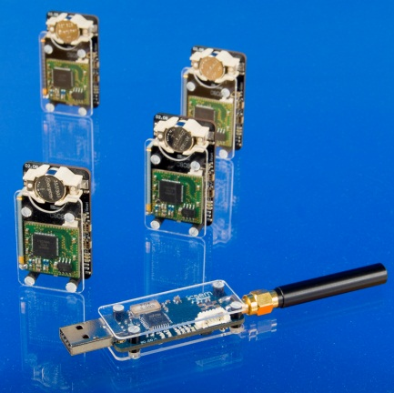

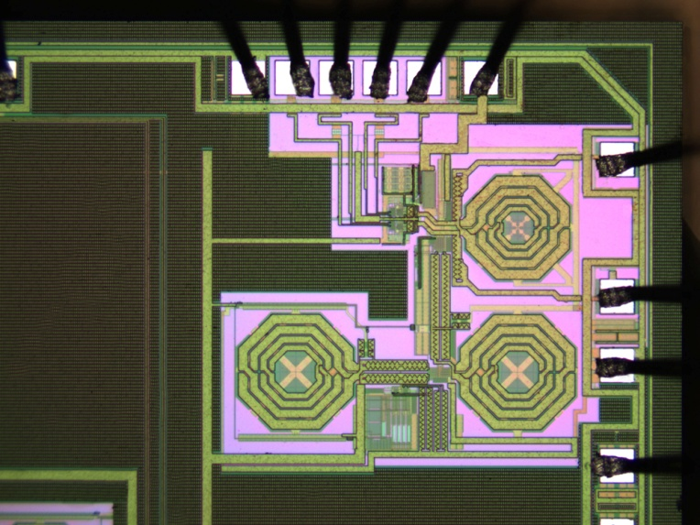
Wireless technologies for sensing and monitoring
Wireless system
RF architectures, modules
Propagation, antennas
Wireless protocols
Proprietary
Standards
WiseMAC, Zigbee, etc
Ultra-low-power
0.18um .. 65nm CMOS
MEMS-radios
RF integrated circuits

Slide 4
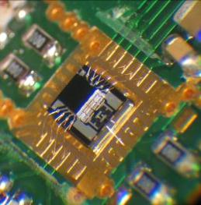





Ultra low power RFIC design
Main keywords
CMOS and UDSM CMOS: 0.18um, 90nm, 65nm
SoC for high degree of integration
Low-voltage down to 1V
Low active power down to mW-levels
Low standby power down to uW
Radio
Narrow-band from 100MHz to 2.4GHz and UWB 6GHz-8GHz
Short-range connectivity radios
Innovative RF circuits, NB & UWB

Slide 5
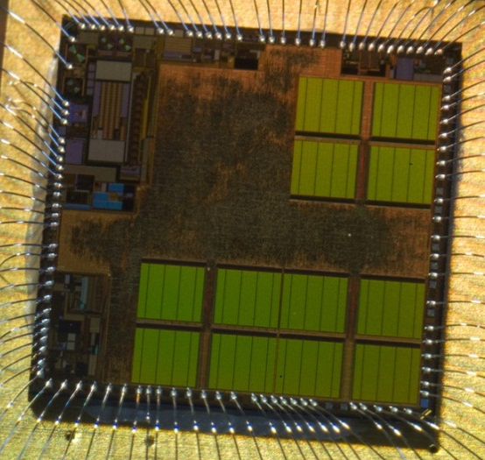
Value of the System-on-Chip (SoC) approach
Power management
Regulators, DC-DC
microprocessor
8b/16b controllers
16b/32b DSP
Radio
ULP, 1V
400MHz .. 2.4GHz
Digital
SRAM, ROM
Registers, timers, etc
Sensor
interface
ADC, filters, amplifiers
Timing
Xtal oscillators, RTC, etc

Slide 6

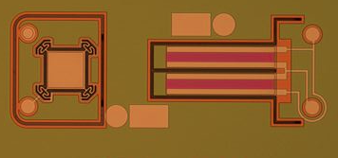
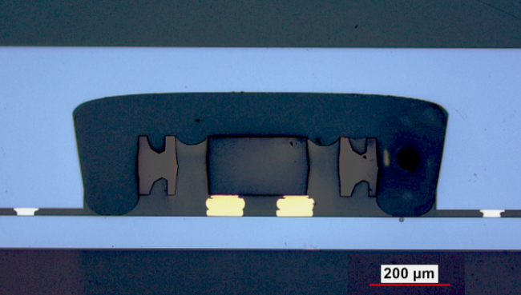
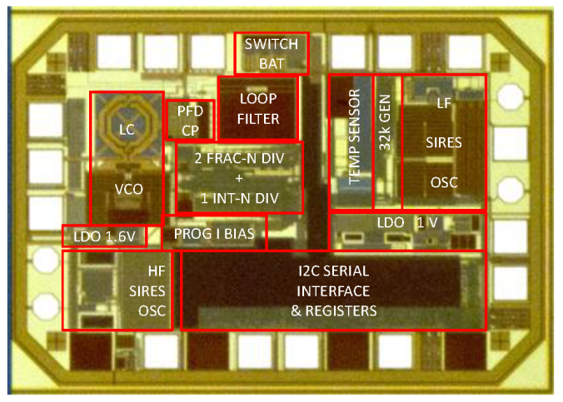
EU Go4Time
Next generation platforms
Timing IC & MEMS microsystem
Ultra-miniature and low-cost
Dual SiRes vs quartz+BAW
+/-2 ppm temperature compensation
Programmable output clock

Slide 7
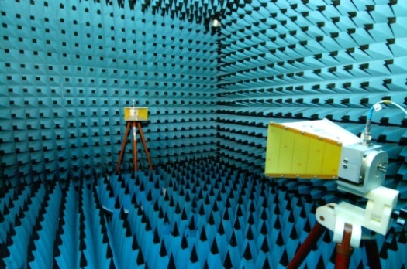
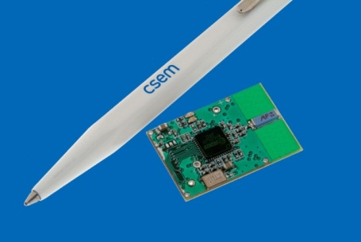

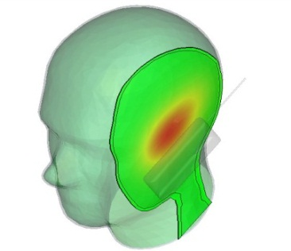
Wireless Embedded Systems
Wireless Embedded Systems
RF (Hz to Terahertz) and propagation
  Antenna design
  Wireless energy transmission & scavenging (incl. RFID)
  RF system design, simulation, modelling and characterization
  RF-based sensing (radar, respiration, …)
SW and Protocols
  Real-time systems (OS and embedded)
  Communications under constraints
    Wired: Fieldbus, RT & industrial Ethernet, High Avail. (HA)
    Wireless: Wireless sensor networks, Body Area Net, HA
Localization

Slide 8
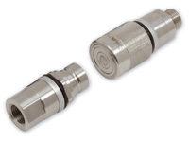
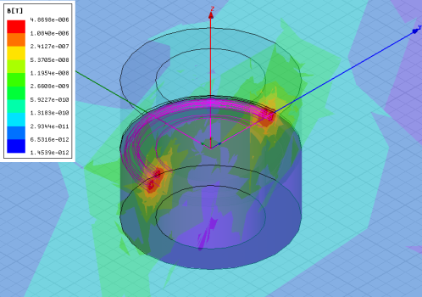
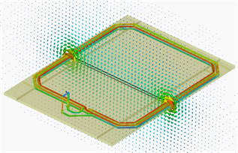
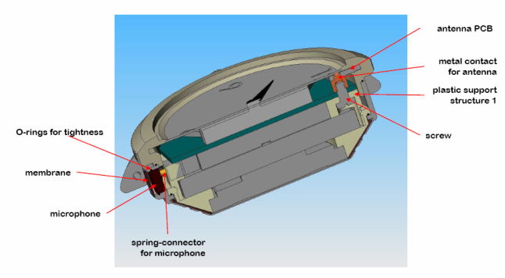
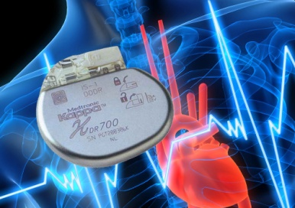
RF and Propagation
Wireless Embedded Systems
RFID applications
  Highly metallic environments systems (125 kHz)
  Label design (UHF GEN2)
High Integration of common/standard radio applications
  Access control (NFC /Bluetooth)
  Watch integration (GSM)
  Sport & Medical devices (GPS /ISM)
  Transportation (ISM)
Tele/Remote-powering
  Medical Implants (MICS)
  Medical dispensers (ISM)

Slide 9
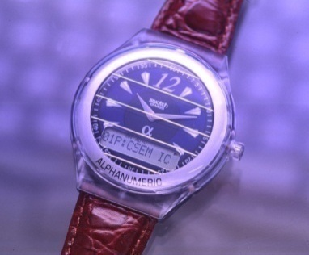


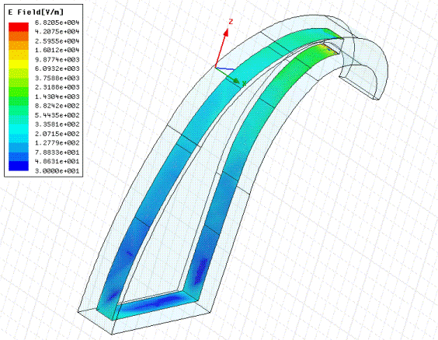

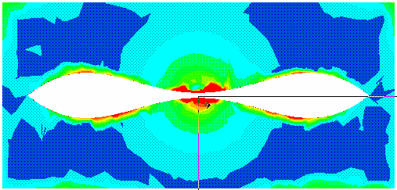
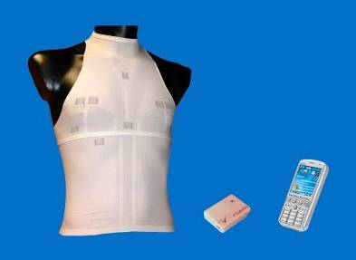
Miniature antenna design
Specific designs for human body environments
  Swiss Watch industries
  Hearing Aid Technology
  Medical Implant Technology
  e-textile (European Programs)
HFSS simulations

Slide 10
Wireless sensor networks (WSN)
What we understand by a wireless sensor network:
    Very low power consumption
    Short-range
    Large coverage with multihop
    Self-organized (no configuration)
    Self-healing
The resulting driving forces for our WSN developments
    ultra low-power operation through HW and SW co-design
    simplicity for network deployment and maintenance
In the field for a few years now
  wireless data harvesting

Slide 11



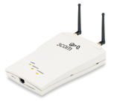
WiseNET® : Low-Power Wireless Sensor Network
Wireless Embedded Systems
WiseNET® is a wireless network of distributed sensors that combine sensing, signal processing, control and short-range wireless communication capabilities in a compact low-power system.
gateway
gateway
GSM access
PDA access
Internet access

Slide 12

WiseMAC: ad hoc networking for WSN
No planning, no configuration
Ultra low power ( downto 500μW average with COTS) for all nodes including relays (routers/coordinators)
  With low latency (100 ms / hop)
  At least 10x less with CSEM ICs
High reactivity (down to 50ms)
Low delay (downto 25ms per hop)
 | XE1203 | IcyCom SoC
WiseMAC | 10x | reference
S-MAC | 70x | 5x
ZigBee -MAC | 250x | 36x
- forwarding 32 bytes every
30 seconds
- wake-up period of 250 ms
“the WiseMAC protocol showed a remarkable consistent behavior across a wide range of operational conditions, always achieving the best, or second-best performance.”
Langendoen & Meier. ACM Trans. Sensor Networks 7(1), 2010.

Slide 13
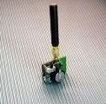
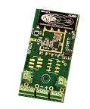

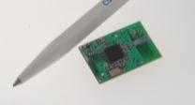
Wireless platforms and stacks
Wireless Embedded Systems
External application / sensor
External application
Serial line
Serial line
Embedded application + sensor
Embedded application + sensor
HCI
HCI
Sensor node
Epidemic routing
Cluster-tree routing
Full 802.15.4
WiseMAC (LPL proprietary MAC protocol)
icycom SOC
XE 1203 / Coolrisc
CC1100 / MSP 430
CC2420 / MSP 430
Ultra low power
Very low power
Low power

Slide 14


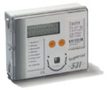
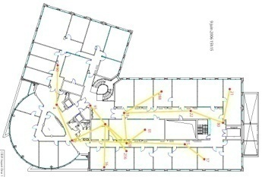
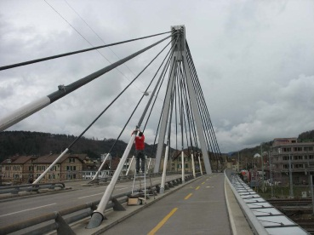
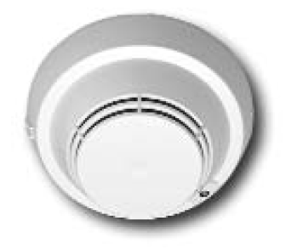




WSN applications and deployments
Industrial control and automation
  Energy positive buildings (eg distr. sensing)
  Transportation
  Object tracking
Security and public safety
  Structural health monitoring
  Surveillance (eg fire)
Agricultural monitoring
  Sensor-based growth optimization
  Animal telemetry
Environmental monitoring
  Air & water quality monitoring
  Hazard detection (fire, slides…

Slide 15
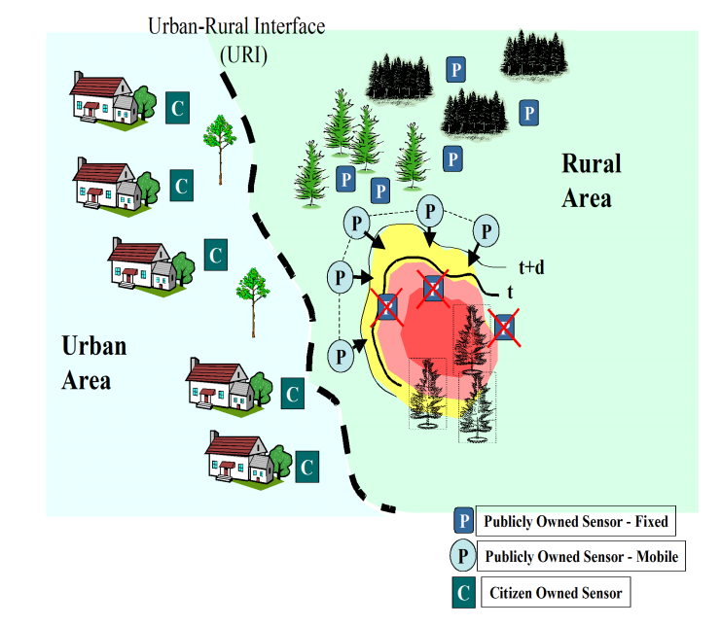


Fire and Flood detection at Wild Urban Interface
Detection & prediction of fire, flood &
their evolution
network of temperature, rain, wind,
humidity sensors
Multiple sinks in urban
premisses
Notes:
14
Large WSNs as part of a larger IT infrastructure for natural hazards early warning systems

Slide 16
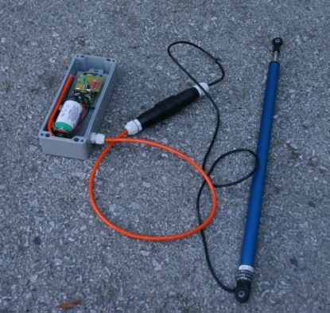
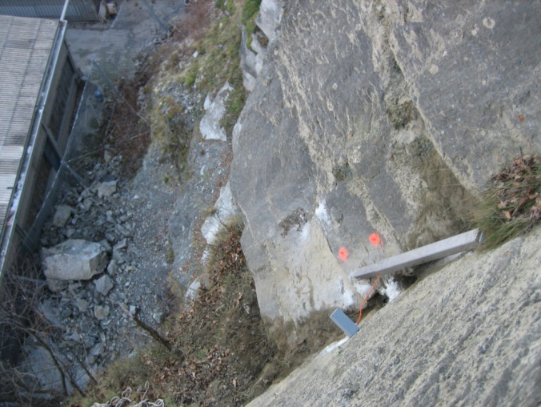
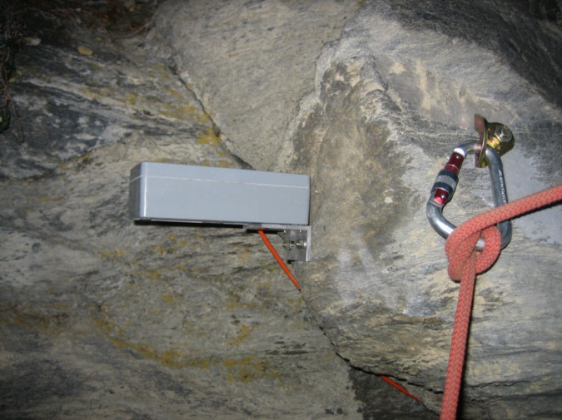
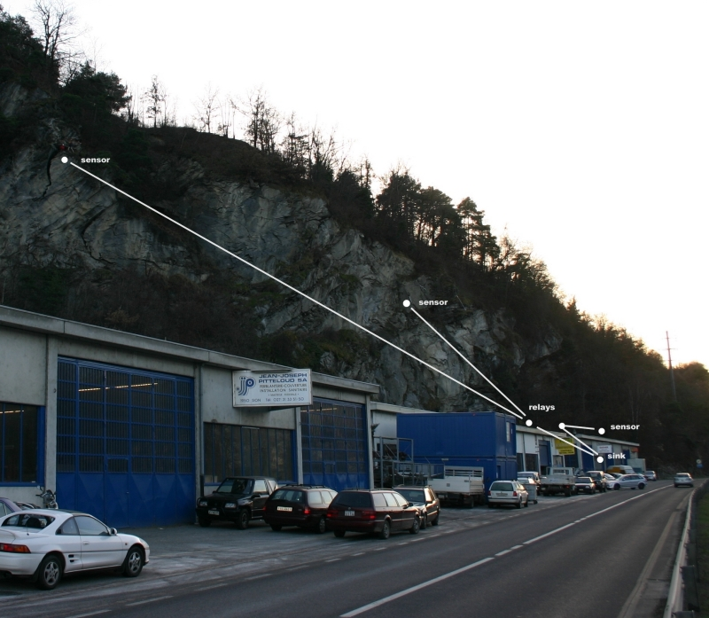
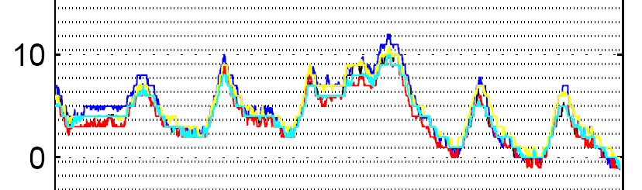
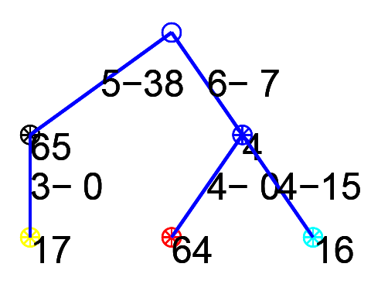
Rock movements monitoring
Pilote test network: Chandoline, Vallis, Switzerland, in cooperation with Crealp (Research center on alpine environment) and MADD Technologies Sarl. In operation since decembre 15th 2006.
Position [mm]
Temperature
Notes:
15
Small network in a difficult to reach area for local operation

Slide 17
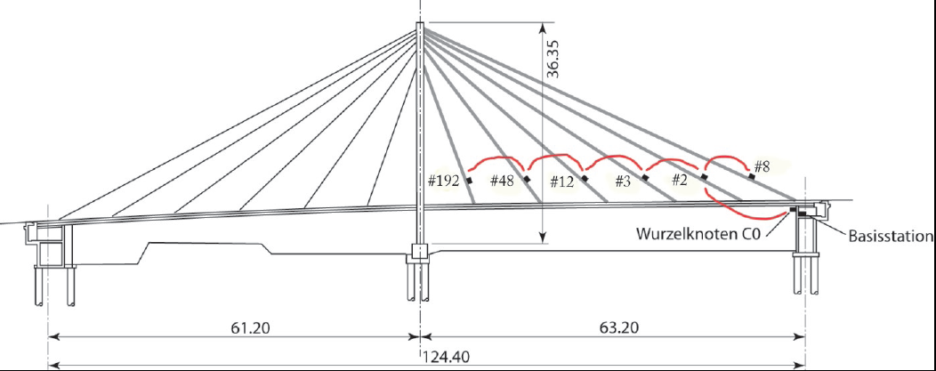

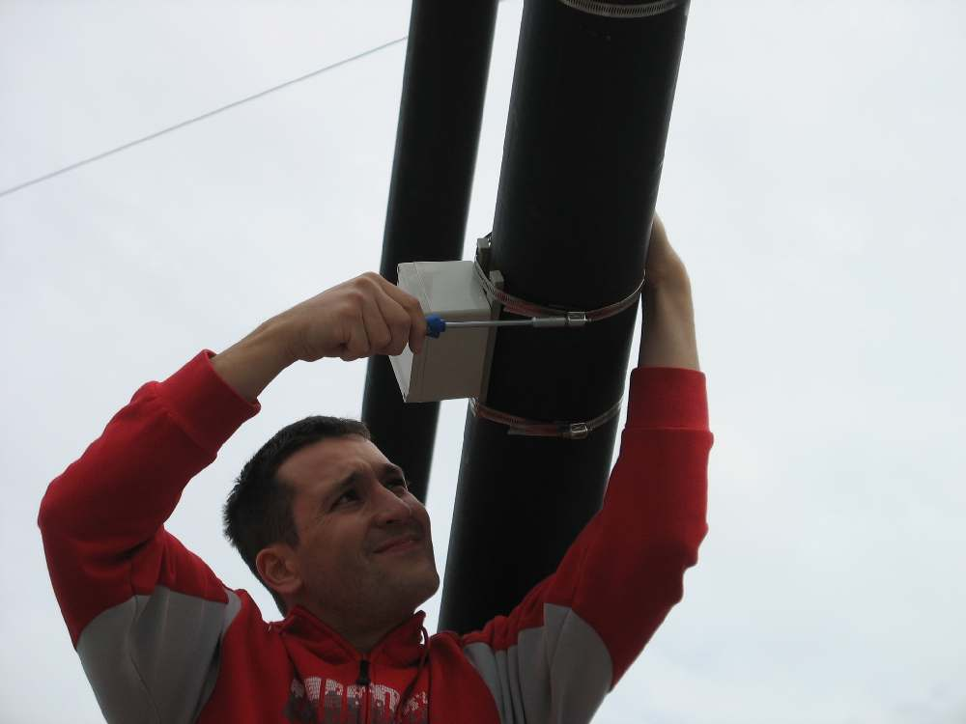
Bridge health monitoring
In collaboration with EMPA
6 nodes in line (25 ultimately), DSP co-processor for measuring vibrations
Single sink with relay to EMPA premises through GSM/GPRS
Notes:
16
Long duration structural monitoring

Slide 18
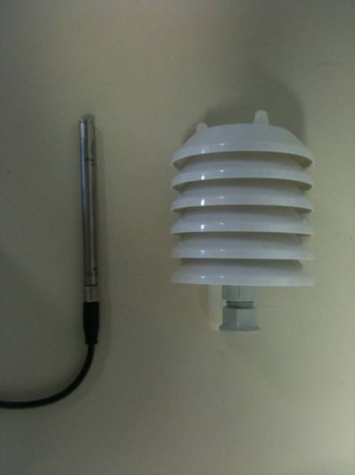

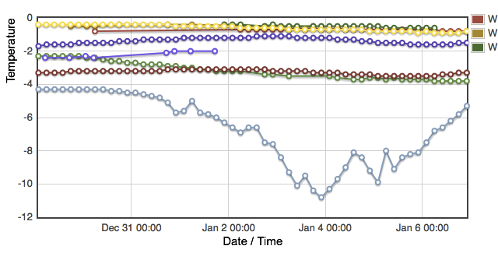
Monitoring glaciers
2800 m altitude
5 years planned
Continuous
monitoring via
GSM

Slide 19
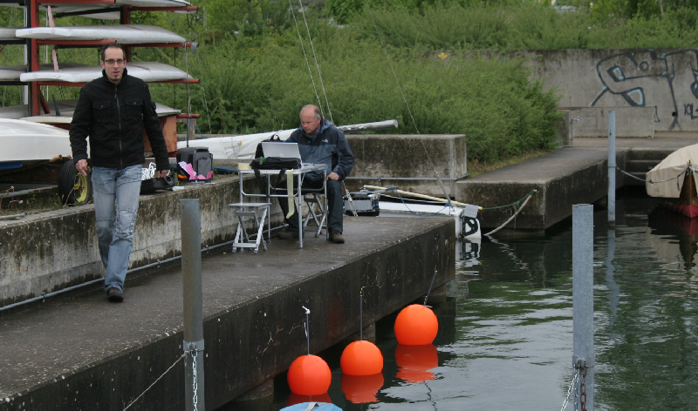
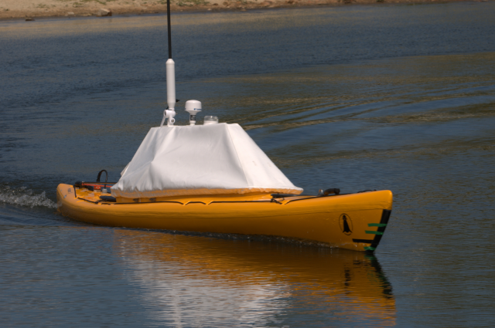
Water quality measurements
Mobile wireless sensor network, with continuous, real-time data collection (including position).
Interfacing with dedicated sensors, energy harvesting

Slide 20



Safety Critical Sensor Networks for Building Applications
  Partners
    SBT (Siemens Building Technology)
    CSEM (Swiss Center for Electronics and Microtechnology)
    ETHZ (Swiss Federal Institute of Technology)
  Project goal: Develop an ultra-low power wireless multi-hop communication system providing high reliability and low delay transmissions. Application to Wireless Fire Detection.
  Contributions from CSEM in the field of ultra-low power medium access control (MAC) for low latency mesh networking.
Notes:
19
Industrial collaboration

Slide 21
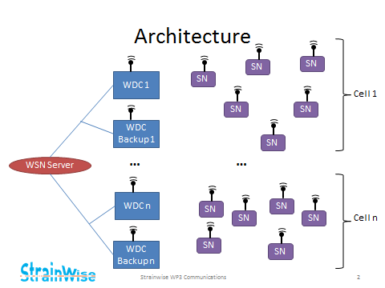



StrainWISE - energy autonomous wireless sensor network for strain monitoring on aircrafts.

Slide 22
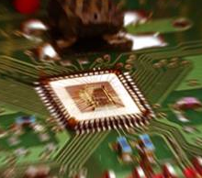
Conclusion
CSEM : your ideal partner for low power RF design
Ultra low-power RF and analog
  180nm, 90nm, 65nm using standard digital CMOS
System simulation and architecture
Protocol design standards-based and proprietary
Antenna design and test

Slide 23
Thank you for your attention!

