Slide 1

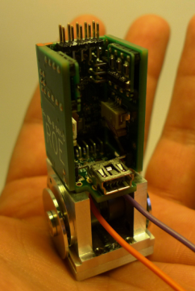
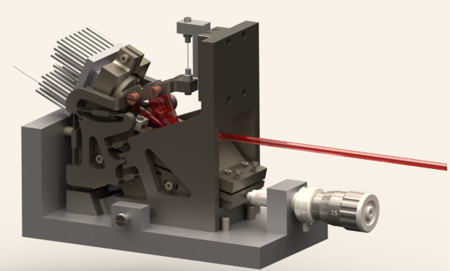
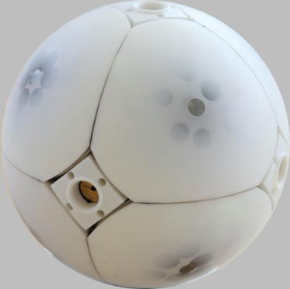
CSEM – 2013
CSEM, an accelerator for Scientific Instrumentation
Dr Ivar KJELBERG
Senior Project Manager
Precision mechanisms, Systems ivar.kjelberg @ csem.ch

Slide 2
Outline
Centre Suisse d’Electronique et de Microtechnique SA
CSEM at a glance
Key competencies for Scientific Instrumentation
Scientific Instrumentation project examples

Slide 3

CSEM at a glance
Centre Suisse d’Electronique et de Microtechnique SA
Our mission: development and transfer of micro-technologies to the industrial sector – in Switzerland, as a priority – in order to reinforce its competitive advantage
Incorporated, not-for-profit Research and Technology Organization (RTO), supported by the Swiss Government
A public-private partnership
31 % public
69 % private
Key figures (2010)
Revenues ~ CHF 70 mio
Employees ~ 400
16% Swiss Confederation (EPFL)
15% Neuchatel (city and canton)
69% Private organizations
shareholders
Notes:
Animated slide -> on click goes to the next paragraph

Slide 4

CSEM’s positioning
Centre Suisse d’Electronique et de Microtechnique SA
Research
Transfer to industry
Production and commercialization
Development and integration of technologies
EMPA, PSI
European Allies
EPFL, ETHZ
Universities
Industrial partners
Spin-off, Start-ups
Notes:
Animated slide -> on click goes to the next paragraph

Slide 5
Outline
Centre Suisse d’Electronique et de Microtechnique SA
CSEM at a glance
Key competencies for Scientific Instrumentation
Scientific Instrumentation project examples

Slide 6
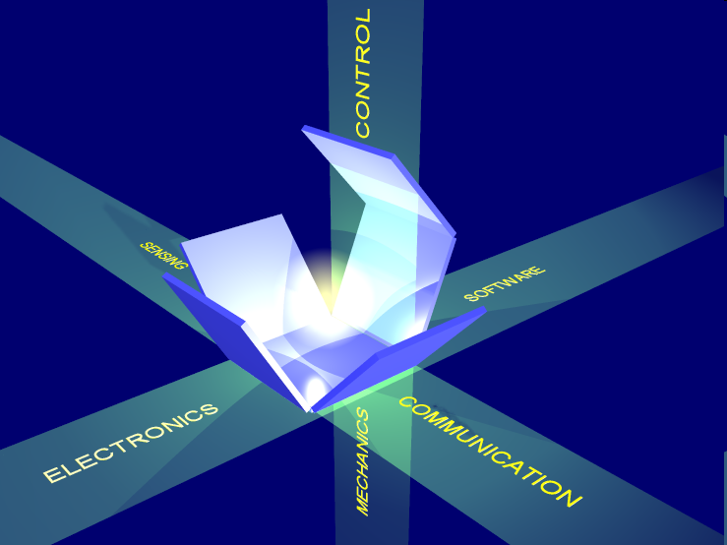

Key competences for Scientific Instrumentation
Centre Suisse d’Electronique et de Microtechnique SA
Key competences to support the Scientific instrumentation for in the development of innovative prototypes and product concepts
Multi-disciplinary team of engineers
Innovative systems design and multi-physics modeling
Capability to produce and to tests advanced prototypes
Perform feasibility studies and small series production
Follow up quality aspects, space hardware …
Focus on three application domains:
MacroMems
Atomic clocks and lasers
Advanced mechanisms for space applications and astrophysics
Management Systems - ISO 9001:2008

Slide 7
Outline
Centre Suisse d’Electronique et de Microtechnique SA
CSEM at a glance
Key competencies for Scientific Instrumentation
Scientific Instrumentation project examples

Slide 8
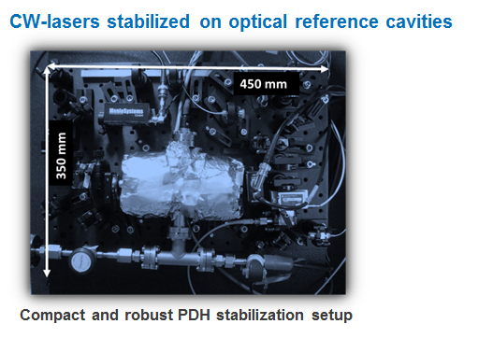
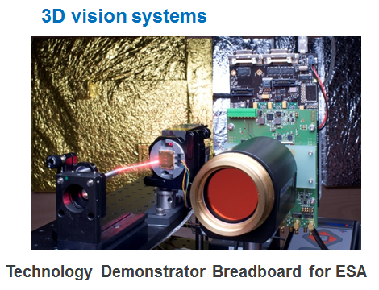
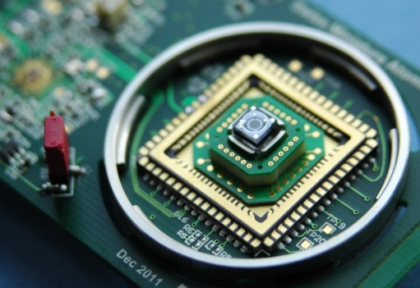
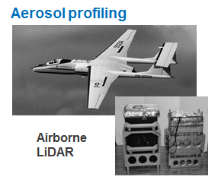
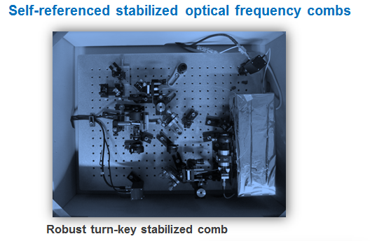
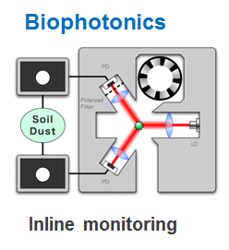
Technology’s Offer
CSEM Scientific Instrumentation technology’s offer
Stabilized lasers
Atomic clocks
Remote optical sensing
Miniature atomic clock

Slide 9
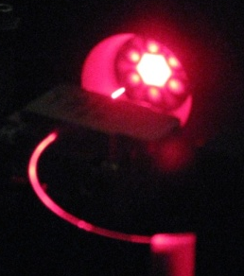
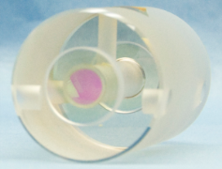
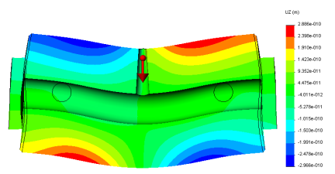
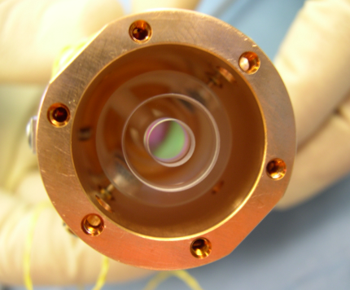
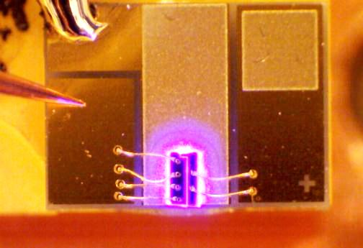
Stabilized Lasers
CSEM Scientific Instrumentation examples Stabilized lasers
Objectives
System integration
Realization of state-of-the-art stabilized lasers
Full know-how on:
Optical frequency reference (optical reference cavity, atomic cells)
Driving and stabilization electronics
Opto-mechanical systems
Fiber & nonlinear optics
Characterization & metrology
Modeling

Slide 10
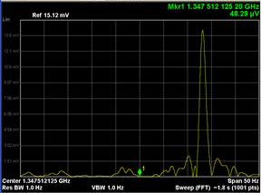
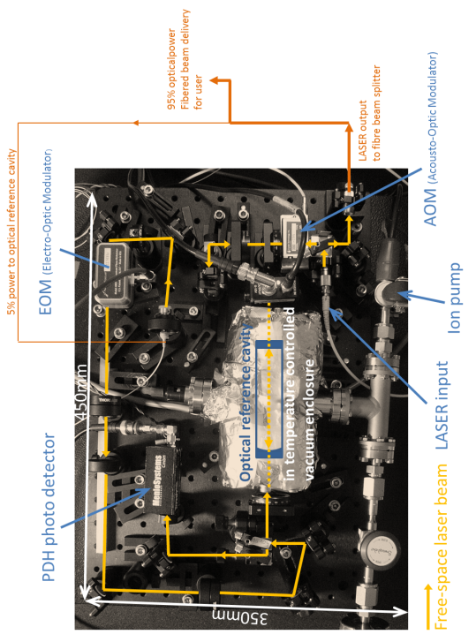
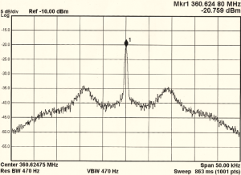
Stabilized lasers
CSEM Scientific Instrumentation examples Stabilized lasers
Results
1-Hz linewidth continuous-wave lasers with <100mHz residual frequency drift
Compact and robust opto-mechanical system
Fully-stabilized 1 micron and 1.5 microns optical frequency combs
Sub-100 attosecond pulse timing jitter of femtosecond lasers at telecom wavelengths
Ultra-low amplitude noise (down to -158 dBc/Hz)

Slide 11
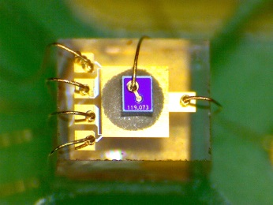
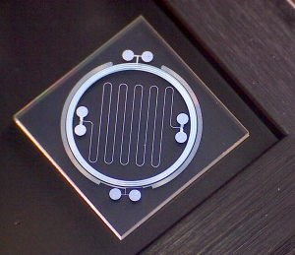
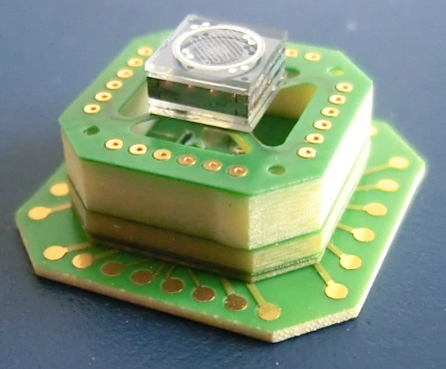
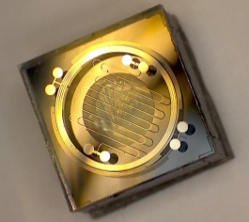
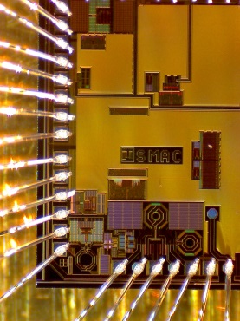

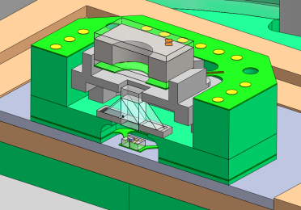
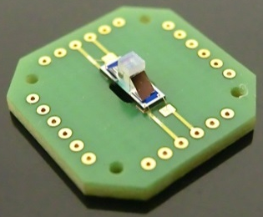
Swiss Miniature Atomic Clock (Swiss–MAC)
CSEM Scientific Instrumentation examples Atomic clocks
Objectives
System integration
Concept and realization of a miniature, low-power and low-cost atomic clock
In house manufacturing and integration of the main building blocks:
miniature atomic vapor cell
stabilized laser source
ultra-low power ASIC
packaging and encapsulation
Swiss–MAC

Slide 12
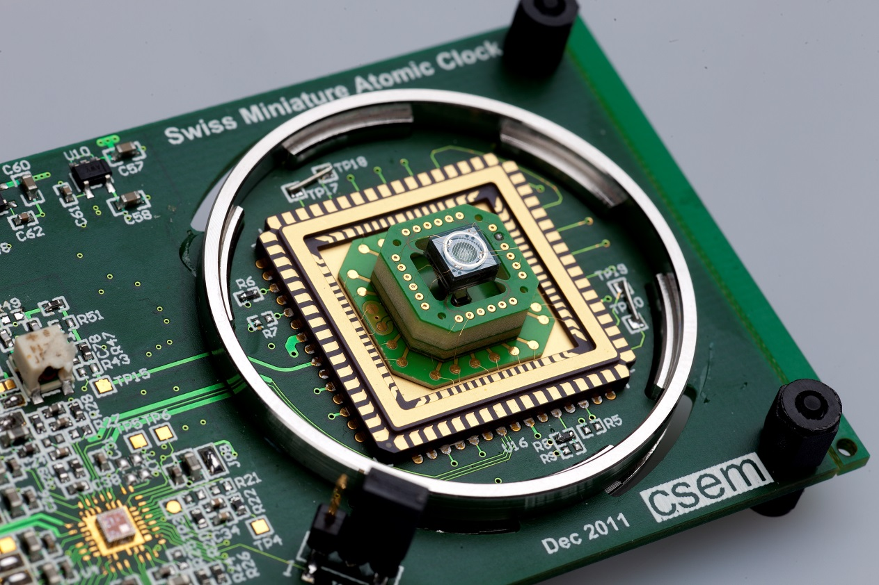
Swiss Miniature Atomic Clock (Swiss–MAC)
CSEM Scientific Instrumentation examples Atomic clocks
Results
Versatile prototype assembled and integrated
Prototype currently under full characterization
Target performances
Frequency stability:
σ_{y} < 2∙10⁻¹⁰ @ 1s
σ_{y} < 2∙10⁻¹¹ @ 1day
Volume < 5 cm³
Power consumption < 100 mW

Slide 13
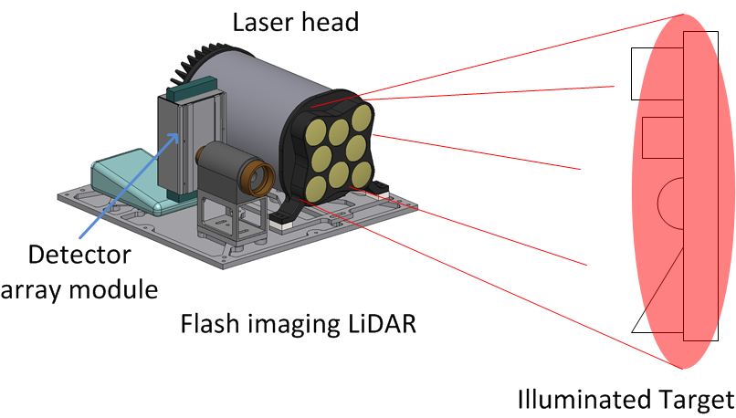
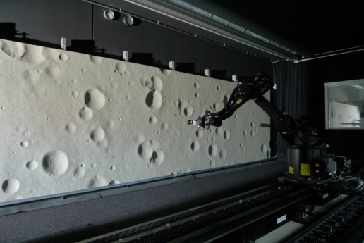
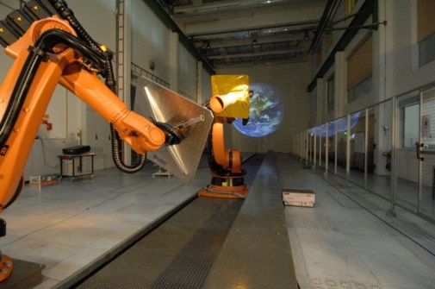
Flash Optical Sensor for Terrain Relative Navigation (EU-FOSTERNAV)
CSEM Scientific Instrumentation examples Remote Sensing
Objectives
Study multiple beam 3D flash imaging LiDAR for soft-landing and rendezvous applications.
Develop/build a prototype
Test the prototype on test benches reproducing missions conditions
Landing test bench
Rendezvous test bench

Slide 14
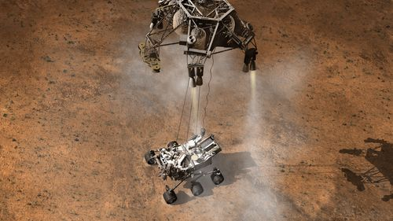
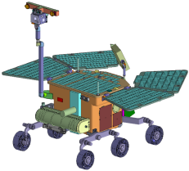


Miniaturized Imaging LiDAR Systems (MILS)
CSEM Scientific Instrumentation examples Remote Sensing
Objectives
Soft-landing
Study 3D flash imaging LiDAR for three space applications:
Develop, build & test a technology demonstrator breadboard
Provide FM development roadmap for each application
Sample container
Rover navigation
Rendezvous

Slide 15
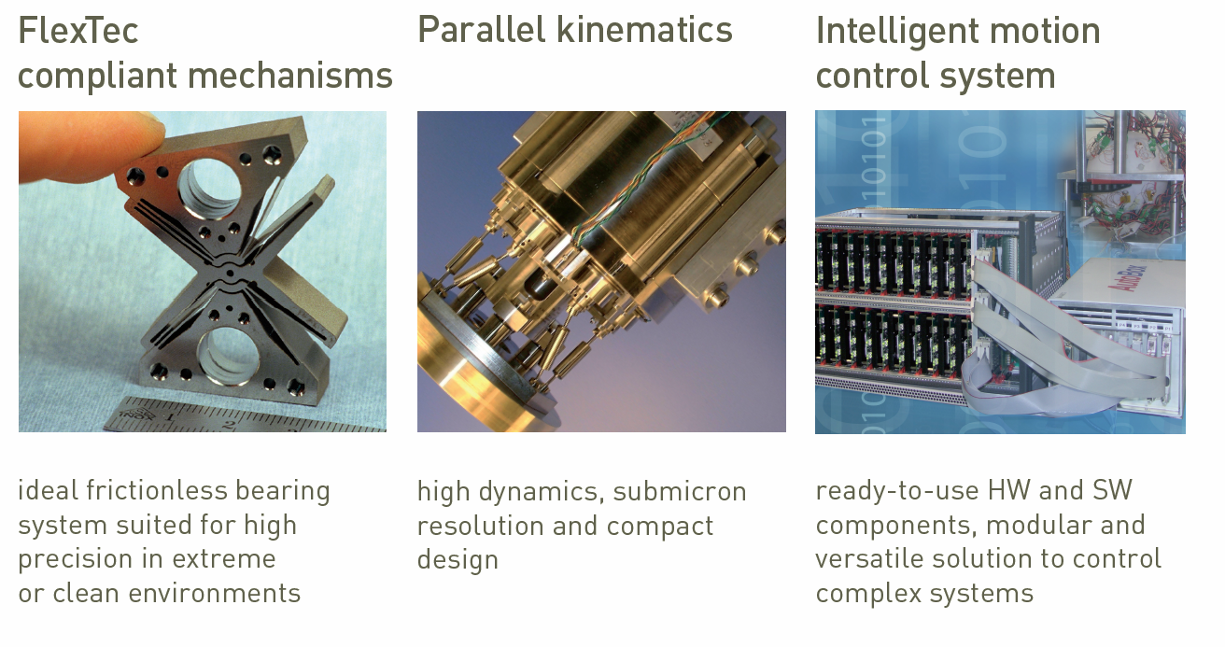
Technology’s Offer
CSEM Scientific Instrumentation technology’s offer

Slide 16
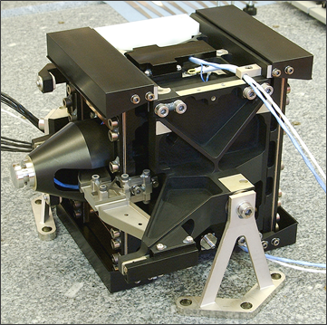
ESA Corner Cube Mechanisms (CCM) on IASI Instrument MetOp
CSEM Scientific Instrumentation examples Space
Objectives
IR interferometer delay line
> 10 years continuous operation at 2.5 Hz
Straight linear motion of optical payload to < 0.5 µm
> ±10 mm stroke at constant 133 mm/s velocity
< 0.2 N exported forces
Fully tested and validated Mechanics and controls law delivered

Slide 17
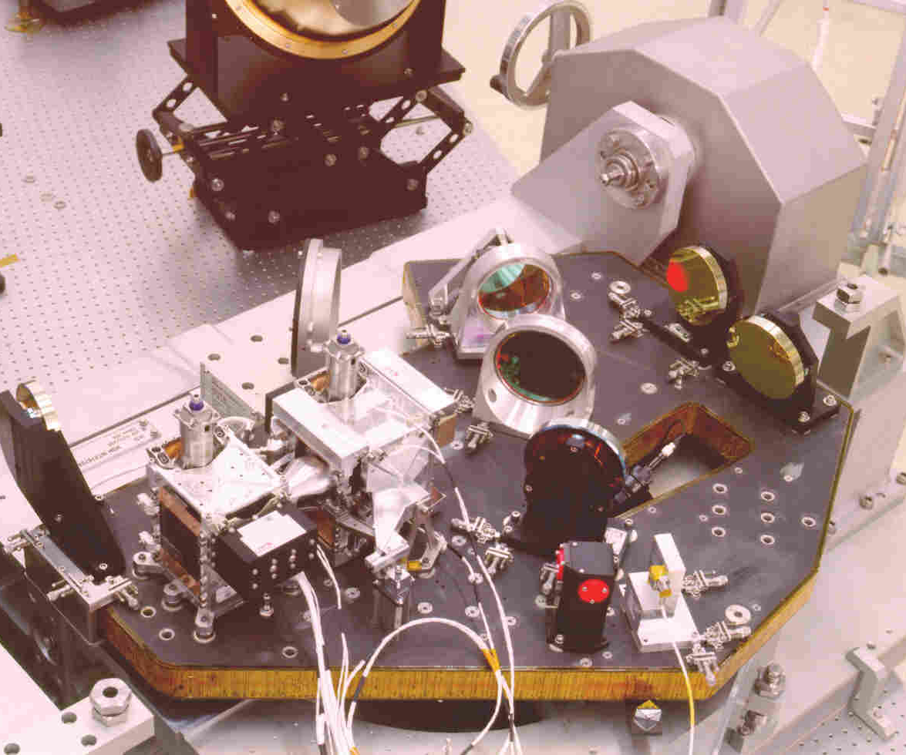
ESA Corner Cube Mechanisms (CCM) on IASI Instrument MetOp
CSEM Scientific Instrumentation examples Space
Results
ESA Project for Aerospatiale (F)
1st launch 2006 MetOp A
2nd launch 2012 MetOp B
3rd launch, in storage, MetOp C
Follow-up project started for next generation of Meteo satellites with ESA / Thales Alenia
Picturese w.r.t. costs savings example
developed software platform
www.esa.int

Slide 18
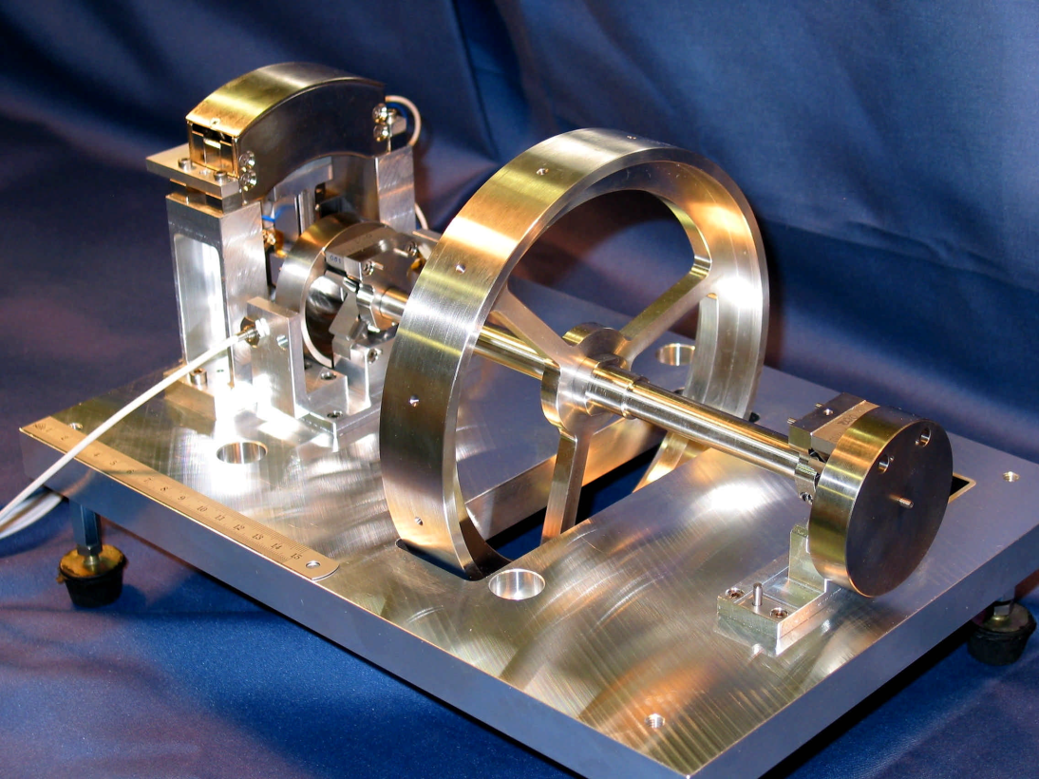
ESA Compliant mechanism HAFHA flexure
CSEM Scientific Instrumentation examples Space
Objectives
ESA project
Design, produce and test a rotational flexure bearing pivot for high precision rotations
Centre of rotation deviation of < 1µm for ± 15° rotation
For payloads > 1 kg
First payload mode > 100 Hz
To withstand launch loads
Rotational stiffness < 1 N m/rad
Test bench with Flex pivots
developed software platform
www.esa.int

Slide 19
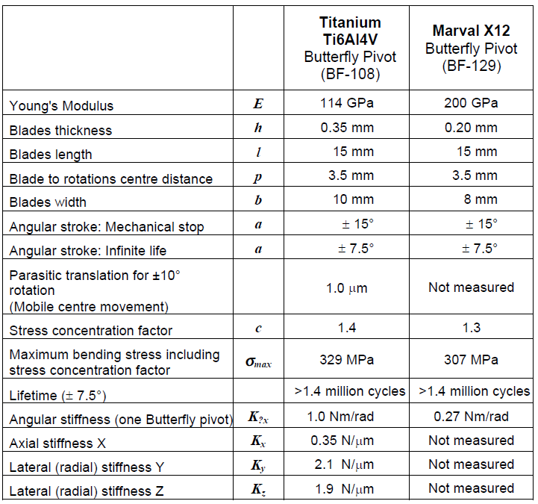
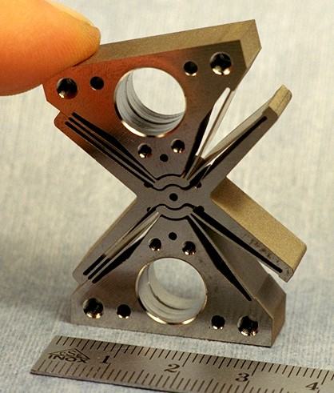
ESA Compliant mechanism HAFHA flexure
CSEM Scientific Instrumentation examples Space
Results
Tested mechanism

Slide 20
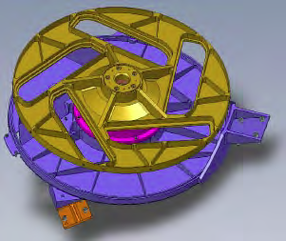
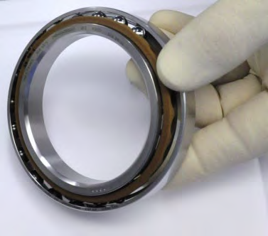
ESA MERIS calibration Mechanism
CSEM Scientific Instrumentation examples Space
Objectives
Calibration wheel for the Medium Resolution Imaging Spectrometer instrument on the ENVISAT satellite
Soft support for several Spectralon® samples, shutter and baffle aperture
No launch lock, mass balance
Precision repositioning
Initial MOS2 lubrication
Currently Fomblin Z25 lubrication

Slide 21
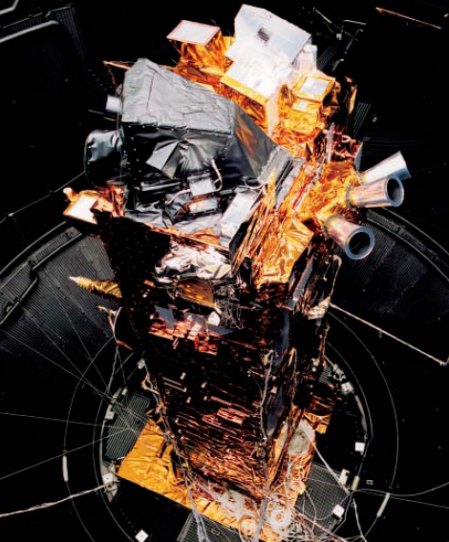
ESA MERIS calibration Mechanism
CSEM Scientific Instrumentation examples Space
Results
Initial project for Aerospatiale Cannes (now Thales Alenia )
Launched on ENVISAT satellite on 1 March 2002
End of mission April 2012
Follow-up mission: performed bearing delivery to CSL for Sentinel-3 : OLCI CM Calibration Mechanism Launch in 2013
Identical design 15 years later !
www.esa.Int

Slide 22
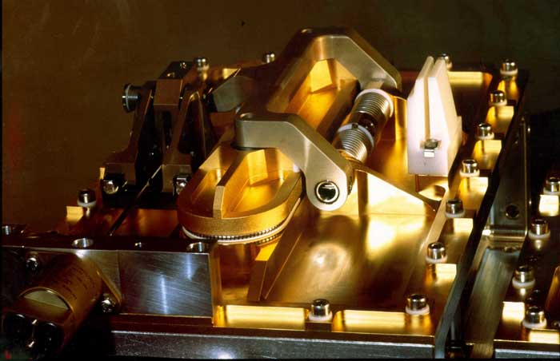
ESA Door Mechanisms for X-ray Multi-Mirror Satellite (XMM)
CSEM Scientific Instrumentation examples Space - Astro
Objectives
UHV protection of CCD detectors for XMM
> 2 years ground storage without loosing UHV pressure
Assembly & test in Class-100 clean-room environment
Door opening in space with extremely high reliability
Critical single Point Failure element for X-ray instrument
Tested mechanism

Slide 23
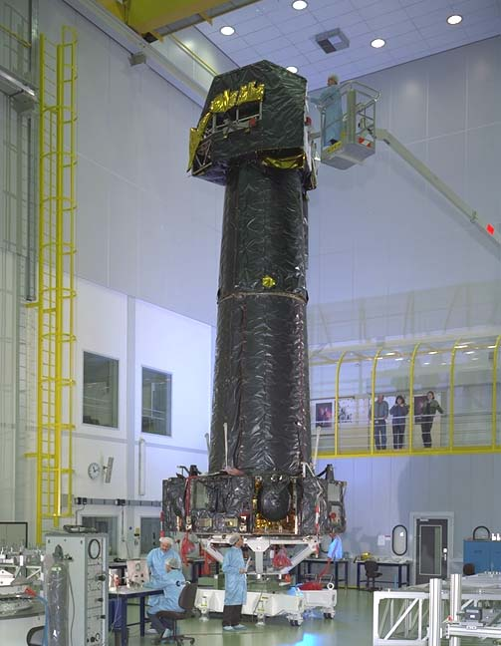
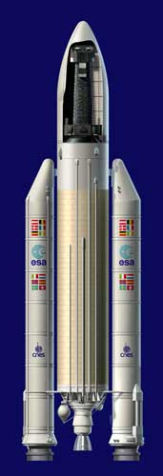
ESA Door Mechanisms for X-ray Multi-Mirror Satellite (XMM)
CSEM Scientific Instrumentation examples Space - Astro
Results
ESA project: Xray telescope for astrophysics (X-rays do not pass through the atmosphere)
Launched in 1999 December 10
Door opening successfully
Mission should last at least 2 years, large success
Telescope is still operational and we are in 2013!
Data processing still ongoing for the
www.esa.int

Slide 24
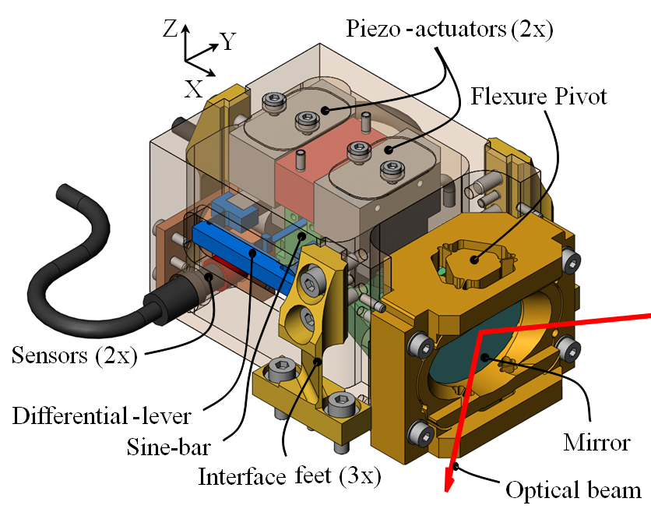
ESA LISA satellite: Point ahead Mechanism
CSEM Scientific Instrumentation examples Space - Astro
Objectives
Highest precision Point ahead mirror mechanism
Angular stroke : ± 412 μrad (mechanical angle)
Scan speed : ± 62.5 prad/s (155 days to cover entire range)
Total Piston error budget below 1.5 pm (0.000 000 001 5 mm) for a 140 nrad rotation (1 nrad = 0.000 000 057 °)
Tested mechanism

Slide 25
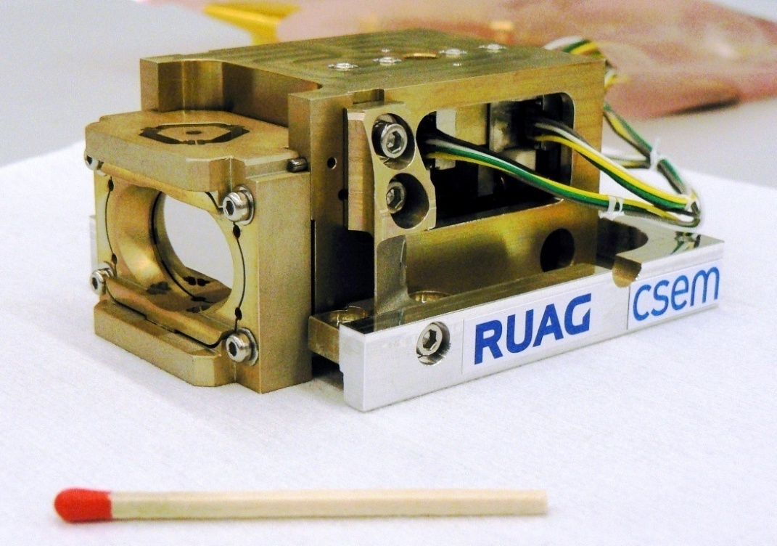
ESA LISA satellite: Point ahead Mechanism
CSEM Scientific Instrumentation examples Space - Astro
Results
ESA project performed in collaboration with RUAG Space
Project terminated in 2010
For the LISA satellites for a gravitational wave observatory
Mechanism delivered, tested in vacuum and cryo configuration
Requested specification have been validated
Mechanism ready to be tested
developed software platform

Slide 26
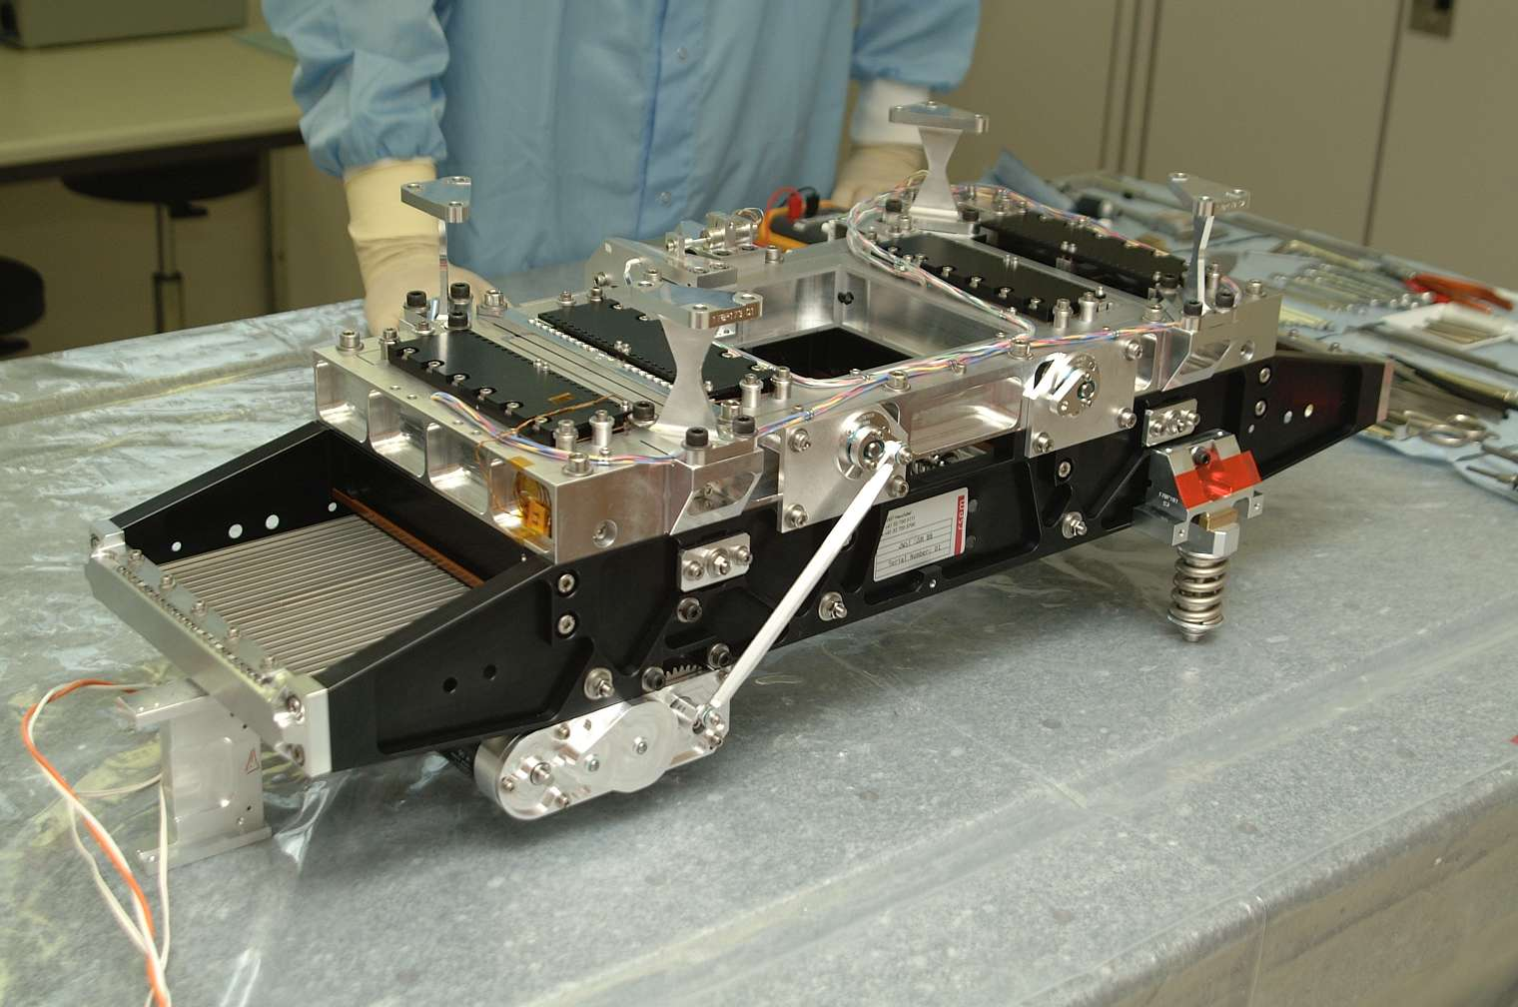
ESA Slit mask for the James Webb space telescope
CSEM Scientific Instrumentation examples Space - Astro
Objectives
Backup solution for JWST space telescope NIRSpec instrument
Cryo mechanism at L_{He} 30 K or (-243°C) temperatures
25 slits of adjustable width
Adjusted to < 5 µm precision
Validate at cryo-temperatures for lifetime and precision
Validate for launch vibration survival with launch locks
Tested mechanism

Slide 27
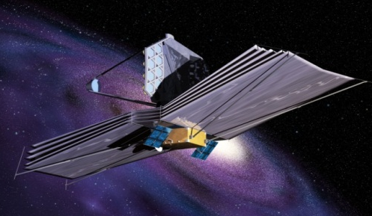
ESA Slit mask for the James Webb space telescope
CSEM Scientific Instrumentation examples Space - Astro
Results
Designed, developed & tested for ESA as part of NIRSpec, 2004
Tested at Liquid Helium conditions at CERN
Tested successfully twice for launch vibration
Finally the telescope will fly with US produced MEMS slits
Allowed interesting follow up projects for ground astrophysics
Artist view of the James Web Telescope
developed software platform
www.esa.int www.nasa.gov

Slide 28
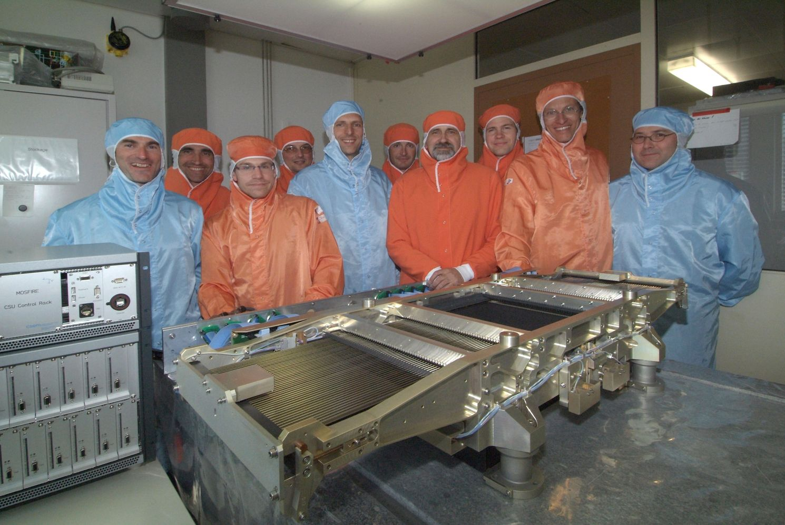
Keck Telescope 1: Cryo Configurable Slit Mask Unit CSU
CSEM Scientific Instrumentation examples Astro
Objectives
Configurable 46 slit mask
Cryo environment L_{N2} > 10 years continuous operation
267x267 mm filed of view
< 10 µm slit reproducibility and precision
< 1.2 W consumption over 30 min
Mechanics, electronics, control law and software delivered
Picturese w.r.t. costs savings example

Slide 29
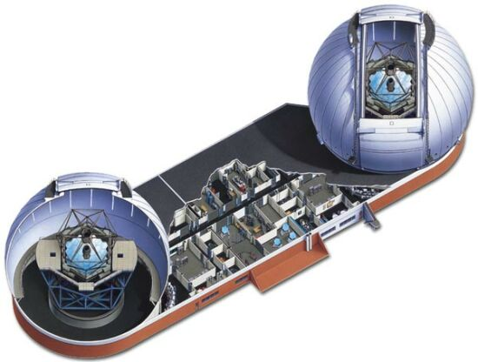



Keck Telescope 1: MOSFIRE instrument in operation
CSEM Scientific Instrumentation examples Astro
Results
Testing and support provided at UCLA before delivery in 2011
Arrived at KECK Hawaii on 22 Feb 2012
First light with CSEM Slit Mask on 4 April 2012
First results presented at SPIE meeting Astronomical Telescopes and Instrumentation in Amsterdam July 2012
Successful operation since
Picturese w.r.t. costs savings example
developed software platform
www.keckobservatory.org

Slide 30
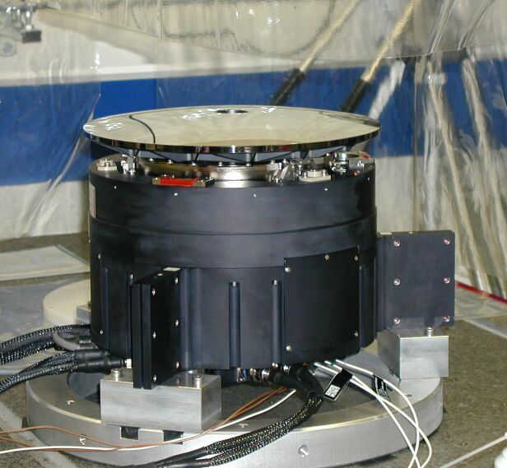
SOFIA Secondary Mirror Mechanism
CSEM Scientific Instrumentation examples Astro
Objectives
Secondary Mirror tip-tilt
Ø 360 mm SiC aspheric mirror
Hexapod for positioning 3 mm
Active tip tilt with momentum compensation 20 Hz chopping
µrad tip tilt resolution
6 DoF testing and calibration
Mechanics, electronics, control laws & software delivered
FAA certification
Picturese w.r.t. costs savings example

Slide 31

SOFIA Secondary Mirror Mechanism
CSEM Scientific Instrumentation examples Astro
Results
Project for DLR / MAN
System delivered in 2002
First official flight in 2010
105 flight in April 2013
Several projects done since for spare parts and support for DSI / DLR & NASA
New project under definition for full new mechanism
Discussions regarding upgraded new generation SMM
SOFIA 747 airplane with 3 m telescope
developed software platform
www.dsi.uni-stuttgart.de www.nasa.gov

Slide 32

SOFIA Secondary Mirror Mechanism
CSEM Scientific Instrumentation examples Astro
Results
FAA compliant flight electronics and control laws for SOFIA
PPC604 & RIO 8062 (CES) VME controllers
18 bit DACs
24 bits ADCs

Slide 33

ESO M2 Mechanism for the four AT auxiliary telescopes
CSEM Scientific Instrumentation examples Astro
Objectives
High stiffness precision hexapod system for secondary mirror control and positioning
The mobile AT telescope provide reference beams for the VLTI interferometer
> 25 years operation
1 µm positioning precision
> 200 Hz first modal resonance
6 DoF testing and calibration
Tested mechanism

Slide 34

ESO M2 Mechanism for the four AT auxiliary telescopes
CSEM Scientific Instrumentation examples Astro
Results
Project for ESO / AMOS (B)
Four mechanism and one spare delivered, mechanics, electronics, control laws and software
Follow up support, spare parts deliveries, and several training provided also on site at Paranal (Chile)
ESA AT telescopes at Cerro Paranal Chile
AT-1, 2 & 3 (4)
www.eso.org

Slide 35

ESO VLT NAOS Field Selector Units (NACO – Instrument)
CSEM Scientific Instrumentation examples Astro
Objectives
Two high precision and high stability Tip tilt piston mirror and control systems
± 6 ° mechanical tip/tilt
< 1 µrad motion resolution
90 mm Ø ultra-flat SiC mirror
Active Piston stabilization
Counter chopping fast response
Delivered: Mechanics, electronics, control laws and software
Tested mechanism

Slide 36

ESO VLT NAOS Field Selector Units (NACO – Instrument)
CSEM Scientific Instrumentation examples Astro
Results
ESO project with LAOG Grenoble and the Observatory of Meudon (Paris)
Key sub-unit for reference star localization of first major Adaptive Optics instrument on VLT-4 Yepun (Paranal - Chile)
In operation since 2002
Provided since support and maintenance and training for ESO Paranal staff
Mechanism ready to be tested
www.eso.org

Slide 37

GTC Secondary Mirror Tip/Tilt & Steering Mechanism
CSEM Scientific Instrumentation examples Astro
Objectives
Secondary M2 steering mechanism for GTC telescope
Mechanism design and control laws performed by CSEM
6-DoF Hexapod + fast tip-tilt chopper (100 kg tip-tilt mass)
M2 mirror of 1.1 m in diameter fully compensated to minimize exported momentum
Final delivery, mechanism, electronics, control laws and software
Tested mechanism

Slide 38

GTC Secondary Mirror Tip/Tilt & Steering Mechanism
CSEM Scientific Instrumentation examples Astro
Results
Mounted on GTC 10.8-m astronomical telescope located on the island of La Palma
M2 mechanism made in partnership with NTE (Spain main contractor) and ADS (Italy)
Delivered in 2005
First light in 2007 July 13
Fully operational in May 2009
Mechanism
www.gtc.iac.es

Slide 39

VISTA Telescope Secondary Mirror Steering Mechanism
CSEM Scientific Instrumentation examples Astro
Objectives
Secondary M2 steering mechanism for the 4 meter VISTA telescope
Mechanism design and control laws performed by CSEM
6-DoF Hexapod,
M2 mirror of 1.1 m in diameter
Final delivery, mechanism, electronics, control laws and software
Tested mechanism

Slide 40

VISTA Telescope Secondary Mirror Steering Mechanism
CSEM Scientific Instrumentation examples Astro
Results
Mounted on Visible and Infrared Survey Telescope for Astronomy located at Paranal Chile
Made in partnership with NTE (Spain) and ADS (Italy)
Delivered in 2005
First light on 11 December 2009
Vista Telescope at Paranal Chile
www.eso.org www.vista.ac.uk

Slide 41



ESO: ELT-M5 Adaptive Optics Tip/Tilt Steering Mechanism
CSEM Scientific Instrumentation examples Astro
Objectives
Design of Full opto-mechanical system, FEM modelling, prototype assembly and tests
Analysis and control simulations of a 3x2.5 meter Silicon Carbide (SiC) mirror (450-600 kg) on three High Power Piezo XXL APA® actuators for dynamic control and image stabilisation
Actuator main specification:
Stroke: > 0.5 mm
Resolution: < 1 nm
Nominal load: < 2 kN
Maximum load: > 15 kN
Total weight of PZT: 4 kg
Full actuator weight: 15.5 kg
APA is a trademark of CEDRAT Technologies, France
Tested mechanism
In collaboration with:

Slide 42

ESO: ELT-M5 Adaptive Optics Tip/Tilt Steering Mechanism
CSEM Scientific Instrumentation examples Astro
Results
The M5 mirror mock-up is here an optical Honeycomb table (450 kg) with representative mirror eigenfrequencies, mounted on a support structure allowing axial rotation for true real-time motion control and validation in closed loop of the specified motion law.
Successful proof of specified requirements obtained
Second generation Mechanism
Full scale prototype courtesy NTE/SENER (ES)

Slide 43

PSI: PRIGO X-ray diffraction analysis goniometer
CSEM Scientific Instrumentation examples Science
Objectives
3 Rotations (Euler Cradle/Arc)
OMEGA [-inf, +inf]
CHI [0-90°]
PHI [-inf, +inf]
Sample Holder Dimension (Vector)
SHx [-3mm, +3mm]
SHy [-3mm, +3mm]
SHz [16mm, 24mm]
TCP Position (Point in space, where beam should hit sample)
Ox [-2mm, +2mm]
Oy [-2mm, +2mm]
Oz [274mm, 276mm]
Tested mechanism

Slide 44




PSI: PRIGO X-ray diffraction analysis goniometer
CSEM Scientific Instrumentation examples Science
Results
Project started by PSI and EPFL
Optimisations of 6 DoF goniometer in collaboration with CSEM
Kinematic modeling
System control laws
Development of calibration procedure
Second generation Mechanism
www.psi.ch

Slide 45
Examples of development tools and data exchange
CSEM Scientific Instrumentation
SolidWorks CAD
GibbsCAM CAM (workshop)
COMSOL Multiphysics FEA
Maple & MapleSim (Modelica based) analytical tools
Matlab & Simulink or Octave & SciLab numerical tools
dSpace rapid prototyping of control algorithms and data acquisitions
LabView data acquisition
C+/# programming
Optics and clean-room labs
Micro-vibration shakers and analysis instruments

Slide 46



FlexTec : Flexure-based mechanisms
CSEM Scientific Instrumentation examples

Slide 47
Thank you for your attention!

