Slide 1
GEM and Micromegas production
Rui De Oliveira
TE/MPE/EM

Slide 2
Summary
GEM Single mask process
Micromegas
  Bulk
  Classical
  resistive

Slide 3
GEM process step by step

Slide 4
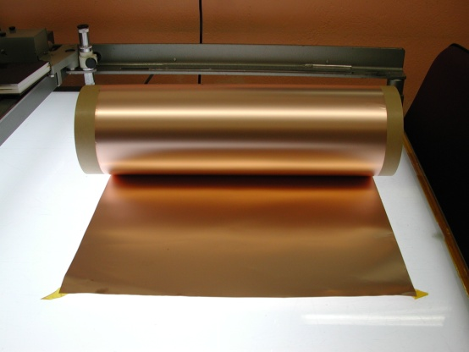
2 suppliers :
Sheldhal (US)
Nippon steel (Jp)
5um Copper
50um Polyimide
CR layer 10nm
5um Copper
Base material
50um adhesiveless copper clad Polyimide
Rolls of 100m x 600mm
Polyimide : APICAL NP or AV

Slide 5
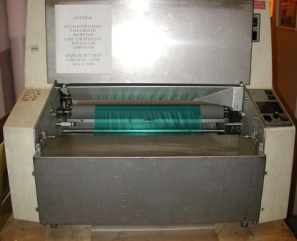
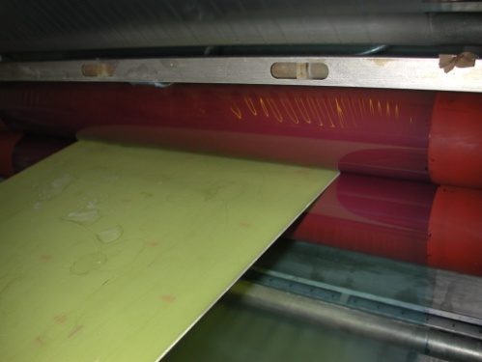
Maximum size 100m x 600mm
Dupont manual laminators
15um resist
15um resist
Photoresist deposition
15um dry resist (KL 1015 – Korea)

Slide 6
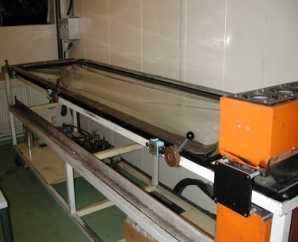
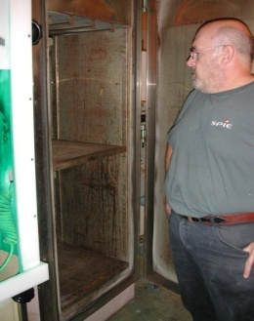
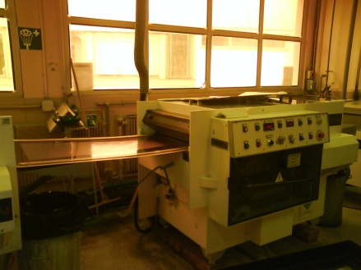
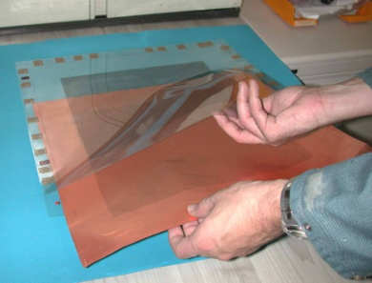
70um
15um resist
15um resist
Photoresist holes patterning

Slide 7
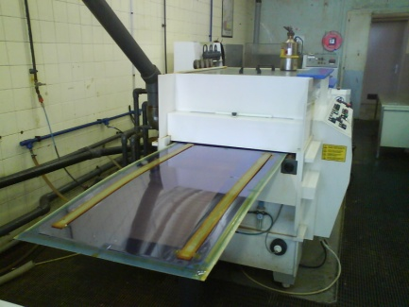
Top copper etching

Slide 8
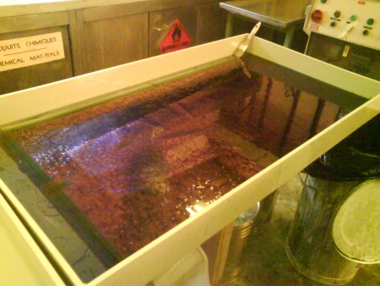
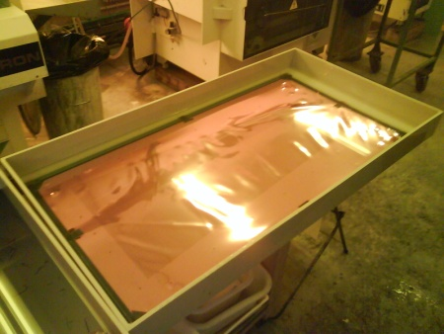
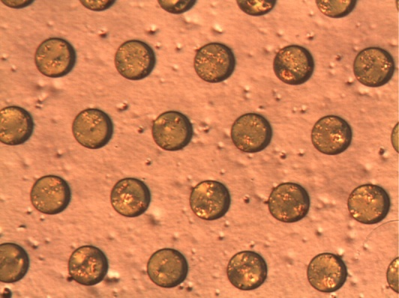
Resist stripping

Slide 9
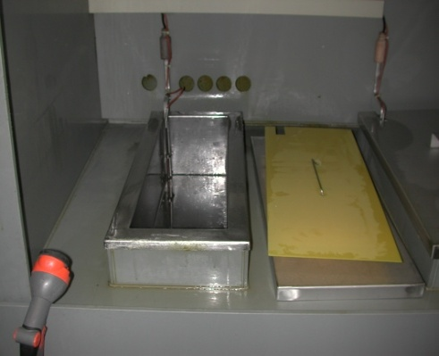
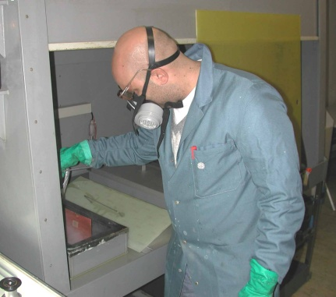
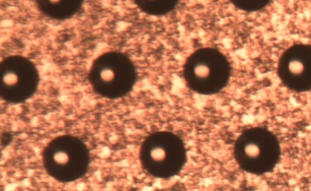
Polyimide anisotropic etching

Slide 10
Bottom resist protection deposition

Slide 11
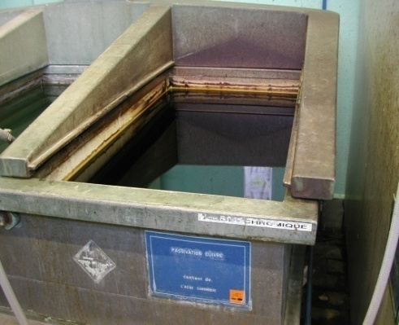
Top copper protected by galvanic connection
etchant
Bottom copper etch by chemical reaction

Slide 12
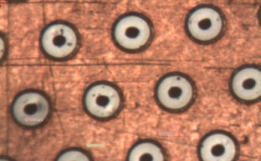
Resist stripping

Slide 13
Soft Polyimide etching
The hole become double conical

Slide 14
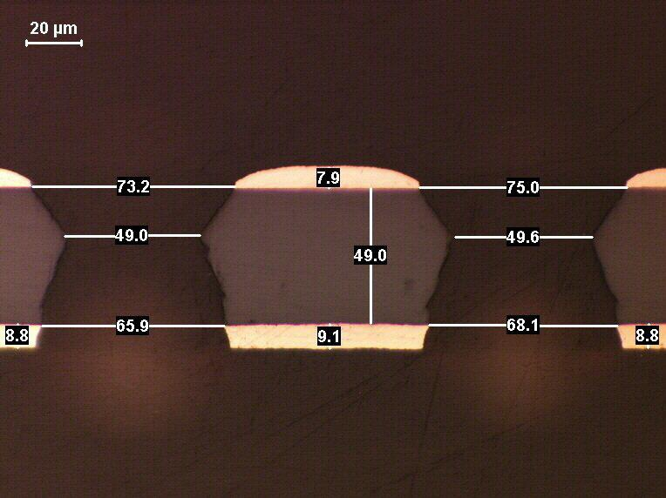
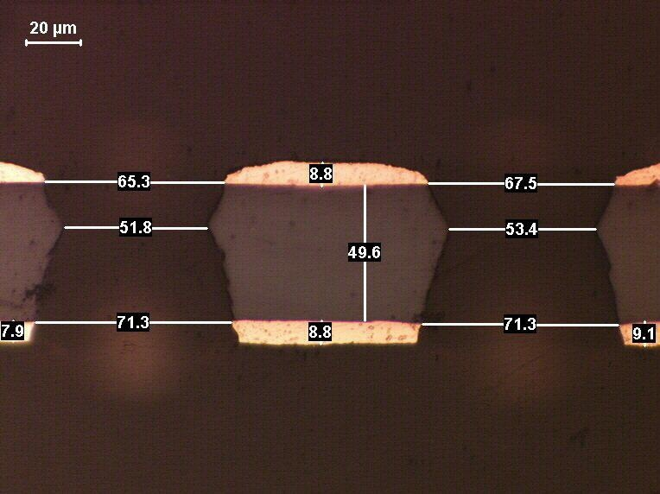
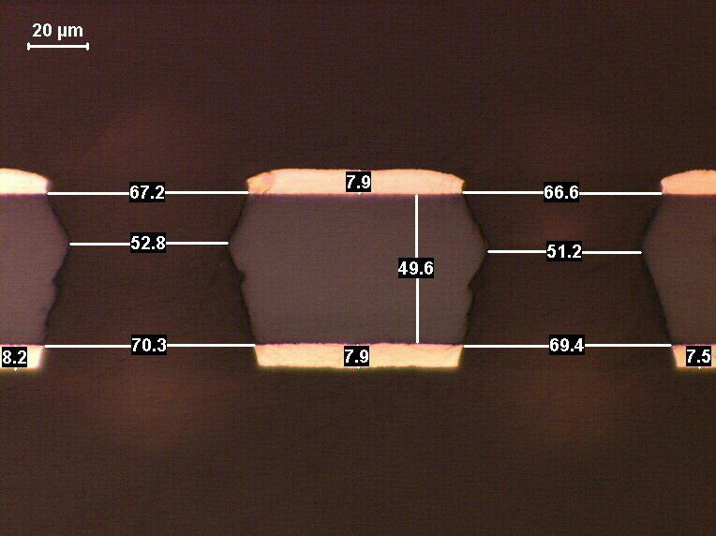
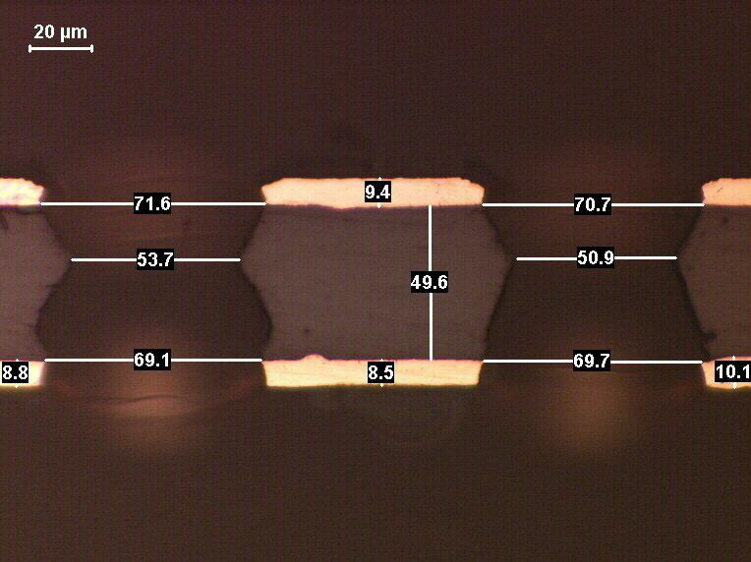
cross section pictures

Slide 15
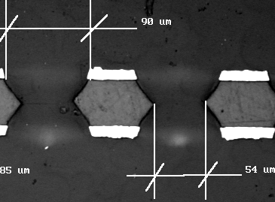
Comparison with std GEM from external supplier

Slide 16
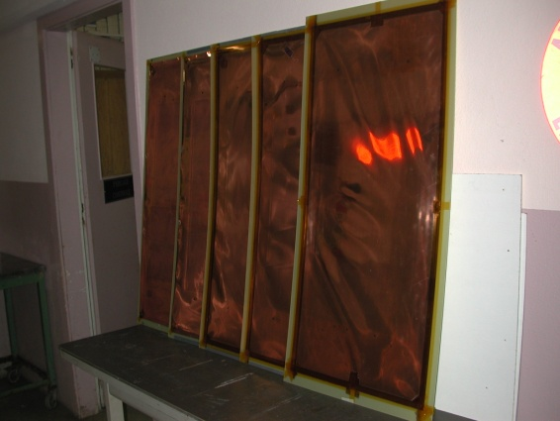
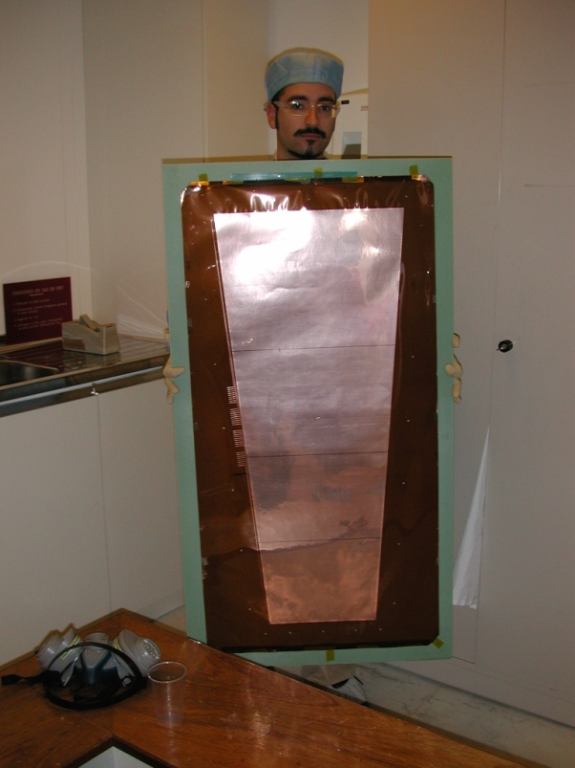
examples
Large GEM already produced:
ILC Dhcal: 1m x 33cm (5 pieces)
Kloe: 750mm x 40cm (30pieces)
CMS: 1m x 45cm (40 pieces)

Slide 17
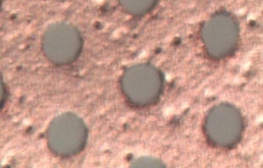
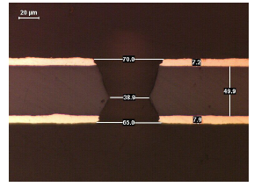
GEM single mask process summary
Chemical Polyimide etching
Copper electro etching
Stripping
Second Polyimide etching
Reality

Slide 18
Bulk Micromegas
BULK Technology
DUPONT PC 1025 coverlay
BOPP Meshes
SERITEC stretching
PCB
lamination
Mesh deposit
lamination
development

Slide 19
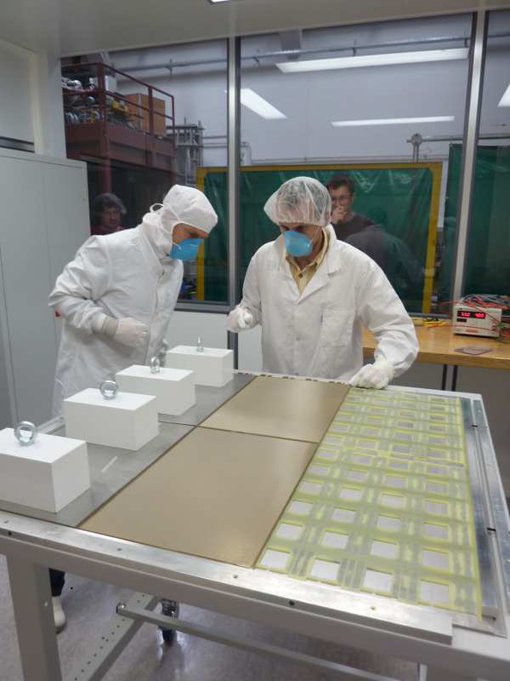
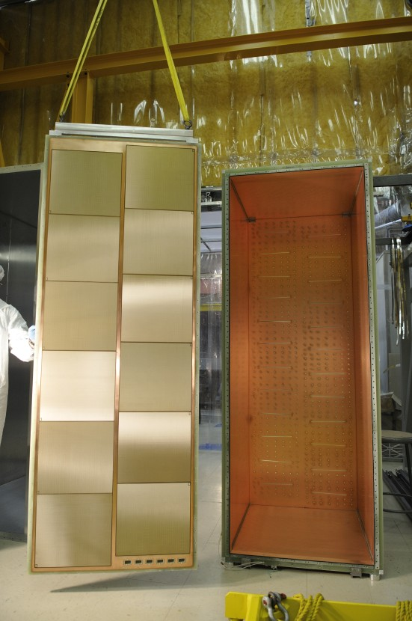
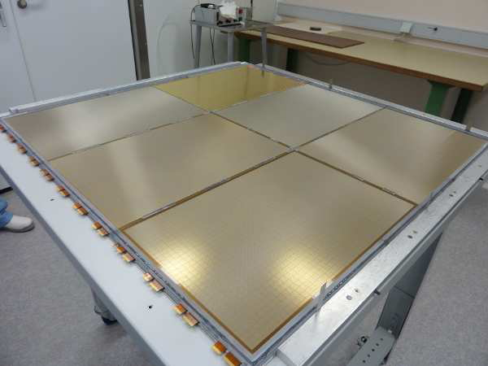
Pad read-out large TPC
Neutrino detector
10 sqr meter in service
Pad read-out 1cm², thickness 8mm for ILC Hadronic calorimetry
Tested in the RD51 1 kHz beam.
The BULK is made on a populated PCB
T2K experiment
Japan (CEA Saclay)
Bulk Micromegas ILC DHCAL first m²
LAPP Annecy
19

Slide 20
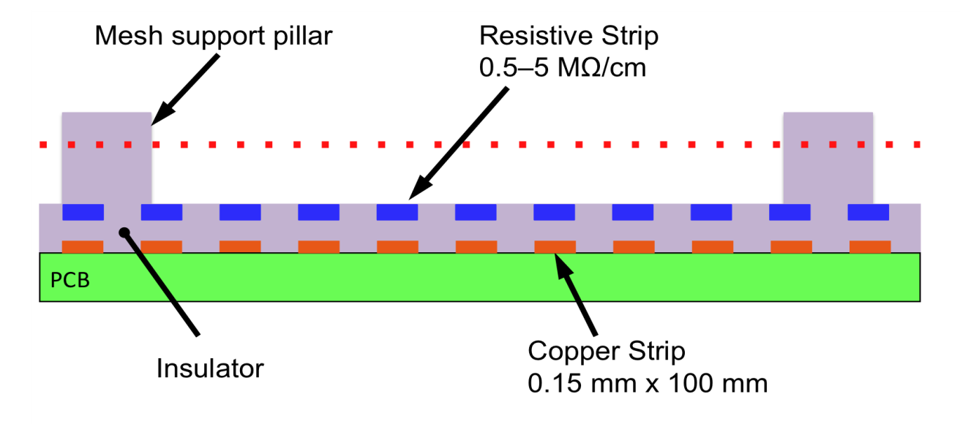
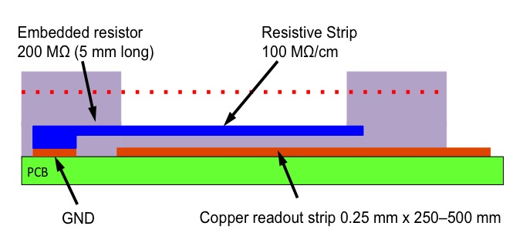
Resistive Bulk MicroMegas

Slide 21
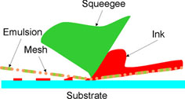
Screen printing of for the resistive strips
-Not compatible with pitches
smaller than 0.4mm
-Thixotropic paste
PCB
PCB
PCB

Slide 22
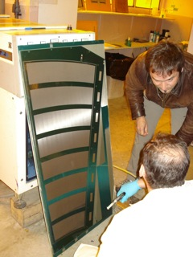
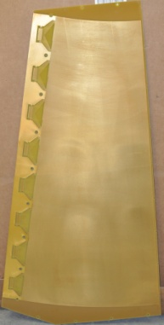
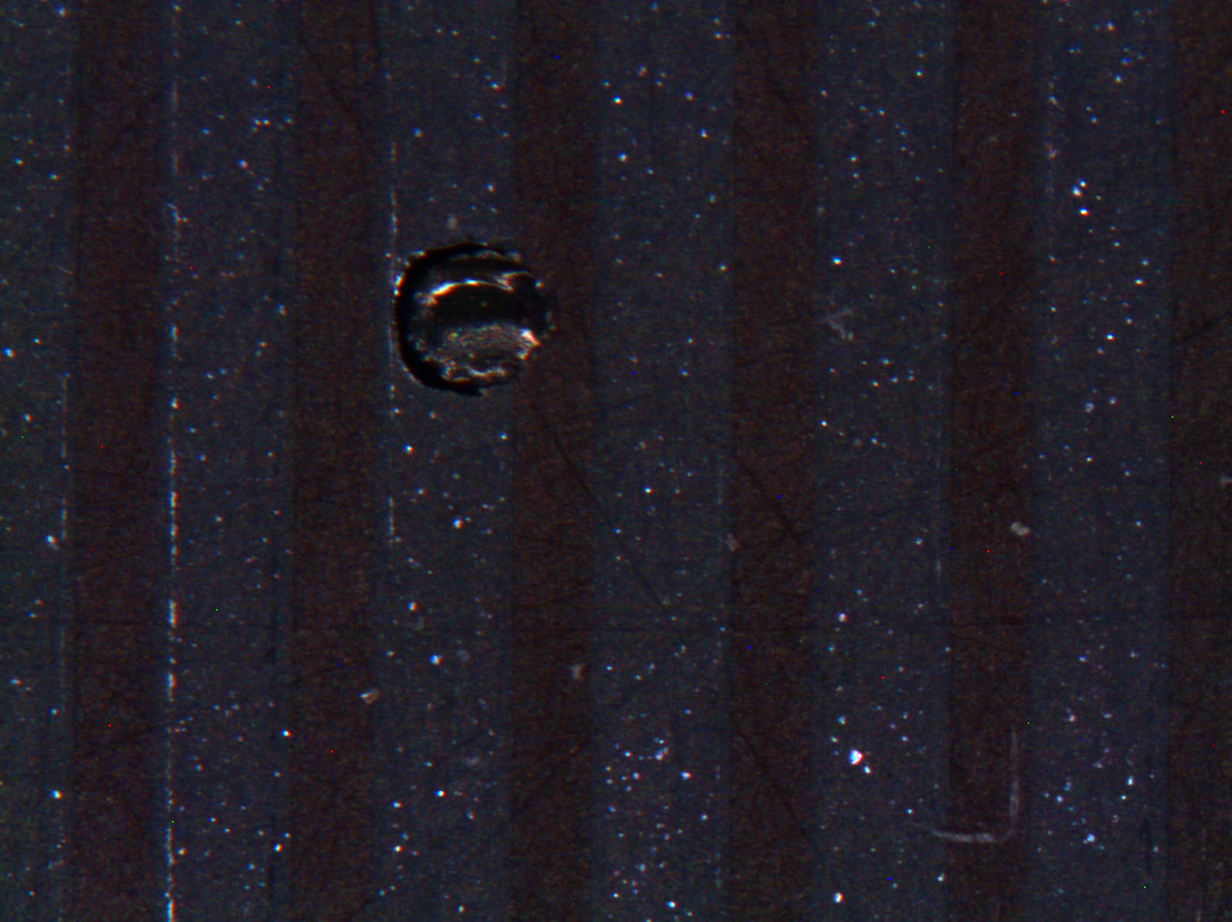
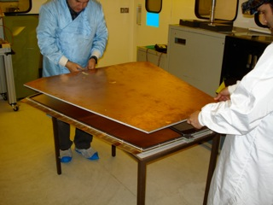
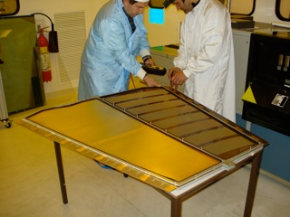
Bulking
Double sided Board
Resistive strip deposit
Closing
Test before closing

Slide 23
Classical MicroMegas resistive or not
1 x 1m2 not to scale detector opened
Stiffening panel
Drift electrode
Pillars (128 µm)
PCB1
PCB2
Aluminum support plate
Rohacell

Slide 24
1 x 1m2 not to scale detector closed
Stiffening panel
5.00
PCB1
PCB2
Aluminum support plate
Rohacell

Slide 25
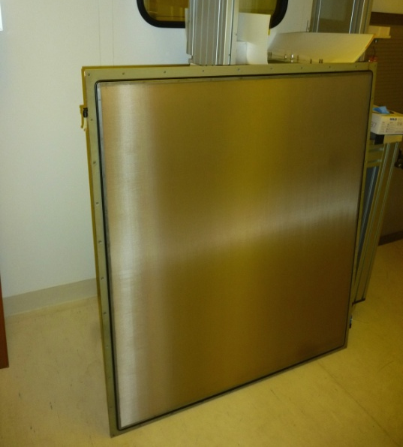
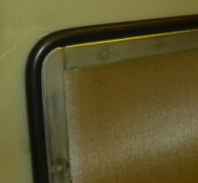
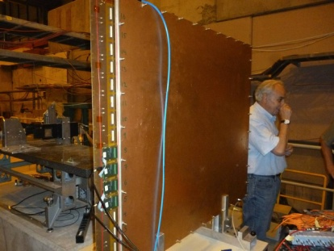
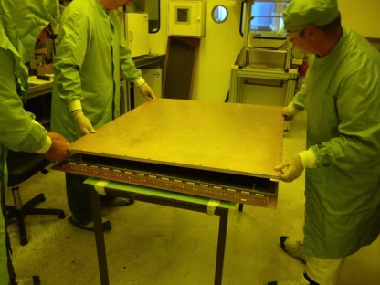
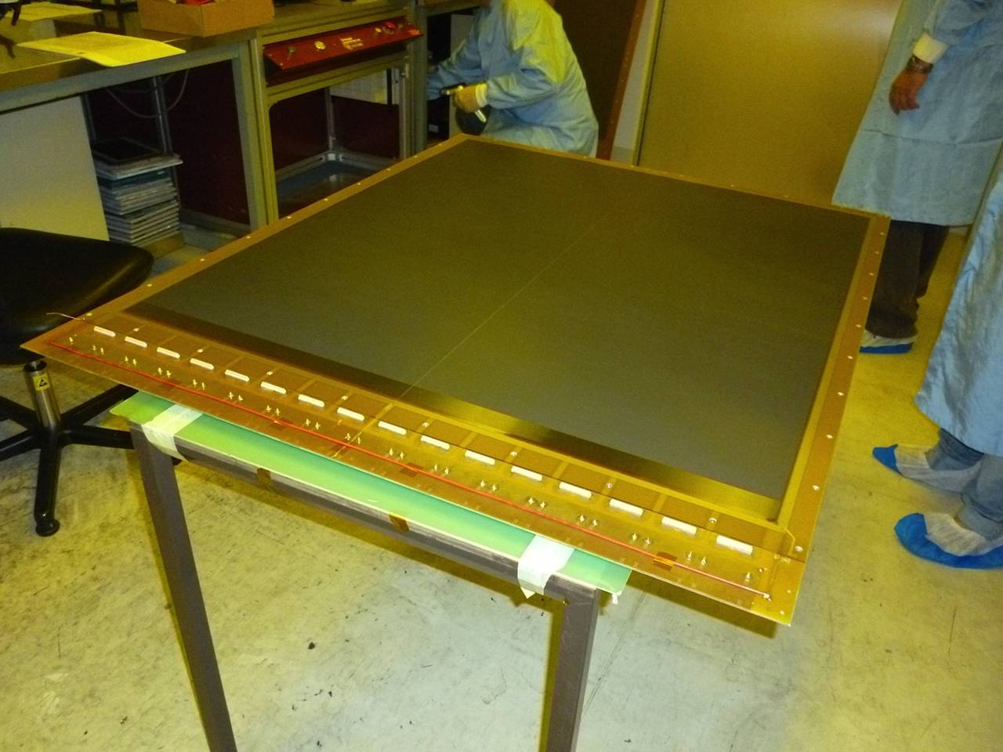
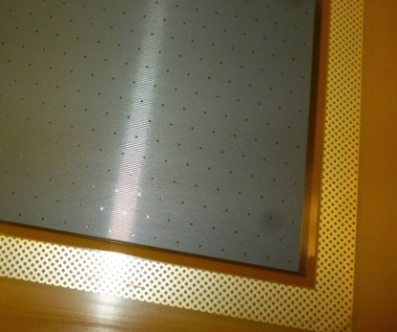
flat gluing
< 10um error
Mesh on drift (10Ncm )
Flat board < 30um error

