Slide 1


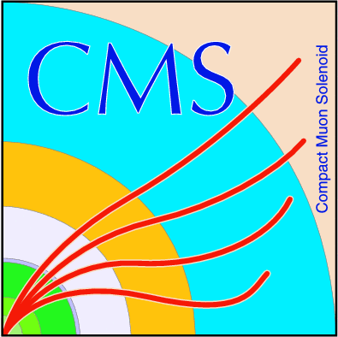
Spike problem

Slide 2
CMS Electromagnetic Calorimeter
(ECAL)
• Measures energies of electrons and photons.
• Ideal for stopping high energy particles.
• Made from crystals of lead tungstate (PbWO4).
• Backed by silicon APD’s
o APD - Avalanche Photo Diode
o Converts light to electricity very efficiently.
• Number of crystals in ECAL
75848 crystals organized into barrel and endcaps.

Slide 3
CMS Trigger system
• The Level 1 (L1) trigger is a hardware trigger close to the detector, consisting of super fast electronics.
• The High Level Trigger (HLT) is a software trigger.
• The trigger system reduces the number of events from about 40 million per second (40 MHz) to ~ 100 per second.
• RAW data from CMS would be ~ 40 terabytes per second.
• After the trigger roughly 100 MB per second remain.

Slide 4
Spike phenomenology
• Isolated high energy deposits in ECAL Barrel (EB)
o Occur at a rate proportional to the intensity of the proton beams.
o Produced by direct ionization of the APD’s by particles created in pp collisions.
o Presents issues for triggering CMS at high luminosity.
- On average, one spike with transevrse energy > 3 GeV is observed per 370 minimum-bias triggers in CMS

Slide 5
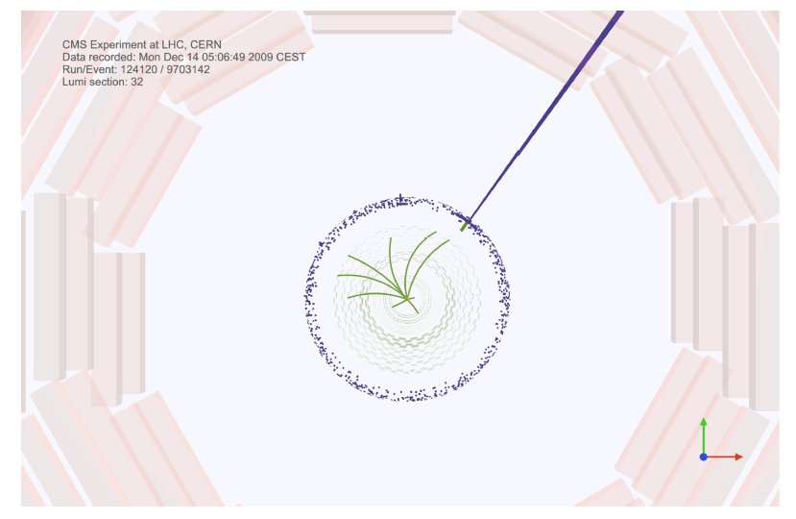
CMS Event Display of a pp collision event, showing an isolated ECAL spike corresponding to a 690 GeV transverse energy deposit.

Slide 6
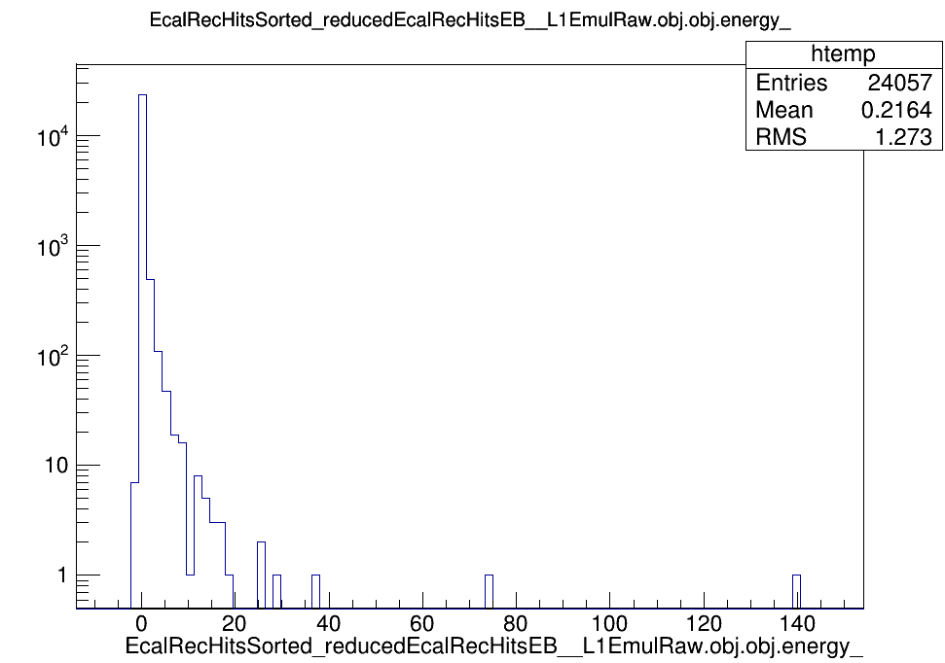
Rechit energy

Slide 7
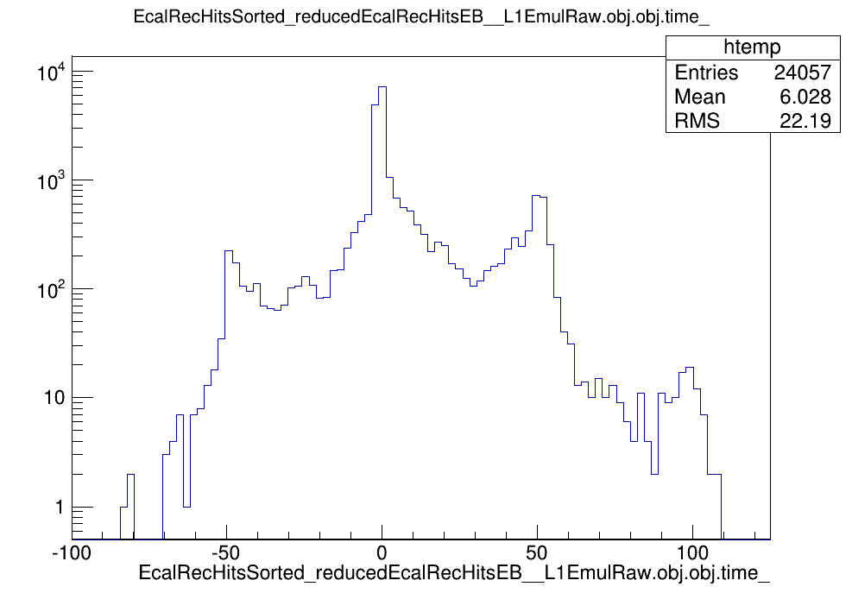
Rechit timing

Slide 8
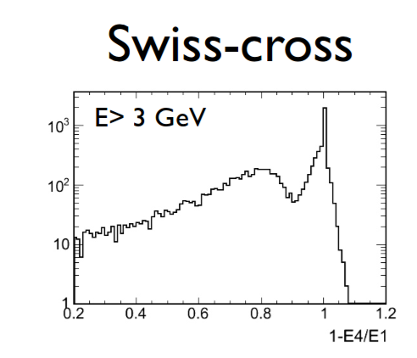

Slide 9
Spike can be solved :
Online rejection.
Offline rejection.

Slide 10
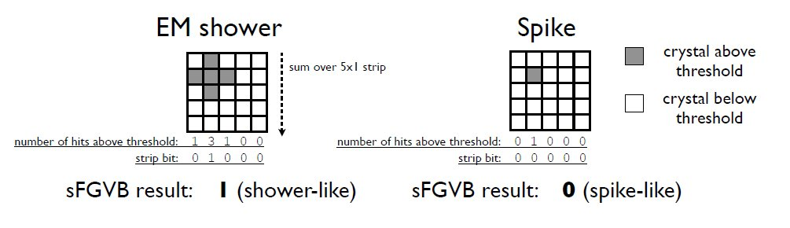
Online rejection:

Slide 11
Offline rejection:
• Cut on topology (”Swiss-cross” variable).
• Cut on timing.

Slide 12
Problems and motivation:
Problems:
1.MC data with spikes signal at 14 TeV and possibly 30TeV.
2.Accessing the online system.
3.Accessing Oracle database that contains the non-event data.
Motivation:
1.Apply and tuning sFGVB thresholds on the channels and compile it with the emulator on CMSSW.
2.Develop codes to emulate it with the emulator.
3.Based on data of 2010,2011,2012 and the factors on which the spikes depends, we will try to predict the spikes rate .

Slide 13
Thanks
Alex Zaby.
Nadir.
Philippe Minne
Sherif Elgammal

