Slide 1

RF Power
Colin Whyte/Kevin Ronald for
The MICE RF Group

Slide 2
Contents
LLRF
High power testing
RF distribution
Procurement
RF Cavities

Slide 3
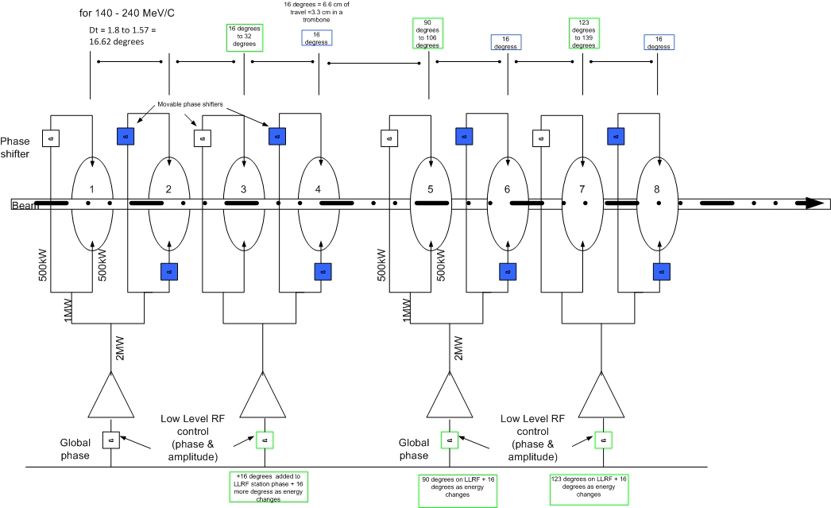
Schematic of System

Slide 4
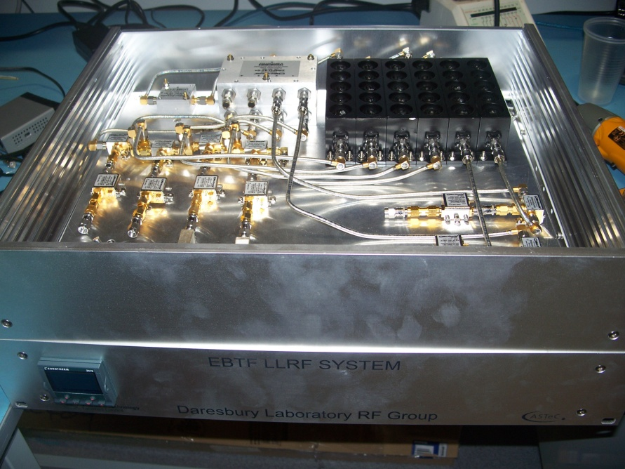
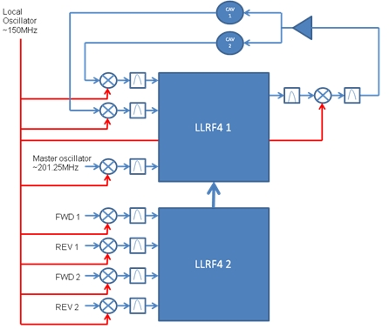
Digital low level RF Control
To control and regulate cavity amplitude and phase angle during the RF pulse. Based on LBNL LLRF4 board.
Target 0.5 degree phase, 1% amplitude
Systems in use already with EPICS control, feedback, feedforward, resonance control etc
Results obtained ( ALICE )
  1 Year of operations. 2 failure conditions
  involving RS232 communications problems.
  – Flat top Phase RMS error 0.04 degree
  – Flat top Amplitude RMS error 0.2%
Ramped pulse structure to limit reflected power tested on bench with 1.3GHz cavity.
Mice cavities
Amplifier

Slide 5
Digital LLRF Control
Completed system contains < £5,000 of parts, plus 1 man week to assemble. To learn how to produce firmware took ~ 4.5 man years.
We have converted our system to run on another accelerator with only a couple of months effort.
Now that we have a working platform, modifying it for other machines isn't a great deal of work.
Digital systems offer great flexibility in upgrading / diagnostics. It doesn't have to be very time / cost intensive.

Slide 6
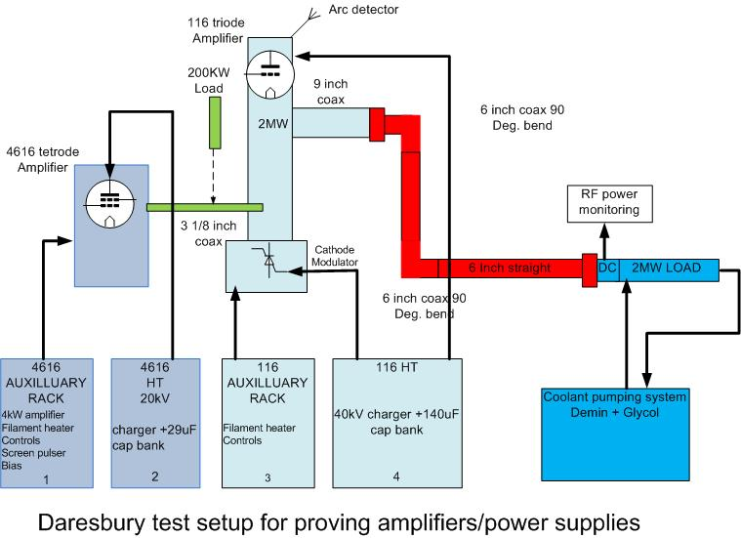
Test system at Daresbury

Slide 7
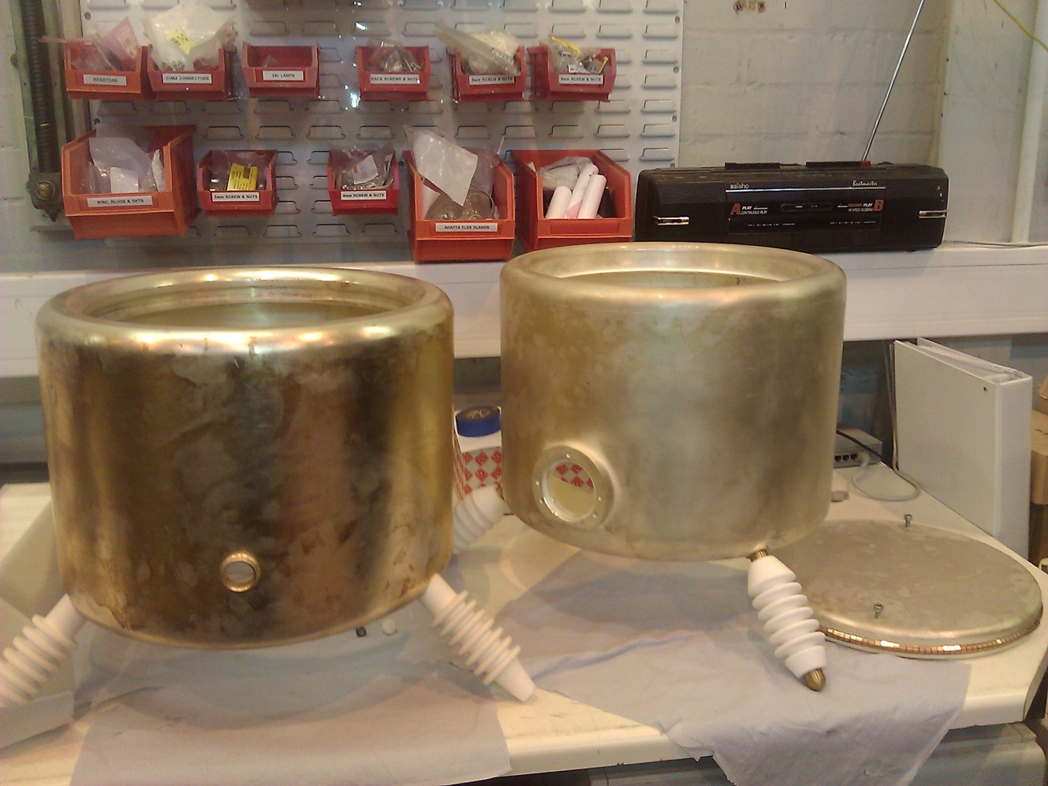
HT top box modification
HT top box is where high voltage is applied to the anode
Water coolant is supplied to the valve using insulating glass rods
On the original LBNL amplifier, coolant passed out of the system as steam
CERN HT top box with ability to pass both coolant flow and return pipes, which is why it was used
Original LBNL HT top box with small inlet for only one coolant pipe
LBNL HT top box has been converted to two water pipes with correct spacing, both types of amplifier will now use CERN type top box and cooling.

Slide 8
Current status of HP Tests
Tube seating problem diagnosed and corrected by end 2012.
Testing of the amplifier system continued into 2013.
Current maximum peak power achieved 1.2MW.
Currently exploiting old used tube to re-establish settings on the amplifier system.
Test re-started with expanded group including new RF engineer, PhD student and Strathclyde staff.
Power supply crowbar issue, diagnosis in progress, alternate protection circuitry under consideration. (see procurement, later)

Slide 9
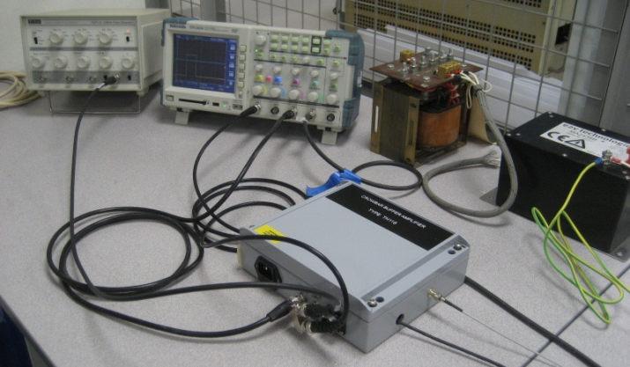
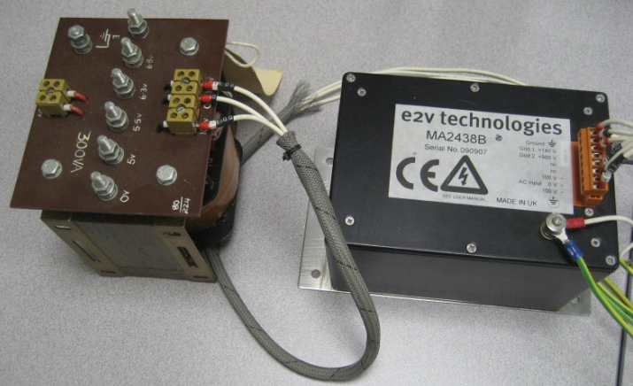
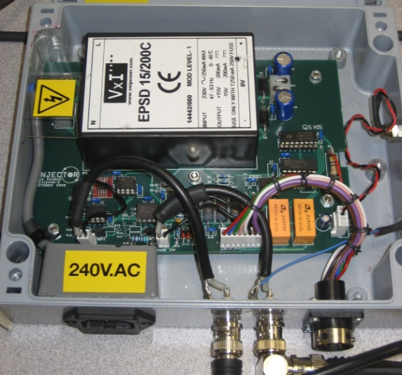
Crowbar Trigger System under investigation - May 2013
False triggers causing firing of crowbar at low voltages (~ 16 kV)
Earthing of circuit has been extensively reviewed and a few minor changes made. These did not affect the premature trigger issue.
Tests to determine if trigger signal is coming from the detector circuit (see photos) or is due to pulse firing unit (E2V MA2438B) operating spontaneously

Slide 10
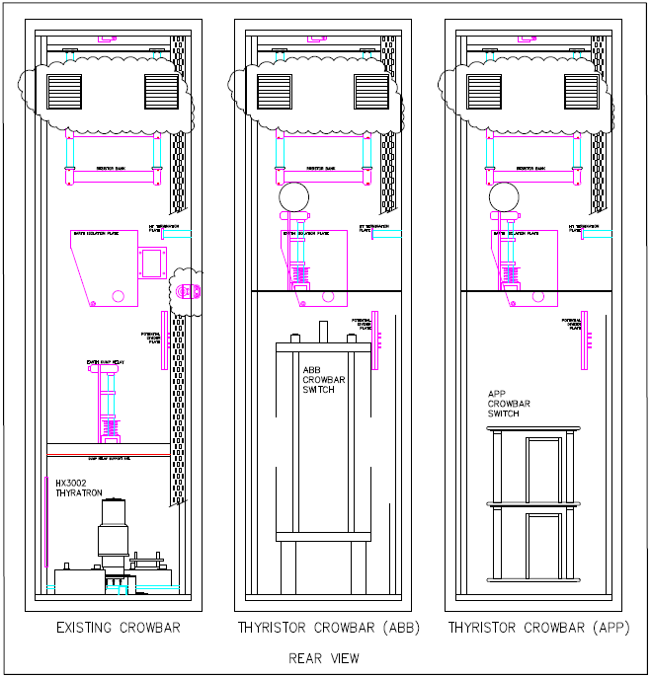
Rear view of 40 kV power supply rack showing existing thyratron crowbar and potential solid state replacement options
APP switch can be accommodated with a few design changes.
ABB switch is large and would be difficult to fit in the existing rack.
Diversified Technologies switch is a complete rack.

Slide 11
Costs
Supplier | 40 kV Crowbar | 20 kV crowbar
ABB | 1 £24,000 (20 weeks) June 2008 – updated quote awaited
Applied Pulsed Power, Inc. | 1 $36,000 (12weeks) 2-3 $32,000 (14 weeks) | 1 $20,000 (12weeks) 2-3 $16,000 (14 weeks)
Diversified Technologies, Inc. | 1 $125,000 (24 weeks)

Slide 12
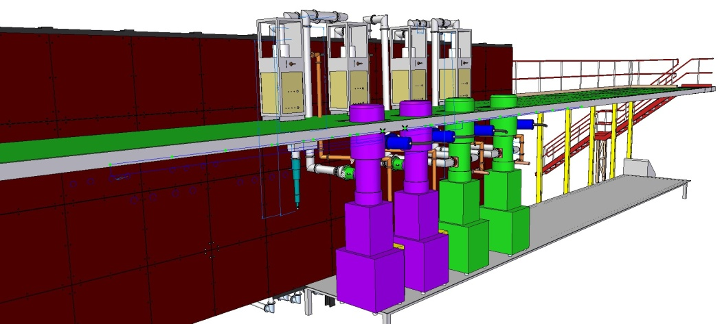
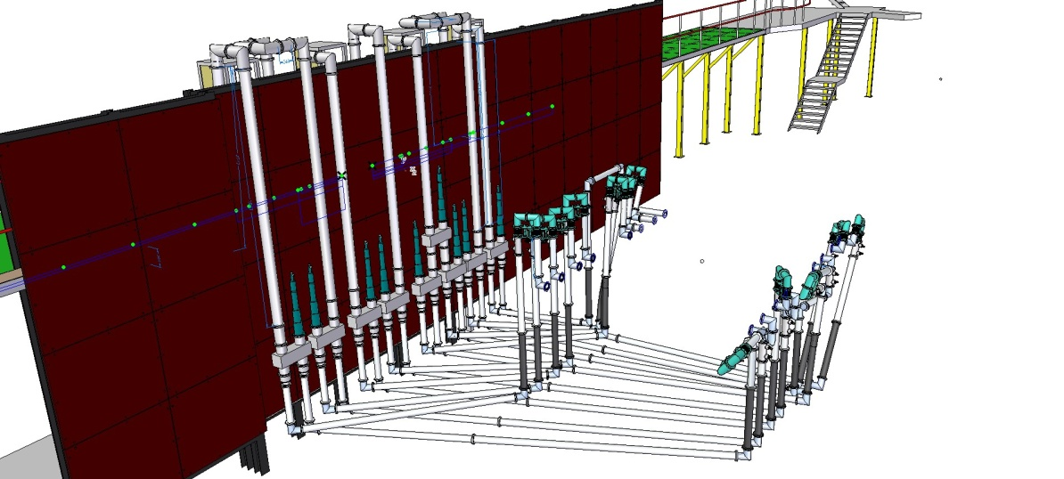
RF Distribution – Final Installation
Amplifiers behind Shield Wall
Amplifiers installed behind shield wall
  Triodes on main floor, Tetrodes on Mezzanine
  Impact of B-fields currently being analysed. Detailed drawings prepared and sent to P.Smith. Currnetly being ananlysed.
  Shielding requirements assessed
4 off 6 inch coax lines over wall
  Pressurised to increase power handling
  Pressure monitor linked to safety system
Line lengths matched using 3D CAD
Easier to assemble – introduced flexible coax
  Allows for small misalignments
Distribution Network to MICE

Slide 13
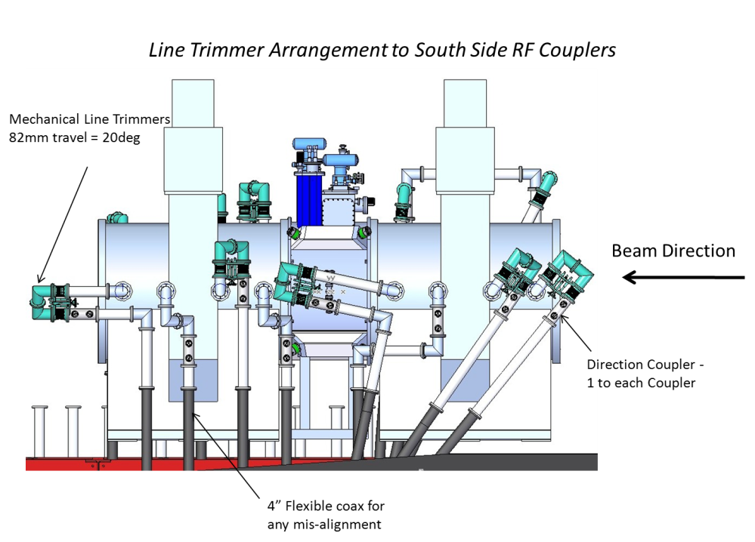
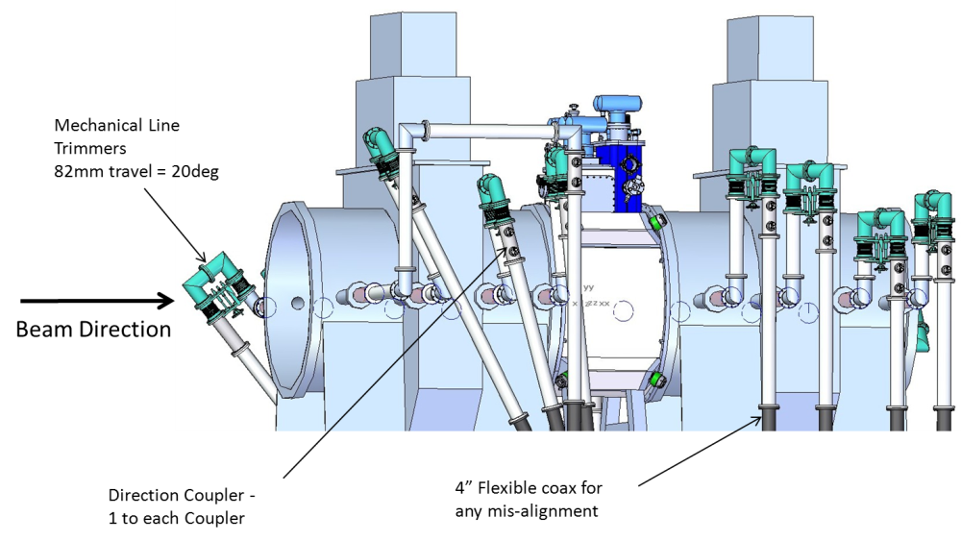
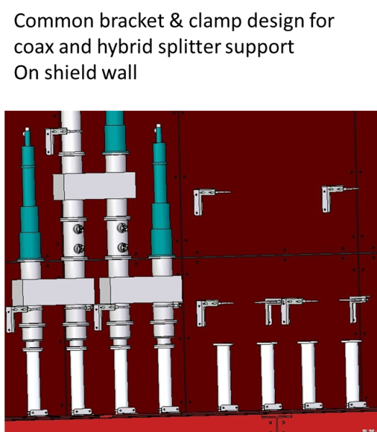
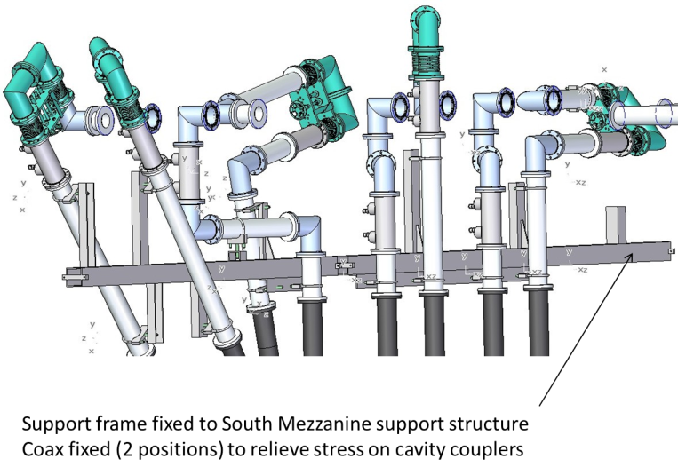
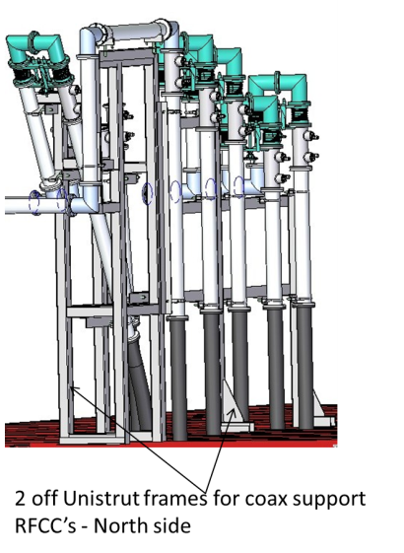
Revised Co-Axial Distribution Network
Co-axial line length calculated: procurement in progress
Most other components already being procured
Hanger and Mounting designs completed and testing in hand

Slide 14
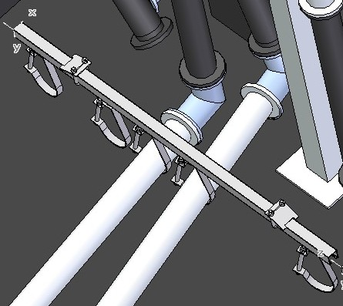
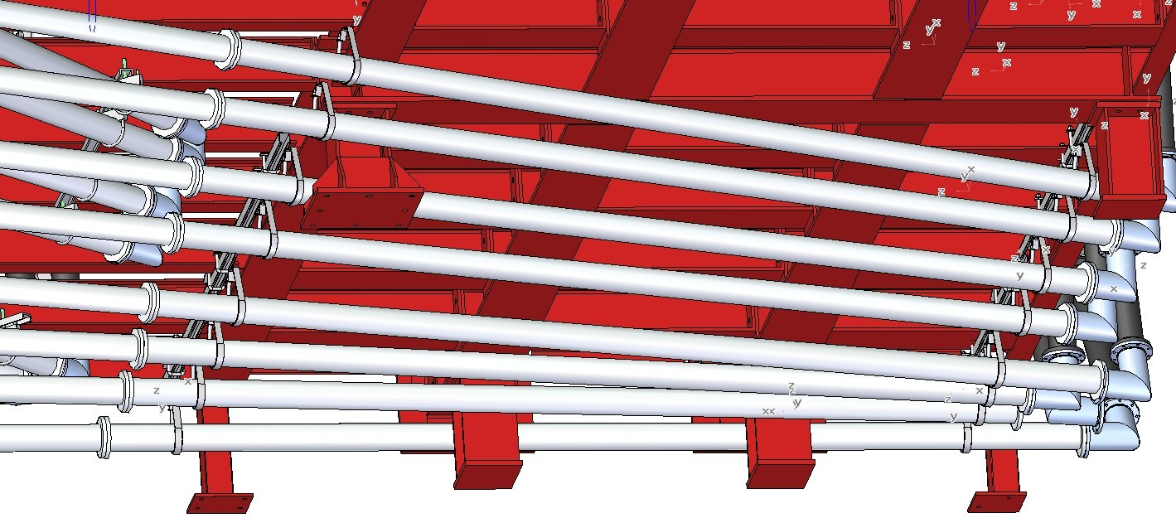
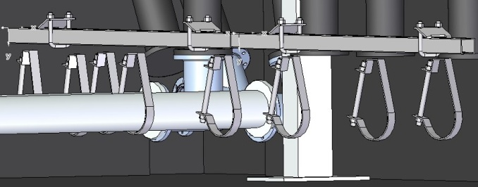
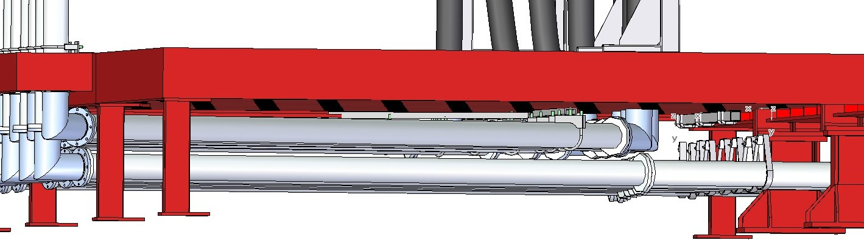
Designs of the RF Coax Support
Coax held in position on ‘hangers’ suspended from floor steelwork. Flexible system
Hangers suspend on Unistrut fixed to steelwork with adjustable clamps.
No support structure on floor. Clear access for cable trays and water pipes.

Slide 15
Procurement
Substantial procurement of RF components through University of Mississippi
  New Tetrode amplifier set delivered to University of Mississippi from Photonis.
  4 new tetrode valves ordered from Photonis
  Loads on order from Altronics.
Distribution Network
  RF 4” elbows delivered to U. Mississippi
  Order placed for all other required co-ax components with Mega.
  Orders for 2 additional capacitors for RF system 2 placed with GA.
  Capacitor chargers ordered from Lambda
  List of equipment prepared to absorb residuals.
    Solid state replacement for crowbar.
    RF test gear
    SSPAs
  Don Summers (and colleagues) working on procurement
All components required for TIARA deliverables ordered.

Slide 16
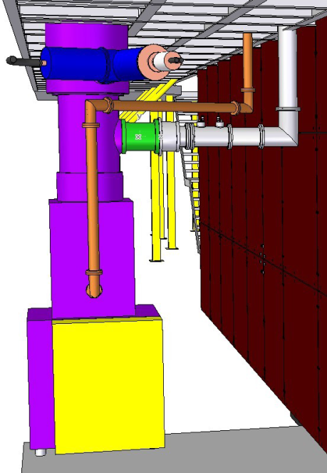
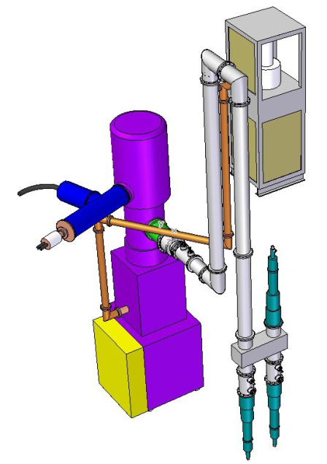
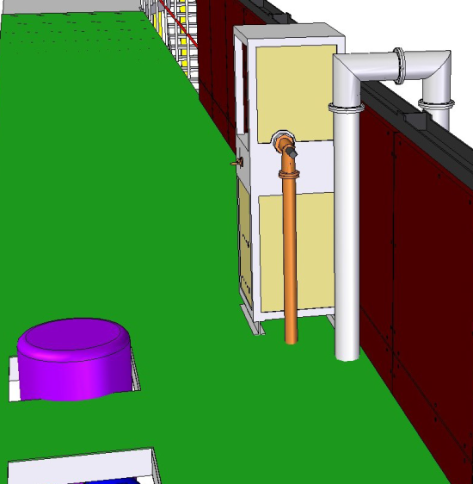
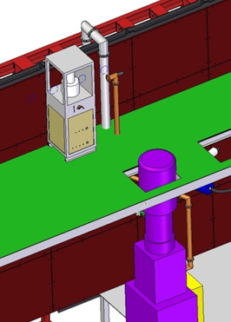
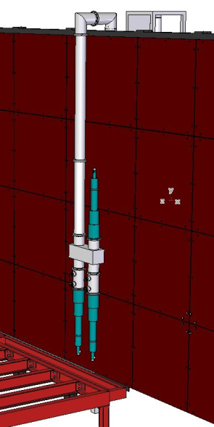
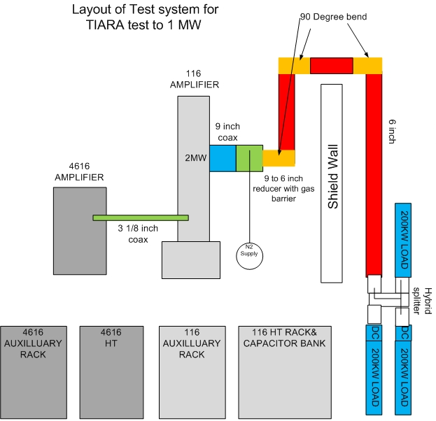
MICE Hall RF system for TIARA Test
One amplifier set installed in operational position
  Installed in the first amplifier station
  Tetrode on Mezzanine, Triodes deep behind the shield wall
  Opportunity to test the impact of B-fields during STEP IV
One hybrid installed on MICE side of shield
3 loads, two will share the output power of the amplifier
Components all on order.
Safety document prepared by RF group.
TIARA Installation Detail

Slide 17
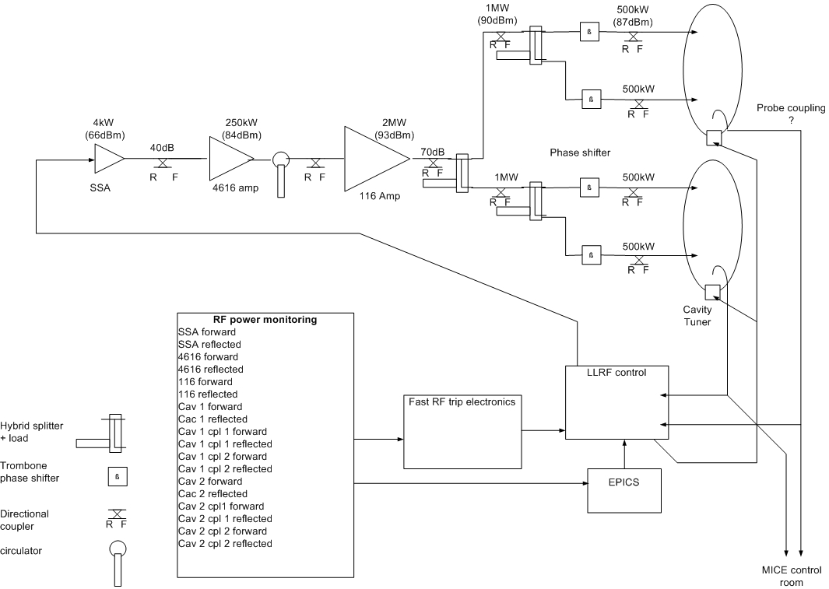
RF system monitoring and protection

Slide 18
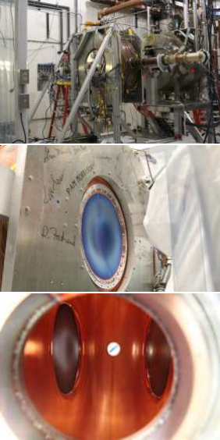
MTA 201-MHz Program Overview
(Surface treatment, NF channel, MICE)
201-MHz MICE prototype cavity with SRF like surface treatment (EP, HP rinse)
– Conditioned to design gradient quickly
– Demonstrated operation with curved Be
windows
– Somewhat reduced performance in fringe field of solenoid
– No surface damage seen on cavity interior
– Some evidence for sparking in the coupler (New design has been implemented)
– Radiation output measured (MICE detector backgrounds)
Future
– Install/operate single-cavity vessel
– Large diameter magnet (“coupling coil”) needed for field configuration closer to MICE/cooling channel

Slide 19
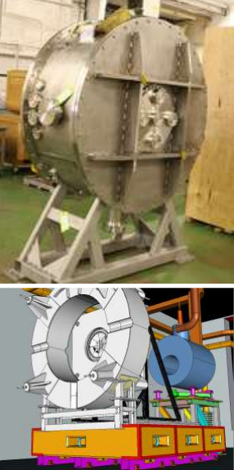
201-MHz Single-Cavity Module
Assembly/integration
– Cavity and vessel at Lab-6
– Clean room prepared
– Plan in place for handling and transport (R. Schultz, J. Volk)
– Assembly fixture designed (A. DeMello)
– Tuner control bench tested (P. Hanlet)
Expect operation Summer 2013
– beam test also under consideration
Ultimately will be tested with the first Coupling Coil Magnet
– Requires 6-month MTA shutdown

Slide 20
201MHz Cavity Outlook
• On track for results from operation of single-cavity module at MTA by cm37.
• tight schedule and lots of work to do.
• resource availability critical.
• Installation will provide valuable experience for MICE RFCC module assembly.
• There may be an opportunity to test MICE RF phase measurement concept.

Slide 21
Summary
High Power Tests
  Air side arcing problem solved.
  Assembly completed, tests in progress, old ISIS valve re-installed for testing.
  High power testing with new RF engineer and PhD student in attendance.
  High power test group expanded to include staff from Strathclyde.
  Time driver is TIARA. 2MW to be demonstrated.
Distribution Network
  Design completed for entire step VI configuration
  Order placed for loads.
  Orders placed for all other co-axial components and lines
    Includes components required for TIARA tests.
LLRF
  Digital control system design will be adapted from DL system with EPICS control, feedback, feedforward, resonance control…
  System can be ordered 6 months in advance with confidence.
Cavities
  Single cavity test stand preparations progressing welll
  On track for results from operation of single-cavity module at MTA by cm37.
  Installation will provide valuable experience for MICE RFCC module assembly.
  Opportunity to test MICE RF phase measurement concept.

