Slide 1
Magnetic field mitigation

Slide 2
Acknowlledgements:
Victoria Bayliss
John Cobb
Luke Fry
Melissa George
Pierrick Hanlet
Ken Long
Craig Macwaters
Courthold Mike
Ian Mullacrane
Roy Preece
Paul Smith
Jason Tarrant
John Webb
Holger Witter
Apologies if
I have omitted
you!

Slide 3
Status at MPB 31Oct13
Mitigation of stray magnetic field

Slide 4
MPB: 31Oct12; R. Preece:

Slide 5
Progress report
Mitigation of stray magnetic field

Slide 6
Magnetic modeling:
P. Smith
Hall Model
  The current MICE Hall Model is ~complete:
    Model now being used to gain information about the fields in the Hall and adjacent buildings
    The racks/compressors contain some fairly fine detail:
      So, given the size of the Hall (and the model) there is a compromise wrt the achieved meshing resolution
        Being studied
  It is clear that the results that the model is producing needs checking with reality:
    Two approaches:
      Validation of calculation: contract with Vector Fields;
      Comparison of measurement and model of Focus Coil in R9

Slide 7
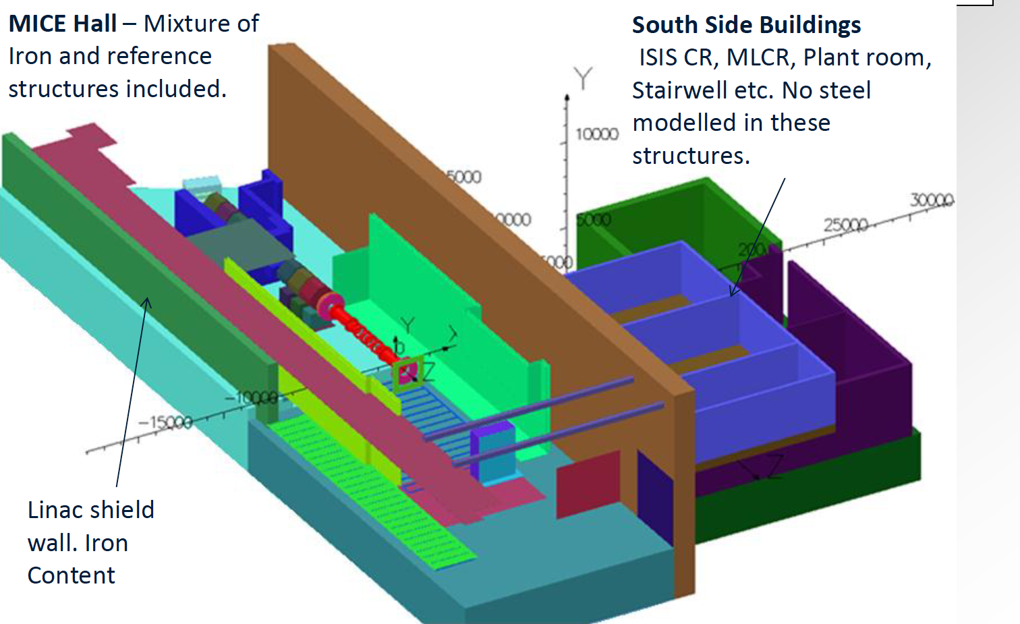
MICE Hall model: contents:
P. Smith

Slide 8
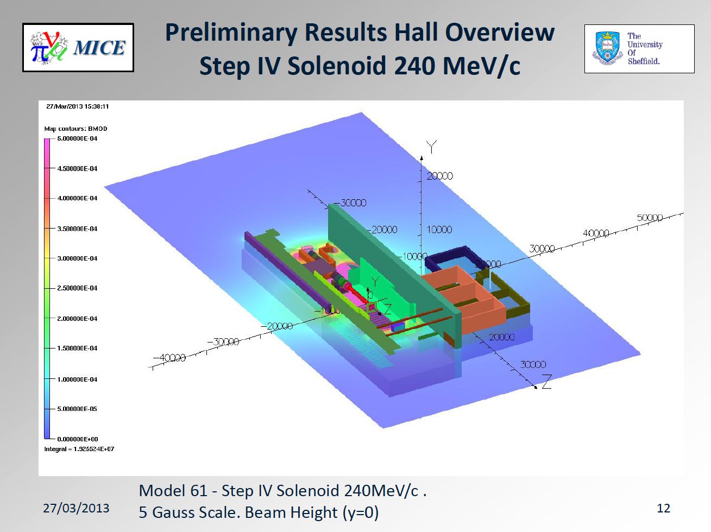

Slide 9
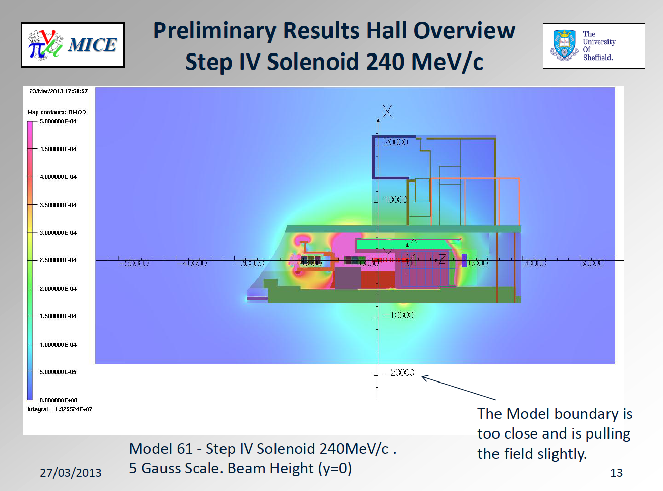

Slide 10
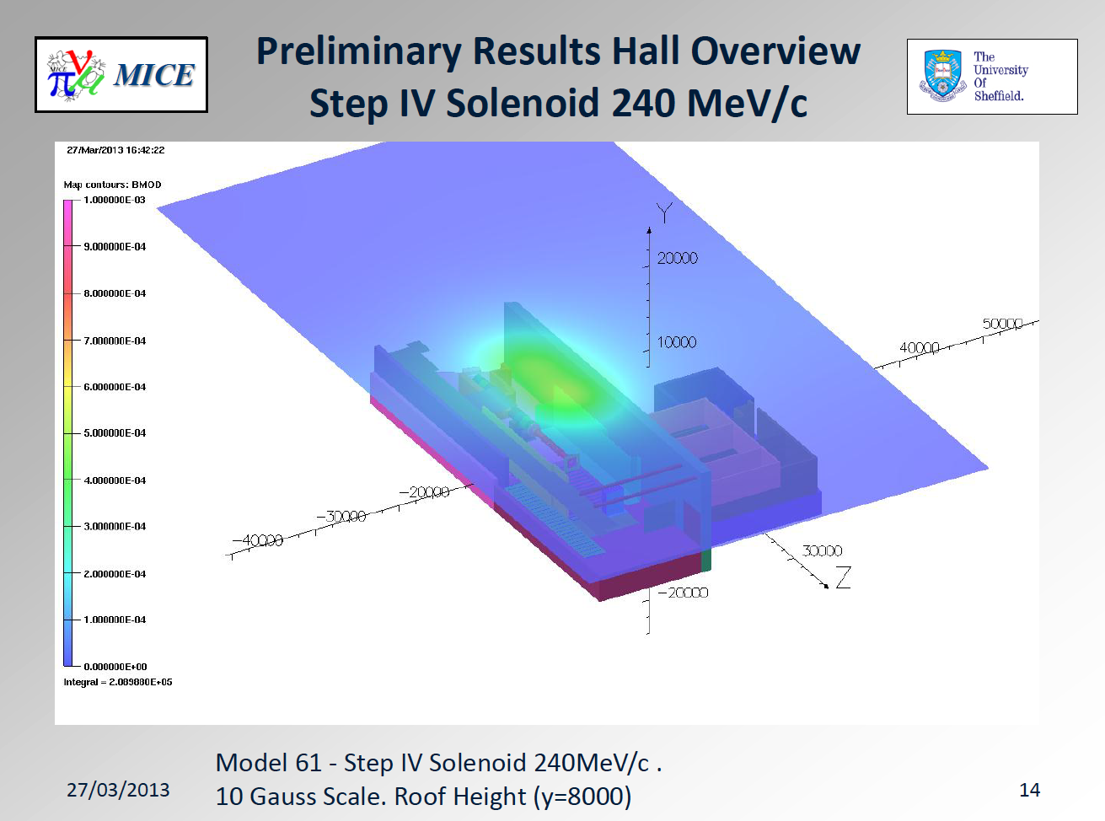

Slide 11
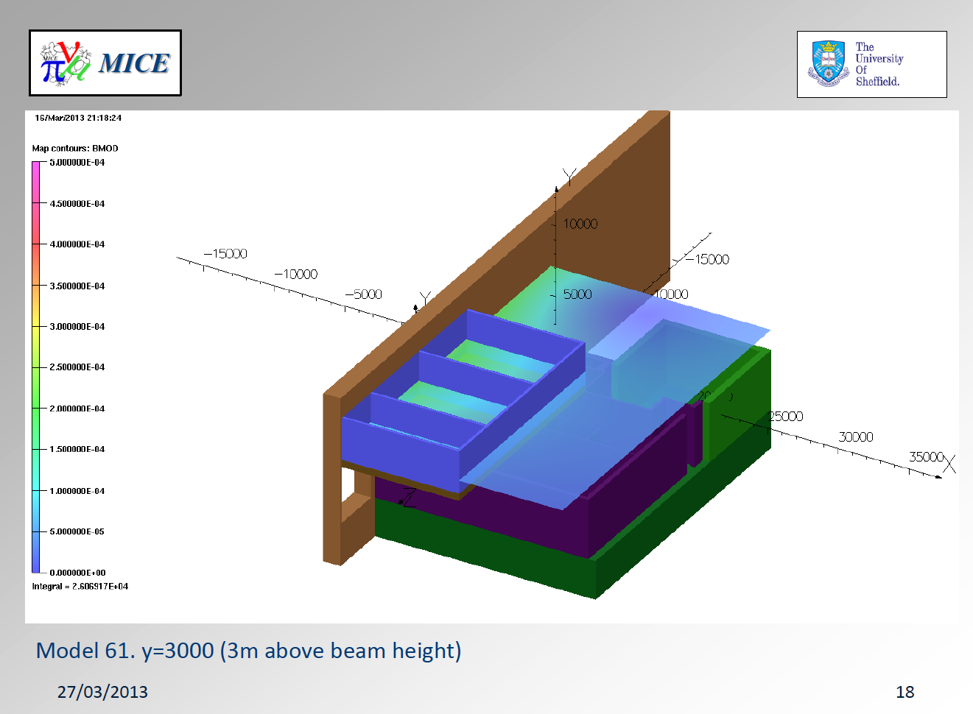

Slide 12
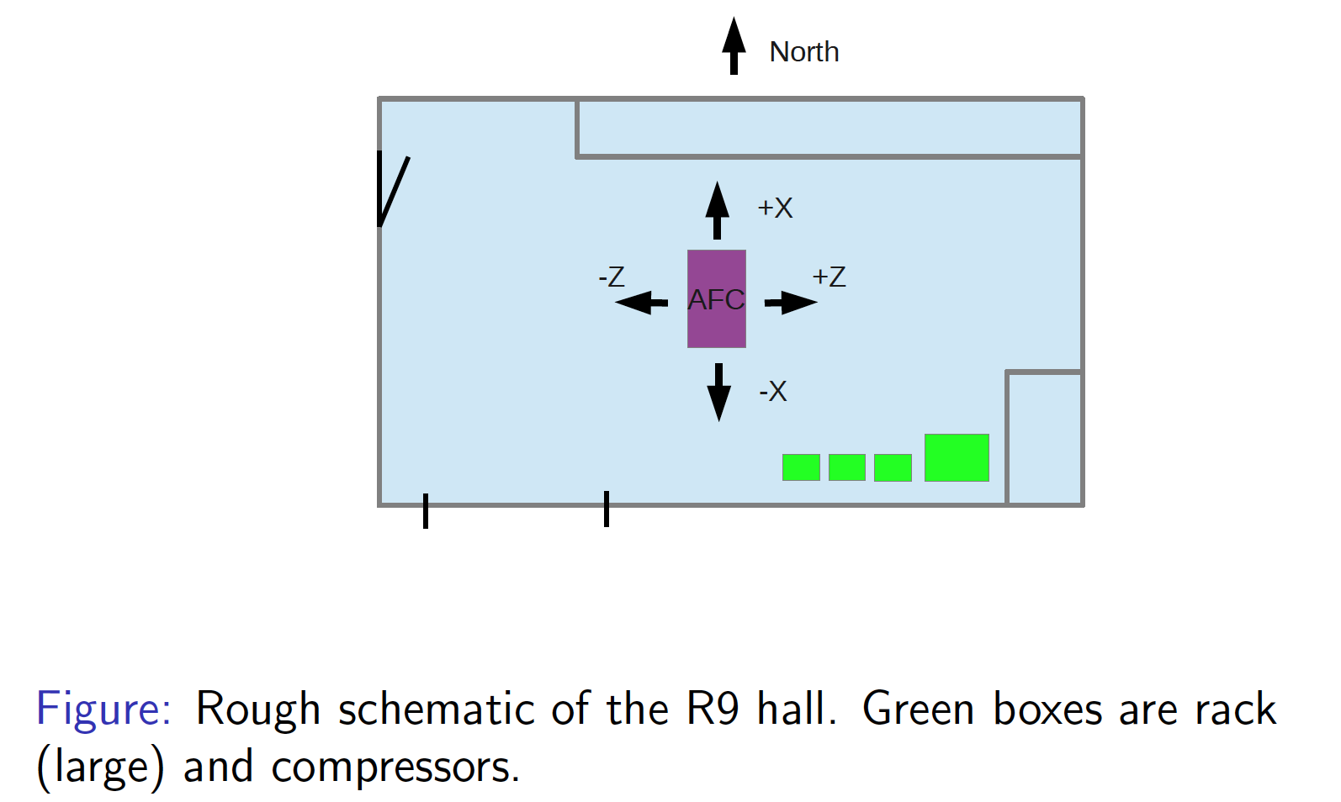
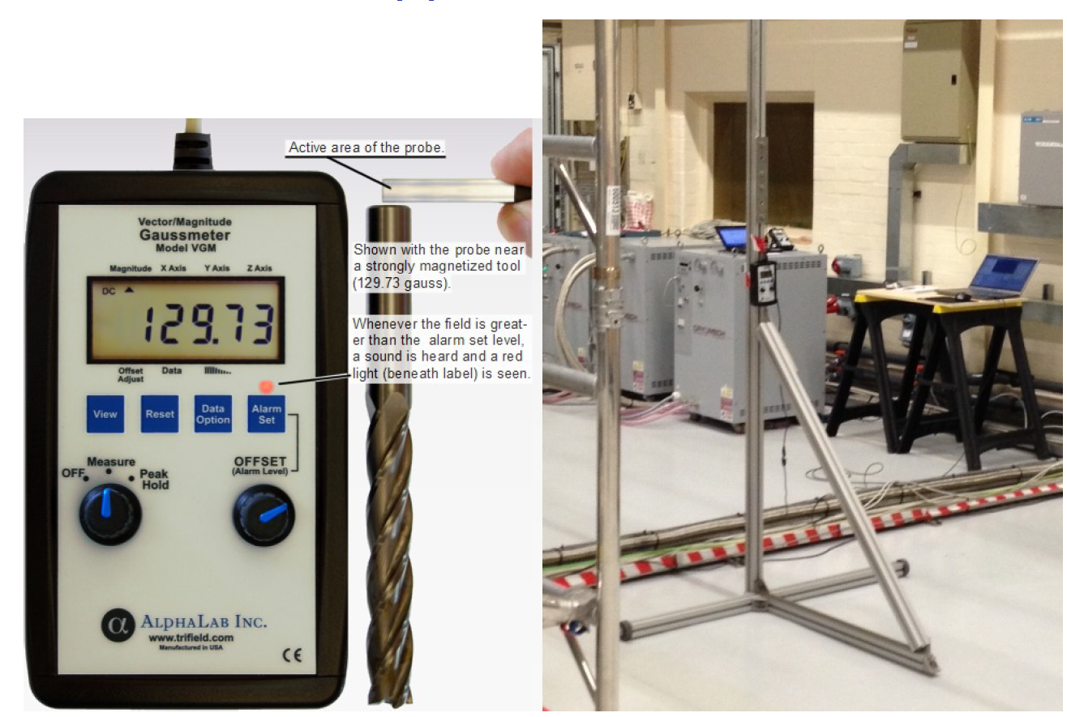
Measurements in R9:
I. Taylor, C. Pidcott, C. MacWaters et al.

Slide 13
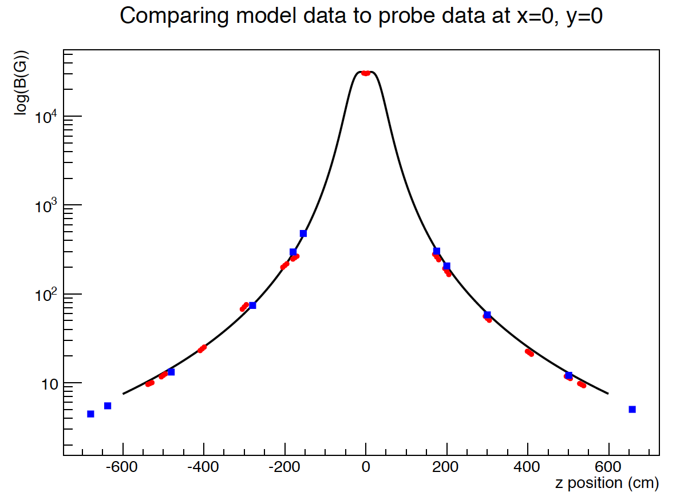
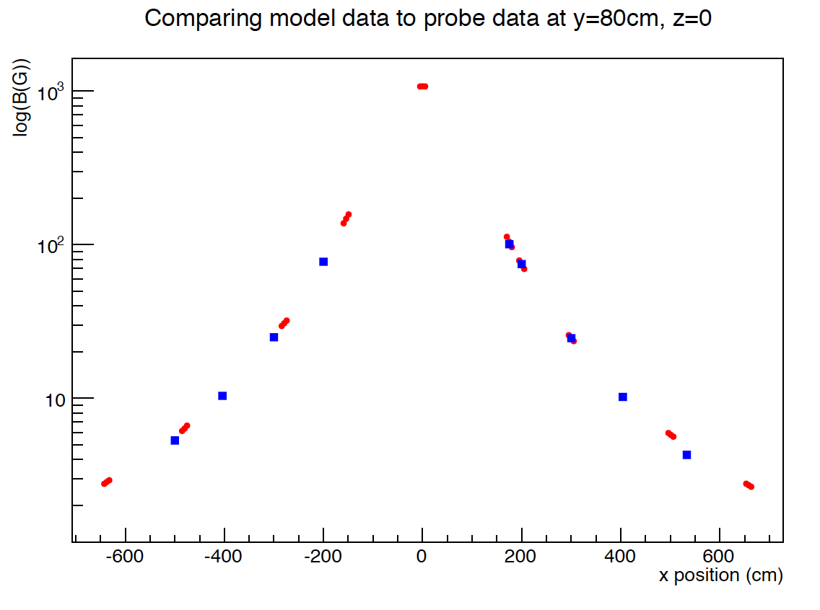
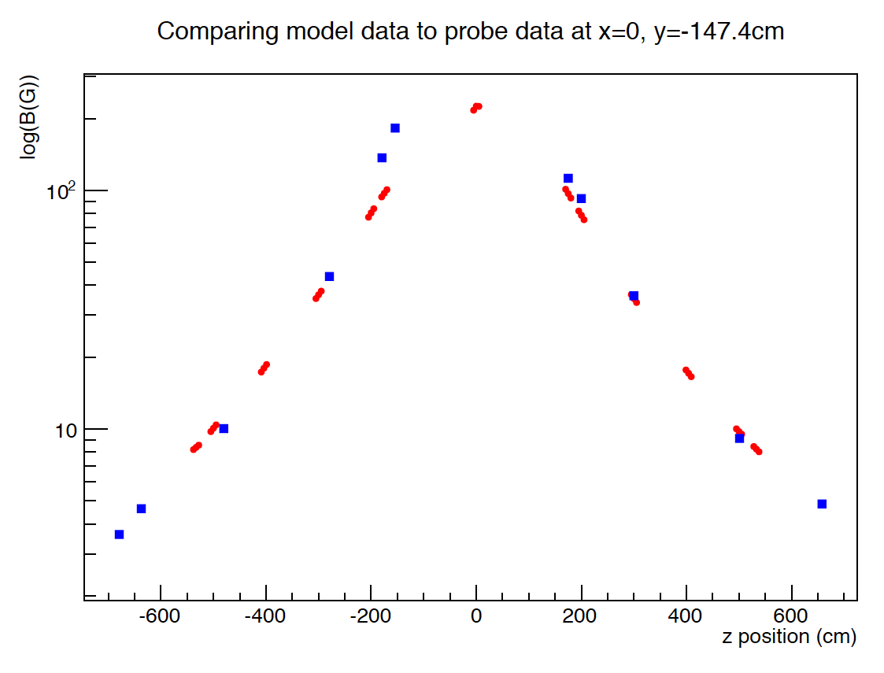
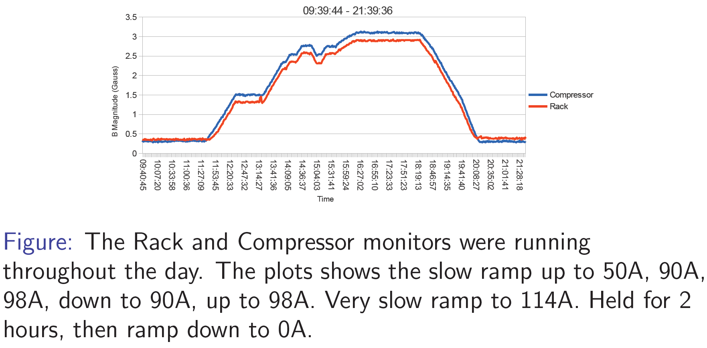

Slide 14
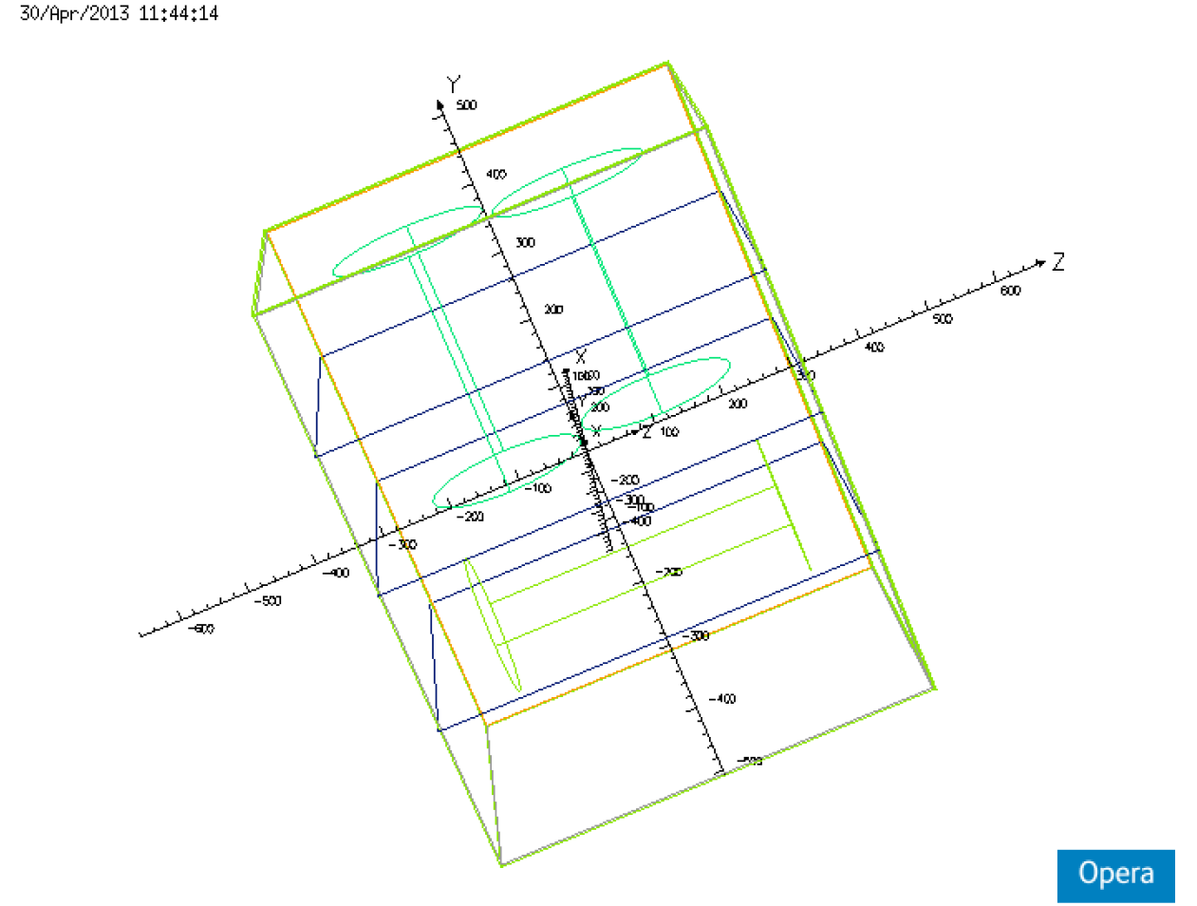
Next steps for measurements:
Measurements taken around and inside compressors and racks:
  Rack/compressor model being built (M. George)
  Comparison of measurement and model in preparation
Measurements of stray field in neighbourhood of racks and compressors made in the Wang set up (P. Hanlet et al):
  Comparison of measurement to model in preparation

Slide 15
Mitigation plan:
Mitigation of stray magnetic field

Slide 16
Mitigation plan:
CM35 agreed:
  Baseline:
    Remove equipment from areas of high field and shield equipment that can not be moved;
  Mitigation of technical risk in the baseline:
    Develop partial return yoke design and integration plan;
Status of work follows:
  Most critical equipment that requires local shielding is the tracker readout

Slide 17
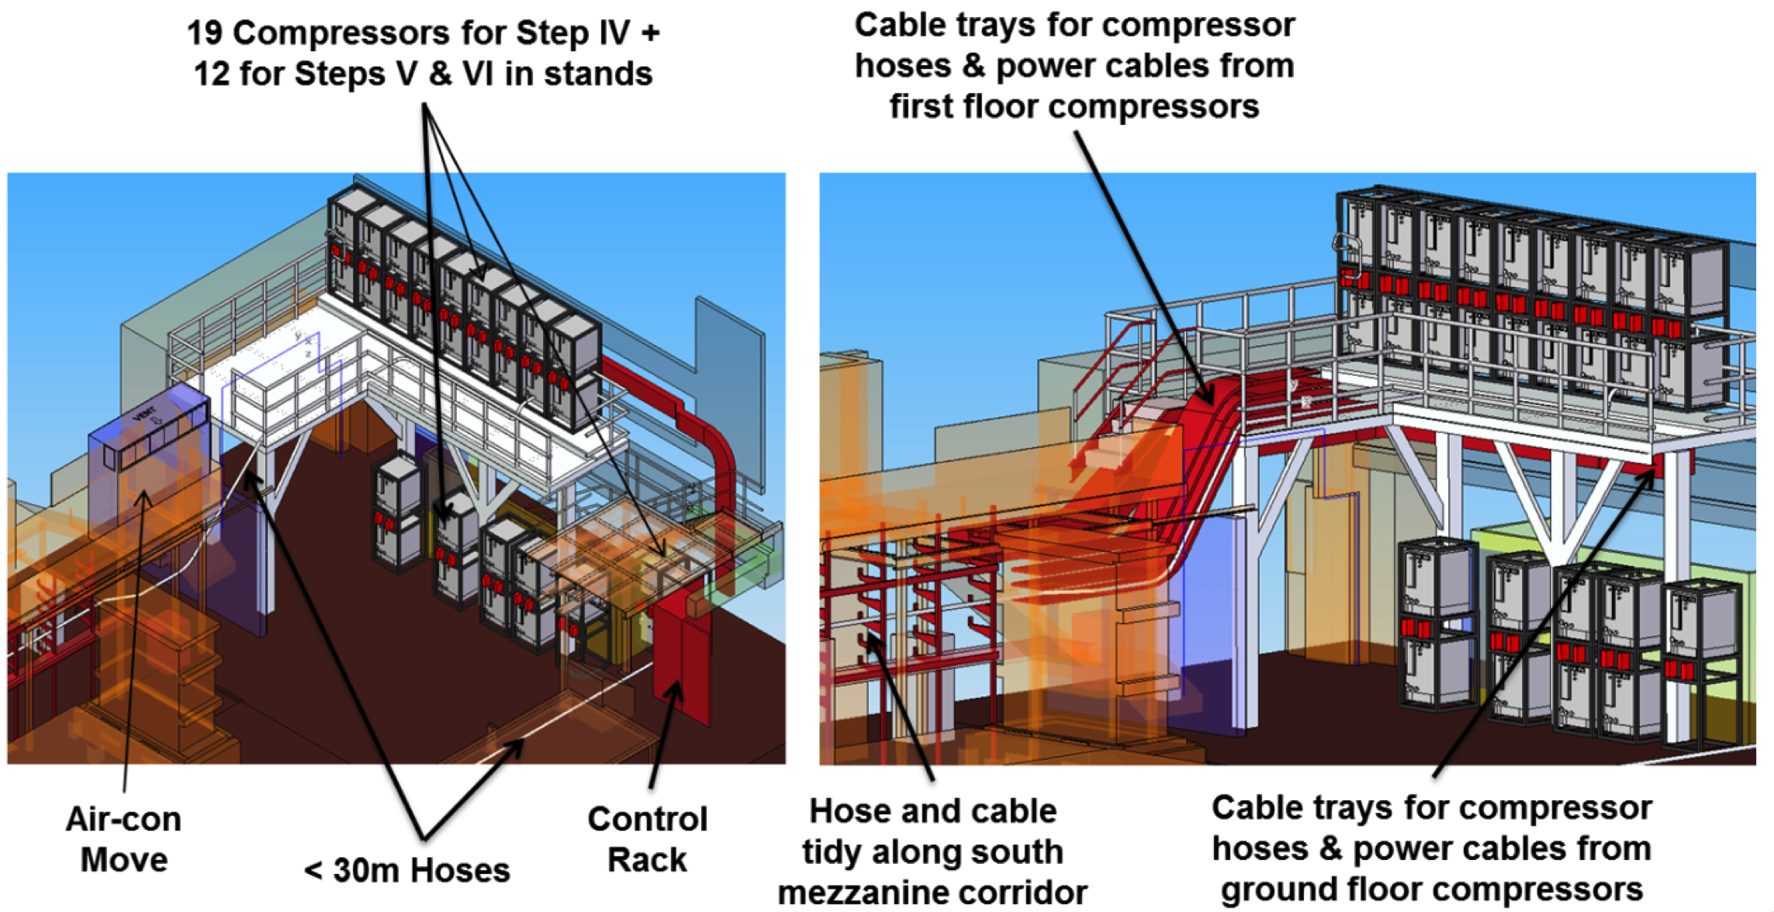
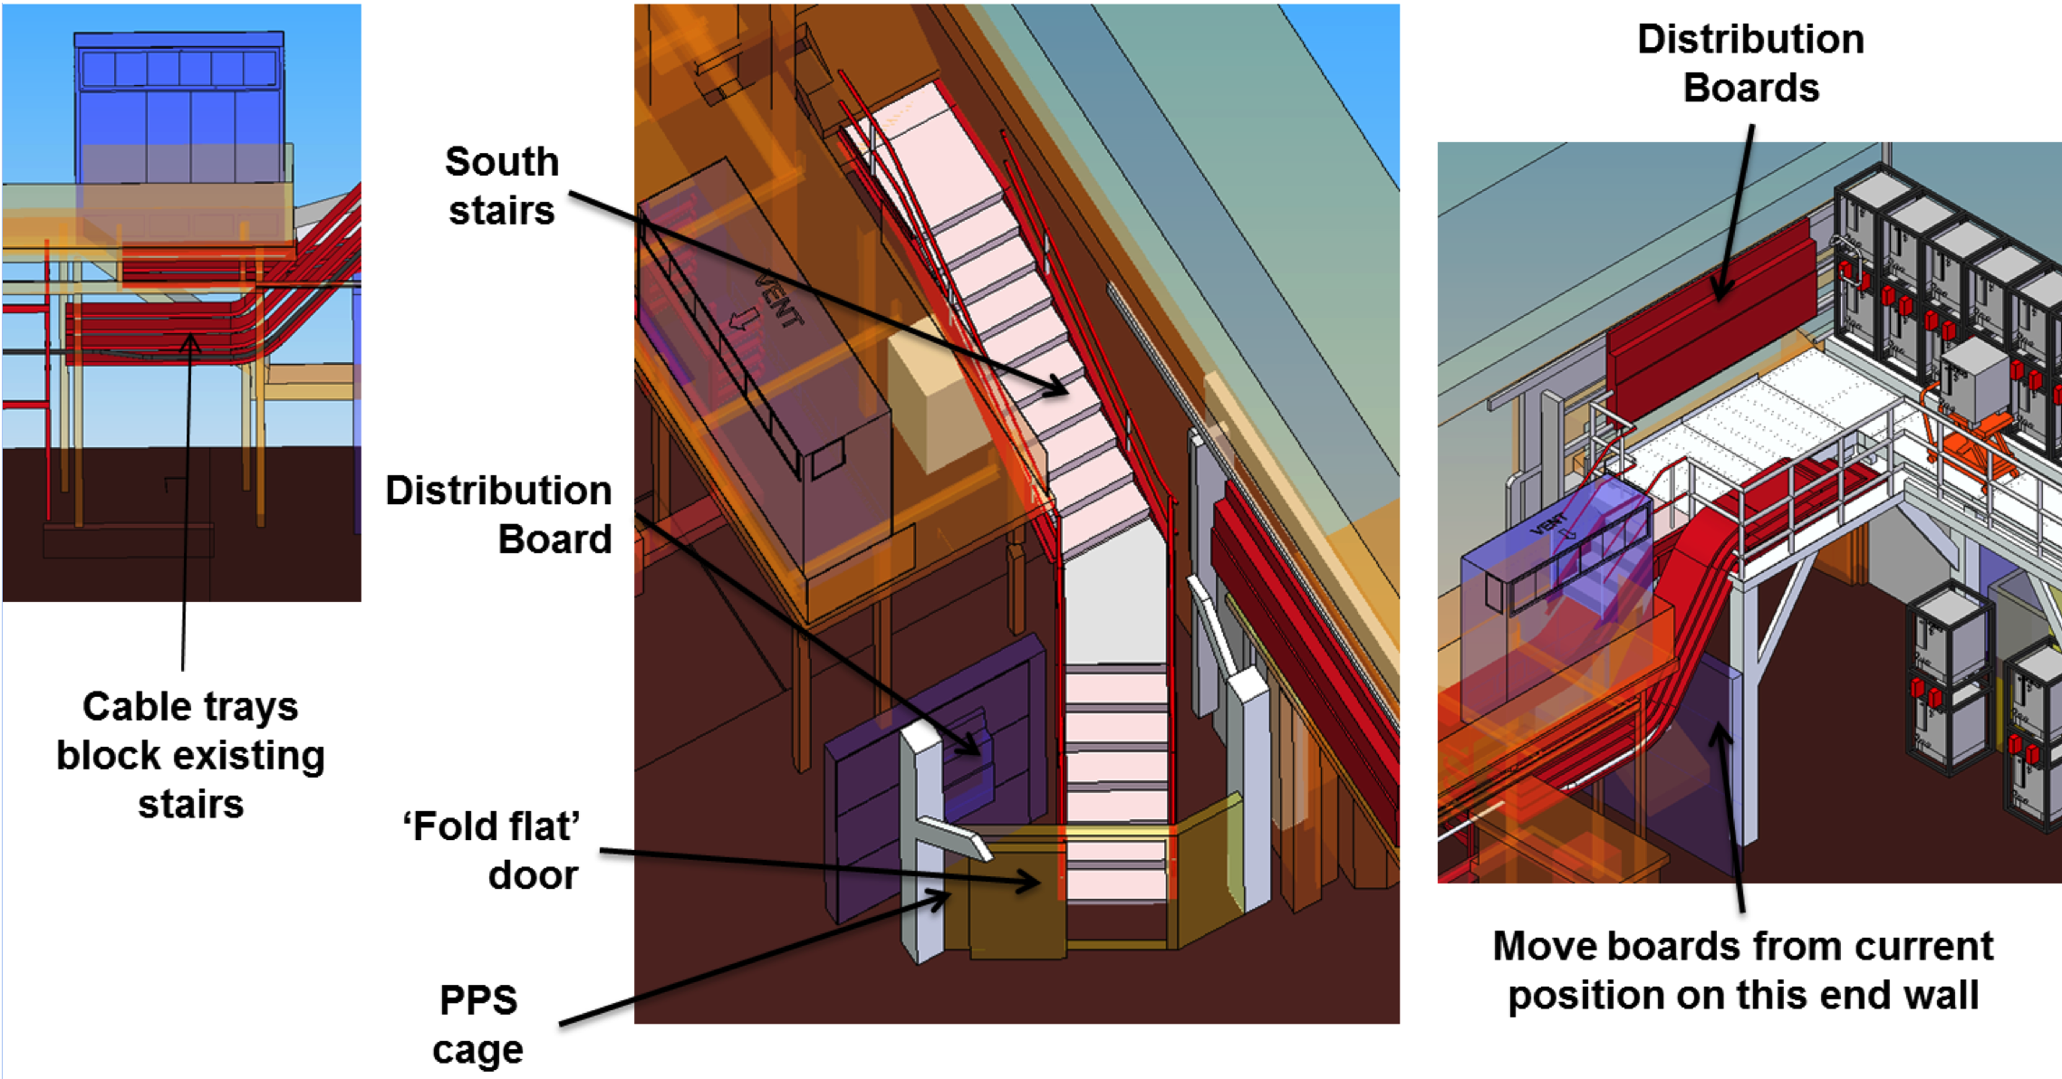
J. Tarrant et al

Slide 18
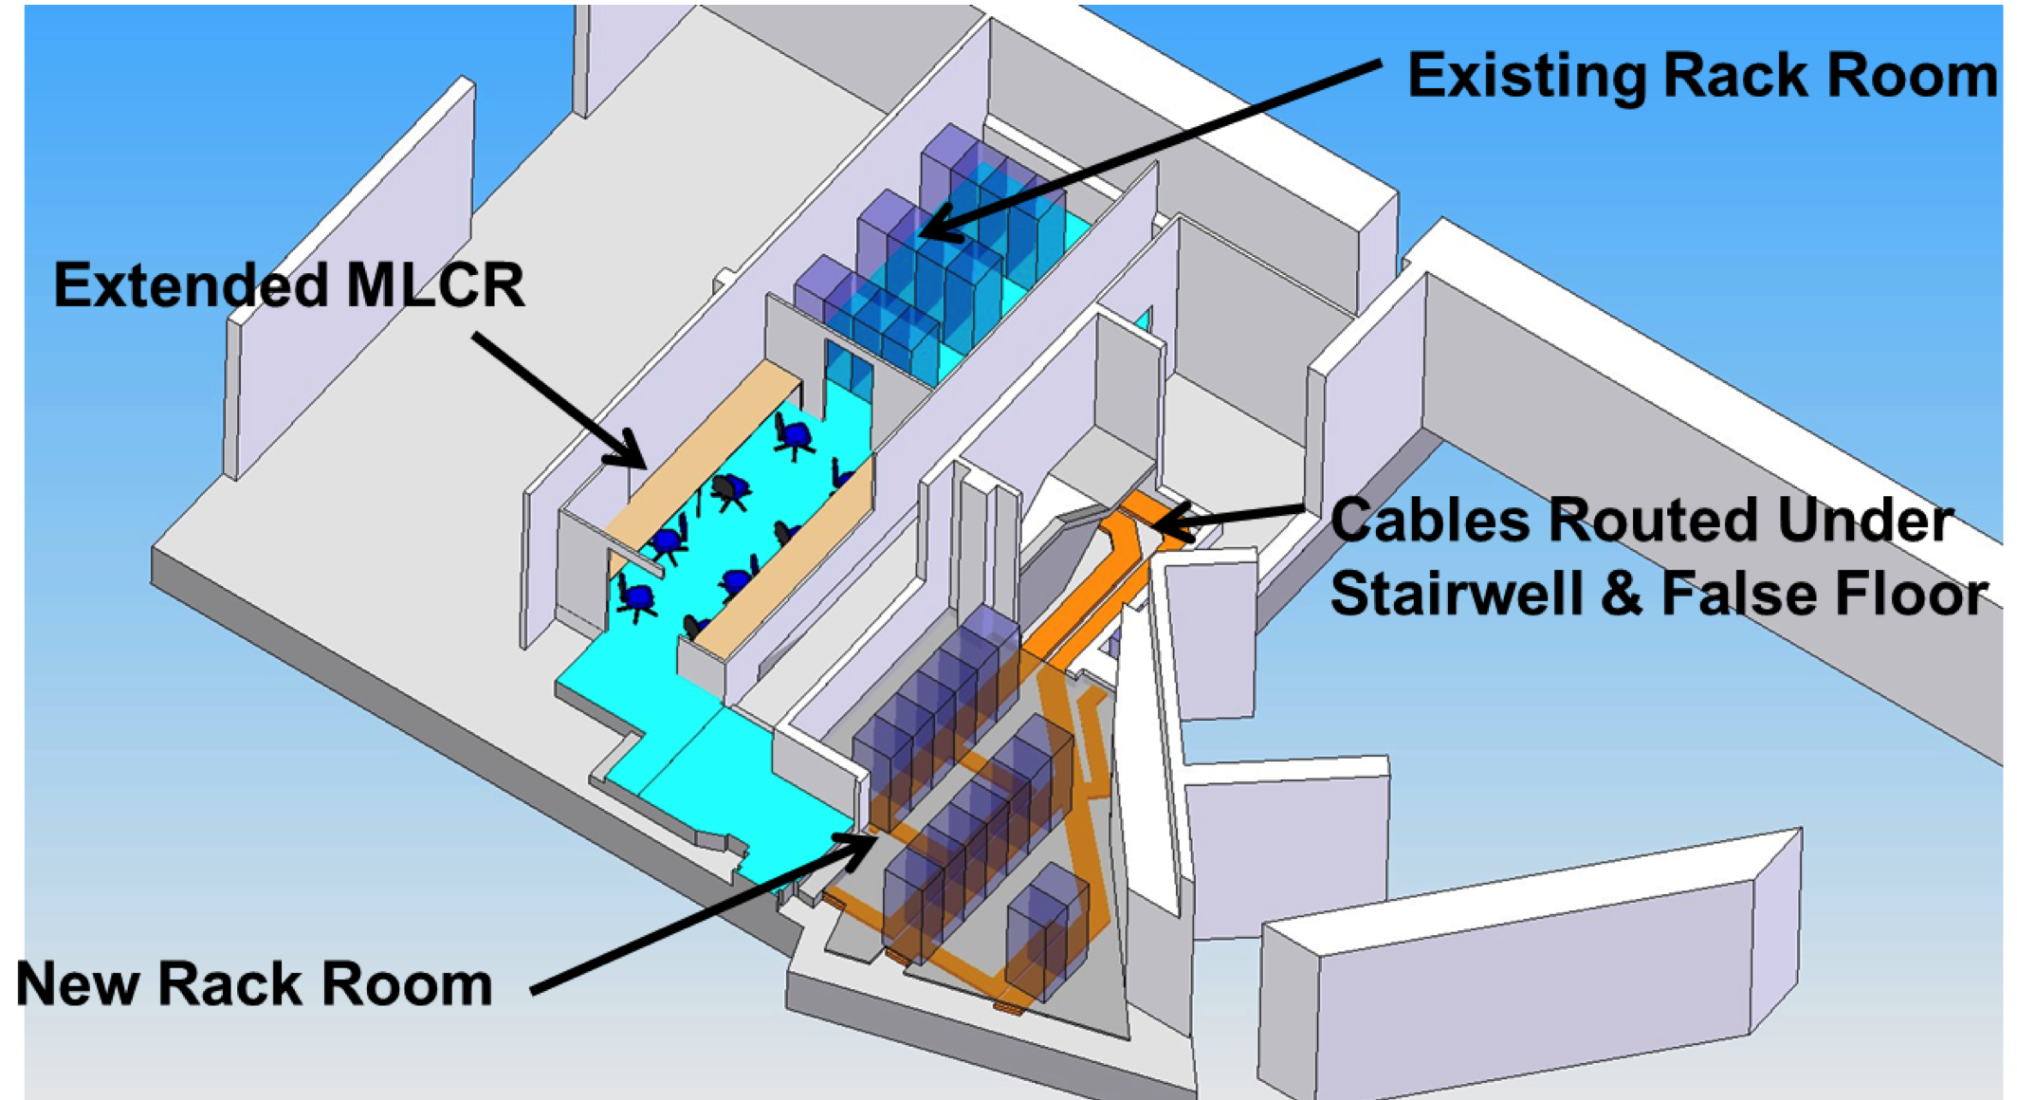
J. Tarrant et al

Slide 19
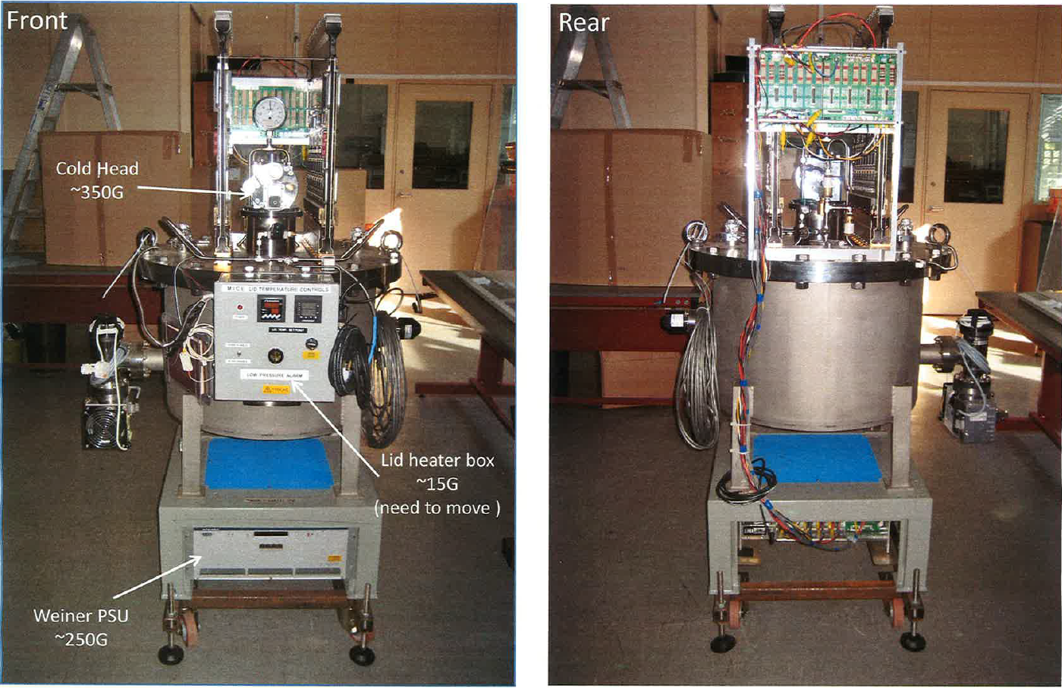
Tracker cryostat:
C. MacWaters

Slide 20
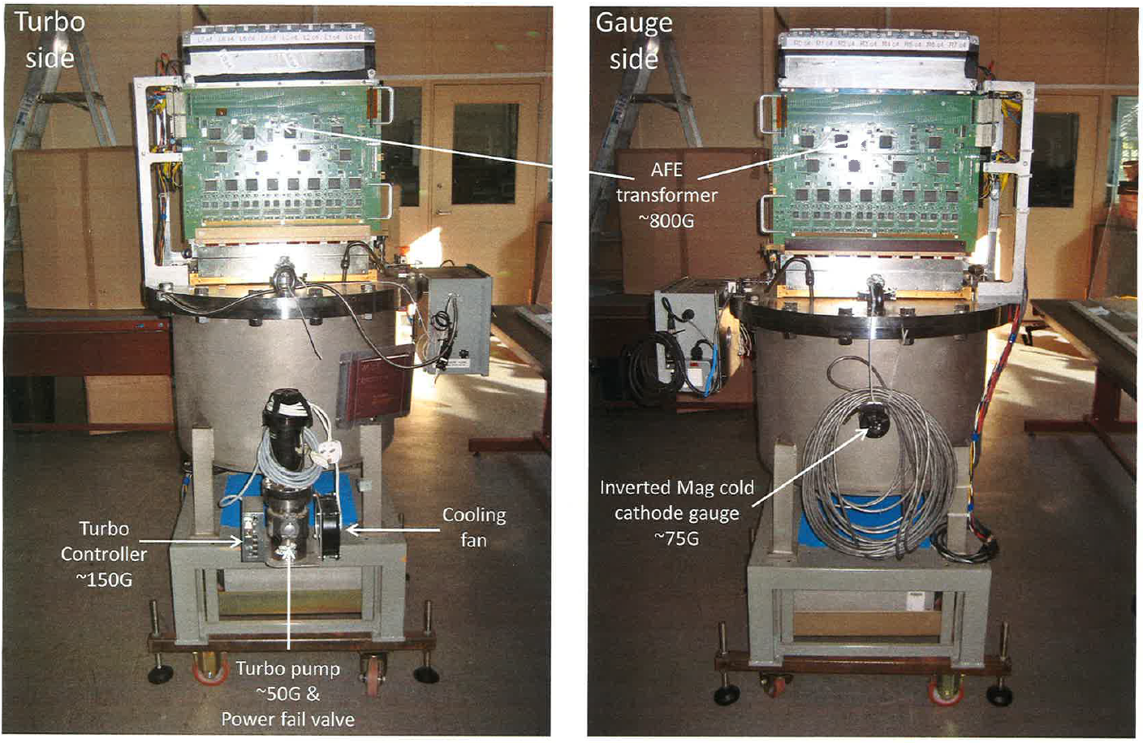
Tracker cryostat:
C. MacWaters

Slide 21
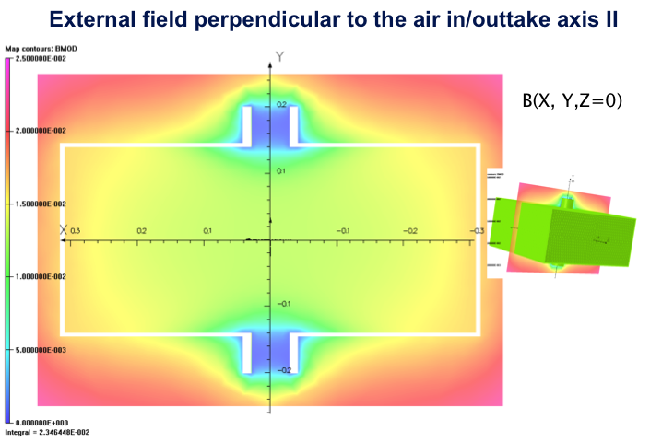
Status of analysis:
Lid heater box:
  Remote
Shielding to be assessed for:
  Cold head
  AFE transformer
  Cold-cathode guage
  Turbo
  Wiener power supply
Started with Wiener:
  Two options:
    Shield (issue is cooling)
    Purchase field-tolerant version
K. Marinov

Slide 22
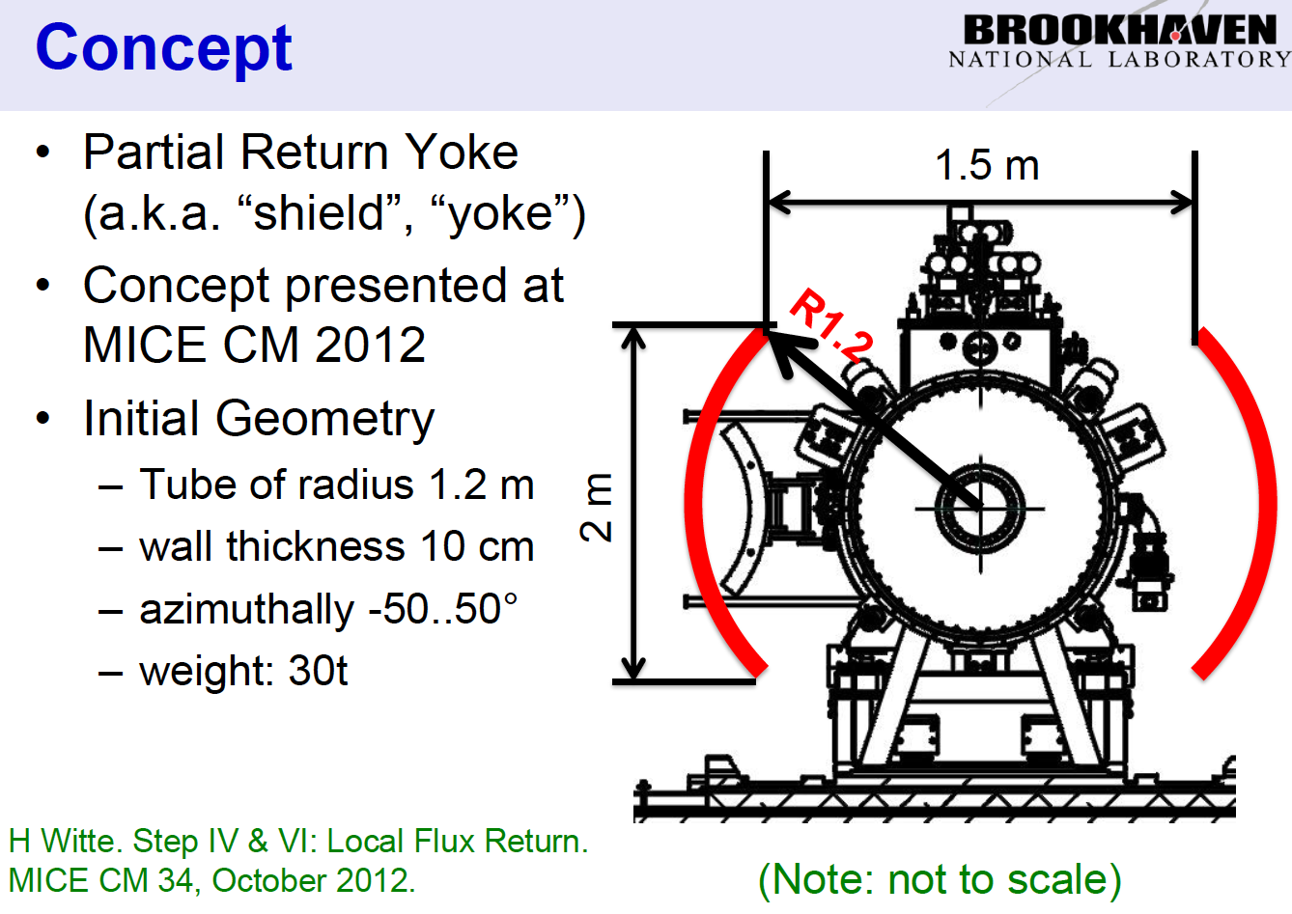
Partial return yoke:
H. Witte

Slide 23
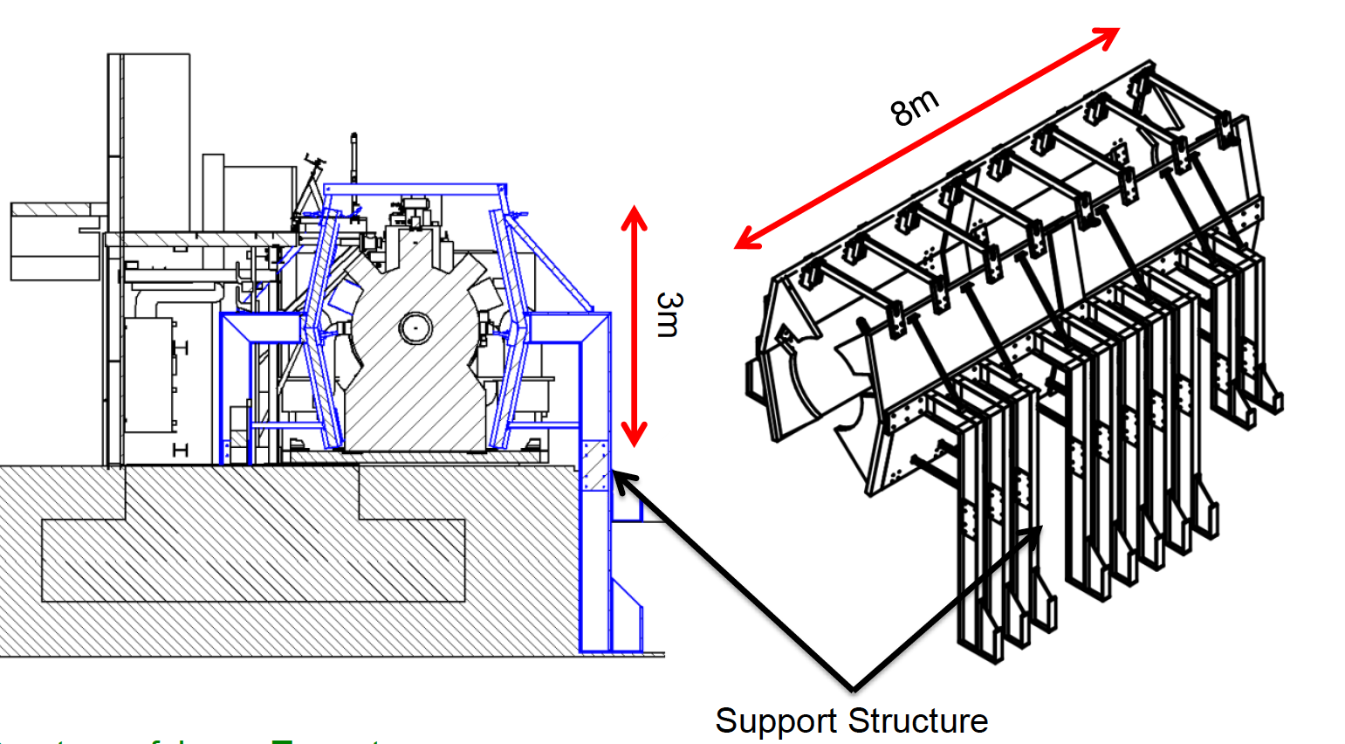
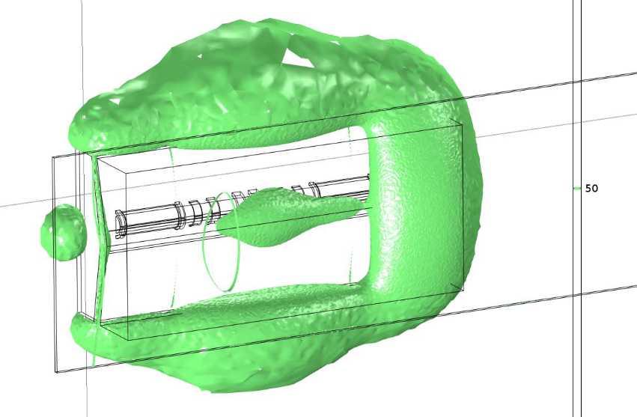
Conceptual design:
H. Witte, S. Plate, J. Tarrant
Analysis shows 5 G line well contained within MICE Hall

Slide 25
Conclusions:
Mitigation of stray magnetic field

Slide 26
Conclusions:
Huge amount of work done since Oct12
  An effect team effort
Mitigation underway:
  Compressors and racks
Better understanding has allowed a number of items to be placed on the “probably OK but check in detail list”, e.g.:
  Substation
  Equipment in trench
  Water monitors etc.
Progress in sub-models:
  Tracker electronics shielding options being developed
  Rack and compressor sub-models in progress
Decision point for initiation of fabrication of partial return yokes for Step IV identified for Sep13

