Slide 1
Micro-strip based detection systems: advances and new technological developments
Yoshinobu Unno
KEK

Slide 2
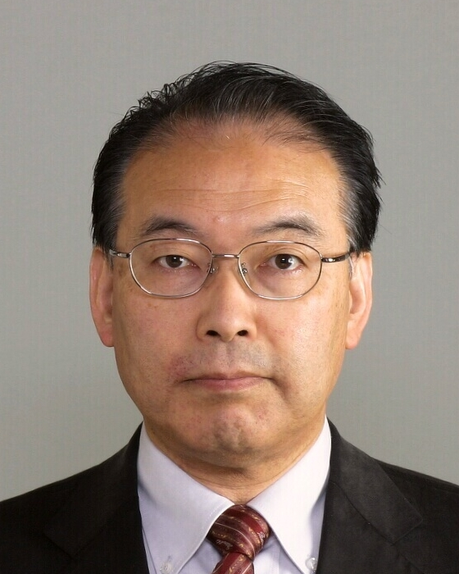
Your Lecturer
Yoshinobu UNNO

Slide 3
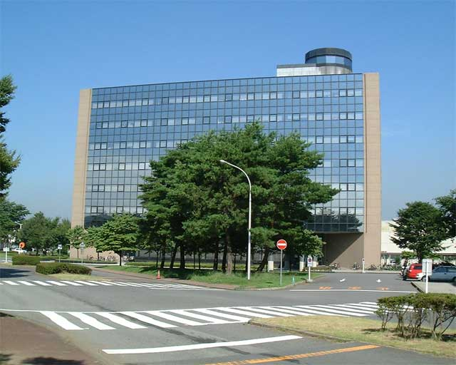
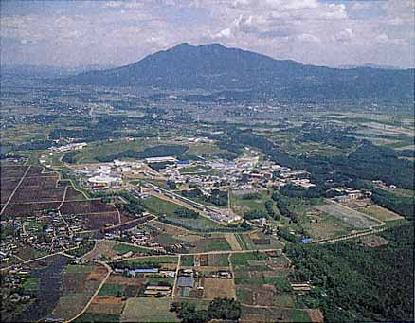
Your Lecturer
.. his office
..is from KEK, Japan
Mt. Tsukuba
Home of Belle, K2K, … experiments
Yoshinobu UNNO
Professor of KEK

Slide 4
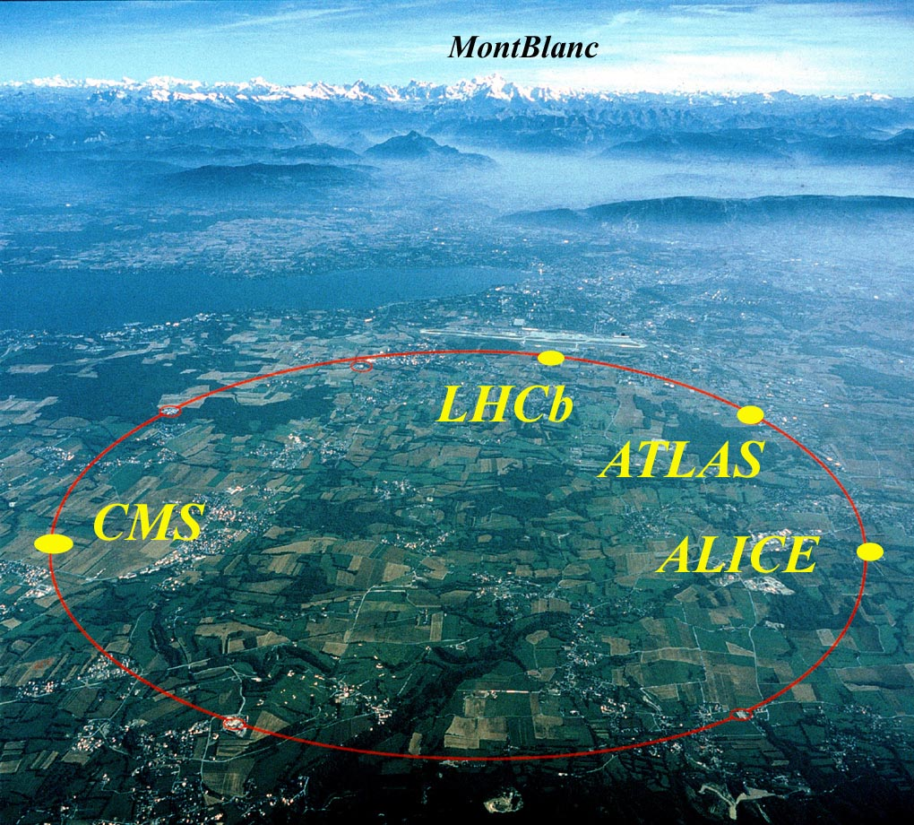
Your Lecturer
.. his office
..is from KEK, Japan
Mt. Tsukuba
Home of Belle, K2K, … experiments
Yoshinobu UNNO
Professor of KEK
ATLAS experiment at CERN
… working for an experiment at CERN

Slide 5
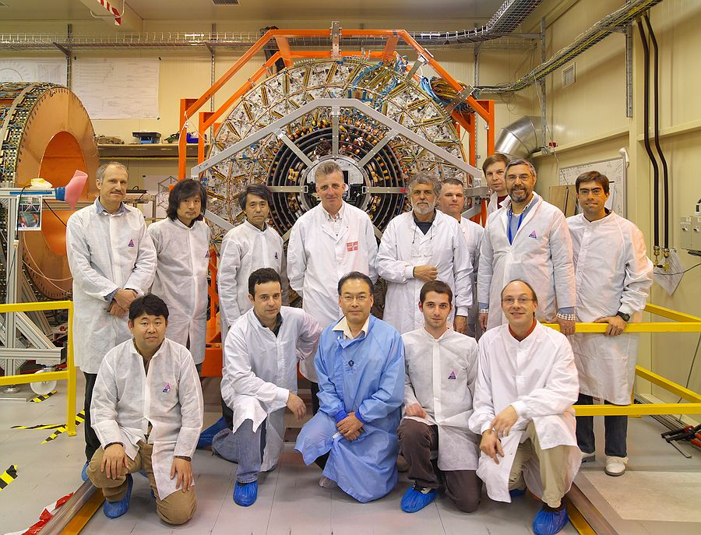
Your Lecturer
.. his office
..is from KEK, Japan
Mt. Tsukuba
Home of Belle, K2K, … experiments
Yoshinobu UNNO
Professor of KEK
ATLAS experiment at CERN
Design, construction, … and upgrade, of the silicon tracker
- together with many colleagues
- for the great discovery
… working for an experiment at CERN

Slide 6
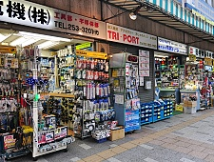

Japan - Wonderland
AKIhabara, Tokyo
One of the advantage is the industry, specially electronics

Slide 7


Japan - Wonderland
AKIhabara, Tokyo
Big electronics giants like HITACHI, …

Slide 8
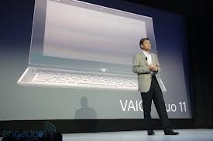

Japan - Wonderland
AKIhabara, Tokyo
Big electronics giants like HITACHI, SONY, …

Slide 9

Japan - Wonderland
AKIhabara, Tokyo
But, we have benefitted from a smaller company …

Slide 10
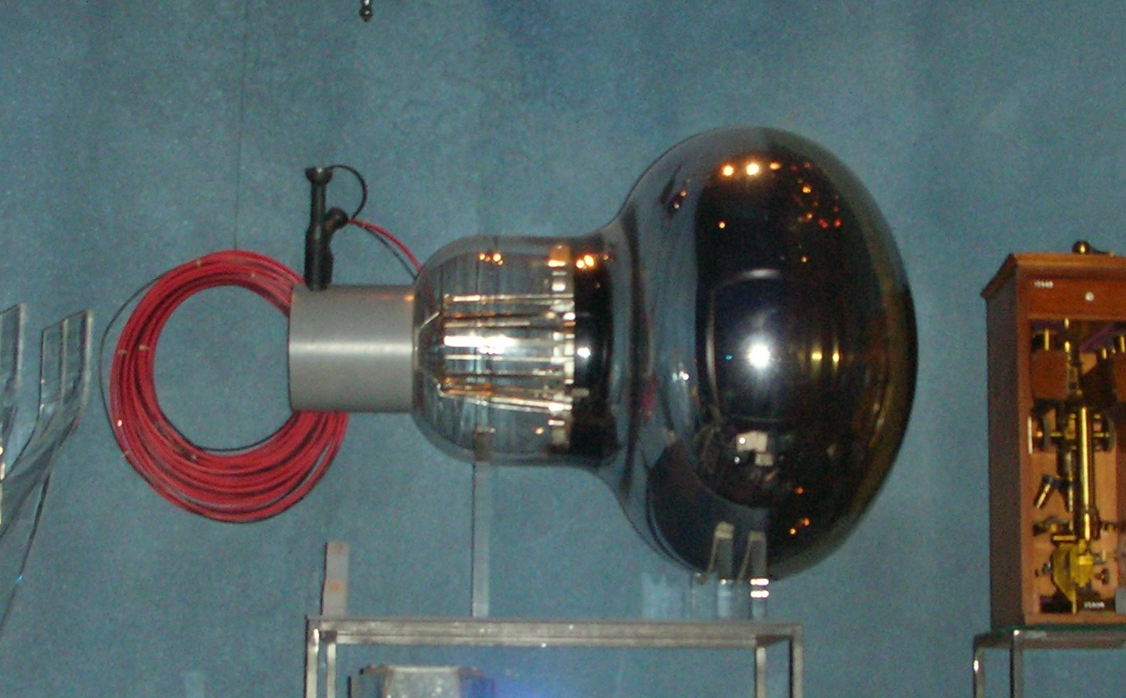
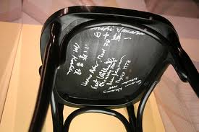
Japan - Wonderland
AKIhabara, Tokyo
Nobel prize for opening the Neutrino astronomy
who has a long history of collaboration with our fields …

Slide 11
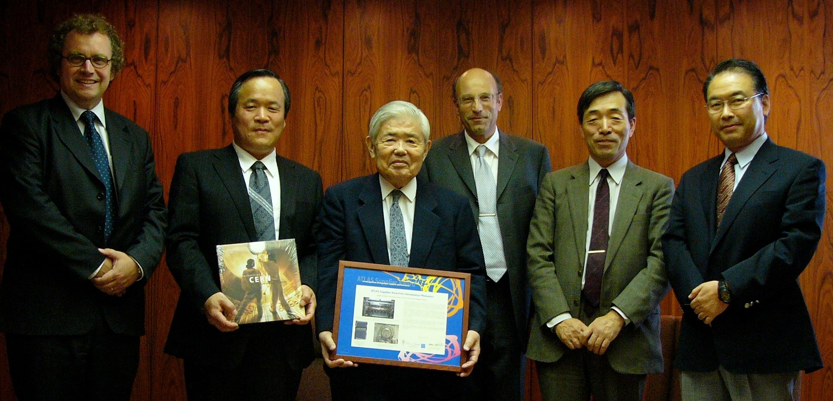
Japan - Wonderland
AKIhabara, Tokyo
ATLAS Supplier Award
Nobel prize for opening the Neutrio astoronomy
Now, we are benefitting from the company…

Slide 12
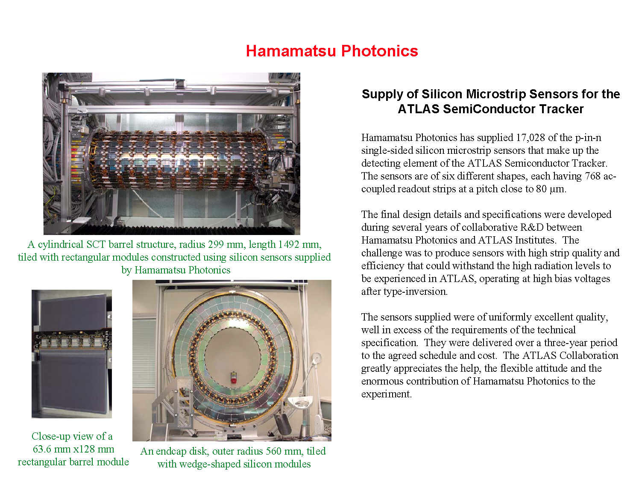
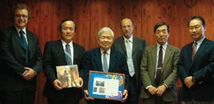
Japan - Wonderland
AKIhabara, Tokyo
ATLAS Supplier Award
Nobel prize for opening the Neutrio astoronomy
for the silicon detectors: ATLAS strips ~92%, CMS strips ~97%

Slide 13
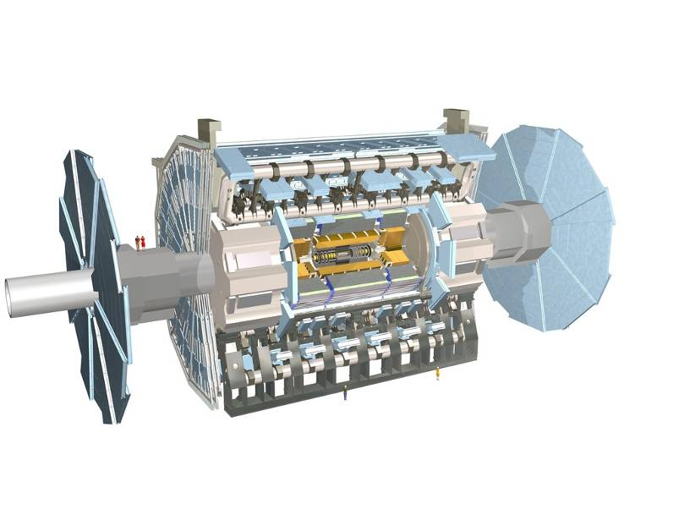
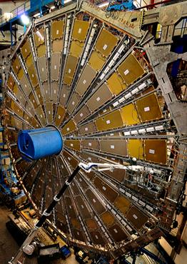
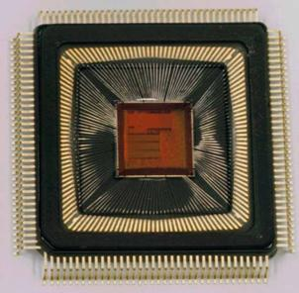
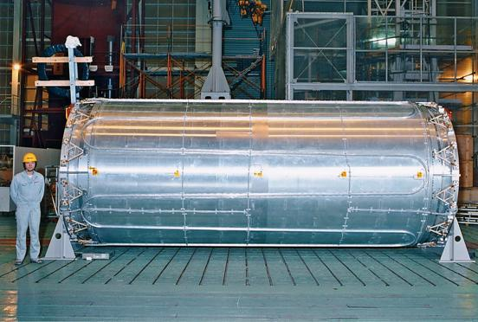
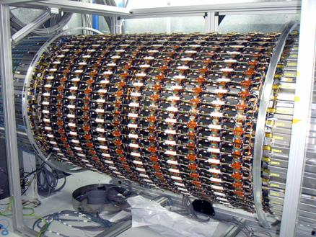
Contributions by Japanese teams in the ATLAS construction
400k ch. of TDC chips for MDT system, KEK
22 m
1200 TGC chambers and
320K ch. L1 Electronics of
endcap muon trigger system
KEK, Tokyo, Kobe, Nagoya...
Superconducting Solenoid, KEK
6000 sensors and 980 modules of barrel SCT system, KEK, Tsukuba, Okayama, Hiroshima …
In addition, many Japanese industries provided high quality detector components: Hamamatsu Phonics, Kawasaki Heavy Industries, Toshiba, Kuraray, Arisawa, Fujikura, etc
13

Slide 14
This lecture
Micro-strip based detection systems
  advances and new technological development
It is not a monopoly of ATLAS nor HPK nor Japan. It is an example of our fields.
  Other experiments: CMS, LHCb, …
  Other industries: Microns, CiS, …
Content
  Brief overview of the current ATLAS silicon microstrip tracker (SCT)
  Issues and achievement of the LHC tracker
  New technological development for the high-luminosity LHC tracker
  Understanding the underlying physics – TCAD simulation

Slide 15
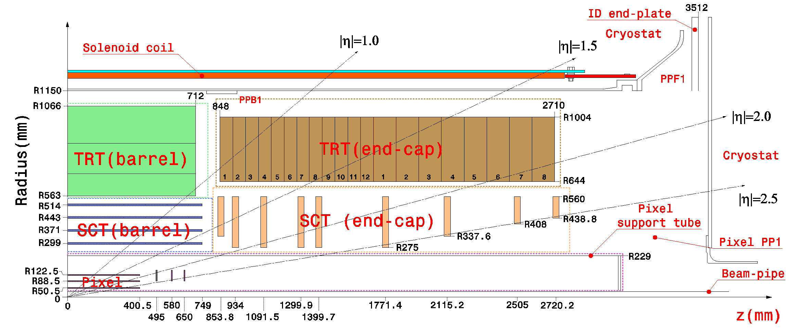
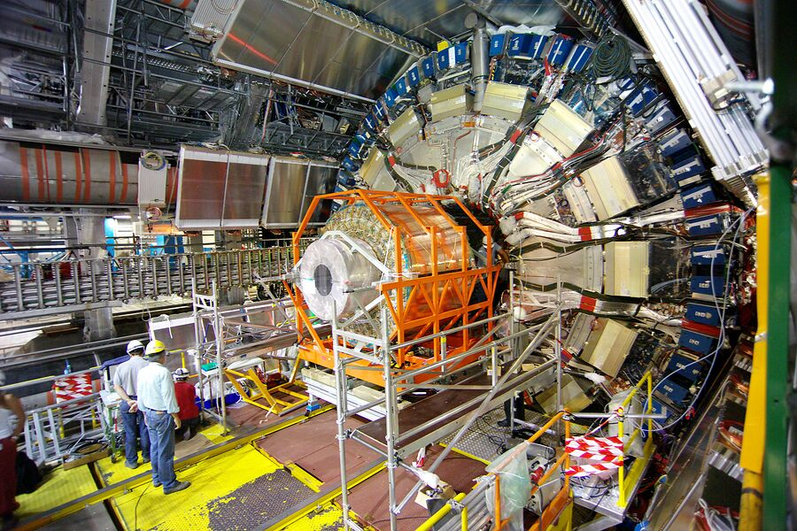
ATLAS Inner Detector
ID ¼ volume
ID=Silicon (Pixel + Strip) + TRT
  Radius~ 1 m, L=5.4 m
Position (φ) resolutions
  Pixel: ~15 µm (50 µm pitch)
  Strip (axial-stereo pair): ~17 µm (80 µm pitch)
  TRT: ~ 22 µm (130 µm drift reso., 36 sampling)
Why Silicon?
Installation into ATLAS
Notes:
p: momentum (GeV/c)
B: magnetic field (tesla)
L: track length in bending plane

Slide 16
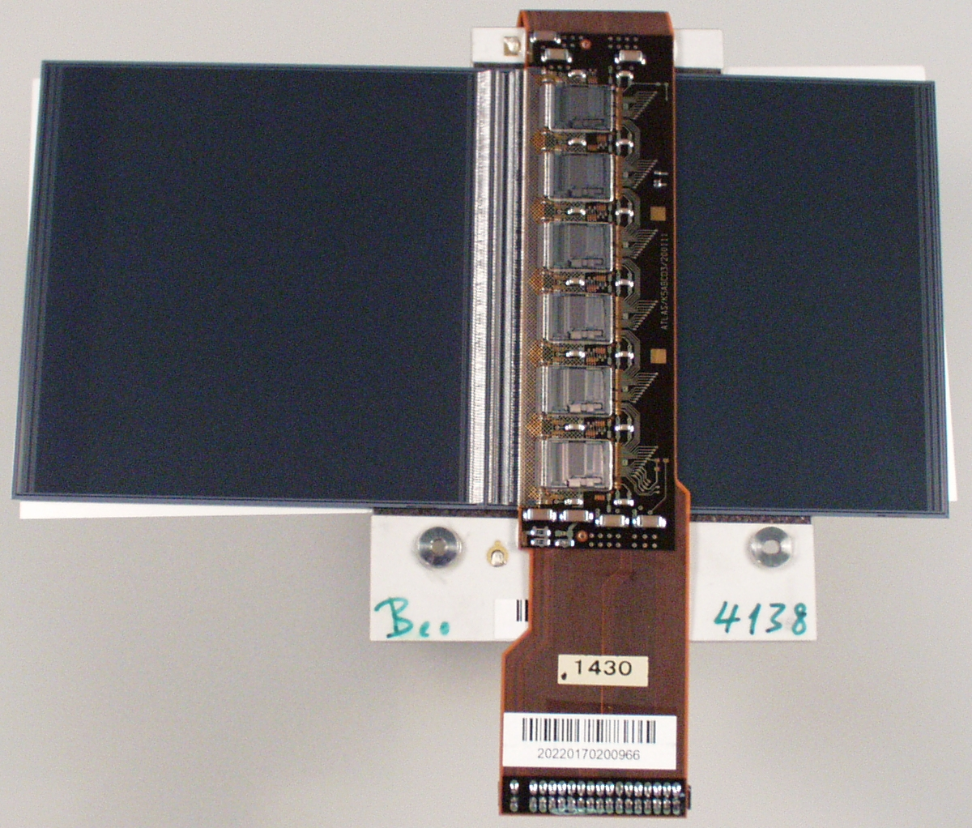
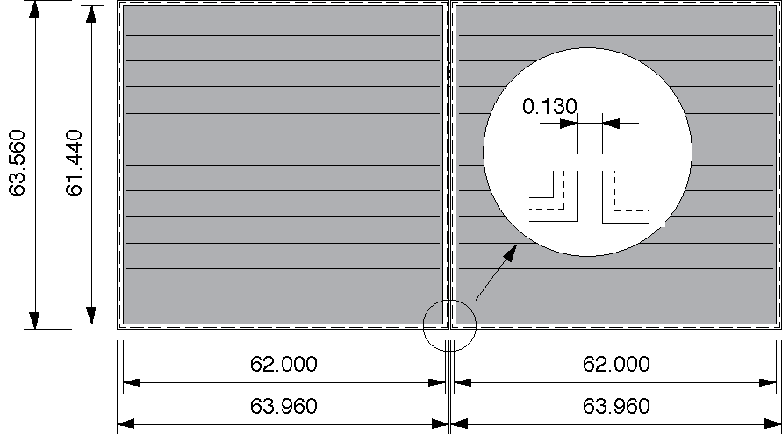
ATLAS Inner Detector
ID ¼ volume
Hybrid
Microstrip
sensor
Barrel modules
  Double-side, stereo readout (40 mrad)
  Sensors: 2 x (6.4 x 6.4 cm²) /side x 2 side (top and bottom）
    4 in. FZ crystal wafer, <111> and some <100>
    80 µm pitch, ~12.6 cm strip lenth, 768 strips
  Hybrids: 6 ABCD chips (128 ch)/side
    Cu/Polyimide flex circuit + Carbon-carbon substrate
Red letters: Contributions of Japan
  Japan: ~980/2112+spares in barrel modules
SCT barrel module

Slide 17
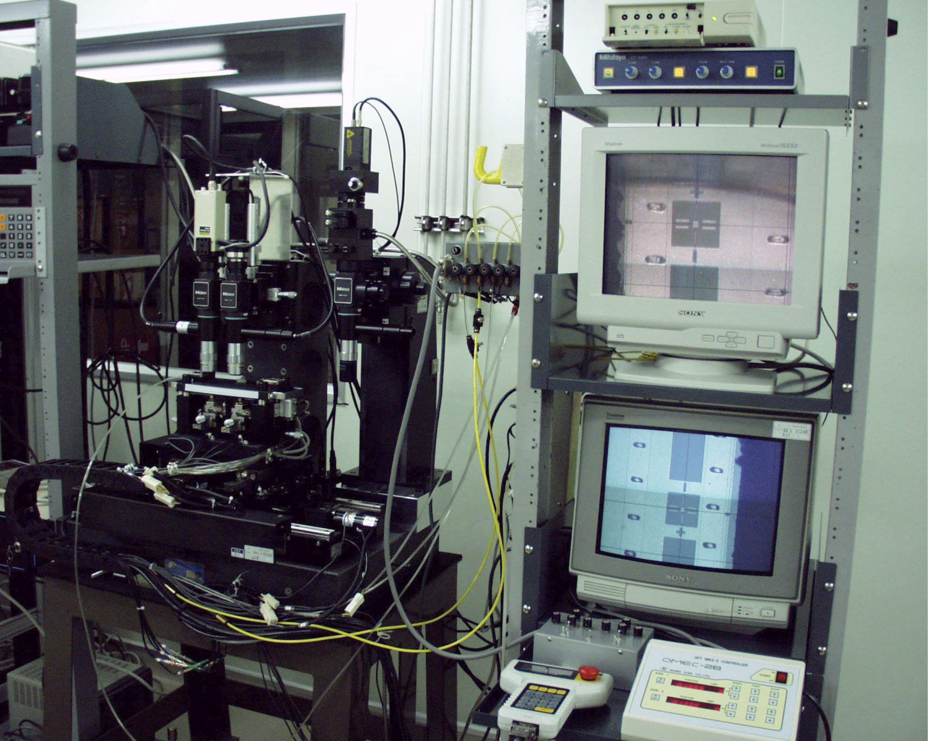
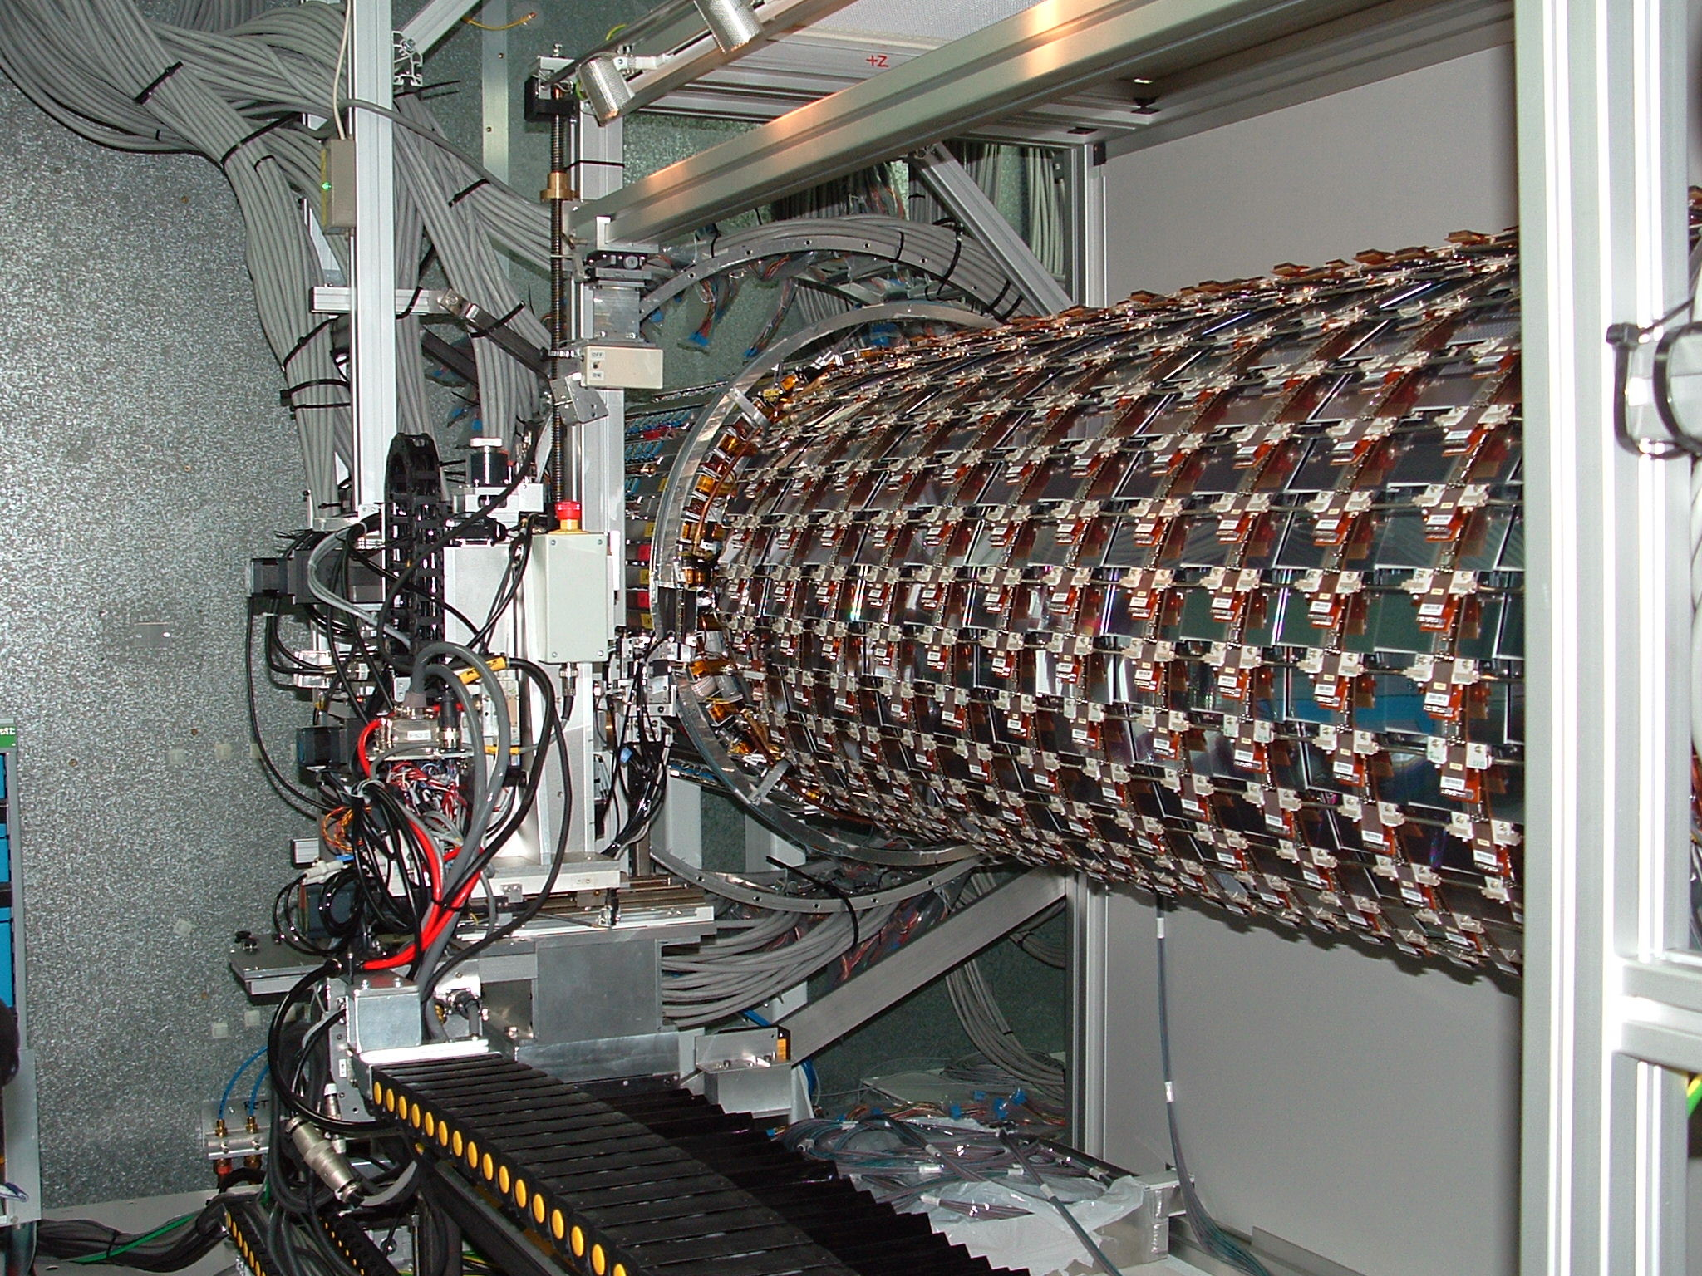
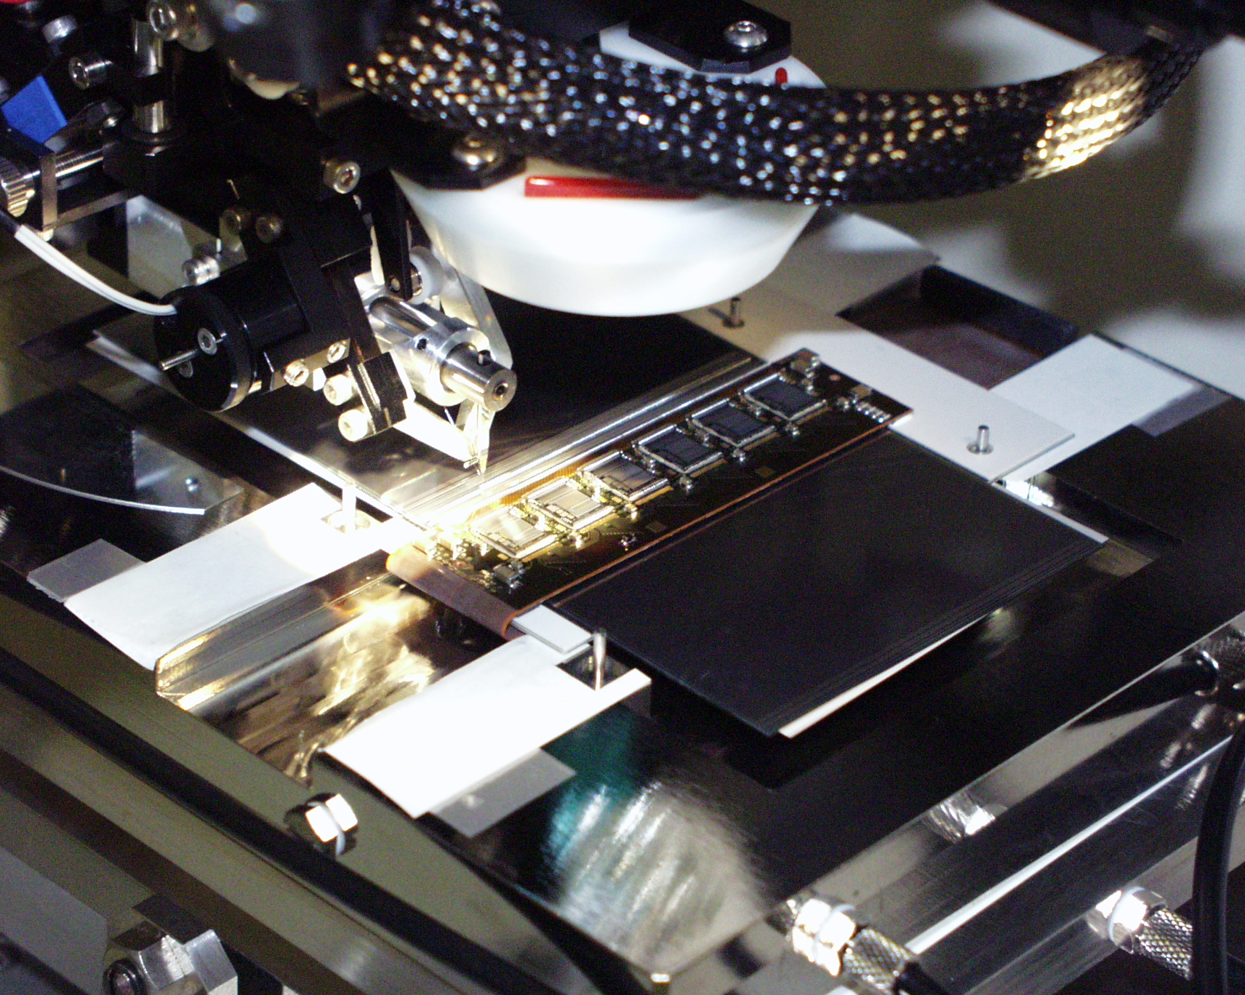
Silicon Detector (LHC)
Assembly station: aligning two sensors in <5 µm
Mounted on the barrel cylinder
Placement robot
at Oxford
in Japan, …
in Japan, …
at CERN
Completed modules
Wire bonding of hybrid-sensor and sensor-sensor: ~3200 bonds
Assembled ID barrel section
Then, installed into ATLAS

Slide 18
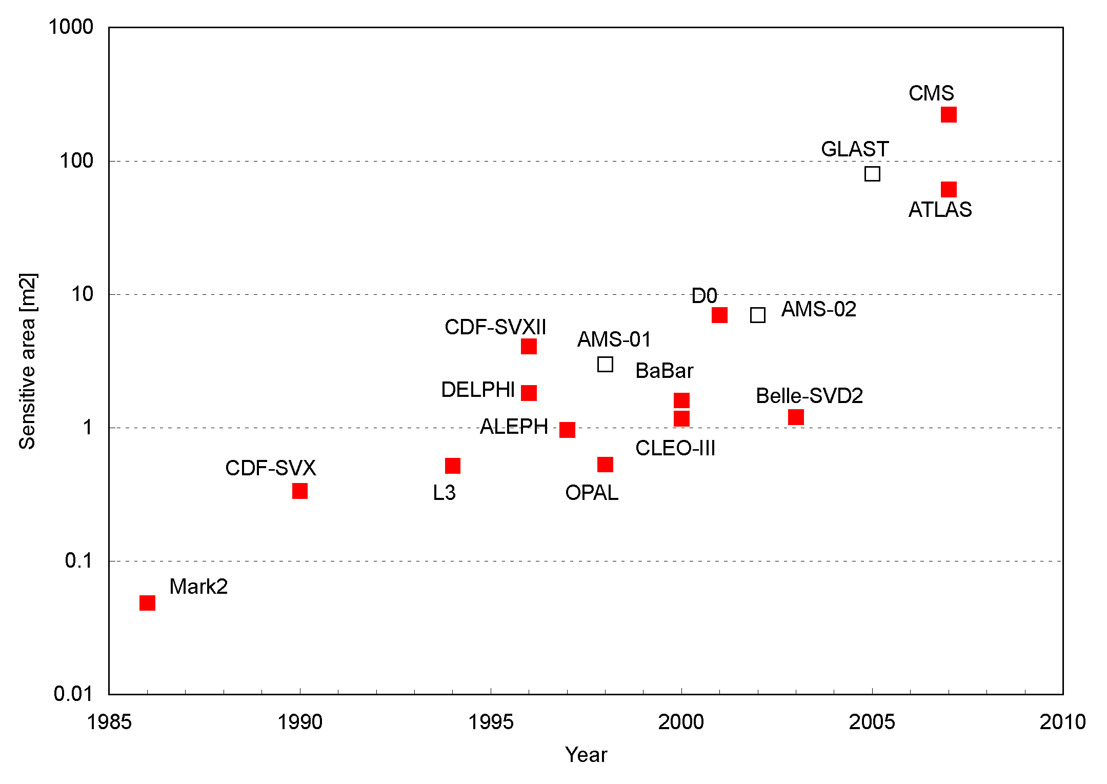
Silicon Detector (LHC)
Silicon area
CMS ~200 m²
ATLAS ~60 m²
LHC silicon microstrip detectors are the largest silicon trackers ever built.
  A scale: cost of the sensor ~1 million Euro/m²
Silicon microstrip detector is the “must” for large area coverage.

Slide 19
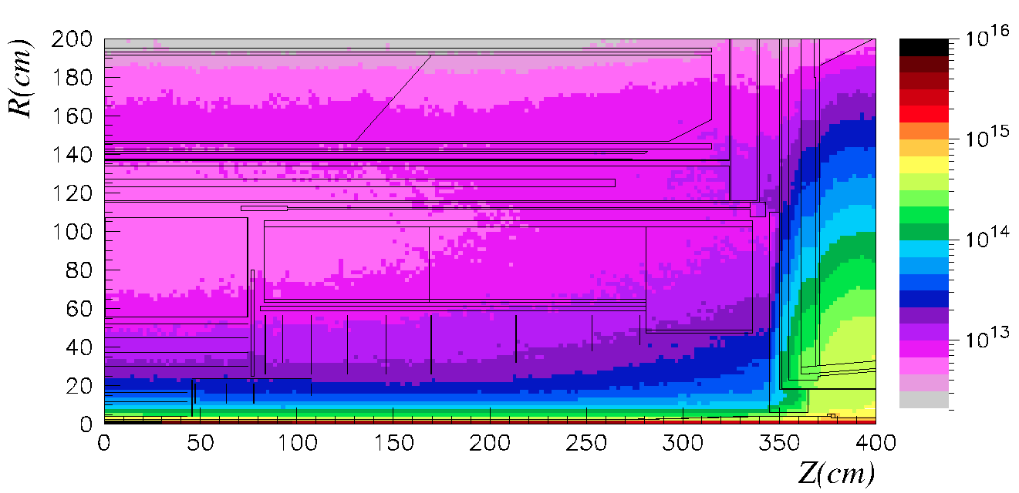
Particle fluence
(1-MeV neq/cm²)
(from ATLAS TDR)
TRT
SCT
PIXEL
Yearly fluence of particles
  in the unit of 1-MeV neutrons equivalent per cm²
  Luminosity: 10³⁴ cm⁻²s⁻¹, integrated:100 fb⁻¹/yr
End of life fluence at SCT (r=30 cm)
  2×10¹⁴ 1-MeV neq/cm² (including 50% uncertainty in pp cross section)

Slide 20
Non Ionizing Energy Loss (NIEL)
1-MeV neutron equivalent

Slide 21
Radiation Damage Studies
Radiation damage of silicon
  the 1st, in our field… 30 yrs ago
    T. Kondo et al, Radiation Damage Test of Silicon Microstrip Detectors
    Proc. of the 1984 Summer Study on the Design and Utilization of SSC, June 23-July 13, 1984, Snowmass, Colorado, pp. 612-614
The messages were
  The prevailing opinion was that silicon vertex detectors were not possible at 10³³ luminosity, but…
  It was shown that silicon is rad-hard, little pulse-height change, cooling needed.

Slide 22
Radiation Damage Studies
Since then, radiation damage studies are continued in Japan, Europe, US., and elsewhere
  Two papers were already published in 1988, (25 yrs ago)
  T. Ohsugi, ... T. Kondo, … K. Yamamoto .., “Radiation Damage in Silicon Microstrip DetectorsT”, Nucl. Instr. Meth. A265(1988)105
  M. Nakamura,…T. Kondo, "Radiation Damage Test of Silicon Multistrip Detectors", Nucl. Instr. Meth. A270(1988)42, using the irradiated sensor by 800 GeV protons

Slide 23
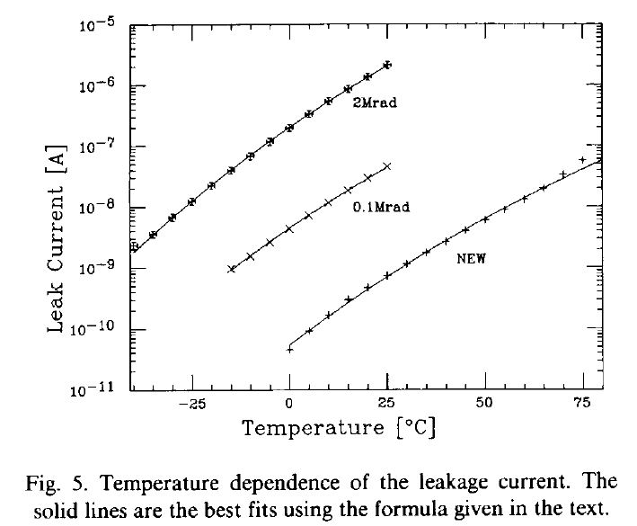
Increase of leakage current
Also, temperature dependence of bulk leakage current
Radiation Damage in Silicon Microstrip Detectors
  T. Ohsugi, ... T. Kondo, … K. Yamamoto .., Nucl. Instr. Meth. A265(1988)105

Slide 24
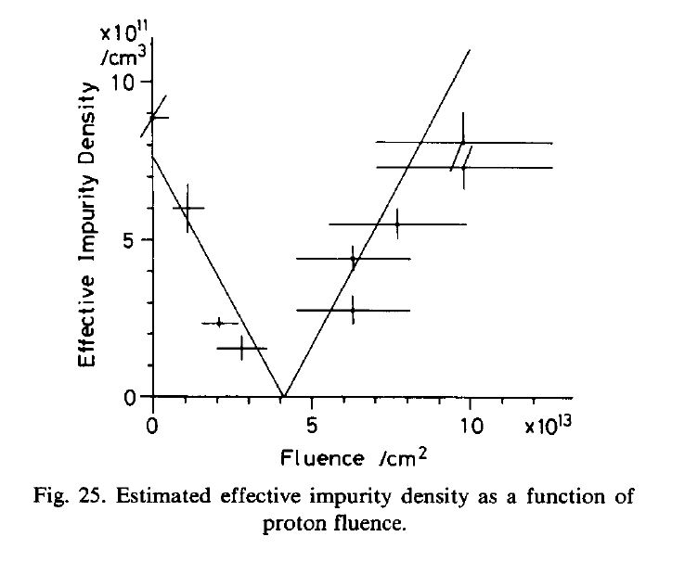
Type inversion of the silicon
Abstract:
……. The effective impurity density decreases with fluence up to ~4x10¹³/cm², but for greater fluences, it increases. This may indicate the type conversion of the bulk silicon ………
M. Nakamura,…T. Kondo, "Radiation Damage Test of Silicon Multistrip Detectors", Nucl. Instr. Meth. A270(1988)42, using the irradiated sensor by 800 GeV protons

Slide 25
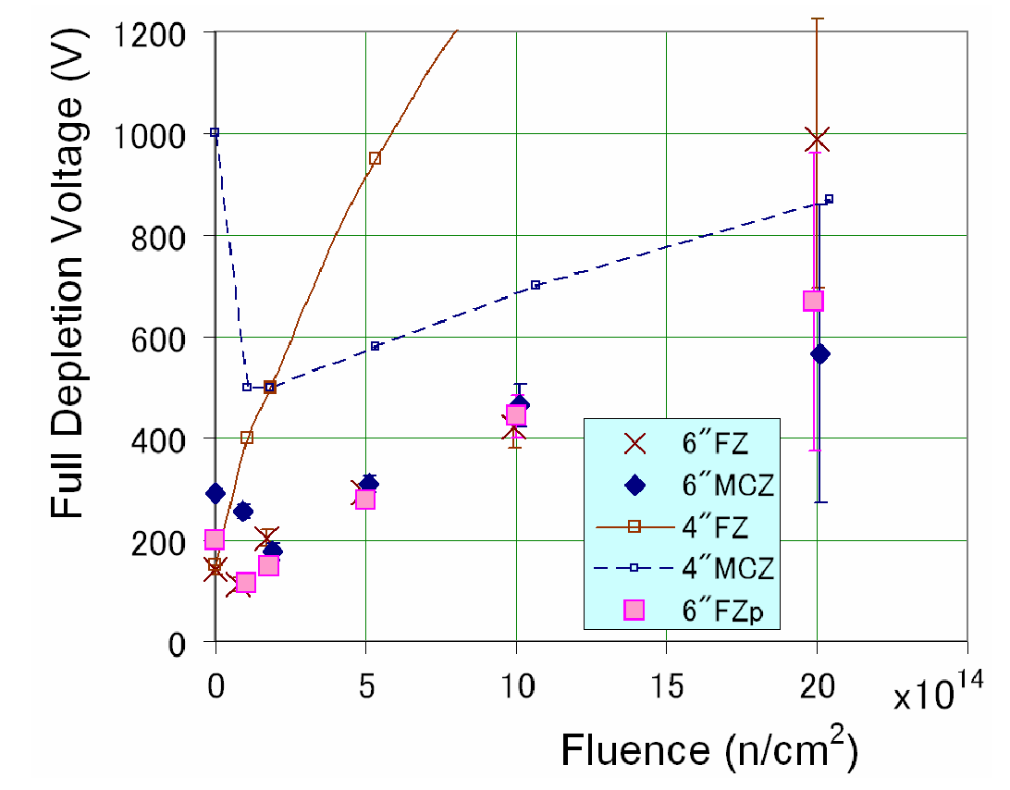
Evolution of depletion voltage
  A thorough study of the radiation damages has been made by RD50 collaboration. But, also done elsewhere…
  E.g. Michael Moll, Ph.D Thesis, 1999.
70 MeV proton irradiation
(p-type silicon)
24 GeV/c proton irradiation
(n-type silicon)
K. Hara et al.,
IEEE Trans. Nucl. Scie. 56 (2009) 468
4 in.
6 in.
6 in. FZ is as same as DOFZ or MCZ

Slide 26
Signal degradation in LHC Silicon Sensors
Pixel sensors:
max. cumulated fluence for LHC
RD50 collaboration
(n-in-”p”)
(p-in-”p”)
Strip sensors:
max. cumulated fluence for LHC
Charge trapping effect
  ← Most of signals at around the strips (see Appendix)
Depleted region
  p-in-n → p-in-p (requires “full depletion”)
  n-in-n → n-in-p (works under “partial depletion”)

Slide 27
Choice of LHC Experiments
Experiment | Type | Wafer
ALICE pixel | p-in-n | standard FZ
ATLAS pixel | n-in-n | oxygenated
ATLAS strips | p-in-n | standard FZ <111> (some <100>)
CMS pixel | n-in-n | standard FZ
CMS strips | p-in-n | standard FZ <100>
LHCb VELO | n-in-n | standard FZ
Cost consideration and compromises
p-in-n:
  single-side process (lower cost)
  requires full depletion, high voltage operation
n-in-n
  double-side process (higher cost)
  works under partial depletion, less requirement for high voltage

Slide 28
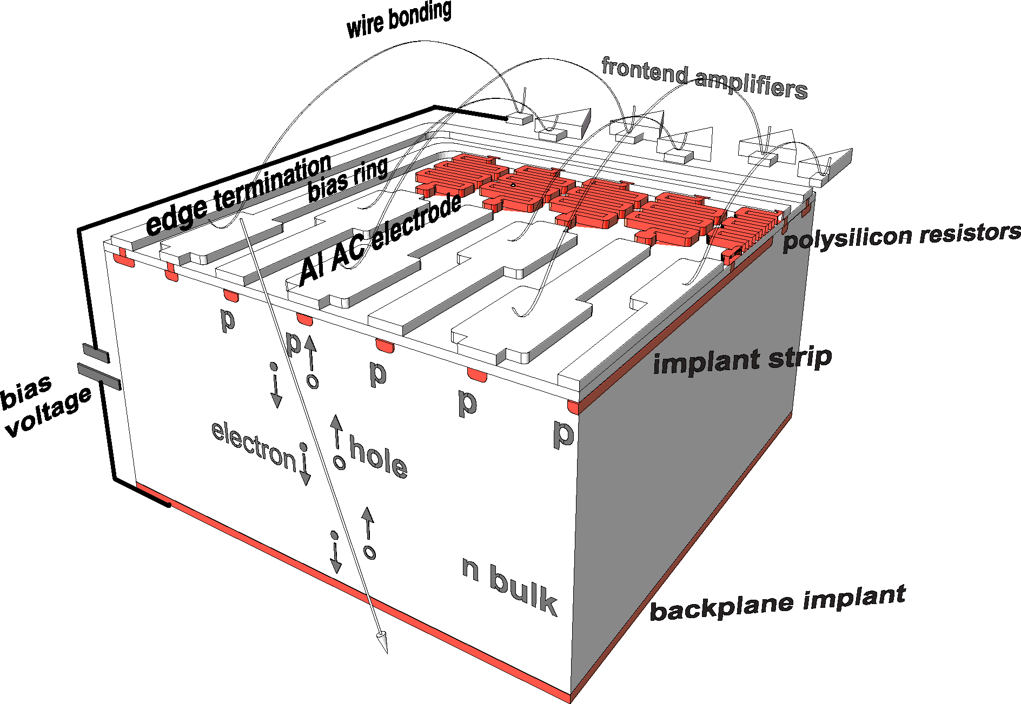
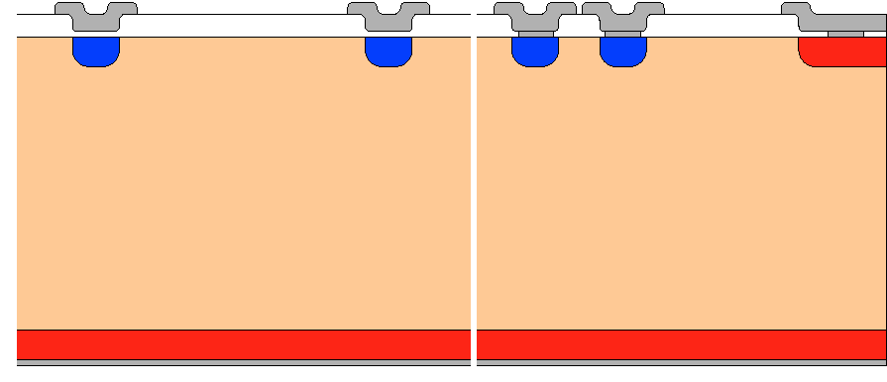
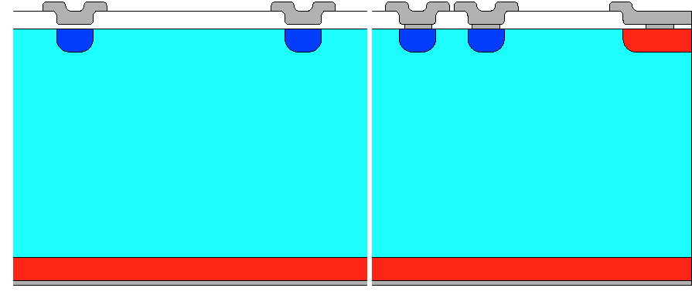
Silicon Detector (LHC ATLAS)
strip region
edge region
p⁺
p-n junction
Depletion
n-bulk
n⁺
LHC: p-readout in n-bulk (p-in-n)
after type-inversion
Silicon sensor principle
  Deplete the bulk by holding the bias voltage at p-n junction
LHC ATLAS: p-in-n strip sensor
  N-bulk: conventional
  Cheaper than other options
  Need full depletion
    500 V max operation/specification
p⁺
“p”-bulk
Depletion
p-n junction
n⁺

Slide 29
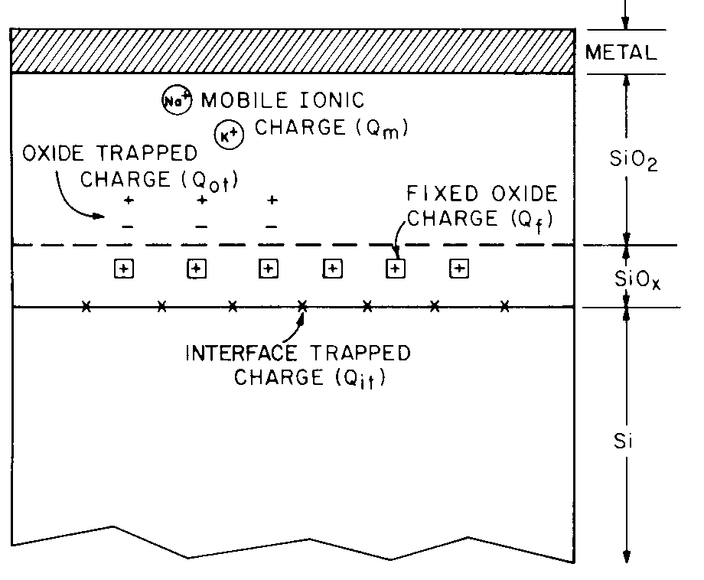
Radiation damage – Surface effect
S.M. Sze, Physics of Semiconductor Devices, 2nd ed., p380
SiO₂ passivation
Incident particles
+ + + + + +
- - - - - -
+ + + + + +
- - - - - -
Surface effect
Vacancies
⊖ ⊖ ⊖ ⊖
Bulk effect
Interstitial silicons
Electrons attracted to the (Positive) “Fixed Oxide charges” (and interface trapped charges
The interfacial region is a single-crystal silicon followed by a monolayer of SiO_{x}, incompletely oxidized silicon, then a strained region of SiO₂ roughly 10-40 A deep.
Interface traps (Q_{if}) and fixed oxide charges (Q_{f}) exist, (as a consequence of thermal oxidation)
Oxide trapped charges (Q_{ot}) can be created by radiation.
Q_{f} and Q_{ot} are “positve” and attract electrons in the Si-SiO₂ interface.

Slide 30
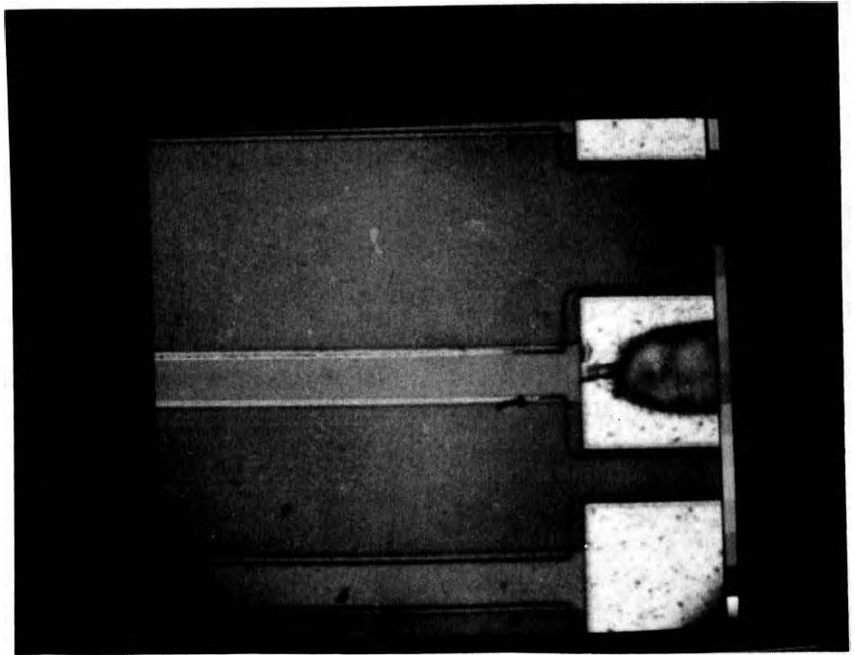
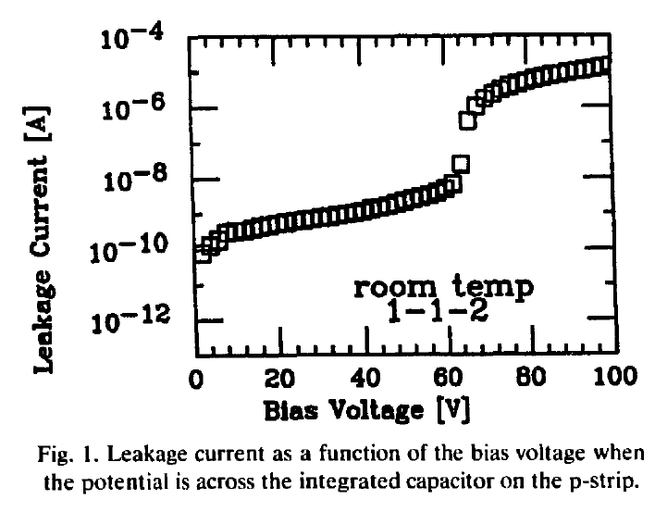
1st Visualization of Microdischarge
High bias voltage → High electric field → avalanche breakdown
  Breakdown field ~ 30 V/µm in silicon
Visualization with an infra-red sensitive camera
T. Ohsugi et al., Nucl. Instr. Meth. A432 (1994) 22

Slide 31
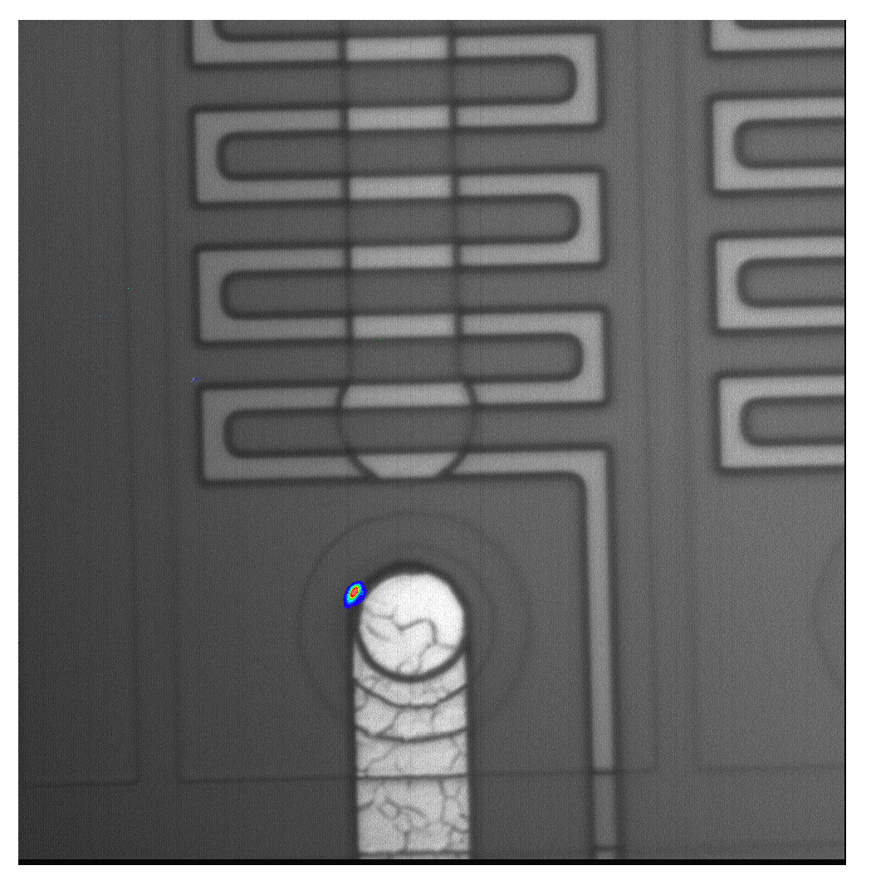
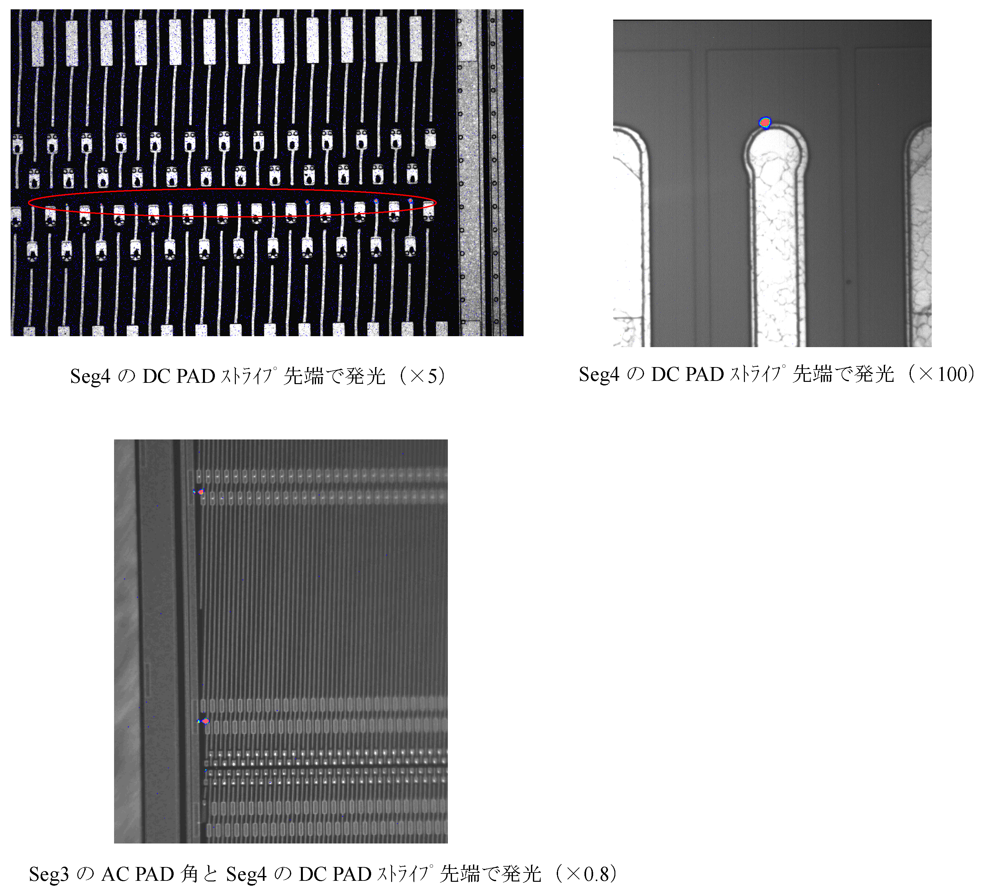
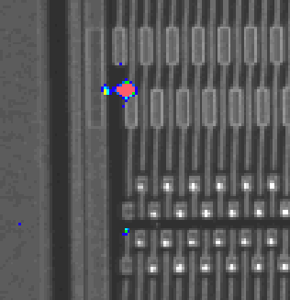
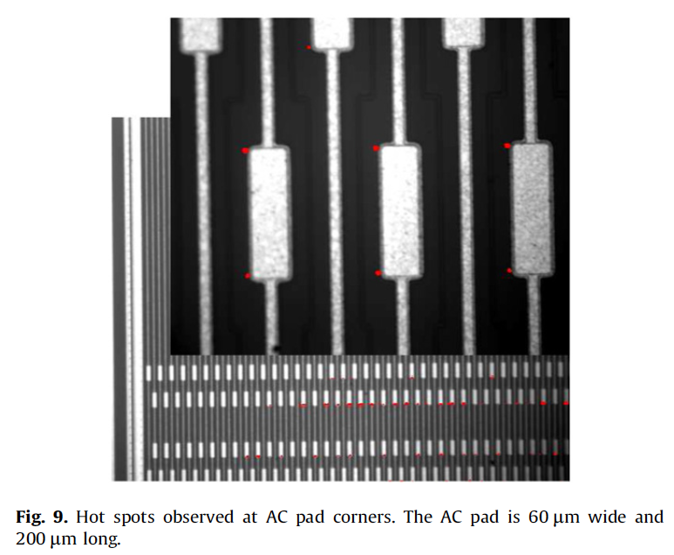
Other examples of hot spots
Y. Unno et al., Nucl. Instr. Meth. A Supplement 636 (2011) S24
  Y. Takahasi et al., http://dx.doi.org/10.1016/j.nima.2012.04.031

Slide 32
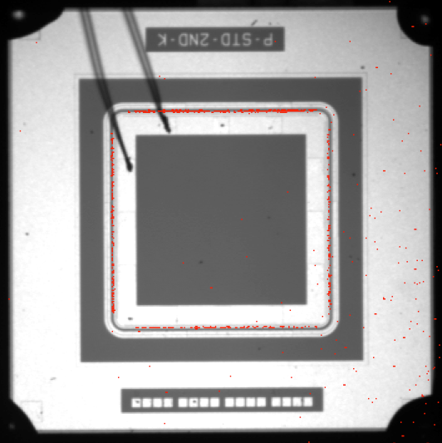
Microdischarge after Irradiation
S. Mitsui et al.,
Nucl. Instr. Meth. A699 (2013) 36-40
Hot electron images confirm that
  hot spots were observed first at the edge of the bias ring, and then at the inside of the edge metal.
  the highest electric field is at the bias ring (n⁺ implant), not at the edge ring (p⁺ implant).
CYRIC proton irradiated
1x10¹⁴ n_{eq}/cm²
10 uA at 2000 V
-15 °C

Slide 33
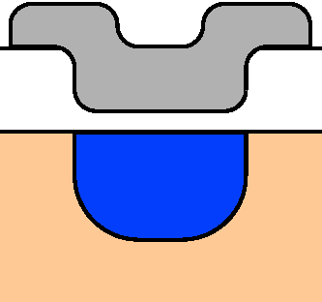
Design of the sensor to high bias voltage
SiO₂ passivation
Edge ring
②
Guard ring
Bias ring
Optimize the edge structure
→ Width, guard ring
between the bias and the dicing edge
HPK design:
width ~ 1 mm
minimum # guard rings, i.e. 1
+ + + + + +
- - - - - -
+ + + + + +
- - - - - -
Surface effect
③
①
Reduce the oxide fixed/trap charges
→ <100> crystal orientation
Less “dangling” bonds in interface
<100>: ~10¹⁰ ions/cm²
<111>: ~10¹¹ ions/cm²
Move the highest electric field from Si (to SiO₂)
→ Extended electronde
Under the condition of
Same potential in implant and metal
⓪
Clean and high quality process
→ little irregularity at high field
where HPK is appreciated.

Slide 34
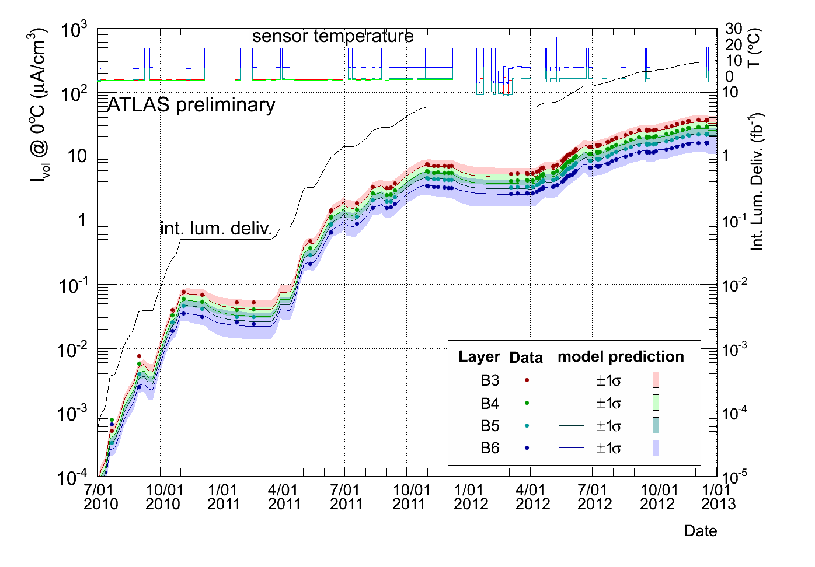
ATLAS SCT in operation
Radiation damage monitoring
  Leakage currents are well consistent with the expectation
99.3% modules are working
  30/4088 modules were disabled due to LV, HV, Cooling problems, …

Slide 35
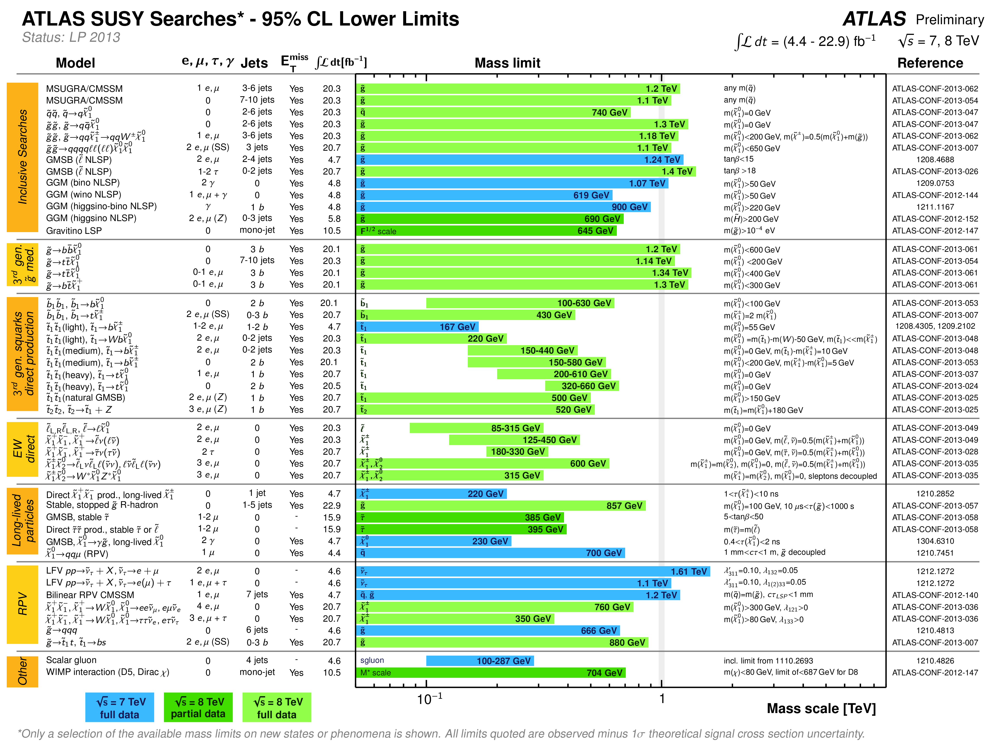
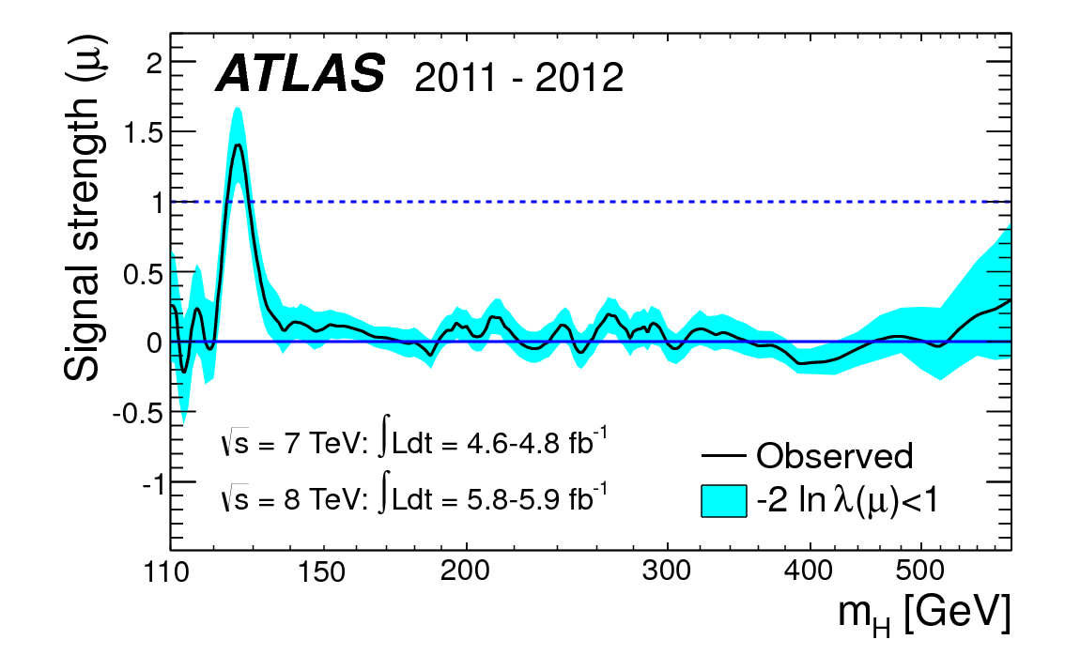
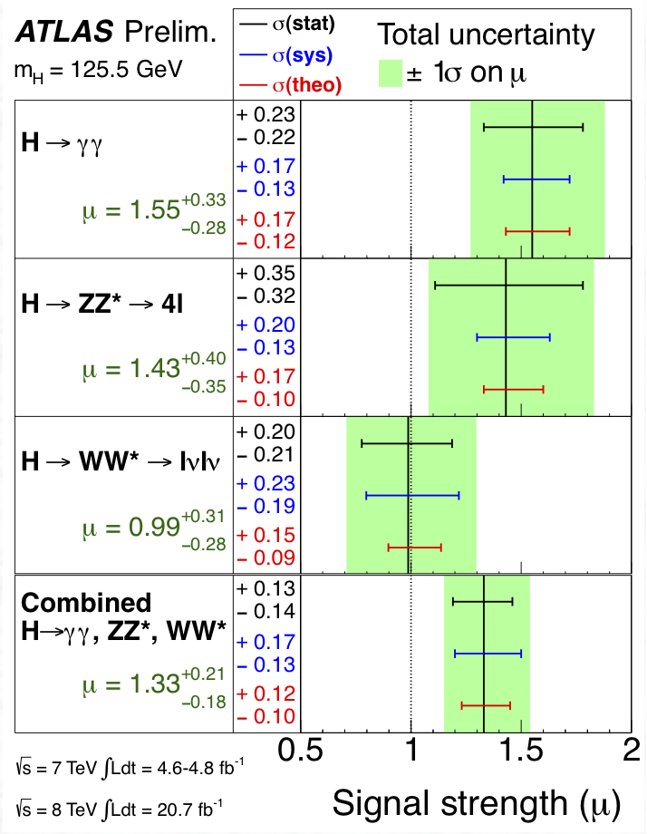
LHC Upgrade (HL-LHC)
Higgs search
Phys. Lett. B 716 (2012) 1-29 Fig.7c
1 TeV
Higgs – Great discovery of the century
Need high statistics
  Study of properties
  Search for “something” in TeV mass region
Spin-Parity 0⁺ favoured
Higgs coupling

Slide 36
Schedule for HL-LHC
2009
Start of LHC
Run 1: 7 and 8 TeV centre of mass energy, luminosity ramping up to few 10³³ cm⁻² s⁻¹, few fb⁻¹ delivered
LHC shut-down to prepare machine for design energy and nominal luminosity
2013/14
IBL installation
Run 2: Ramp up luminosity to nominal (10³⁴ cm⁻² s⁻¹), ~50 to 100 fb⁻¹
2018
Injector and LHC Phase-I upgrades to go to ultimate luminosity
LHC
Run 3: Ramp up luminosity to 2.2 x nominal, reaching ~100 fb⁻¹ / year accumulate few hundred fb⁻¹
~2022
Phase-II: High-luminosity LHC. New focussing magnets for very high luminosity with levelling
HL-LHC
Run 4: Collect data until > 3000 fb⁻¹
2030

Slide 37
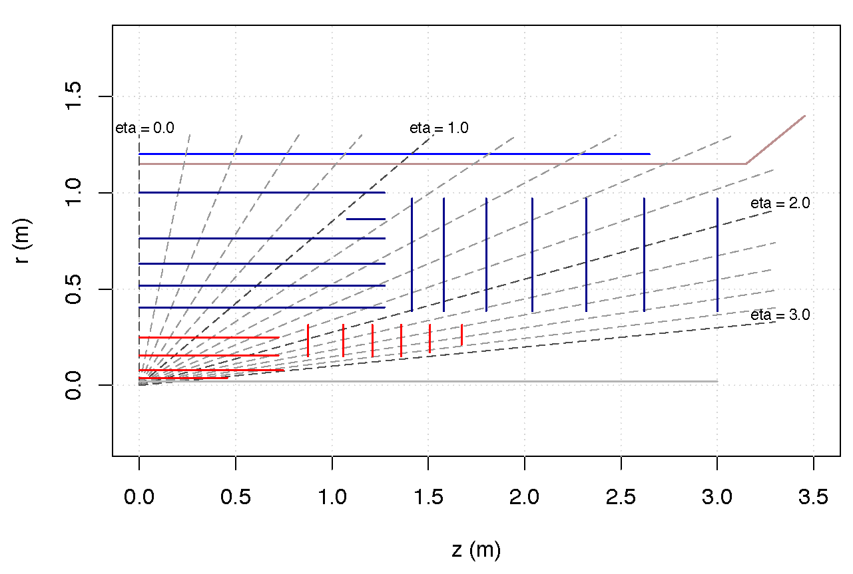
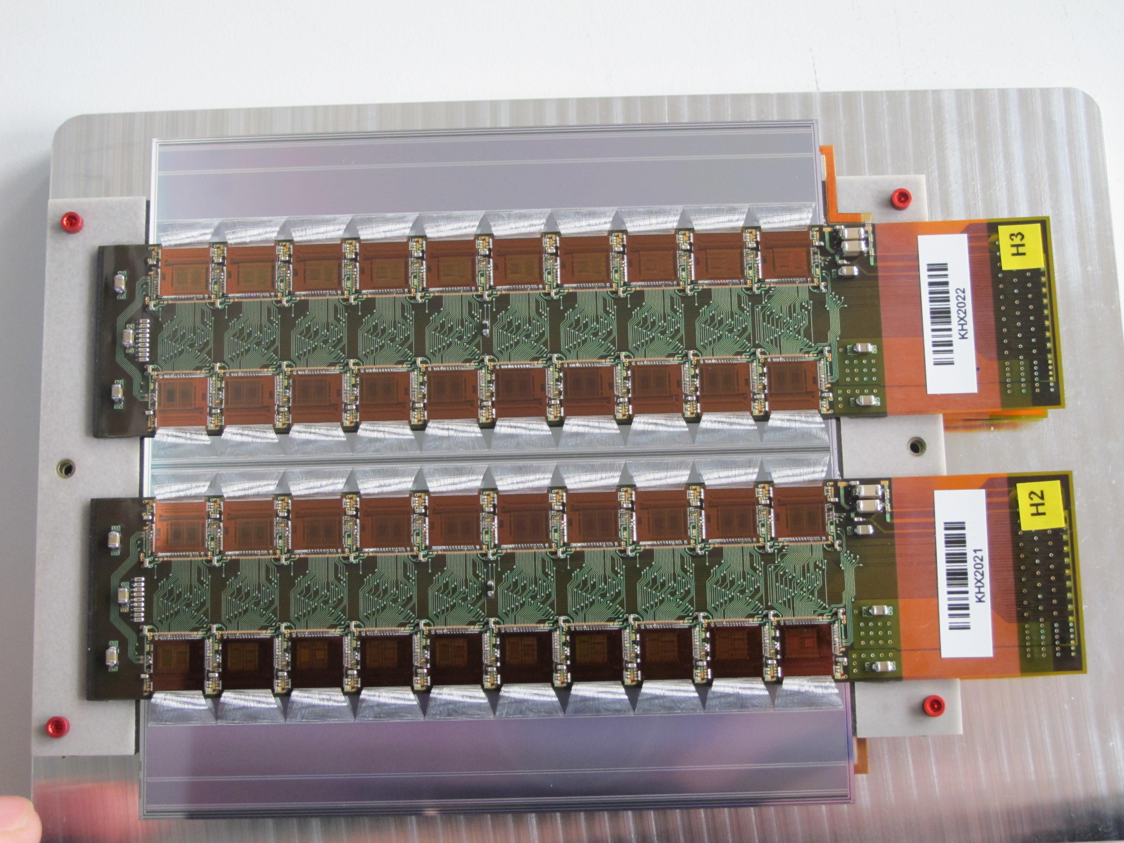
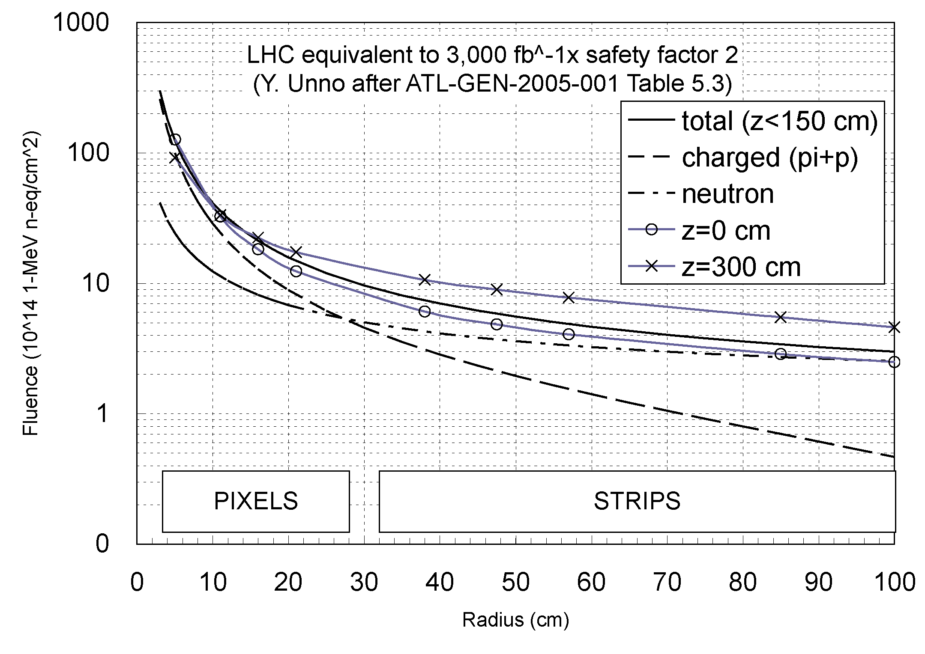
Inner Detector Upgrade (HL-LHC)
Full silicon tracker
Strip sensor module, example
TRT → Strip
Strip
Pixel
~1x10¹⁶
2022 – Full tracker replacement
  Area: ~200 m²
  Silicon strips: ~1×10¹⁵ neq/cm²
Silicon sensors
  Max. 1000 V operation
  Full depletion might not be possible…
~1x10¹⁵

Slide 38
Cost-effective n-in-p planar sensor
n-in-n
for heavy radiation environments
Bulk radiation damage
  one way to be “p” type
n⁺ readout
  p-n junction to allow getting signals from “partially” depleted sensor
Special in n+ readout
  conductive layer in the surface
    ~MΩ/square
    due to the electrons attracted to the oxide trap/fixed charges
    no junction effect at the n⁺ implant
  the electron layer must be
    interrupted (p-stop), or
    cancelled (p-spray)
+ + + +
- - - -
+ + +
- - -
n⁺
p⁺
p⁺
Radiation damage
n-bulk → “p”-bulk
Double-side mask process
p⁺
n⁺
+ + +
- - -
(LHC pixel sensors of ATLAS, CMS)
n-in-p
+ + + +
- - - -
+ + +
- - -
n⁺
p⁺
p⁺
Single-side mask process
Radiation damage
p-bulk → “p”-bulk
p⁺
Diffusion process
ATLAS choice for strip sensors for HL-LHC

Slide 39
n-in-p sensors for HL-LHC
Sensors with the p-stop isolation
Operable to 1000 V bias voltage.
  Equivalently, suppressing “microdischarge” breakdown up to ~1000 V
How?
  Those 0, 1, 2, backed by 3
  In addition, protection against beam splash: punch-through-protection (PTP) structure
① Optimization of p-stop structure
② Optimization of edge width
n-in-p
+ + + +
- - - -
+ + +
- - -
n⁺
p⁺
p⁺
⓪ Hardening the strip edges
Radiation damage
p-bulk → “p”-bulk
p⁺
③ Understanding the physics
← Technology CAD (TCAD) simulation

Slide 40
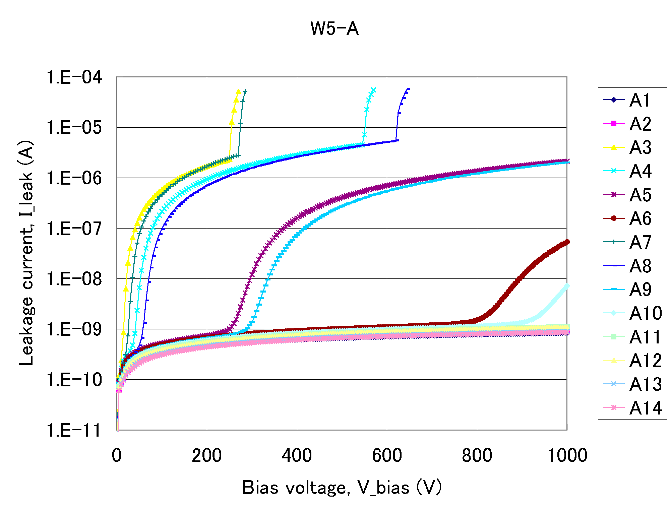
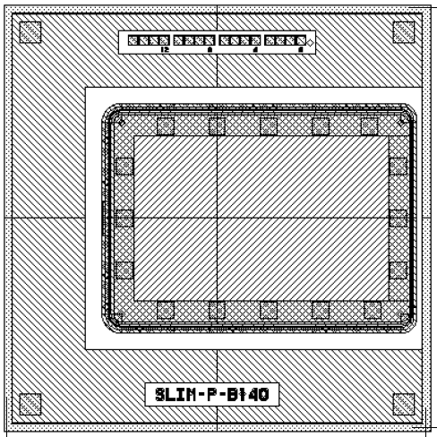

Study of required edge width
N-sub/N-edge
Width varied at one edge
Results are from N-type wafer
Thickness (as is, thinned)
  320 (W5), 200 (W7,13) µm
Edge implantation
  N+ or P+
N-sub
P+
P+
N+
GR
Edge
N-sub/P-edge
N-sub
P+
P+
P+
GR
Edge

Slide 41

Underlying physics of the edge width
SiO₂ passivation
Edge ring
Guard ring
Bias ring
+ + + + + +
- - - - - -
+ + + + + +
- - - - - -
Surface effect
Lateral depletion along the surface
Square root of V_bias is linearly dependent on the edge distance
  Reflecting the depletion along the surface
Distance can be ≤500 µm for the bias voltage up to 1 kV
… Different story if the side wall is implanted e.g., - active edge

Slide 42

Required width after Irradiation
S. Mitsui et al, NIMA 699 (2013) 36-40
Required width is ~450 µm to hold 1000 V.
  At around 1x10¹³, the required edge space is more than 450 µm, but also the depletion voltage is decreased less than that of non-irrad. and anyway it is much less than 1000 V.
  At higher fluences, the required width is less than that of the non-irrad.

Slide 43



P-stops between N-implants
Problems - Hot spots
  IR image overlaid on visual image
  Microdischarge = Onset of leakage current
How to optimize the structures to reduce the electric fields?

Slide 44





P-stop Structures Optimization
TCAD simulations
Y. Unno et al., Nucl. Instr. Meth. A636 (2011) S118–S124
… and comparison with test structures

Slide 45



Optimization of the p-stops
10 cm x 10 cm strip sensor in 6 in. wafer
Stereo strip section
P-stop
  away from the n-implant
  symmetric location
N-implant
  pitch not too narrow nor not too wide
Once known, simple.
1000 V

Slide 46


Technology CAD (TCAD)
TCAD started to build the links between the
  semiconductor physics and electrical behavior
  to support circuit design
Modern TCAD consists of
  Process simulation, and
  Device simulation
Originated from the work of
  Prof. Robert W. Dutton and his group at Stanford Univ.
Widely used in semiconductor industry
  to reduce the development cost and time
  to understand the physics behind
    that is even impossible to measure
TCAD: Computer Aided Design for Semiconductor Technology
The core is the “Finite Element Analysis”.
  The numerical analysis method with modern computer.
MOS transistor
Process simulation
Device simulation

Slide 47

Brief History
1977: Prof. Dutton, Stanford
Process/Device simulator
SUPREM-I (1D)/PISCES
1979: Technology Modeling Associates (TMA/Synopsys)
TSUPREM4 (2D)/MEDICI
1989: Silvaco International
ATHENA (2D)/ATLAS
1989: Integrated Systems Engineering AG (ISE)/Synopsys)
DIOS (2D)/DESSIS
1992: TMA
TAURUS (3D TSUPREM4/DEDICI)
1993: Prof. Law, Florida
Process sim: FLOOPS (3D)
2002: ISE
FLOOPS (3D)
2005: Synopsys
Sentaurus (3D TAURUS)
Prof. Robert W. Dutton
(from Stanford TCAD Home page)
In Japan,
1996: 3D HyENEXSS (Selete/TCAD Int.)
Selete: Consortium of 10 semiconductor co.
2011: 3D HyENEXSS (Selete)
Project ends
TMA⇒AVANT!/1998⇒Synopsys/2001
ISE⇒Synopsys/2004

Slide 48


Process Simulator Device Simulator
ion-implantation process (M.C.-model)
Process steps
  Oxidation
  Deposition
  Etching
  Ion implantation
  Annealing
Mostly for process experts
  Unless you know the process parameters, you have no way to simulate.
Solving equations
  Poisson eq. (ψ, n, p)
  Current continuity eq. Jn, Jp (ψ, n, p)
  Heat conduction eq. (“Drift Diffusion model) (TL)
  …
Four equations and four variables
  potential ψ, electron-density n, hole-density p, and lattice-temperature TL

Slide 49
Caveat
Jungle of semiconductor physics models and parameters
  Device simulator e.g.,
  Transport models
  Mobility models
  Generation-recombination models (SRH, Auger, II, trap, surface…)
    SRH: Shockley-Read-Hall model
    II: Impact Ionization model
Finite Element method
  3D vs. 2D
    3D: Usually “very” time consuming
    2D: Most of the cases, good enough
  Meshing: resolution vs. time
  Convergence of calculations
    Try and error for finding best procedures (method, physics model)
The real caveat is
  “What you get is what you put.”
  Although semiconductor industry is trying to simulate perfectly, we may still miss models, e.g., radiation damages

Slide 50
TCAD Simulations
Semiconductor Technology Computer-Aided Design (TCAD) tool
  ENEXSS 5.5, developed by SELETE in Japan
  Device simulation part: HyDeLEOS
N-in-p strip sensor
  75 µm pitch, p-stop 4x10¹² cm⁻²
  150 µm thickness
  p-type bulk, N_{eff}=4.7×10¹² cm⁻³, V_{FDV}=80 V at 150 µm
Radiation damage approximation:
  Increase of acceptor-like state → Effective doping concentration
  Increase of leakage current → SRH model
  Increase of interface charge → Fixed oxide charge

Slide 51

Bulk leakage current
After irradiation, the current increases as a function of fluence
∆I /V ~ α × φ (n_{eq}/cm²)
α ~ 4×10⁻¹⁷ (A/cm) : damage constant
E.g.,
Volume = 75 µm x 1 µm x 150 µm = 1.13 x 10⁻⁸ cm³
φ=1x10¹⁵ n_{eq}/cm²
∆I ~45 nA
Damage created levels
Donor level
xxxxx
Acceptor level
Community has a view that
  the leakage current increases with an introduction of levels near the middle of the forbidden band,
  with the energy of band gap being half (of the full gap), the leakage current flows order of magnitude larger…
Unfortunately, we have no freedom to change/add a program to the ENEXSS, but
  we can simulate the leakage current by modifying the model parameters to an unrealistic world…

Slide 52

Shockley-Reed-Hall (SRH) Model
Leakage current: SRH model
  Generation-recombination of carriers (electrons and holes) by thermal effect
  A_{n}, A_{p} : model parameters
    Decrease them as though increasing temperature
n_{i}: intrinsic carrier density,
n, p: electron, hole carrier density

Slide 53


Radiation Damage Approximation
Potential in bulk
Leakage current
  Backplane at 200 V
Black: non-irrad.
  N_{eff}=4.7×10¹² cm⁻³, A_{n}, A_{p} = 1.0
Green: Irrad.
  Increase of full depletion voltage, N_{eff}=1.5×10¹³ cm⁻³
  Increase of leakage current, A_{n}, A_{p} = 1×10⁻⁸

Slide 54


Interstrip Resistance, R_{int}
Bulk - depleted by bias condition
Decrease of interstrip resistance after irradiation
  is quantitatively explained by the increase of leakage current.
  Other factors, the effective doping concentration nor the oxide interface charge, do not change the interstrip resistance.
  In retrospect, it is natural that the current is the other manifestation of the resistance.

Slide 55



Electric potential of p-stop
- Introduction of Si-SiO₂ interface charge -
p-stop
Potential in bulk, 2D display
n⁺-Implant
n⁺-Implant
Backplane (-200 V)
Non-irrad:
  N_{eff}=4.7×10¹² cm⁻³,
  SRH A_{n}, A_{p}=1.0,
  Fixed Oxide Charge =1×10¹⁰ cm⁻²
Irrad:
  N_{eff}=1.5×10¹³ cm⁻³,
  SRH A_{n}, A_{p}=1×10⁻⁸ ,
  Fixed Oxide Charge =1×10¹² cm⁻²

Slide 56


Electric Potential between Strips
Y. Unno et al., 10.1016/j.nima.2013.04.075
Measurement
Positive
charge
Negative
charge
Electric potential of p-stop
  decreases as the interface charge increases positively,
  increases as the interface charge increases negatively.
Measurement confirms that the interface charge is positive.

Slide 57


Breakdown at High Voltages
Silicon avalanche breakdown
voltage ~300 kV/cm
Under the “Irradiated” condition
Breakdown occurs at high voltage at the n⁺ edge, although the p-stop edge was the higher electric field initially.
The rate to increase of the electric field at the p-stop edge is saturating at higher voltage.
The p-n junction eventually overtakes the highest electric field by the time of breakdown.
Why?

Slide 58

Insight into the physics
Electron inversion layer is diminishing
  as the bias voltage is being increased.
  This also explains that in p-bulk the bias voltage helps to isolate the n⁺ implants.
Understanding the underlying physics is only possible with TCAD simulation, eventually …

Slide 59
Summary
Brief overview of the current ATLAS silicon microstrip tracker (SCT)
  ATLAS SCT strip detector is working well (so far).
Issues and achievement of the LHC tracker
  Radiation level, 2×10¹⁴ 1-MeV n_{eq}/cm²
  Radiation damage effects were identified
  High voltage operation was designed up to 500 V
  Strip edge hardening against high electric field was applied
New technological achievement for the high-luminosity LHC tracker
  Radiation level, ~1×10¹⁵ 1-MeV n_{eq}/cm²
  High voltage operation up to 1000 V
  Minimum dead area in the edge is evaluated
TCAD simulation
  Simulating radiation damage effects with approximation
  Very effective in understanding the underlying physics
This is all about of the conventional planar silicon microstrip sensor...
  You still have a lot of challenges ahead in different world/requirements.

Slide 60
Appendix

Slide 61

Signal from n⁺ or p⁺ strips
Signal ~ half of the carriers.
High field around the strips
Weighting field, mobility
n-bulk:
Low field toward n⁺ strip

Slide 62





Punch-Through Protection (PTP) Structure
BZ4D-3
(No gate)
BZ4D-5
(Full gate)
Flunece dependence of PTP onset voltage
0
Non-irrad.
“Full gate” induced PTP onset in lower voltages than “No gate”.
Onset voltage went down first and then started to increase.
  What causes the transitions?

Slide 63

PTP Simulations
TCAD
  no bias resister in parallel
  NPTP:“No gate”
  Others: “Full gate”
Parameters:
  NB/DB: non/damaged bulk
  LT/HT: lo/hi interface charge
  LC/HC: lo/hi current
  Non irrad: NB*LT*LC
  Irrad: DB*HT*HC
Irrad. simulation
  Damaged bulk,
  hi interface charge,
  hi leakage current
TCAD simulation of
“Full gate” PTP, irradiated
Electric field at onset
  when the backplane bias voltage at -200 V
  V_{test} (left implant) at -50 V

Slide 64


PTP Simulations
The fluence dependence can be understood as the effect of
  Build-up of the Interface charge and
  Increase of acceptor-like levels.
The systematic “offset”
  difference between the 2D simulation and the 3D real.
Doping conc.
increase
Leakage current
increase
Oxide charge
increase
No gate
→Full gate
No gate
→Full gate
Doping conc.
increase
Oxide charge
increase
Onset voltage decreased as
  No gate (black) → Full gate (colored)
  Interface charge increased
Increased as
  accepter-like state increased

