Slide 1
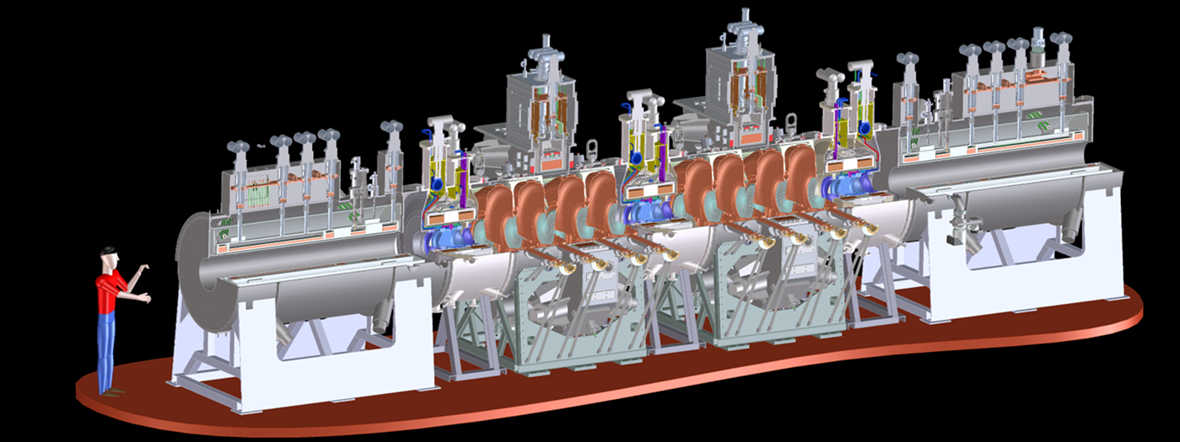
RF Cavities and RFCC Modules
Steve Gourlay
For the MICE Magnet Team
May 7, 2013

Slide 2
Outline
RF Cavities
  Current status
  Remaining tasks
RFCC Module
  Coupling Coils
  Vacuum vessels
  Integration of the RFCC module
    Single cavity vessel at Fermilab
    Vacuum vessels for the CC magnet
Summary

Slide 3
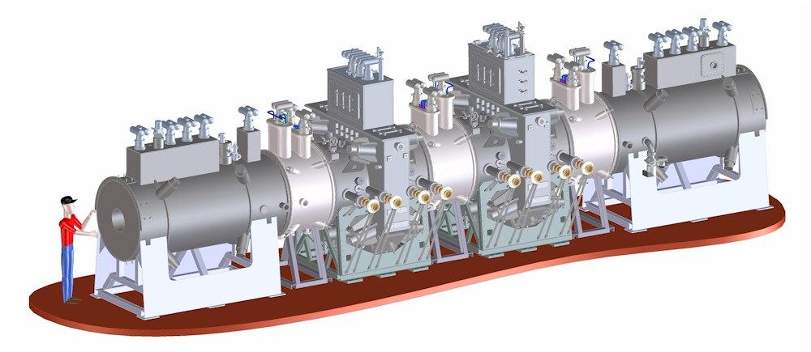
Introduction
MICE cooling channel has two RFCC (RF cavity and Coupling Coil Magnet) modules
Each RFCC module has
  Four normal conducting 201-MHz cavities in a vacuum vessel
  One superconducting coupling coil magnet
RFCC Module #2
RFCC Module #1

Slide 4
RF Cavities

Slide 5
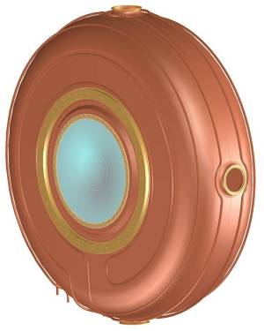
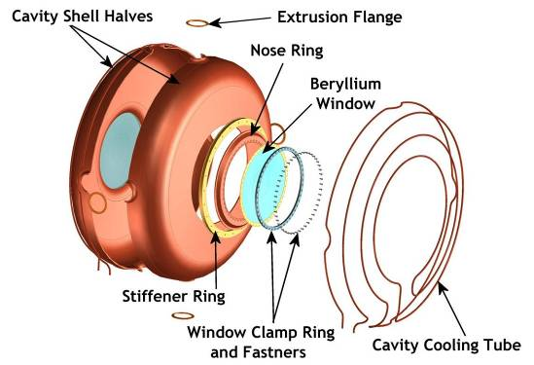
MICE RF Cavities
Spinning of half shells using thin copper sheets and e-beam welding to join the shells; extrusion of four ports; each cavity has two pre-curved beryllium windows, but also accommodates different windows

Slide 6
Current Status of the RF Cavities
  Ten RF cavities made at LBNL
    One electro-polished cavity is at MTA, Fermilab to be used as a prototype for single cavity vessel testing this summer
    Nine cavities to be electro-polished at LBNL in FY13
  Eleven thin and curved beryllium windows at LBNL
  Ten ceramic RF windows at LBNL
  Six tuner arms fabricated at Fermilab
  Six actuators are being fabricated at LBNL and will be completed this week
  RF coupler design complete and ready for fabrication

Slide 7
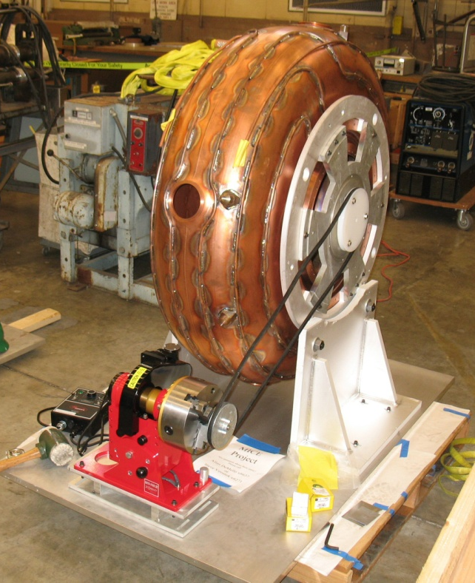
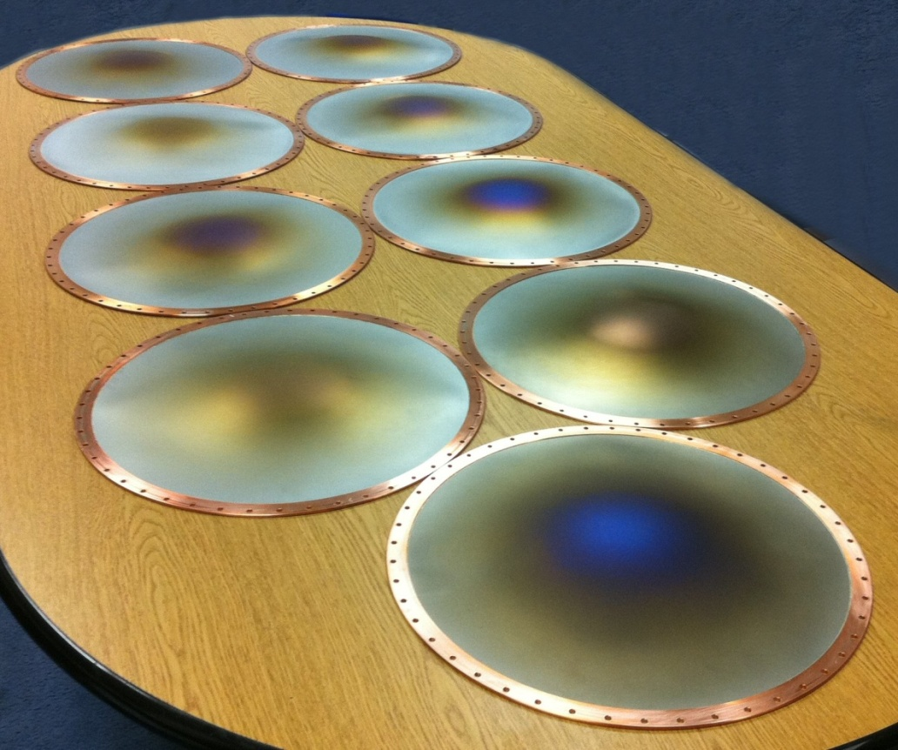
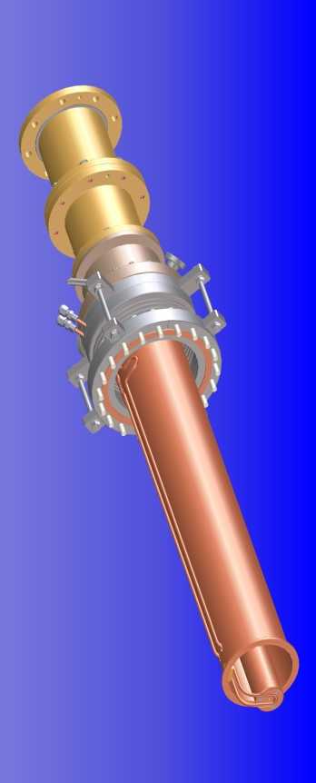
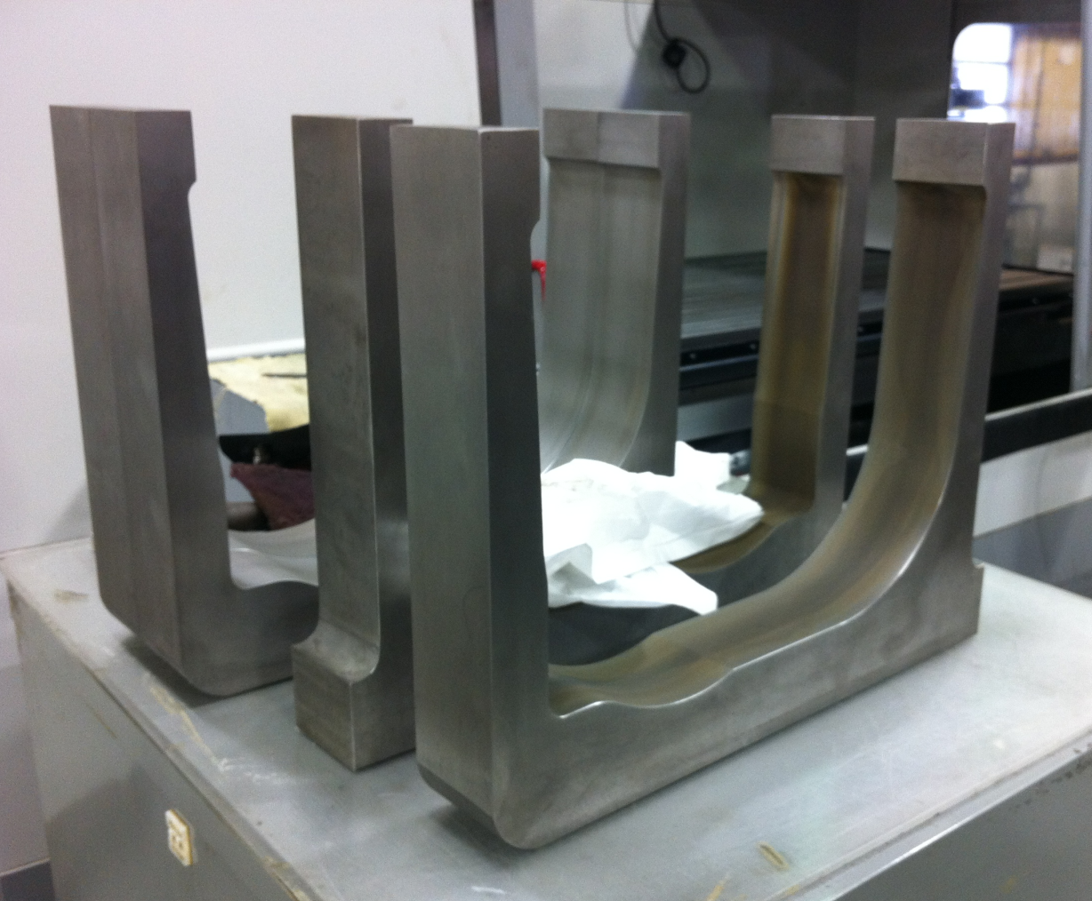
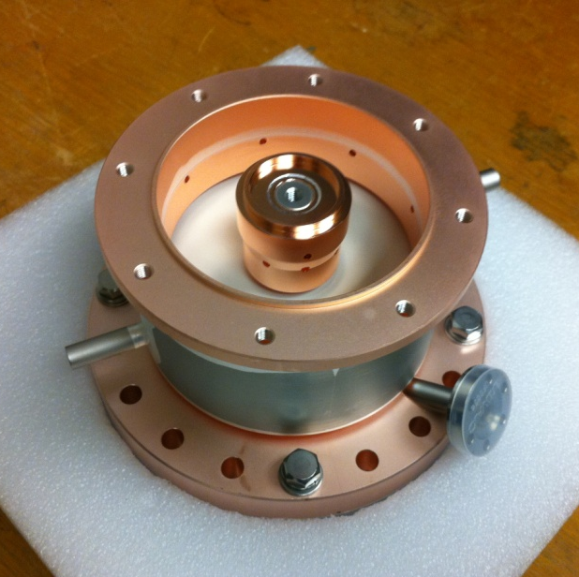
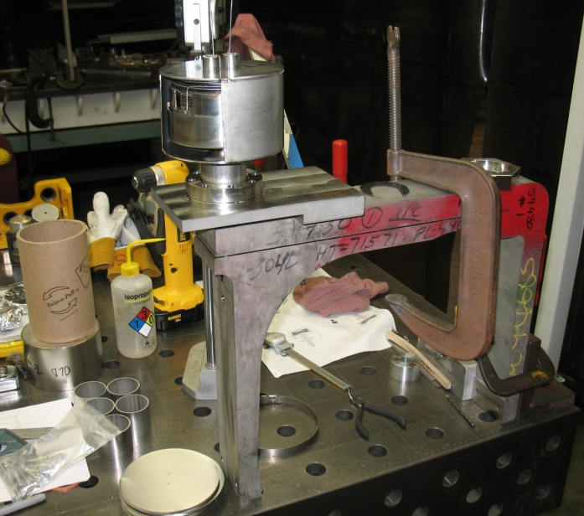

Slide 8
Summary
MICE RF cavitiy schedule is dominated by available resources and the schedule of the CC magnet
All (four) RF cavities and their accessory components (tuners, couplers, actuators and etc.) and vacuum vessels must be ready at FNAL when integration of RFCC module #1 starts in Apr. 2016
  Many of the remaining tasks for RF cavities and RFCC vacuum vessels can start earlier if funding is available

Slide 9
Coupling Coils

Slide 10
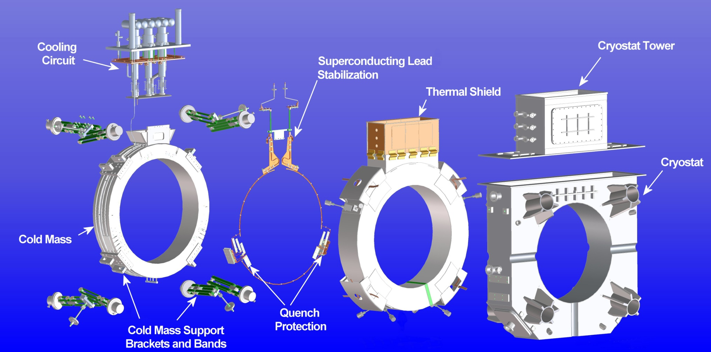
Coupling Coil Subassemblies

Slide 11
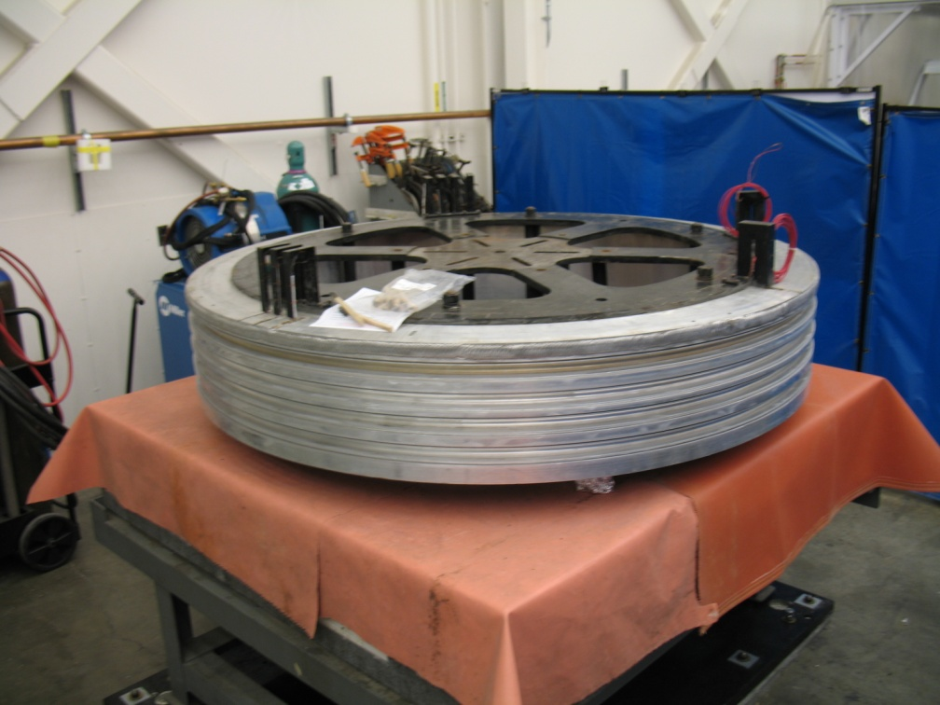
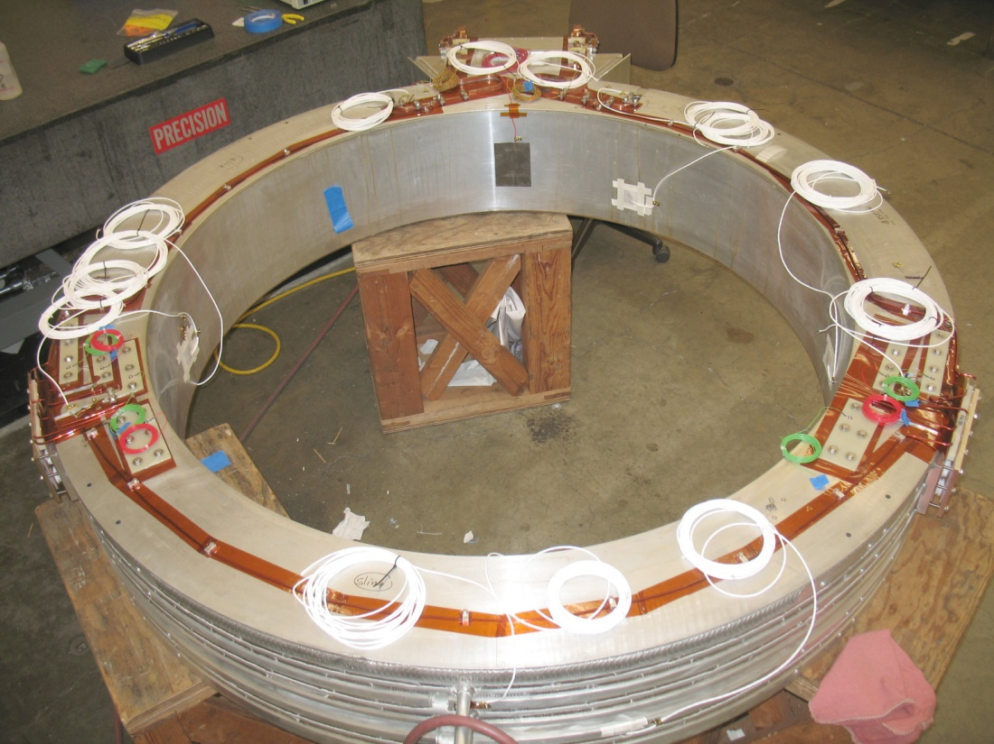
CC Status
Cold mass
  Preparation of cold mass coil #1 finished at LBNL and at FNAL for testing
  Winding of cold mass coils #1 finished by QiHuan Company (Beijing, China)
  Winding of cold mass coils #2, #3 and #4 scheduled to begin June 2013
  Preparation of cold mass coil #2, #3 and #4 at LBNL scheduled to begin January 2014
  Quench Protection
  Cernox Sensor
  Strain Gauges
  Voltage Taps

Slide 12
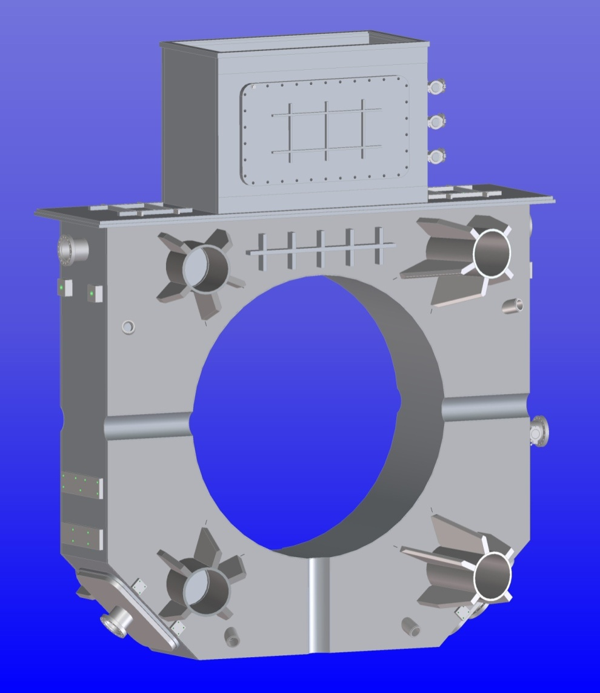
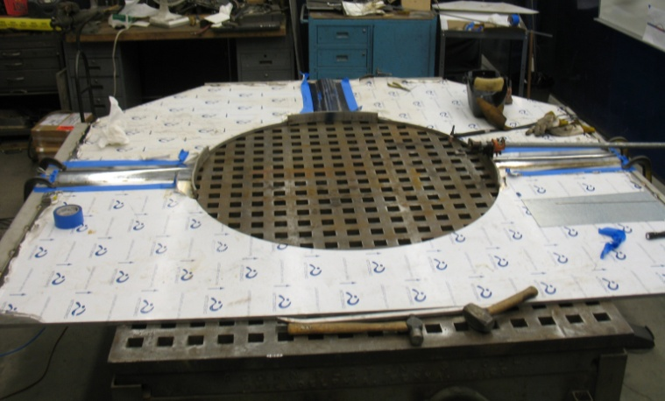
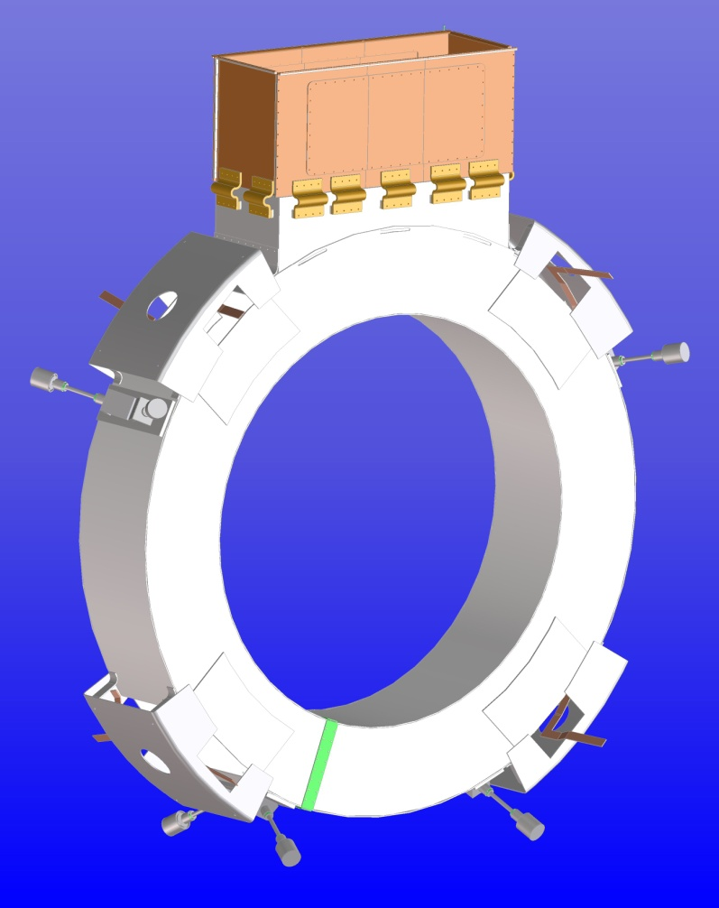
CC Status
Coupling Coil Cryostat
  LBNL mechanical shop is in the process of fabricating the first cryostat
  Estimated completion in July 2013
  Drawings will be updated to reflect the “as built” cryostat
  Determine fabricator for the additional 2 cryostats
Thermal Shield
  Thermal shield design is nearly complete
  Drawings have been red lined but not update
  Some SINAP parts/drawings will need to be revised for better manufacturability
  LBNL shops will fabricate the first thermal shield

Slide 13
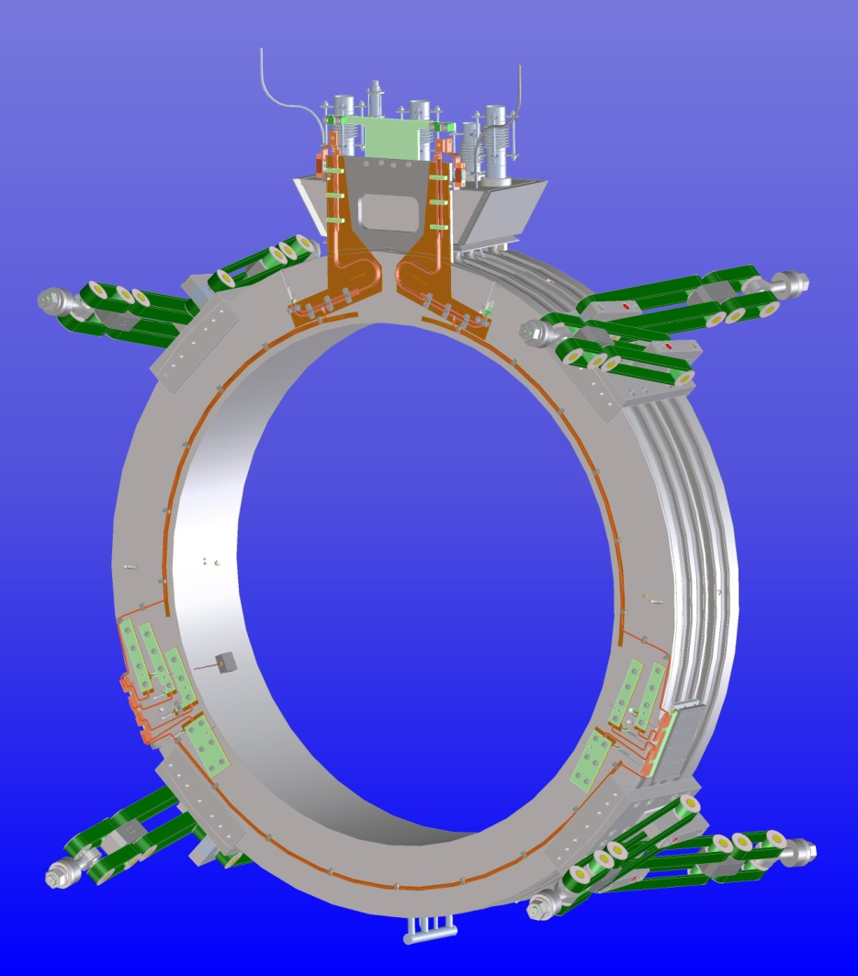
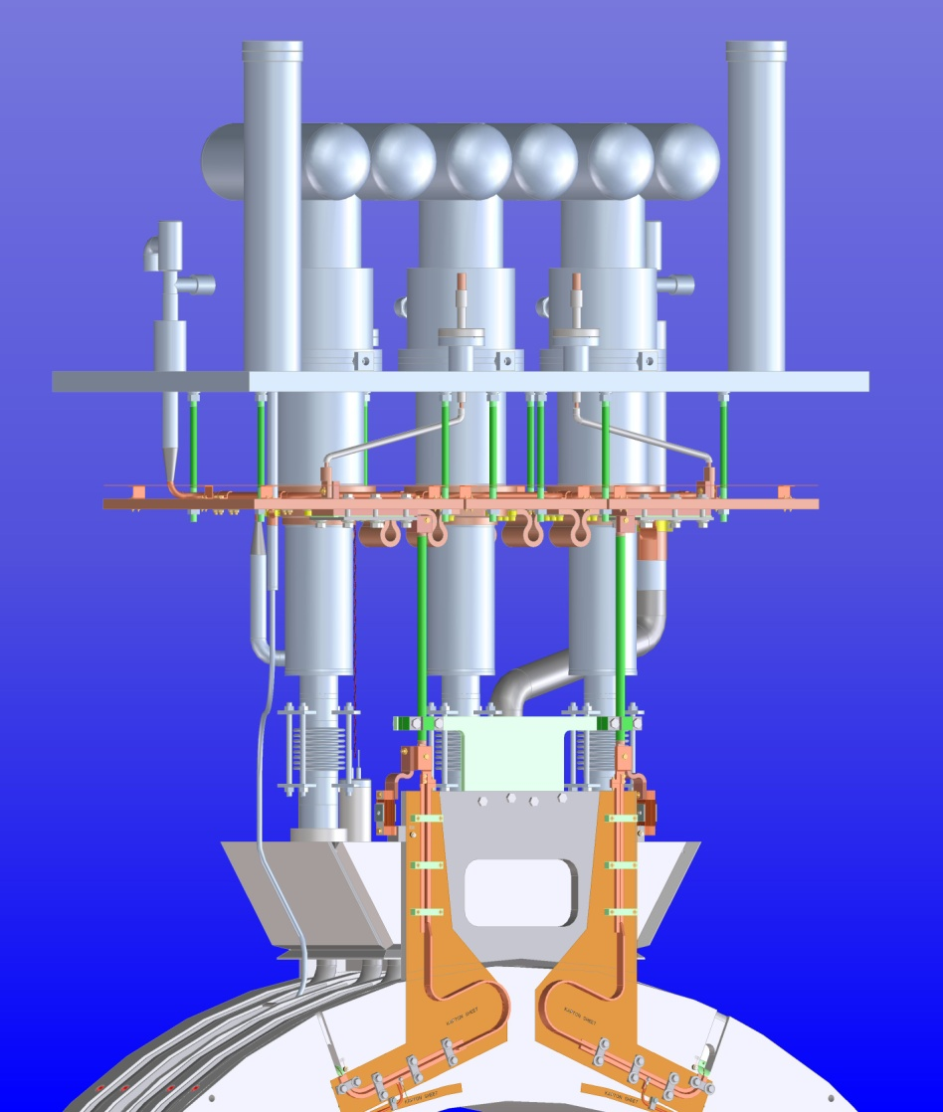
CC Status
Coupling Coil Assembly at FNAL
  Complete the reservoir/cooling circuit installation on cold mass
  Install the cold mass support brackets and support bands
  Wrap the cold mass with MLI
Cooling Circuit Assembly at FNAL
  Finalize cooling circuit design (LBNL)
  Create detailed fabrication drawings
  Fabrication of component parts
  Assemble components

Slide 14
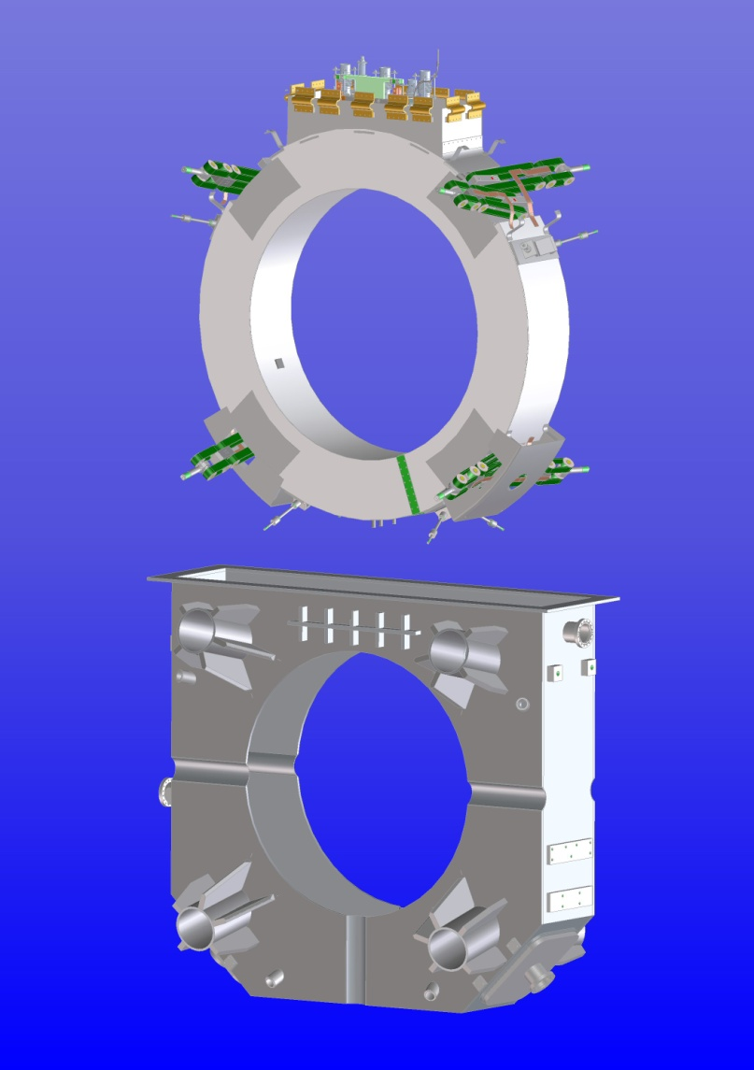
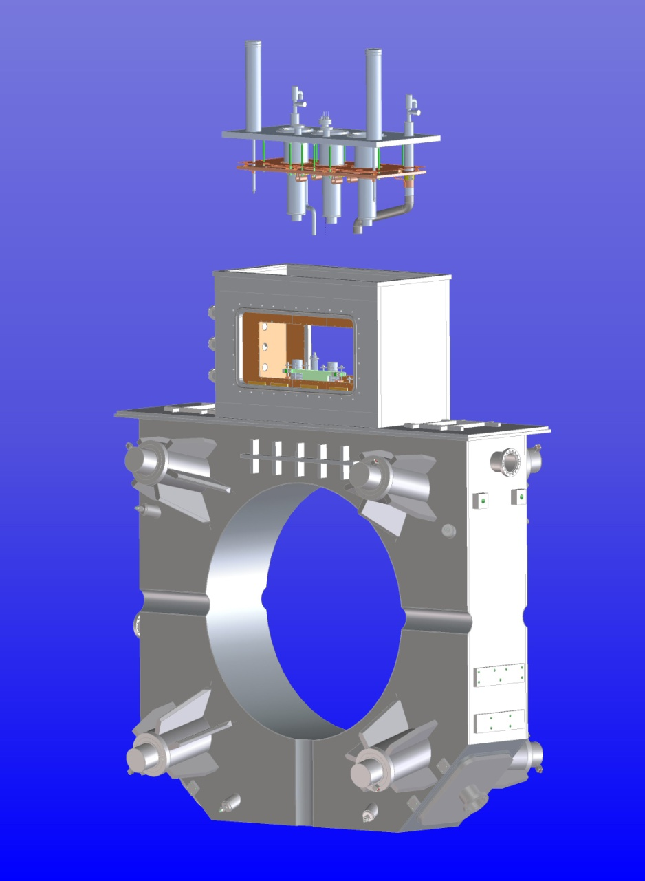
CC Status
Coupling Coil Integration at FNAL
  Cold mass prepared for integration with cryostat
  Assemble thermal shield around cold mass
  Insert cold mass into cryostat
  Weld on cryostat tower and inner bore
  Weld tower assembly to cryostat
  Assemble upper cooling circuit
  Attach upper cooling circuit to the cold mass cooling circuit
Test at FNAL

Slide 15
Major Risks
Failure of first coil due to design or assembly
  Mitigation – Three additional coils will be wound. Fewer splices in new coils. Winding review held. Experienced personnel on hand for critical operations.
Assembly of first coil into cryostat
  Mitigation – Experience at FNAL from MuCool coil. Use of mock-ups for critical assembly procedures.
Excessive heat load – cryocoolers cannot maintain operating temperature
  Experience from Spectrometer Solenoids shows that heat loads can be accurately calculated and, when using experience assembly techs, can be obtained in practice

Slide 16
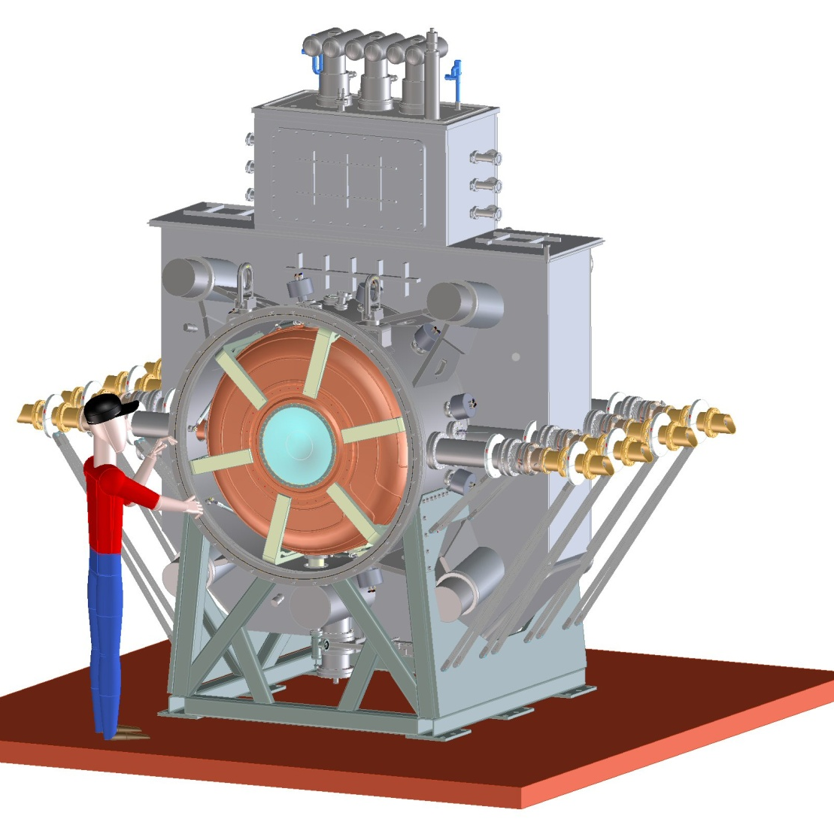
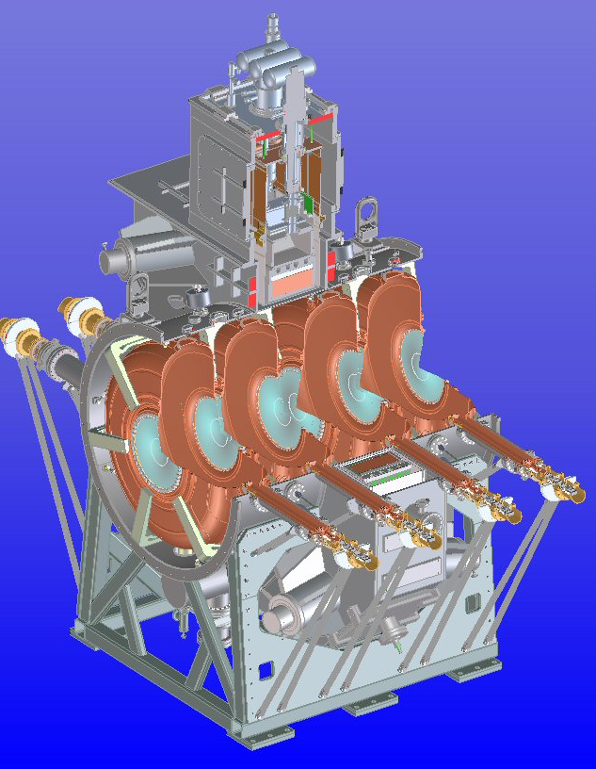
RFCC Module
RF Cavities
Coupling Coil
Magnet
Six Tuner
Arms
Coaxial Loop Couplers

Slide 17
Status of RFCC Modules
Fabrication of the 1st cryostat vessel (for MuCool) started and will be completed in July 2013
Design of RFCC vessel 80% complete
A single cavity vacuum vessel has been fabricated and will be used at MTA for the 1st MICE cavity test this summer, the vessel has
  Allow for testing of both types (left and right) of MICE cavities

Slide 18
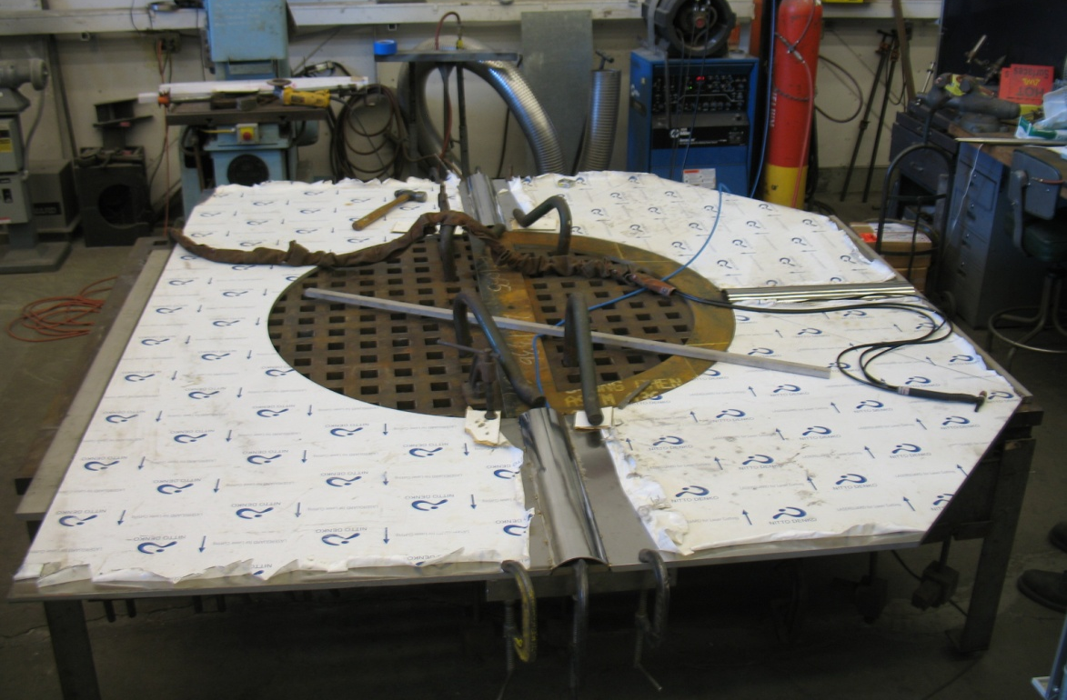
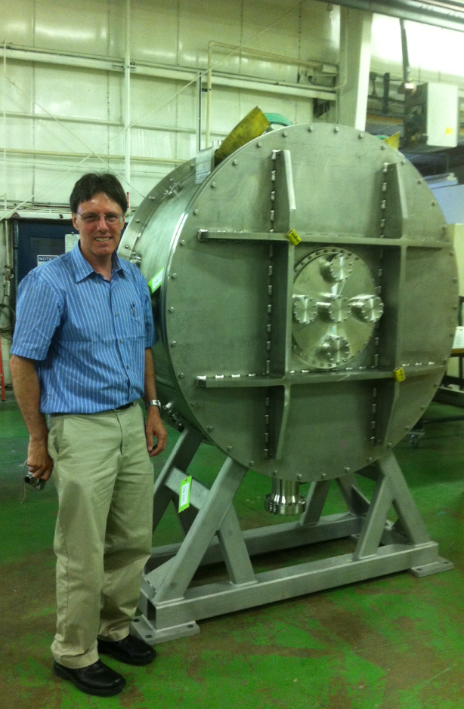
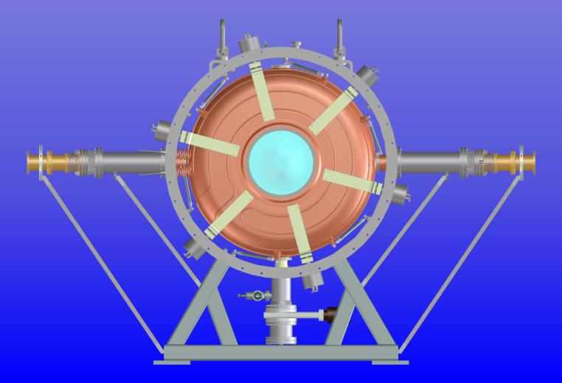
Cryostat fabrication at LBNL (Apr. 2013)
Integration of
Single cavity
Single cavity vessel at Fermilab

Slide 19
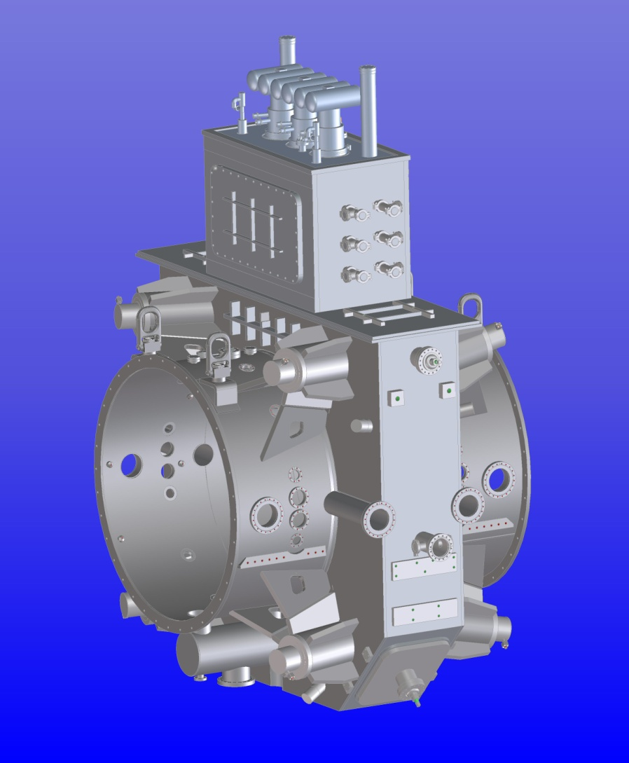
Integration of RFCC Module
Minimize distortion during welding
Requirements for good alignment of RF coupler ports and actuators
Fixtures for welding, lifting and support
Risk: Integration of RFCC module
  Unforeseen issues during assembly: vacuum vessel to CCM; RF cavity to RFCC module
Mitigation:
  Incorporate design updates with the welder(s)/technician(s) who will work on assembly

Slide 20
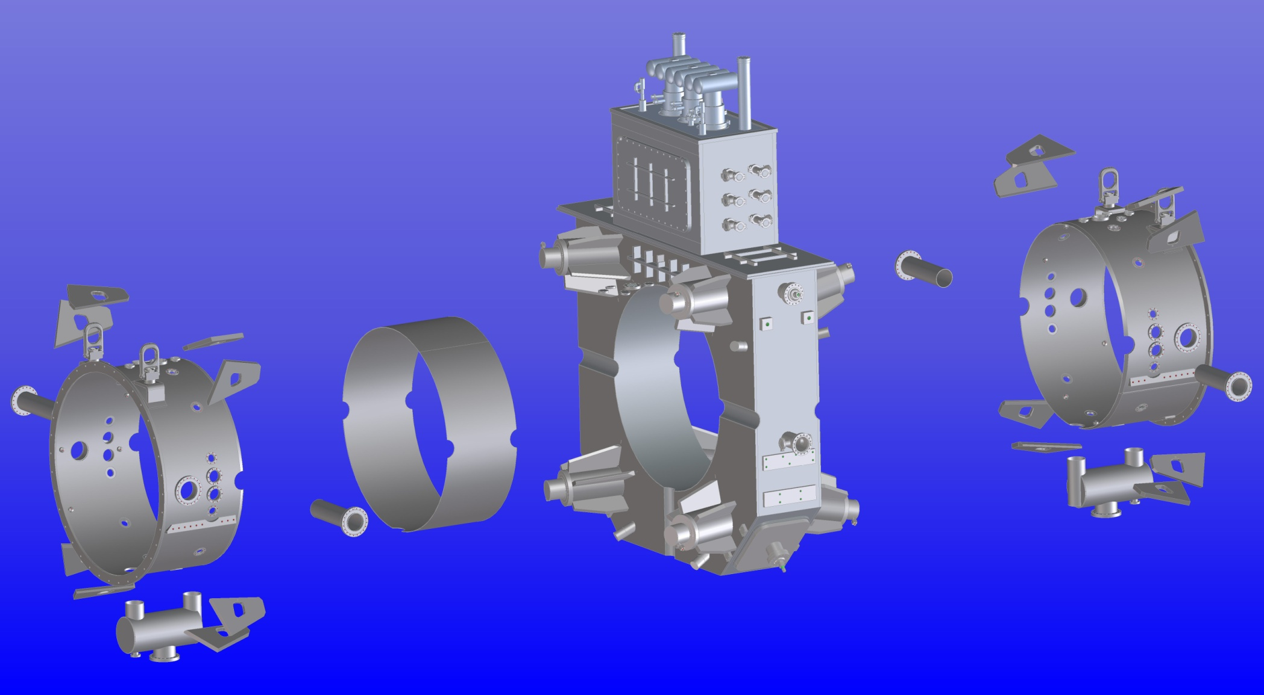
RFCC Module Integration
Exploded view showing the integration
of RFCC module vacuum vessel
Gussets to be welded
to the CCM
Sleeve for the CC magnet
RF coupler port
Vacuum manifold
and ports

Slide 21
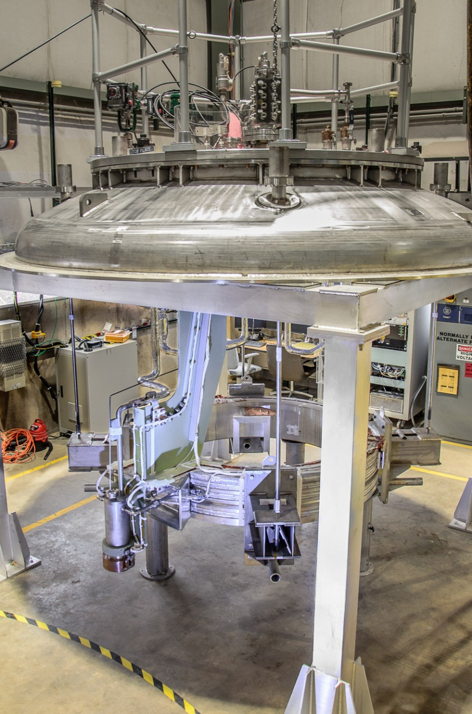
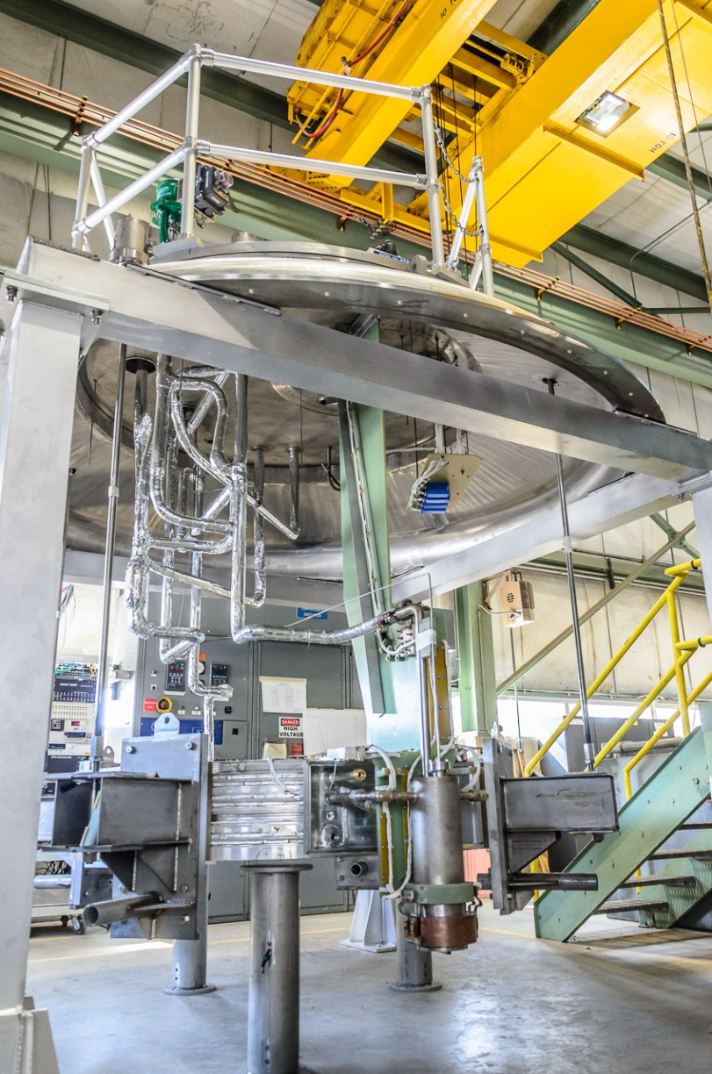
Test Preparations at FNAL
Completed and Checked:
Mechanical Supports
Cryo Piping
Current Leads
Valves, Instrumentation
Pressure Test
Leak Check
Hipot

Slide 22
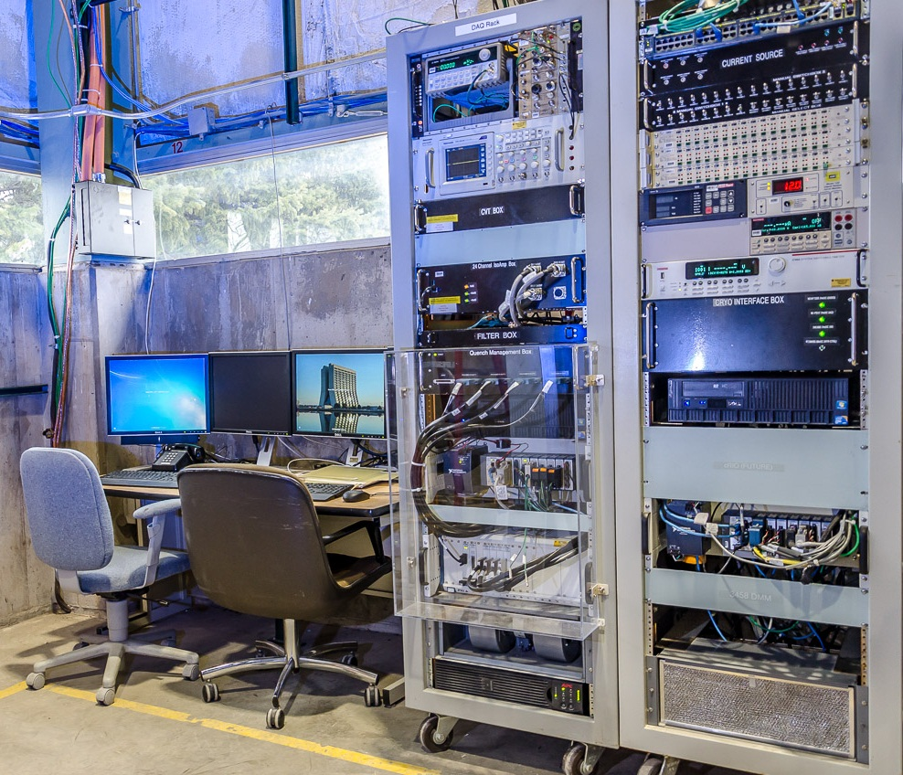
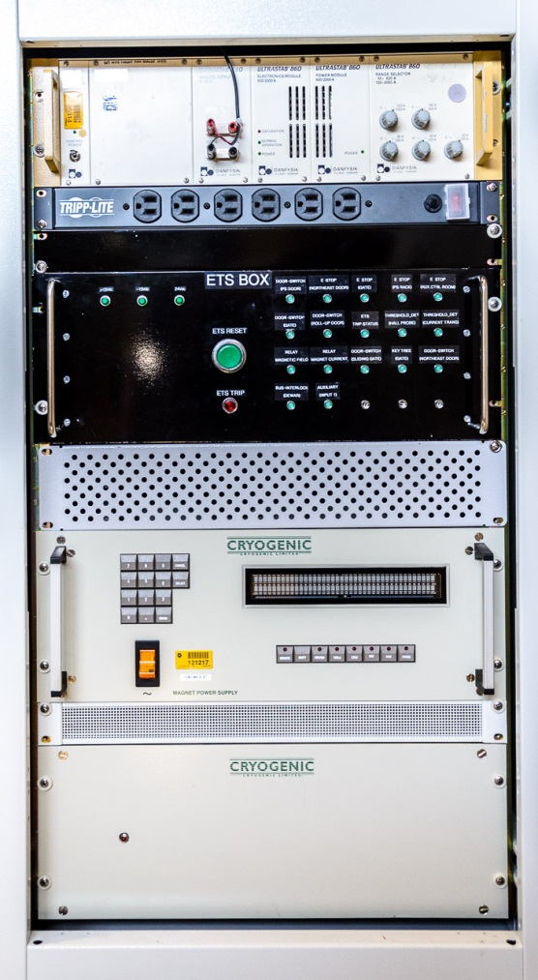
Controls, DAQ, Power System
Cryo Controls, DAQ, and Power System checked out and ready

Slide 23
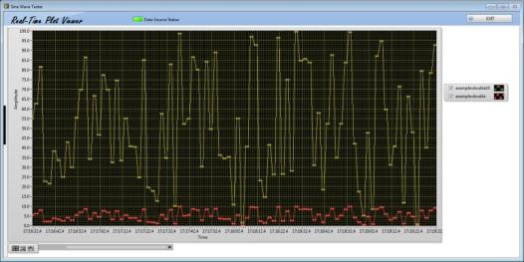
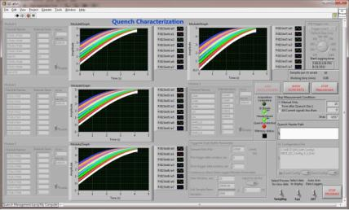
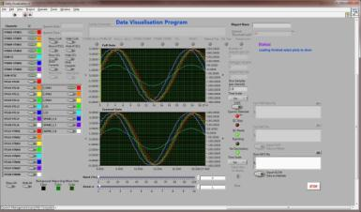
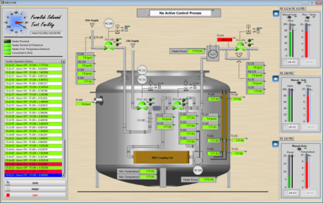
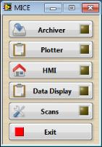
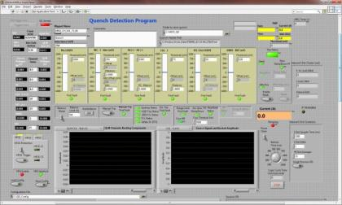
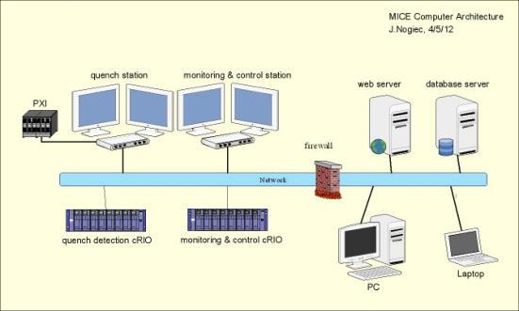
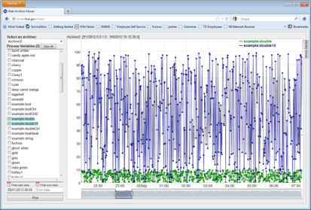
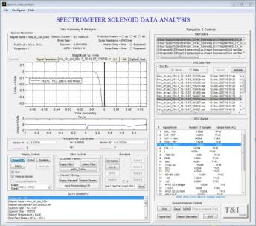
Software User Interface
Monitoring & Control Subsystem UI
Quench Subsystem UI
Web-based Data UI

Slide 24
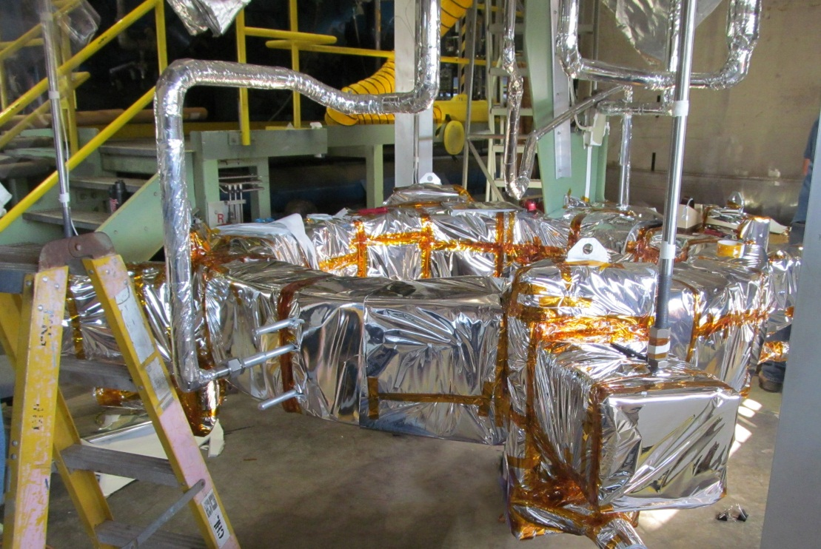
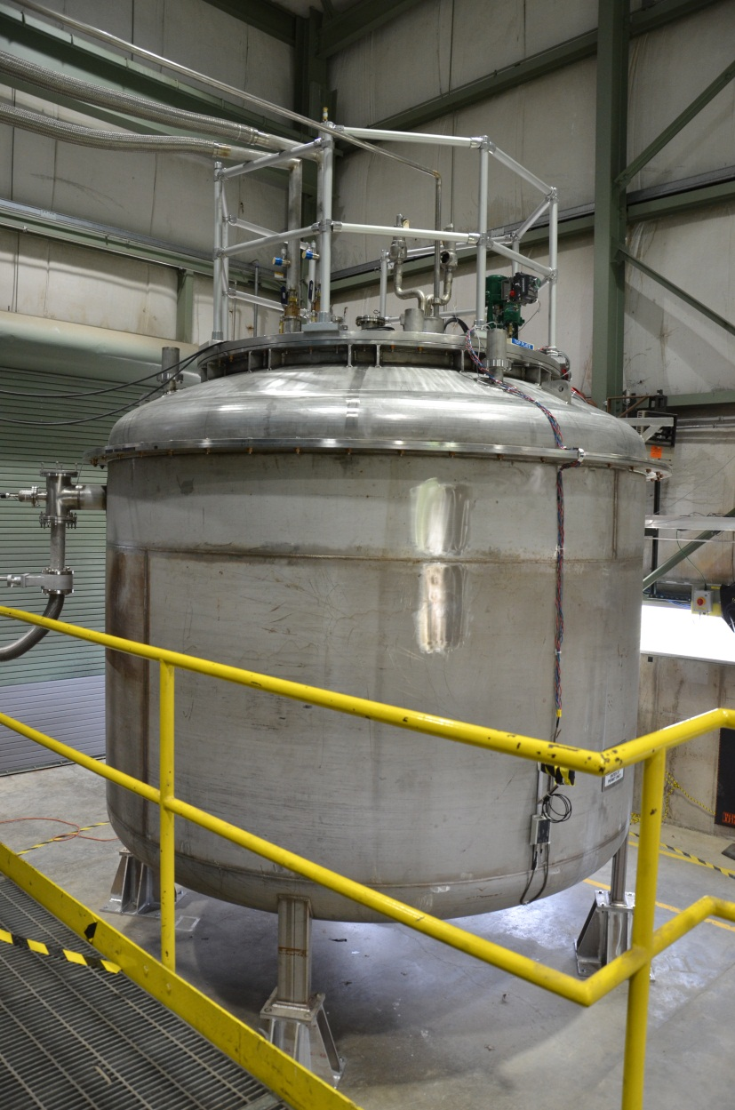
Coil Wrapped in MLI and Inserted in Vacuum Vessel
Warm commissioning completed
Test Cryostat connected to CHL Liquid Helium Dewar

Slide 25
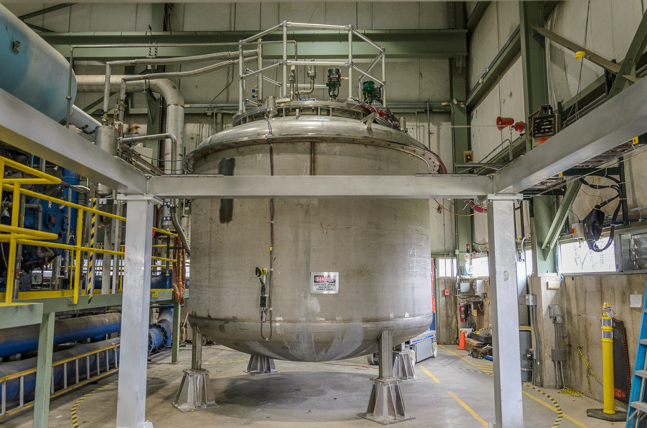
Current Status of 1st CC Coil Test
Operational Readiness Clearance (ORC) granted April 17, 2013
CHL making Liquid Helium and filling the LHe dewar
Transfer Line Cold already
Expect to start coil cooldown Monday 5/6/13

Slide 26
Test Plan
Following test plan “MuCool-01 Magnet Test Plan, TID-N-571”
  Approved April 17, 2013
  In the final steps of Section 3 “Cryogenic System Commissioning”
  Expect to start Section 4 “Cooldown to 4.5 K” on Monday May 6th.
Cold Power Testing (Section 7) expected to start after coil cooldown (Section 4), Thermal Tests at 4.5K (Section 5), and Cold Electrical Checkout (Section 6)

Slide 27
Acknowledgement
Ruben Cargagno, FNAL
Derun Li, Steve Virostek, Allan DeMello, LBNL

