Slide 1
Electrical Infrastructure and Control
Update, Schedule and Future Requirements
Steve Griffiths
7th May 2013

Slide 2
Contents
Decay Solenoid
  Replacement of Power supply and protection circuit
Quench Protection System
  DL system and future requirements
Rack Room 2
  Rack allocation and design considerations
  Alternative location and implications
Cooling Channel
  Main Control system
  AFC Power Supply and Instrumentation
  SS Power Supply and Instrumentation
RF System
  Electrical requirements

Slide 3
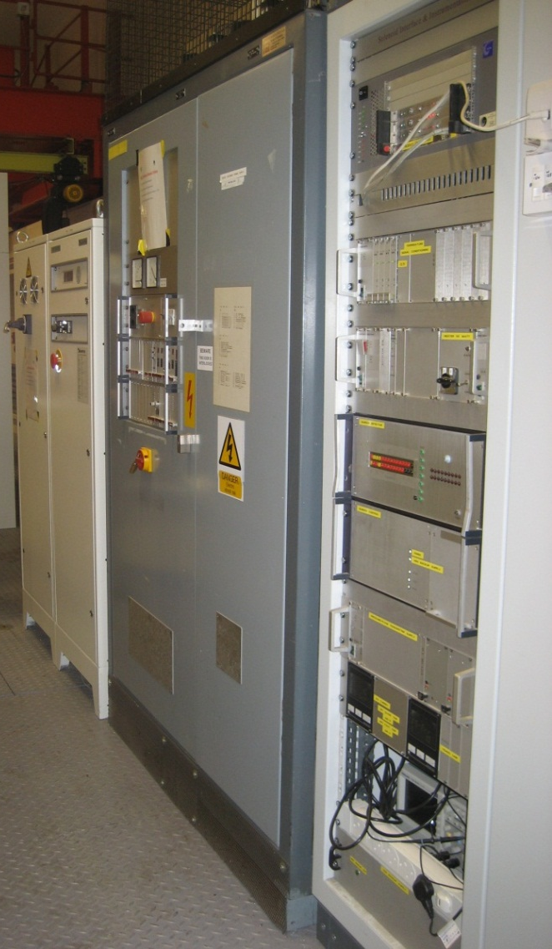
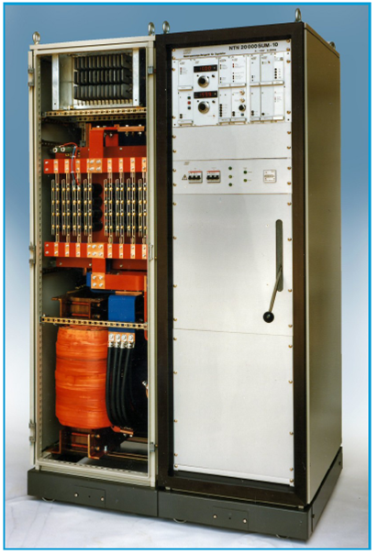
Decay Solenoid Power Supply Replacement
SC Magnet, PSU and control system donated by PSI.
Operational for over 30 years.
Existing system is electrically noisy and unreliable.
New FuG Power Supply delivered June 2013.
Guaranteed for 2 years – need to review spares requirement.
System installed and electrically commissioned July 2013.
FuG - Superconducting Magnet Power Supply - 10V, 1000A
Existing PSI Power Supply & Control System

Slide 4

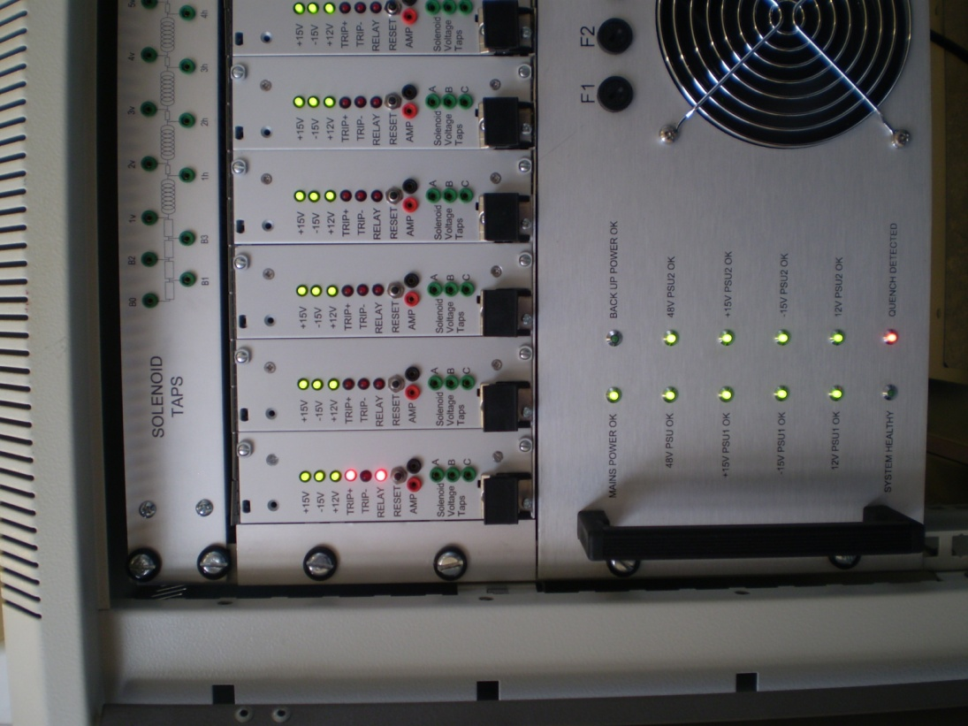
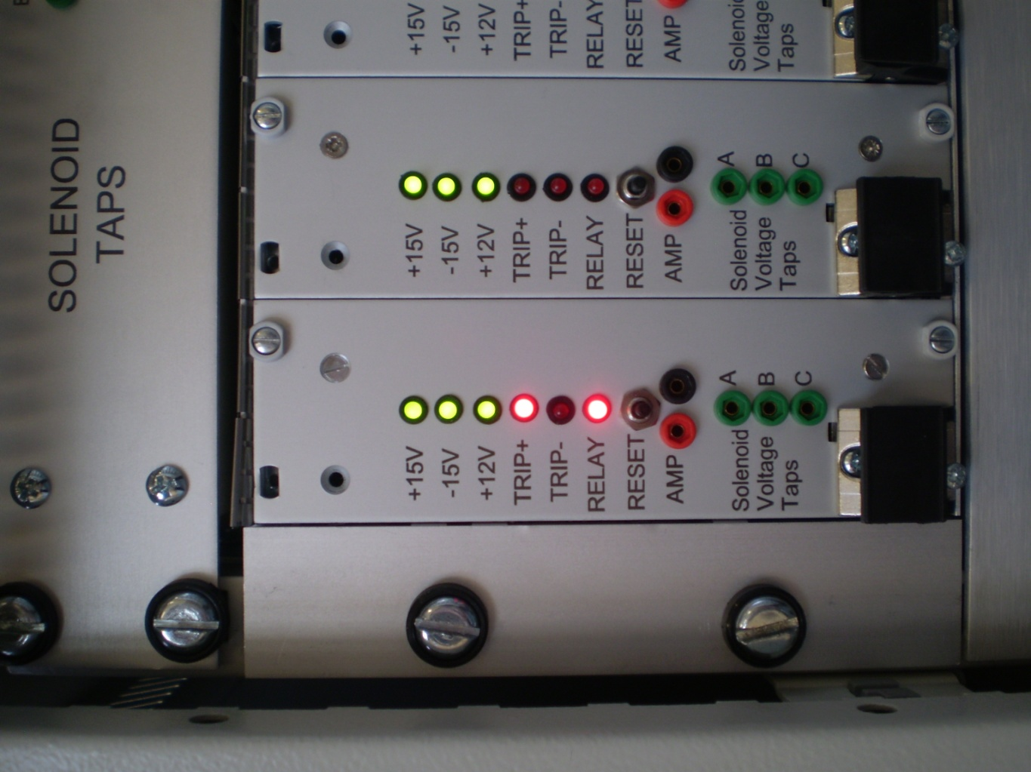
Quench Detection System
Existing system contains obsolete components and new QD systems also required for AFC#1&2.
A QD system has been developed at DL.
Combining the reliable PSI philosophy with a modern modular designed.
Additional monitoring included but it has NO Data logging capability.
Commissioned June 2013.

Slide 5
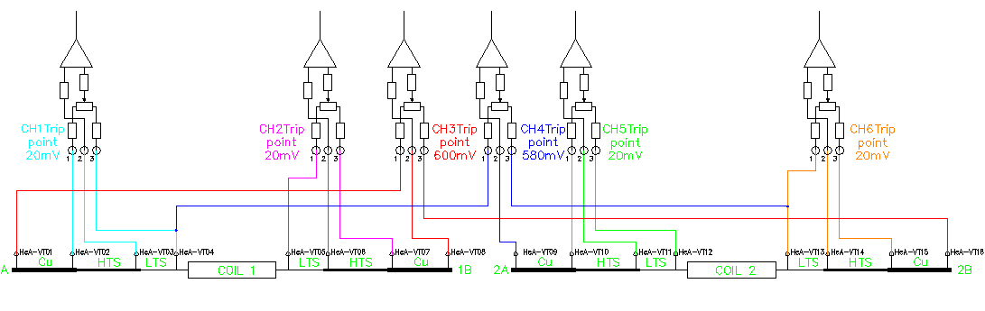
Quench Detection System for Cooling Channel
The new QD System has been successfully tested on the AFC#1.
Decay Solenoid and AFC#2 QD systems available June 2013.
AFC QD system configuration
The Spectrometer tests utilised the FNAL QD system.
  Combines protection and data logging – cost and size considerations
A specification for a QD system capable of protecting and diagnosis is being written.
An independent data logging system is currently being tested at DL.

Slide 6
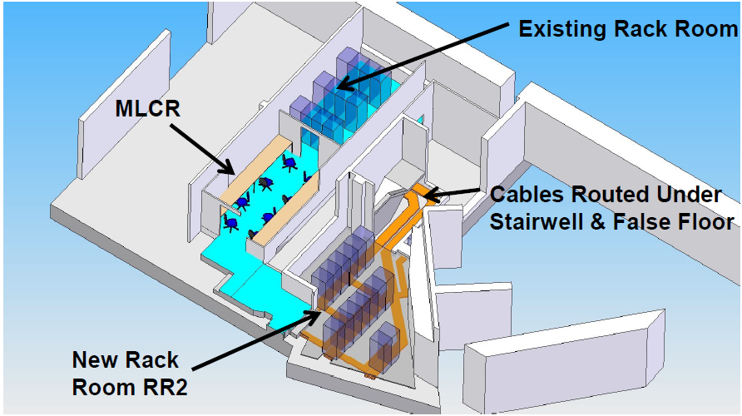
Cooling Channel Rack Location – RR2
Only 7 racks required for Step IV.
Additional rack spaces available for Steps V & VI.
Rack positions and cable management reviewed and optimised.
Cable lengths and sizes calculated.
Cost savings by directly installing in RR2.
Cables for cooling channel cannot be installed until rack & associated magnet are ready.

Slide 7
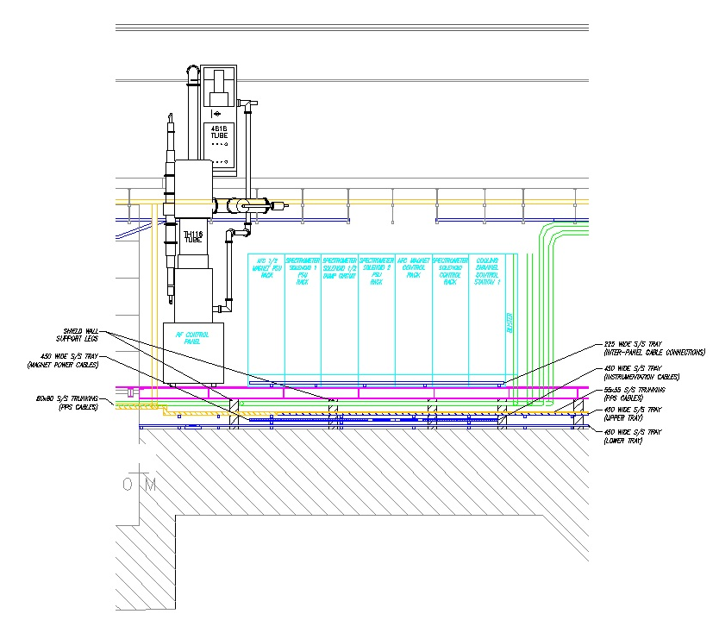
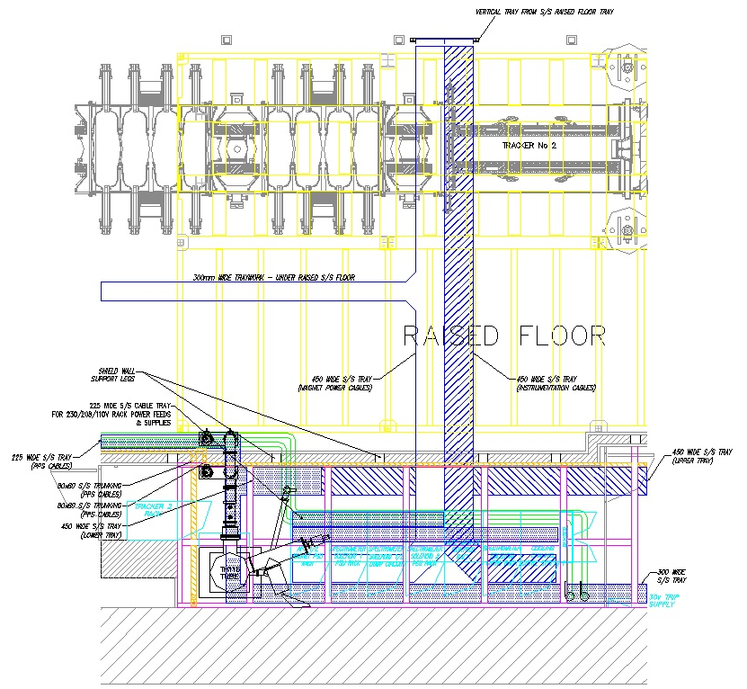
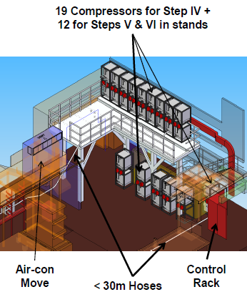
Cooling Channel Rack Location – North Wall
7 Cooling Channel controls, instrumentation and power supply racks designed and under construction
An additional rack will be required for Vacuum and Compressor controls

Slide 8
Cooling Channel Rack Configuration
Cooling Channel Control Rack
AFC Control & Instrumentation Rack
Spectrometer #1&2 Control & Instrumentation Rack
AFC Power Supply Rack
Spectrometer #1 Power Supply Rack
Spectrometer #2 Power Supply Rack
Spectrometer #1&2 discharge circuit Rack
Portable control and instrumentation racks designed, assembled and operational for AFC and SS.
Modifications and improvements incorporated in the final rack designs.

Slide 9
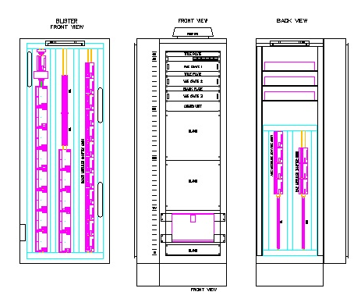
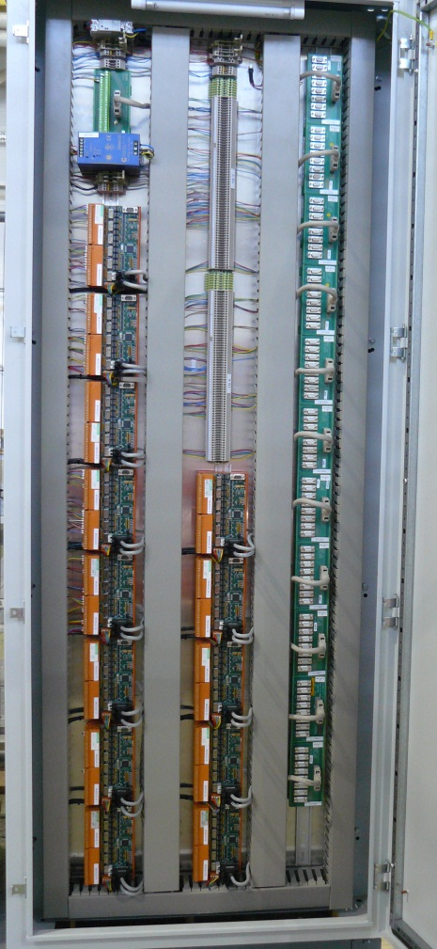
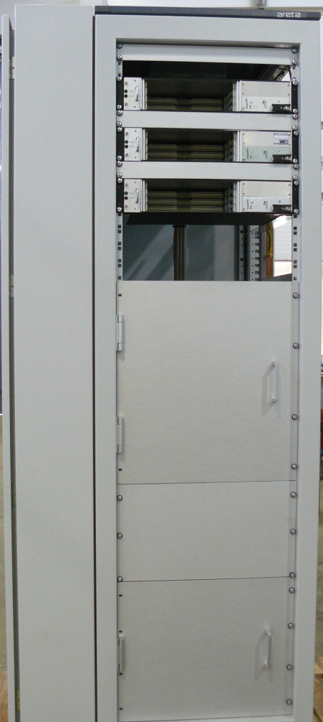
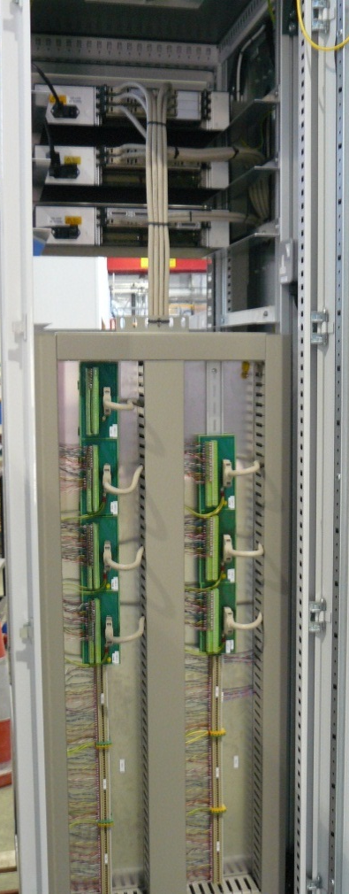
Cooling Channel Control Rack
Front
Back
Control system designed and hardware procured.
Rack assembled and wire checked.
Rack houses – VME crates, CANBUS modules, ADC, DAC and serial interfaces.
Testing scheduled for June 2013
Blister

Slide 10
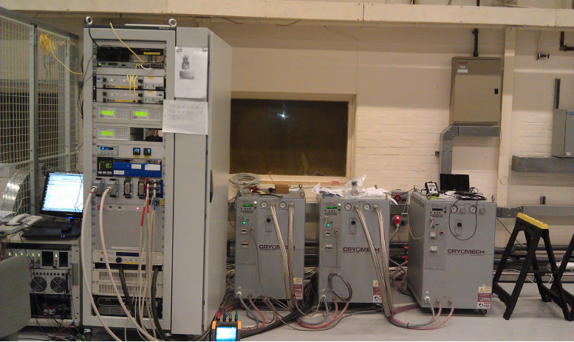
AFC – Portable Control & Power supply rack
Rack houses – VME crates, helium level monitors, temperature monitor / controllers, pressure indicators, power supply, energy absorbers and plant interfaces.
Two racks are required for the AFC#1&2.
  One rack containing instrumentation – control & monitoring
  And a separate rack for power supplies and energy absorbers
All instrumentation and control will be re-used in final design once testing complete,

Slide 11
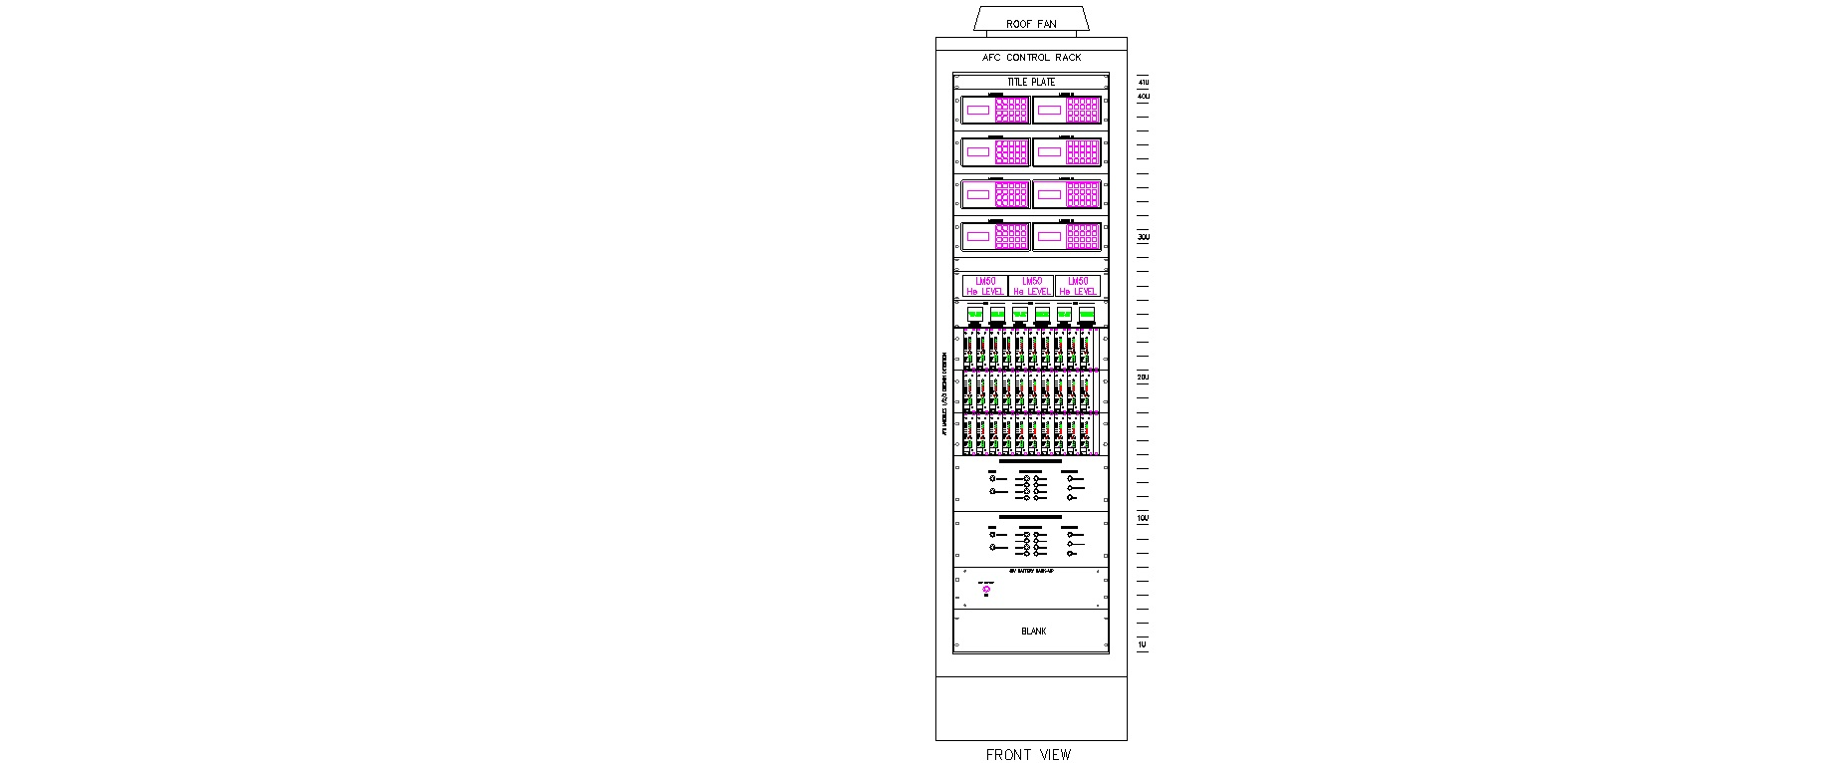
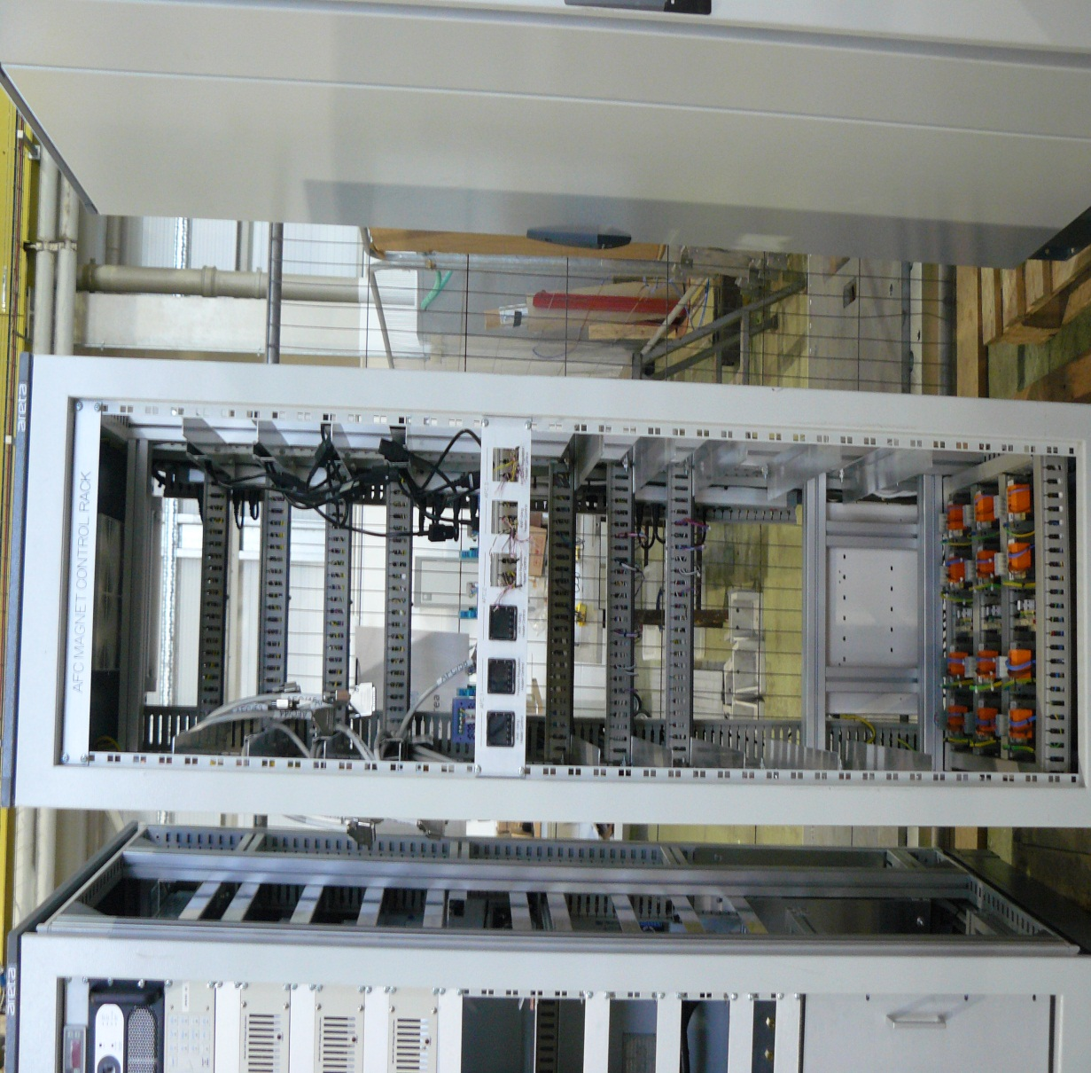
AFC #1,2&3 – Control Rack
Controls system designed and hardware procured.
Rack assembled and wire checked.
Full integration testing scheduled for June 2013.
Rack houses – 3 x QD systems, He level gauges, temperature indicators / controllers, pressure indicators and interfacing.
Instrumentation for control and monitoring still needs to be purchased.
Equipment will also be reclaimed from portable control rack in R9.

Slide 12
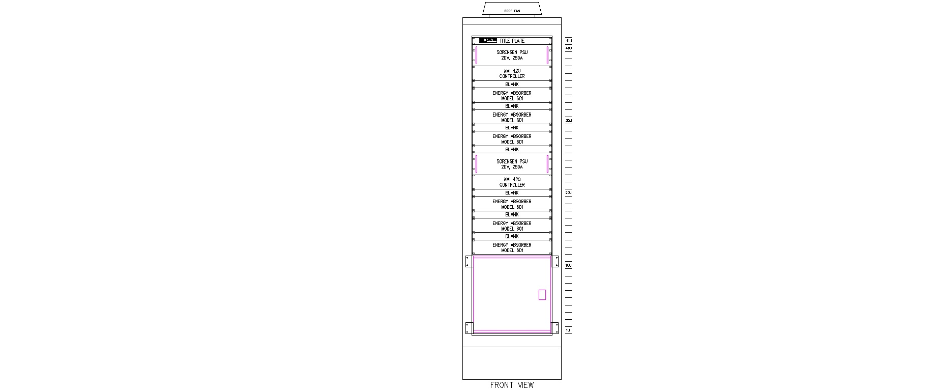
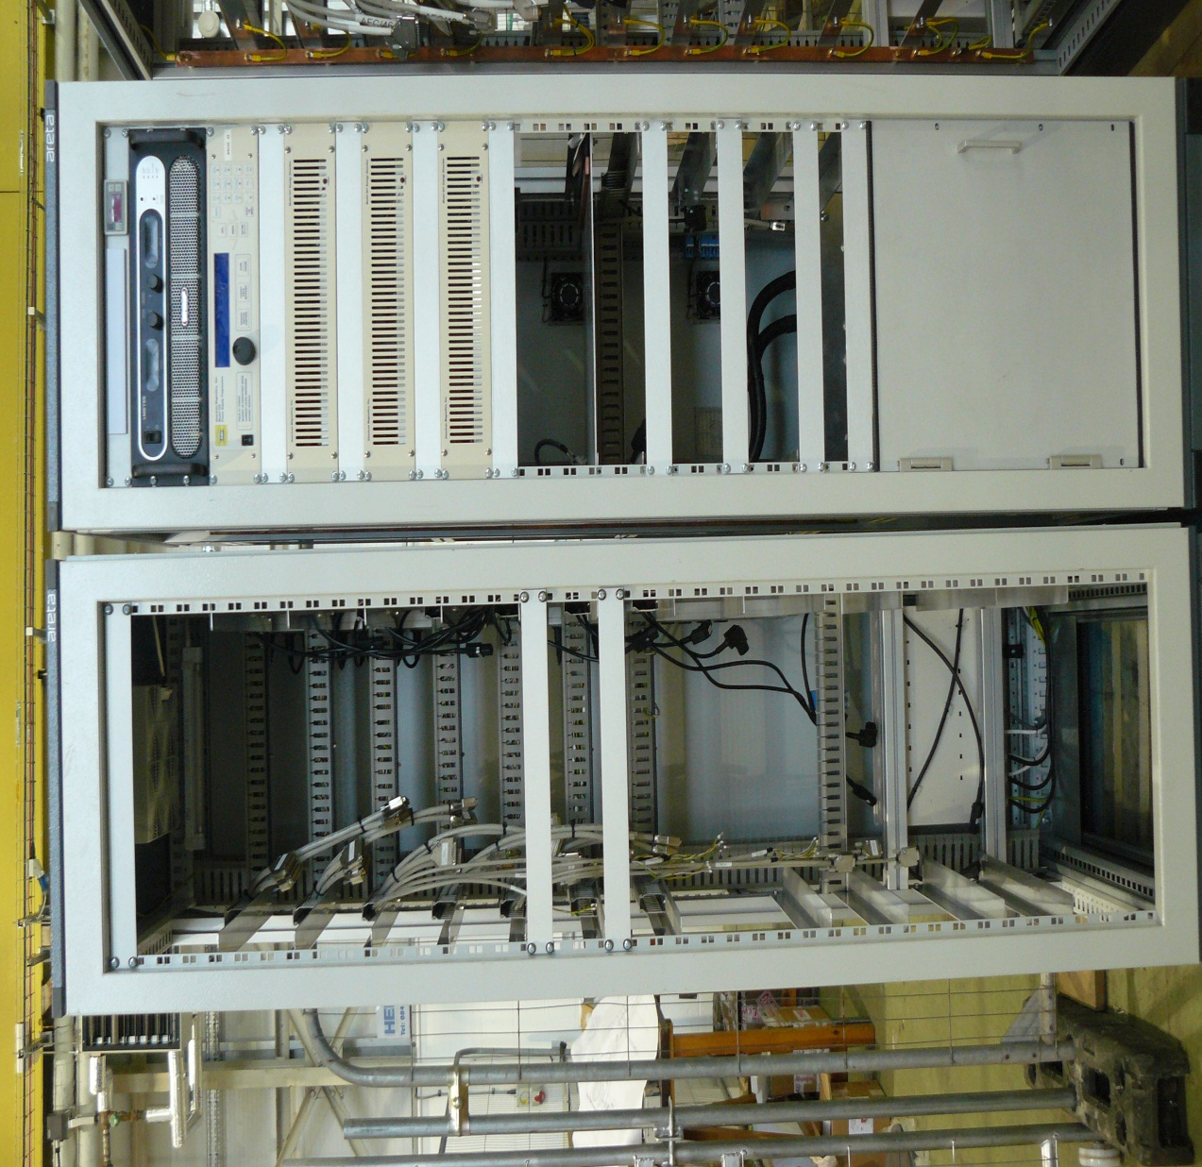
AFC #1&2– PSU Rack
Power supplies and energy absorber circuit designed and hardware procured.
Rack assembled and wire checked.
Full integration testing scheduled for June 2013.
Rack houses – power supplies & controllers, energy absorber modules, main contactors and interfacing.
Equipment will be reclaimed from portable control rack in R9.

Slide 13
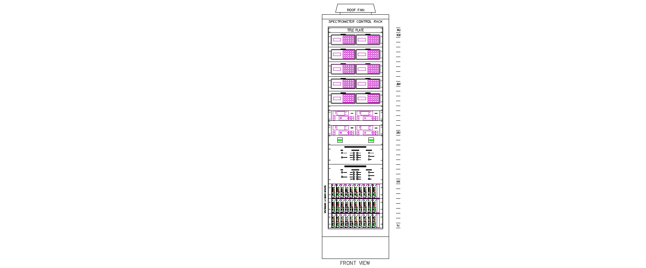
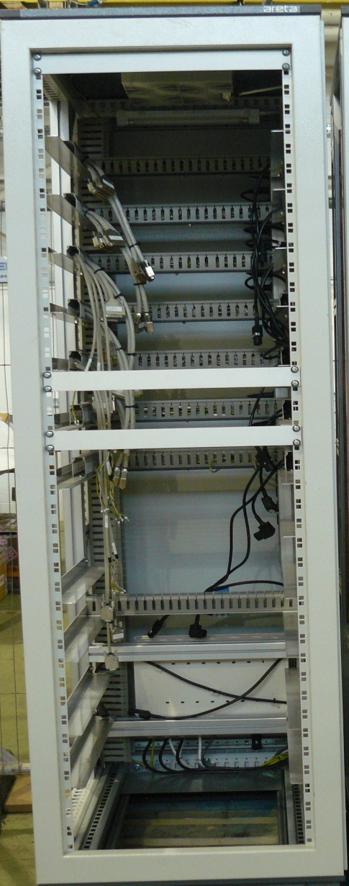
Spectrometer Control Rack
Controls system designed and hardware procured.
Rack assembled and wire checked.
Full integration testing scheduled for June 2013.
Rack houses – 2 x QD systems?, He level gauges, temperature indicators / controllers, pressure indicators and interfacing.
Instrumentation for controls and monitoring still needs purchasing.
Rack will be fully populated once testing at WANG completed.

Slide 14
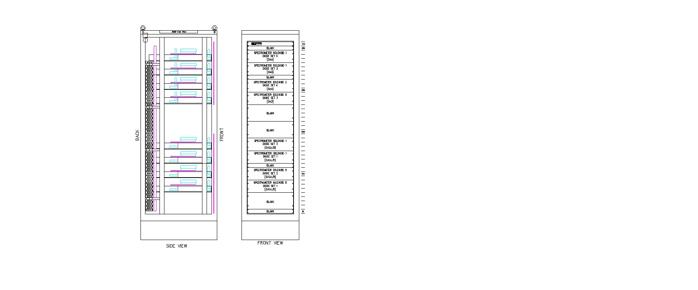
Spectrometer Energy Discharge Rack
Rack design complete and under construction.
One set of discharge circuits at DL.
Rack assembled complete May 2013.
Full integration testing scheduled for June 2013.
Rack houses – energy absorber circuits and fast discharge circuits.
Rack fully populated once testing at WANG completed.
Some module modifications required.

Slide 15
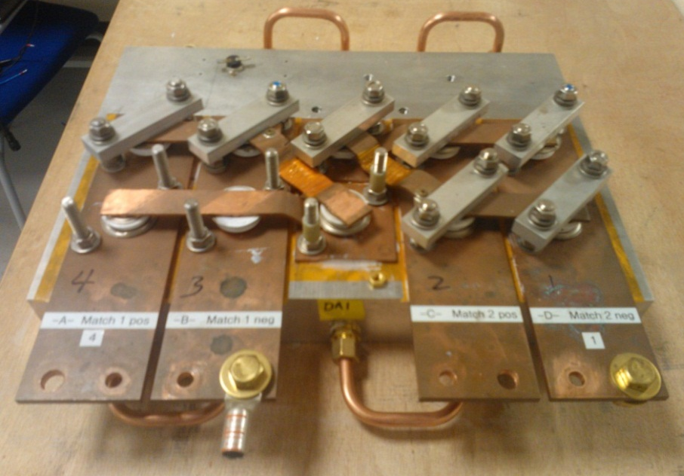
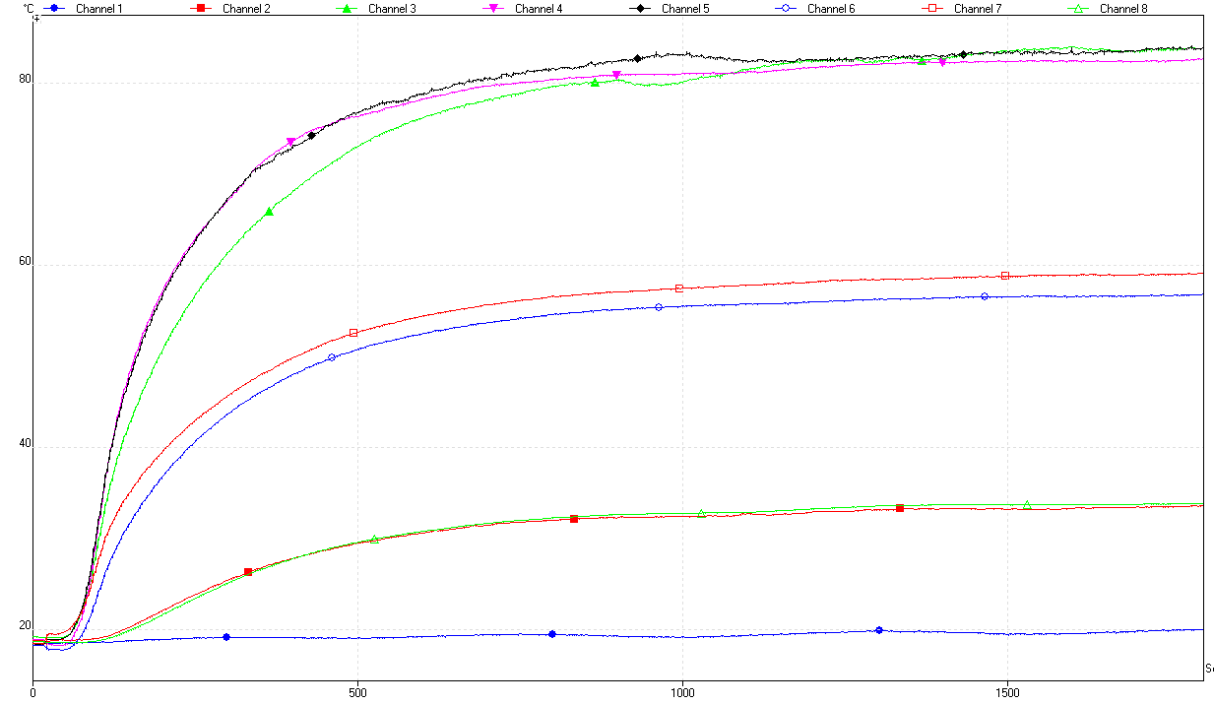
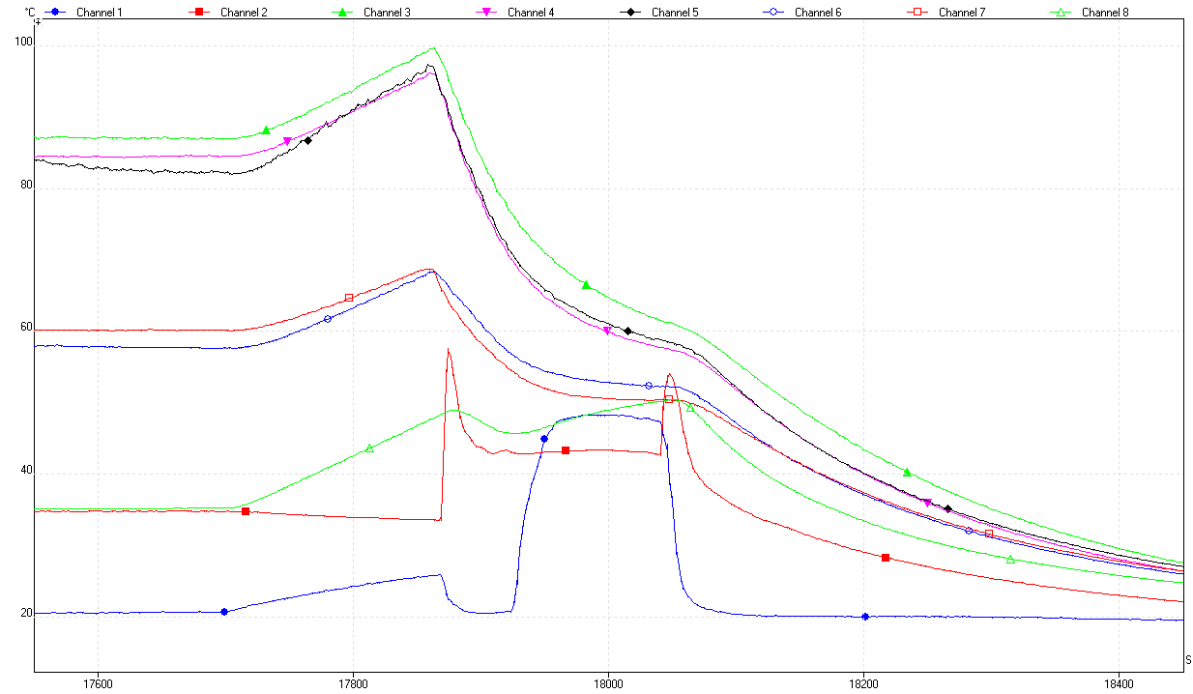
Spectrometer Dump Circuit - Testing
Max Temp on copper busbar - 85°C
Within minutes excessive temps reached on copper busbars.
Electrical insulation with good thermal conductivity added.
All modules to be thermally tested.
A cooling water failure will damage components and a reservoir tank needs to be assessed.
Water failure

Slide 16
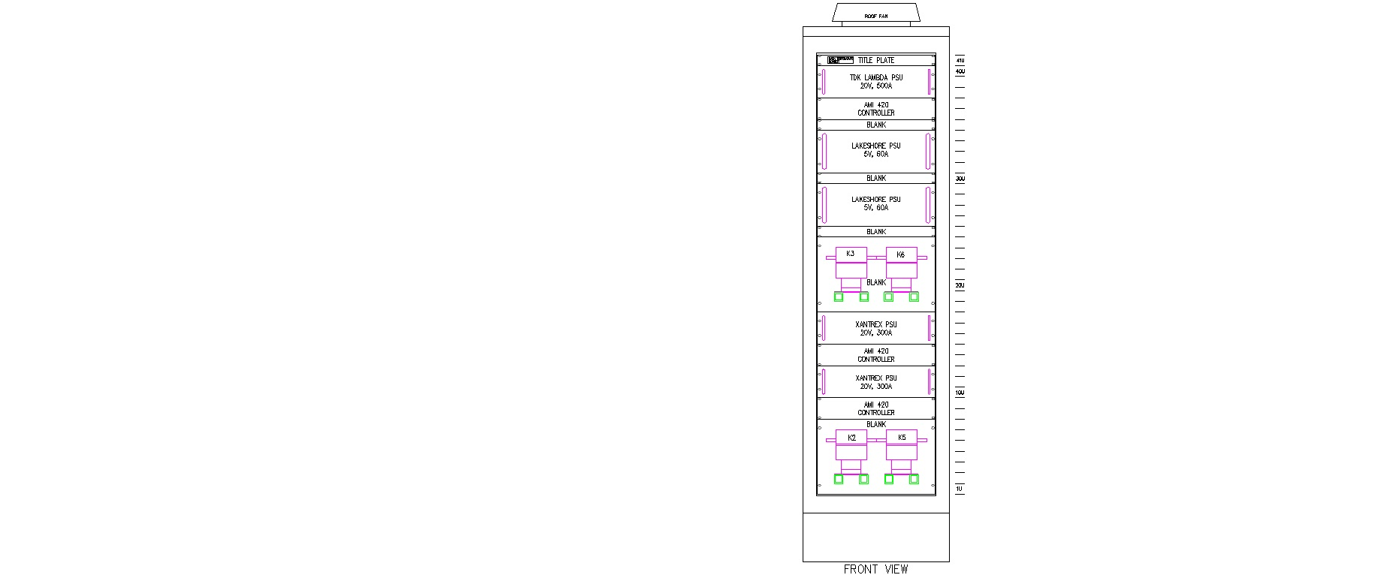
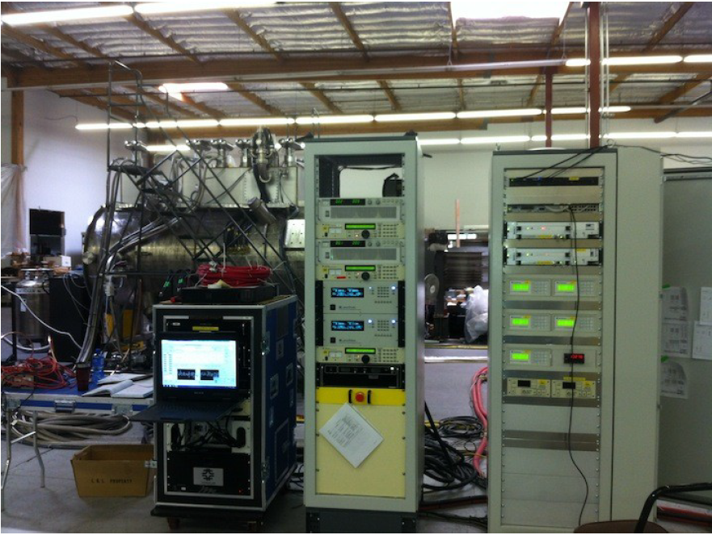
Spectrometer PSU Racks
Control & Instrumentation rack operational at WANG
SS#1&2 power supply rack layout design complete.
Assembly started May 2013.
Rack will be fully populated once testing at WANG complete. (DL has 1 complete system)

Slide 17
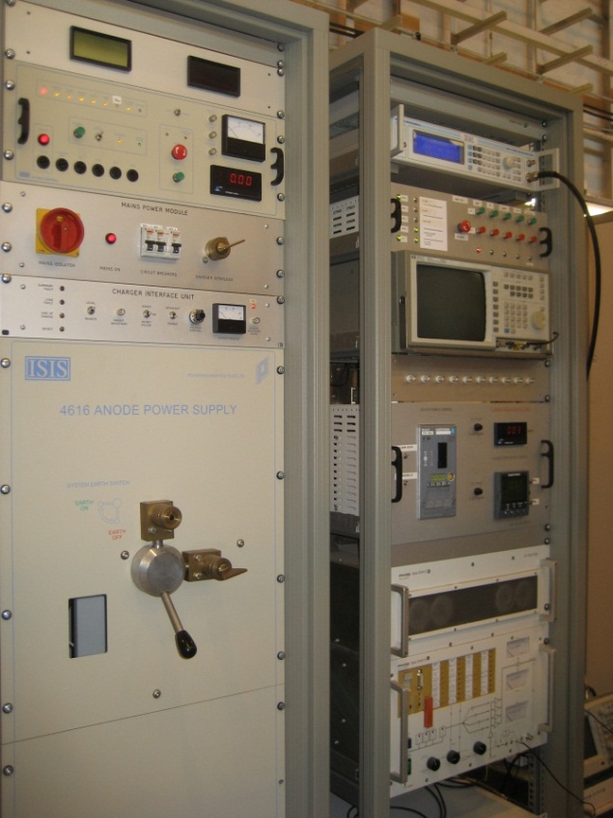
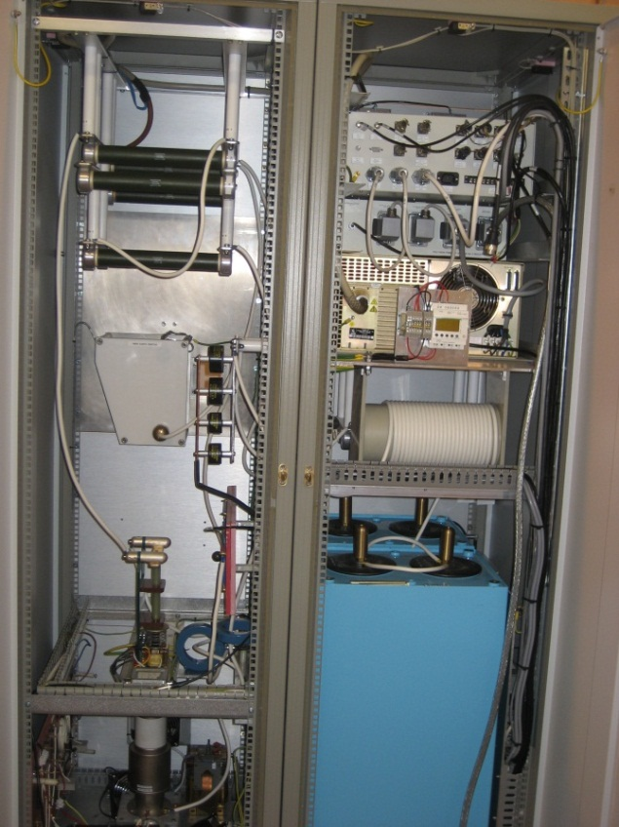
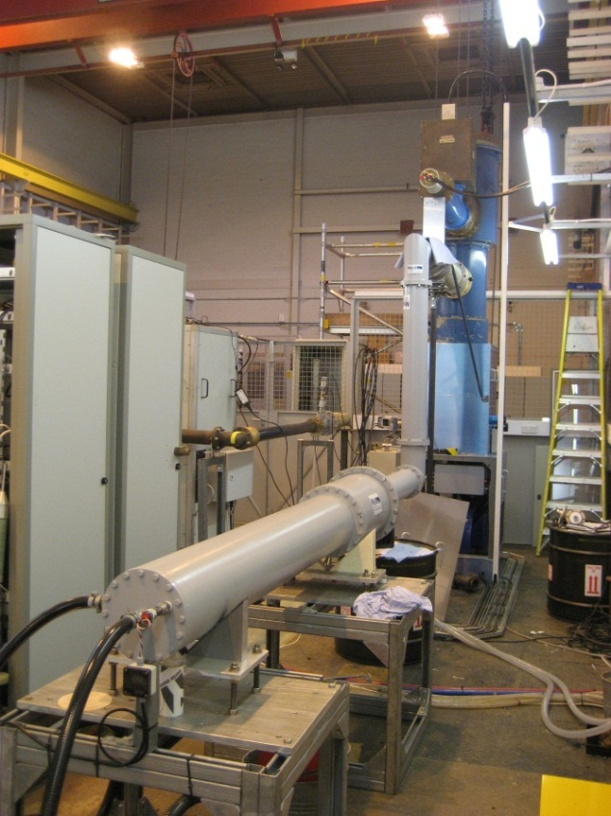
Assembly and Testing - RF System
4616 Control & PSU
TH116 Control & PSU
TH116 Amplifier & Load
RF System#1 assembled complete and testing well advanced.
Only manual control available and some system developments required.
Crowbar protection is sensitive and has a limited HV operating range.
RF System#2 partially constructed – lower priority

Slide 18
Questions?
Thanks for listening

