Slide 1
MICE Resource-Loaded Schedule Review
Integration of MICE at RAL
Historical constraints
The integration project described
Local organisation, safety and administration
The resources pool
Schedule considerations
Risks and contingencies
Andy Nichols, STFC, RLSR, 8-5-13

Slide 2
Historical constraints
MICE was allocated a redundant ISIS building (R5.2) at the start of the project in which to build and operate the cooling channel
  It’s about 50*20*20 metres
  It’s heavily shielded, typically 1m thick concrete
    Modifications to the fabric are difficult and very expensive
  Access is very poor
    It’s at the foot of a narrow compound angle slope and the door is small
  Crane capacity is quite limited
    Tandem lifts will be required, full RFCC module is very near total crane capacity
  Services infrastructure is >50 years old
    But we have 2MVA electrical upgrade
  Personnel accommodation is at a premium
    Control room extension is only practical route
  And it’s only just big enough
    The cooling channel is designed to fit and it will, but little space for anything else
    Parallel assembly and workshop area in R9

Slide 3
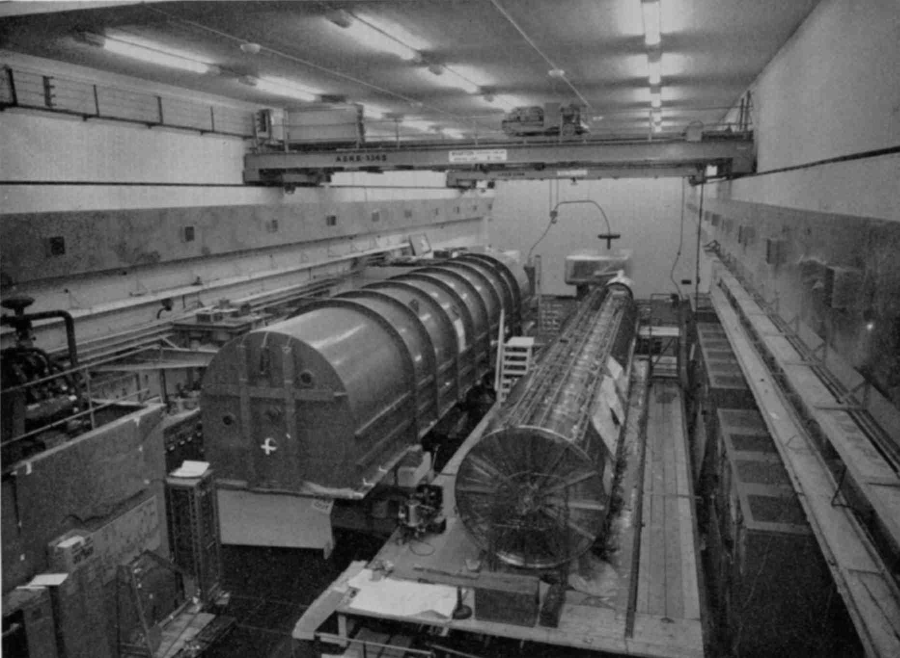
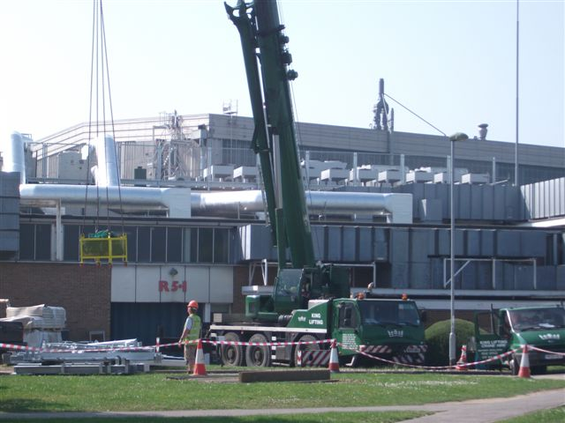
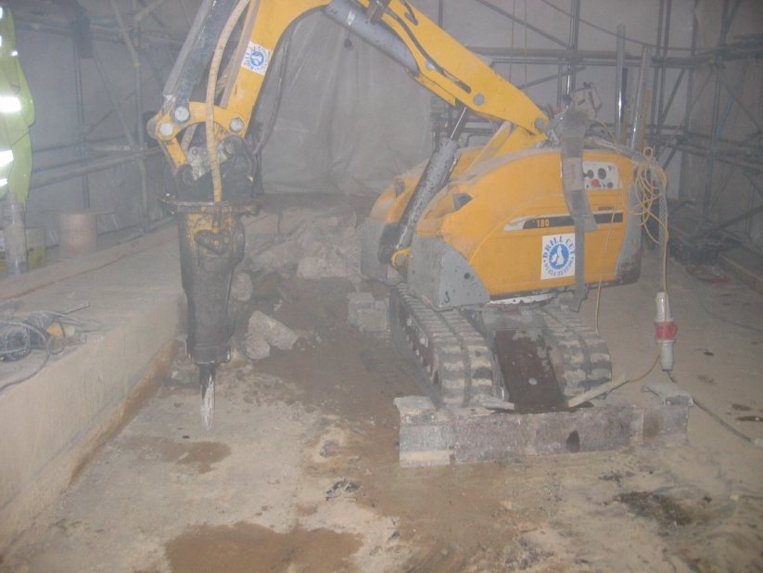
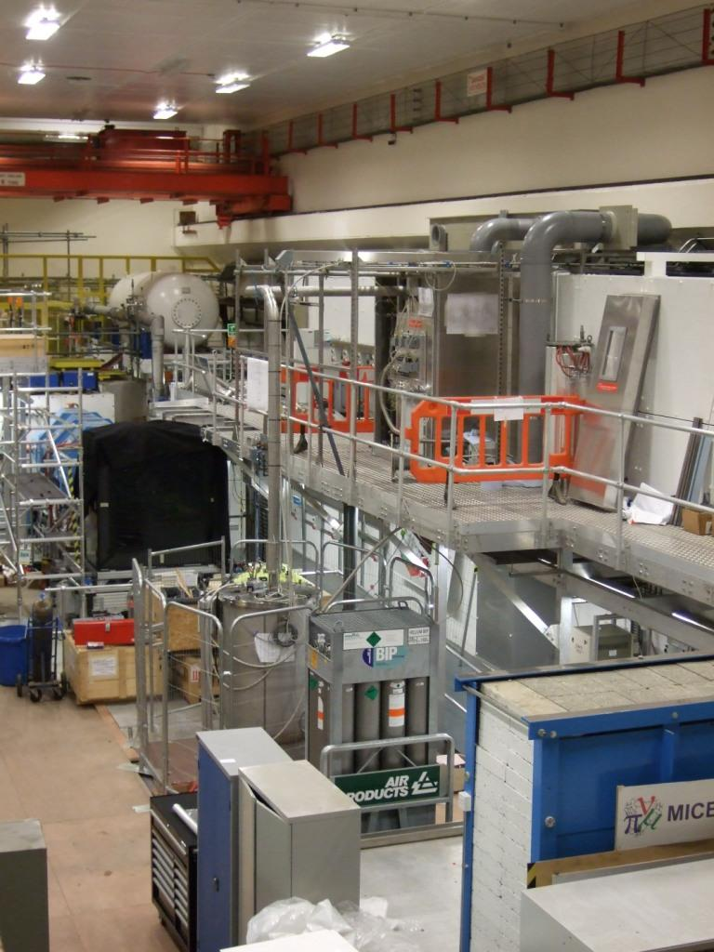
Circa 1963
2009
Fifty years of the MICE Hall
Late 2012

Slide 4
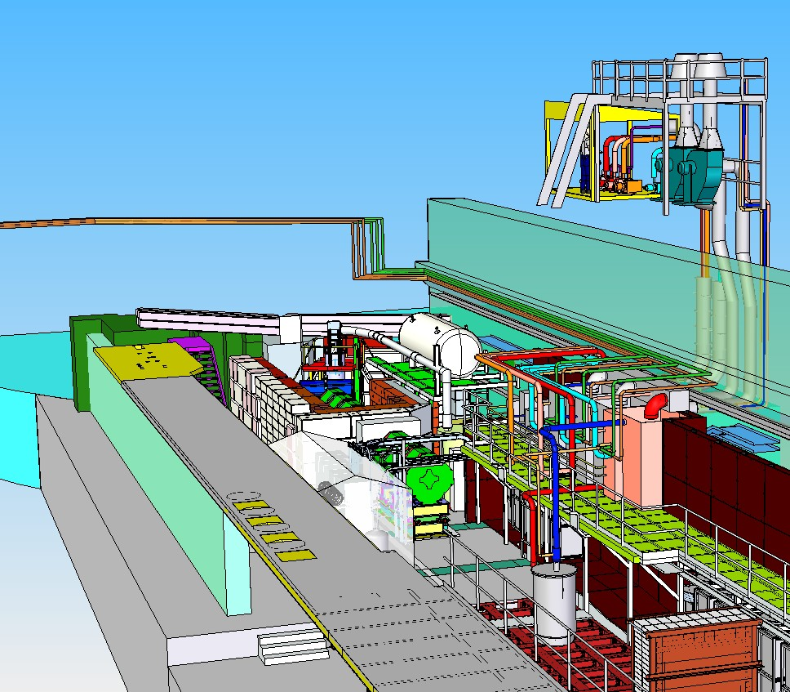
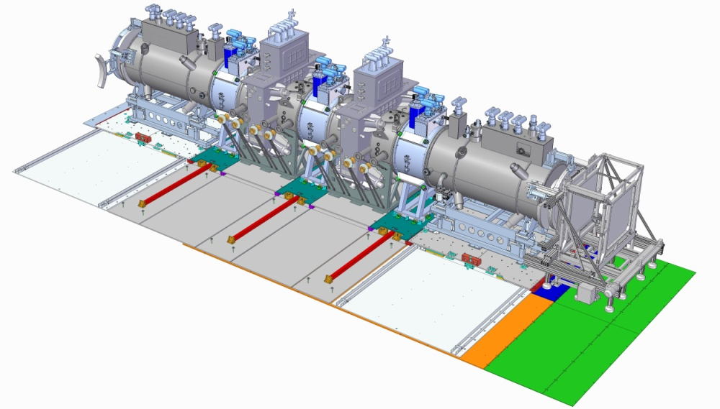
We not only have to
install the cooling
channel, but all the
infrastructure that
enables it
This is an important point;
hosting a large experiment
completely is a new experience
for STFC
A lot of non-scientific stuff needs
to be worried about and paid for

Slide 5
The Integration project described
Preparation of the infrastructure – Tim Hayler
  Adaption of the building fabric
  Redecoration
  Upgrade of electrical services
  Installation of 2MVA substation
  Installation of air conditioning
  Installation of demin water supply
  Supply and build of magnetic shield wall
  Installation of aluminium alloy mezzanines
  Installation of PPS (Personal Protection System)
  Provision of rack room
  Provision of control room
  Installation of ODH gear and fire protection
  Installation and survey of magnet and detector supports
  Provision of decay solenoid liquid helium plant
The infrastructure task was started in 2007 and is largely complete
Can now move to installation phase…..

Slide 6
The Integration project described
Liquid hydrogen delivery system – Steve Watson
  Provision of ATEX-rated valve panel
  Installation of external vent system
  All N2 jacketted pipework installed
  External bottle pack storage and charging area for He and N2
  Internal H2 charging station installed
  Provision of dedicated hydrogen control room
  R&D vessel and transfer line for system test
  Overall compliance with UK DESEAR framework
The delivery system task was started in 2009 and is largely complete
The R&D system becomes system A for Step IV
Can now move to installation phase…..

Slide 7
The Integration project described
RF delivery system – Andy Moss
  Complete refurbishment of two RF amplifiers from LBNL
  Commissioning of two amplifiers from CERN
  Construction of dedicated RF test stand at DL
  Provision of dummy loads, waveguides and all hardware for MICE system
  Provision of all electrical controls and HV and powering hardware
  Installation of TIARA set up

Slide 8
The Integration Project Described
The installation phase aligns naturally with the MICE experimental steps; for Step IV we have to install and align:
  One focus coil
    With interchangeable liquid and solid absorbers
  Two spectrometer solenoids
    With trackers, diffuser and Virostek shielding
  One Electron-Muon Ranger (EMR)
  Although not related to Step IV, installation of one RF amplifier, dummy load, power and controls will be installed under the TIARA framework will be started in 2013
  One radiation shutter
    Not required for Step IV, but advantageous to fit
  Field mitigation baseline
    West wall mezzanine
    Control room extension
    Rack/cable re-route for above
    Local shielding for fixed equipment
  Cabling for magnets
    All electrical support for powering and controls

Slide 9
The Integration Project Described
For Step V:
  Re-locate downstream Spectrometer solenoid in Z
  Install one focus coil module
    With liquid or solid absorbers
  Pre-assemble RFCC
    Turn thro’ 90 deg
    Fit & weld vac vessel
    Install cavities
    (note, this is presently an open issue – it is not clear that it can be done in the MICE Hall – integration in R9 and transport to R5.2 is an (expensive) fall back
  Install one RFCC
  Re-locate downstream spectrometer solenoid
  Install LH2 system B
  Install RF system A
  As with Step IV, full electrical support for controls and powering
  Install field mitigation
    (Also an open issue – likely to be partial return yoke)

Slide 10
The Construction Project Described
For Step VI:
  Re-locate downstream Spectrometer solenoid in Z
  Install one focus coil module
    With liquid or solid absorbers
  Pre-assemble second RFCC
    Turn thro’ 90 deg
    Fit & weld vac vessel
    Install cavities
    (note, this is presently an open technical issue – it is not clear that it can be done in the MICE Hall)
  Install second RFCC
  Install third Focus coil module
  Re-locate downstream spectrometer solenoid
  Install LH2 system C
  Install RF system B
  As with Step IV, full electrical support for controls and powering

Slide 11
Local organisation, safety and administration
In STFC we are dependent on the goodwill and co-operation between Departments at DL and RAL, and also with the MICE collaboration members. The integration responsibilities are shared roughly like this:
  DL Technology Dept
    Electrical controls and powering, magnet requirements, specialised electrical installation, detector and magnet survey, engineering design
  RAL Technology Dept
    Mechanical engineering, work package and project oversight, delegated responsibility for safety
  DL AsTEC
    Provision of RF hardware, testing and installation
  RAL BPG
    Civil and structural engineering, domestic electrical installations
  ISIS ancillary plant Group
    Air conditioning and chilled water supply
  The MICE collaboration
    Assistance with installation of their own usually delicate equipment

Slide 12
Local organisation, safety and administration
The MICE Project Manager has delegated responsibility for safety across the whole project
  We comply with the UK Construction Design and Maintenance (CDM) framework for construction projects and are assessed regularly – this is a legal responsibility for STFC in the UK
  Building and running an experiment at the same time is an unusual challenge
  We must also comply with STFC safety codes of practice (SCP); these include:
    Pressurised equipment
    Flammable gases (DESEAR)
    Lifting and handling
    Oxygen deficiency
    Electrical safety
    Stray magnetic fields
    And of course, many, many more………..
  Radiation safety is covered by the IRR99 framework by the RPS, Tim Hayler
  The MICE Hall Manager is locally responsible for implementing all the above

Slide 13
The Resources pool
MICE Integration Engineer – Jason Tarrant
In the MICE hall as permanent staff we have:
  The Hall Manager (A.Nichols, acting, but UK funded vacancy in process)
  One mechanical technician – M.Surman
  One electrical technician – S.Windsor
  One fitter/machinist – E.Capocci
  In general this has worked well
  Other departments provide their own staff for specific jobs that we pay for, for example installation of mezzanines, etc; these are costed in the more detailed plans
Other MICE-specific construction staff are included in detailed resource tables on %FTE basis as detailed by Alan Grant

Slide 14
Schedule considerations
Despite the amount of discussion it provokes, the schedule is easy to understand:
  The construction is dependent on only a few very large deliverables
  And on a flat funding profile in US and UK
  Understand both the above and the rest falls into place
  We think we are starting to understand them
  The top level schedule is articulated by the Spokesman’s experimental schedule, reviewed at each CM
  It takes into account practical and financial limitations
  Detailed Ganntt charts are mapped onto it (Alan. Peter, Rich)
  The detailed construction project is somewhat down the food chain, but:
    Flexibility is the key, reacting to last minute changes
    At this level there is not a detailed Ganntt chart
    But we have strictly enforced weekly planning meetings to plan the next week’s work

Slide 15


Provisional MICE SCHEDULE
update: May 2013
μ
Run date:
STEP I
EMR run July 2013
STEP IV
(Q2 2014,
no field)
Q1 2015
to Q1 2016
Under construction:
STEP VI
Possible Step V run Q4 2017
Step VI 2019

Slide 16

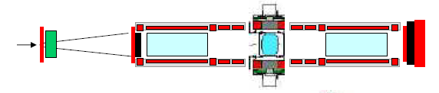
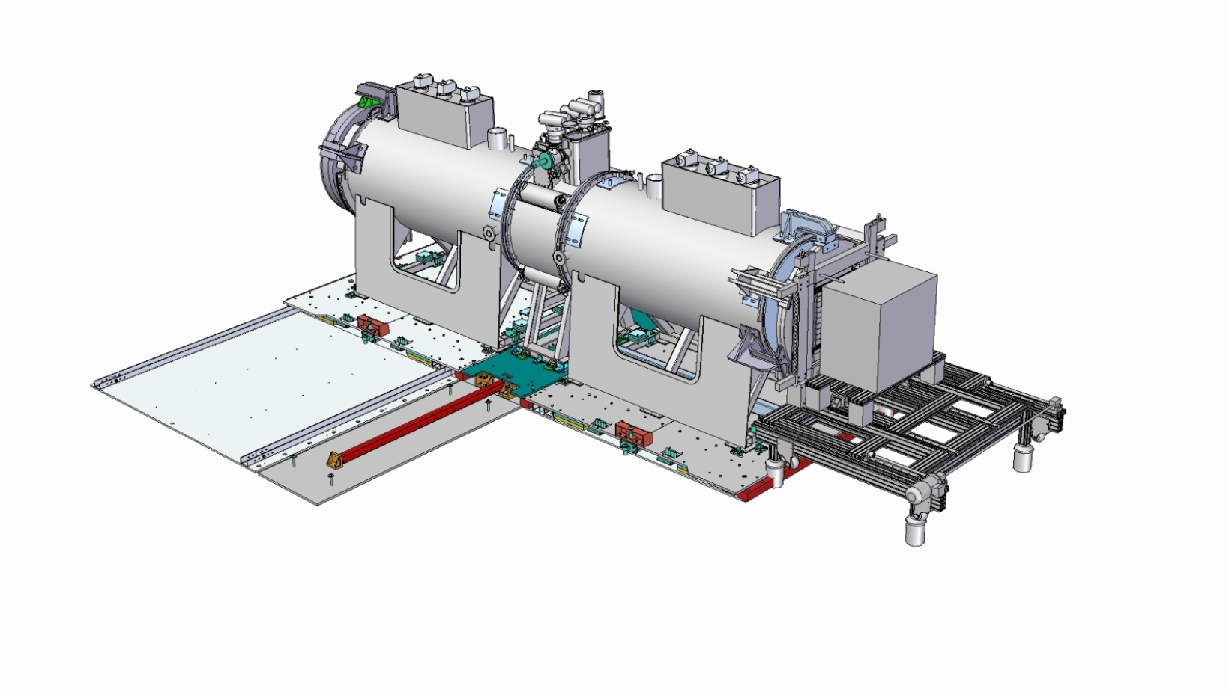
STEP IV
Subsystem | Date
Spectrometer solenoid #1 | Jul 2013
Spectrometer solenoid #2 | Sep 2013
Fibre tracker #1 + #2 | Ready
Focus coil #1 | Sep ’13
LH₂ system A | TBC
Solid absorber(s) | TBC
Liquid absorber | Ready
Diffuser | Ready
Virostek plate & TOF cage assy | Ready
Substation upgrade | Ready
EMR installation | Jul 2013
Radiation shutter | Ready
AFC Moving platform #1 | Ready
SS platforms Installation | Ready
Magnetic shielding Review | Aug 2013
Step IV ready August, 2014

Slide 17
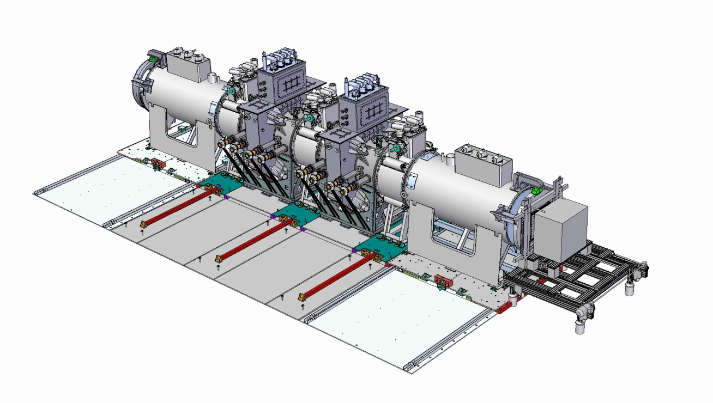
STEP VI
Under Construction!!
Step VI target date....2019

Slide 18
Risks and contigencies
Some of the more prominent integration risks and their effects:
  Late delivery of equipment
    Cost of keeping the ‘standing army’ employed
    Adverse affect on staff morale
  Protracted commissioning, due to technical problems, specifically running the magnets together
    Need to draw in new skills
  Pressure on staff and building space from other projects
    MICE has little autonomy or bargaining power when team-building or negotiating for space, both of the above risks will increase this pressure
  CDS review at RAL
    Not clear how this will affect BPG work on MICE – it may be that more work is loaded directly onto projects
  Living with financial pressure
    Might be forced to go more slowly with the same amount of staff
  Technical de-scope
    Could be forced either by the above, or by technical problems
    Ie magnets or RF not working to spec

Slide 19
Risks and contigencies
  Shortage of critical skills
    For example, the Hall Manager
    Magnet engineer/expert
  Management interference when team-building
    Very important that MICE takes leading role when selecting staff
    And that unsuitable staff are not ‘given’ to us
  Simple ‘things don’t fit’ type of problems
    Jason is working on uniform engineering approach, controlled through MICE Technical Board, but we can still be caught out
    MICE is driven now by one parametric CAD assembly model
    Consequences are of course delay and cost

