Slide 1
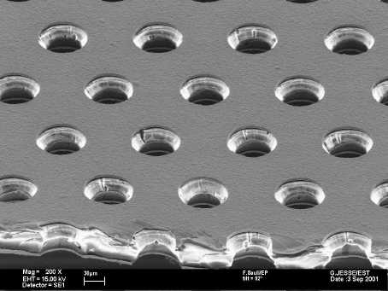
Memorandum of Understanding
RD-51 Collaboration

Slide 2
MoU
Outlines the purpose of the Collaboration
Lists the membership in the Collaboration
Lays down the ground-rules for the organization and functioning of the Collaboration

Slide 3
Goals
Short description what the Collaboration wants to do , wants to achieve
Technical details are given in the proposal

Slide 4

Membership
Research institutes only
Industrial partners can collaborate on specific issues under separate agreements

Slide 5

Organization
Collaboration Board defines policies
  One representative per collaborating institute
Management Board runs ‘daily’ affairs
Spokespersons executes policies
Conveners direct research activities

Slide 6

Procedures
Nominations and elections
Cost sharing
Change in membership
Disputes
Further details will be in separate agreements

Slide 7

Responsibilities
Contributions
Publications

Slide 8
Intellectual property issues
Define rules
  See talk by B.Denis

