Slide 1




Scintillation Readout From Micropatterned Electron Multipliers
For Dual-phase Dark Matter Detectors
Joaquim M.F. dos Santos
GIAN – Atomic and Nuclear Instrumentation Group
University of Coimbra
University of Aveiro
Weizmann Institute of Sciences
Micro-pattern Gas Detectors (RD51) Workshop
16-18 April 2008, Nikhef, Amsterdam, The Netherlands

Slide 2

Scintillation vs. Charge
Higher Amplitude
Lower Statistical Fluctuations
Scintillation
C. A. N. Conde and A. J. P. L. Policarpo, Nucl. Instr. Meth. Vol. 53 (1967) 7-12
A. J. P. L. Policarpo and C. A. N. Conde, Nucl. Instr. Meth. Vol. 55 (1967) 105-119

Slide 3
Optical TPCs
A. Breskin, R. Chechik, Z. Fraenkel, D. Sauvage et al., Nucl. Instr. Meth. A 273 (1988) 798
Only few applications
U. Titt, A. Breskin, R. Chechik, V. Dangendorf et al., Nucl. Instr. Meth. A 416 (1998) 85
F.A.F. Fraga, L.M.S. Margato, S.G.T. Fetal, et al., Nucl. Instr. Meth. A 471 (2001) 125
S.T.G. Fetal, F.A.F. Fraga, L.M.S. Margato, et al., Nucl. Instr. Meth. A 581 (2007) 202
L. Weissman, M. Gai, A. Breskin, R. Chechik et al., J. Inst. 1 P05002

Slide 4
Recent Relevant Applications of
Optical TPCs
E. Aprile, K.L. Giboni, P. Majewski, et al., New Astron. Rev. 49 (2005) 289
D.Yu. Akimov, G.J. Alner, H.M. Araújo, et al., Astrop. Phys., 27 (2007) 46
P. Benetti, R. Acciarri, F. Adamo, et al., Astrop. Phys. 28 (2008) 495–507
Dark Matter search
XENON, LUX, ZEPELIN, WARP experiments
Secondary scintillation
amplification, for higher sensitivity, with PMT readout
Double mesh, uniform field scintillation gap
e.g. secondary scintillation yield of
466 photons/e⁻/cm @ 4.1 kV/cm/bar
(C.M.B. Monteiro et al., J. Inst. 2 P05001)

Slide 5
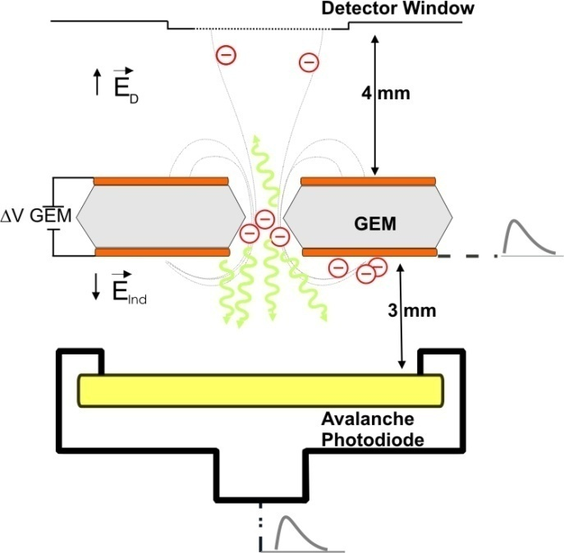
GEM scintillation vs. charge readout - 1
A.S. Conceição, et al., J. Inst. 2 P09010

Slide 6
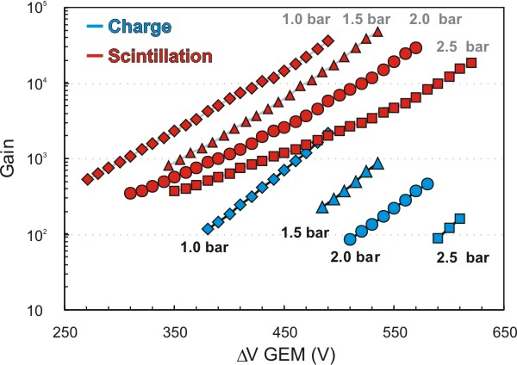
GEM scintillation vs. charge readout - 2

Slide 7
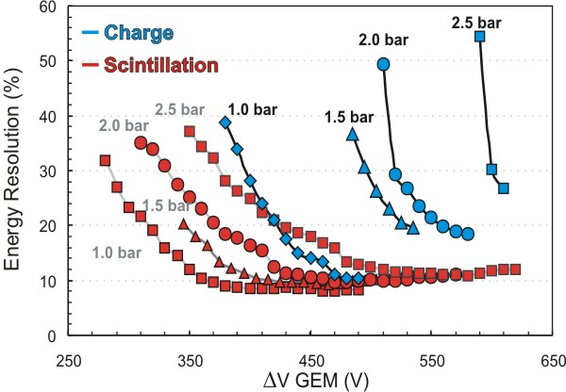
GEM scintillation vs. charge readout - 3

Slide 8
Scintillation Yield - 1

Slide 9
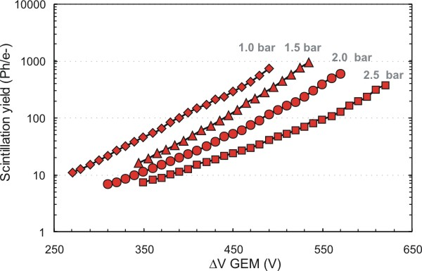
Scintillation Yield - 2

Slide 10
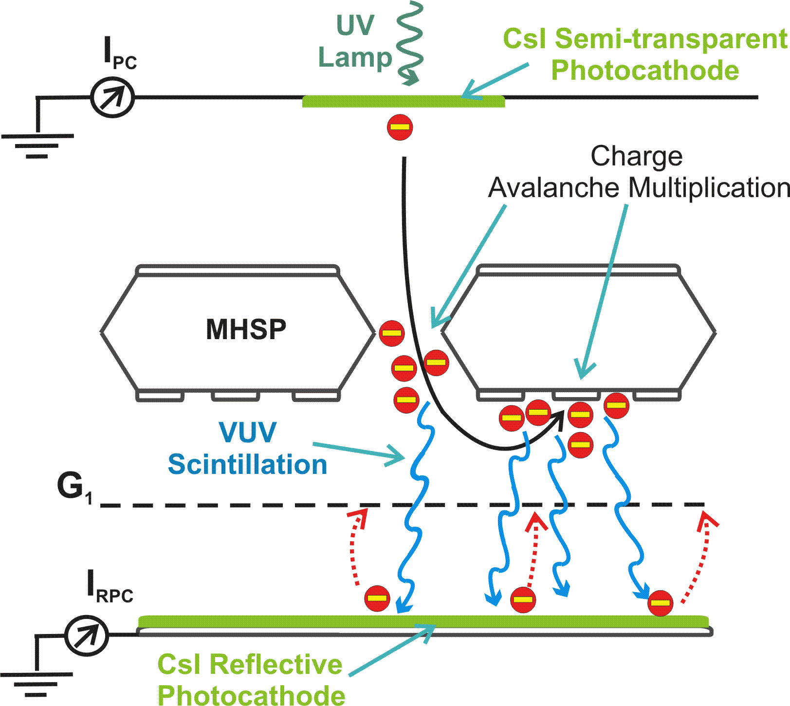
Micro Hole & Strip Plate

Slide 11
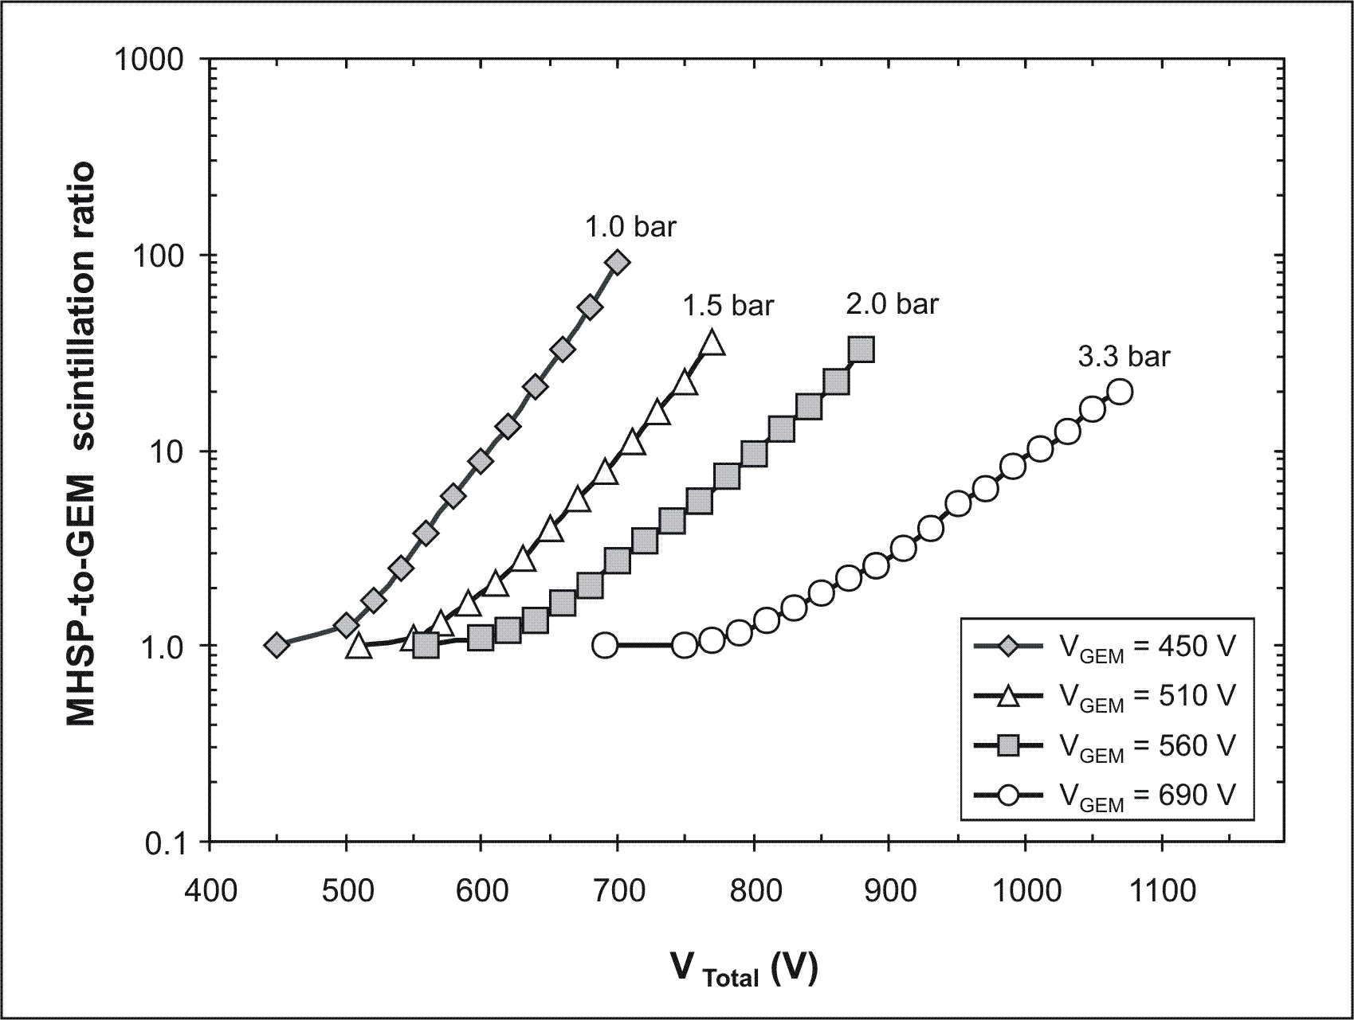
MHSP vs. GEM
Gain above 10⁵ in scintillation readout mode

Slide 12
Summary - 1
Secondary scintillation for signal readout
high gains + good energy resolution with single-GEM at low voltages
Stable operation without discharges
Max Gain_{scint} > 100 × Max Gain_{charge}
above 2 bar
Energy Resol_{scint} < 0.5 × Energy Resol_{charge}
GEM-APD or MHSP-APD scintillation readout
Good alternative to double stainless steel mesh-PMT readout
(reduced background for DM search experiments)
Suitable GEM voltages → GEM scintillation yield higher than for uniform field
MHSP-APD gains > 10⁵ → single electron detection with high efficiency

Slide 13
Summary- 2
More attractive than scintillation readout
charge readout alternatives with micropattern devices
capable of overcoming charge gain limitations of GEM
in high pressure xenon and argon
for large detection areas
THGEM
Micromegas
Nevertheless, scintillation has significant advantages
Potential alternatives:
readout of scintillation from micropattern devices
simultaneous readout of secondary charge and scintillation
from micropattern devices
improved Energy
and Position resolution

Slide 14
0-neutrino Double-beta Decay and WIMPs:
Will the Searches Converge?
David Nygren
LBNL / Stockholm U

Slide 15
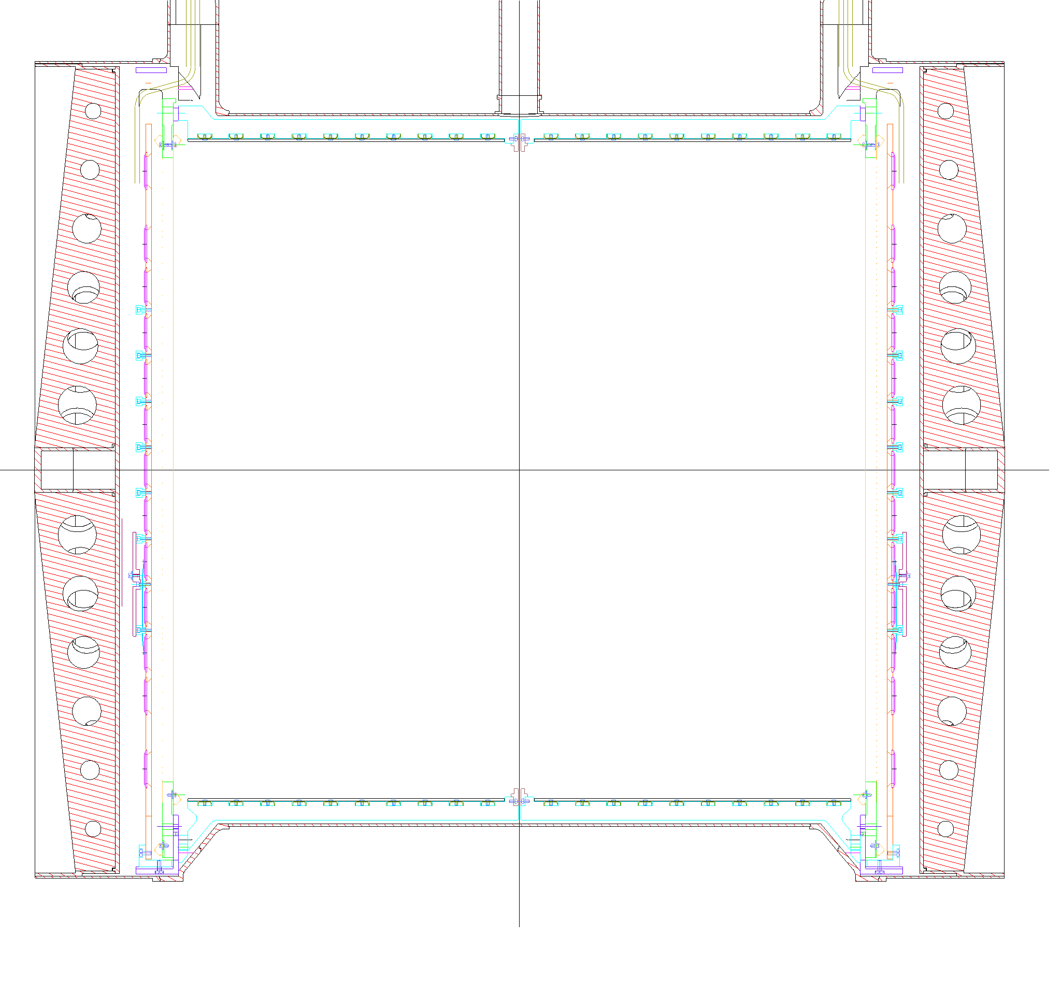
The EXO-200 detector: a dual TPC
charge drift direction
cathode
crossed wire
planes and avalanche
photodiodes
NIM A581 (2007) 632-642
field shaping rings

Slide 16
Future work
Study the performance characteristics obtained reading the scintillation produced along the charge avalanches of THGEM and MHSP with Large Area APD.

