Slide 1
ATLAS Forward Proton Detectors
Michael Rijssenbeek – Stony Brook University for the ATLAS Forward Proton group
the proposed ATLAS Forward Proton Detector
AFP – Status
Request to this community …

Slide 2
ATLAS Forward Detectors
Collaborating Institutions:
Canada: U Alberta, U Toronto;
Czech Republic: Prague Charles U, Palacky U, Prague AS, Prague CTU
France: Saclay
Italy: U Bologna, U Genova, U Milano, U Roma 2, Trento
Norway: U Bergen, U Oslo
Poland: Cracow AGH-UST, Cracow IFJ PAN
Portugal: LIP
Spain: IFAE Barcelona
Switzerland: U Bern, U Geneve
USA: Stony Brook U, UT Arlington, U New Mexico, U Oklahoma
Will grow further if AFP is approved by ATLAS (e.g. Giessen, Cosenza, Lecce, Glasgow, Manchester, UCL, Ohio, SLAC)
Many Thanks to all my colleagues for fruitful collaboration and help!

Slide 3
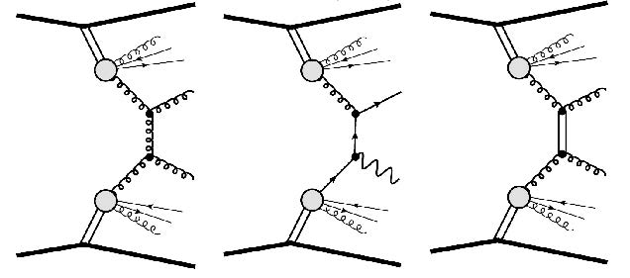
Forward Physics
At proton colliders like the Large Hadron Collider (LHC) at CERN, Geneva, protons typically interact inelasticly, i.e. as collisions between the proton’s constituent quarks and gluons
  Many of the proton remnants go down the beam pipe at small angles (mrad)
However, in a fraction of pp collisions, one or both protons stay intact:
  Elastic scattering (~25%):
    Single Pomeron (IP ) exchange;
    appreciable only at very small (μrad) angles,
  Diffraction (~25%):
    soft, non-perturbative QCD processes
  Hard Central Diffraction (<<1%):
    Double Pomeron and Double Photon Exchange
    accessible to QCD (and QED) predictions
    Measure the structure of the Pomeron
    Must measure proton energy loss ξ & angle
IP
IP:= ‘Pomeron’, a color-less object with Q-numbers of the vacuum; a ‘gluon ladder’
see the multitude of physics talks at this workshop
p*
IP
IP
γ
IP
γ
IP
IP
IP
IP
IP

Slide 4
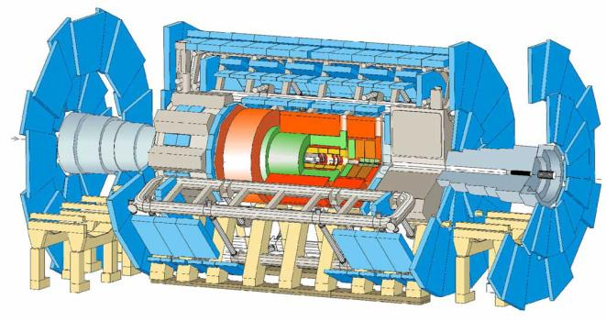
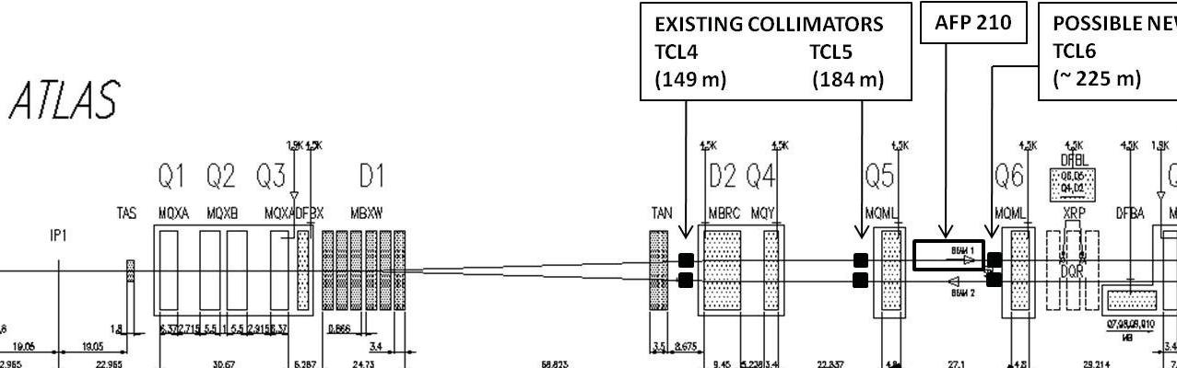
ATLAS Forward detectors
LUCID
~17m
Proton remnants and low p_{T} particles
ZDC
140m
Proton / Ion remnants: γ, π⁰, n
AFP
206m-214m
Diffractive
protons
ALFA
237m-241m
Elastic protons
The 40 m long central ATLAS detector detects/identifies/measures most interaction products, except those going down the beam pipe!
➔ ATLAS Forward Detectors

Slide 5
Getting close to the Beam …
Options:
  Surround the Beam Pipe:
    ATLAS FCAL, LUCID; CMS Forward Detectors
  Hamburg Beam Pipe: movable section of beam pipe with thin window facing the beam (‘floor’) and entry/exit windows: AFP
  Roman Pot: movable UHV insert entering the beam aperture with thin ‘floor’ and entry/exit windows: ALFA, AFP; CMS/TOTEM
HBP – parking position
measurement position
thin
beam
diff. p
sensors
sensors
thin
beam
diff. p
sensors
sensors
measurement position
RP – parking position

Slide 6
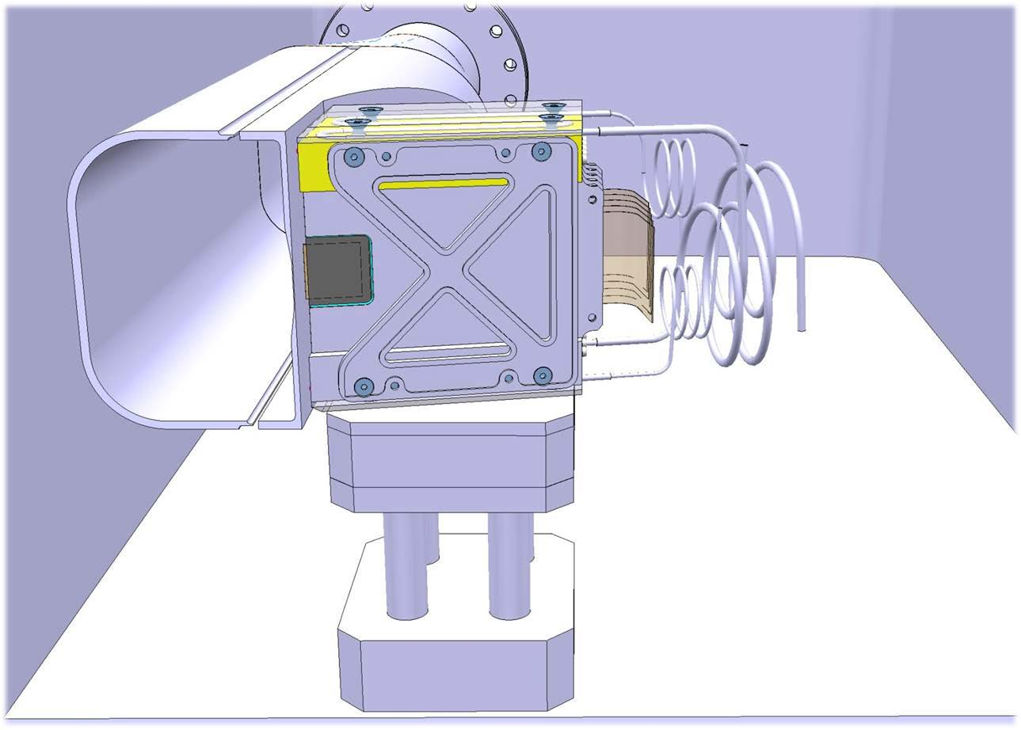
AFP – HBP plus Tracker …
readout flex
thin floor
sensors
evaporative
cooling
AFP
AFP214
AFP206
AFP206
AFP214
ATLAS

Slide 7
AFP – ATLAS Forward Protons
AFP measurements:
Tag and measure momentum of intact protons from interactions seen in the central ATLAS detector
Soft QCD (Diffraction) in special low/medium-luminosity runs
  avoid backgrounds from additional interactions in the same BX ➔ μ≃1
    cross sections are rather high: many pb’s
    need clean interactions in ATLAS, i.e. low pile-up
  need ~3 weeks of data taking at μ≃1 (or ~1 week at μ≃3 ?)
    at μ>1, require proton time-of-flight measurement to correlate forward protons with interaction vertex measured in central ATLAS detector ➔ σ_{t}=30 ps ⇔ σ_{z}=7 mm
Hard Central Diffraction in standard running (μ~50)
  huge background from pile-up: 1 proton per side in each BX from soft QCD (Single Diffraction)
    pile-up suppression requires precise proton time-of-flight measurement.
    any increase spatial and temporal granularity improves efficiency and rejection
AFP214
AFP206
AFP206
AFP214

Slide 8
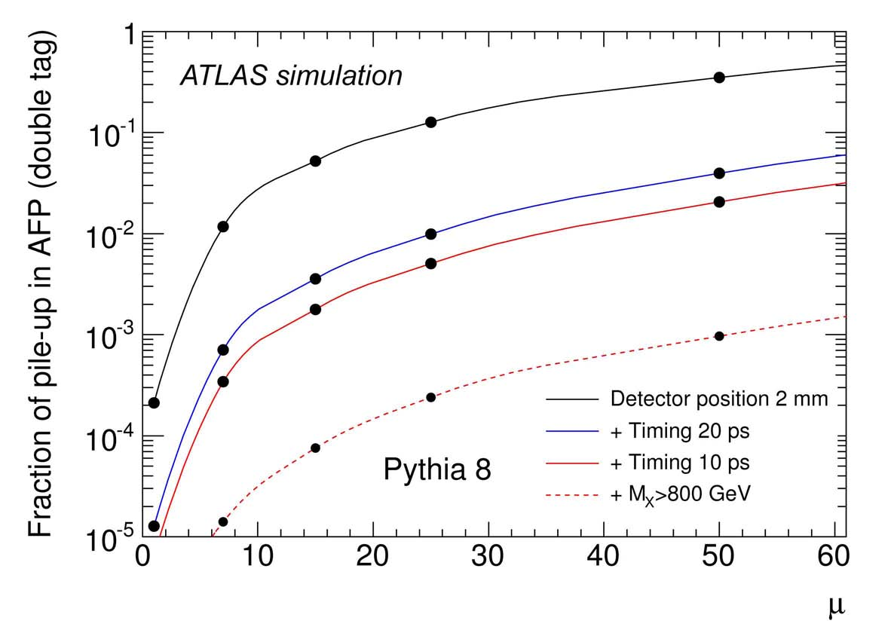
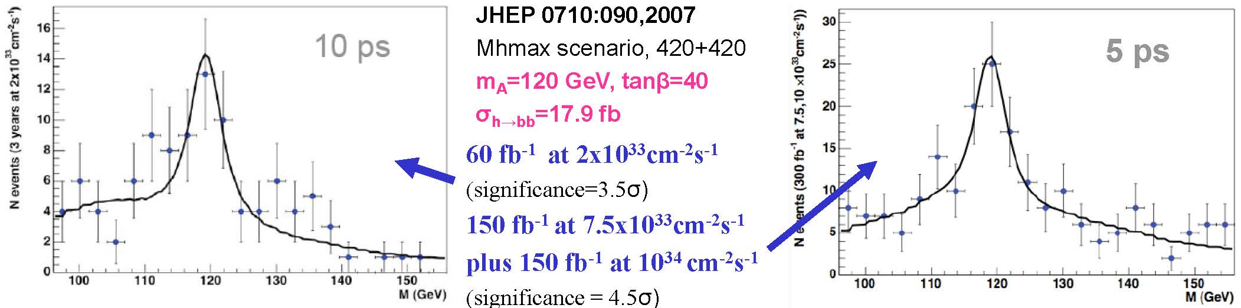
Fast Time-of-Flight
Main CEP background: overlap of SD
protons with non-diffractive events
= ‘pile-up’ background
Reduce by:
  central mass matching:
    M_{central} = M_{AFP} = (s ξ_{Left} ξ_{Right})^{½}
  ToF:
    z_{vtx} = c(t_{Left} – t_{Right})/2
    E.g.: σ_{t} = 10 ps ➔ σ_{zvtx} = 2.1 mm
  not a new idea; FP420:

Slide 9
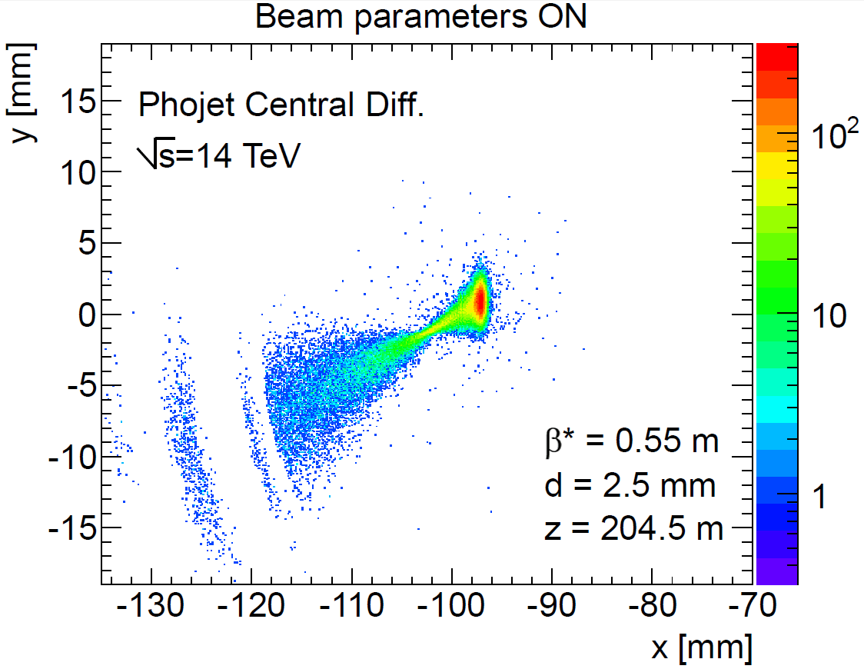
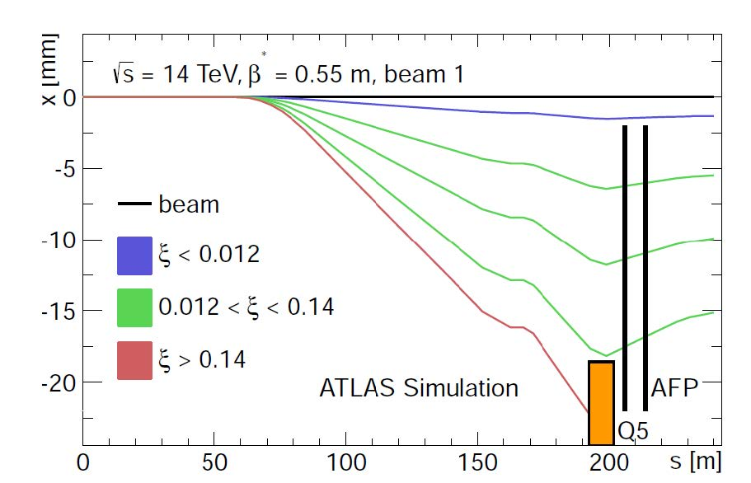
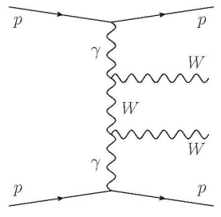
Diffractive Protons in AFP
Number of protons per 100 fb^{–1} (~1 LHC yr) per Si pixel (50 μm × 250 μm):
  Proton energy loss ξ
  is related to x:
  Central Mass M is related
  to both protons’ energy
  losses ξ₁, ξ₂ :
----- detector area
(20 mm × 20 mm)

Slide 10
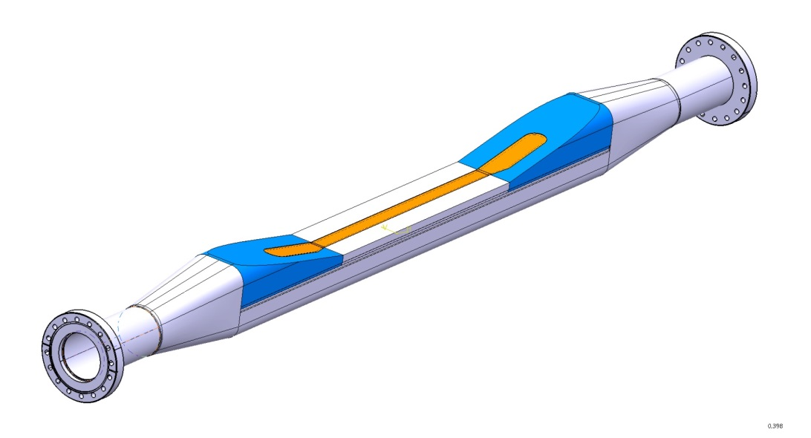
Hamburg Beam Pipe
ATLAS design: Be floor and windows in Al structure
  Tilted windows (11°) minimize beam coupling and losses
Beryllium windows and floor, and Al structure
minimize interactions and multiple scattering
Ample space for tracking and timing devices
Results of detailed RF simulations:
  Impedance Z_{long} is at the level of 0.5%/station at 1 mm from the beam ☺
  Similar for Z_{trans} ☺
  Power loss (heating) is manageable ~30 W, mostly in conical sections
  Bellows are not yet included, but we are confident we can minimize their effect
thin
450 mm
ALUMINUM
BERYLLIUM
ALUMINUM - AUSTENITIC STEEL FLANGEs

Slide 11
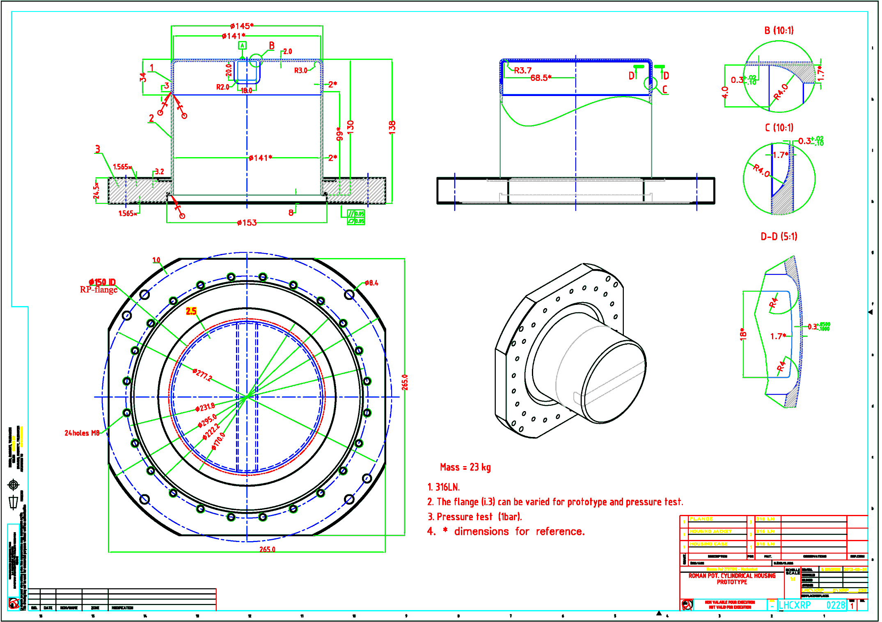
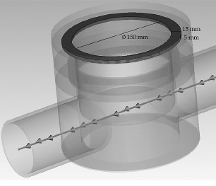
TOTEM Pot vs. 31 May ‘13
ferrite ring
TOTEM Upgrade Proposal - CERN-LHCC-2013-009 ; LHCC-P-007, 13 Jun 2013

Slide 12
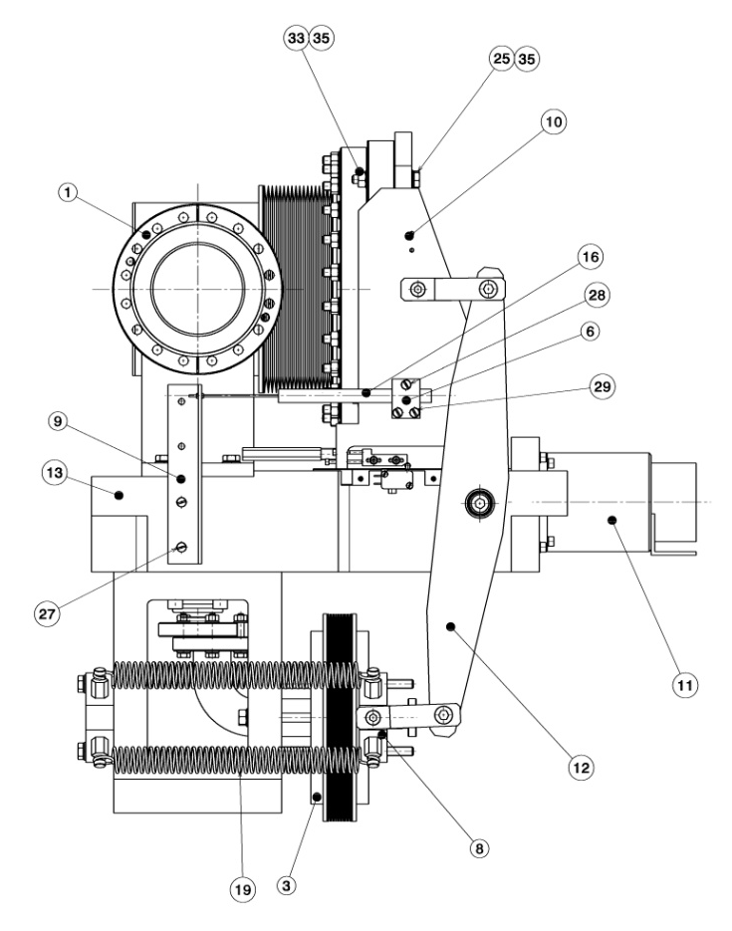
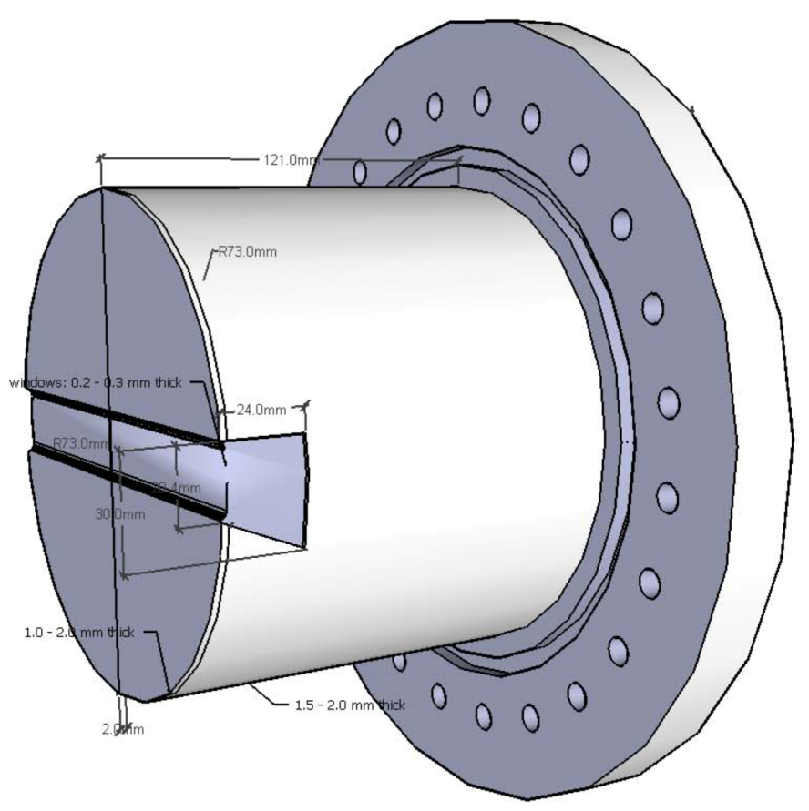
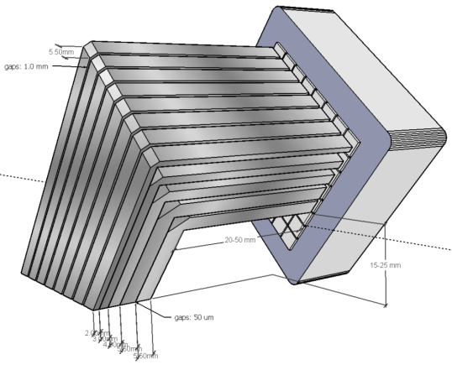
AFP Roman Pot & Station
AFP Pot adaptation from TOTEM design
  shown with a possible timing detector …
Copy RP Station design of ALFA & TOTEM:
  Ample operational experience
  Known cost and construction & installation procedures
AFP Pot
AFP timing
beam
TOTEM horizontal RP station
(beam view)

Slide 13
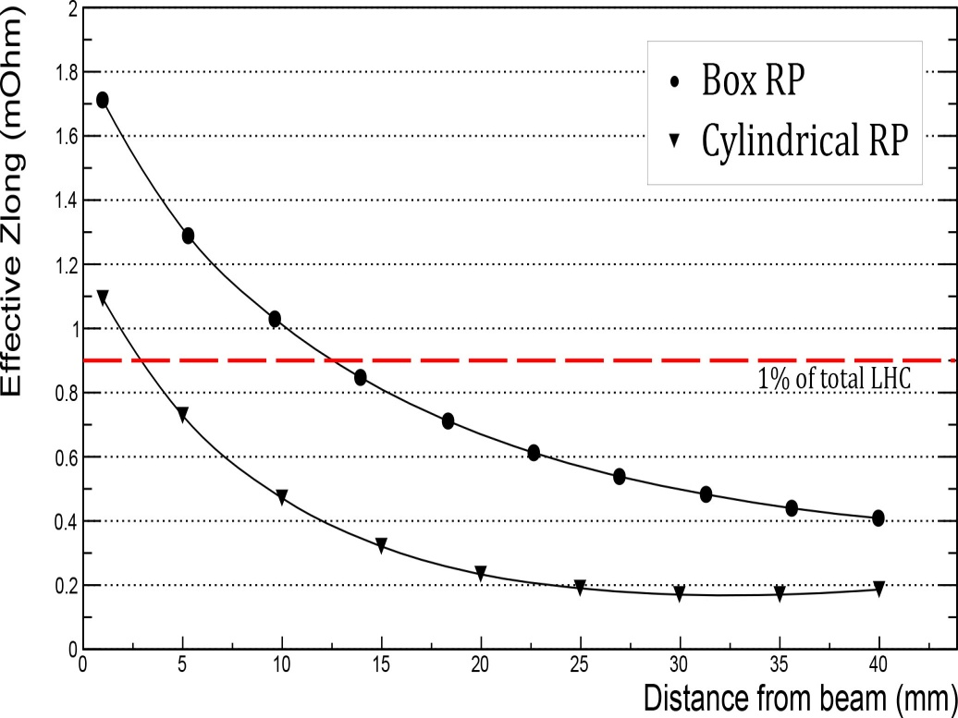
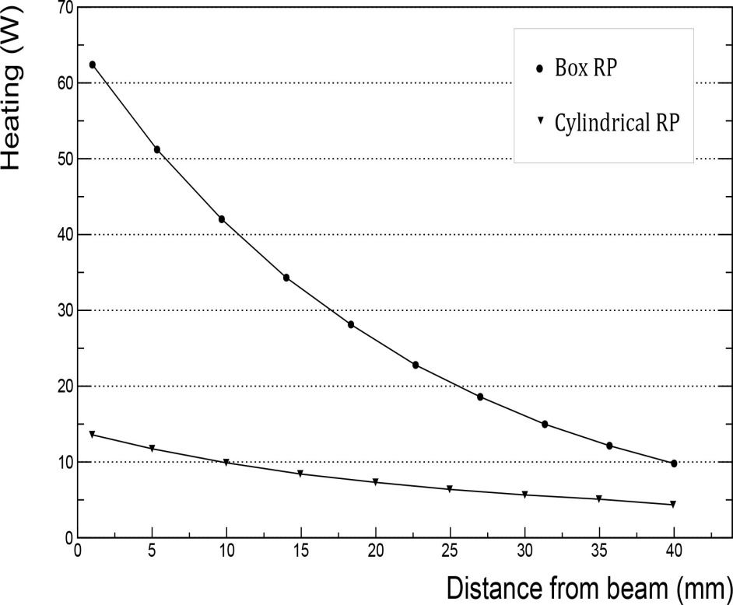
Simulations: Impedance and Heating
TOTEM simulations (N.Minafra, B.Salvant, et al.)
 | Distance to beam (mm) | (mΩ) | cfr. LHC: 90 mΩ (%) | (kΩ/m) | cfr. LHC: 25 MΩ/m (%) | Power Loss (W)
Cylindrical RP | 1 5 40 | 1.1 0.73 0.18 | 1.2 % 0.81 % 0.20 % | 60 | 0.2 % | 13 11 4
TOTEM Upgrade TDR – June 2013

Slide 14

Pot and Window Materials
Al pot with Be window and floor?
  Started discussion with BNL RP physicist & engineer
  Discussing with Materion Corp. re Beryllium & Composites
    Be window with 2 mm SS pot (incl. conflat): ~18 k$
    Materion makes Be beam pipes for LHC experiments
    … and Be supports and X-ray windows
      see e.g. https://indico.cern.ch/conferenceDisplay.py?confId=245511
➔
➔
➔
Al/SS
Be ?

Slide 15
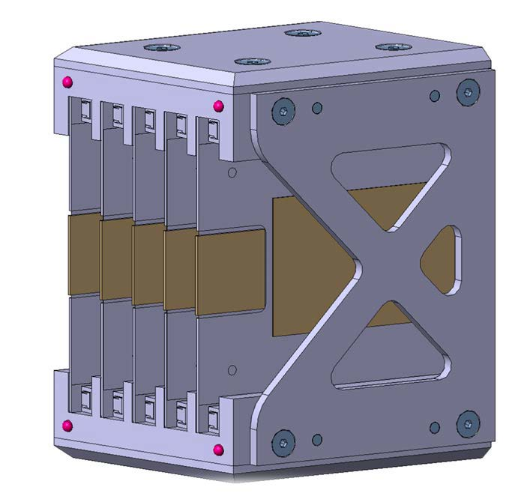
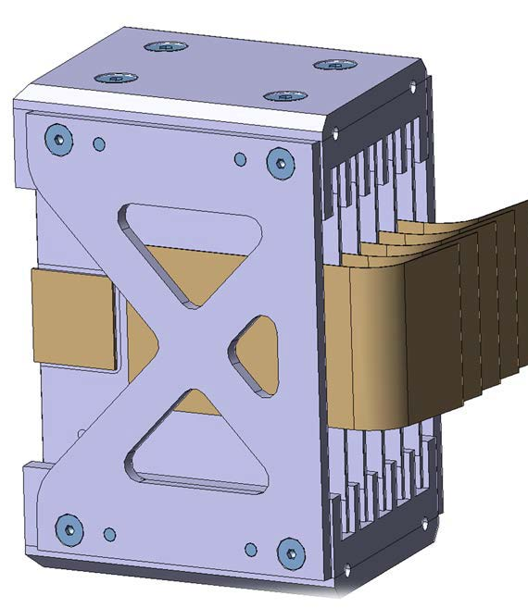
Tracking Detectors
AFP will use ATLAS IBL pixel sensors bonded with FE-I4 readout chips
  50 μm × 250 μm pixels size
  future: edgeless 3-D pixel sensors ➔ closer to beam
  Readout ATCA based RCE readout
AFP Detector R&D: P. Sicho et al.
see 3D Si & ATLAS IBL talks at this conference!
precision
positioning balls
Readout chip
FEI4
insulated
pyrolitic
graphite foil
& stiffener
pixel
sensor

Slide 16
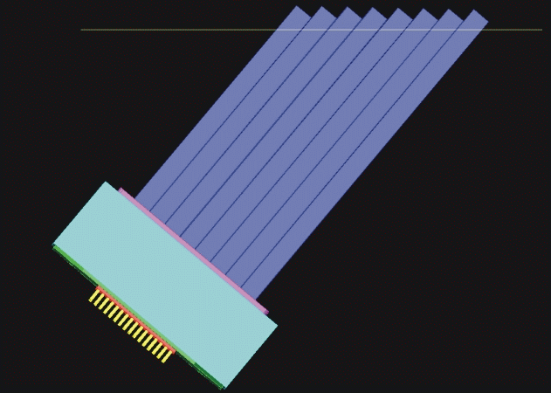
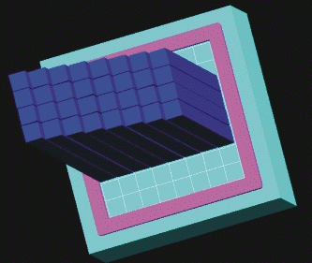
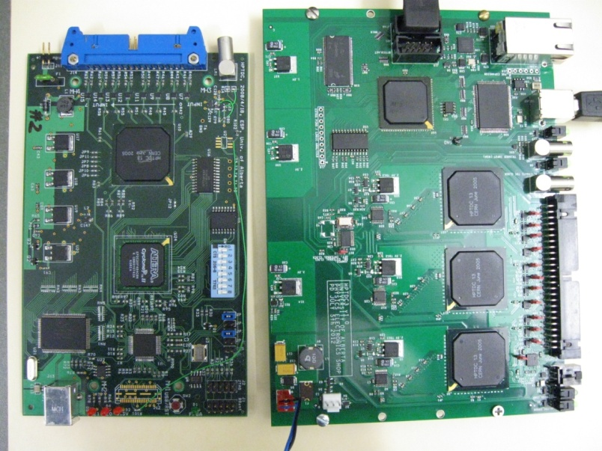
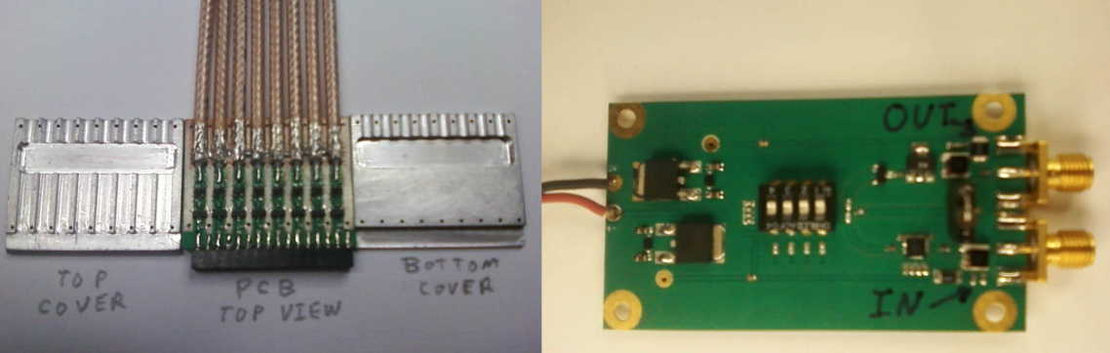
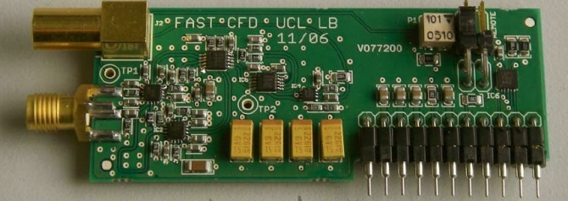
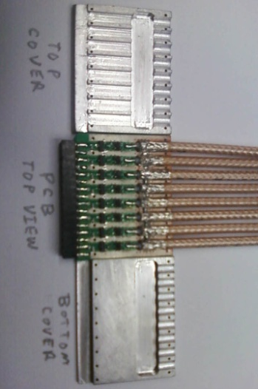
AFP Fast Time-of-Flight
QUARTIC concept: Mike Albrow for FP420 (joint ATLAS/ CMS effort) (2004) based on Nagoya Detector.
  Initial design:
  4 trains of 8 Q bars: 6mm × 6mm ×100mm
  mounted at Cherenkov angle θ_{Č} ≃ 48°
  Isochronous – Cherenkov light reaches tube
  at ~same time for each bar in a train
  arrival time of proton is multiply measured:
  bar + readout resolution less stringent!
    e.g 30 ps / bar ➔ 11 ps for train of 8 bars
2011 DOE Advanced Detector
Research award for electronics development:
proton
θ_{Č}
Č photons
trains
1 2 3 4
MCP-PMT
8-Channel Preamplifier (PA-a)
HPTDC Board
SMA
pigtails
PA-b Programmable Gain Amp
CFD Daughter Board
Detector & PMT R&D: U Texas at Arlington (A. Brandt et al.);
Electronics R&D: Stony Brook (M.R. et al)

Slide 17
Backgrounds
Sources:
  IP: single diffraction pile-up
  secondary interactions in upstream beam elements
  Beam Halo
Low-μ (special) runs: backgrounds are OK
  see: ALFA runs at β* = 90 m, 1 km
  OK for the soft diffraction program of AFP
High-μ (standard) runs: backgrounds are very high
  see: TOTEM standard-optics runs (Joachim Baechler’s talk)
    evidence that the source is primarily IP and secondary interactions in collimators (1 & 2)
  we are analyzing recently recovered ALFA run at β*=0.55 m (15’ run, 2 Mevts)
  we are simulating the high-μ environment with β*=0.55 m optics …

Slide 18
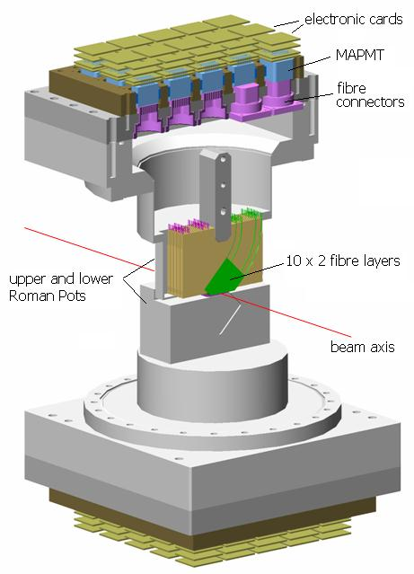
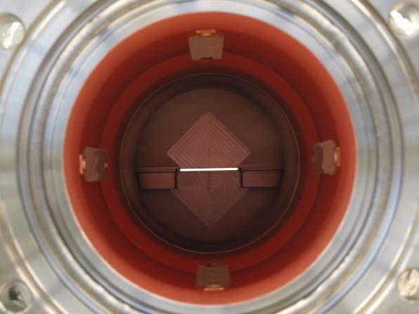
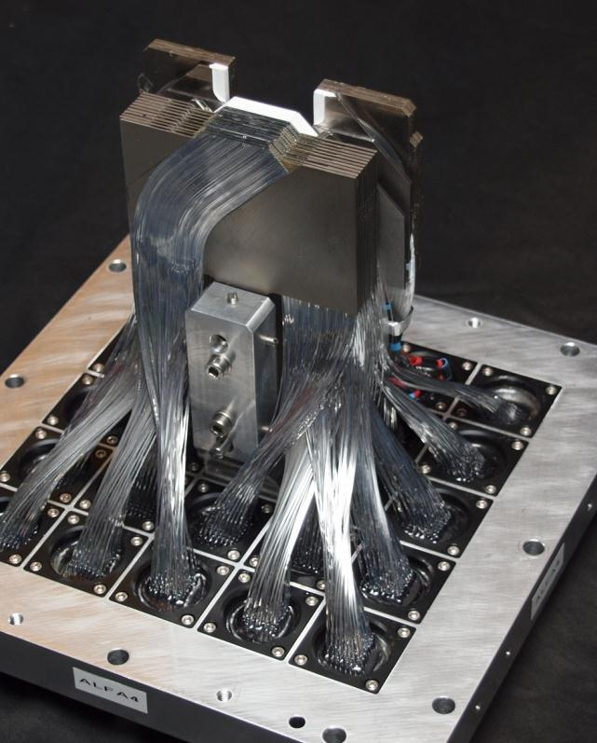
ALFA – Detectors
Four detector stations, two per side, at ~240 m from the IP
  Station consists of two (up & down) 10-plane detectors approaching the beam along Y (vertical)
  A single detector plane consists of a Ti plate sandwiched between two crossed
  (u, v) fiber layers, each layer 64 square fibers, 0.5 mm x 0.5 mm, Al-coated
  The fibers are read by 20 Hamamatsu 64-channel MAPMTs R7600
  effective detector resolution: ~60 μm
Overlap detectors measure vertical distance between pots with ~30 μm relative accuracy
2 trigger tiles (2 mm thick), trigger efficiency > 99.9% for coincidence

Slide 19
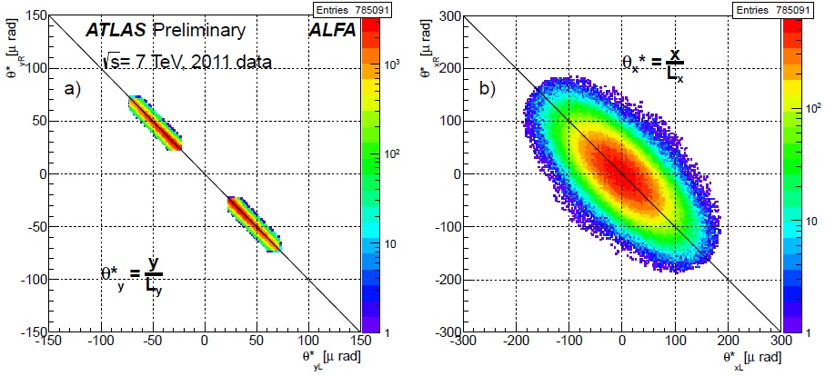
ALFA – Data taking at β * = 90 m
Data run#1:
  October 18-20, 2011: 2 bunches of 7×10¹⁰ ppb & 12 pilots
  optics measurements and
  data taking to find safe distance
  data taking at 6.5 sigma ≃ 1.8 mm
  from the beam
  about 1.4 M elastic and 2 M
  diffractive triggers
  0.8 M clean elastic events
  Ang. correlation plots for elastics:
Data run#2:
  July 7, 2012: low intensity run with 3 bunches 1×10¹¹ ppb
  scraping at 4σ, due to beam loss closest position 4.5 σ impossible
  2 hours data runs at 6, 8, 9.5σ : 3.6 / 65 M elastic /minimum bias triggers
    issue: accidental ramp down of ATLAS magnet prevented luminosity calibration
Data run#3:
  July 14, 2012: high intensity run with 108 bunches of 0.9×10¹¹ ppb
  Roman Pots at 9.5σ
    part#1: mainly elastic triggers from 3 bunches only (3 hours)
    part#2: mainly diffractive triggers from all bunches (5 hours)
  6.5 / 284 / 12 M elastic /minimum bias /diffractive triggers useful for physics
Reconstructed scattering angle correlation between left and right side for elastic candidates after background rejection cuts a) in the vertical and b) in the horizontal plane

Slide 20
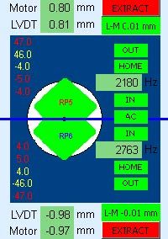
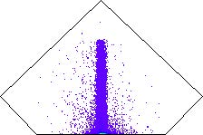
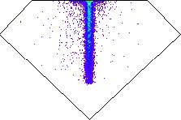
ALFA – Data taking at β* = 1 km
t_{min}~0.0005 GeV²: first measurement in Coulomb-Nuclear interference region!
  Oct 24-25, 2012: de-squeeze to β* = 1km in ~45 minutes
  repeated scraping with primary collimators to 2σ, followed by retraction to 2.5σ to reduce backgrounds …
  10 hours of data taking with Pots
  at 3σ (~0.85 mm distance pot to beam!)
  0.3 M elastic events, and
  many diffractive triggers recorded
dσ/dt [GeV^{–2}]
2015 β* 2500 m
2012 β* 1000 m
β* 90 m
Enormous work was done to understand the large β* optics ➔ now converging
Expect ALFA results on L, σ_{tot}, ρ, b soon …

Slide 21
AFP – History and Status
LoI approved early in early 2012
Physics & Technical Review held Sept 2012
  Technical review passed
    most critical issues: HBP and ToF detectors
  ATLAS Physics Review NOT passed
    we were mostly unprepared for detailed Soft QCD discussion
    we concentrated on Central Exclusive Diffraction at high luminosity (because of the high-pT bias of ATLAS)
    High luminosity running of AFP was considered too ambitious …
AFP recovered during early 2013, and we will have a second (and last ?) try on August 28, 2013
In parallel: work on technical aspects and organization:
  Full simulation of AFP/ALFA & lattice; evaluate use of Roman Pots
  New – ‘staged’ – proposal for the AFP program:

Slide 22
AFP – A Staged Approach …
07/13
2013-2015:
  Sep 2013: AFP approval, start TDR
  Jun 2014: AFP TDR approval; final go-ahead for AFP
    start order/construction of RPs
  Support TOTEM with insertion of 1+1 Horizontal RPs
    Jul 2013: Expression of Support by LHC Forward Physics Working group ??
  2015: Measure & evaluate backgrounds at P5
  2014-15: prep work for AFP installation
  Xmas 2015: Install 2+2 Horizontal RPs in ATLAS
    RP 206m: tracking; RP 214m: tracking + (modest) timing
2016-2017 (Phase 0)
  2016: Measure & evaluate backgrounds at ATLAS
  2016-17: Low-μ Physics
  Aug 2016 – Jan 2017: Decision point: HBP or Timing in 3rd RP ?
  Aug 2016 – Jan 2017: Decision point: AFP420 ?
2018-2021 (Phase 1)
  2018 (LS2): Final AFP installation
  2019-21: AFP Data taking
TOTEM Installation
TDR
01/14
AFP Propototyping & Production
07/14
01/15
TOTEM Data Taking
07/15
Install
01/15
AFP Data Taking
07/15
01/16
07/16

Slide 23
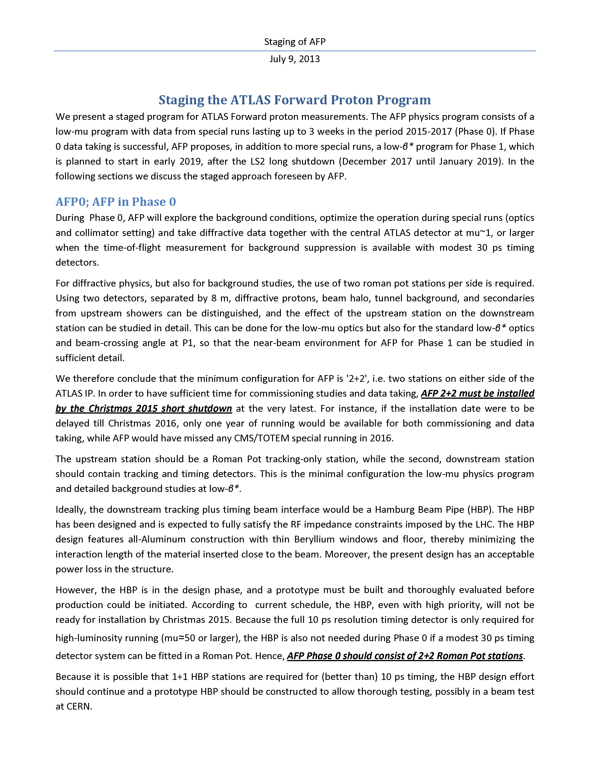
Staging of AFP – AFP0

Slide 24
Staging of AFP – AFP0 (2)

Slide 25
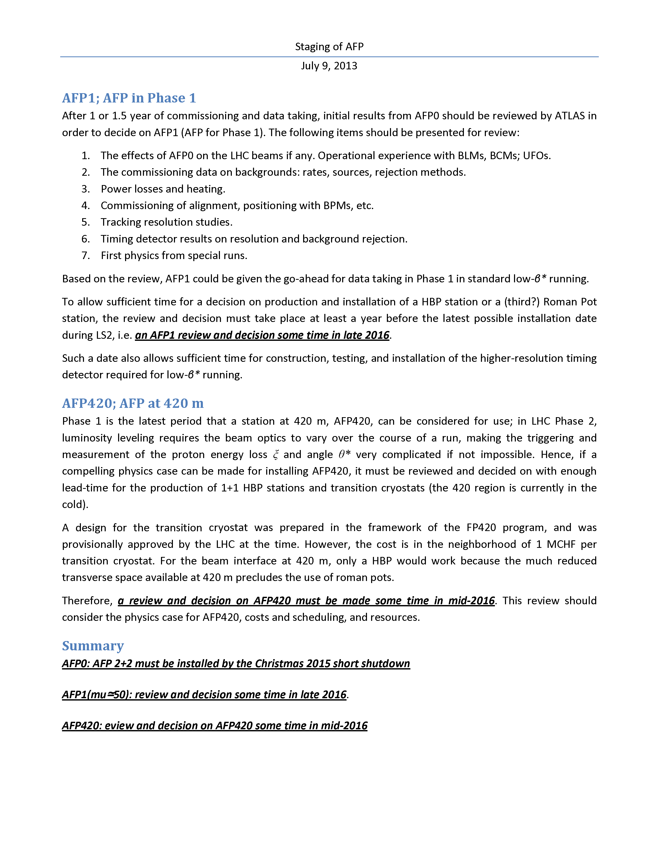
Staging of AFP – AFP1

Slide 26
Staging of AFP – AFP420 ?
Summary:
  AFP 2+2 must be installed by the Christmas 2015 short shutdown at the very latest
  AFP0 (Phase 0): should consist of 2+2 Roman Pot stations
  AFP1 (Phase 1): review and decision some time in late 2016
  AFP420: a review and decision on AFP420 some time in mid-2016
First reactions are positive

Slide 27
Request to the Diffractive Community
Need strong support from the diffractive community to build a diffractive program with tagged protons at the LHC …
  High-pT physics program has top priority
  Diffractive physics is generally seen as ‘dirty’ and not leading to new insights …
  Without support from the full experimental community, funding will not be available …
The LHC Forward Physics Working group must make its opinion and arguments clear to the full LHC physics community (LHCC; ATLAS, CMS, …)

Slide 28
Request to the Diffractive Community
1st Practical step:
declare strong support for TOTEM to put in 1+1 RPs during LS1
  experimental exploration of the backgrounds (simulations can only go so far …)
  test the fast time-of-flight concept in a harsh environment
  must happen in 2014 so that one can learn with the machine …
2nd Practical step:
formation of a Technical LHC-FP sub-group
  discuss/consult on backgrounds
  discuss/collaborate on fast Time-of-Flight detectors
  …

Slide 29
AFP Summary
The critical AFP Physics Review is planned for Aug 28, 2013.
A conservative staging of the AFP program has been developed
  Roman Pots are used in the first stage: well-understood LHC interface
  AFP HBP design is well advanced and may be used in a second stage, depending on experience after LS1
The AFP physics program needs strong support from this community;
  a VERY useful 1st step would be a ‘statement of support’ for 1+1 Pot installation by TOTEM during the current LS1 shutdown
  formation of a Technical FP sub-group?

