Slide 1
Backgrounds, Running Scenarios
Discussion

Slide 2
Severe Backgrounds at the LHC
Sources:
  IP: single diffraction pile-up
  secondary interactions in upstream beam elements
  Beam Halo
Low-μ (special) runs: backgrounds are OK
  see: ALFA runs at β* = 90 m, 1 km
  OK for the soft diffraction program of AFP
High-μ (standard) runs: backgrounds are very high
  see: TOTEM standard-optics runs (Joachim Baechler’s talk)
    evidence that the source is primarily IP and secondary interactions in collimators (1 & 2)
  we are analyzing recently recovered ALFA run at β*=0.55 m (15’ run, 2 Mevts)
  we are simulating the high-μ environment with β*=0.55 m optics …
dominant !

Slide 3

List of Insertions at β* = 0.6 m in 2012
Date | Pots involved | min. dist. | Observations, Result | Consequence
16.10. | all V all H | 12 σ 30 σ | no problem dump on XRPH.A6R5.B1 (slow losses, 5s) | no UFO activity
05.11. | all H | 30 σ | dump on XRPH.A6R5.B1 (slow losses, 5s) | no UFO activity
14.11. | all H | 32mm ~ 270 σ | dump on XRPH.A6R5.B1 (fast losses) | UFO activity in 6L5
16.11. | H, not A6R5.B1 | 14 σ ∼ 2mm | no problem, beams separated by 4σ | slow losses (5s) in each ramp until conditioning (heat up) of beam screen in Q6
(*)
(*) The (fast) UFOs in 6L5 were later found to originate from TCL5 [Tobias]
insertion at low β*
beam heating – LHC vacuum – RP optimization- rates

Slide 4
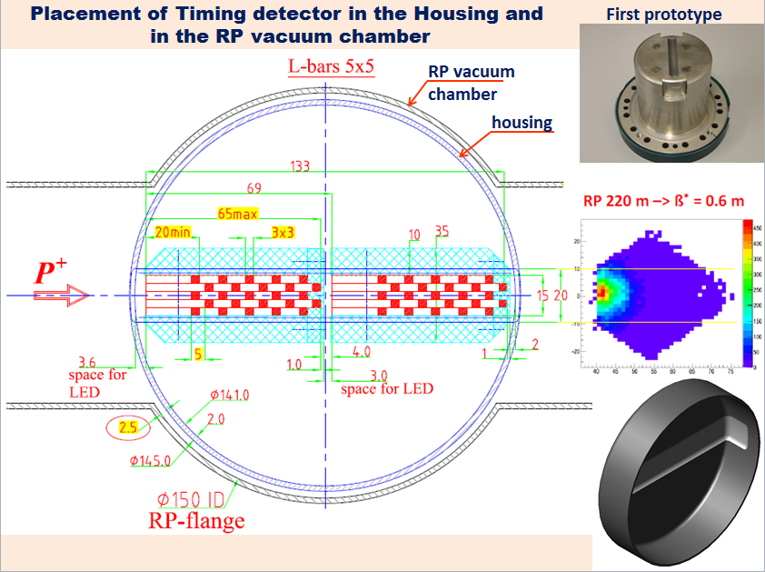
Integration of cylindrical Roman Pot in station

Slide 5
Horizontal RP Rate at 14 σ
from: Joachim Baechler’s talk of yesterday
 | 56-F | 45-N | 45-F
Rate for 1368 b with beam separation | 2 MHz | 1 MHz | 3 MHz (incl. showers from N)
separation lumi factor | 1 / 15.7 | 1 / 18.6 | 1 / 22.6
Rate for 1368 b without separation | 31 MHz | 19 MHz | 68 MHz (22.6* 3 MHz)
Rate for 1 b without separation | 23 kHz | 14 kHz | 50 kHz
Hits per bx w/o separation | 2.0 | 1.2 | 4.4 (50 kHz/11.2kHz)
Expected rates
after LS1 are different
(L, bunch scheme)
Beam conditions (fill # 3288):
1.6 x 10¹¹ p/b
E = 4 TeV
β* = 0.6 m
ε_{n} = 2.8 μm rad
μ = 31 (without separation)
L = 6.7 x 10³³
Revolution frequency: 11.2 kHz
average crossing rate : 11.2 * 1368 = 15.3 MHz
average interaction rate (without separation) : 15.3 * 31= 47.4 MHz
expected SD rate per arm within acceptance:
~ 0.4 / bx (event rate / bunch crossing)
insertion at low β*
beam heating – LHC vacuum – RP optimization- rates

Slide 6
RP operation performance & operation limitation -> LHC & Roman Pot
Operation limitation
RF - heating
RP electronics impact
RP housing impact
Performance limitation
Eff Z –
Transverse
Impedance
BLM signal
increase due to sec.
particles produced in RP
material & LHC gas
Insertion
of RP:
Distance to beam
Beam optics
Luminosity
Collimators
LHC beam stability
Local LHC vacuum
degradation
Eff Z-Longitudinal Impedance
RF RP heating : ferrite performance
temp increase - out gassing – Curie temp.
thermal run away
TOTEM RP development:
multi parameter optimization

Slide 7
Low-μ Runing Scenarios
‘Special runs’: ~3 weeks
  30 wks/yr ➔ 10% of ATLAS/CMS luminosity
  Pro:
    ‘full’ control of machine parameters
    scraping and special optics to get closest to the beam
  Con:
    always a tension between high-pT and soft-QCD running
‘Special bunch trains’: ~10/1300 bunches at low intensity?
  ~0.7% (?) of ATLAS/CMS luminosity
  Pro:
    Large integrated luminosity possible
    Forward Detectors always ‘on’ and always in readout – even in high-μ
    Possibly overlapping interest with high-pT program for calibrations; cross-checks, background studies
  Con:
    only standard optics possible; must learn to live gradually closer to the beam
    Forward Detectors always ‘on’ and always in readout – even in high-μ

