Slide 1
Status of the CENF integration and design studies
1st meeting

Slide 2
INTEGRATION EHN1
Integration CATIA EHN1 buil. 887. Lausanne side first:
  Scans → T. Dobers (BE-SU) meeting on Mo 6th @887
  Beam lines + infrastructure → FSU EN-06 (EN-MEF): start next week
  CE bat 887 → L. Faisandel (on going)

Slide 3
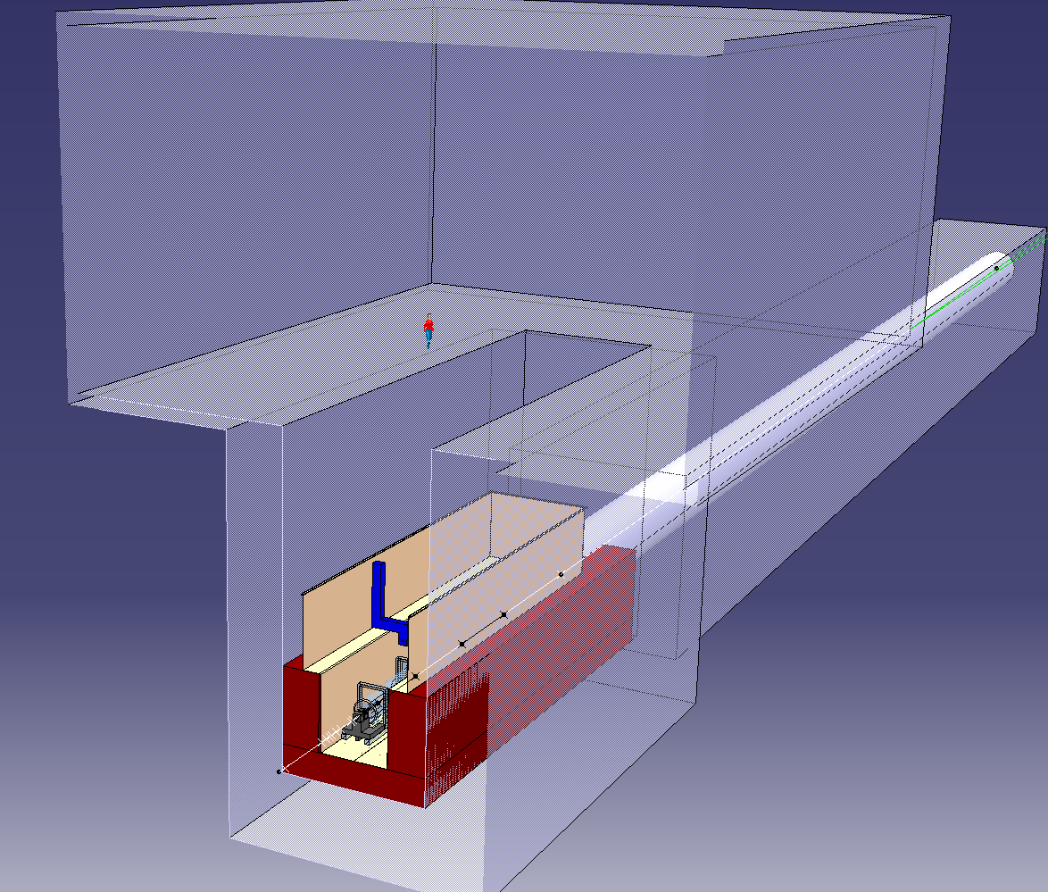
Target building

Slide 4
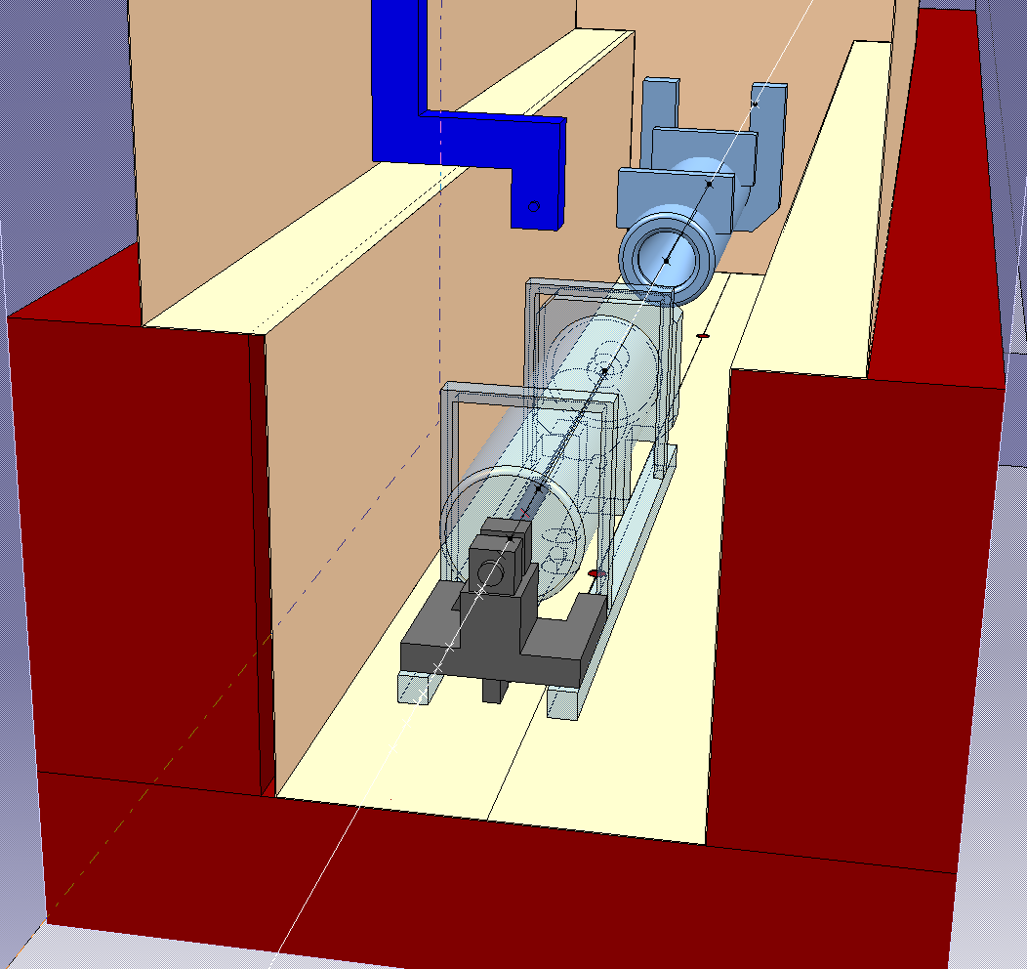
Helium sump

Slide 5
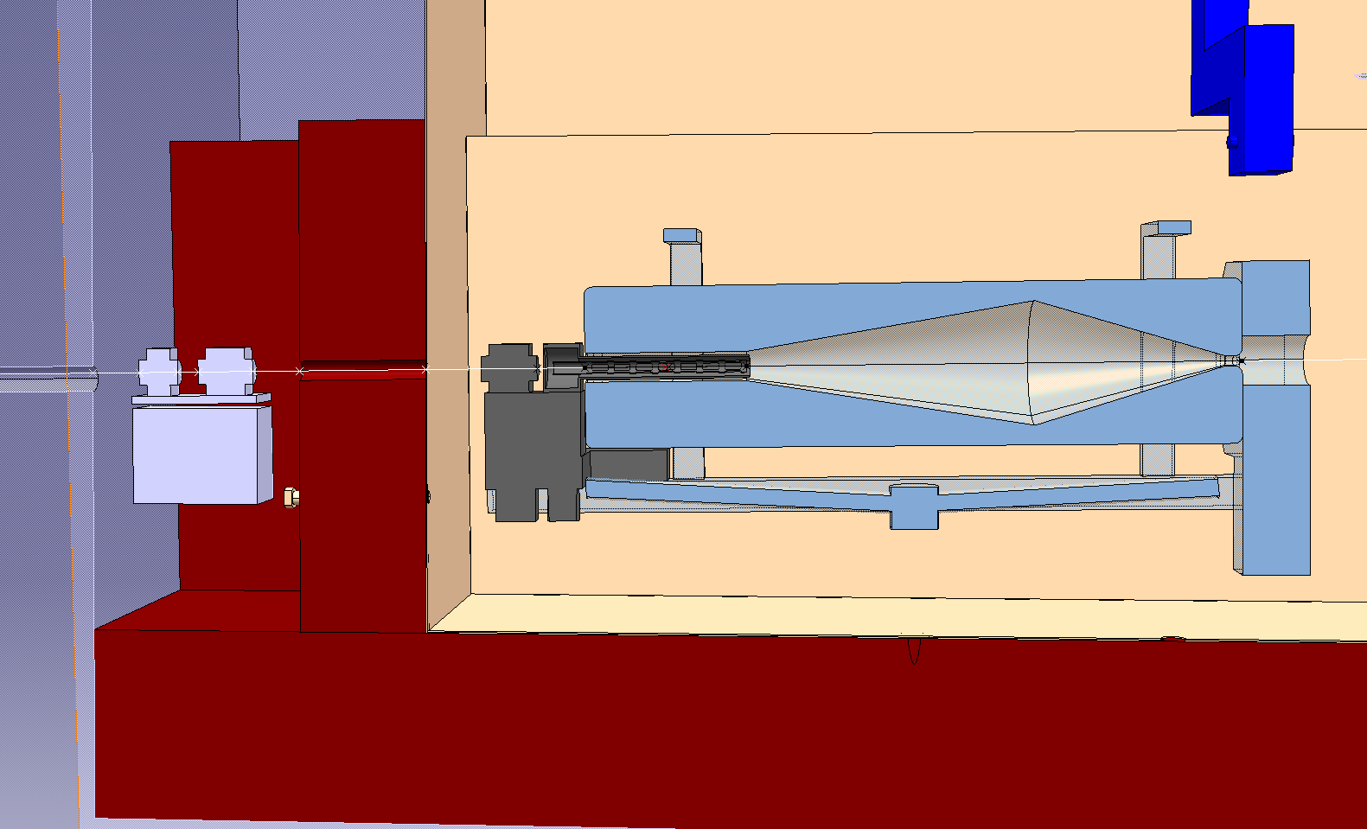
Target + horn

Slide 6
discussions
Engineering choices….

