Slide 1


Data Preservation in HEP Use Cases, Business Cases, Costs & Cost Models
Jamie.Shiers@cern.ch
Grid Deployment Board
International Collaboration for Data Preservation and
Long Term Analysis in High Energy Physics

Slide 2

DPHEP-fest
Today: DPHEP@GDB
Monday Oct 14: DPHEP@CHEP
Update on progress since CHEP 2013
Wednesday Oct 16: DPHEP WS @ CHEP
DPHEP “Common Projects”;
Moving from a “Problem Statement” (Blueprint) to Services, Solutions and Projects

Slide 3
DPHEP Implementation Board
Equivalent to GDB / MB for DPHEP
Indico: https://indico.cern.ch/categoryDisplay.py?categId=4458
Twitter: https://twitter.com/search?q=%23DPHEP
Mail archives: https://groups.cern.ch/group/DPHEP-IB/default.aspx

Slide 4

DP in the Wider Context
Many projects / disciplines active
At least some “mature” in many aspects
We can profit a lot by collaboration (bi-directional)
International / inter-disciplinary coordination:
Alliance for Permanent Access (APA) [ executive board candidate ]
RDA Preservation e-Infrastructure Interest Group [ vice-chair ]
Several relevant conferences / workshops:
APA
iDCC
iPRES
PV
(RDA)

Slide 5
High Level Strategy wrt Others
Make “them” aware of us
“Them” = other projects, funding agencies, …
Clarify what we can offer
e.g. “bit preservation” at 100PB -> 1EB scale
This seems to be working

Slide 6
The remainder of this talk will concentrate on:
Use Cases;
Associated Business Cases;
Costs & Cost Models.
Why is this relevant for the GDB?
Because there are messages and implications for the funders
As they may well be service and other implications (“best practices”)
Because members of the GDB can provide input to the elaboration of the costs & cost models
Once we have these we can prepare a “roadmap” for handling the key Use Cases
An analysis of the costs is essential for future work…

Slide 7
DPHEP – 1st Workshop
“The problem is substantial and past experience shows that early preparation is needed and sufficient resources should be allocated.”
“The “raison d’être” of data preservation should be clearly and convincingly formulated, including a viable economic model.”

Slide 8
Use Cases
Three Use Cases have been identified, based on the “Problem Statement(s)” in the DPHEP Blueprint
They are simple enough for discussions with non-experts
They may be over-simplified but IMHO this does not dramatically alter the bottom line

Slide 9
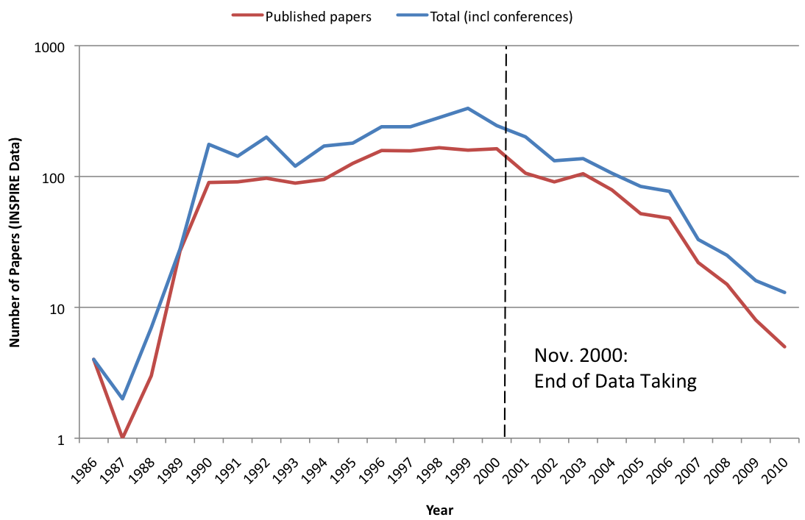
1 – Long Tail of Papers

Slide 10
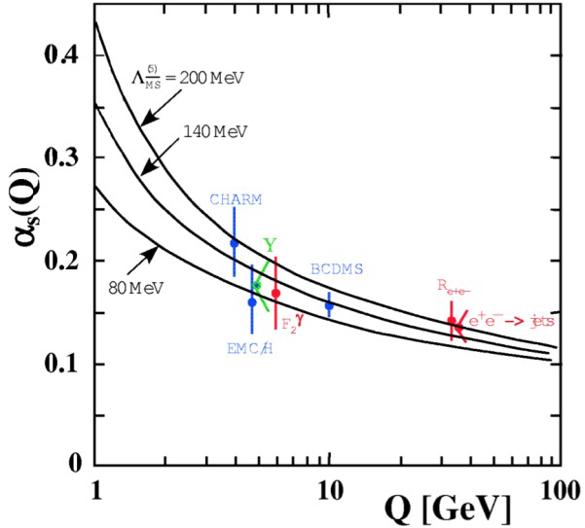
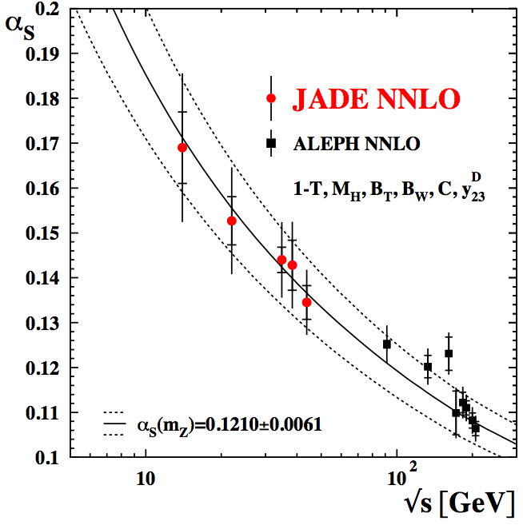
2 – New Theoretical Insights

Slide 11
3 – “Discovery” to “Precision”

Slide 12
4 – (whatever)
There is a general feeling that “we” should preserve data “forever” “just in case”
No clear business case
An understanding of the costs can help clarify the strategy (e.g. “best effort” – bit preservation + ?)
Preservation of data + software + knowledge beyond human lifetimes not obvious…
(Cost benefit analysis)

Slide 13
Use Case Summary
Keep data usable for ~1 decade
Keep data usable for ~2 decades
Keep data usable for ~3 decades
Re-visit after we have understood costs & cost models, plus potential “solutions”

Slide 14
Costs and cost models

Slide 15
Costs – Introduction
We do not know exactly what the costs will be in the future
But, we can make estimates, based on our “knowledge” and experience
In some areas these estimates will be relatively accurate
In others, much less so
“Acceptable” costs compared to what?
Cost of LHC? WLCG? A specific service, such as DB?

Slide 16
A DB Service
Costs include:
Hardware;
Licenses & maintenance;
People.
There is also value = business case
10 FTEs @EUR100K/year = EUR1M/year

Slide 17
Costs of Curation Workshop
Within DPHEP, and in collaboration with external projects (e.g. 4C), we are planning a “no stone left un-turned” workshop
Look at the many migrations we have performed in the (recent) past – plus those foreseen
Estimate / calculate costs
Come up with scenarios for the future:
10 year preservation = 3 media migrations + n build systems + p s/w repositories + q O/S versions + …
20 year preservation: more disruptive changes
30 year preservation: more still
Manpower almost certainly the dominant cost
What can we do to optimize it?
Coordinate validation activities -> service
Streamline emulation activities -> tool-kit(s)
Best practices & support for migration activities -> support activity
Can we do things in a way that costs less in the future – and make our data more “preservational”?

Slide 18
Summary
Your input and experience is needed to make the workshop successful
Jan 13/14 (or Jan 27/28)
We will start to build agenda now – output will be a report with costs & cost models
This should help guide our work – and IMHO is a pre-requisite for obtaining funding / resources

Slide 19
Conclusions
Unless there are real surprises (IMHO not consistent with “experiment”), the real and necessary costs of curation are affordable
Affordable means business case is valid / strong
Knowing the numbers can only help

Slide 20
Entity | Description | Input and Positioning | Output
DPHEP Project Manager | Project management, administrative, technical, funding | Main operational coordinator, maintain contacts, organises meetings, lead proposals for funding | Reports to the steering committee

