Slide 1
Global Service Registry
Laurence Field & Maria Alandes, CERN
CERN IT Department, Support for Distributed Computing Group
GDB 11th December 2013

Slide 2

Contents
Introduction
VO Information Systems
Global Service Registry
What is next?

Slide 3
Introduction
The WLCG Information System is comprised by a set of heterogeneous information systems
  Central portals: OIM and GOCDB
  Distributed BDII hierarchy
Synchronising these components is a challenging activity
Each VO has created its own configuration database
  Some information duplicated from the WLCG IS
  Maintenance implies manual changes in many cases
The Global Service Registry aims at addressing these issues

Slide 4

VO Information Systems (I)
VO Information Systems are
  Configuration Databases where all the information needed for the experiment framework to run is gathered
    Generic information about services
      Duplicated from GOCDB, OIM or BDII!
    VO Specific information (e.g. Internal naming and semantics)
  Single authoritative source for all information
  Central repositories where the VO has absolute control over the information
    Addressing inconsistencies

Slide 5
VO Information Systems (II)
ALICE
  Central LDAP server as part of ALiEN
  Updated Manually
LHCb
  Configuration service as part of DIRAC
  Supports automatic and manual updates
CMS
  Oracle DB accessed through GUI and API web interface (Site DB)
  Site is responsible for maintaining information about itself and services it provides
ATLAS
  Oracle DB + Django web application framework (AGIS)
  Information automatically retrieved from different sources and managed directly in AGIS

Slide 6
VO configuration DBs and WLCG IS interactions
WLCG IS components | GOCDB | OIM | BDII | Could the WLCG IS provide part of the needed information?
VO configuration DBs
ALICE | - | - | - | YES
ATLAS | YES | YES | YES | YES
CMS | - | - | - | YES
LHCb | YES | - | YES | YES
How do VOs get the list of sites belonging to the VO?
  Sometimes the VO DBs point to sites that aren’t defined in REBUS or GOCDB
  VOs have their own criteria to add a site in their VO DBs

Slide 7
VO configuration DBs and WLCG IS information flow
Downtimes and sites
Monitoring
VO feed
ALICE DB
LHCb DB
ATLAS DB
CMS DB
Site BDII
Site BDIIs
Top BDIIs
EGI GOCDB
OSG OIM
Site BDII
Opportunistic Resources
Site BDIIs
Site BDIIs
WLCG Resources
Resource BDIIs

Slide 8
VO Information Systems in Summary
Configuration DBs are information sources for the experiment framework
Information is quasi-static and describes the topology of the infrastructure from the VO perspective
Duplication of information between the configuration DB and their information sources
Duplication of information and functionality among configuration DB themselves

Slide 9
Global Service Registry (I)
Common solution from where VOs can obtain information about grid services in the WLCG infrastructure
Ensure common requirements are met so that VOs can focus on their unique challenges

Slide 10
Global Service Registry (II)
Monitoring
VO feed
ALICE DB
LHCb DB
ATLAS DB
CMS DB
Global Service Registry
EGI GOCDB
OSG OIM
WLCG Resources
Opportunistic Resources DB
WLCG Resources
Resource BDIIs
Site BDIIs
Top BDIIs

Slide 11
Global Service Registry (III)
The GSR caches the static information needed by the VOs to populate their configuration DBs, offering:
  Aggregation
    Bring together information scattered among different sources
  Unique entry point
    One central service to control the information
  Single interface
    Abstraction from the different sources of the information
  Automation
    Avoid manual maintenance of up to date information
  Caching
    Cache information from the underlying components and apply hot fixes when necessary

Slide 12
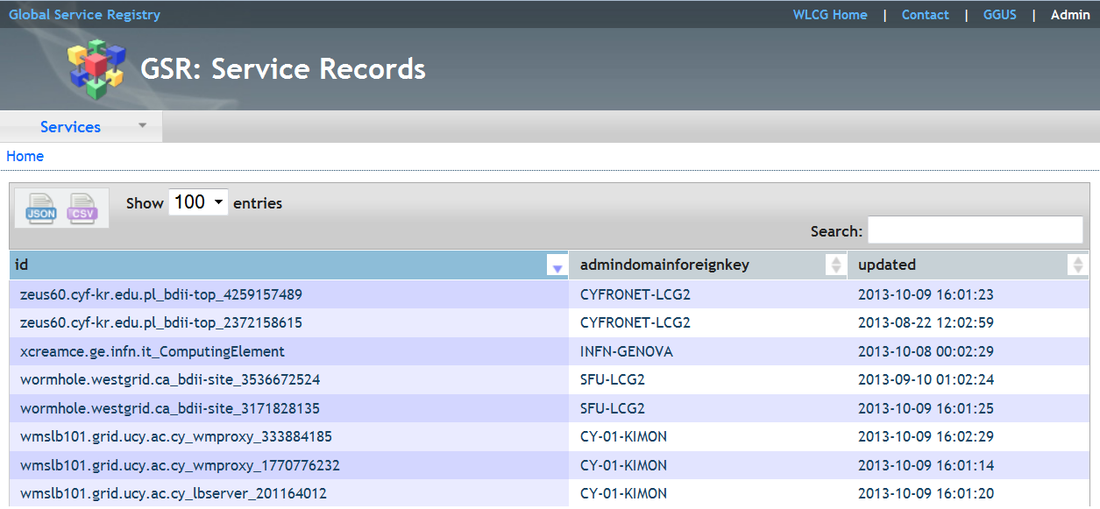
Global Service Registry (IV)
A GSR prototype has been implemented
  Central server running Django + MySQL DB
We integrated some use cases that could be interesting for LHCb and ATLAS as suggested by S. Roiser and A. Di Girolamo.

Slide 13
What is next? (I)
We think the GSR is a good idea
  First prototype implemented and feedback was positive
At the same time, it is not clear what the authoritative sources for information are and how they end up in the VO configuration DBs
  E.g. If the GOCDB is not considered to be the authoritative source for a certain VO, what is the advantage of aggregating this information?

Slide 14
What is next? (II)
We need a real use case to make further progress
  But VOs have their solutions in place and there is no need to move to something else in the short/medium term
We also have to understand the total cost of ownership for VO specific systems vs the cost of provision and migration of the GSR

Slide 15


Slide 16
WLCG Information System
GOCDB and OIM
  Which grid services should be in the WLCG infrastructure
    Limited static information
      Although it could be extended as of the last release!
  Scheduled and unexpected downtimes
BDII
  Which grid services are in the WLCG infrastructure
    Static and dynamic information
      Not very reliable, on going effort to improve the quality with the glue-validator

