Slide 1

HEPiX Fall 2013 U Michigan, Ann Arbor / U.S.
Helge Meinhard, CERN-IT (partly using material prepared by Michel Jouvin / IN2P3-LAL)
Grid Deployment Board 11-Dec-2013

Slide 2
HEPiX – www.hepix.org
Global organisation of service managers and support staff providing computing services for HEP community (“sites”)
22 years old; informal, self-organised forum; open to everybody interested
Subscribe to hepix-users@hepix.org
WLCG Tier-0, Tier-1s, some Tier-2s regularly attend
More sites very welcome
Workshops of one week twice per year
Exchange of experience, reports on recent work, work in progress, future plans
Usually no showing-off

Slide 3
HEPiX Fall 2013
October 28 to November 1 2013 at University of Michigan, Ann Arbor (MI), U.S.A.
(Larger) part of a significant distributed ATLAS Tier-2
Very well organised; rich programme
115 registered participants – record for North-American meeting
North America: 47, Europe: 48, Asia: 3, Australia: 2, plus 15 company representatives; 42 different affiliations
Serious thread by US Government shutdown (“man-made business continuity issue”), fortunately things worked out right
65 presentations, total duration: 26 hours
Many discussions after talks and off-line
Programme and complete slides: http://indico.cern.ch/e/Hepix2013UM
Trip report (HM): https://cds.cern.ch/record/1630741

Slide 4
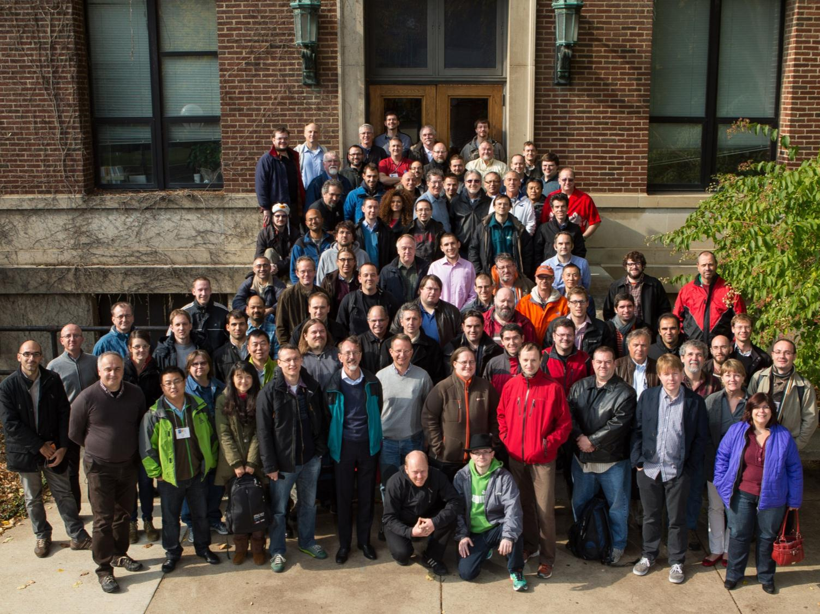

Slide 5
Tracks and Trends
Networking and security (9 talks)
Computing and batch systems (6 talks)
IT facilities (3 talks)
Basic IT services (8 talks)
End-user IT services and OS (3 talks)
Grids, clouds, virtualisation (7 talks)
Storage and file systems (10 talks)
16 site reports

Slide 6
Networking and Security
IPv6 working group
100 GE is now available for WAN in several places, in particular in the US and between CERN and Wigner
Changing dramatically the traditional division between LAN and WAN
Several demonstrations of efficient usage
BNL mentioning looking at IPoIB as an alternative to 10 GE
Preliminary test demonstrated 40 Gb over 56 Gb QDR
Lower latency (10x) than 10 GE: open the path for new use cases, potential cost advantage
Identity federations (3 talks)

Slide 7
Storage
OpenAFS: Complex situation
Two companies, one of which forking for their own developments (YourFileSystem Inc.)
Still heavily used in HEP, little alternative
No plan for IPv6 support, no need in HEP, no willingness to share potential development cost
CEPH: Very promising, several successful pre-prod deployments
CERN, RAL
Currently, mainly distributed object storage (block device), but many other interesting options
Very interesting talk by Western Digital on drive reliability
Look at slides: highly technical!
New features to improve future failure prediction

Slide 8
Batch systems
Regular discussion item in recent workshops
Trend towards two systems – Grid Engine and HTCondor
Several (large) sites moved to Grid Engine (GE)
Most sites moved at the end to UNIVA GE – Oracle sold all GE assets to UNIVA
Little uptake at scale of open-source projects
Several sites looking at HTCondor
Scalability and dynamism seems impressive
Successfully used at OSG sites for many years
RAL moved its production CE, CERN investigating
RAL chose ARC CE; CREAM CE working too
Disappointing experience with SLURM
Several disappointing scalability tests: good scaling with high number of nodes but not with high number of jobs (100+ Kjobs)

Slide 9
Other interesting trends
Log analysis
Configuration management: Puppet is the clear winner

Slide 10
HEPiX Working Groups (1)
IPv6 (David Kelsey)
Benchmarking (Michele Michelotto, Manfred Alef)
Lots of results collected
Free lunch with SL6 (about +5% wrt SL5)
New SPECcpu benchmark announced for October 2014
Preparation for new HEP benchmark to start now
Gather people willing to contribute
Identify typical experiment applications to compare with new SPECcpu
Discuss boundary conditions (OS, compiler, no of parallel instances etc.)
Presentation and discussion at GDB in January

Slide 11
HEPiX Working Groups (2)
Configuration Management (Ben Jones, Yves Kemp)
Focusing on Puppet for now – tool of choice at many sites
Cfengine, Quattor, Chef still around
Establishing best practices and a common repository for HEP-specific issues
To include configuration of Grid middleware components
Bit preservation (German Cancio, Dmitry Ozerov)
Technical advice on bit preservation as input to DPHEP
Survey done and presented, work going on
Energy efficiency (Wayne Salter)
Insufficient interest at Ann Arbor, new attempt at next meeting

Slide 12
Next HEPiX meetings
Spring 2014: LAPP Annecy, France
May 19 – 23
Same tracks as in fall 2013
Fall 2014: Very probably at University of Nebraska in Lincoln (CMS Tier-2)
Date to be defined
Spring 2015: Candidate site in Europe identified
Proposals are always welcome…

Slide 13

Final Words
Hope to see many of you in Annecy (19 to 23 May 2014)

