Slide 1

The HEPiX IPv6 Working Group
David Kelsey (STFC-RAL)
WLCG GDB, CERN
11 Dec 2013

Slide 2
Outline
Update of status and plans
General news
HEPiX IPv6 testbed
  And file transfer tests
Software and tools survey
Some technical matters
Future plans
  Use cases for testing
  IPv6 workshop
Summary

Slide 3
General News
IPv4 addresses running out at CERN
IPv6 usage worldwide taking off – Google report > 2.5% and growing
New testbed sites
  IHEP (CN), Glasgow, Imperial London, NDGF, PIC, USLHCNet Caltech (Chicago), QMUL & FNAL
More engagement of LHC Experiments
  CMS (in from the start)
  LHCb next (although not so active right now)
  ATLAS and ALICE now engaged
Lots of testing (data transfer, monitoring, jumbo frames, …)
WLCG Ops Team IPv6 task force created – we work together
  Defining use cases for testing and performing software survey
Test of dual-stack services at Imperial London Tier 2

Slide 4
The HEPiX IPv6 Testbed
A dedicated distributed testbed
Connected to IPv6 and IPv4 networks
  IPv6-only/IPv4-only names also registered in DNS
  e.g. hepix-v6.desy.de & hepix-v4.desy.de
Caltech, CERN, Chicago, DESY, FNAL, FZU, Glasgow, IHEP, Imperial, INFN, KIT, NDGF, PIC
http://hepix-ipv6.web.cern.ch/content/hepix-ipv6-distributed-testbed

Slide 5
IPv6 file transfer tests
Tony Wildish (CMS)
Simple mesh of simultaneous data transfers (IPv6)
Transfers a 1 GB file using GridFTP (globus-url-copy)
  Measures time to transfer
  Records any errors
Uses UberFTP to confirm arrival and then delete
Have been running for last 8 months

Slide 6
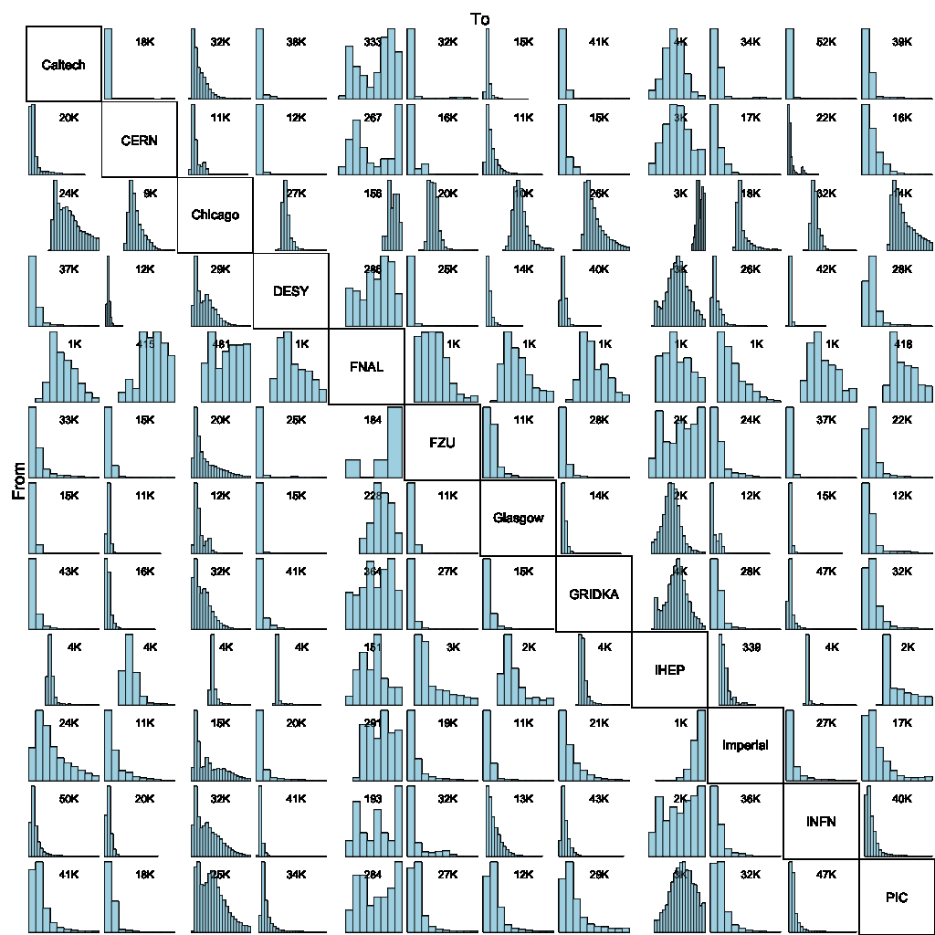
GridFTP IPv6 data transfer mesh
> 2 PB data transferred in 6 months
Success rate > 87%
Very High!
  Operating at risk
Time to transfer max 500 s

Slide 7
CMS PhEDEx/FTS3/DPM
Dual-stack FTS3 server deployed at Imperial
IPv6-only DPM SE’s at Imperial and Glasgow
CMS transfer data using PhEDEx (IPv6)
> 120 TB data transferred in 2 months
Conclusion – “PhEDEx can operate to CMS production standards with IPv6-enabled services”

Slide 8
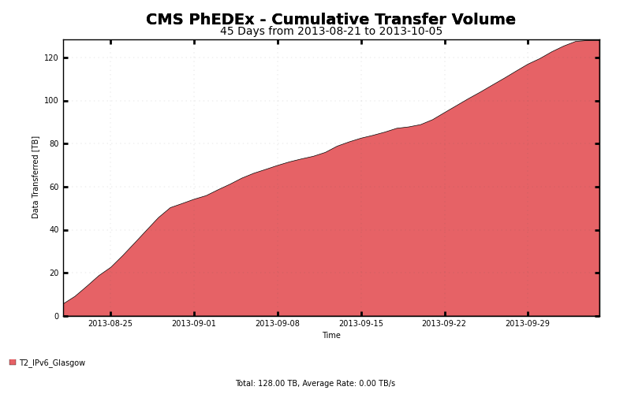
CMS PhEDEx transfers

Slide 9
Data transfer lessons learned
CMS PhEDEx is production ready on IPv6
The testing is very useful for finding site IPv6 problems
  E.g. allows some level of stress testing
Over the months we have experienced some breaks, performance problems, asymmetric routing, …
  E.g. cpu utilisation in FNAL border router reaches 60% with IPv6 traffic flows of 200-300 Mbps
The reason for ongoing data transfer tests
It is useful for a site to be in the IPv6 testbed

Slide 10
Dual-Stack services at Imperial
Tier 2 Imperial College, London
Configured a subset of their service to be IPv4/IPv6 dual stack
  DNS, SSH, NFS, EMI 2 and EMI 3 CREAM CEs, EMI 2 Worker Nodes, ARC CE and dCache (headnode, SRM component only), all BDII services
  Stateless address autoconfiguration (SLAAC)
No problems observed
  Did not need to turn IPv6 off

Slide 11
Software and Tools survey …

Slide 12
Software & Tools IPv6 Survey
An “Asset” survey is underway
  Need to reach out to all sites and the LHC experiments
  Includes all applications, middleware and tools
If IPv6-readiness is known, can be recorded
Otherwise we will need to investigate further
  Ask developer and/or supplier
  Scan source code or look for network calls while running
  Test the running application under dual stack conditions

Slide 13
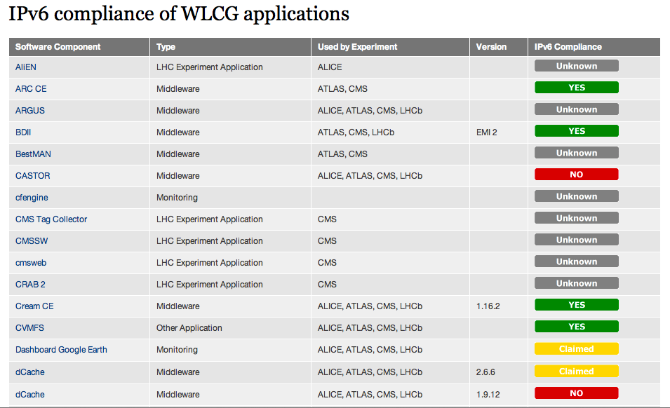
http://hepix-ipv6.web.cern.ch/wlcg-applications

Slide 14
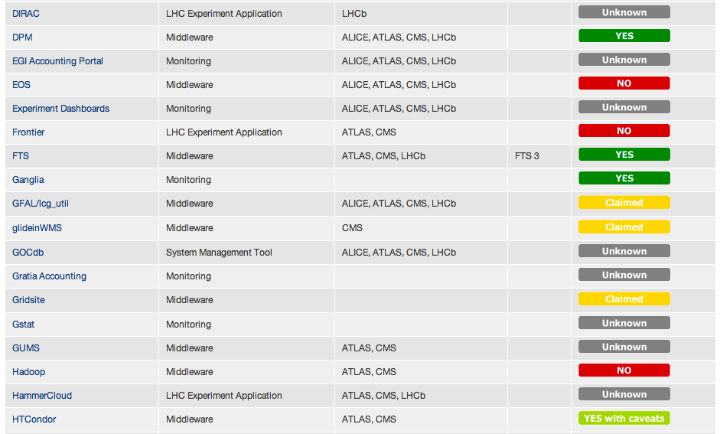
Software survey (2)

Slide 15
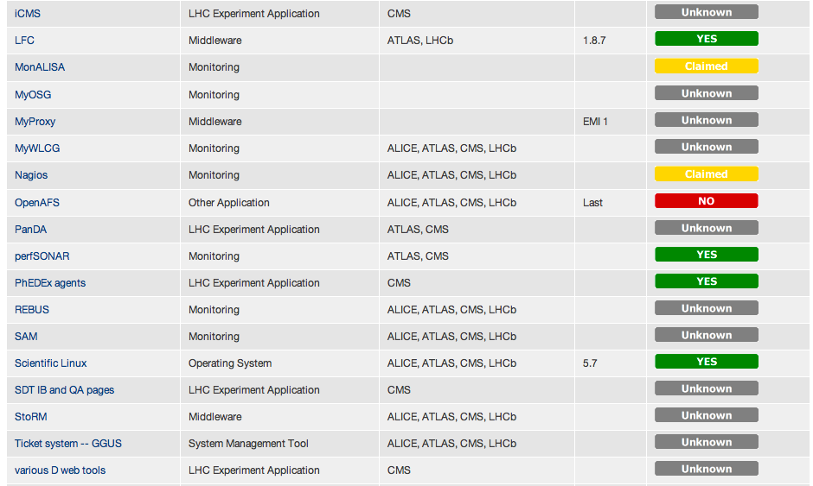
Software survey (3)

Slide 16
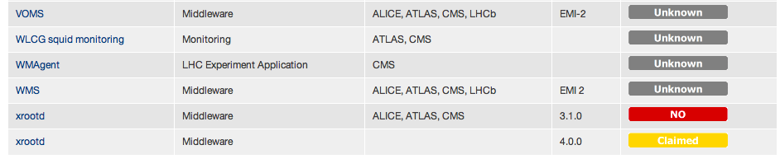
Software survey (4)

Slide 17
Some technical matters
Storage: DPM, StoRM, dCache all work on IPv6 (in some configurations)
  Our survey database not yet updated
NDGF just joined testbed – having initial problems with dCache (DCAU not supported) – using special v2.7.2
Globus 5.2.5 now released
  With patch for ftp client IPv6 enviroment variables
At CERN will use VMs for dual-stack testing rather than LXPLUS nodes
  https://twiki.cern.ch/twiki/bin/view/LCG/DualStackCERNVirtualMachine
File transfers fail from time to time (whole host of reasons!)
Still waiting for xrootd 4.0 (with IPv6 support)
HTCondor and ARC-CE being tested

Slide 18
Future plans and next steps …

Slide 19
Use Cases for testing
– dual stack services
http://hepix-ipv6.web.cern.ch/content/wlcg-ipv6-task-force-0
Basic job submission
  The user submits a job using the native middleware clients (CREAM client, Condor-G, etc.) or intermediate services (gLite WMS, glideinWMS, PanDA, DIRAC, AliEN, etc.)
Basic data transfer
  The user copies a file from his node to a SE and back
Third party data transfer
  The user replicates a bunch of files between sites via FTS-3
Production data transfer
  The user replicates a dataset using experiment-level tools (PhEDEx, DDM, DIRAC, etc.)
Conditions data
  A job access conditions data from a batch node via Frontier/squid
Experiment software
  A job accesses experiment software in CVMFS from a batch node

Slide 20
Use cases (2)
Experiment workflow
  A user runs a real workflow (event generation, simulation, reprocessing, analysis)
  This test combines all previous tests into one
Information system
  A user queries the information system
Job monitoring
  Monitoring information from jobs, coming either from central services or from batch nodes via messaging systems, is collected, stored and accessed by a user
TESTING plan
all services must be tested in dual stack
all user clients must be tested in IPv4 and dual stack
all batch nodes must be tested in IPv4, IPv6 and dual stack

Slide 21
Testing 2014
Systematic tests of the Use Cases
Try more (a small number!) Tier 2 sites with dual stack services
Glasgow, KIT, CERN are deploying larger scale test-clusters
  Use these for more complete testing
Turn on dual-stack services as soon as possible

Slide 22
Timetable WLCG IPv6 transition
In 2012 we said:
  Support for IPv6-only clients *not before* Jan 2014
Still true!
  And likely to be much later
  Needs MANY sites to support IPv6 (still not true)
Sysadmins, Security staff, Monitoring and Operations
  Training required
  New operational procedures
The WG will continue to test Use Cases
Aim for dual-stack on most/many services – when?
Aim for an IPv6 workshop at CERN in Spring/Summer 2014

Slide 23
Further info
HEPiX IPv6 web
http://hepix-ipv6.web.cern.ch
HEPiX IPv6 wiki
https://w3.hepix.org/ipv6-bis/
Working group meetings
http://indico.cern.ch/categoryDisplay.py?categId=3538
WLCG Operations IPv6 Task Force
http://hepix-ipv6.web.cern.ch/content/wlcg-ipv6-task-force-0

Slide 24
Summary
Good progress has been made by the HEPiX IPv6 working group with proving that dual stack IPv4/IPv6 services work in WLCG
  But work is slow and there is lots more to do!
We are very much effort-limited
  Tier 1 and Tier 2 sites
  Experiments
We do need to encourage sites to deploy IPv6
  The 2014 workshop should help here
VOLUNTEERS to join the group are always welcome
  please contact me!

Slide 25
Questions?

