Slide 1

Francesca Bisello
Dosepix
Midterm Review Preparatory Meeting
ARDENT Project
June 13th, CERN

Slide 2
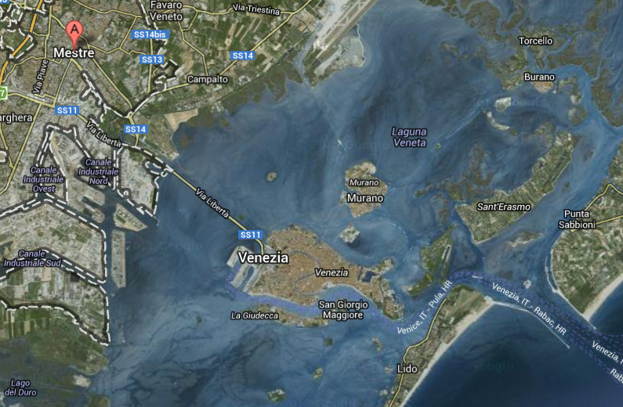
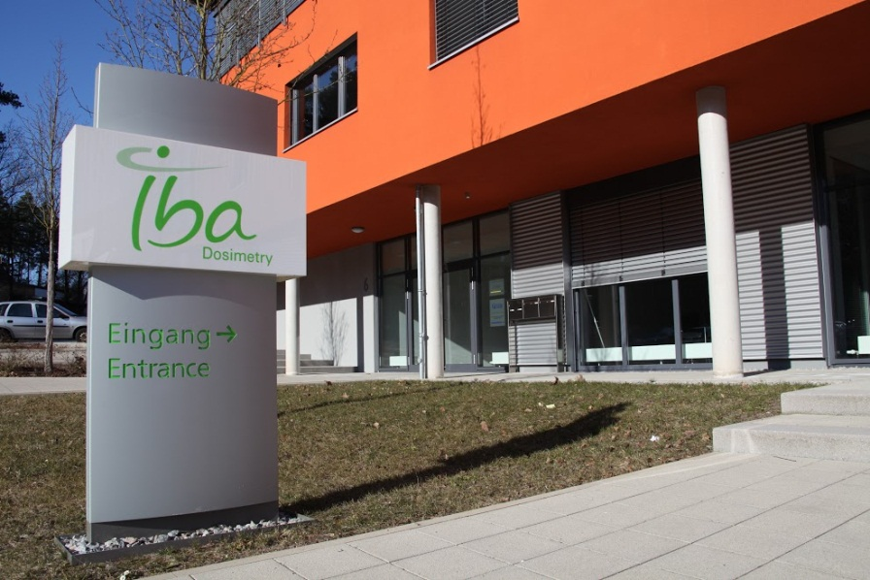
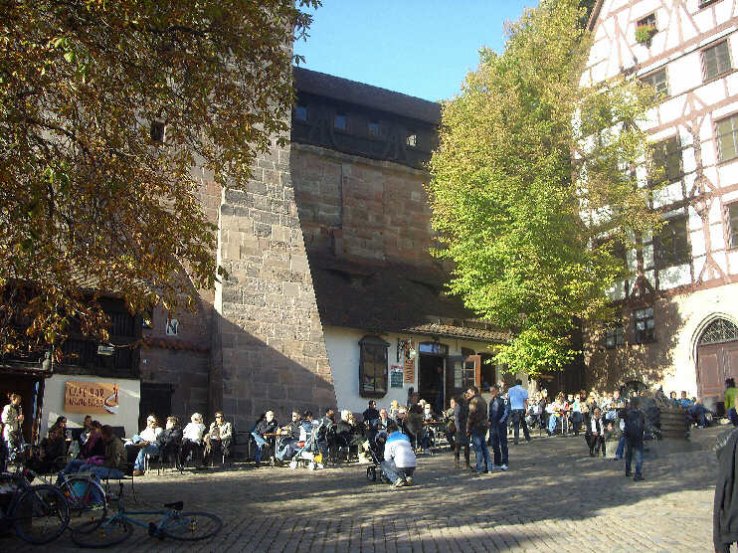
Hello everybody!
Outline
Dosepix
Training & Conferences
To do
About Me...
..where I come from
Where I am now…
Francesca Bisello, ESR 10 Midterm ARDENT Meeting, June 13th 2013, CERN

Slide 3
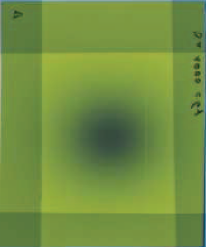
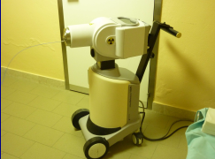
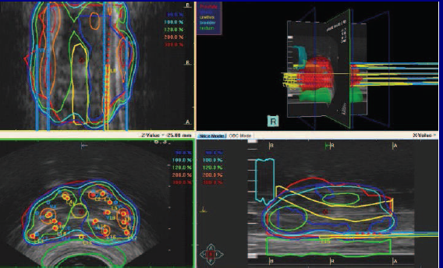
Hello everybody!
Outline
Dosepix - General
To do and what I have done
About Me..
..in between:
University of Padua: Bachelor Degree
Erasmus at Ludwig Maximilians Universität München
University of Bologna : Master Degree in Applied Physics
Master Thesis: „Characterization of a radiochromic film Gafchromic EBT2 in relation to a Ir-192 source“, Sant´Orsola-Malpighi hospital, Bologna
Francesca Bisello, ESR 10 Midterm ARDENT Meeting, June 13th 2013, CERN

Slide 4
Hello everybody!
Outline
Dosepix - General
To do and what I have done
Overview
ARDENT ESR 10
Goal
Development of a medical Quality Assurance for different Xray modalities devices with Dosepix detector
Methods:
Chip evaluation at different radiation energy
Reconstruction and analysis of Radiation Spectra
Optimization of the device in different design
Francesca Bisello, ESR 10 Midterm ARDENT Meeting, June 13th 2013, CERN

Slide 5
Hello everybody!
Outline
Dosepix - General
To do and what I have done
Dosepix
Few words about Dosepix …
Francesca Bisello, ESR 10 Midterm ARDENT Meeting, June 13th 2013, CERN

Slide 6
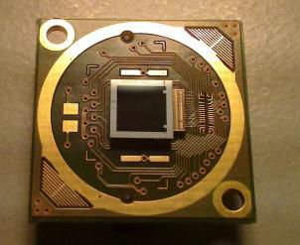
Hello everybody!
Outline
Dosepix - General
To do and what I have done
Dosepix – Hybrid Silicon Pixel Detector
Dosepix
Hybrid Silicon Pixel Detector
Read out Electronics
Time-Over-Threshold
Francesca Bisello, ESR 10 Midterm ARDENT Meeting, June 13th 2013, CERN

Slide 7
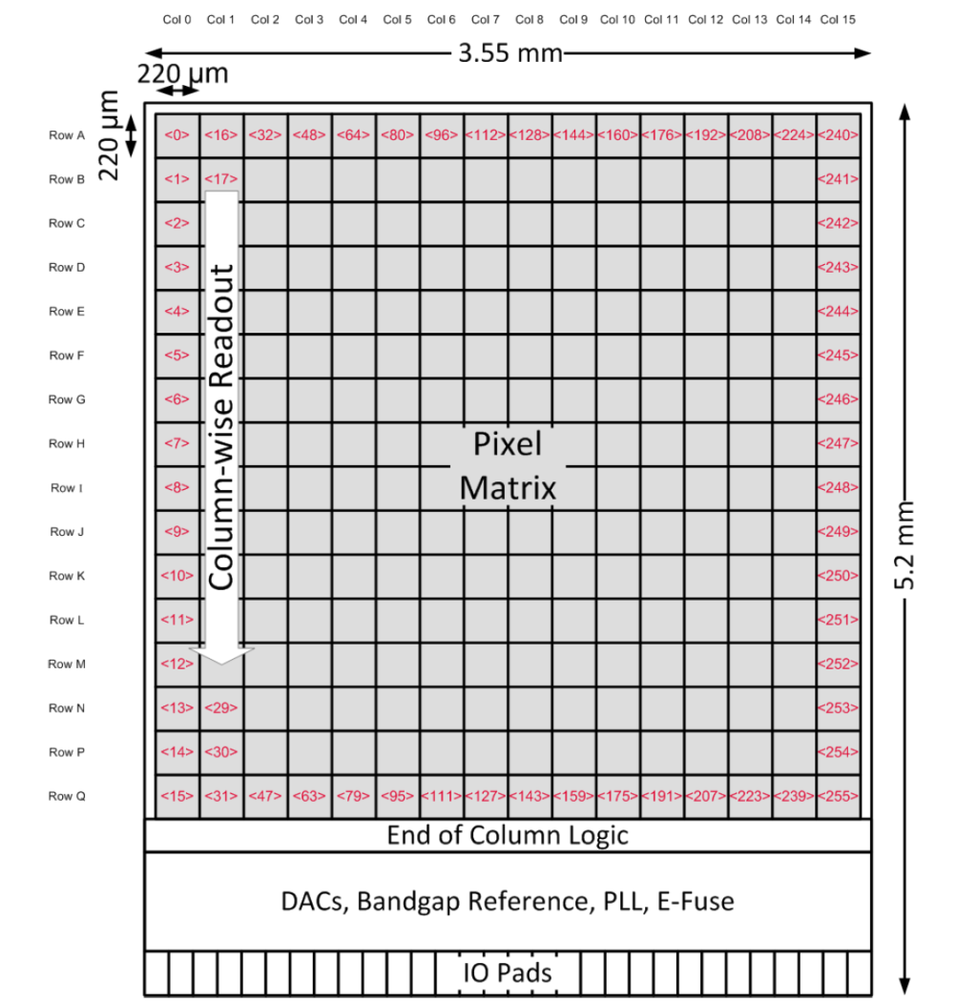
Hello everybody!
Outline
Dosepix - General
To do and what I have done
Dosepix – Hybrid Silicon Pixel Detector
PARAMETER | SPECIFICATION
Pixel Pitch | 220 µm x 220 µm
No. of Rows | 16
No of Columns | 16
Sensitive Area | 3.52 mm x 3.52 mm
Sensor Thickness | 300 µm
Sensor Material | Silicon
Francesca Bisello, ESR 10 Midterm ARDENT Meeting, June 13th 2013, CERN

Slide 8
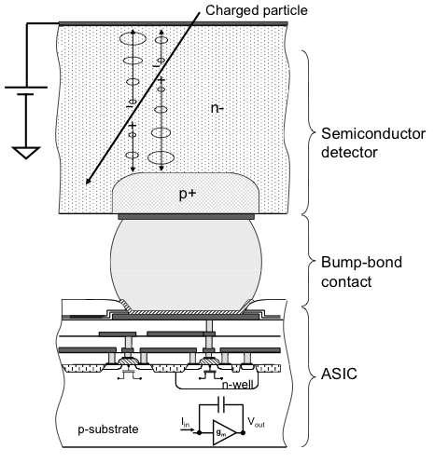
Hello everybody!
Outline
Dosepix - General
To do and what I have done
Dosepix – Read-out Electronics
Dosepix
Hybrid Silicon Pixel Detector
Read-out Electronics
Time-Over-Threshold
Francesca Bisello, ESR 10 Midterm ARDENT Meeting, June 13th 2013, CERN

Slide 9
Hello everybody!
Outline
Dosepix - General
To do and what I have done
Dosepix – Read-out Electronics
Three Operation Mode:
Integration-Mode:
Measure the sum of energies of incoming radiation
Counting-Mode:
Counts the number of events during the irradiation
Dosi-Mode:
Counts the number of photon in each Energy Bin
Francesca Bisello, ESR 10 Midterm ARDENT Meeting, June 13th 2013, CERN

Slide 10
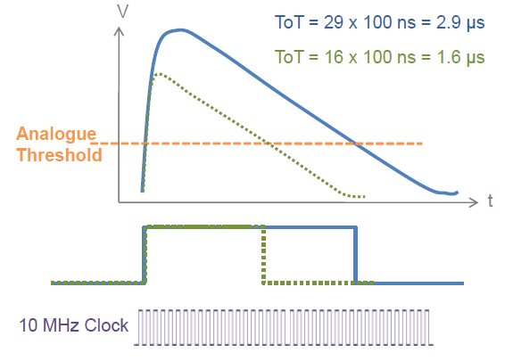
Hello everybody!
Outline
Dosepix - General
To do and what I have done
Dosepix – Time-Over-Threshold
Dosepix
Hybrid Silicon Pixel Detector
Read-out Electronics
Time-Over-Threshold
Francesca Bisello, ESR 10 Midterm ARDENT Meeting, June 13th 2013, CERN

Slide 11
Hello everybody!
Outline
Dosepix - Calibration
To do and what I have done
Dosepix – Calibration
Before the measurements:
Calibration Methods
Francesca Bisello, ESR 10 Midterm ARDENT Meeting, June 13th 2013, CERN

Slide 12
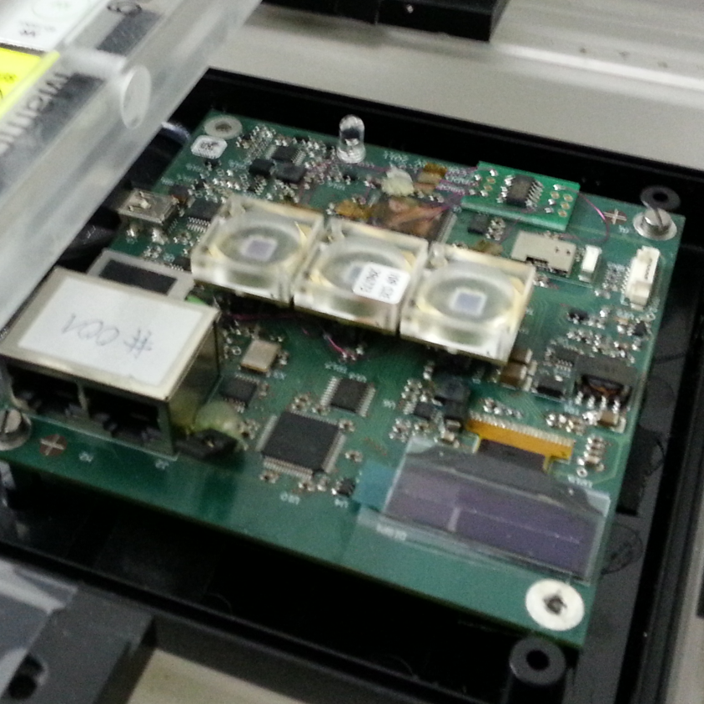
Hello everybody!
Outline
Dosepix - Calibration
To do and what I have done
Dosepix – Calibration
ThS-Equalization
Analogue Test Pulse
Energy Binning
Francesca Bisello, ESR 10 Midterm ARDENT Meeting, June 13th 2013, CERN

Slide 13

Hello everybody!
Outline
Dosepix - Calibration
To do and what I have done
Dosepix – Threshold Equalization
Different threshold pixelwise
Homogeneity of the detector
Detection of the
noise-level
Starting Point
Francesca Bisello, ESR 10 Midterm ARDENT Meeting, June 13th 2013, CERN

Slide 14
Hello everybody!
Outline
Dosepix - Calibration
To do and what I have done
Dosepix – Threshold Equalization
Different threshold pixelwise
Homogeneity of the detector
Detection of the
noise-level
Goal
Francesca Bisello, ESR 10 Midterm ARDENT Meeting, June 13th 2013, CERN

Slide 15
Hello everybody!
Outline
Dosepix - Calibration
To do and what I have done
Dosepix – Threshold Equalization
Different threshold pixelwise
Homogeneity of the detector
Detection of the
noise-level
Method
Francesca Bisello, ESR 10 Midterm ARDENT Meeting, June 13th 2013, CERN

Slide 16
Hello everybody!
Outline
Dosepix - Calibration
To do and what I have done
Dosepix – Analogue TestPulse Calibration
0 | 0 | 0 | 0 | 0 | 0 | 0 | 0 | 0 | 0 | 0 | 0 | 0 | 0 | 0 | 0
0 | 0 | 0 | 0 | 0 | 0 | 0 | 4 | 0 | 0 | 0 | 0 | 0 | 0 | 0 | 0
0 | 0 | 0 | 0 | 0 | 0 | 0 | 0 | 0 | 0 | 0 | 0 | 0 | 0 | 0 | 0
0 | 0 | 0 | 0 | 0 | 0 | 0 | 0 | 0 | 0 | 0 | 0 | 0 | 0 | 0 | 0
0 | 0 | 0 | 0 | 0 | 0 | 0 | 13 | 0 | 0 | 0 | 0 | 1 | 0 | 0 | 0
0 | 0 | 0 | 0 | 0 | 0 | 0 | 10 | 0 | 0 | 0 | 0 | 0 | 0 | 0 | 0
0 | 0 | 0 | 0 | 0 | 0 | 0 | 28 | 0 | 0 | 0 | 0 | 6 | 0 | 0 | 0
0 | 0 | 0 | 0 | 0 | 0 | 0 | 60 | 0 | 0 | 0 | 0 | 18 | 0 | 0 | 0
0 | 0 | 0 | 0 | 0 | 0 | 0 | 46 | 0 | 0 | 0 | 0 | 7 | 0 | 0 | 0
0 | 0 | 0 | 0 | 0 | 0 | 0 | 136 | 0 | 1 | 0 | 0 | 73 | 0 | 0 | 0
0 | 0 | 0 | 0 | 0 | 0 | 0 | 146 | 0 | 0 | 0 | 0 | 78 | 0 | 0 | 0
0 | 0 | 0 | 0 | 0 | 0 | 0 | 231 | 0 | 0 | 0 | 0 | 207 | 0 | 3 | 0
0 | 0 | 0 | 0 | 0 | 0 | 0 | 55 | 0 | 0 | 0 | 0 | 71 | 0 | 4 | 0
0 | 0 | 0 | 0 | 0 | 0 | 0 | 210 | 0 | 7 | 0 | 0 | 6 | 0 | 29 | 0
0 | 0 | 0 | 0 | 0 | 0 | 0 | 116 | 0 | 20 | 0 | 0 | 28 | 0 | 37 | 0
0 | 0 | 0 | 0 | 0 | 0 | 0 | 108 | 0 | 56 | 0 | 0 | 139 | 0 | 61 | 0
0 | 0 | 0 | 0 | 0 | 0 | 0 | 90 | 0 | 53 | 0 | 0 | 131 | 0 | 11 | 0
0 | 0 | 0 | 0 | 0 | 0 | 0 | 119 | 0 | 28 | 0 | 0 | 172 | 0 | 140 | 0
0 | 0 | 0 | 0 | 0 | 0 | 0 | 68 | 0 | 7 | 0 | 0 | 52 | 0 | 3 | 0
0 | 0 | 0 | 0 | 0 | 0 | 0 | 254 | 0 | 140 | 0 | 0 | 120 | 3 | 199 | 0
0 | 0 | 0 | 0 | 0 | 0 | 0 | 170 | 0 | 101 | 0 | 0 | 131 | 7 | 9 | 0
0 | 2 | 0 | 0 | 0 | 0 | 0 | 111 | 0 | 75 | 0 | 0 | 237 | 11 | 79 | 0
0 | 6 | 0 | 0 | 0 | 0 | 0 | 53 | 0 | 75 | 0 | 0 | 148 | 42 | 50 | 0
0 | 24 | 0 | 0 | 0 | 0 | 0 | 194 | 0 | 99 | 0 | 0 | 30 | 122 | 21 | 0
0 | 37 | 0 | 0 | 0 | 0 | 0 | 237 | 0 | 201 | 0 | 0 | 62 | 98 | 176 | 0
0 | 57 | 0 | 0 | 0 | 0 | 0 | 145 | 0 | 44 | 0 | 0 | 30 | 233 | 59 | 0
0 | 84 | 0 | 0 | 0 | 0 | 0 | 99 | 0 | 85 | 0 | 0 | 13 | 43 | 78 | 0
0 | 163 | 0 | 0 | 0 | 0 | 0 | 82 | 0 | 108 | 0 | 0 | 9 | 42 | 25 | 0
0 | 117 | 0 | 0 | 0 | 0 | 0 | 37 | 0 | 0 | 0 | 0 | 2 | 199 | 139 | 0
0 | 206 | 0 | 0 | 0 | 1 | 0 | 17 | 0 | 69 | 0 | 0 | 0 | 158 | 46 | 0
0 | 50 | 0 | 0 | 0 | 3 | 0 | 19 | 0 | 218 | 0 | 0 | 1 | 219 | 44 | 0
0 | 44 | 0 | 0 | 0 | 10 | 0 | 10 | 0 | 177 | 0 | 0 | 0 | 83 | 15 | 0
0 | 79 | 0 | 0 | 0 | 70 | 1 | 1 | 0 | 104 | 0 | 0 | 0 | 255 | 5 | 0
0 | 169 | 0 | 0 | 0 | 121 | 5 | 4 | 0 | 42 | 0 | 0 | 0 | 135 | 1 | 0
0 | 233 | 0 | 0 | 0 | 157 | 2 | 0 | 0 | 52 | 0 | 0 | 0 | 154 | 1 | 0
0 | 12 | 0 | 0 | 0 | 208 | 2 | 0 | 0 | 7 | 0 | 0 | 0 | 176 | 0 | 0
0 | 126 | 0 | 0 | 0 | 210 | 8 | 0 | 0 | 5 | 0 | 0 | 0 | 167 | 0 | 0
0 | 9 | 0 | 0 | 0 | 47 | 41 | 0 | 0 | 6 | 0 | 0 | 0 | 112 | 0 | 0
0 | 146 | 0 | 0 | 2 | 212 | 60 | 0 | 0 | 0 | 0 | 0 | 0 | 104 | 0 | 0
0 | 90 | 0 | 0 | 8 | 247 | 164 | 0 | 0 | 0 | 0 | 0 | 0 | 15 | 0 | 0
0 | 60 | 0 | 0 | 11 | 236 | 11 | 0 | 0 | 0 | 0 | 0 | 0 | 13 | 0 | 0
0 | 16 | 0 | 0 | 38 | 87 | 174 | 0 | 0 | 0 | 0 | 0 | 0 | 0 | 0 | 0
0 | 10 | 0 | 0 | 93 | 10 | 159 | 0 | 0 | 0 | 0 | 0 | 0 | 2 | 0 | 0
0 | 13 | 0 | 0 | 72 | 144 | 85 | 0 | 0 | 0 | 0 | 0 | 0 | 0 | 0 | 4
0 | 4 | 0 | 0 | 68 | 67 | 195 | 0 | 0 | 0 | 0 | 0 | 0 | 0 | 0 | 0
0 | 3 | 0 | 0 | 164 | 225 | 51 | 0 | 0 | 0 | 0 | 0 | 0 | 0 | 0 | 9
0 | 0 | 0 | 0 | 195 | 166 | 220 | 0 | 0 | 0 | 0 | 0 | 0 | 0 | 0 | 14
0 | 0 | 0 | 7 | 146 | 53 | 77 | 0 | 0 | 0 | 0 | 0 | 0 | 0 | 0 | 22
0 | 0 | 0 | 5 | 7 | 194 | 197 | 0 | 0 | 0 | 0 | 0 | 0 | 0 | 0 | 11
0 | 0 | 0 | 15 | 46 | 55 | 56 | 0 | 0 | 0 | 0 | 0 | 0 | 0 | 0 | 36
0 | 0 | 0 | 13 | 85 | 201 | 184 | 0 | 0 | 0 | 0 | 0 | 0 | 0 | 0 | 40
0 | 0 | 0 | 43 | 79 | 11 | 215 | 0 | 0 | 0 | 0 | 0 | 0 | 0 | 0 | 54
0 | 0 | 0 | 101 | 106 | 8 | 83 | 0 | 0 | 0 | 0 | 0 | 0 | 0 | 0 | 81
0 | 0 | 0 | 201 | 38 | 0 | 49 | 0 | 0 | 0 | 0 | 0 | 0 | 0 | 0 | 77
0 | 0 | 0 | 248 | 192 | 0 | 37 | 0 | 0 | 0 | 0 | 0 | 0 | 0 | 0 | 244
0 | 0 | 0 | 173 | 141 | 0 | 7 | 0 | 0 | 0 | 0 | 0 | 0 | 0 | 0 | 203
0 | 0 | 0 | 236 | 74 | 0 | 3 | 0 | 0 | 0 | 0 | 0 | 0 | 0 | 0 | 207
3 | 0 | 0 | 142 | 81 | 0 | 0 | 0 | 0 | 0 | 0 | 0 | 0 | 0 | 0 | 81
0 | 0 | 0 | 27 | 143 | 0 | 1 | 0 | 0 | 0 | 0 | 0 | 0 | 0 | 0 | 109
21 | 0 | 0 | 31 | 20 | 0 | 0 | 0 | 0 | 0 | 0 | 0 | 0 | 0 | 0 | 129
41 | 0 | 0 | 239 | 5 | 0 | 0 | 0 | 0 | 0 | 0 | 0 | 0 | 0 | 0 | 249
140 | 0 | 0 | 171 | 2 | 0 | 0 | 0 | 0 | 0 | 0 | 0 | 0 | 0 | 0 | 223
250 | 0 | 0 | 195 | 1 | 0 | 0 | 0 | 0 | 0 | 0 | 0 | 0 | 0 | 0 | 21
255 | 0 | 0 | 144 | 0 | 0 | 0 | 0 | 0 | 0 | 0 | 0 | 0 | 0 | 0 | 25
185 | 0 | 0 | 42 | 0 | 0 | 0 | 0 | 0 | 0 | 0 | 0 | 0 | 0 | 0 | 26
171 | 0 | 0 | 132 | 0 | 0 | 0 | 0 | 0 | 0 | 0 | 0 | 0 | 0 | 0 | 208
35 | 0 | 0 | 48 | 0 | 0 | 0 | 0 | 0 | 0 | 0 | 0 | 0 | 0 | 0 | 149
20 | 0 | 0 | 57 | 0 | 0 | 0 | 0 | 0 | 0 | 2 | 0 | 0 | 0 | 0 | 31
62 | 0 | 0 | 12 | 0 | 0 | 0 | 0 | 0 | 0 | 4 | 0 | 0 | 0 | 0 | 85
177 | 0 | 0 | 7 | 0 | 0 | 0 | 0 | 0 | 0 | 8 | 0 | 0 | 0 | 0 | 41
220 | 0 | 0 | 18 | 0 | 0 | 0 | 0 | 0 | 0 | 6 | 0 | 0 | 0 | 0 | 178
114 | 0 | 0 | 4 | 0 | 0 | 0 | 0 | 0 | 0 | 79 | 0 | 0 | 0 | 0 | 85
72 | 0 | 0 | 0 | 0 | 0 | 0 | 0 | 0 | 0 | 190 | 0 | 0 | 0 | 0 | 21
232 | 0 | 0 | 0 | 0 | 0 | 0 | 0 | 1 | 0 | 182 | 0 | 0 | 0 | 0 | 141
145 | 0 | 0 | 0 | 0 | 0 | 0 | 0 | 0 | 0 | 57 | 0 | 0 | 0 | 0 | 99
69 | 0 | 0 | 0 | 0 | 0 | 0 | 0 | 6 | 0 | 53 | 0 | 0 | 0 | 0 | 68
0 | 0 | 0 | 0 | 0 | 0 | 0 | 0 | 0 | 0 | 0 | 0 | 0 | 0 | 0 | 0
0 | 0 | 0 | 0 | 0 | 0 | 0 | 0 | 0 | 0 | 0 | 0 | 0 | 0 | 0 | 0
0 | 0 | 0 | 0 | 0 | 0 | 0 | 0 | 0 | 0 | 0 | 0 | 0 | 0 | 0 | 0
0 | 0 | 0 | 0 | 0 | 0 | 0 | 0 | 0 | 0 | 0 | 0 | 0 | 0 | 0 | 0
0 | 0 | 0 | 0 | 0 | 0 | 0 | 0 | 0 | 0 | 0 | 0 | 0 | 0 | 0 | 0
0 | 0 | 0 | 0 | 0 | 0 | 0 | 0 | 0 | 0 | 0 | 0 | 0 | 0 | 0 | 0
0 | 0 | 0 | 0 | 0 | 0 | 0 | 0 | 0 | 0 | 0 | 0 | 0 | 0 | 0 | 0
0 | 0 | 0 | 0 | 0 | 0 | 0 | 0 | 0 | 0 | 0 | 0 | 0 | 0 | 0 | 0
0 | 0 | 0 | 0 | 0 | 0 | 0 | 0 | 0 | 0 | 0 | 0 | 0 | 0 | 0 | 0
0 | 0 | 0 | 0 | 0 | 0 | 0 | 0 | 0 | 0 | 0 | 0 | 0 | 0 | 0 | 0
0 | 0 | 0 | 0 | 0 | 0 | 0 | 0 | 0 | 0 | 0 | 0 | 0 | 0 | 0 | 0
0 | 0 | 0 | 0 | 0 | 0 | 0 | 0 | 0 | 0 | 0 | 0 | 0 | 0 | 0 | 0
0 | 0 | 0 | 0 | 0 | 0 | 0 | 0 | 0 | 0 | 0 | 0 | 0 | 0 | 0 | 0
0 | 0 | 0 | 0 | 0 | 0 | 0 | 0 | 0 | 0 | 0 | 0 | 0 | 0 | 0 | 0
0 | 0 | 0 | 0 | 0 | 0 | 0 | 0 | 0 | 0 | 0 | 0 | 0 | 0 | 0 | 0
0 | 0 | 0 | 0 | 0 | 0 | 0 | 0 | 0 | 0 | 0 | 0 | 0 | 0 | 0 | 0
0 | 0 | 0 | 0 | 0 | 0 | 0 | 0 | 0 | 0 | 0 | 0 | 0 | 0 | 0 | 0
0 | 0 | 0 | 0 | 0 | 0 | 0 | 0 | 1 | 0 | 0 | 0 | 0 | 0 | 0 | 0
0 | 0 | 0 | 0 | 0 | 0 | 0 | 0 | 0 | 0 | 0 | 0 | 0 | 0 | 0 | 1
0 | 0 | 0 | 0 | 0 | 0 | 0 | 0 | 6 | 0 | 0 | 0 | 0 | 0 | 0 | 1
0 | 0 | 0 | 0 | 0 | 0 | 0 | 0 | 12 | 0 | 0 | 0 | 0 | 0 | 0 | 0
0 | 0 | 0 | 0 | 0 | 0 | 0 | 0 | 20 | 0 | 1 | 0 | 0 | 0 | 0 | 0
2 | 0 | 0 | 0 | 0 | 0 | 0 | 0 | 71 | 0 | 7 | 0 | 0 | 0 | 0 | 3
4 | 0 | 0 | 0 | 0 | 0 | 0 | 0 | 110 | 0 | 5 | 0 | 0 | 0 | 0 | 3
4 | 1 | 0 | 0 | 0 | 0 | 0 | 0 | 133 | 0 | 18 | 0 | 0 | 0 | 0 | 3
21 | 1 | 0 | 0 | 1 | 1 | 0 | 0 | 249 | 0 | 32 | 0 | 0 | 0 | 0 | 11
46 | 6 | 0 | 0 | 1 | 0 | 0 | 0 | 72 | 0 | 91 | 0 | 0 | 2 | 0 | 10
179 | 25 | 0 | 3 | 9 | 2 | 2 | 0 | 255 | 0 | 55 | 0 | 1 | 25 | 3 | 6
201 | 26 | 0 | 5 | 10 | 0 | 6 | 0 | 199 | 0 | 3 | 0 | 4 | 17 | 10 | 4
36 | 26 | 0 | 7 | 9 | 4 | 5 | 0 | 211 | 0 | 114 | 0 | 0 | 20 | 6 | 17
97 | 83 | 0 | 14 | 52 | 15 | 31 | 0 | 45 | 7 | 205 | 0 | 7 | 109 | 75 | 30
130 | 223 | 0 | 166 | 44 | 171 | 150 | 1 | 28 | 22 | 23 | 0 | 62 | 243 | 249 | 131
85 | 217 | 0 | 179 | 55 | 176 | 147 | 1 | 235 | 37 | 68 | 0 | 73 | 217 | 114 | 45
110 | 88 | 0 | 121 | 17 | 96 | 162 | 238 | 64 | 119 | 36 | 0 | 190 | 212 | 191 | 6
92 | 46 | 0 | 234 | 248 | 26 | 72 | 115 | 230 | 138 | 253 | 0 | 216 | 76 | 78 | 178
175 | 173 | 0 | 139 | 250 | 157 | 114 | 128 | 32 | 171 | 187 | 0 | 2 | 128 | 41 | 87
147 | 54 | 0 | 54 | 65 | 53 | 49 | 228 | 216 | 80 | 143 | 0 | 195 | 58 | 65 | 126
196 | 188 | 0 | 235 | 223 | 243 | 230 | 18 | 101 | 2 | 253 | 0 | 155 | 144 | 222 | 94
3 | 33 | 0 | 81 | 66 | 80 | 69 | 10 | 114 | 39 | 79 | 0 | 250 | 252 | 75 | 35
228 | 46 | 0 | 116 | 107 | 165 | 147 | 217 | 199 | 122 | 135 | 0 | 106 | 140 | 34 | 129
89 | 189 | 0 | 135 | 99 | 183 | 165 | 174 | 141 | 155 | 132 | 0 | 91 | 119 | 83 | 118
126 | 103 | 0 | 50 | 11 | 232 | 89 | 199 | 109 | 62 | 181 | 0 | 150 | 155 | 117 | 156
63 | 150 | 0 | 146 | 28 | 55 | 152 | 33 | 114 | 111 | 199 | 0 | 46 | 194 | 3 | 14
87 | 214 | 0 | 28 | 191 | 81 | 254 | 146 | 117 | 198 | 95 | 0 | 128 | 114 | 224 | 146
4 | 28 | 0 | 199 | 93 | 250 | 169 | 50 | 0 | 40 | 1 | 0 | 4 | 29 | 68 | 99
2 | 96 | 0 | 104 | 149 | 208 | 82 | 185 | 1 | 77 | 3 | 0 | 232 | 71 | 110 | 19
0 | 11 | 0 | 80 | 20 | 80 | 74 | 5 | 0 | 52 | 0 | 0 | 115 | 15 | 20 | 143
0 | 3 | 0 | 25 | 9 | 30 | 17 | 116 | 0 | 147 | 0 | 0 | 64 | 0 | 10 | 150
0 | 1 | 0 | 29 | 11 | 41 | 28 | 99 | 0 | 115 | 0 | 0 | 26 | 1 | 6 | 119
0 | 0 | 0 | 5 | 0 | 17 | 10 | 120 | 0 | 114 | 0 | 0 | 23 | 0 | 1 | 93
0 | 0 | 0 | 1 | 0 | 0 | 1 | 197 | 0 | 28 | 0 | 0 | 5 | 0 | 0 | 251
0 | 0 | 0 | 0 | 0 | 1 | 0 | 127 | 0 | 3 | 0 | 0 | 1 | 0 | 0 | 176
0 | 0 | 0 | 4 | 0 | 7 | 1 | 22 | 0 | 23 | 0 | 0 | 3 | 0 | 0 | 5
0 | 0 | 0 | 0 | 0 | 1 | 0 | 248 | 0 | 6 | 0 | 0 | 2 | 0 | 0 | 19
0 | 0 | 0 | 0 | 0 | 0 | 0 | 128 | 0 | 0 | 0 | 0 | 0 | 0 | 0 | 84
0 | 0 | 0 | 0 | 0 | 0 | 0 | 51 | 0 | 0 | 0 | 0 | 0 | 0 | 0 | 77
0 | 0 | 0 | 0 | 0 | 0 | 0 | 27 | 0 | 0 | 0 | 0 | 0 | 0 | 0 | 46
0 | 0 | 0 | 0 | 0 | 0 | 0 | 19 | 0 | 0 | 0 | 0 | 0 | 0 | 0 | 16
0 | 0 | 0 | 0 | 0 | 0 | 0 | 25 | 0 | 0 | 0 | 0 | 0 | 0 | 0 | 55
0 | 0 | 0 | 0 | 0 | 0 | 0 | 9 | 0 | 0 | 0 | 0 | 0 | 0 | 0 | 46
0 | 0 | 0 | 0 | 0 | 0 | 0 | 8 | 0 | 0 | 0 | 0 | 0 | 0 | 0 | 24
0 | 0 | 0 | 0 | 0 | 0 | 0 | 2 | 0 | 0 | 0 | 0 | 0 | 0 | 0 | 1
0 | 0 | 0 | 0 | 0 | 0 | 0 | 1 | 0 | 0 | 0 | 0 | 0 | 0 | 0 | 0
0 | 0 | 0 | 0 | 0 | 0 | 0 | 0 | 0 | 0 | 0 | 0 | 0 | 0 | 0 | 5
0 | 0 | 0 | 0 | 0 | 0 | 0 | 0 | 0 | 0 | 0 | 0 | 0 | 0 | 0 | 0
0 | 0 | 0 | 0 | 0 | 0 | 0 | 0 | 0 | 0 | 0 | 0 | 0 | 0 | 0 | 0
0 | 0 | 0 | 0 | 0 | 0 | 0 | 0 | 0 | 0 | 0 | 0 | 0 | 0 | 0 | 0
0 | 0 | 0 | 0 | 0 | 0 | 0 | 0 | 0 | 0 | 0 | 0 | 0 | 0 | 0 | 0
0 | 0 | 0 | 0 | 0 | 0 | 0 | 0 | 0 | 0 | 0 | 0 | 0 | 0 | 0 | 0
0 | 0 | 0 | 0 | 0 | 0 | 0 | 0 | 0 | 0 | 0 | 0 | 0 | 0 | 0 | 1
0 | 0 | 0 | 0 | 0 | 0 | 0 | 0 | 0 | 0 | 0 | 0 | 0 | 0 | 0 | 0
0 | 0 | 0 | 0 | 0 | 0 | 0 | 0 | 0 | 0 | 0 | 0 | 0 | 0 | 0 | 0
0 | 0 | 0 | 0 | 0 | 0 | 0 | 0 | 0 | 0 | 0 | 0 | 0 | 0 | 0 | 0
0 | 0 | 0 | 0 | 0 | 0 | 0 | 0 | 0 | 0 | 0 | 0 | 0 | 0 | 0 | 0
0 | 0 | 0 | 0 | 0 | 0 | 0 | 0 | 0 | 0 | 0 | 0 | 0 | 0 | 0 | 0
0 | 0 | 0 | 0 | 0 | 0 | 0 | 0 | 0 | 0 | 0 | 0 | 0 | 0 | 0 | 0
0 | 0 | 0 | 0 | 0 | 0 | 0 | 0 | 0 | 0 | 0 | 0 | 0 | 0 | 0 | 0
The pixels are „equalized“:
they detect the noise at the same level of threshold
Level of the
Analogue Threshold
Pixels
Francesca Bisello, ESR 10 Midterm ARDENT Meeting, June 13th 2013, CERN

Slide 17
Hello everybody!
Outline
Dosepix - Calibration
To do and what I have done
Dosepix – Analogue TestPulse Calibration
Analogue Test Pulse
Calibration Curve:
Analogue Test Pulse - ToT
Francesca Bisello, ESR 10 Midterm ARDENT Meeting, June 13th 2013, CERN

Slide 18
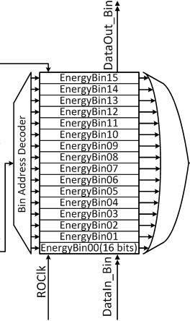
Hello everybody!
Outline
Dosepix - Calibration
To do and what I have done
Dosepix – Energy Binning
Energy Binning
Francesca Bisello, ESR 10 Midterm ARDENT Meeting, June 13th 2013, CERN

Slide 19
Hello everybody!
Outline
Dosepix - Calibration
To do and what I have done
Dosepix – Energy Calibration
Energy Calibration
Energy Calibration:
Flouresce line of different material
Different for each pixel
Francesca Bisello, ESR 10 Midterm ARDENT Meeting, June 13th 2013, CERN

Slide 20
Hello everybody!
Outline
Dosepix - Measurements
To do and what I have done
Dosepix - Measurements
and then…measurements
Francesca Bisello, ESR 10 Midterm ARDENT Meeting, June 13th 2013, CERN

Slide 21
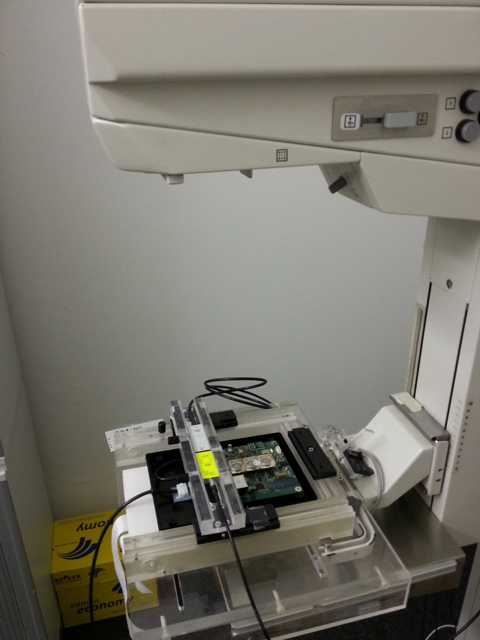
Hello everybody!
Outline
Dosepix - Measurements
To do and what I have done
Dosepix – Measurements
I – Mammo Device
IBA Dosimetry, Schwarzenbruck
Energy | 22-35 KeV
Anode | Mo
Filters | Mo Rh
Dosepix | Different experimental Setup
Francesca Bisello, ESR 10 Midterm ARDENT Meeting, June 13th 2013, CERN

Slide 22
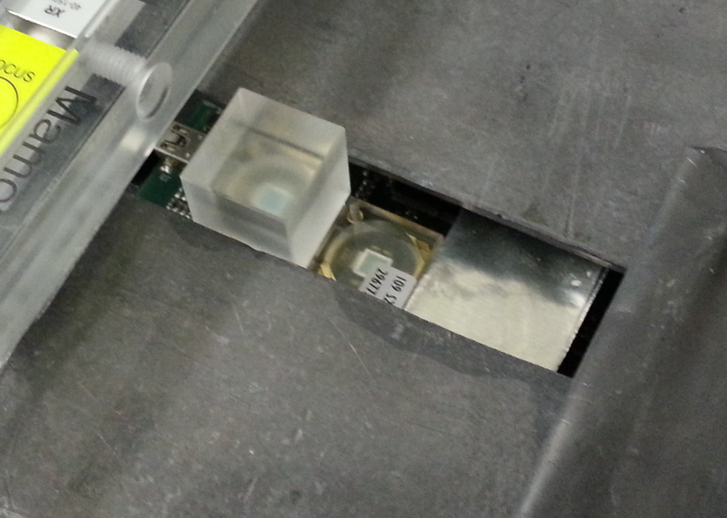
Hello everybody!
Outline
Dosepix - Measurements
To do and what I have done
Dosepix – Measurements
II – Xray Tube ECAP
Erlangen University
Energy Current | 40-120 KeV 1-40 mA
Anode | W
Filters | 3,8 mm Al
Dosepix | Slot 1: 15mm PMMA Slot 2 : Free Slot 3: 200µm Sn
Francesca Bisello, ESR 10 Midterm ARDENT Meeting, June 13th 2013, CERN

Slide 23
Hello everybody!
Outline
Dosepix - Measurements
To do and what I have done
Dosepix – Measurements
Informations about Tube Energy
Francesca Bisello, ESR 10 Midterm ARDENT Meeting, June 13th 2013, CERN

Slide 24
Hello everybody!
Outline
Dosepix - Measurements
To do and what I have done
Dosepix – Measurements
Define the region of use of the device : Pileup Problem
Current
Francesca Bisello, ESR 10 Midterm ARDENT Meeting, June 13th 2013, CERN

Slide 25
Hello everybody!
Outline
Dosepix - Measurements
To do and what I have done
Dosepix – Measurements
Informations about Pile-up
Current
Francesca Bisello, ESR 10 Midterm ARDENT Meeting, June 13th 2013, CERN

Slide 26
Hello everybody!
Outline
Dosepix
To do and what I have done
End…
To do and what I have done:
I – Fluorescence Calibration
II – Pileup Understanding : Analysis of spectra with different filters
MonteCarlo Simulation Monte-Carlo with
EGSnrc (M.Birkner) 13 May 2013
III – Radiation Hardness Test V National School INFN Padova,
15-19 April 2013
IV – Firmware Improvement : Modify the speed of read-out
New Setup
V – Participation to 2013 IEEE Nuclear Science Symposium and Medical Imaging Conference, Seoul October 27- November 2
@ IBA Dosimetry: Training on Absolute and Relative Dosimetry (A. Giuliacci)
Francesca Bisello, ESR 10 Midterm ARDENT Meeting, June 13th 2013, CERN

Slide 27
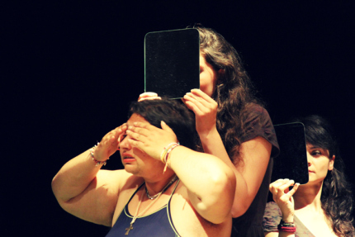
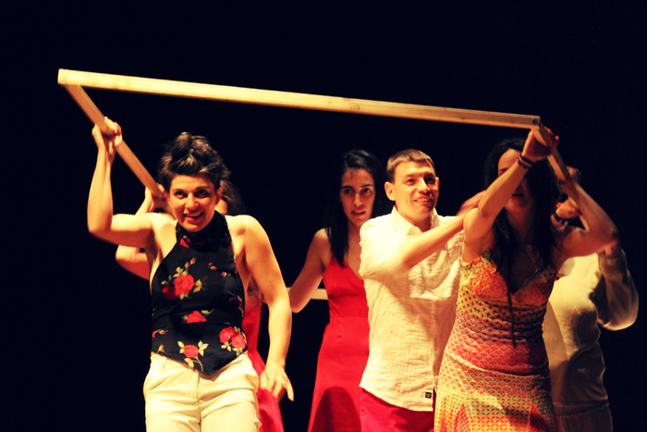
…Thanks!
Francesca Bisello, ESR 10 Midterm ARDENT Meeting, June 13th 2013, CERN

