Slide 1

Activities within the ARDENT-project: November 2012 – June 2013
Benedikt Bergmann
Institute of Experimental and Applied Physics, Czech Technical University in Prague, Czech Republic
CERN - 06/13/13

Slide 2
Experimental Activities
Measurement at CMI (Czech Metrological Institute) with TPX device in different neutron fields (AmBe, Cf-252)
LANSCE (Los Alamos Neutron Science Center) neutron spallation source
  Using Time-of-Arrival Mode of TPX to apply Time-of-Flight technique
  See following slides
  Results will be presented at IWoRiD
Calibration of TPX device at Van-de-Graaff accelerator in Prague (14MeV neutrons)
Exposure of TPX to different radiation fields with well defined dose rates at SURO (National Radiation Protection Institute) in Prag
Measurement in proton fields with different energies at DKFZ (German Center for Cancer Research) in Heidelberg
  TPX was perpendicular irradiated with monoenergetic protons (energies 48MeV, 150MeV and 221MeV)

Slide 3
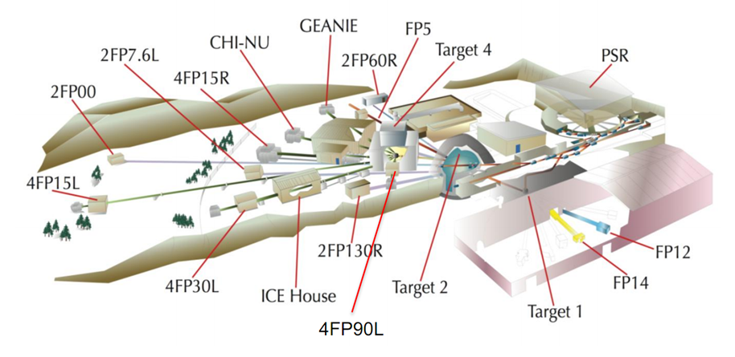
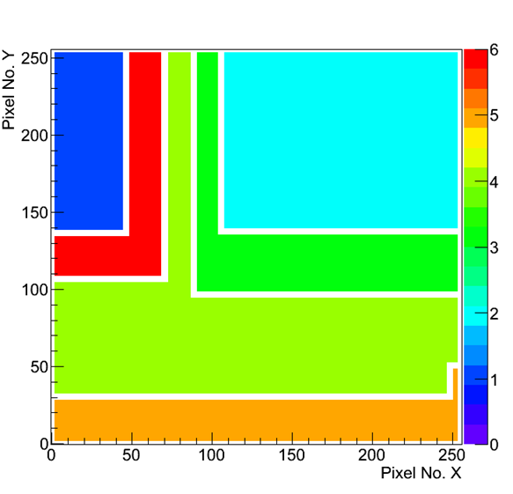
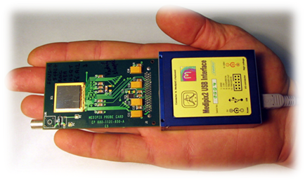
LANSCE – Los Alamos Neutron Science Center
Neutron beam from spallation source:
  Pulsed beam with repetition rate 1.8µs (micropulses)
  Kinetic neutron energies up to 800MeV
  Reference neutron fluence was provided by a fission chamber
TPX-detector with conversion layers for enhanced neutron detection
  Time-of-Arrival mode permitted application of the Time-of-Flight technique
LiF
PE
LiF+Al
PE+Al
Al
uncovered

Slide 4
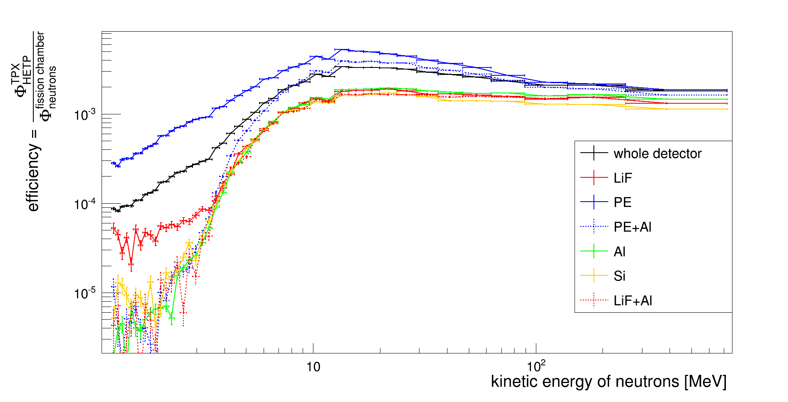
LANSCE – Neutron Detection Efficiency over Energy for Different Regions
Pattern recognition tool identified clusters and put them into different categories:
  Neutrons are detected as “High Energy Transfer Particles“, i.e. “Heavy Blobs“ (big clusters with rounded shapes) or “Heavy Tracks“ (big clusters with elliptical shapes) due to recoiled protons below PE and/or reactions in the Silicon itself

Slide 5
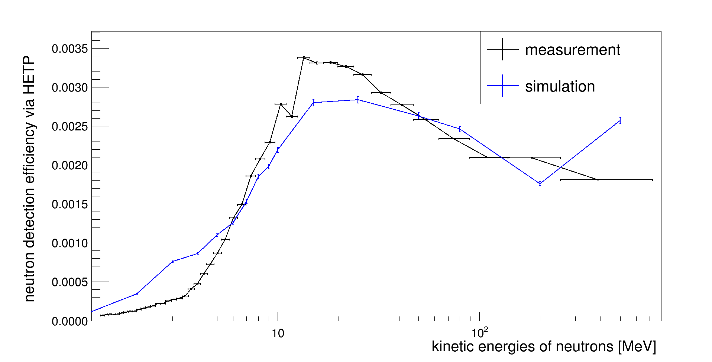
Neutron Detection Efficiency - Comparison with simulation
Measured neutron detection efficiency important input/verification for the simulation over a wide energy range
Maxmium deviation ~30%

Slide 6
Conferences, workshops and presentations
1st Annual ARDENT workshop in Vienna:
  “Inroductory presentation“
MPX meeting CERN:
  “The ARDENT project and MPX detectors“
ECAP Seminar in Erlangen:
  “The ARDENT Project and Neutron Detection with TPX Detctors“
Tagung der Deutschen Physikalischen Gesellschaft (= Annual Conference of the German Physical Society) in Dresden:
  “Studies on Activation in the ATLAS cavern with MPX Detectors“ (see next slide)
Joint International Workshop on Off-Site Gamma Dose Rate and Ground Contamination Measurements
Reports and presentations in the restricted weekly meeting of ATLAS MPX detector group: access to the presentations can be given by request!

Slide 7
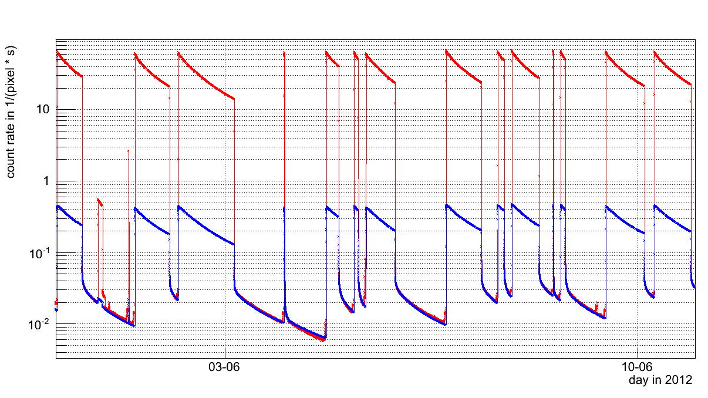
Studies on Activation in the ATLAS cavern with MPX Detectors – Measured Count Rates and Modelled Activation
Contribution of the count rate due to activation
  During collisions ~1%
  After collision: 100%
Measured count rates
Estimated activation count rate

Slide 8
Other Training and Activities
Czech language training
  4.5 hours once a week!
Training and test on management and radiation safety at Los Alamos Neutron Science Center
Working on a publication together with Dr. Thilo Michel (University Erlangen)
  “Measurement of the double K-Shell vacancy creation probability in the electron capture decay of Fe-55 with a photon counting pixel detector“
  Expected to be finished soon!
See also:
https://ardent.web.cern.ch/ardent/ardent.php?link=esr09
https://ardent.web.cern.ch/ardent/ardent.php?link=esr09-logbook
And presentations:
https://ardent.web.cern.ch/ardent/ardent.php?link=dissemination

Slide 9
Future Activities
Experimental:
  Perform measurements in different proton fields (following up the measurements, I already did at DKFZ in Heidelberg) – Pavia, CNAO?
  Submitted proposal for a second beam time in Los Alamos (LANSCE): Investigate a wider energy range (especially to lower energies)
Conferences and workshops:
  Poster contribution at IWoRiD: “Time-of-Flight Measurement of Fast Neutrons by Means of Timepix Detectors“
  2nd ARDENT workshop in Milano
Other Training:
  Czech language courses – ongoing

Slide 10
Thank you for your attention!

