Slide 1



Michele Togno
ARDENT ESR 11 – 2D Ionization Chambers Array for Clinical Applications

Slide 2

Outline
Few words about me and my career
Introduction to ARDENT ESR 11 project
Work carried out on February/May
Planned activities for future
Overview on trainings and conferences

Slide 3

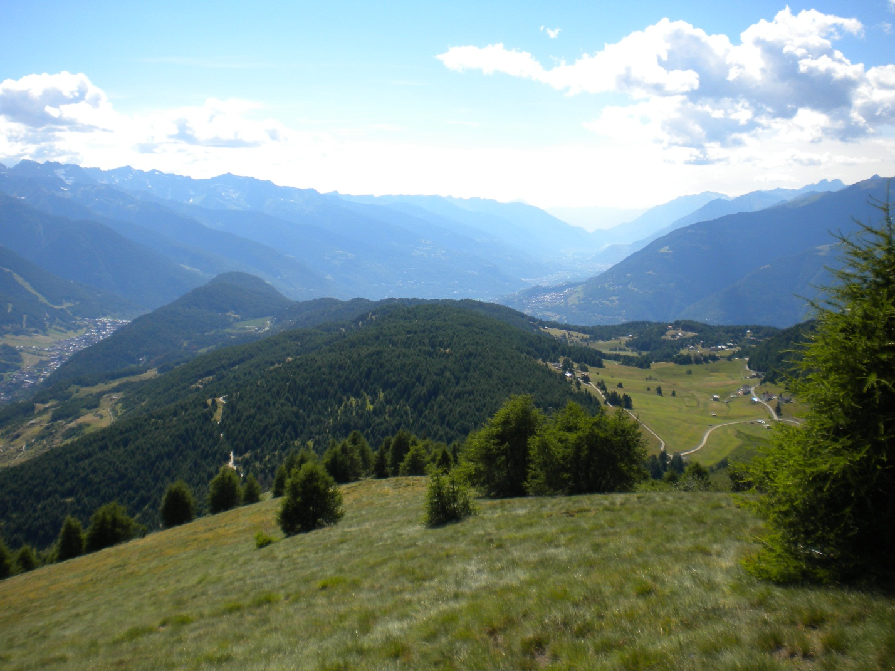

Personal data
I’m 26 and I’m from Italy, precisely from Valtellina. I enjoy hiking and skiing on these mountains!

Slide 4
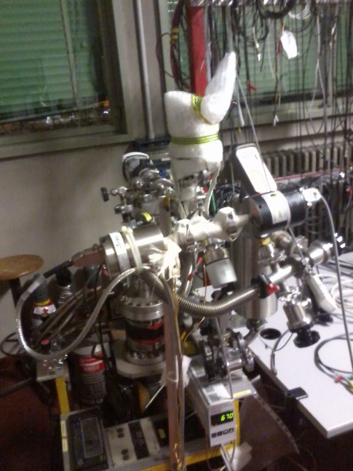
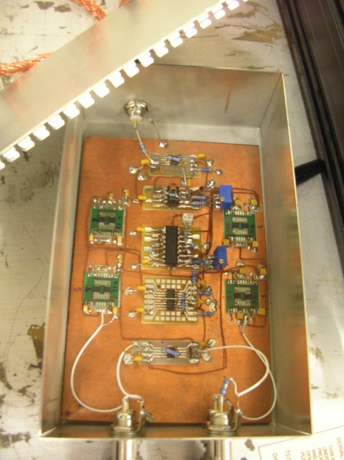
Education and Previous work
Bachelor Degree in Physical Engineering (Politecnico di Milano): “Superconductivity and Isotopic Effect”
Master Degree in Nuclear Engineering (Politecnico di Milano): “Study of a Logarithmic Compression Amplifier for Microdosimetry”
Ten months spent at the National Institute of Nuclear Physics in Legnaro (Padova) where I carried out part of my thesis work and I became familiar with gas detectors (especially with TEPC for microdosimetry)

Slide 5
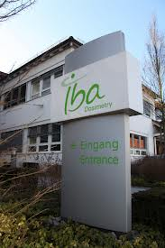
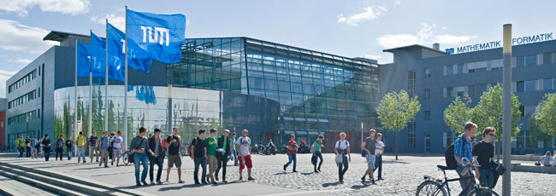
ARDENT ESR11 - Project
Hosting organizations
Iba-Dosimetry: The company is located in Schwarzenbruck (Germany) and is a leading manufacturer of quality assurance equipment for radiation therapy and X-ray diagnostics
Acquisition of general dosimetry background
Main experimental activities are carried out here
Hosting institute for PhD: medical physics unit, department of radiotherapy

Slide 6
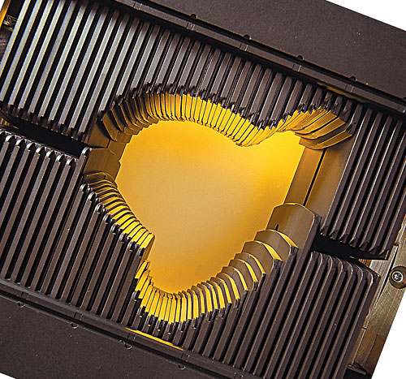
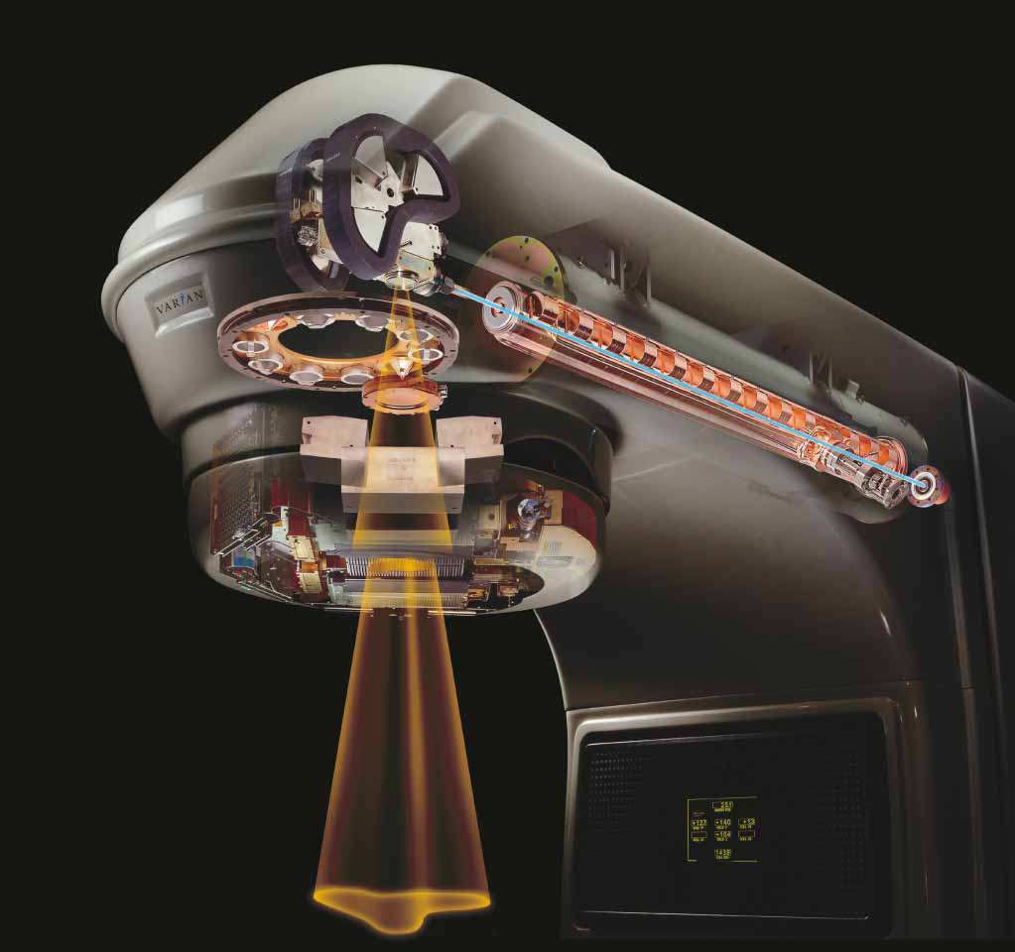
ARDENT ESR11 - Project
2D Ionizations Chambers Array for Clinical Application
Verification of measured vs planned IMRT treatment cycles
Analysis of critical Linac QA parameters: penumbra, symmetry, flatness and field size

Slide 7

ARDENT ESR11 - Project
2D Ionizations Chambers Array for Clinical Application
Concept: development and characterization of a new generation of ionization chambers arrays aimed to radiotherapy applications, particularly for the measurement of absorbed dose from photon, electron and proton radiation.
Start of the activity: experimental characterization of pre-existing 1D array prototype
Fast and accurate field profiling, suitable to be used within a water phantom
Test new technical solution in view of a future development of 2D array
Design and geometry represent a strategic know-how for the company, in future this technology will be protected by a patent

Slide 8
ARDENT ESR11 - Project
2D Ionizations Chambers Array for Clinical Application
Goals | Benefits
Test new solutions for IC arrays, upgrade of present company array detectors | better future products
Reduce pitch and pixel size | better spatial resolution
Reduce chamber thickness | improved efficiency at high dose rate
Study of materials and geometry | improved stability
Simple assembling, robust design | improved yield, cost, service

Slide 9
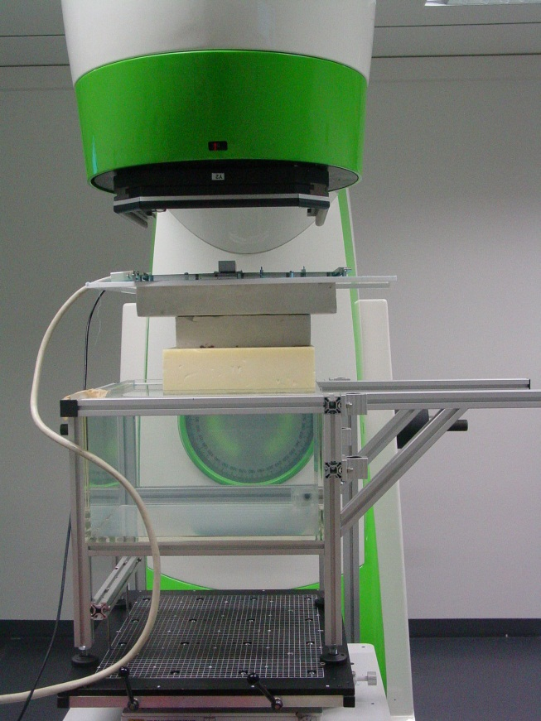
2D Ion Chambers Array for Clinical App.
Experimental work at IBA
First prototypes: several small arrays on a multi-layer PCB
Different shapes and geometries
Possibility to readout only one pixel or the whole array
Due to small chamber volume, at a dose rate of 1Gy/min the ionization current is in the order of few pA
Actually, the signal outcoming from chambers can be read by a commercial KEITHLEY electrometer or by a multi-channel electrometer developed at IBA but not dedicated to this application

Slide 10
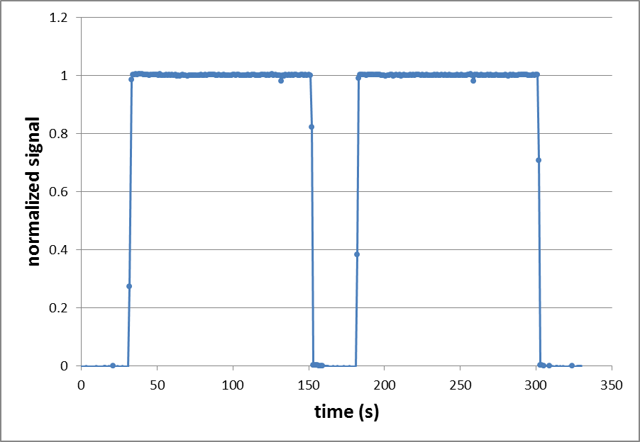
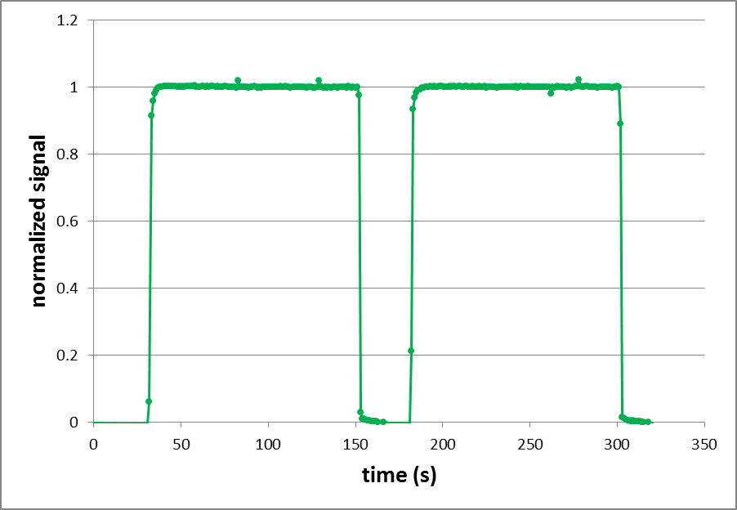
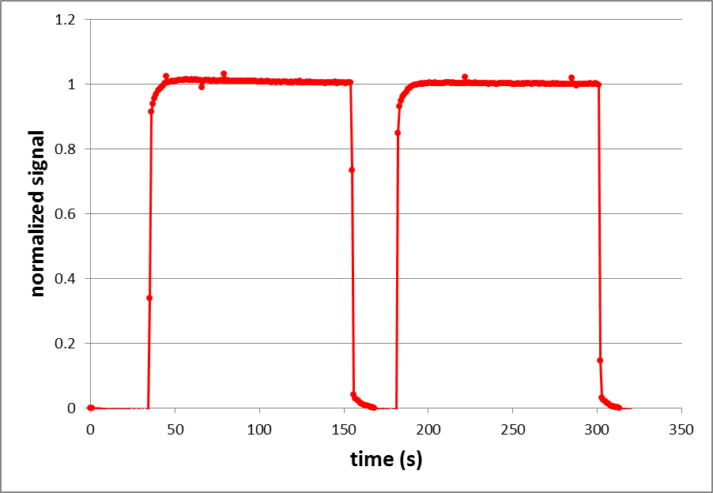
2D Ion Chambers Array for Clinical App.
Experimental work at IBA
Preliminary results: sensitivity is not stable with the time. This is probably due to the presence of spurious components
10V bias
50V bias
Series of pulses, time profile
200V bias

Slide 11
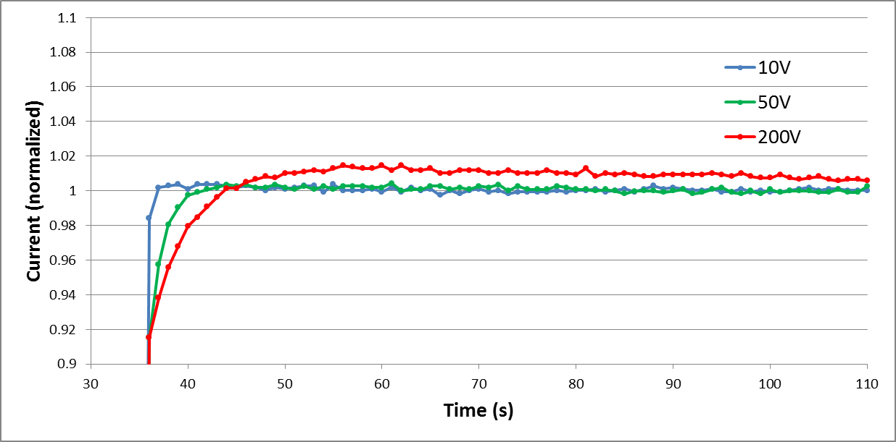
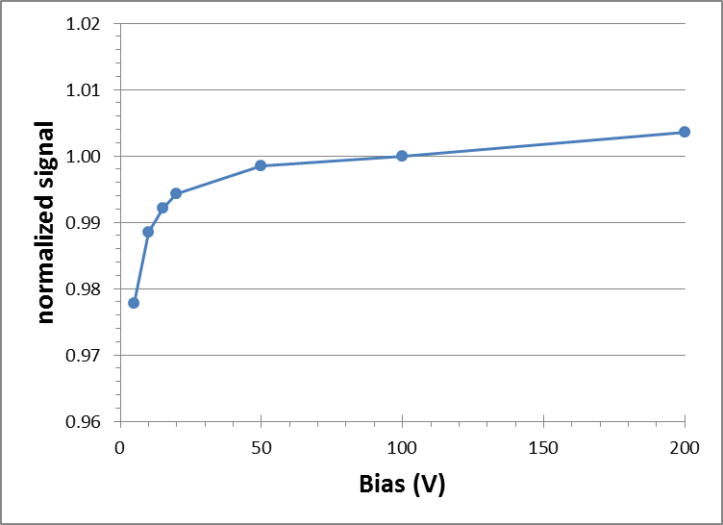
2D Ion Chambers Array for Clinical App.
Experimental work at IBA
Signal fluctuation depends on Vbias.
Chamber saturation region is not clearly defined as well

Slide 12
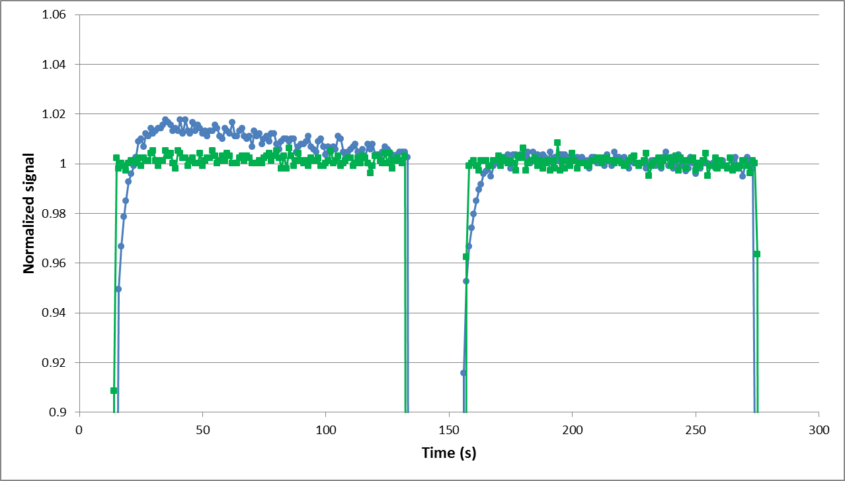
2D Ion Chambers Array for Clinical App.
Experimental work at IBA
Where these spurious effects take source?
  Ionization of materials outside of chamber volume?
We improved guarding, in order to minimize radiation induced leakage currents
Time profile,
100V bias
Michele Togno – ARDENT midterm review preparatory meeting, CERN

Slide 13
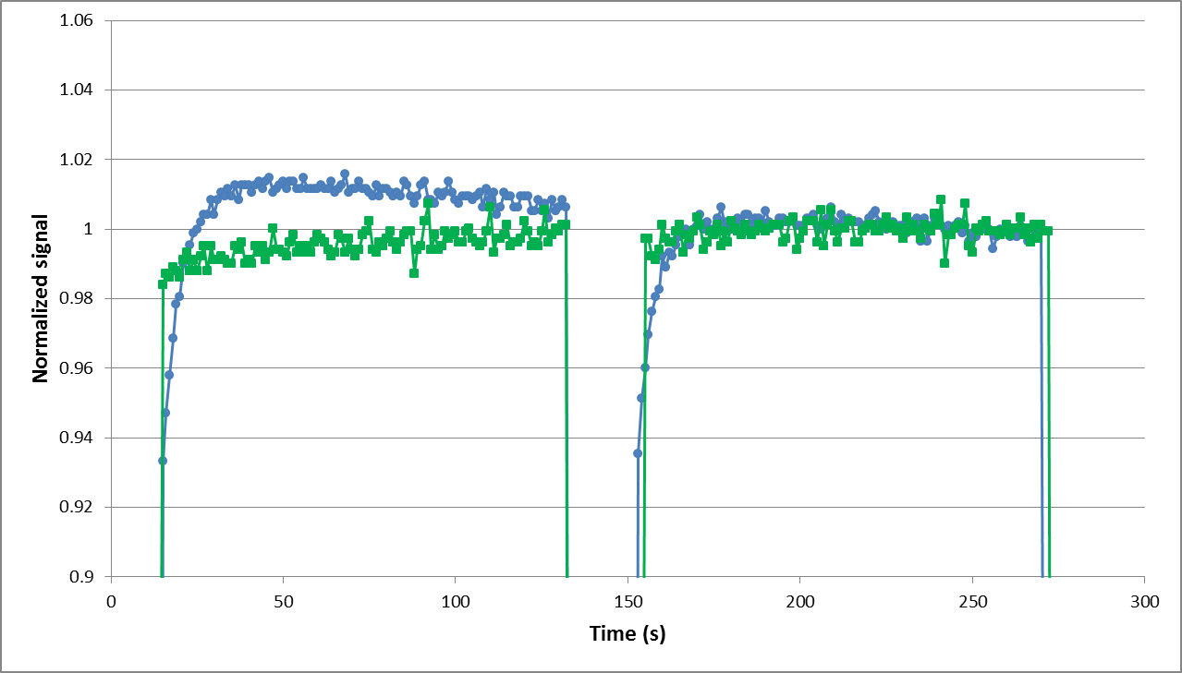
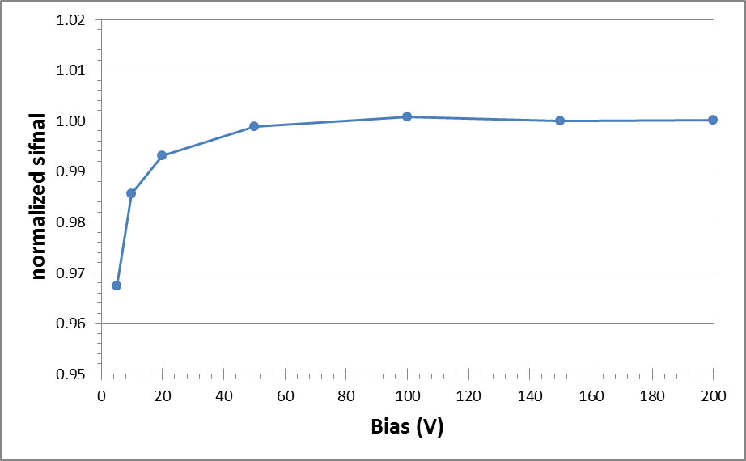
2D Ion Chambers Array for Clinical App.
Experimental work at IBA
Time profile, 200V bias
Slow spurious component still persist at high bias
Saturation curve shows a better behavior, plateau is reached between 50 and 100 Volts
Michele Togno – ARDENT midterm review preparatory meeting, CERN

Slide 14
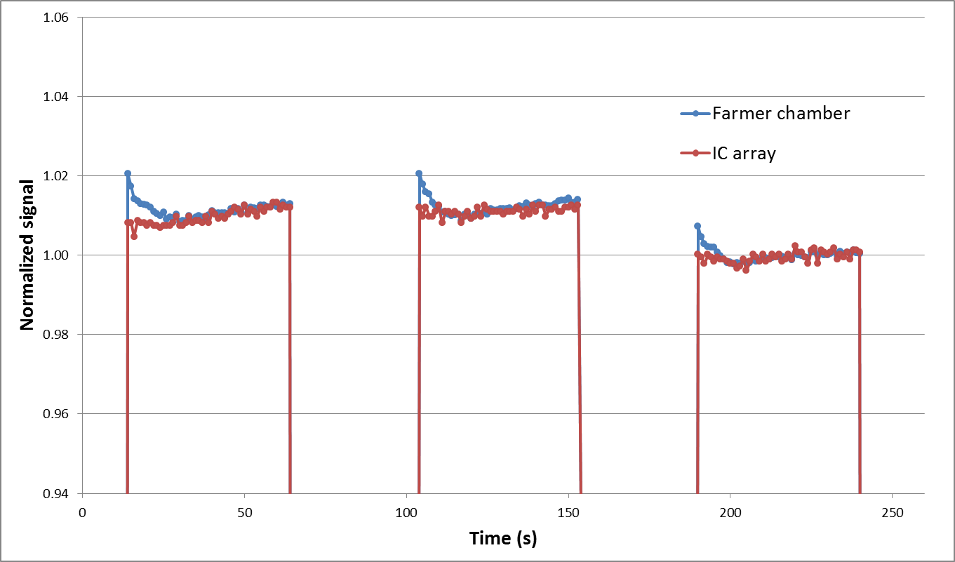
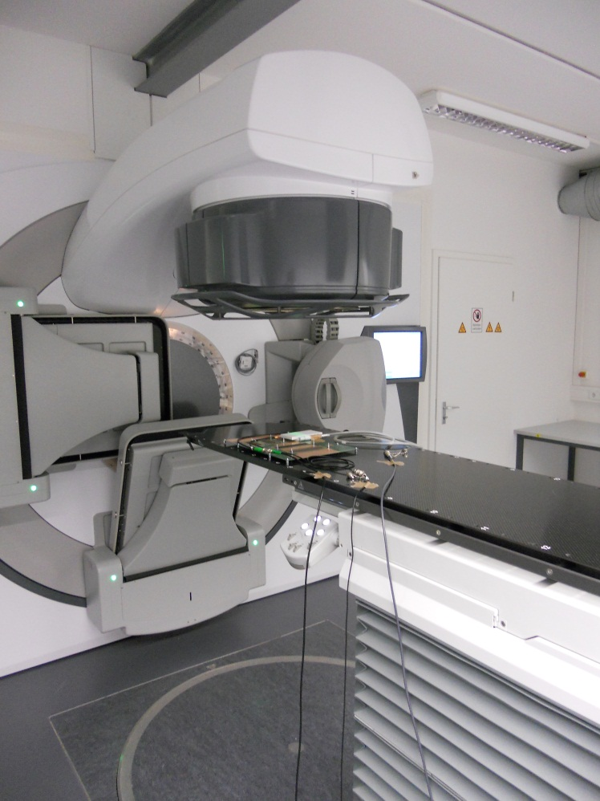
2D Ion Chambers Array for Clinical App.
Experimental work at IBA
Test under pulsed X-rays beam (LINAC facility)
6MV beam quality, dose rate 400 MU
Time profile 100V bias, comparison with a reference Farmer chamber
Michele Togno – ARDENT midterm review preparatory meeting, CERN

Slide 15

2D Ion Chambers Array for Clinical App.
Work in progress and planned activities
Complete the debug of first prototype
Design and implementation of a new improved prototype, which will take into account the results of carried out measurements
Implementation of a new multi channel readout electronics
Monte Carlo simulation of ion chambers, useful to better understand the physics and to correctly choose materials and geometries

Slide 16
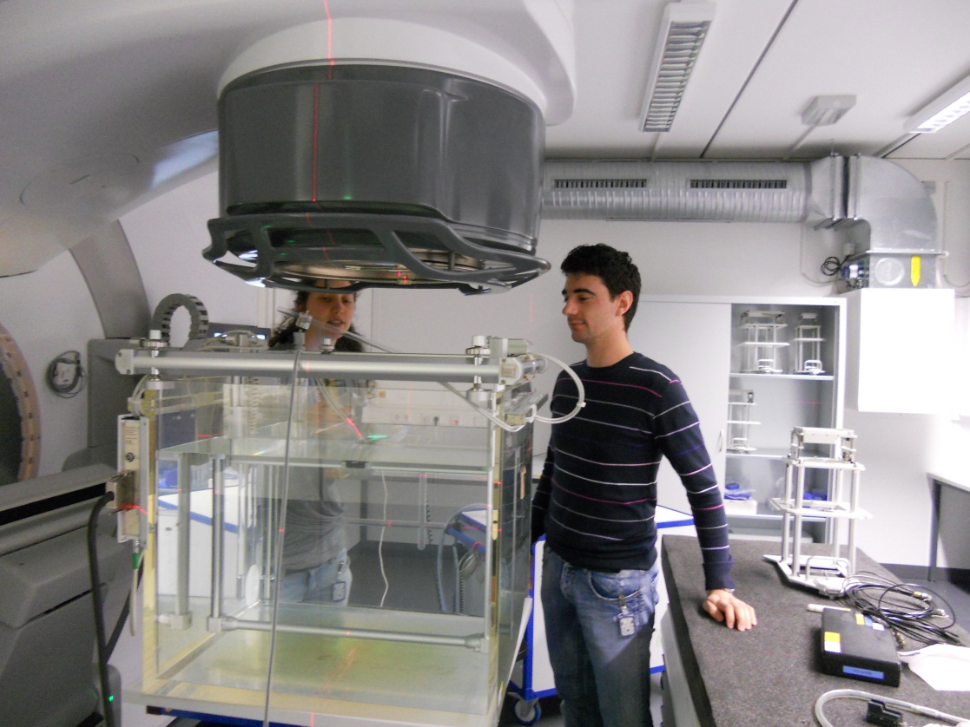
ARDENT Project
Trainings received and schools/conferences attendance
EGSnrc Monte Carlo code training, photons and electrons simulation
Relative and absolute dose measurement with LINAC facility

Slide 17
ARDENT Project
Trainings received and schools/conferences attendance
Practice with TERABALT and GAMMATRON irradiation facilities (⁶⁰Co)
Company delivered trainings:
  Introduction to working safety
  Introduction to QM system
  Radiation safety
German language course
“V National School in Detector and Electronics for High Energy Physics, Astrophysics, Space Applications and Medical Physics, INFN Padova (Italy)”, which was focused on radiation damage in detectors, front-end electronics and medical application of radiation.
Planned attendance at IEEE, NSS-MIC, Seoul

Slide 18
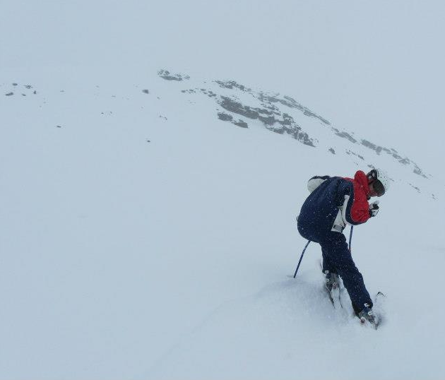
Thank you

