Slide 1
Quench limits for transient losses - Collimation Review 2013.05.30
The quench limits for transient losses
Mariusz Sapinski BE/BI
for many people participating in quench tests
and now in the analysis
Acknowledgements:
Collimation Review, 2013/05/30
1
Notes:
1

Slide 2
Outlook
Quench limits for transient losses - Collimation Review 2013.05.30
Quench limits overview.
What transient losses affect collimation?
Quench limit investigations for transient losses:
  Ultra-fast losses,
  Millisecond-timescale losses.
Conclusions.
Acknowledgements:
2
Notes:
2

Slide 3
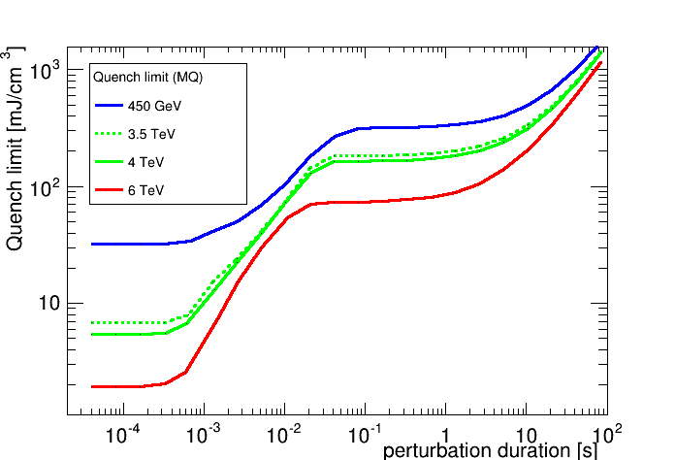
Motivation: decrease of the quench limit
Energy needed to quench a magnet decreases for shorter losses so short “spikes” on collimators can potentially lead to magnet quench even if steady-state cleaning is safe.
Quench limits for transient losses - Collimation Review 2013.05.30
MQ
MQ
MQ
Note44 alg.
IR7 magnets
MBRB
MQ
MQ, MB, MQML, MQY
analyzed - conclusive
not analyzed
in work
MQM
3
Notes:
3

Slide 4
Motivation: decrease of the quench limit
Energy needed to quench a magnet decreases for shorter losses so short “spikes” on collimators can potentially lead to magnet quench even if steady-state cleaning is safe.
Quench limits for transient losses - Collimation Review 2013.05.30
MQ
MQ
MQ
Note44 alg.
IR7 magnets
MBRB
MQ
MQ, MB, MQML, MQY
~MILLISECOND
analyzed - conclusive
not analyzed
in work
ULTRA-FAST
MQM
4
Notes:
4

Slide 5
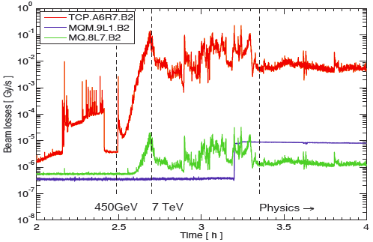
What kind of transient losses?
UFO losses – small amplitude seen on collimators, large in UFO location.
losses at capture are probably 'slow‘: they depend on the dipole ramp rate.
losses at end of ramp are also generally slow (tails cut by closing collimators)
losses during the squeeze were often correlated with orbit drifts and OFB.
losses at the end of squeeze due to instabilities .
Quench limits for transient losses - Collimation Review 2013.05.30
from Giulia Papotti
Failure losses:
failure warm separation dipoles D1 (thesis of A. Gomez Alonso, 2009)
asynchronous dump – losses on dump protection collimators
Stefano’s presentation
5
Notes:
5

Slide 6
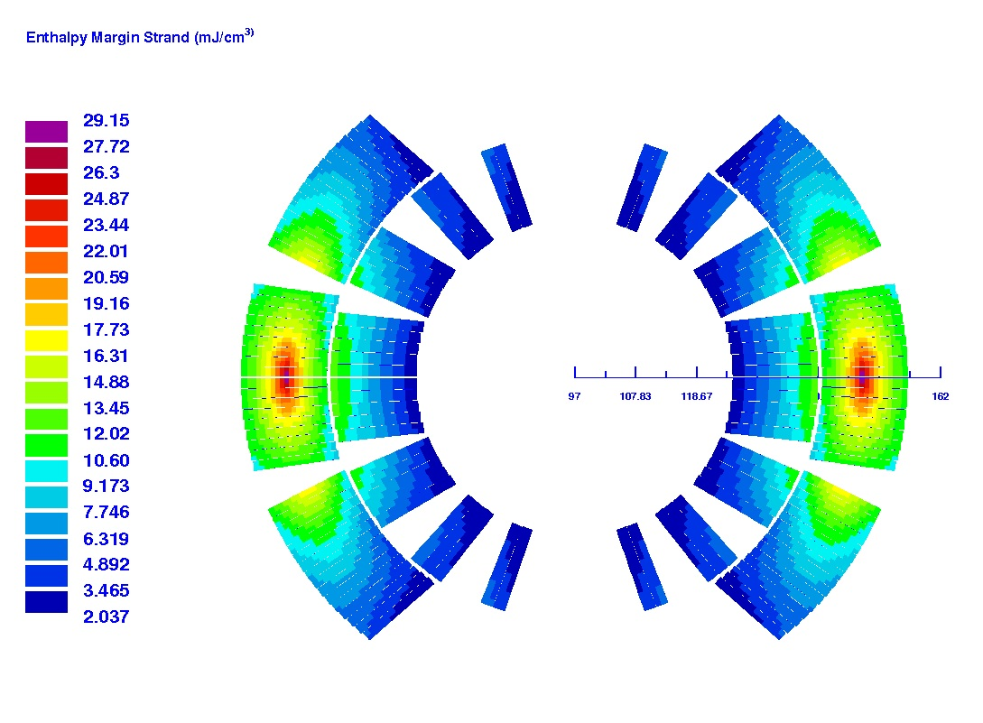
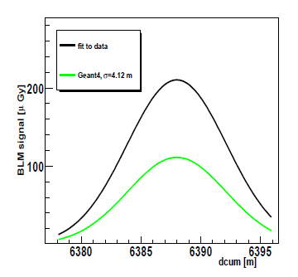
Quench limits of ultra-fast losses
Ultra-fast = much shorter than 1 ms.
Easy to compute:
  see LHC-Project-Note-044 (1996): ΔH_{wire} = H_{wire}(T_{c}) –H_{wire}(1.9K)
  parametrization of specific heat
  implemented in ROXIE.
Several tests at injection (CERN-LHC-Project-Note-422, 2008):
  QL from Note044: 31 mJ/cm³,
  QL from Geant4: 13-50 mJ/cm³.
Operational quenches during Run 1: only ultra-fast at injection.
One test at “above 4 TeV”.
Quench limits for transient losses - Collimation Review 2013.05.30
6
Notes:
Not really analytical…
6

Slide 7
Q6 quench test
Slide by Chiara Bracco
Performed on 2013.02.15
Quench limits for transient losses - Collimation Review 2013.05.30
TCLIB
Injected beam
Emittance from SPS: H ~0.5 μm, V ~ 0.5 μm ➔ impact parameter 4.5 σ (full beam intercepted).
Pilot bunch 6-6.5e10p+ (probe beam limit increased to 1E11p+).
Q6.L8 Current steps: 1000 A, 1500 A, 2000 A and 2500A (~ 6 TeV) ➔ Quench!
Fluka studies ongoing, will give us very good quench limit at 6 TeV.
Acknowledgements:
7
Notes:
7

Slide 8
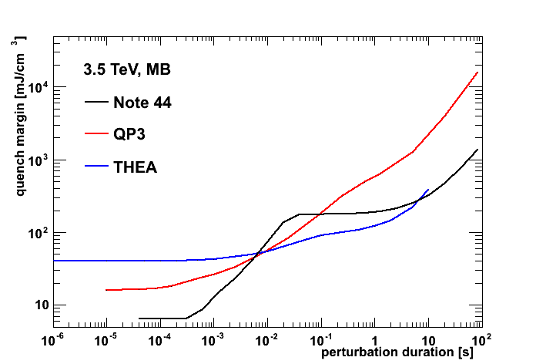
Quench limits for ~millisecond losses
Quench limits difficult to compute (LHe plays crucial role, various heat transfer mechanisms).
Two tests done, both motivated by UFO losses:
  wire scanner (2010),
  fast ADT and orbit bump (2013).
Quench limits for transient losses - Collimation review 2013.05.30
8
Notes:
8

Slide 9
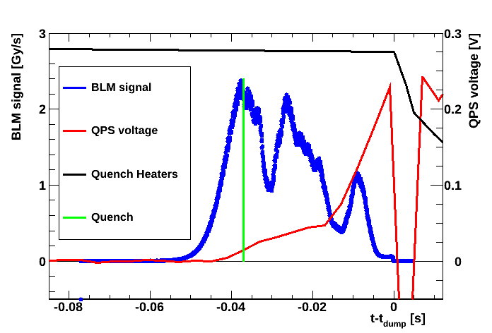
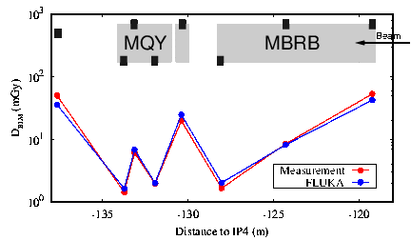
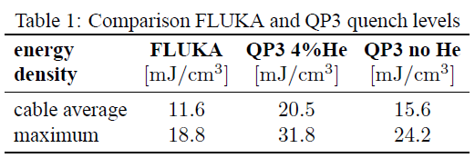
Wire scanner quench test
Performed on Nov. 1st, 2010 .
Beam energy 3.5 TeV.
Intensity 1.53 ∙ 10¹³ protons.
Wire speed 5 cm/s.
Quenched MBRB dipole (4.5K).
33 meters downstream wire scanner.
analysis and FLUKA simulations presented in CERN-ATS-2011-062
Quench limits for transient losses - Collimation Review 2013.05.30
(IPAC11)
9
Notes:
9

Slide 10
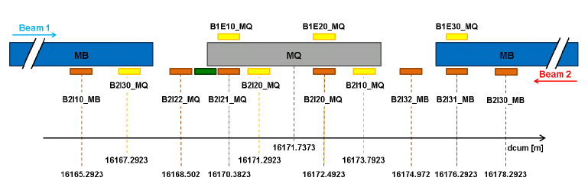
Fast ADT and orbit bump quench test
Procedure:
Inject and ramp 10 bunches (to have multiple attempts).
Scrape a single bunch by vertical blow to intensities < 10⁹ p
(special collimators setting).
Create horizontal orbit bump (Q12L6).
Excite single bunch in horizontal plane by MKQ kick and then by ADT using sign flip mode (anti-damping).
If no quench – scrape less next bunch.
Challenges:
For damper: ultra-low sensitivity mode: 5∙10⁷ protons.
For instrumentation: measure intensity and emittance of low-intensity bunches.
We were prepared: 4 MDs, additional instrumentation.
Quench limits for transient losses - Collimation Review 2013.05.30
Procedure proposed by Wolfgang Hofle
10
Notes:
10

Slide 11
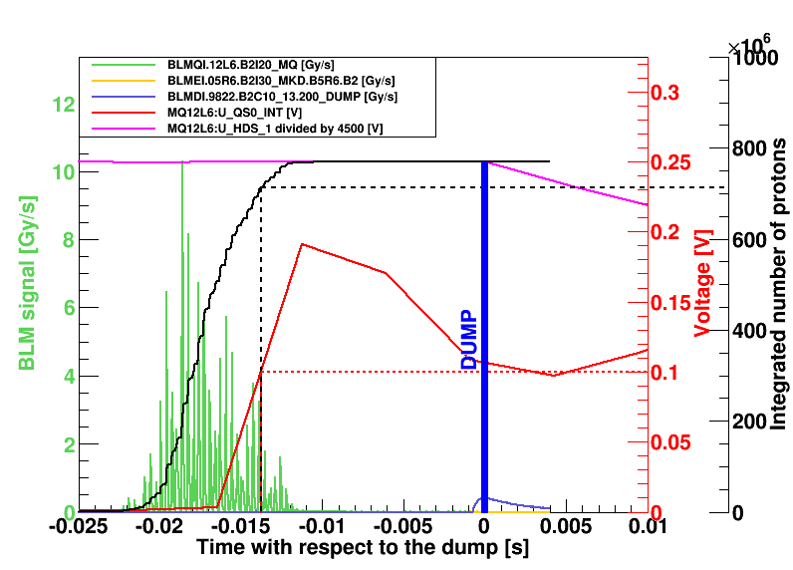
Fast ADT and orbit bump quench test
Plot by Agnieszka Priebe
Quench limits for transient losses - Collimation Review 2013.05.30
Performed on February 15th, 2013.
Quench with 7.7∙10⁸ lost protons.
No quench with 4∙10⁸ lost protons.
Loss duration: 5-10 ms:
  2-3 ms expected,
  UFO: shorter than 1 ms.
Spiky loss time-structure:
  UFOs are gaussian.
For 2.56 ms (typical dump by UFO) signal is higher by factor 6 than expected. Potential increase of BLM thresholds on all cold magnets!
BLM signal integ. time | Signal (Gy/s) | S/Quech
640 μs | 1.99 | 2.1
2.56 ms | 1.46 | 6.1
10.2 ms | 0.73 | 12.0
11
Notes:
11

Slide 12
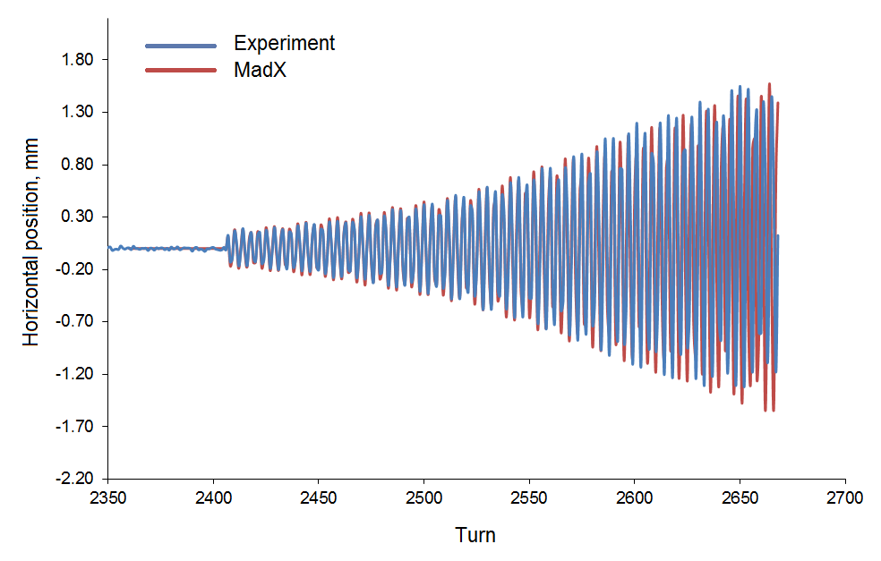
Fast ADT and orbit bump quench test
Quench limits for transient losses - Collimation Review 2013.05.30
Analysis:
Simulate loss pattern using MadX.
Use MadX loss pattern as input for FLUKA/Geant4 simulations.
“Control” the FLUKA/Geant4 results comparing with measured BLM signal.
Obtain energy deposited in the coil.
Use FLUKA/Geant4 radial energy gradient in the coil as input to QP3.
Compare QP3 and FLUKA/Geant4.
Plot by Vera Chetvertkova
SIMULATIONS ONGOING
12
Notes:
12

Slide 13
Conclusions
Quench limits for transient losses - Collimation Review 2013.05.30
Quench limits for transient losses investigated in 4 types of experiments:
  Ultra-fast at injection
  Ultra-fast at ~6 TeV
  Millisecond with wire scanner
  Millisecond with ADT and orbital bump
Agreement between QP3 estimations and FLUKA-based analysis in case C.
Agreement between enthalpy limit and Geant4-based analysis in case A.
Cases B and D in analysis, but:
larger than expected quench limit for UFO-timescale losses
(possible increase of BLM thresholds on all cold magnets).
Acknowledgements:
13
Notes:
Substantial effort must be given during LS1 in order to analyse quench tests and tune QP3 code (and BLM thresholds).
13

Slide 14
Quench limits for transient losses - Collimation review 2013.05.30
Thank you for your attention
Acknowledgements:
14
Notes:
14

Slide 15
Quench limits for transient losses - Collimation review 2013.05.30
Extra slides
Acknowledgements:
15
Notes:
15

Slide 16
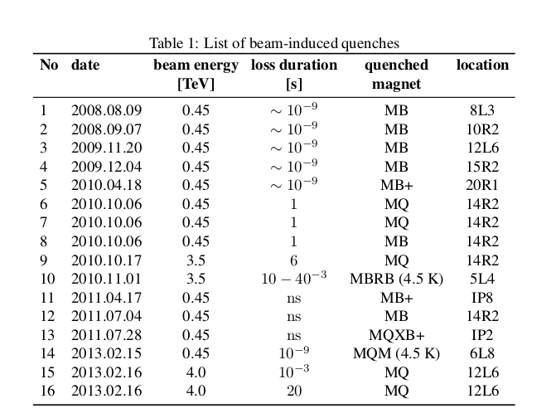
Beam induced quenches
Quench limits for transient losses - Collimation review 2013.05.30
First quench test campaign
/6 TeV
Acknowledgements:
Second quench test campaign
16
Notes:
16

Slide 17
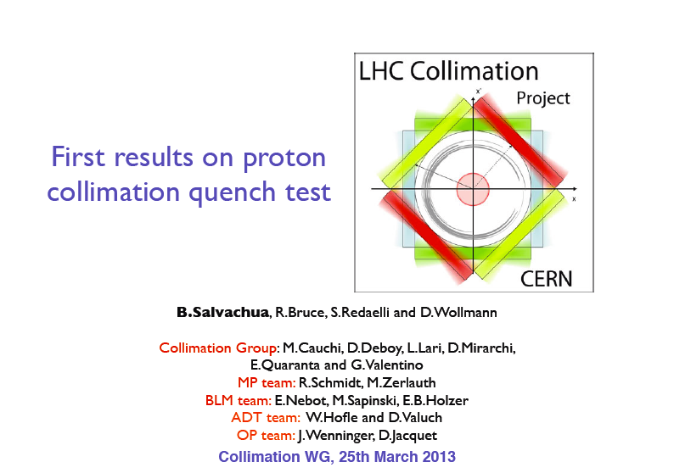
Steady-state dispersion suppressor with protons
Quench limits for transient losses - Collimation review 2013.05.30
17
Notes:
17

Slide 18
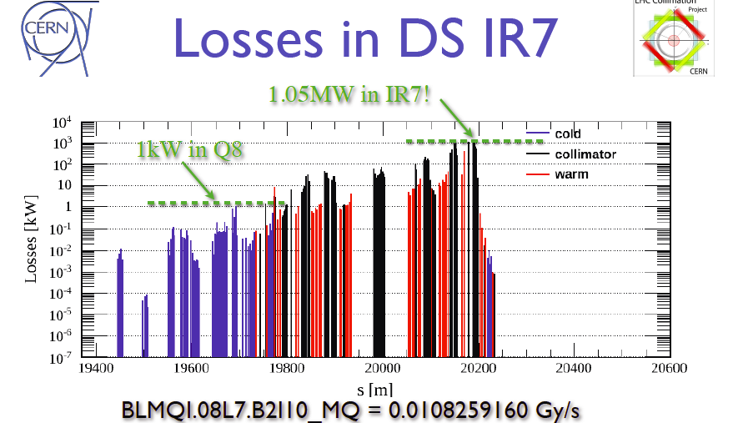
Steady-state dispersion suppressor with protons
Quench limits for transient losses - Collimation review 2013.05.30
Last ramp (out of 3 for actual test)
10⁻³ instead of 10⁻⁵
Special collimators settings
800 m
18
Notes:
18

Slide 19
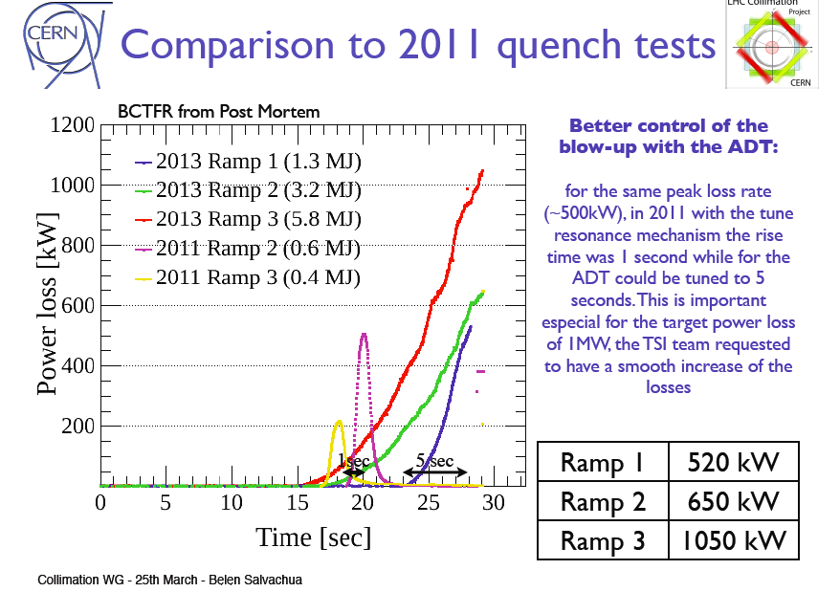
Steady-state dispersion suppressor with protons
Quench limits for transient losses - Collimation review 2013.05.30
19
Notes:
19

Slide 20
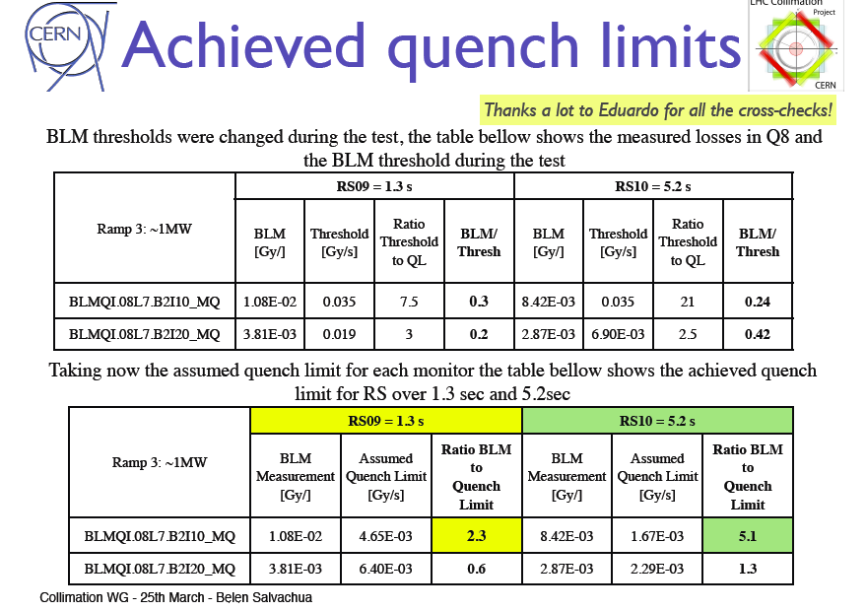
Steady-state dispersion suppressor with protons
Quench limits for transient losses - Collimation review 2013.05.30
No quench!
20
Notes:
20

Slide 21
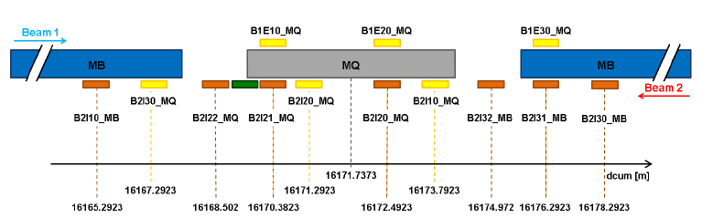
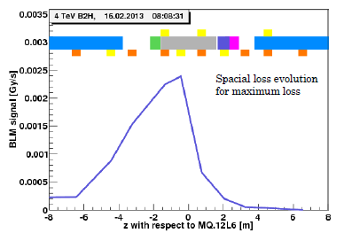
Steady-state with orbital bump (and ADT)
Plots courtesy Agnieszka Preiebe
Quench limits for transient losses - Collimation review 2013.05.30
RS10 (5.2s)
RS09 (1.3s)
BLM | BLMQI.08L7.B2I20_MQ | BLMQI.12L6.B2I20_MQ
Signal | 2.87 mGy/s | 2.36 mGy/s
Threshold | 2.29 mGy/s
S/T | 1.3 | 1.03
pos2 pos1
no quench quench
(as expected!)
Loss scenario has an important impact on quench level as seen in BLMs.
21
Notes:
21

Slide 22
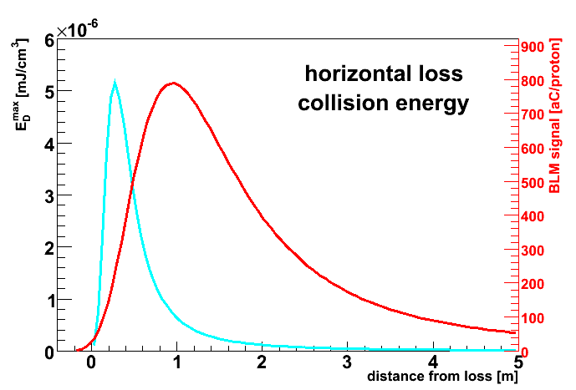
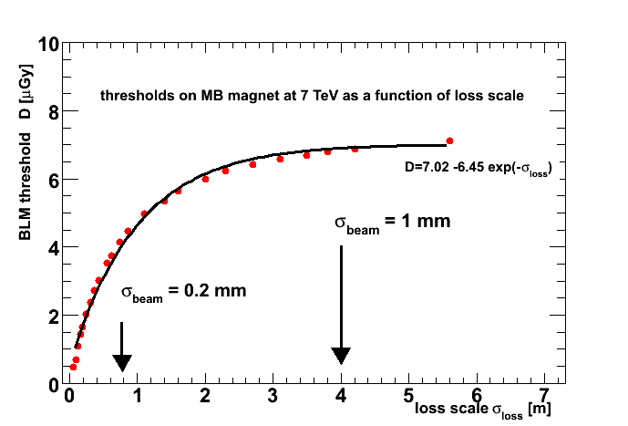
Why is that?
We will need FLUKA/Geant4 simulations to understand this in details but…
CERN-LHC-Project-Note-422 (2009), MB case:
First look on quench tests - LMC 2013.03.27
Pointlike losses
Threshold=QL*BLMsignal / E_{dep} ^{coil}
When we smear the loss the amplitude of thinner distribution decreases faster than thicker one.
So more distributed losses lead to higher BLM signal at quench.
22
Notes:
22

Slide 23
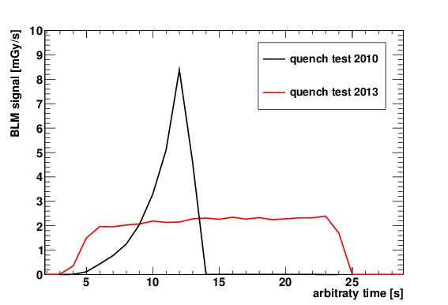
Steady-state with orbital bump (and ADT)
The loss rate obtained during this quench exercise was very flat and lasted about 20 s.
First look on quench tests - LMC 2013.03.27
23
Notes:
23

Slide 24
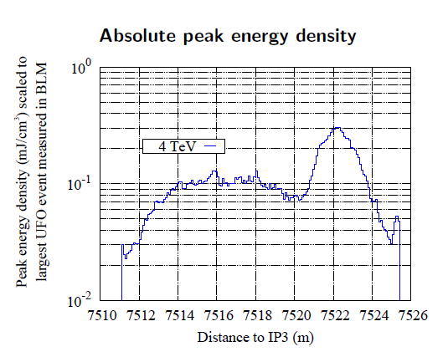
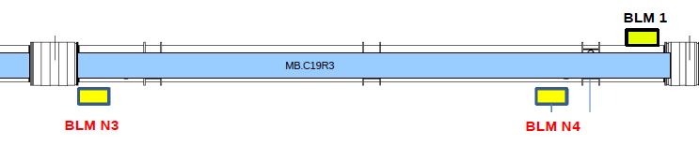
But we must be careful extrapolating to UFOs
According to simulations (backed up by observations in especially equipped cell) maximum energy deposit is due to neutral particle peak.
Ratio of BLMsignal/E_{dep} ^{coil} might be different than in our experiment.
To make the analysis more challenging the loss pattern during quench test seems to move from turn to turn.
Quench limits for transient losses - Collimation review 2013.05.30
courtesy of Anton Lechner
neutral
particle
peak
UFO
Special MAD-X simulations started to understand the time-dependent loss pattern (Vera Chetvertkova).
FLUKA/Geant4 simulations also necessary
24
Notes:
24

