Slide 1
Collimator design and operational experience
A. Bertarelli, O. Aberle, R. Losito 30 May 2013

Slide 2
Acknowledgement
The number of people I have to thank is too big for this slide..
Main Actors are
  Vacuum
  Transport
  Survey
  Integration and coordination of installation
  Cabling
  Cooling & Ventilation
  Procurement
  Radioprotection
  Beam Instrumentation
  Collimation and operation teams…

Slide 3
Outline
Overall design & actuation systems
Problems
Solutions (if any)
Worries

Slide 4
Overall Design: the collimator “zoo”
TCP: Beam cleaning and general protection (stage 1)
TCSG: Beam cleaning and general protection (stage 2)
TCT(A&B): protect the triplets (stage 3)
TCLA: intercept the cleaning-induced shower
TCLP: catch the showers induced by experiments (p-p collisions)
TCDI: injection collimation
TCLIB: active injection protection
TCLIA: active injection protection
TCAPx: Passive absorbers

Slide 5
Overall Design: the basics (TCSG)
Two independent long jaws (1200 mm)
Very accurate precision and geometric stability
Maximum positioning flexibility (adjustable jaws)
Multiple azimuthal orientations (0º, 90º, 45º, 135º …)
High absorbed heat loads
High robustness in accident cases (450 GeV and 7 TeV)
Jaw spare surface (5th axis)
UH Vacuum compatibility (< 5.10-7 Pa / < 10-12 mbar.l/s.cm2)
Low electrical resistivity and RF efficiency
Auto-retraction from beam in case of motor failure
Quick connection and disconnection
Ease of handling and maintenance
In-situ bake-out at 250ºC
Limited space budget

Slide 6
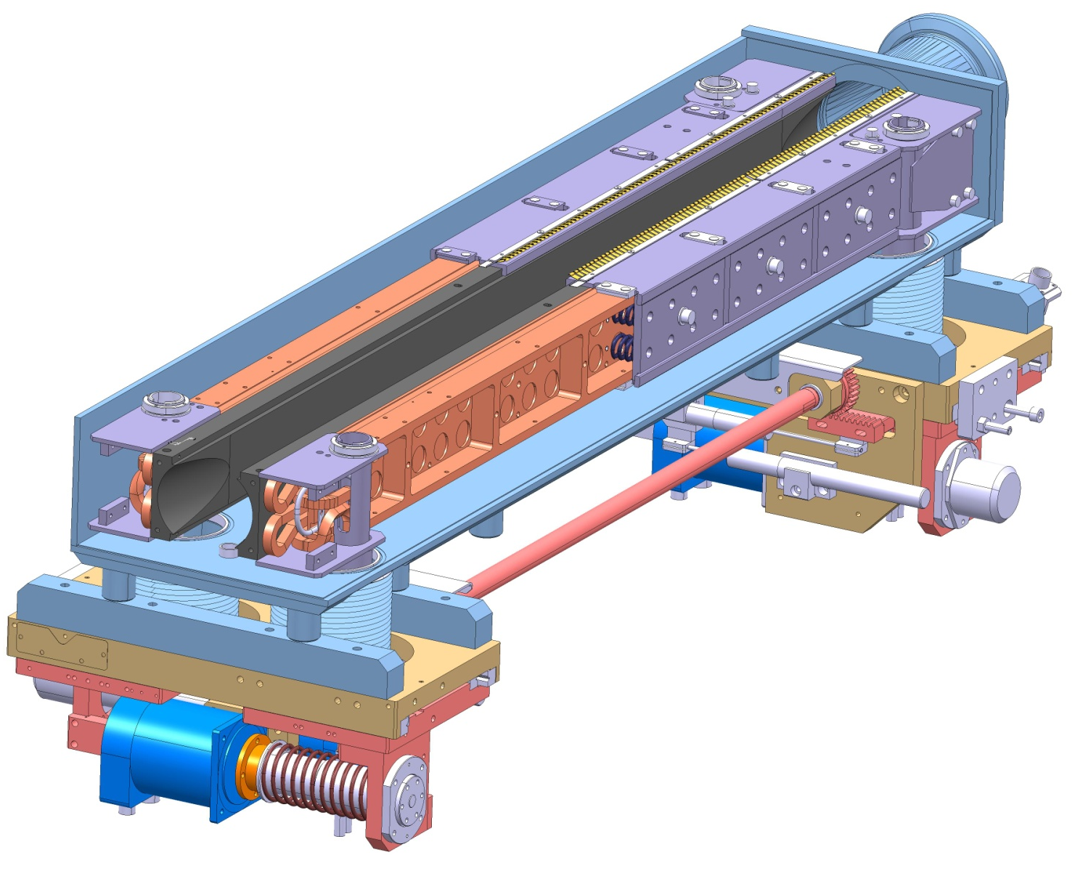
Overall Design
Collimator Main subsystems
RF contact system
Jaw Assembly
Vacuum Vessel
Cooling system
Actuation system

Slide 7
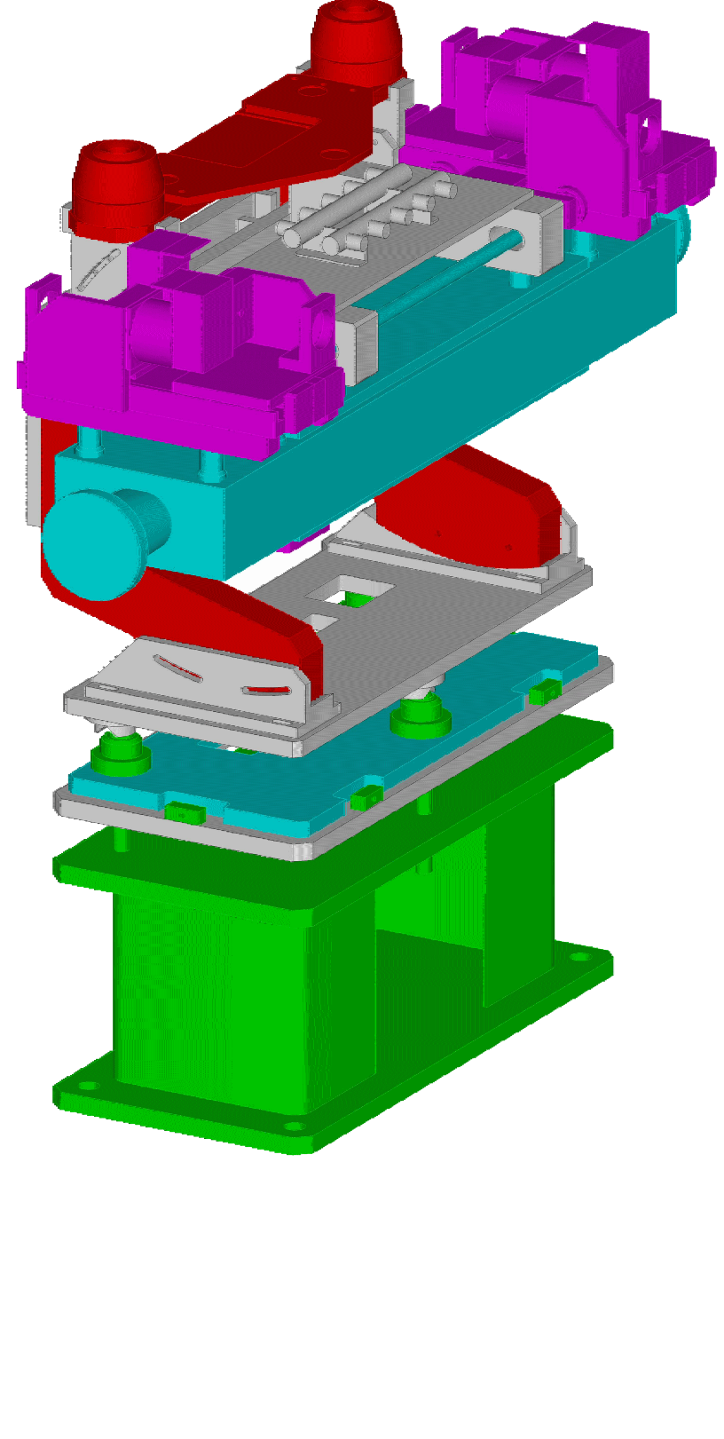
Overall Design
Overall length: 1480mm
Tank width: 260mm
Collimator assembly
Adjustable Stand (horizontal)
Beam axis
Plug-in system
allowing to quickly connect mechanically, hydraulically and electrically the collimator to the base support

Slide 8
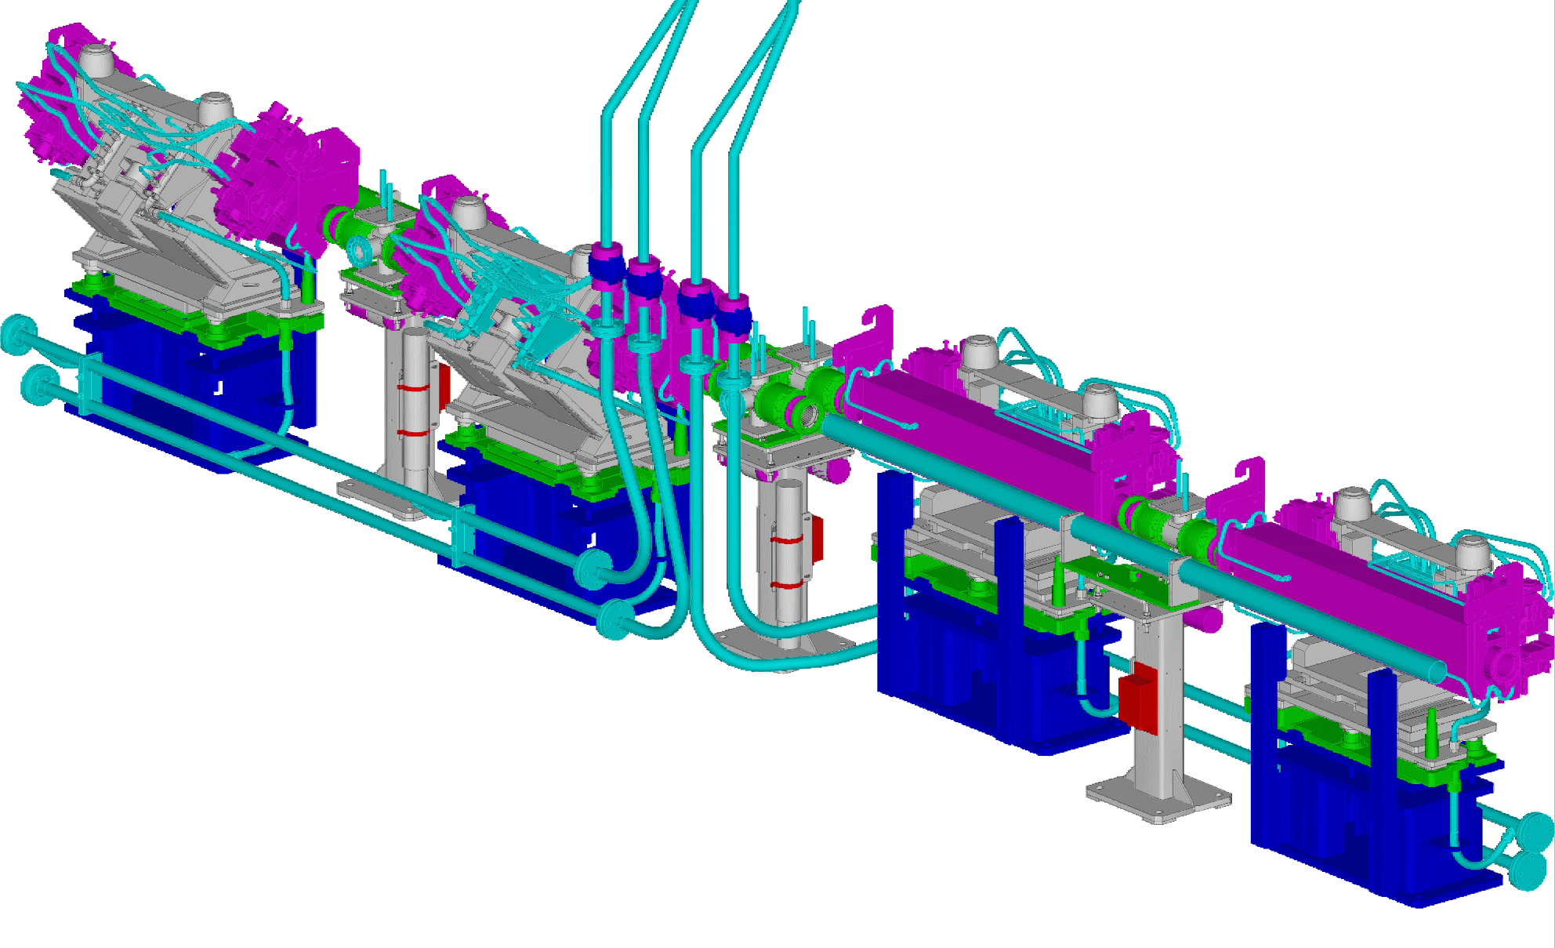
Overall Design
Collimator general layout
(vertical and skew shown)
Water
Connections
Vacuum pumping
Modules (TS-MME & AT-VAC)
Collimator
Tank (water cooled)
Quick connection
flanges
Beam 2
BLM

Slide 9
Overall Design: Motors and sensors
The collimators are equipped with
  4 stepping motors (5th axis not relevant for this analysis)
  4 Resolvers
    1 for each motor
  6 LVDTs
    1 for each axis (LU, LD, RU, RD)
    1 for each gap (GU, GD)
  Switches for in/out anticollision…
Side view at one end
Vacuum tank
CFC
CFC
Temperature sensors
Reference
Reference
Motor
Motor
Sliding table
Gap opening (LVDT)
Resolver
Gap position (LVDT)
Resolver
+ switches for IN, OUT, ANTI-COLLISION

Slide 10
Overall Design: Motors and sensors
In practice:
  4 Degrees Of Freedom
  10 sensors measuring independently any DOF or a combination of them.
Side view at one end
Vacuum tank
CFC
CFC
Temperature sensors
Reference
Reference
Motor
Motor
Sliding table
Gap opening (LVDT)
Resolver
Gap position (LVDT)
Resolver
+ switches for IN, OUT, ANTI-COLLISION

Slide 11
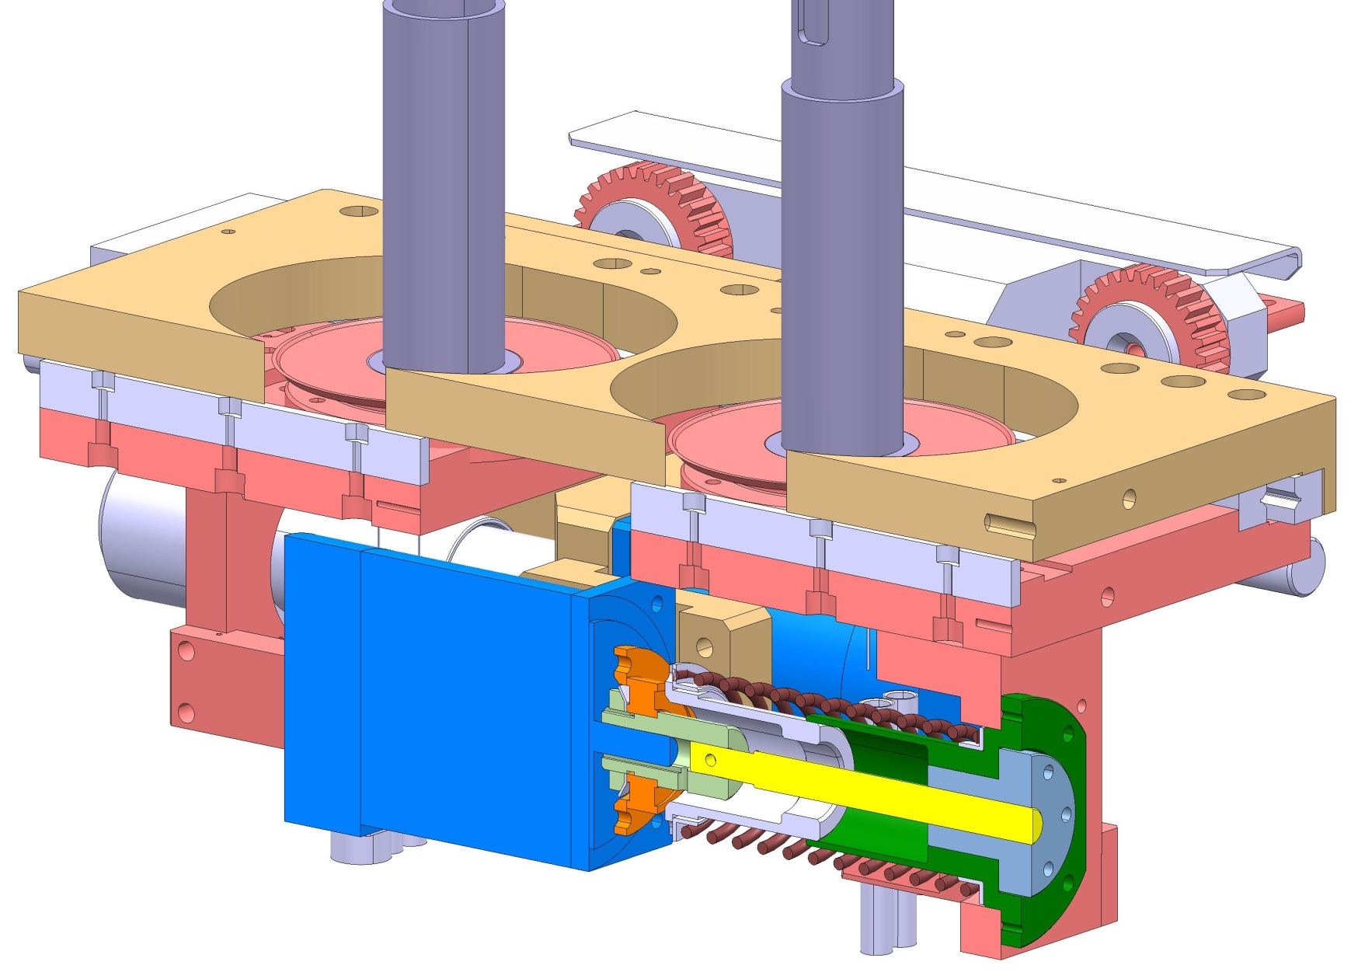
Actuation System Design
Actuation System design principles
Fixed table
Pinion
Linear Bearing
Mobile table
Roller Screw nut
Stepper motor
Sleeve Bushing
Roller screw shaft
Return spring

Slide 12
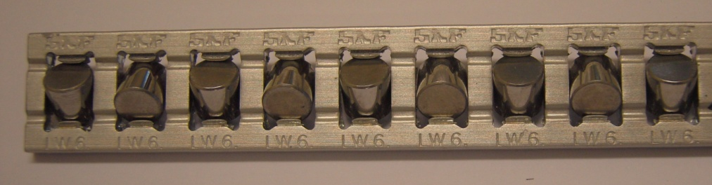
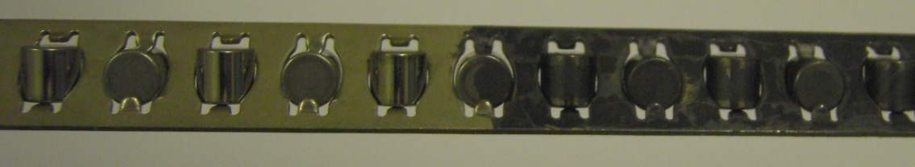
Actuation System Design
Actuation System design principles
Linear bearings allow compact sliding of mobile table on fixed table. Wet lubrication is not possible because of radioactive and dirty environment
  TCP, TCSG, TCT/TCLA and TCDI adopt crossed-roller bearings. Preload 880 N per rail.
  All-metal components (corrosion resistant). Qualified by suppliers for use in non-lubricated conditions.
  Nickel plated steel cages replaced by Aluminum cages because of cage creeping and wear problems.
  Graphite dry lubricant (DAG 156) although reducing wear cannot be used with aluminum cages because of oxidation risks in non-anodized surfaces.
Roller cage
Roller

Slide 13
Radiation Hardness
Overall radiation hardness never assessed (a collimator is too big!)
Individual materials and components carefully chosen, NDA with producers of motors and sensors to have them disclose all materials and procedures used.
Special grades for metallic parts recommended to improve resistance to corrosion, all organic materials known and tested separately to 10 Mgy. None of them showed any degradation (all selected to resist at least 50 MGy).
Frequent visits to manufacturing plants to ensure agreed procedures were really implemented.
Maximum anticipated dose on TCPs: 3 Mgy/year.

Slide 14
Radiation Hardness
Collaboration with Kurchatov Institute (Alexander Ryazanov), to assess change of physical properties in graphite and C-C.
Further collaboration with BNL (N. Simos, A. Bertarelli) to assess properties of novel materials

Slide 15
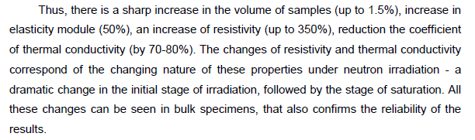
Radiation Hardness
Nominal loss scenario 10¹⁶ protons/year on all the LHC
From the report, high effect on physical properties also with very low DPA (10^-2)
Useful to inspect (if possible) TCPs as they come out of the machine
May impact spare strategy!

Slide 16
Selection of issues occurred in operation since 2008
NO linear bearing problem (suspected to be the major candidate for troubles)
2 LVDT‘s exchanged, connection problem (pins).
1 motor burned before the start of LHC.
2 switches replaced due to irregular contact behaviour.
1 TCP in IR 7 heated up above the threshold.
Up to date 3 rollers screws have been exchanged.
Major worry today

Slide 17
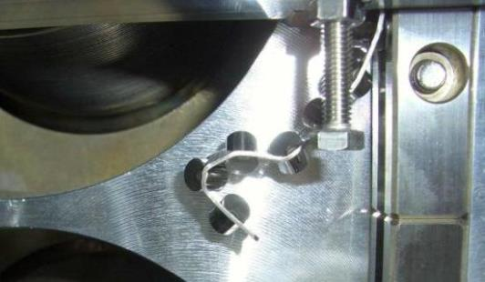
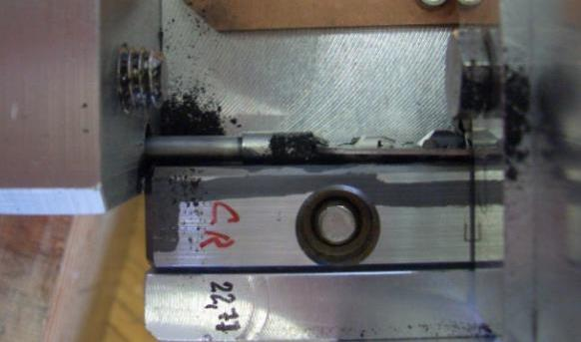
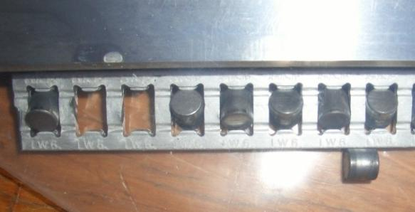
Rails (historic)
Observations:
Linear bearing cages creep during cycling tests
INOX roller cages deform and get destroyed
Intermediate solution with positioning hooks only with reduced lifetime
Rollers in Al cages fall out after LHC lifetime cycling, but are kept within the rails

Slide 18
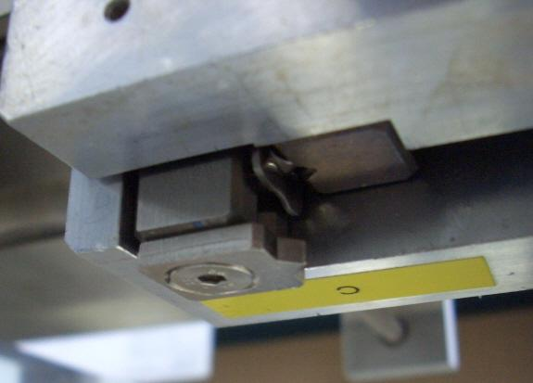
Effects
„Prototype“ effect:
Cycling in 2006, CERN assembly:
  Horizontal :  9000 full cycles
  Vertical:  4000 cycles
  Skew (135 °):  3000 cycles
  Additional testing in small intervals:  2000 cycles (detailed report to come)
NO problem detected
Re-testing after several interventions in 2008:
  Several voyages to the tunnel, manipulations with Palfinger,
  no movement for more than 1 year, dust and corrosion
  Damage after a few 100 cycles!
  Systematic cycling during shut down for installed collimators and spares envisaged.

Slide 19
Final solution
Replace all Inox cages with Al cages
Bring 28 collimators to the surface
Disassemble the motion tables (special tools to hold the jaws)
Exchange the Inox cages
Re-assemble and re-measure in the Metrology
Re-install all collimators to 18 vacuum subsectors

Slide 20
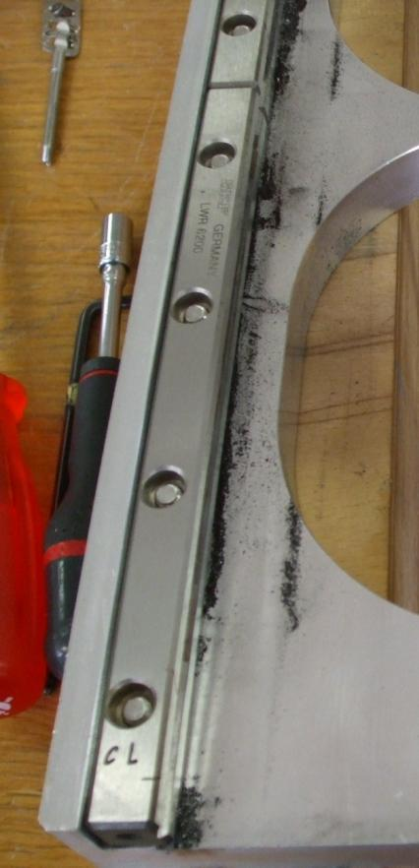
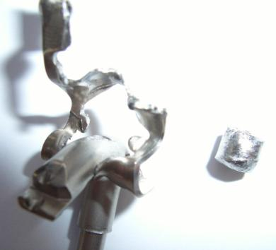
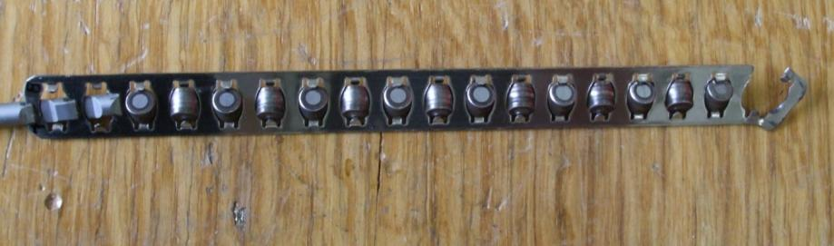
Rail exchange campaign
Huge effort for many groups
Restrictions to the workshop
Tight schedule and
addition work for the
vacuum group
WORTH IT!!!

Slide 21
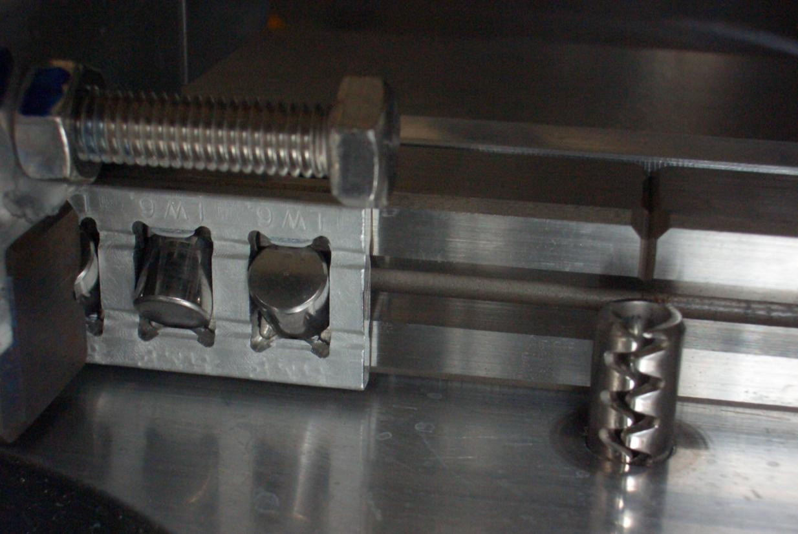
Rail configuration today – No degradation since!
Solved

Slide 22
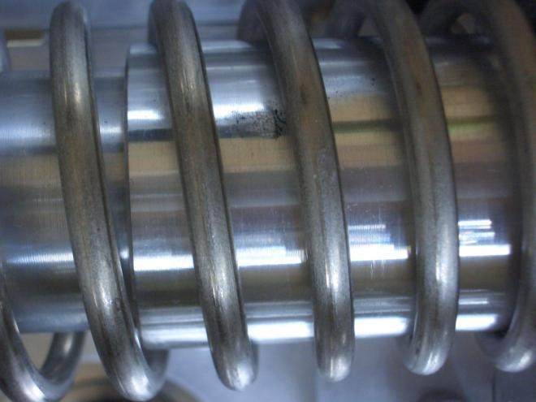
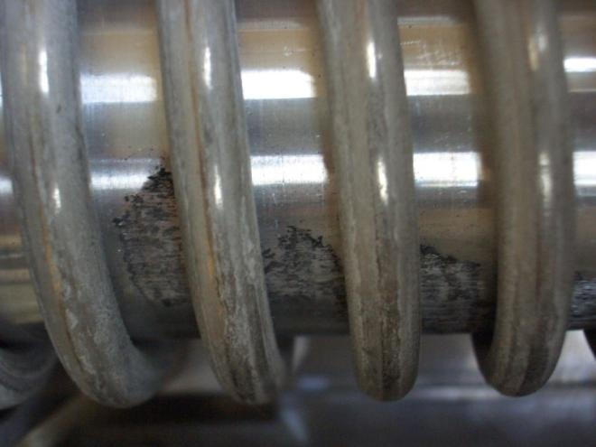
Auto retraction
Dust and particles:
  5 mm springs nearly clean
  6 mm springs produces considerably amounts of dust
  “normal tunnel” dust
Dust falls into rails and bellows
Worst orientation: 45°

Slide 23
Solution
Keep actual configurations
Modify bad orientations (45°) to 5 mm spring
Maintenance scenario
  Preventive cleaning during shut down
  Use grease on springs to trap dust?
  Surface treatment on Al-parts was not very efficient
No negative effect of spring wear on linear rails or bellows found up to date
Can the produced metallic dust affect the rollers screw (which is relatively well protected)?
General regular cleaning sufficient to keep the effect under control

Slide 24
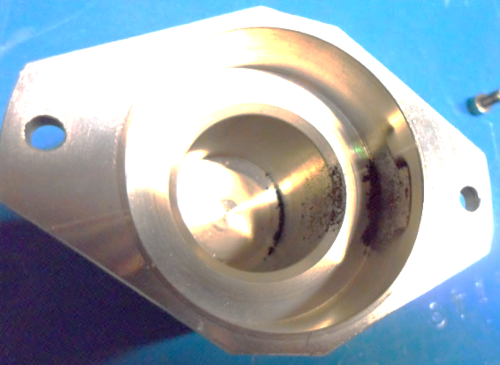
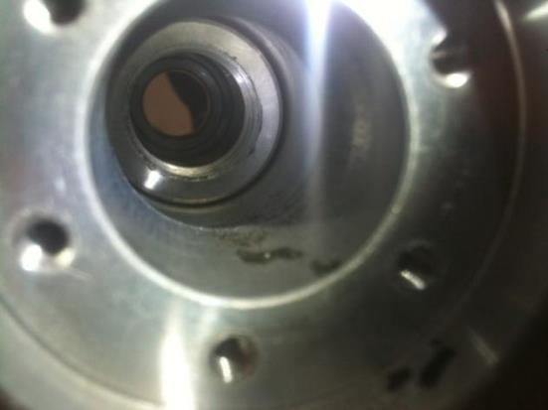
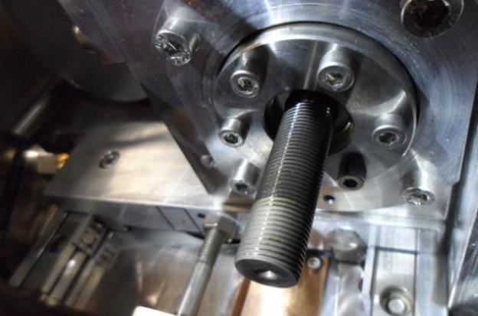
Collimator roller screw replacement (April 2012)
Dust and debris in the end cap and the housing
Some dry screws regreased

Slide 25
Collimator roller screw replacement (situation April 2012)
The roller screw on TCSG.5L3.B1 had to be replaced due to mechanical wear. There is a clear correlation between a high torque value and the noise pattern.
"SEM observations and EDS analyses of debris found in a roller screw from a LHC TCS collimator table“
https://edms.cern.ch/document/1212253/1
A second roller screw was found, based on the noise recording. The torque measurement did not yet indicate problems.
Affected is the axis A on the TCP.6R3.B2. The screw showed signs of wear and was exchanged preventively.
Collimators in Pt. 3, 5, 7 and 8 have been crosschecked with visual inspection. No further case has been found.
All collimators are commissioned and ready for operation.

Slide 26
Collimator roller screw replacement (April 2012)
Collimator Functional Name | Collimator CERN name
TCSG.5L3.B1 | TCS025
TCDIH.29465 | TCDI212
TCLIA.4R2 | TCLIA002
TCP.6R3.B2 | TCP103
TCSG.6L7.B2 | TCS019
TCDIH.20607 | TCDI207
TCTH.4R5.B2 | TCT301
In combination of acoustic check and torque measurement a good indication for problems can be found, but:
TCP.6R3.B2 not detected with torque measurement

Slide 27
Collimator roller screw replacement (April 2012)
Collimator with the problem

Slide 28
Inspection this year (95 % of collimators checked in depth)
COLLIMATOR POSITION | ORIENTATION | PROBLEM
TCL.5R5.B1 | Horizontal | D axis extremely noisy in movement. Could be spring but seems to have a slight grinding noise. Screw is greased but grease is black, no dust in the cap
TCLA.6R3.B1 | Horizontal | A axis cap has a small amout of black and metallic dust. Other screws seem ok visually
TCLA.7L3.B2 | Horizontal | Spring rubbing on aluminium screw protection, visible aluminium dust. Vibration can be heard in video as well as short bursts of a grinding noise
TCP.6R3.B2 | Horizontal | Spring rubbing on aluminium screw protection, visible aluminium dust. Vibration can be heard. Black dust found in B axis cap
TCSG.4R3.B1 | Horizontal | Both A and C axis screws checked and both look very dry with very little grease in place.
TCSG.A5R3.B1 | Horizontal | C axis screw very dry.
TCTH.4R1.B2 | Horizontal | D screw, grease seems to have conjealed in rings around the thread. This grease is slightly thicker and darker than normal.
TCTVA.4L5.B1 | Vertical | A axis screw, grease very dark like the other 3 but there is a loud grinding noise towards the end of its "In" cycle.
TCTVA.4R5.B2 | Vertical | C axis screw has a clicking and high pitched sound when cycling in and out.
TCSG.B4L7.B1 | Horizontal | Collimator and tables coved in large flakes of paint and dust. As are the items to the left hand side.
TCSG.A4L7.B2 | Skew | Collimator and tables coved in large flakes of paint and dust. As are the items to the left hand side.
TCSG.B5L7.B2 | Skew | Brass plate fixed under moving tables has metalic dust
TCP.D6L7.B1 | Vertical | B axis scrw very noisy in both in and out cycles
TCLA.C6R7.B1 | Vertical | D axis screw very dry
TCP.D6R7.B2 | Vertical | Cap for C axis screw contains a lot of black and metalic dust. Screw is completely dry with signs of "rust"
TCLA.B6R7.B1 | Horizontal | B and D axis a littl noisey, checked screws, visually ok.
TCSG.A6R7.B2 | Skew | B axis screw dry
TCSG.B5R7.B2 | Skew | D axis spring rubbing on aluminium protectionn dust apparent
TCDIH29465 | Horizontal | A axis cap has a small amout of black and metallic dust. Other screws seem ok visually
TCP.6L3.B1 | Horizontal | C axis screw very dry and clumps of hard grease on screw (SAM_1519). A axis screw dry.
TCSG.5L3.B1 | Horizontal | B axis cap has a lot of fine black dust, also some near linear bearing (may have fallen when cap was removed)
TCSG.B5L3.B2 | Horizontal with Skew | B axis spring rubbing on Aluminium protection. Dust visible

Slide 29
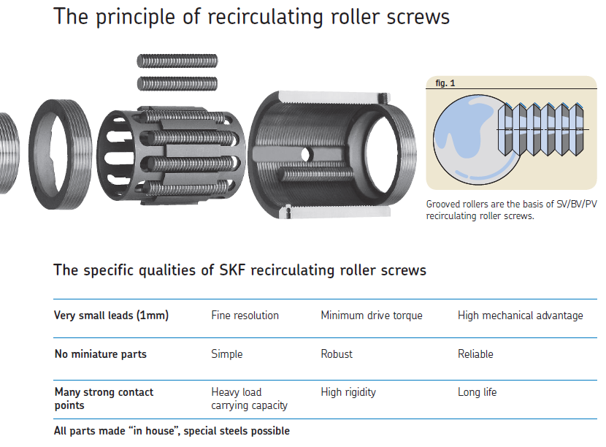
Roller screw
Custom made for collimators
Thouroughly tested at the company
From inspection we have to replace 4-5 screws and clean/regrease a bunch

Slide 30
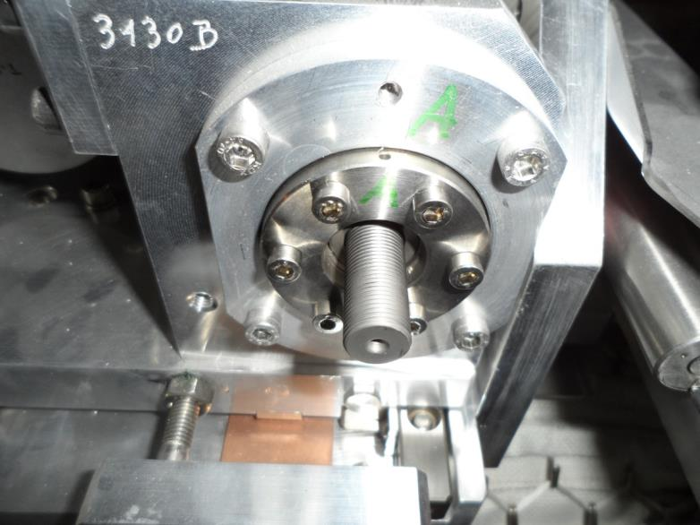
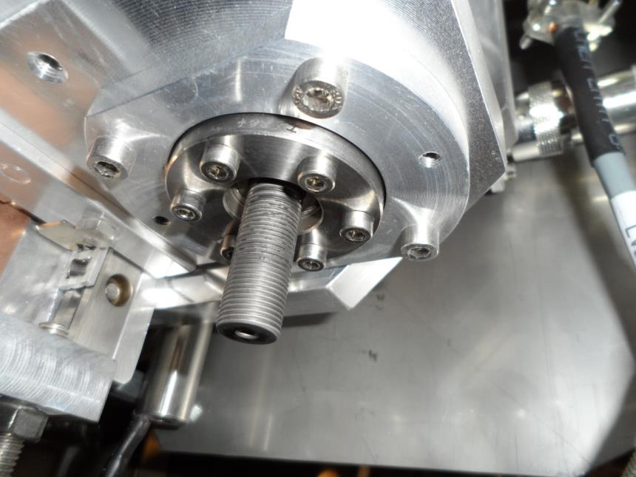
Picture showing a very dry Roller Screw.
Picture showing dry “clumped” grease on Roller Screw.

Slide 31
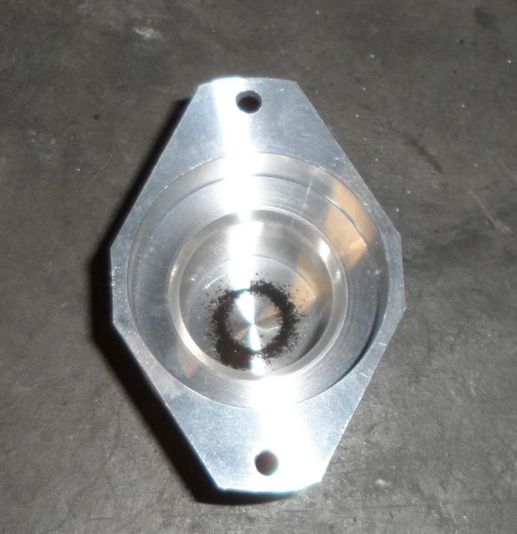
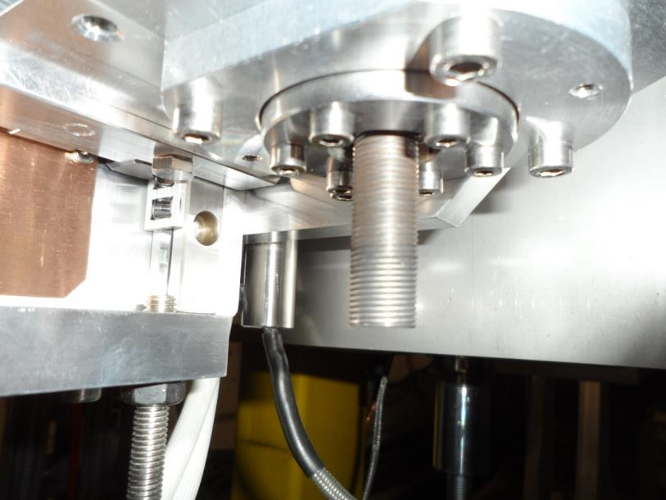
Picture showing both Black and Metallic dust which has fallen during general operation – This is the cap of a vertical position collimator. The cap is in the lower position
Picture showing what looks like rust on the surface of a Roller Screw in Point 7.

Slide 32
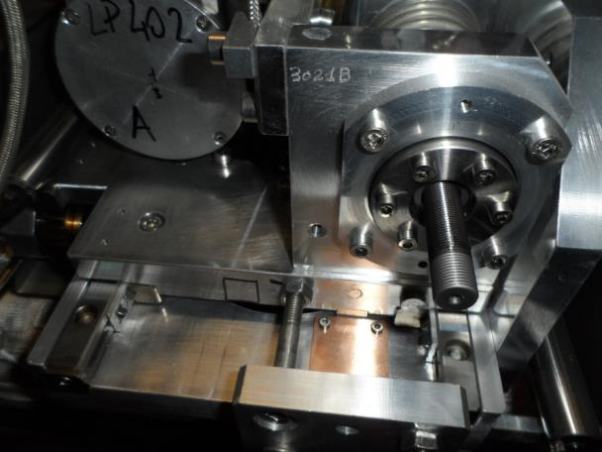
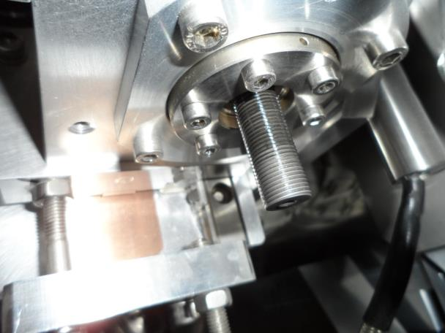
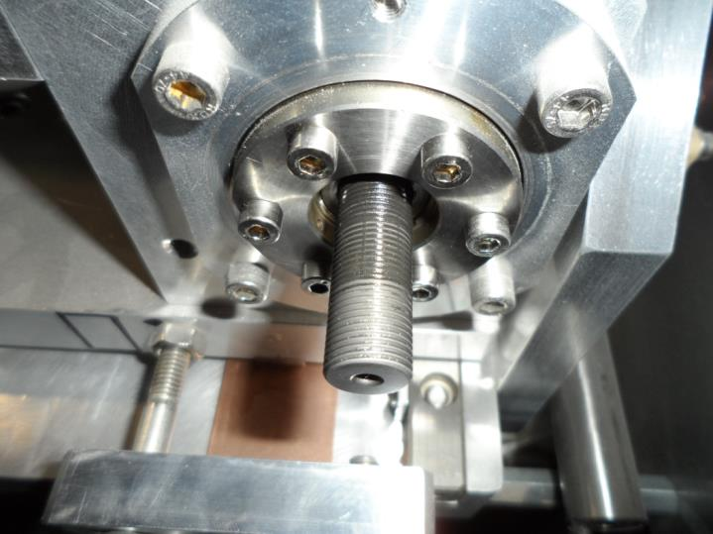
These pictures show the discolouration of the grease from white/opaque/clear to dark almost black.

Slide 33
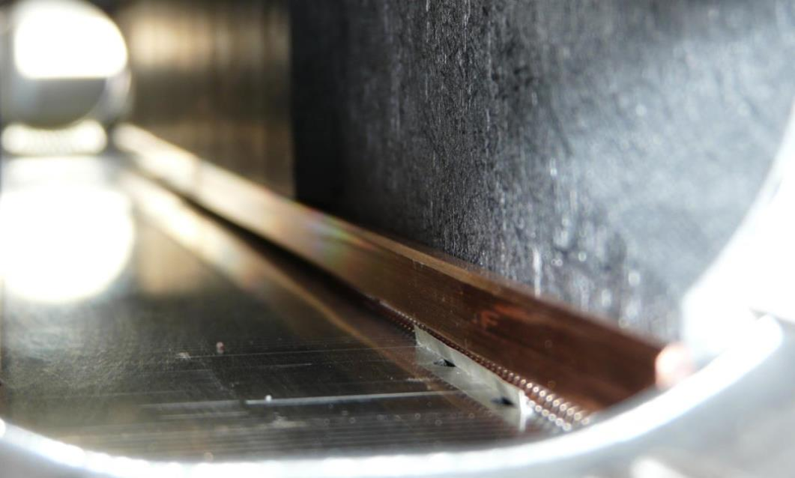
Other issues
Dust production due to RF finger friction
No obvious effect on beam operation so far

Slide 34
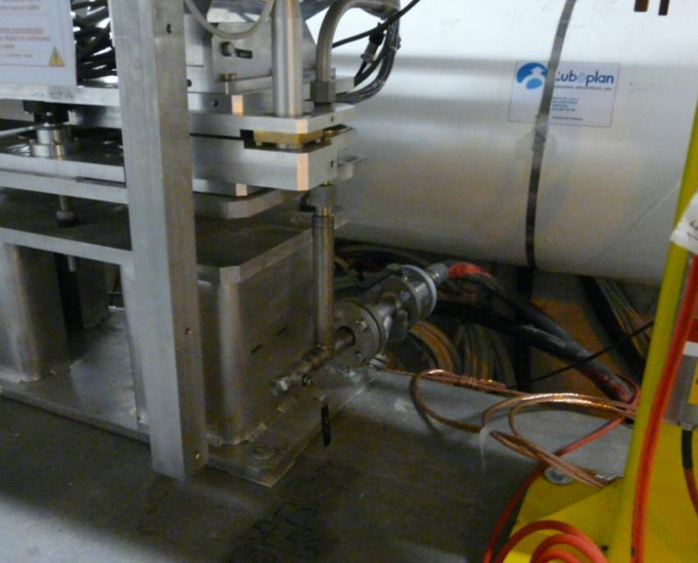
Cooling and cabling
Other than Point 3 and 7:
Single connections DN 25 with rubber hoses (lower radiation)
General remark:
Valves get “sticky” after some time of non-use
Specially delicate in Pt7
Cable isolation and cooling hose material will degrade with time and radiation
In high dose areas we have specific cables and metallic hoses

Slide 35
TIM and Robot intervention
Important to improve the remote inspection of collimators.
Today we have two options for visual/sound inspection:
Sound inspection of the collimators done with the TIM in S34 (23/24 April 2012).
Visual and acoustic inspections with camera can be useful in the future (TIM automatically, Telemax robot more flexible).
Vacuum disconnection testing with the Telemax robot on-going.
Use of robot for visual inspections/leak tests (He spray).
Profit from the long shutdown to verify the integration and do some hardware tests to confirm the procedures.

Slide 36
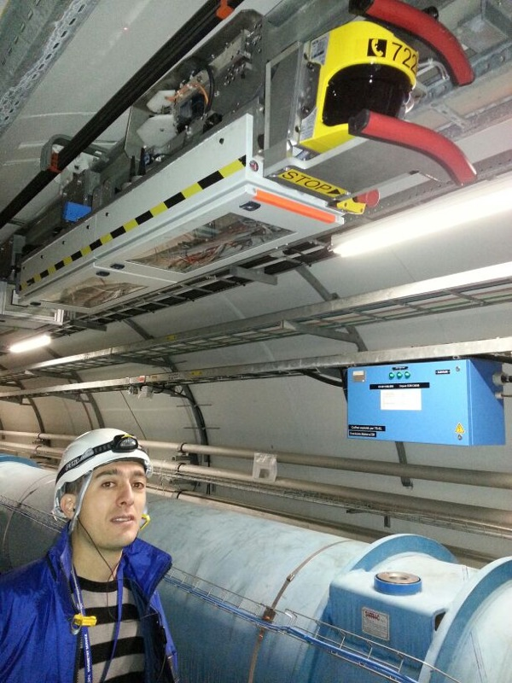
TIM and Robot intervention
Important to improve the remote inspection of collimators.
Today we have two options for visual/sound inspection:
TIM:
Sound inspection of the collimators done with the TIM in S34 (23/24 April 2012).
Possible to take pictures.
Acknowledgment to EN/HE!!!

Slide 37
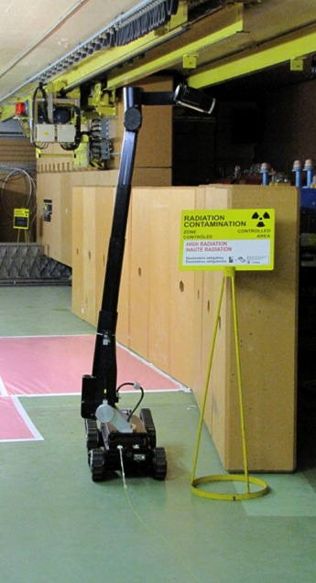
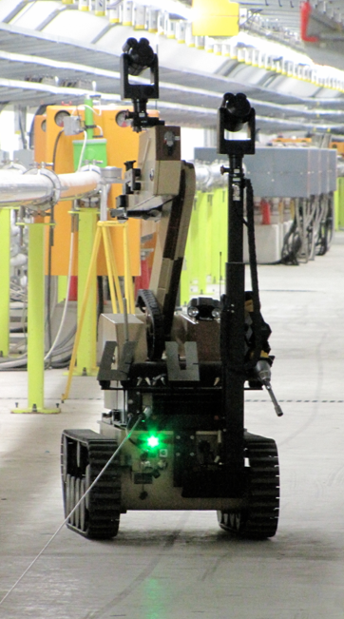
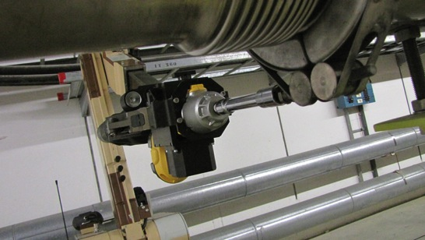
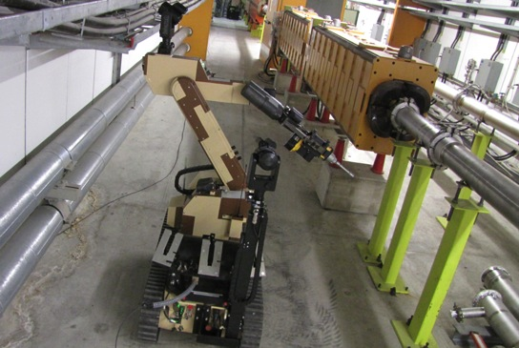
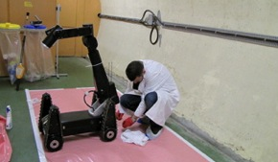
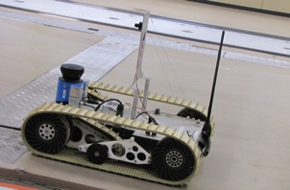
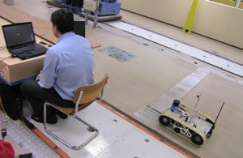
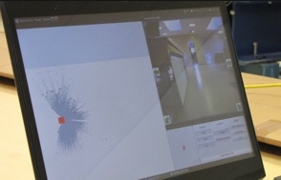
Real scale tests at CERN
Technical Specification

Slide 38

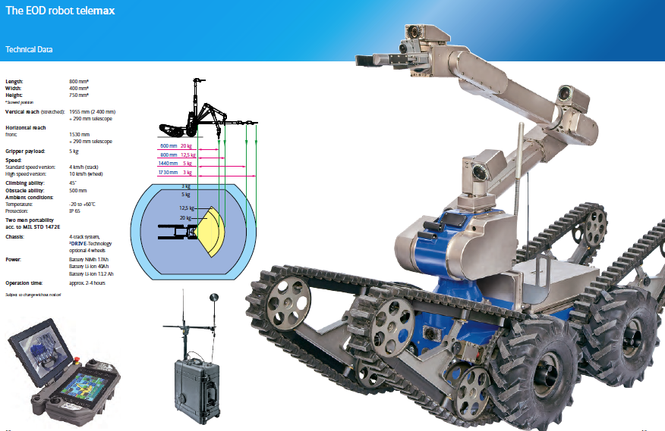
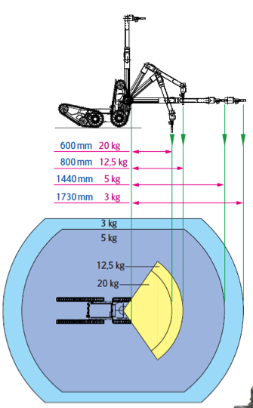
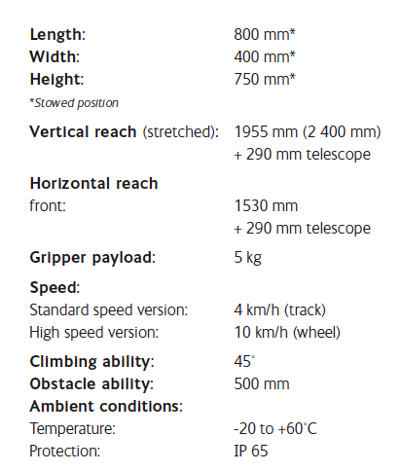

Slide 39
Collimator standard maintenance (inspection)
Check each collimator mechanics and electronics.
  Cycle from out to in, to anti-collision and back to out.
  Check 5th axis for clearance
  Check water cooling flow
  Check temperature sensors
  Check switches, LVDT’s, resolvers, motors and drivers
  Map sound profile for each collimator
  Check rails
  Check roller screws

Slide 40
Redo Hardware Commissioning Steps
Full system tests (with or without vacuum)
remove blocking of jaws
verify switch position with respect to mechanical end stops
check jaw movement, position sensors/switch response and low level control (power supply,...)
check temperature sensors
check auto-retraction (amount of retraction)
LVDT and resolver calibration
check interlock chain
check communication
check water tightness/ adjust flow-rate
Full system tests (vacuum required)
final auto-retraction test
measurement of mechanical play
check LVDT and resolver calibration (if not done before under vacuum)
The results of all steps are entered to MTF, in general an OK, date and operator. For some steps, data has to be filled in (auto-retraction, calibration).

Slide 41
Maintenance issues identified
Screws
Rails
Motors
Switches
LVDT
Connectors
Resolver
Dust (from springs, screws, rails, environment)
Water (connectors, flow rate, filter, manifolds)

Slide 42
Collimator spare situation before/after LS1
New production of 16 + 4 TCTP
New production of 2 + 1 TCSP
New production of 2 + 1 TCAPD
 | Installed | Spare | Installed | Spare | "recovered spares"
Collimator type | before LS1 |  | after LS1
TCP | 8 | 3 | 8 | 2
TCS | 32 | 4 | 30 | 4 | 2
TCSP | - | - | 2 | 1
TCT | 30 | 3 | 14 | 3
TCTP | - | - | 16 | 4 | 16
TCLP | 4 | 6 | 8 | 2
TCLIA | 2 | 1 | 2 | 1
TCTVB | 4 | 1 | 0 | 1 | 4
TCDI | 13 | 3 | 13 | 3
TCDD | 1 | 1 | 1 | 1
Total | 94 | 22 | 90 | 26

Slide 43
Precise measurement of collimator position
LVDTs are intrinsically precise, they accuracy depends only on electronics!
In laboratory we consistently have accuracieis weel below the micrometer.
In the tunnel, in normal conditions we get better than 5 micrometer accuracy (often also less than 1 micrometer).
However, they have shown an unexpected sensitivity to slowly varying magnetic fields.
Up to 200 micrometer drift measured during cycling of warm magnets. Partially mitigated by magnetic shielding (µ-metal).

Slide 44
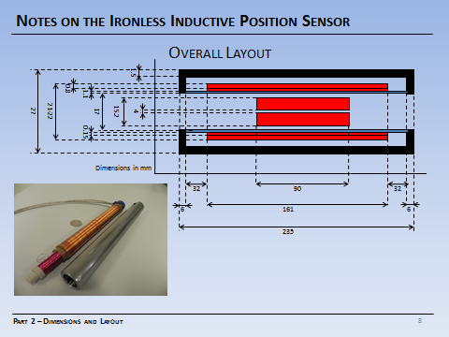
Interference on LVDT (PhD A. Danisi)

Slide 45
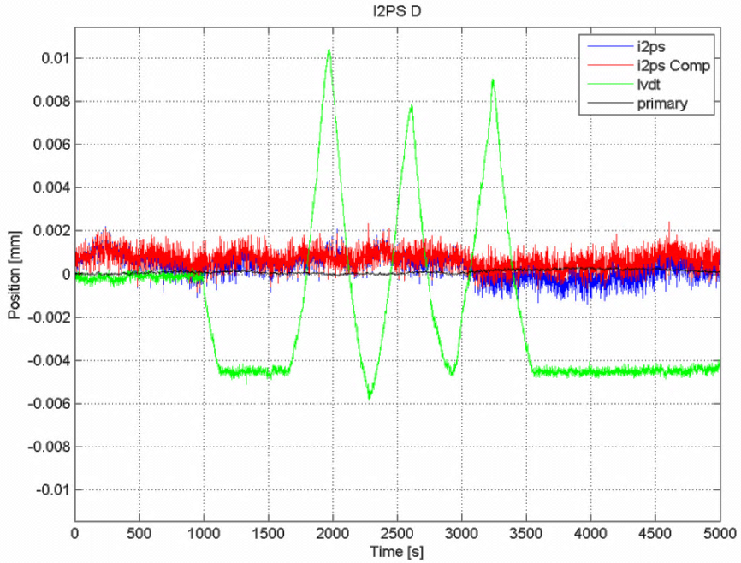
Interference on LVDT

Slide 46
Conclusions (1/2)
Tackle the roller screw problem as first priority
Detect problems in early stages
Investigate on the capabilities of the TIM, the Telemax or similar robots for inspections and interventions.
Reference sound recording of all collimators.
Improve the accessibility to the screw (cap) (Phase 2!)
A regular check during long breaks and shut-downs with re-lubrication of the screw.
Automatic motion cycles during LS1 (long period without regular motion cycles) to be planned.

Slide 47
Conclusions (2/2)
Order enough spare roller screws for replacements
Work on improving the design/ phase 1 and 2 tables – search for other producers and screw types
Systematic reconditioning of replaced collimators
Reconsiders the spare situation (TCP!)
Swap in the (near?) future from screw replacement to collimator replacement
Improve the remote operations for the inspection and the collimator exchange (vacuum connections, transport and handling)
Store (space) replaced collimators for future reconditioning

Slide 48
Spare slides

Slide 49
Collimator roller screw replacement
Elogbook 22/04/2012 00:16:45 22/04/2012 00:46:43 00:29:58
  Collimator Hardware TCSG.5L3.B1 Collimator stuck; won't drive to injection settings. - The TCSG.5L3.B1 failed to go correctly to injection settings after the collimator setup ( suspected problem with roller screw), and required piquet reset. Normally this collimator should not be included in the active set until the hardware problem is fixed.
Performance loss on axis B. First steps lost during the week end, recovery with simple resetting. Within 3 days the situation was degrading a lot. The axis, and therefore the collimator had to be disabled in parking position after regularly loosing steps.
This triggered a systematic sound check with the TIM in point 3. The noise profile off all 16 out of 18 collimators have been registered, a list of conspicuous collimators has been delivered for further inspection.
In parallel, torque measurements have been performed on most of the collimators, in reducing the motor current until steps are lost.
These values have been compared with original data taken during commissioning campaigns.
All suspicious collimators have been checked and validated for operation in situ.

Slide 50
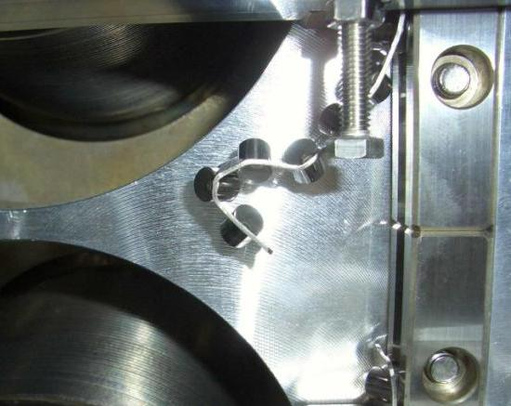
Effects
First problem observed:
„TCDI 206“ effect (2006)
  Vertical orientation, cage moves out completely
    Origin of problem traced back to insufficient (abnormal) preload
    Revision of assembly procedure, adding of central pin, development of CERN tool to uniform preload.
TCS 10“ effect (2006 production, control tests end of 2007)
  Skew orientation, cage moves until end stop, stoke limitation
INOX cage problematic:
Soft material (Ni steel), marks on rollers, profile verification of roller spacing
  Visit to SKF, Statement: Every imperfection in alignment (microns) will make the cage move out.
  Re-machining at the SKF plant of two tables and the base plate did not solve the detected hard points. A change to an other cage form and material was discussed  rigid Al cage with same rollers.
  Several tests with a few 100 cycles showed good results
  CERCA assembly much more efficient with new cages
  Every table not welded to the beam has been disassembled, pinned and remounted with Al cages
Other possible effects:
  Torque increase
  Wear
  Hard points

Slide 51
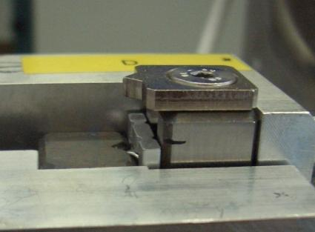
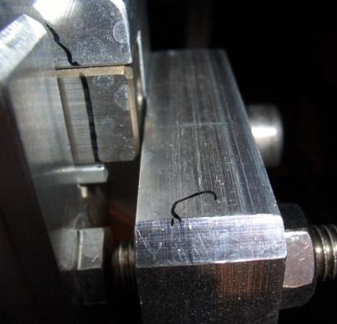
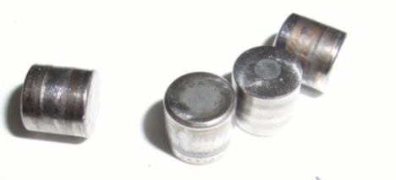
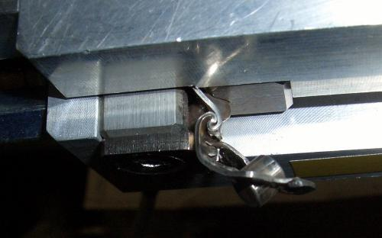
Rails
„Prototype“ effect:
After damage, tables re-conditioned with 3 sides INOX roller cages, 1 table with Al cages:
  Vertical: 300 cycles
  1 side (INOX) reaches end stops (lower left side)
  Torque measurement: No significant increase detected
  Test re-launched on upper jaw
  (1 side INOX, 1 side Al)
  Total of 3500 cycles:
  Al moved less than 1 mm
  INOX destroyed

Slide 52
Next tests
Vertical collimator first series (TCS 003, 2 years of LHC tunnel)
  Torque measurement, Cycle 1000 times, torque measurement etc....
Vertical collimator (TCS or TCP with Al cages)
  Torque measurement, Cycle 1000 times, torque measurement etc....
Re-launch Prototype?
  What conditions
Prepare improvement on existing collimators (installed or surface)

Slide 53
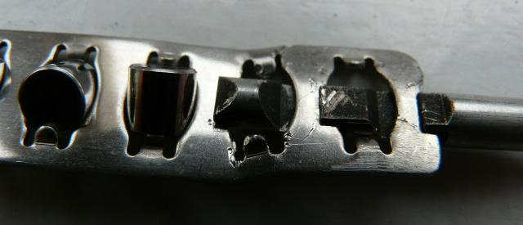
Intermediate solution
Equip critical orientations (skew and vertical) with “hook”
Summer effort with MME to install the hooks in the tunnel!

