Slide 1



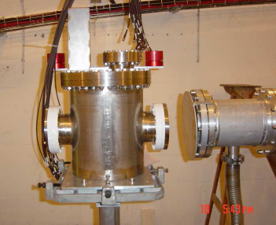
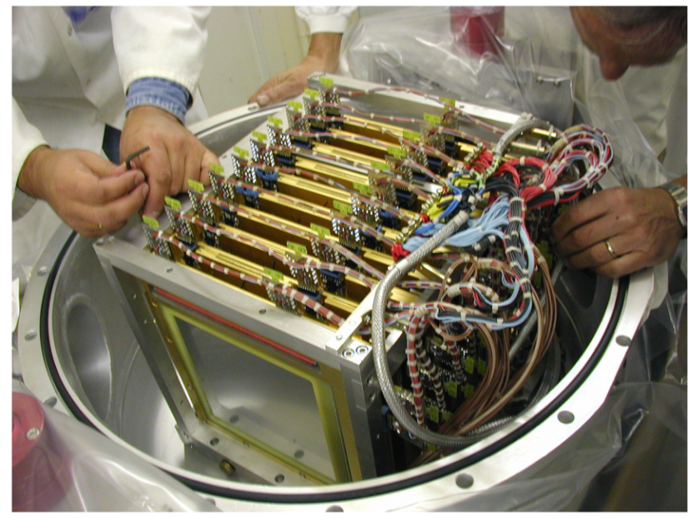
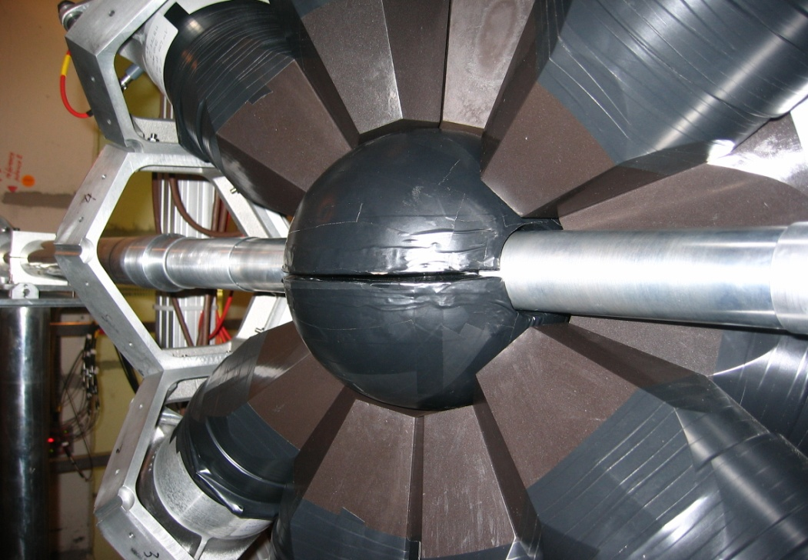
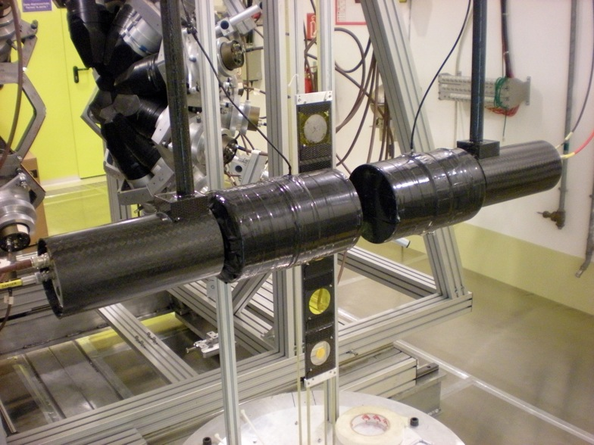
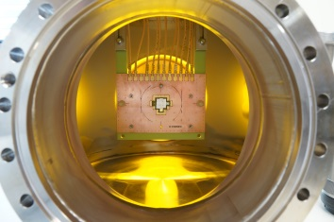
An outlook on "Physics at the new CERN neutron beam line"
The n_TOF Collaboration, www.cern.ch/nTOF
Physics at the new CERN neutron beam line
Carlos GUERRERO on behalf of The n_TOF Collaboration
CERN, Geneva (Switzerland)
With figures from: E. Chiaveri, V. Vlachoudis, S. Girod, S. Barros, C. Lederer, C. Weiss, G. Smith, S. Pomp, …

Slide 2
The n_TOF Collaboration
The n_TOF Collaboration
30 Research Institutions from Europe, Asia and USA.
16 PhD students
NUCLEAR ASTROPHYSICS: stellar nucleosynthesis
Neutron capture and (n,α) cross section of stable & unstable isotopes playing a role in the s- and r-processes (0.1-500 keV).
NUCLEAR TECHNOLOGIES: ADS, Gen-IV and Th/U fuel cycle
Neutron capture and fission cross sections of Actinides in the thermal (meV), epithermal (eV-keV) and fast (MeV) energy regions.
BASIC NUCLEAR PHYSICS: fission process, levels densities, γ-ray strength functions
Time-of-Flight measurements with dedicated detectors providing valuable information on basic nuclear physics quantities.

Slide 3
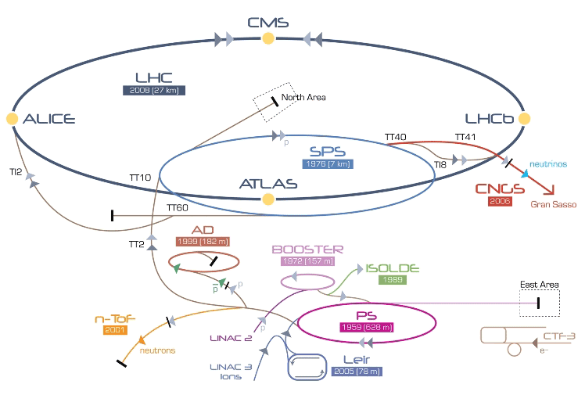
n_TOF: A spallation neutron source using the PS 20 GeV/c p beam

Slide 4
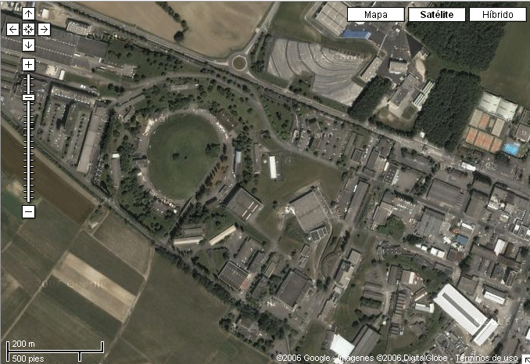

The n_TOF Facility at CERN
n_TOF EAR-1 @185 m
n_TOF EAR-2 @20 m
Booster
1.4 GeV
PS 20 GeV
Linac
50 MeV

Slide 5
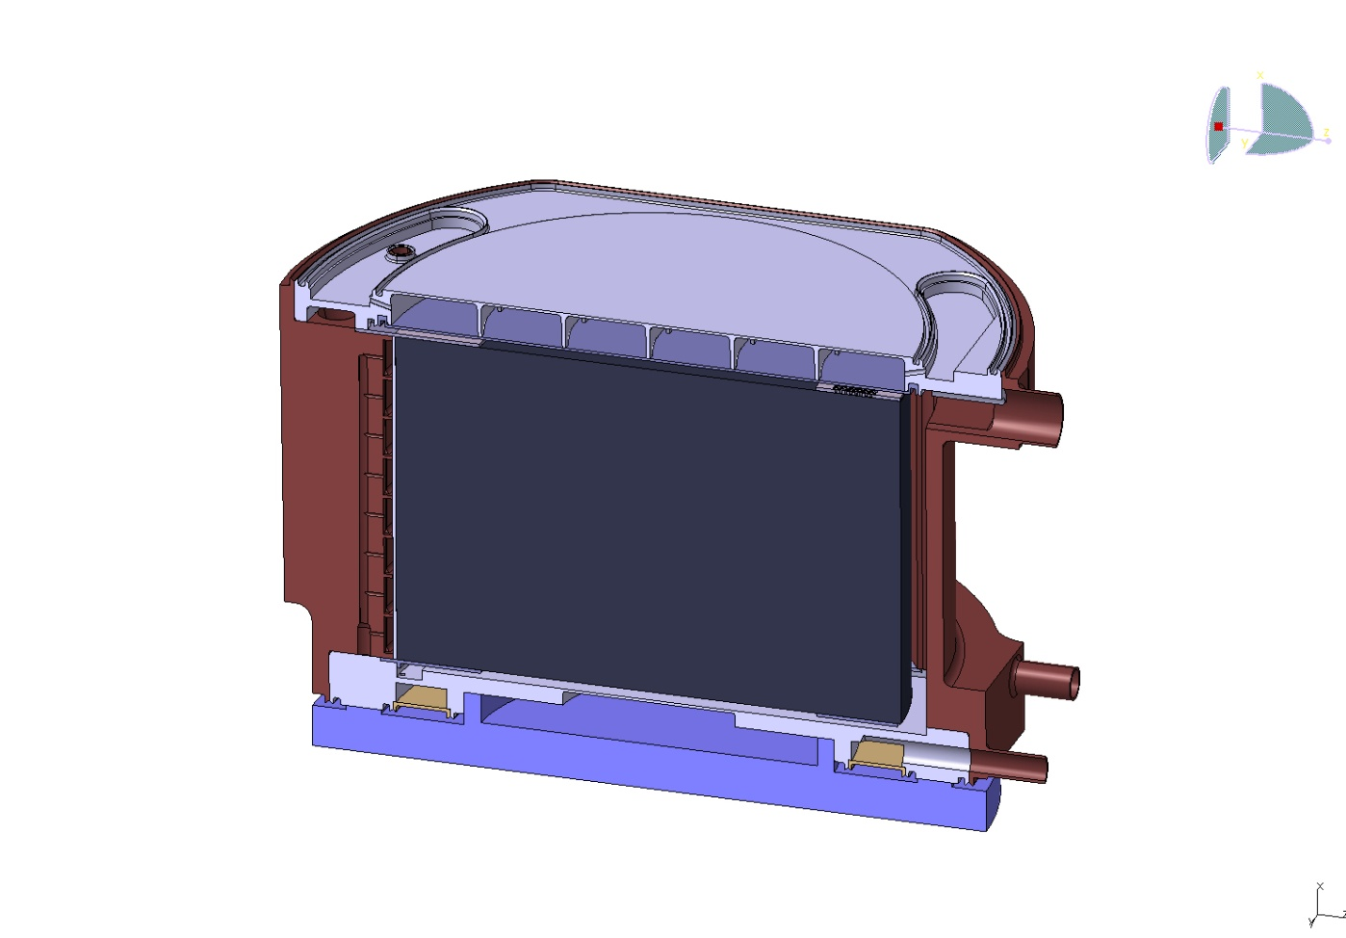
The n_TOF lead spallation target (from 2008 onwards)
Neutrons (EAR-2)
(meV to ~300 MeV)
1 cm cooling (water)
4 cm moderator (water/borated water)
Protons
(20 GeV/c)
Neutrons (EAR-1)
(meV to GeV)
Pb
Approx. 400 FAST (MeV-GeV) neutrons/proton (20 GeV/c) are generated @target
- EAR-1: Moderation in 5 cm of water+¹⁰B-water and 185 m horizontal flight path (meV to GeV)
- EAR-2: Moderation in ~1 cm of water meV to GeV and 20 m vertical flight path (meV to ~300 MeV)
ToF (GeV) ~ 630 ns
ToF (MeV) ~ 13 μs // 1.3 μs
ToF (keV) ~ 420 μs // 42 μs
ToF (eV) ~ 13 ms // 1.3 ms
ToF (10 meV) ~ 133 ms // 13 ms

Slide 6
The existing n_TOF EAR1 @185 m

Slide 7
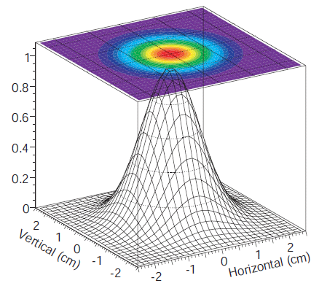
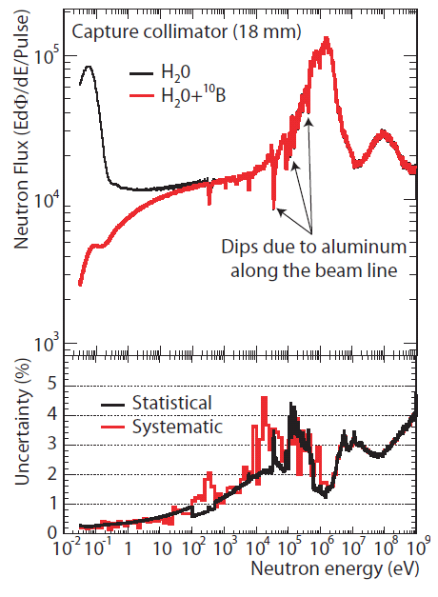
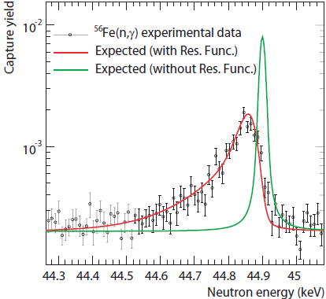
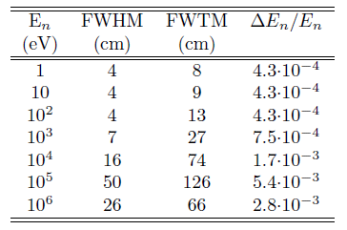
Main characteristics of the existing n_TOF EAR-1
BEAM PROFILE
NEUTRON FLUX
σ~7 mm
Ø_{capture} ≈2 cm
Ø_{fission} ≈ 8 cm
ENERGY RESOLUTION
0,6·10⁶ neutrons/pulse (capture mode)
12·10⁶ neutrons/pulse (fission mode)
See C. Guerrero et al. Eur Phys. J. A 49:27 (2013)

Slide 8
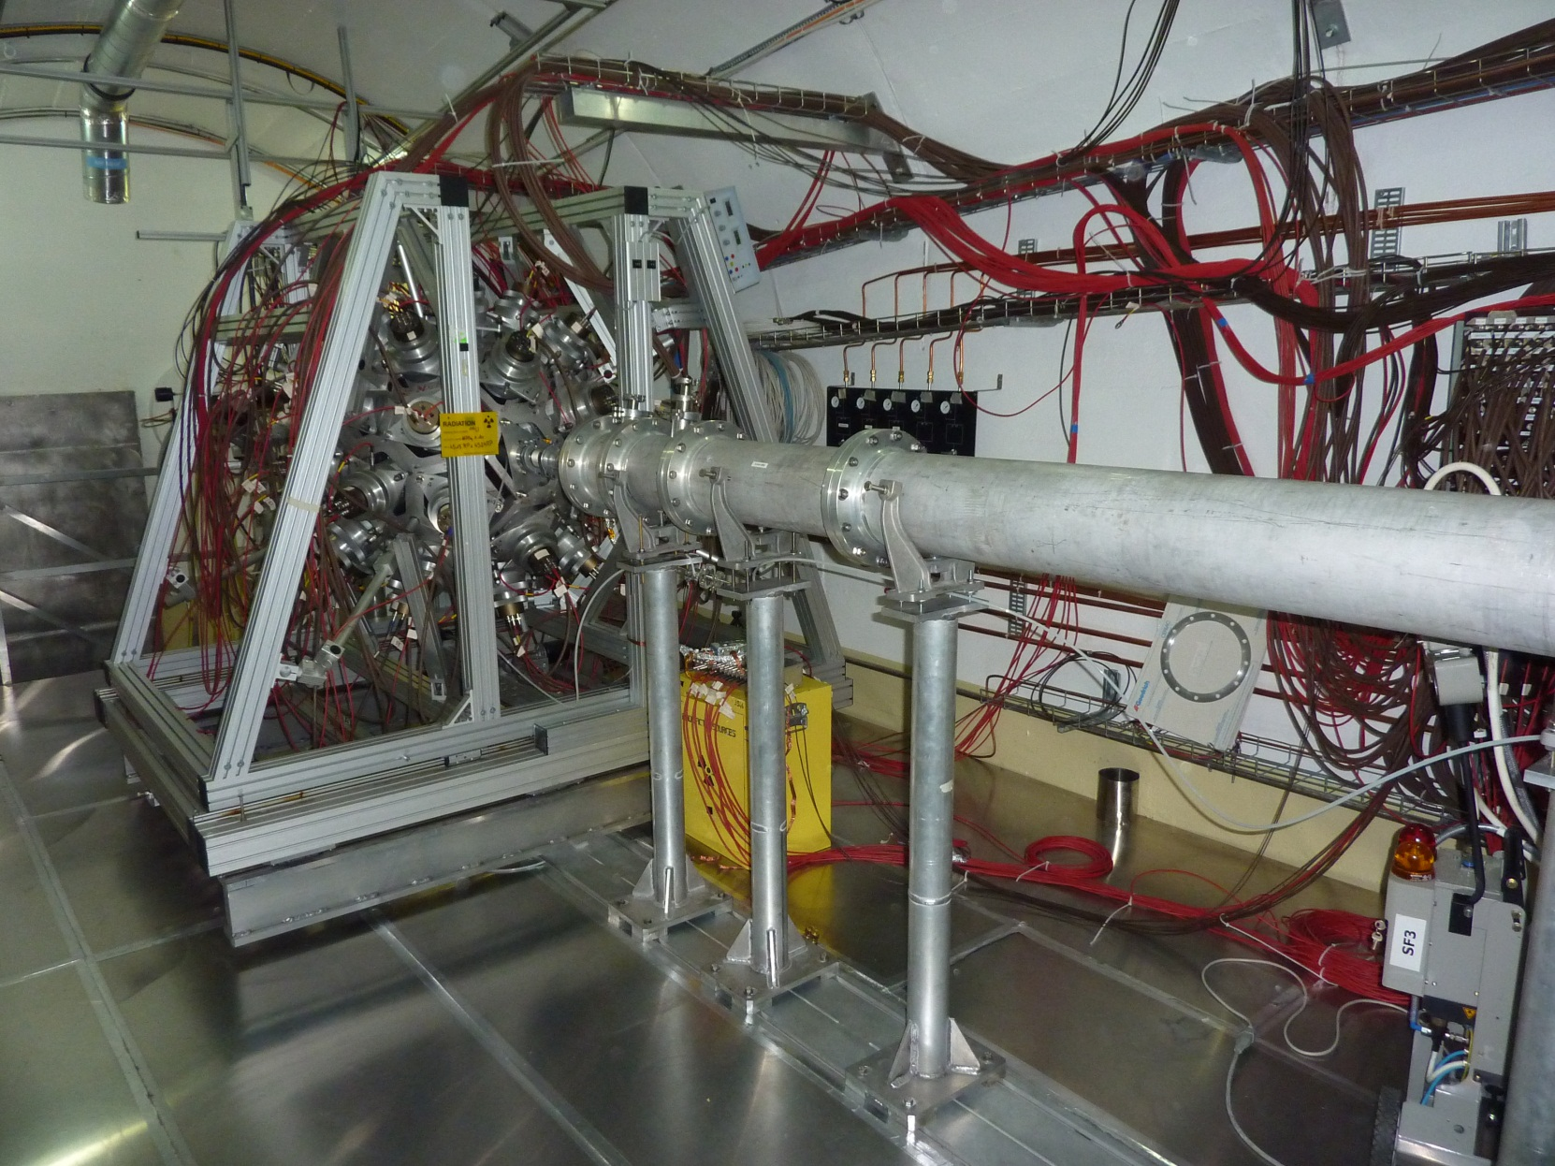
Main characteristics of the existing n_TOF EAR-1
Work Sector Type A:
use of non-encapsulated radioactive samples allowed since 2010!!!

Slide 9
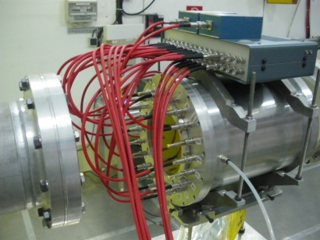
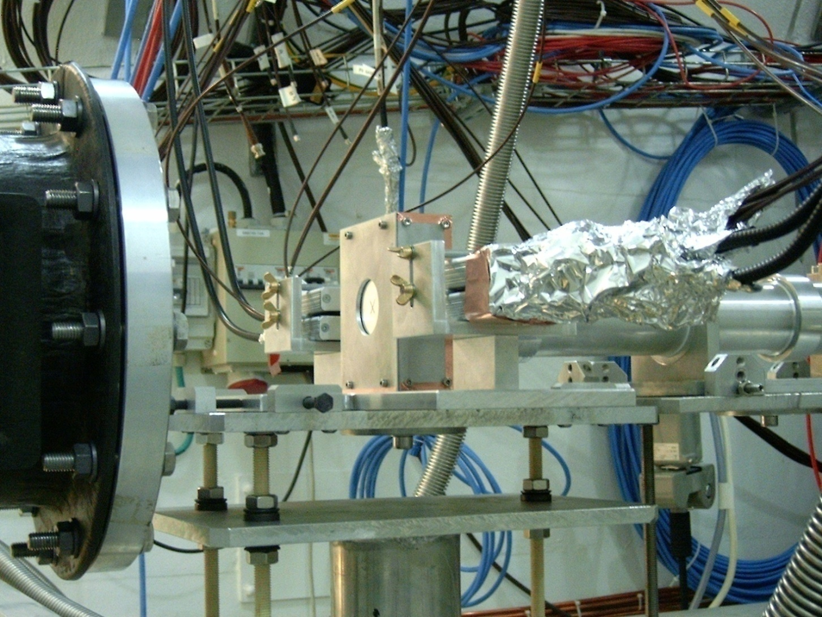
n_TOF EAR1 Phase2 (2009-2012)
Nuclear technologies
Nuclear Astrophysics
Medical applications
Ang. Distrib. FF
²³²Th, ²³⁷Np, ^{234,235,238}U
Fission
^{240,242}Pu, ²³⁵U
Neutron capture
^{54,56,57}Fe, ^{58,60,62,63}Ni,²⁵Mg, ⁹³Zr, ^{235, 236,238}U, ²⁴¹Am
(n,α)
¹⁰B, ³³S, ⁵⁹Ni

Slide 10
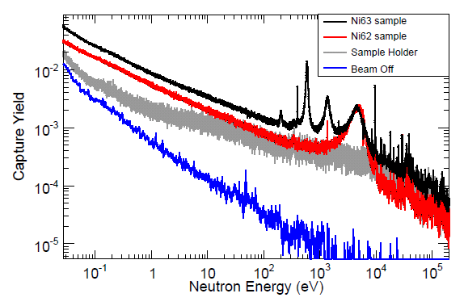
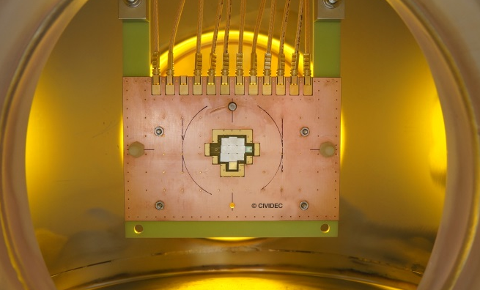
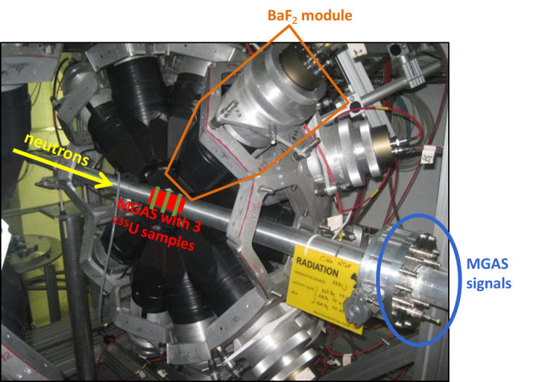
Recent results
C. Lederer et al., "Neutron capture cross section of unstable ⁶³Ni: implications for stellar nucleosynthesis", Phys. Rev. Lett. 110 (2013) 022501
C. Weiss et al., "A new CVD diamond mosaic-detector for (n,α) cross-section measurements at the n_TOF experiment at CERN", Nucl. Instrum. and Meth. A (In Press)
C. Guerrero et al., “Simultaneous measurement of neutron-induced capture and fission reactions at CERN”, Eur. Phys. J. A (2012) 48:29
See more on E. Mendoza and A. Tsinganis talks!

Slide 11
The future n_TOF EAR2 @20 m

Slide 12
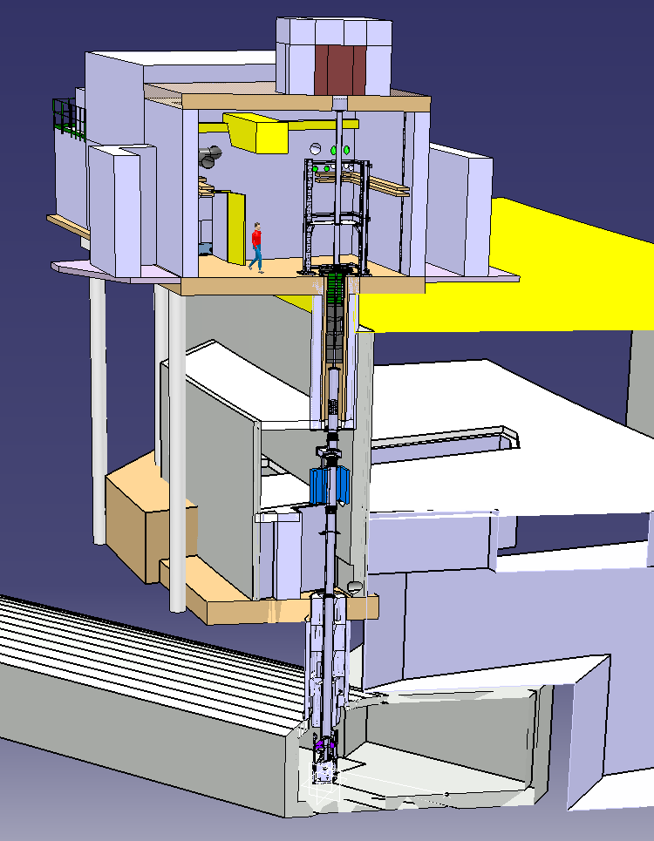
The future: n_TOF vertical flight path at 20 m
Beam Dump
EAR-2 Exp. Hall
Collimator
New
20 meters flight path
Magnet
Existing
Pit shielding
Target

Slide 13
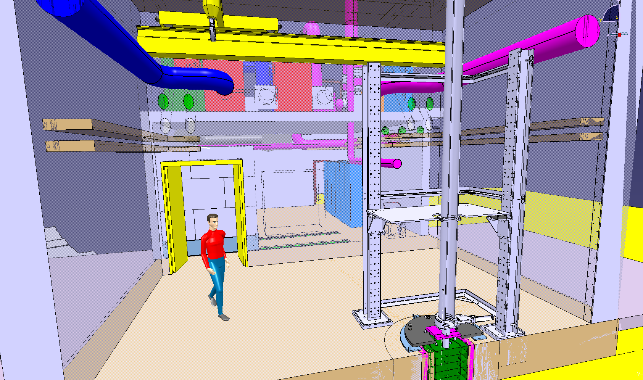
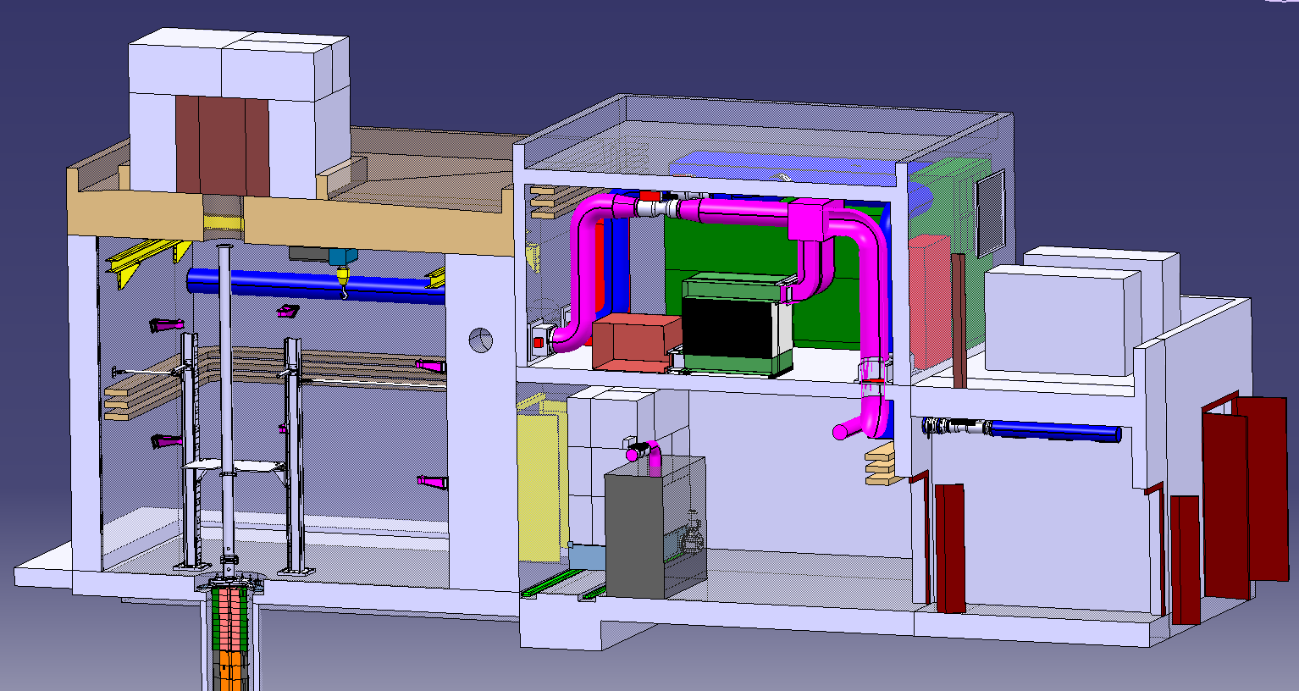
The future: n_TOF vertical flight path at 20 m

Slide 14
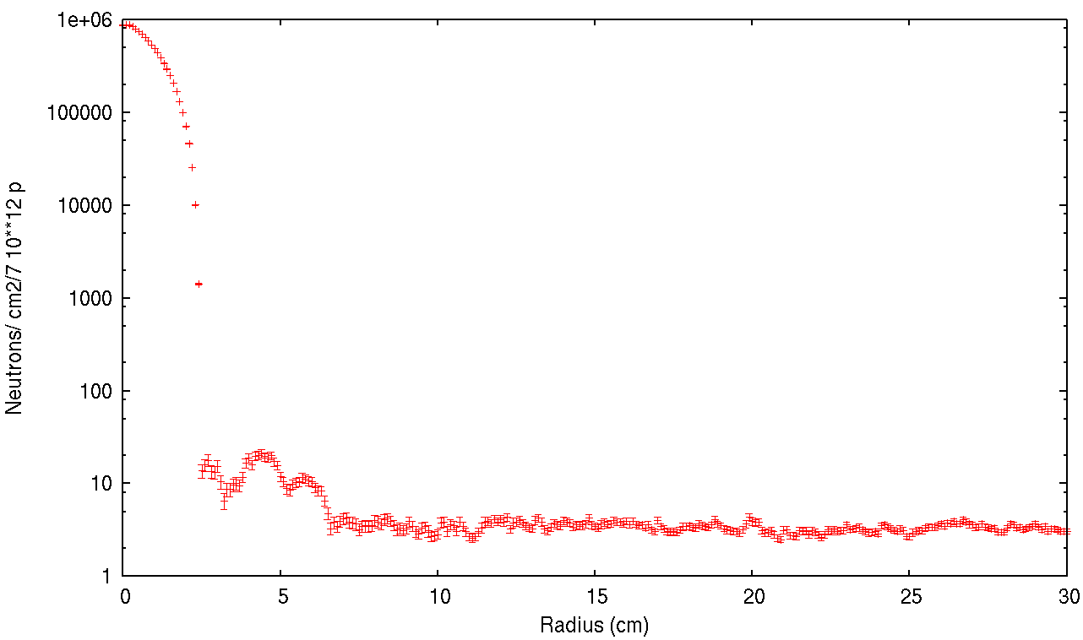
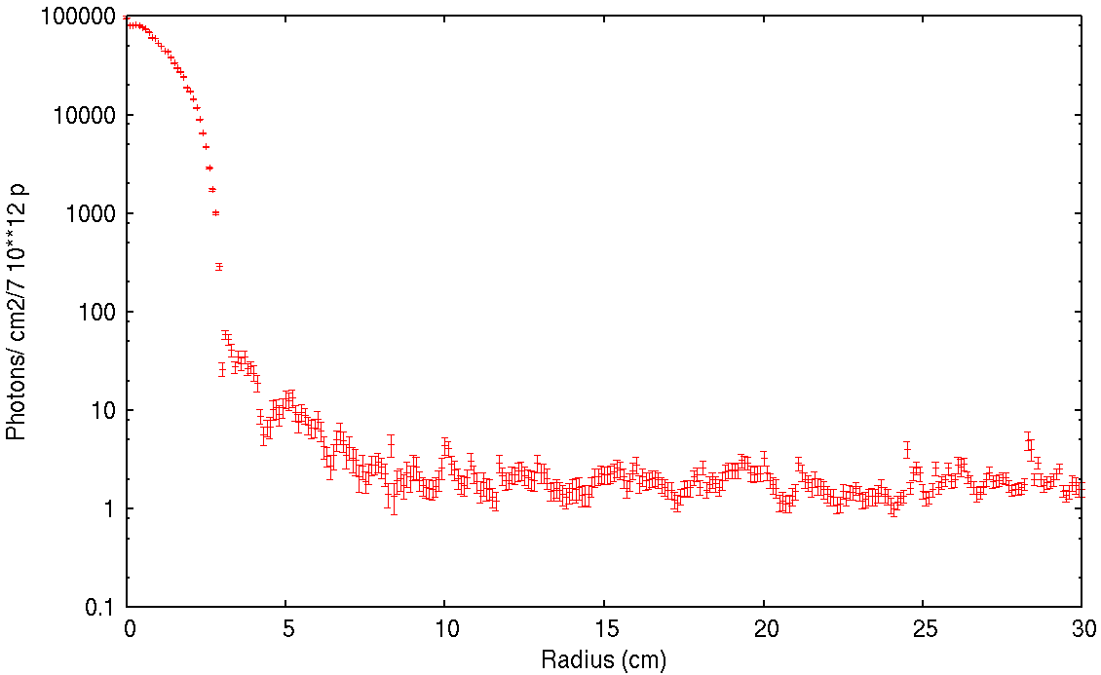
Detailed FLUKA simulation for the design of collimators and dump
Neutrons (200 eV – 20 keV)
5 orders of magnitude
Photons (10 us - 100 us)
4 orders of magnitude

Slide 15
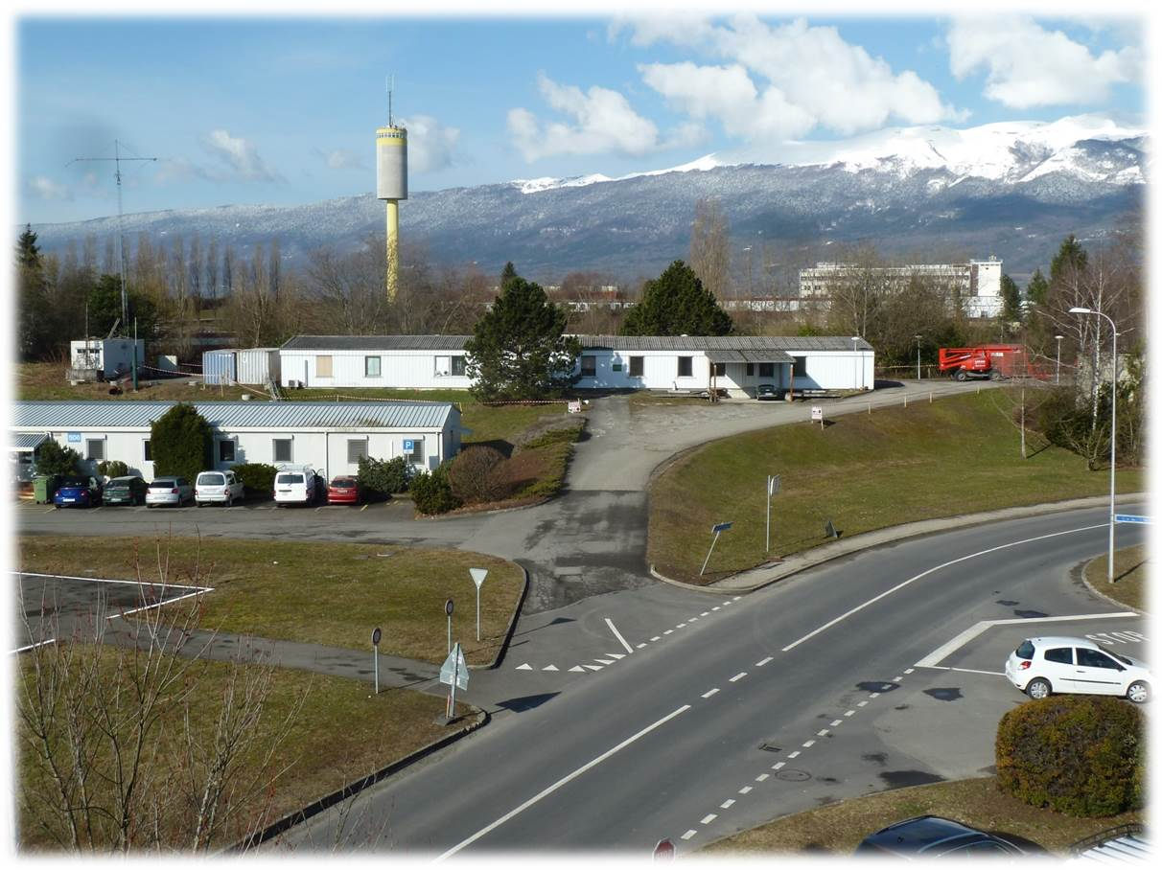
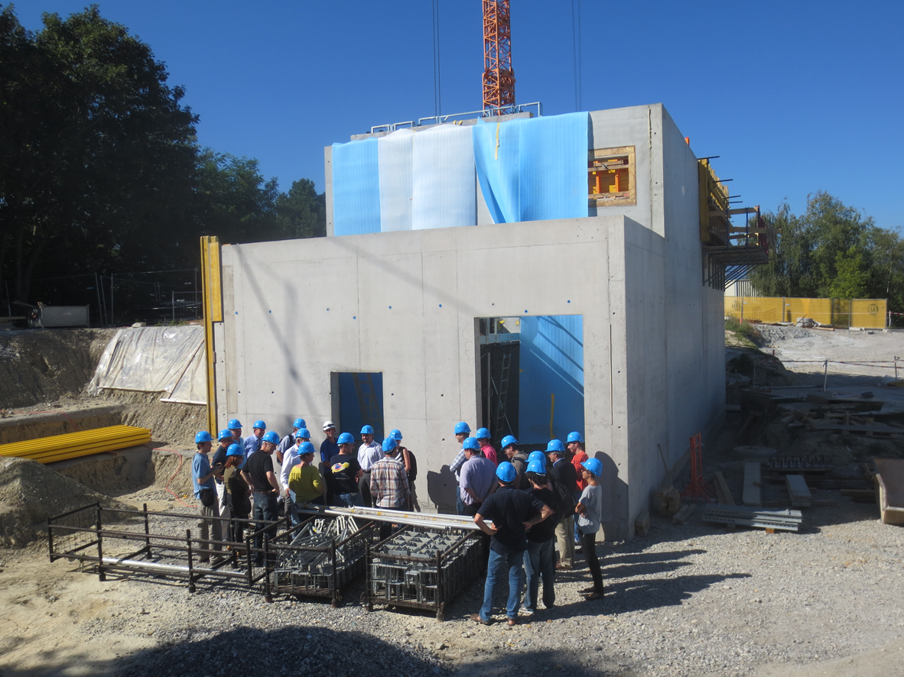
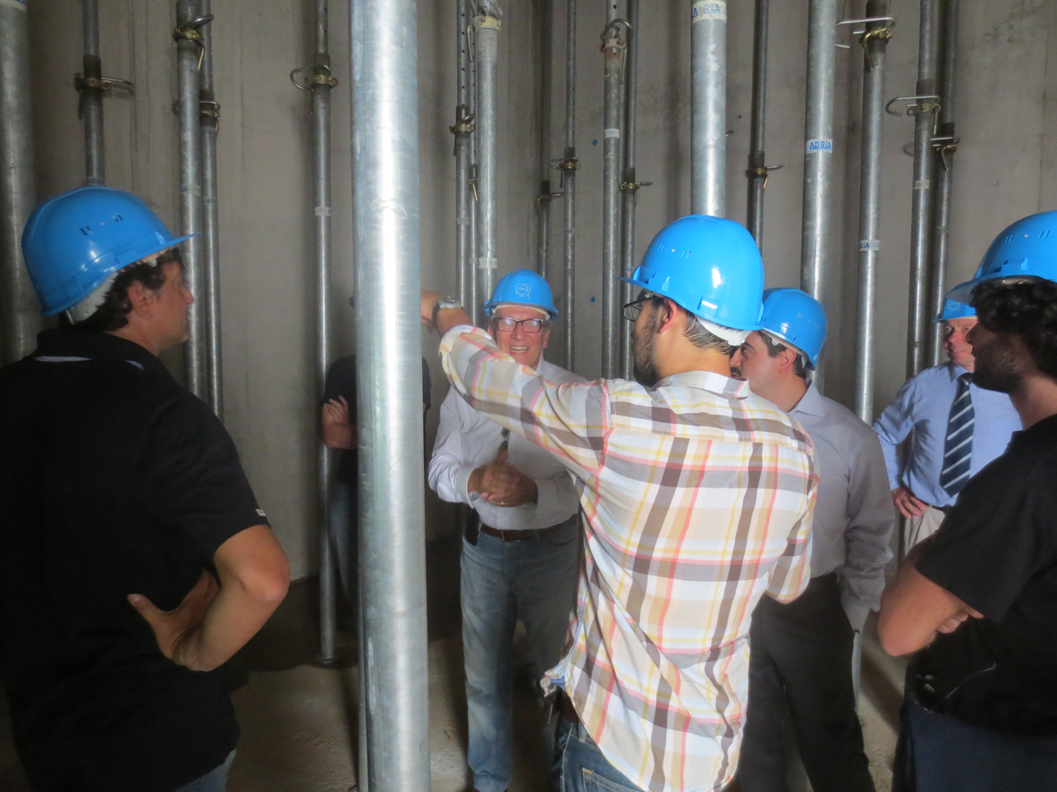
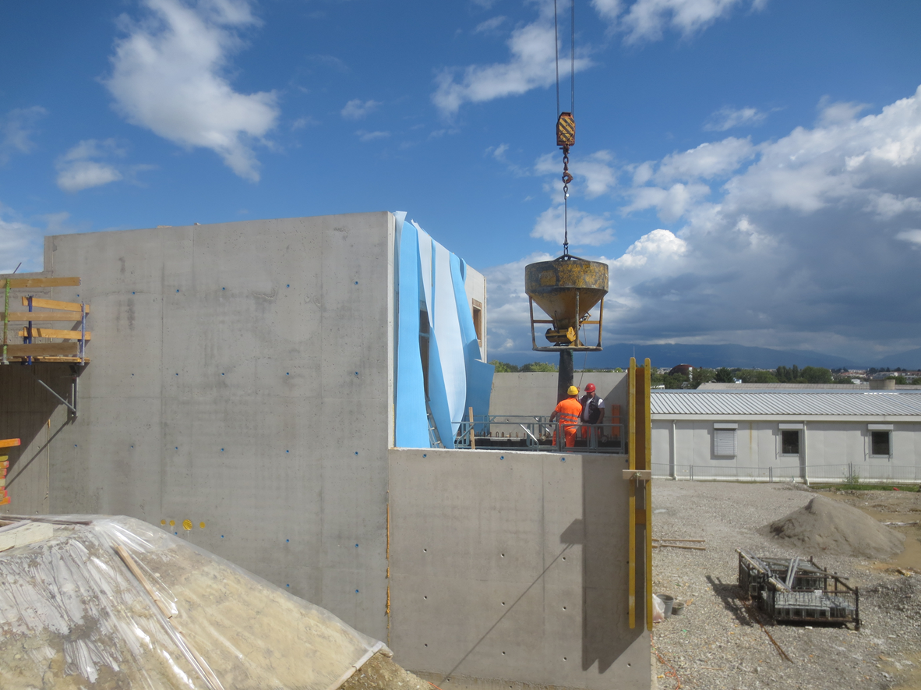
Construction of n_TOF EAR-2

Slide 16
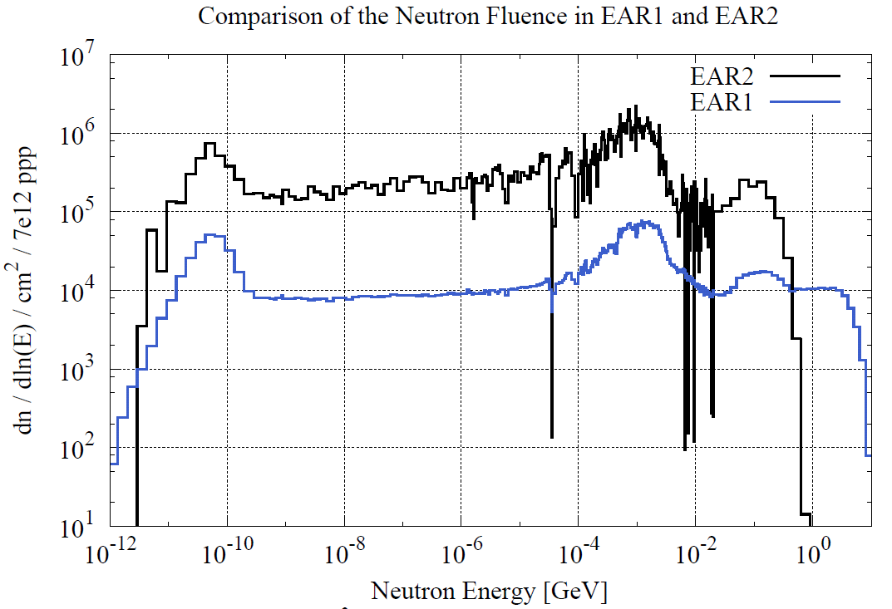
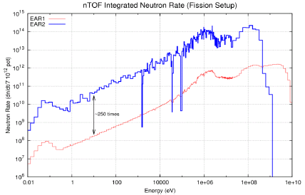
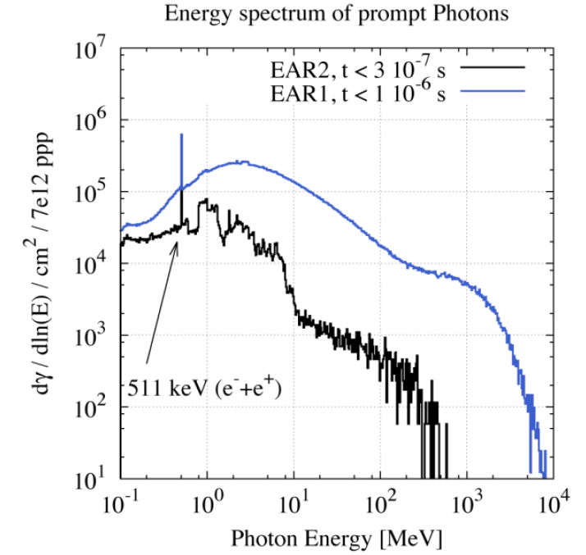
Main characteristics of the future n_TOF EAR-2
BEAM PROFILE
NEUTRON FLUX
Ø_{capture} ≈2 cm
Ø_{fission} ≈ 8 cm
γ-flash
φ_{EAR-2} ~ 25 x φ_{EAR-1}
E. Chiaveri et al., “Proposal for n_TOF Experimental Area 2”, CERN-INTC-2012-029

Slide 17
Proposals for experiments at n_TOF EAR-2
Advantages of EAR-2 compared to EAR-1:
on very small samples: reduce activity or use samples with limited availability
on isotopes with very small cross sections: where signal/background ratio is crucial
in much shorter time: some meas. can be eventually repeated to reduce systematic errors
on neutron-induced cross sections at high energies (E_{n}>1-100 MeV), which are not possible in the existing EAR-1, will benefit if the γ-flash is reduced.
possibility to bring a ‘basket’ with electronics component down to only 1.5 m from the target (10¹⁰ neutrons/pulse): irradiation facility (e.g. SEE)

Slide 18
Proposals (some) for experiments at n_TOF EAR-2
Commissioning
First beam scheduled for July 2014
The commissioning, led by F. Gunsing, will take 3 to 6 months
First beams for physics by the end of 2014: detailed proposal for CERN INTC February 2014
Nuclear Technology
The role of ²³⁸Pu and ²⁴⁴Cm in the management of nuclear waste: (n, γ) cross sections
Measurement of the capture (and fission) cross sections of the fissile ^{239,241}Pu and ²⁴⁵Cm
Measurements of (n,xn) reaction cross sections with HPGe detectors (¹⁹⁷Au, ¹⁸¹Ta, etc.)
Measurements of (n,n) and (n,xn) reactions cross sections with CsI+Si telescopes
Fission process and the emission of prompt γ’s on ²³⁵U and ^{239,241}Pu isotopes with STEFF
Fission cross section of the ²³⁰Th, ²³¹Pa and ²³²U reaction
…..
Astrophysics
Measurement of the ²⁵Mg(n, α)²²Ne cross section
Neutron capture measurement of the s-process branching points ⁷⁹Se and ¹⁴⁷Pm
Destruction of the cosmic γ-ray emitter ²⁶Al by neutron induced reactions
Measurement of ⁷Be(n,p)⁷Li and ⁷Be(n,α)⁴He cross sections, for the cosmological Li problem.
…..
Others include basic nuclear physics, medical physics, detectors tests, etc.

Slide 19
Capture cross sections of fissile isotopes
TAC + MGAS technique successful @ EAR1, BUT:
For ²³³U and ²³⁵U masses of ~30-100 mg used
Requires a stack of many samples/ detectors
Background from fission detectors
Difficulty to find large number of samples
The thin/Thick approach also difficult (samples)
Need TAC for background identification (no C6D6)
γ-flash limits the neutron energy (E_{n}<10 keV)
All these are overcome at EAR-2
A two sample back-to-back approach will be employed
Detector choice for capture could be array of C₆D₆ (x4) or new calorimeter (see CHANDA!)
The reduced γ-flash should allow for a higher energy limit
First campaigns for ²³³U and ²³⁵U, then ^{239,241}Pu and ²⁴⁵Cm

Slide 20
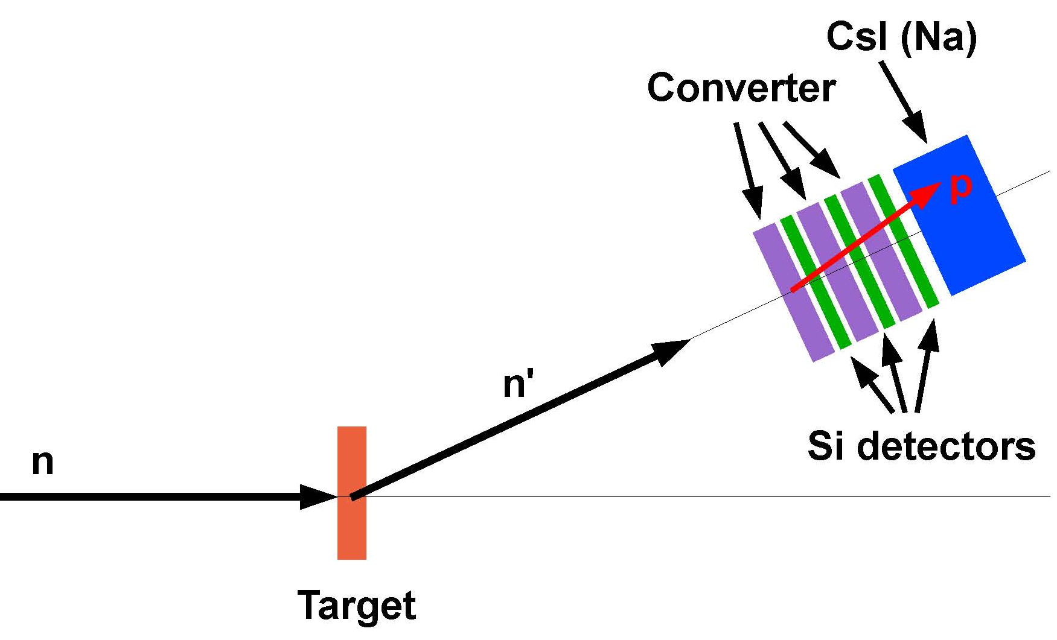
(n,n) and (n,xn) cross sections at high energy
Physics: optical model, …
Applications: ADS, SEE, Medical, Dosimetry, …
Exp. data: some (n,n) above 30 MeV [e.g. Öhrn et al., PRC77 (2008) 024605]
almost nothing on (n,nx)! [e.g. Sagrado Garcia et al., PRC84 (2011) 044619]
Option A
Principle:
Measure (n,xn) through identification of the reaction product’s γ-ray emission.
Detectors:
HPGe (γ-flash could be an issue).
Groups involved:
NTUA (Greece), CEA (France), IFIN-HH (Romania) et al.
Option B
Principle: Measure the ejected neutron via the associate proton recoil in a convertor.
Groups involved: UU (Sweden), CEA (France) et al.

Slide 21
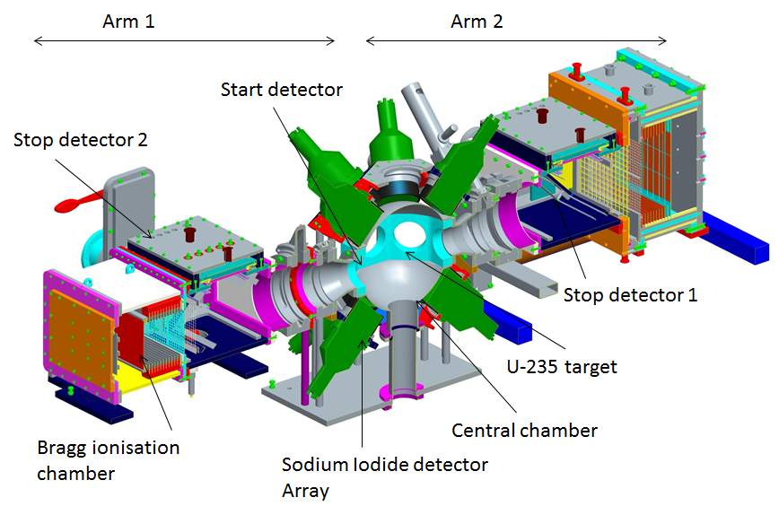
(n,f) and prompt γ-ray emission of ²³⁵U and ^{239,241}Pu with STEFF
STEFF: Spectrometer for Exotic Fission Fragments [University of Manchester (UK)]
Fragment Mass identification through ToF (velocity) plus Bragg IC (energy)
γ-rays energies and multiplicities through NaI detector array (x16) [NEA HPRL]
2-Energy, 2-velocity Spectrometer.

Slide 22
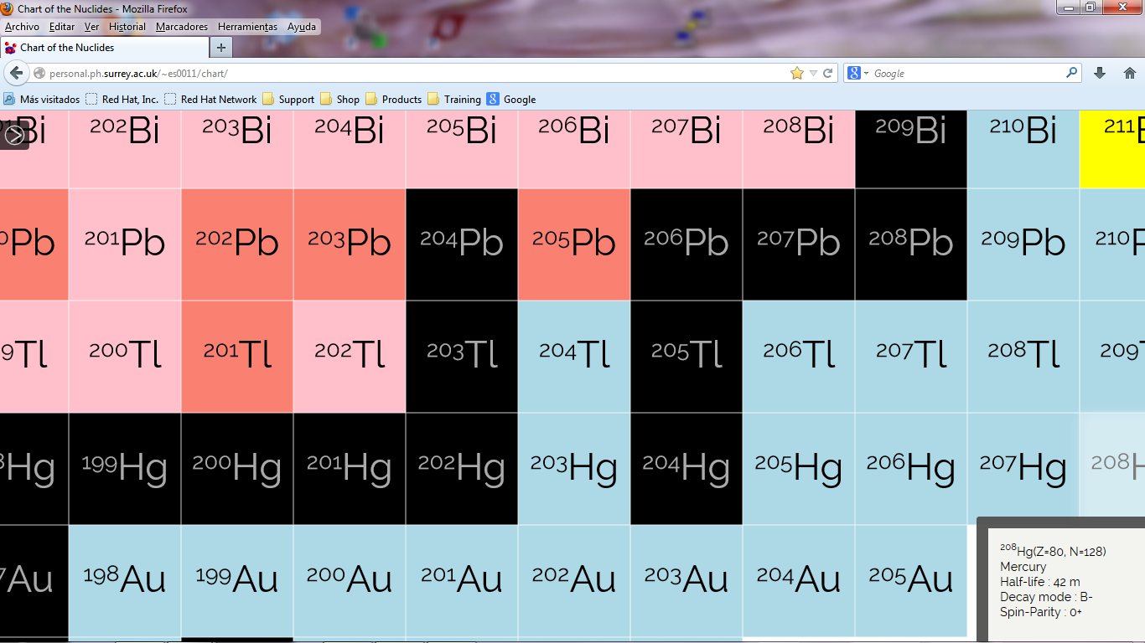

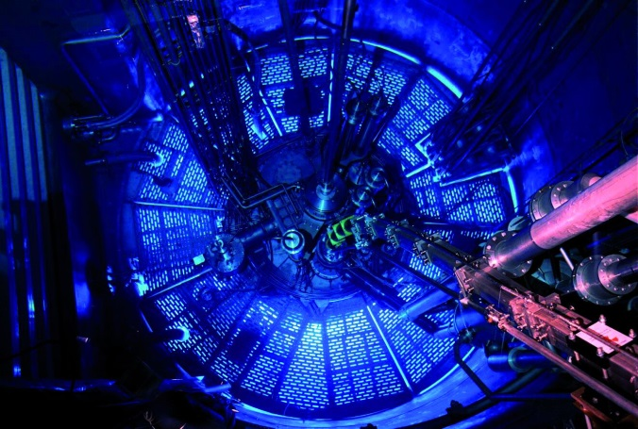
Tackling the s-process branching points ⁷⁹Se, ¹⁴⁷Pm, ¹⁷¹Tm and ²⁰⁴Tl
e.g. s-process branching at ²⁰⁴Tl
  ²⁰⁵Pb (t_{1/2} = 1.5x10⁷ a) is s-only, thus the SS abundances of ²⁰⁵Pb/²⁰⁵Tl provides chronometric info on the time span between the last nucleosynthetic events and the formation of solar system solid bodies. (At present, upper limit for the ²⁰⁵Pb/²⁰⁴Pb abundance ratio of 9x10⁻⁵ in meteorites)
Production via (n,γ) or (n,γ)β⁻ in the ILL research reactor
Φ_{n,th} = 1.5x10¹⁵ n/cm²/s (→ 60 days)
¹⁴⁷Pm: ¹⁴⁶Nd(n,γ)¹⁴⁷Nd (β⁻, 10d)¹⁴⁷Pm → 0.29 mg (2.6 y)
¹⁷¹Tm: ¹⁷⁰Er(n,γ)¹⁷¹Er (β⁻, 7.5h)¹⁷¹Tm → 3.69 mg (1.9 y)
²⁰⁴Tl: ²⁰³Tl(n,γ)²⁰⁴Tl → 11.0 mg (3.8 y)
GOAL is to measure MACS with C₆D₆ at EAR-2
ILL: a source for radioactive samples

Slide 23
Conclusions and perspectives
The new n_TOF EAR-2 20 m neutron beam line will be operative at CERN from July 2014
25 times higher flux (n/pulse) than n_TOF EAR1 (185 m)
250 times higher flux neutron rate (n/s) than n_TOF EAR1
Reduced energy resolution(no RR above ~10 keV)
Runs in parallel to EAR1
First physics experiments by end 2014:
Capture on fissile isotopes
Capture on small mass s-process branching points
Fission spectroscopy and prompt γ-rays with STEFF
Elastic/inelastic reactions (HPGe or CsI+Si telescopes)
Fission on high activity samples (e.g. ²⁴⁰Pu)
Irradiation of electronic components (@1.5 m)
…

