Slide 1


Coordination of European efforts to exploit up-to-date neutron beam technology novel research on advanced concepts for nuclear fission reactors
and the transmutation of radioactive waste.
Transnational Access to Large Infrastructures
Consortium of all relevant nuclear data facilities in Europe
Pool of 2500 hours of beam time for experiments in 36 months
01.12.2010 – 30.11.2013.
Competence building of young scientists
Scientific support of experiments
10 scientific visits (up to 8 weeks each) at the participating institutes
Communication and dissemination of results
4 scientific workshops at Dresden, Prague, Jyväskylä, Geneva
www.erinda.org

Slide 2
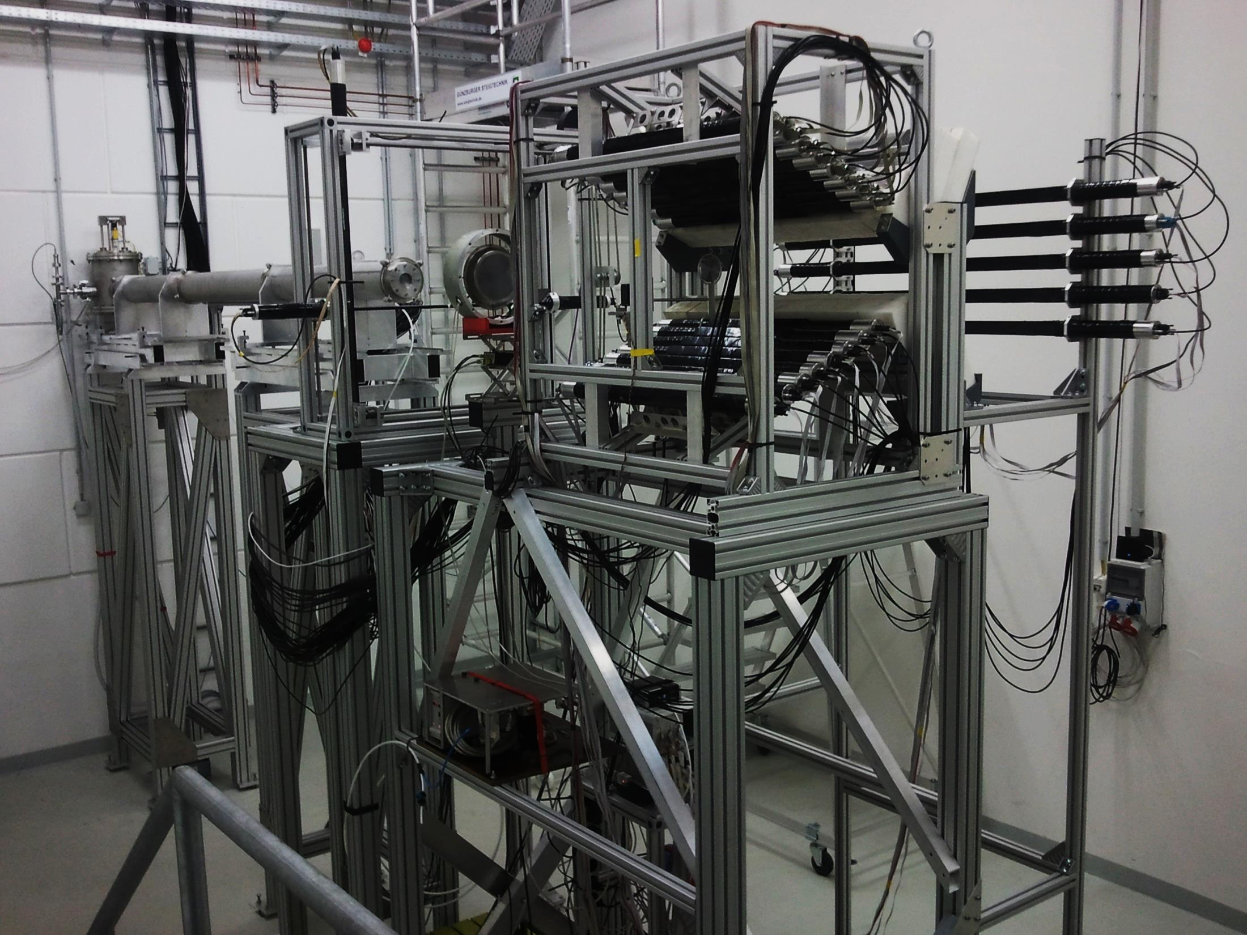
ERINDA Objectives
Establish access for nuclear data measurements
at the consortium facilities
Experiments shall account for nuclear data requests of
highest priority and scientific value.
Simulation methods to predict the running conditions
of innovative reactor systems and the transmutation of nuclear waste.
Generation of complete, accurate and consistent nuclear data libraries and measured nuclear reaction cross sections.
nELBE double time-of-flight experiment, HZDR Dresden

Slide 3

















ERINDA Facilities
15 ERINDA Partners:
Time of flight facilities for fast neutrons:
  nELBE (HZDR, Dresden); n_TOF (CERN, Geneva); GELINA(IRMM, Geel)
Charged-Particle Accelerators
  production of quasi-monoenergetic neutrons
  electrostatic accelerators at Bordeaux, Orsay, Bukarest, Dresden
  Neutron reference fields at PTB Braunschweig, NPL Teddington
  Cyclotrons at Rez, Jyväskylä, Oslo, Uppsala neutron energy range up to 180 MeV
  Pulsed Proton Linear Accelerator at Frankfurt
Research reactor
  Budapest, Rez cold neutron beam, PGAA

Slide 4
ERINDA results
Nuclear data measurements for:
optimisation of existing power plants
design and operation of advanced reactor systems
nuclear waste management strategies and transmutation
advancing nuclear safety and security
development of new experimental techniques
Performance Indicators:
25 Experiments 2876 beam time hours
109 Participants 21 young researchers
18 scientific visits to ERINDA institutes ( average duration 40 days)
4 scientific workshops at Dresden, Prague, Jyväskylä, Geneva
33 publications in refereed journals (status: September 2013)
www.erinda.org
68 %
26 %
6 %

Slide 5
ERINDA thank you on behalf of the MB
A project is only as good as ist participants
THANK YOU to all ERINDA Partners, Experimenters
and scientific visitors for their excellent contributions and collaboration.
See you all at CHANDA

