Slide 1
The RD51 Collaboration:
Development of Micro-Pattern Gas Detector Technologies
Leszek Ropelewski, CERN, Switzerland
Maxim Titov, CEA Saclay, France
OUTLINE:
RD51 Highlights
RD51 Collaboration Activities and Results
Technology Achievements
Detector Assembly Optimization, QA, Long Term Stability
Electronics for MPGDs
Software tools
MPGD workshop upgrade & industrialization
RD51 test beam facility
RD51 Plans and Outlook
114th LHCC Meeting, CERN, 12-13 June 2013

Slide 2
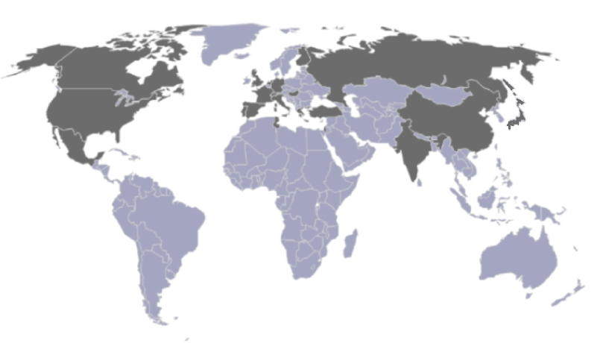
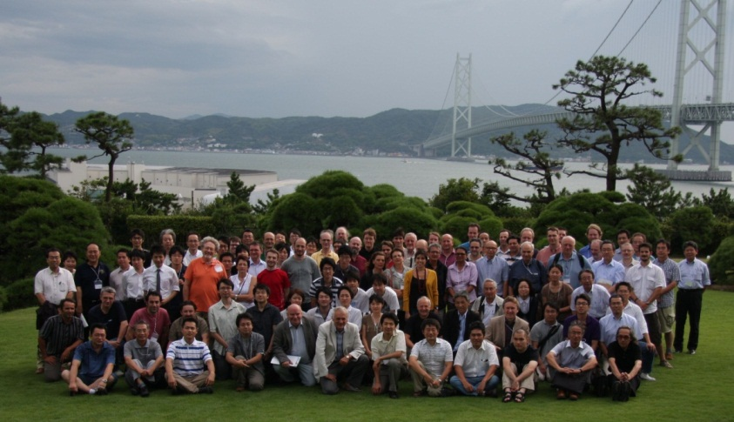
RD51 Collaboration
The main objective of the R&D programme is to advance technological development of Micropattern Gas Detectors
http://rd51-public.web.cern.ch/rd51-public/
~ 80 institutes
~ 450 people involved
Representation (Europe, North America, Asia, South America, Africa)
“RD51 aims at facilitating the development of advanced gas-avalanche detector technologies and associated electronic-readout systems, for applications in basic and applied research”
http://gifna.unizar.es/mpgd13/
Kobe, Japan, September 2011
RD51 contributes to the LHC upgrades, BUT, the most important is:
RD51 serves as an access point to
MPGD “know-how” for the world-wide community
2

Slide 3
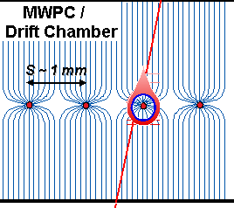
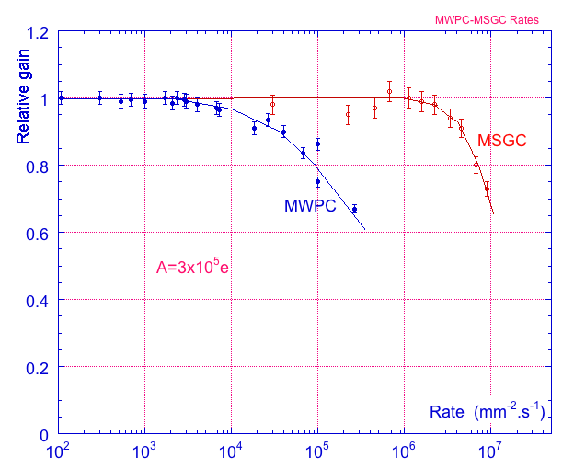
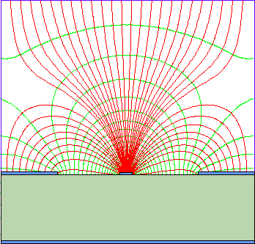
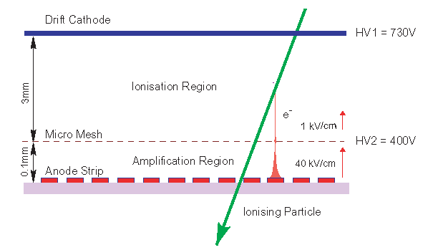
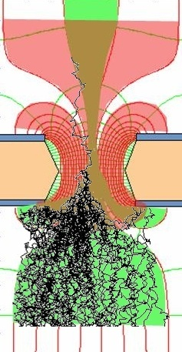
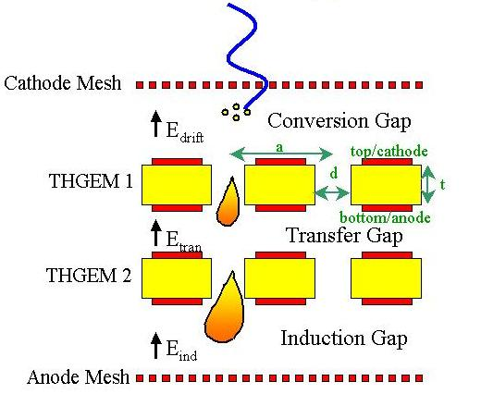
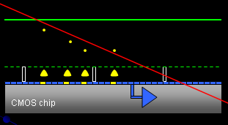
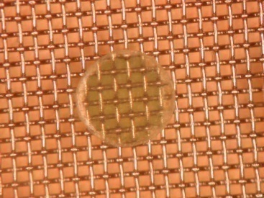
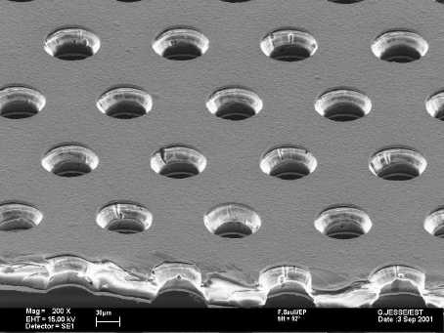
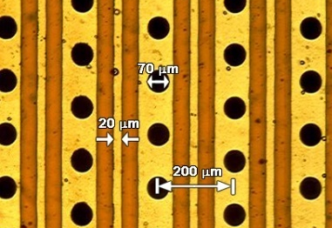
Micro-Pattern Gas Detectors
High Rate Capability
High Gas Gain
Good Space, Time and Energy Resolution
Good Ageing Properties
Ion Backflow and Photon Feedback Reduction
Large Size
Low Cost
Rate Capability Comparison for MWPC and MSGC
Ions
40 %
60 %
Electrons
Micromegas
GEM
THGEM
MHSP
Ingrid
3

Slide 4
RD51 Achievements Highlights
Consolidation of the Collaboration and MPGD community integration ( >80 Institutes, 450 members);
Major progress in the MPGD technologies development in particular large area GEM (single mask), MicroMegas (resistive), THGEM; some picked up by experiments (including LHC upgrades);
Secured future of the MPGD technologies development through the TE MPE workshop upgrade and FP7 AIDA contribution;
Contacts with industry for large volume production, MPGD industrialization and first industrial runs;
Major improvement of the MPGD simulation software framework for small structures allowing first applications;
Development of common, scalable readout electronics (SRS) (many developers and > 50 user groups); Production (PRISMA company and availability through CERN store); Industrialization (re-design of SRS in ATCA in EISYS);
Infrastructure for common RD51 test beam and lab facilities (>20 user groups)

Slide 5
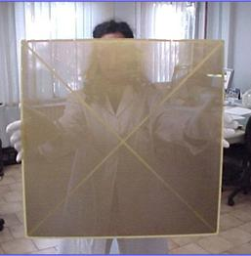
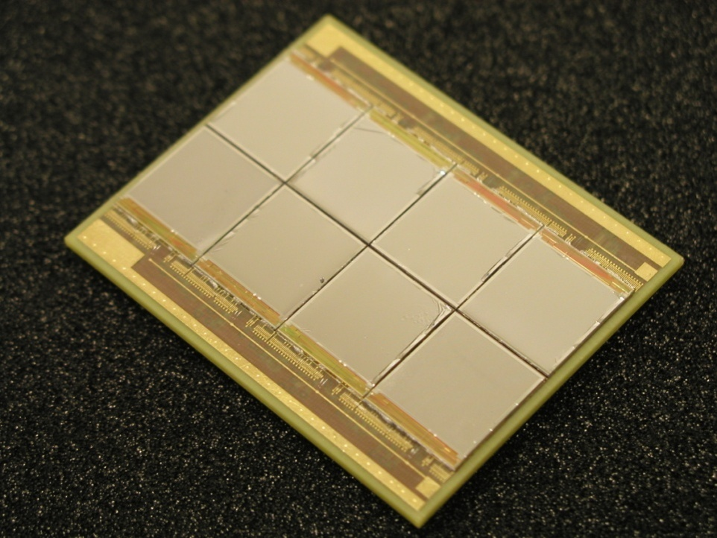
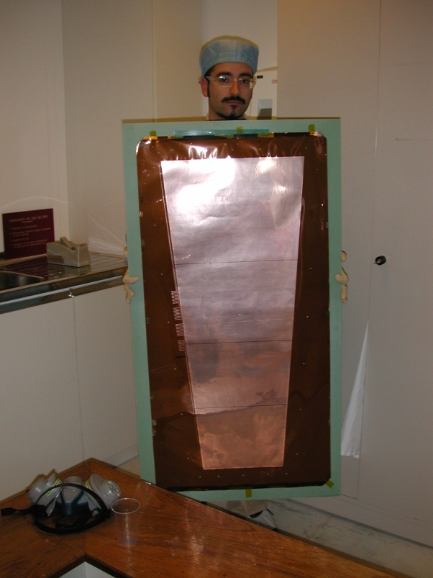
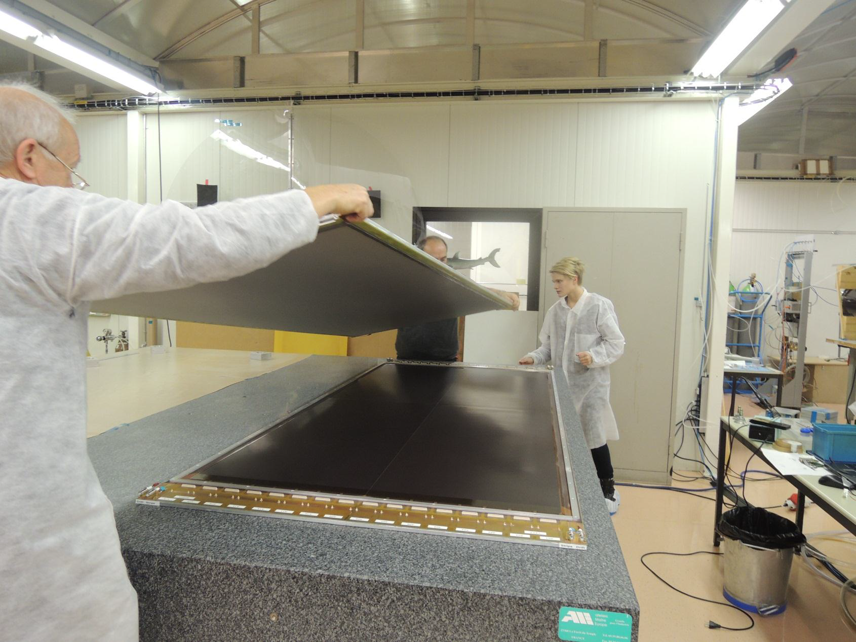
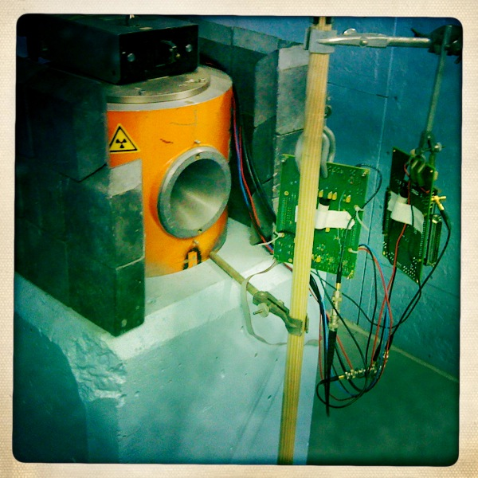
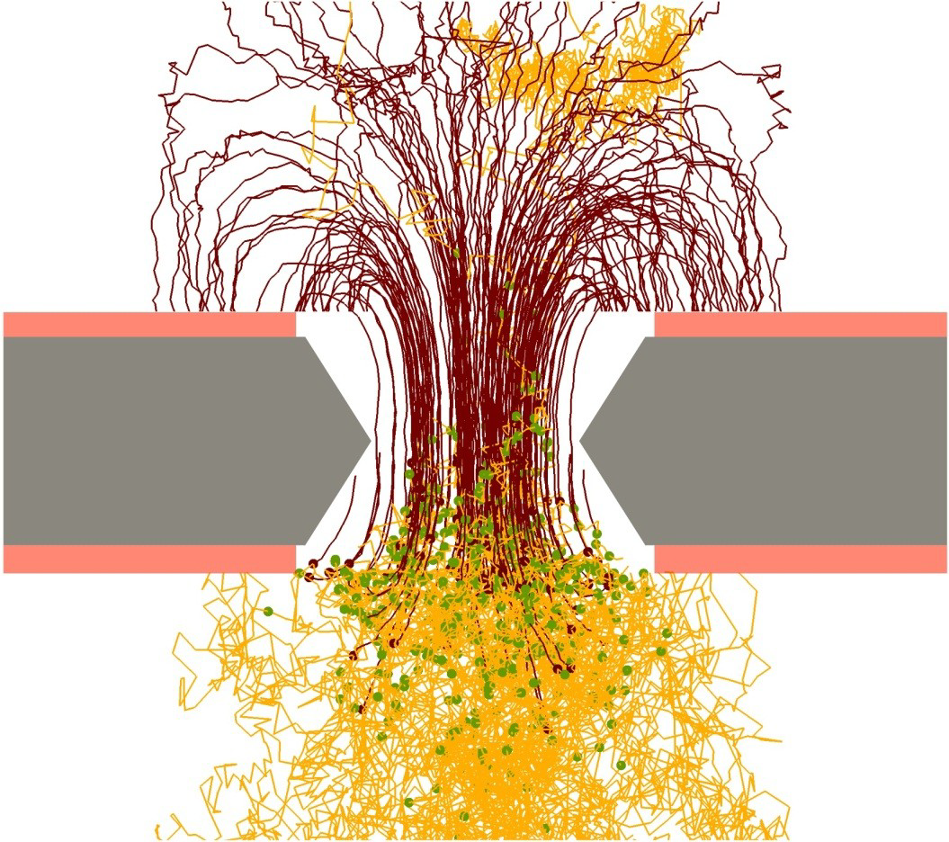
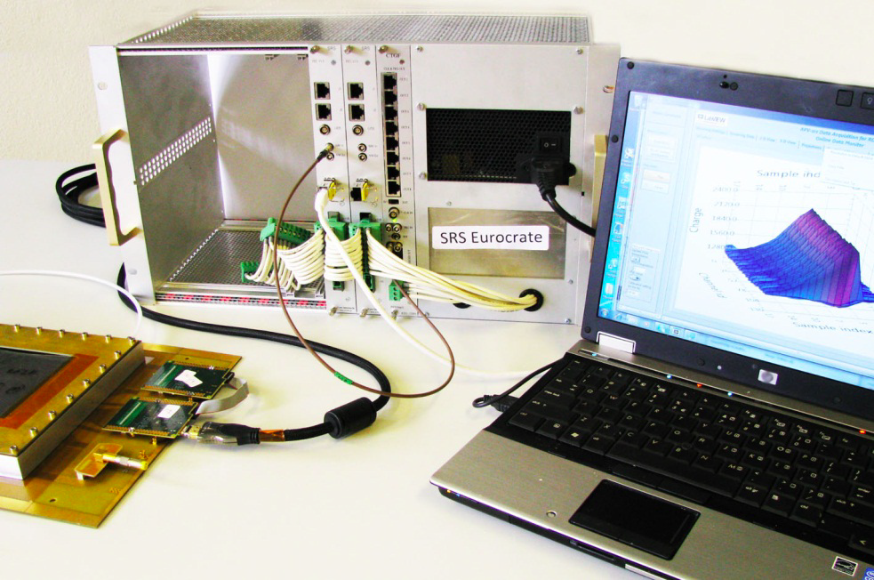
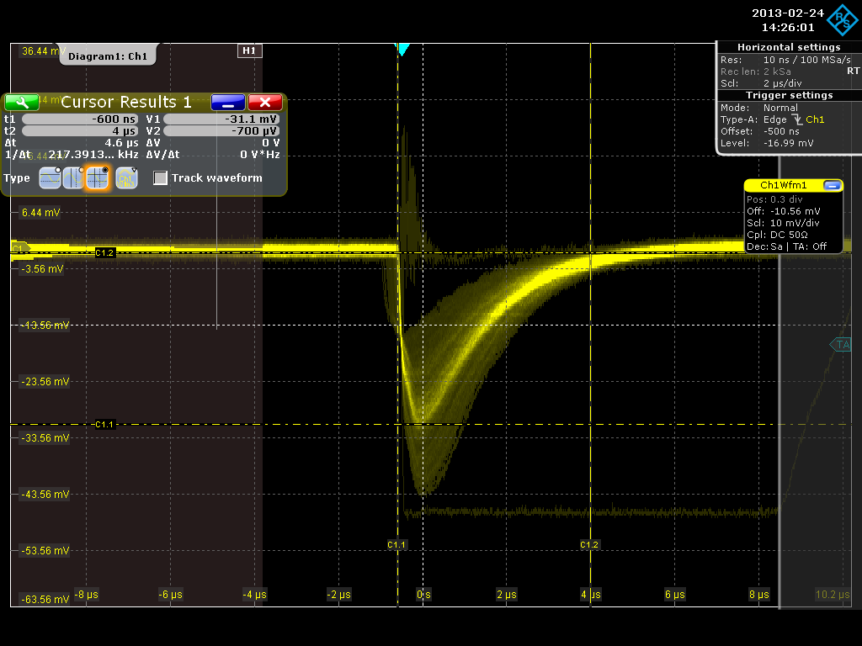
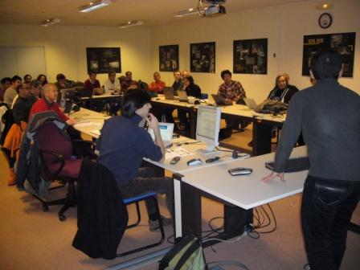
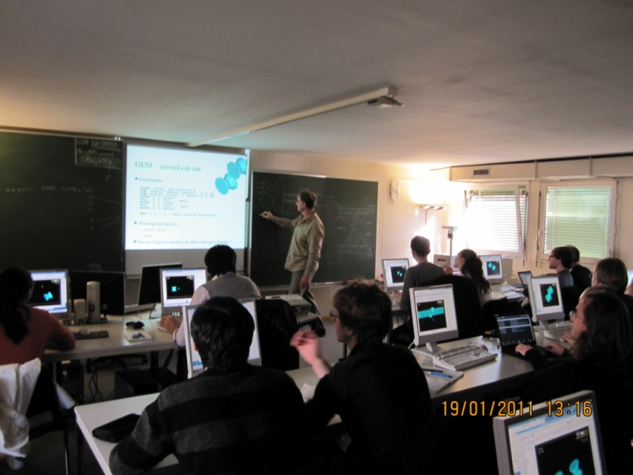
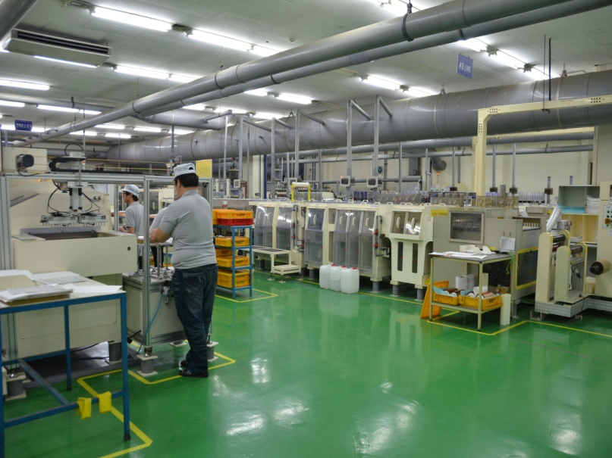
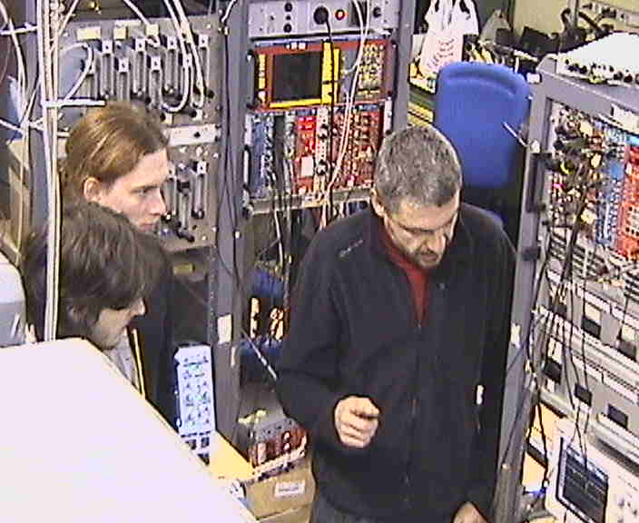
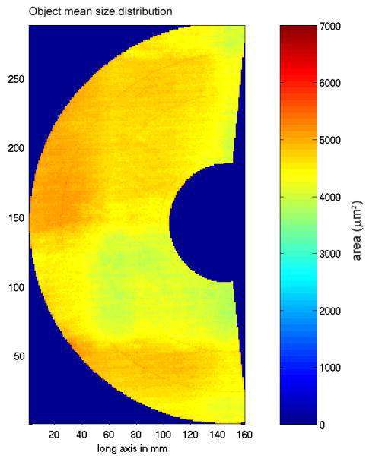
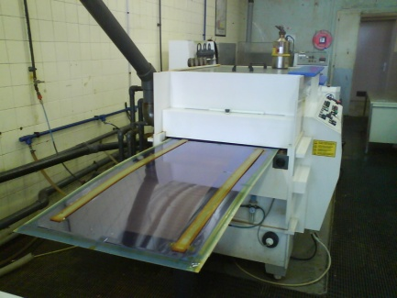
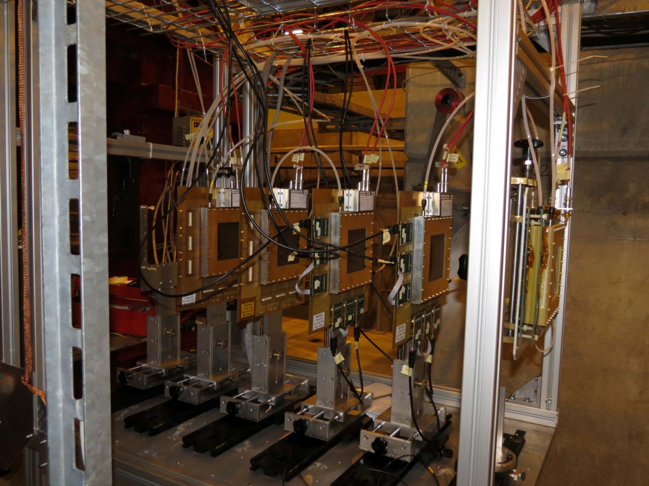
RD51 Collaboration
RD51 Common Projects
Generic R&D
Long Term Stability
Large Area Detectors
Assembly Optimization
WG2:
WG1:
WG5:
RD51
Software Tools and
Simulations
MPGD Electronics
WG4:
WG7:
WG6:
Conferences, Meetings and Schools
CERN MPGD Workshop
Quality Control
and Industrialization
RD51 Common
Test Beam and Lab Facilities

Slide 6
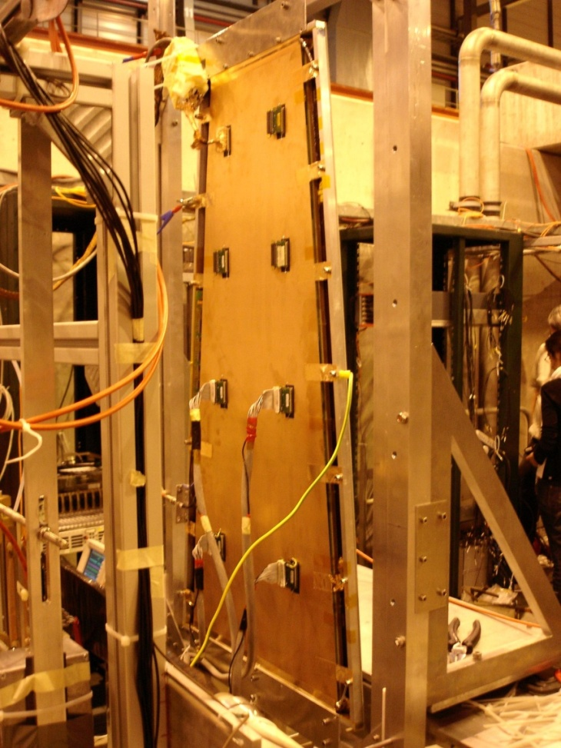
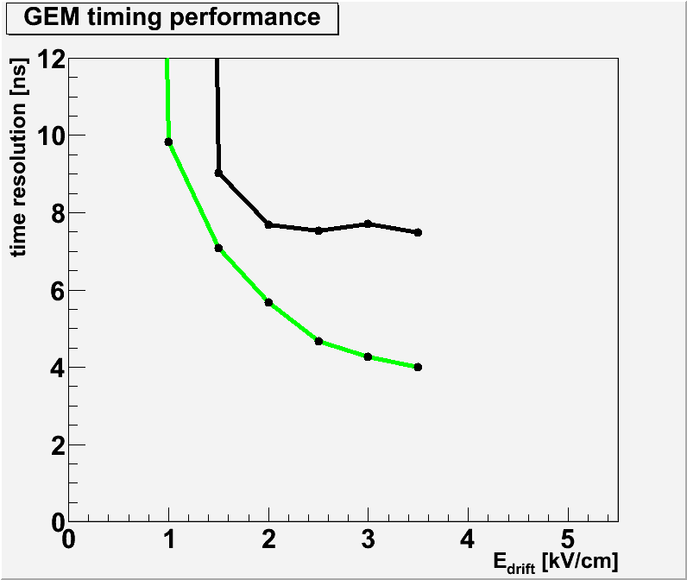
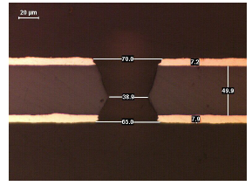
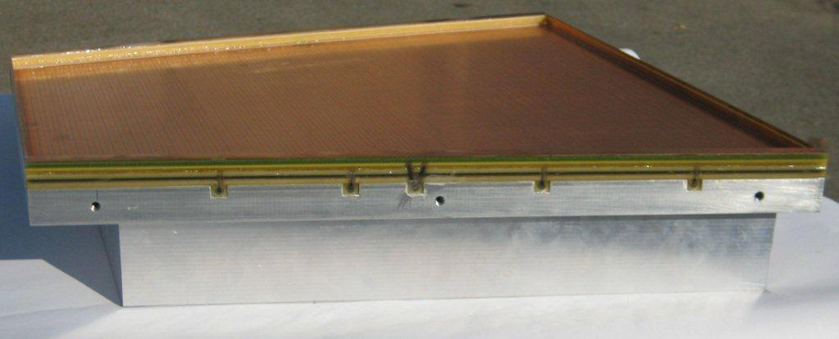
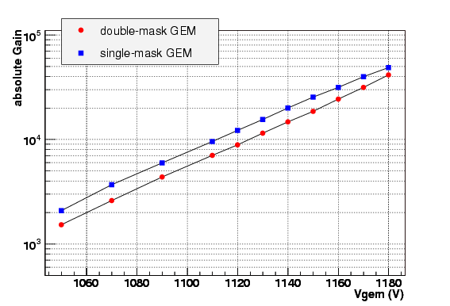
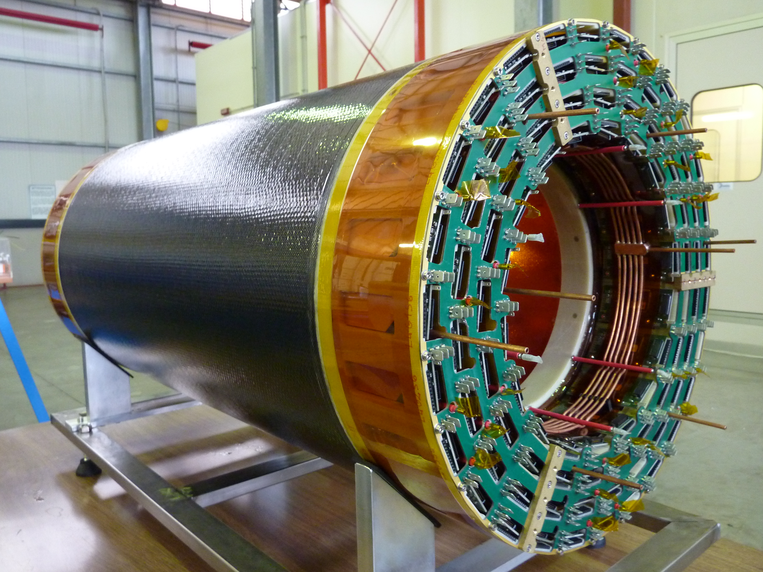
Technology Development Highlights
GEM Single Mask Technique
Ions
40 %
60 %
GEM Single Mask Process
Electrons
Chemical Polyimide etching
CMS high eta upgrade triple GEM prototype in the RD51 test beam facility
Time resolution
4 ns
Copper electro etching
Stripping
Second Polyimide etching
Result
Standard double mask method limits max. size of the detector to 30x30 cm²
Single mask technique reduces costs and production time
Performance comparison (max. gain, stability, rate capability..) shows no difference
ALICE triple GEM TPC end-cap module
6
KLOE2 inner tracker: 4 layers of triple cylindrical GEM detectors

Slide 7
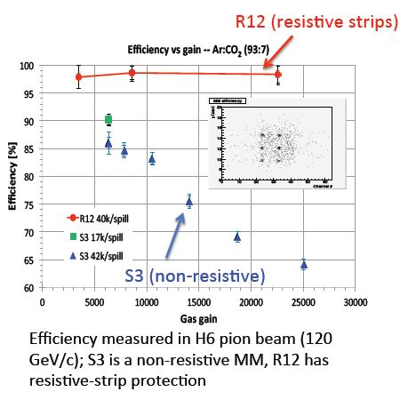
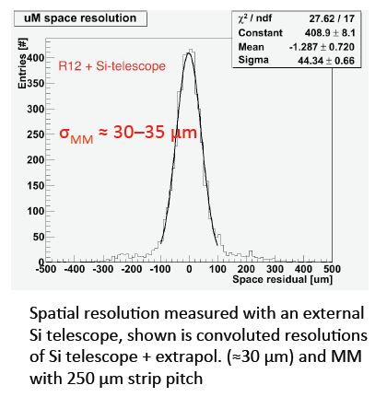
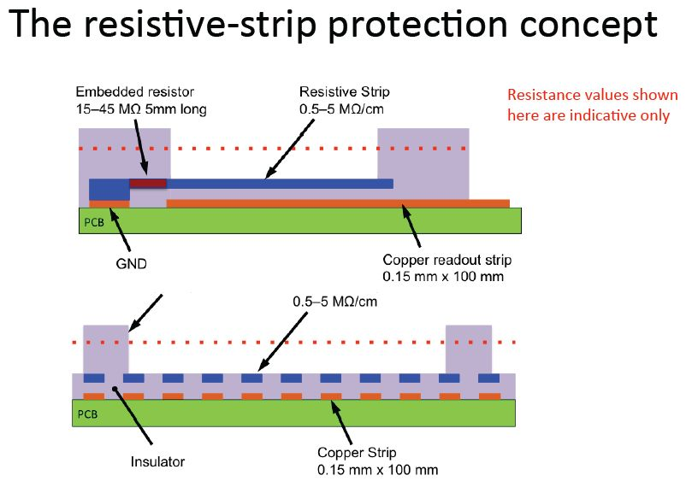
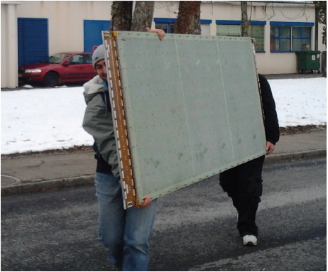
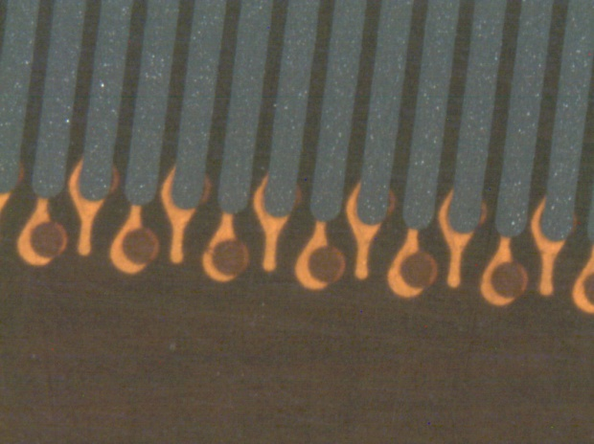
Technology Development Highlights
Resistive MicroMegas
Bulk MicroMegas Process
Standard Bulk MicroMegas suffers from limited efficiency at high rates due to discharges induced dead time
PCB
Lamination
Mesh deposit
Lamination
Development
ATLAS small wheels upgrade project
resistive MicroMegas prototype
7

Slide 8
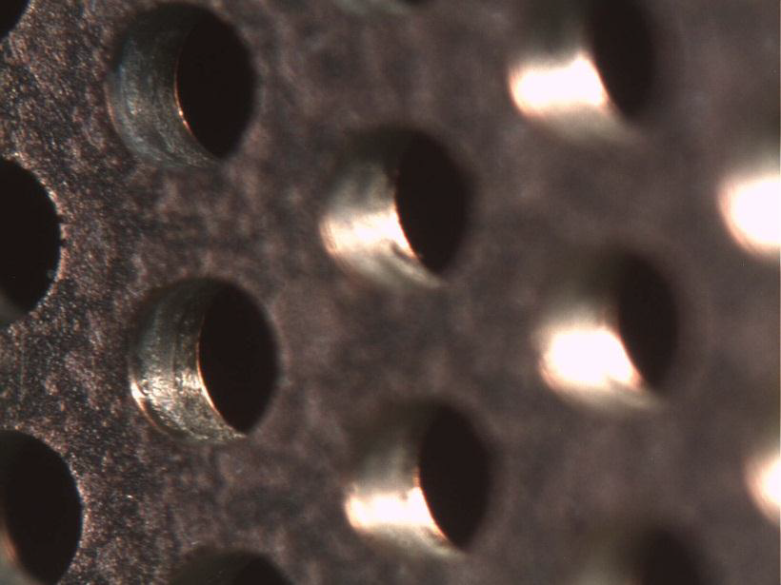
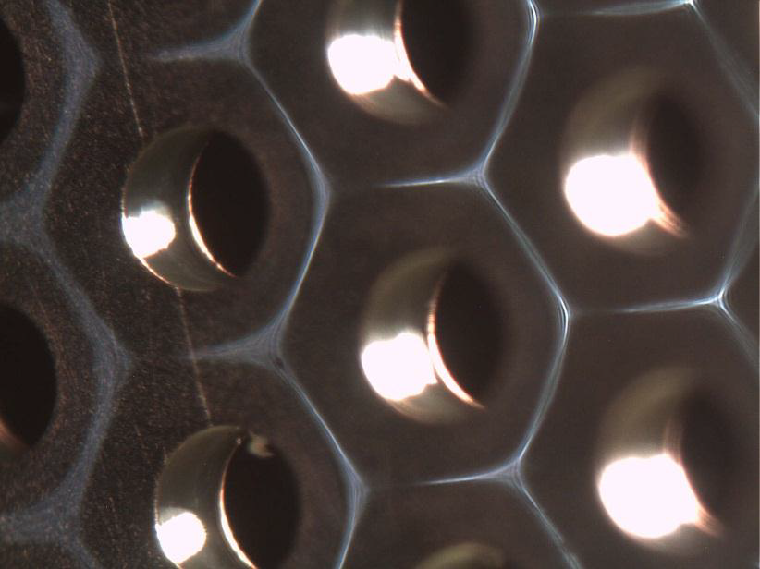
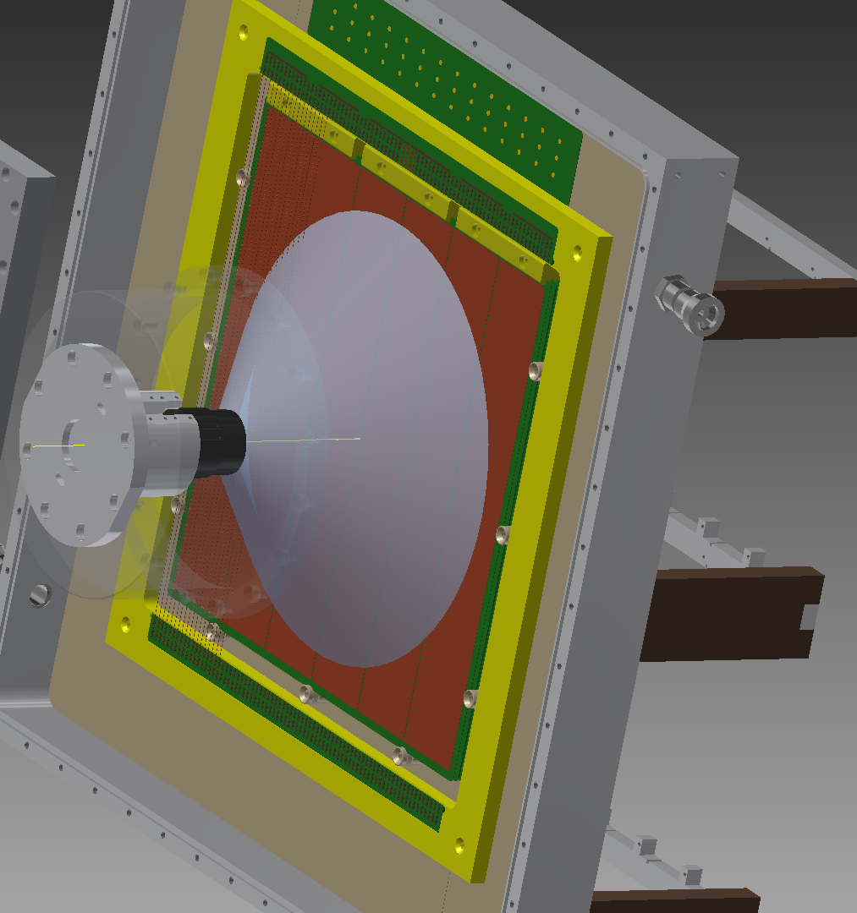
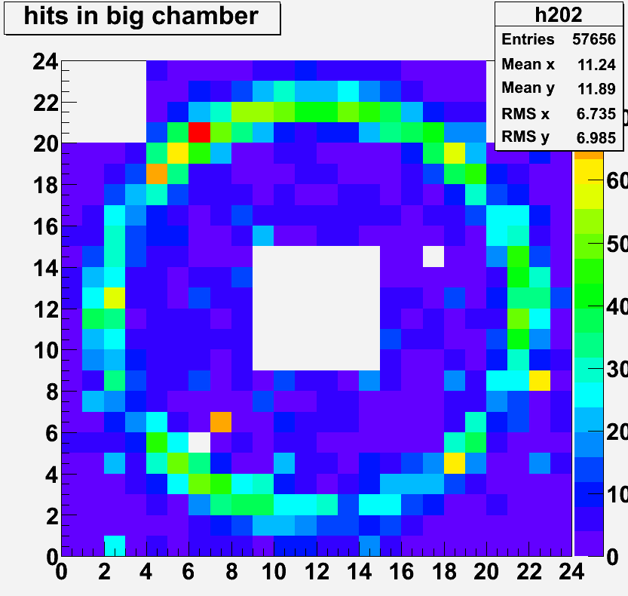
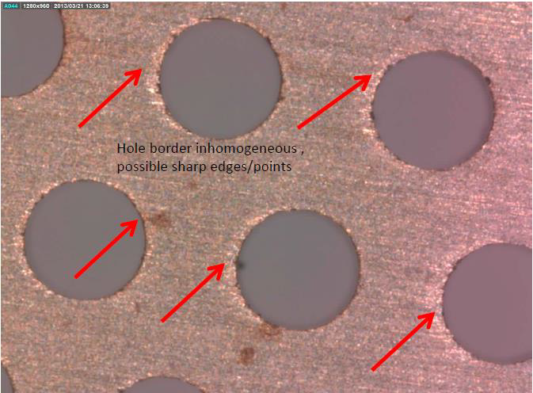
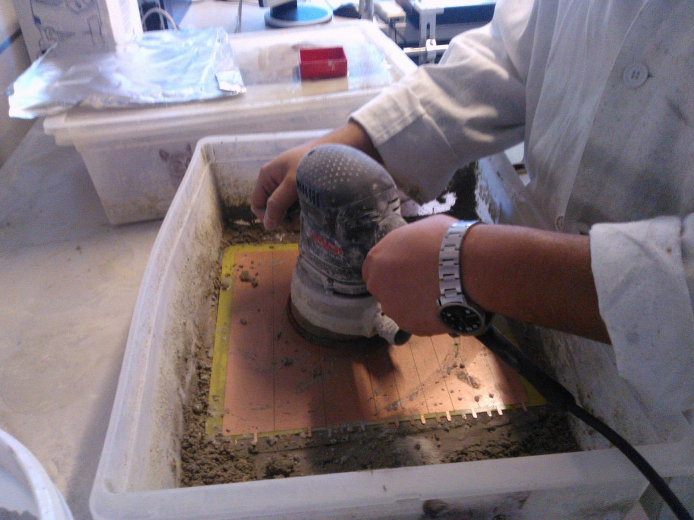
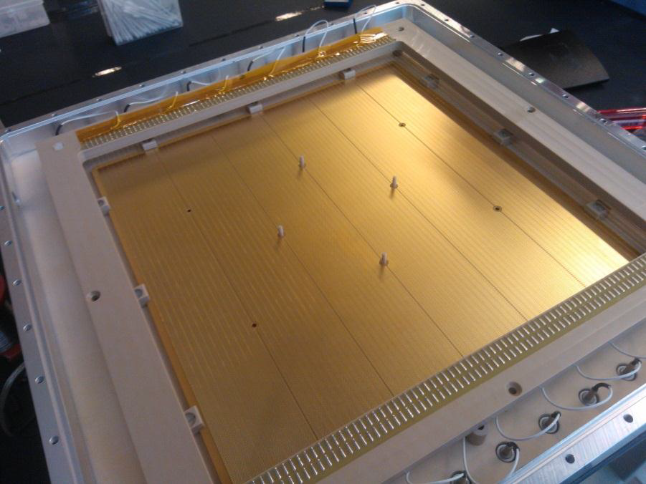
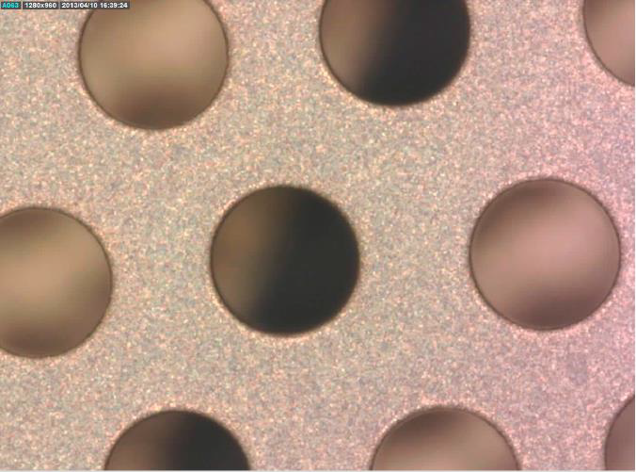
Technology Development Highlights
THGEM Surface Treatment
Polyurethane Treatment
Non-treated THGEM suffers from: limited max. gain, response non-uniformity and time instabilities
Polishing and Cleaning
COMPASS RICH photo-detector upgrade prototype
8

Slide 9
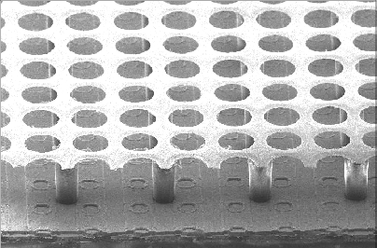
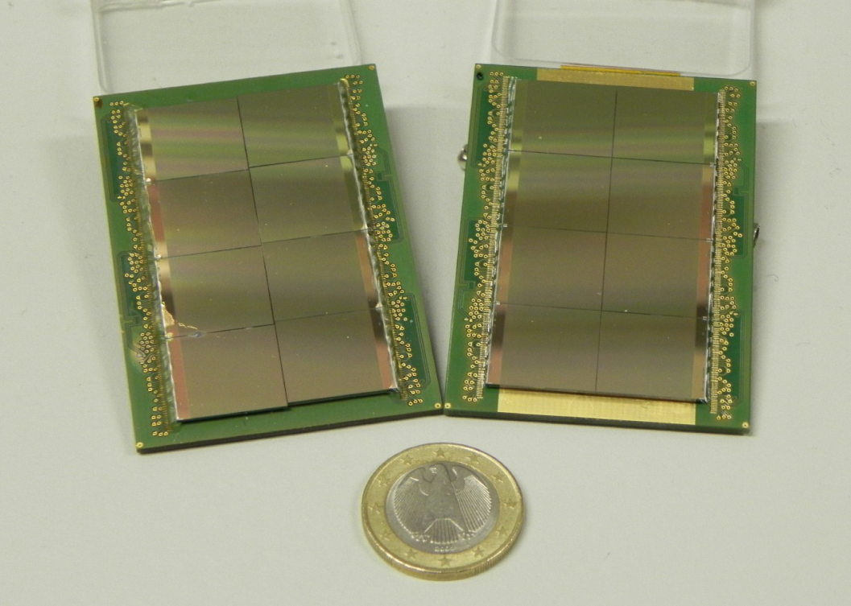
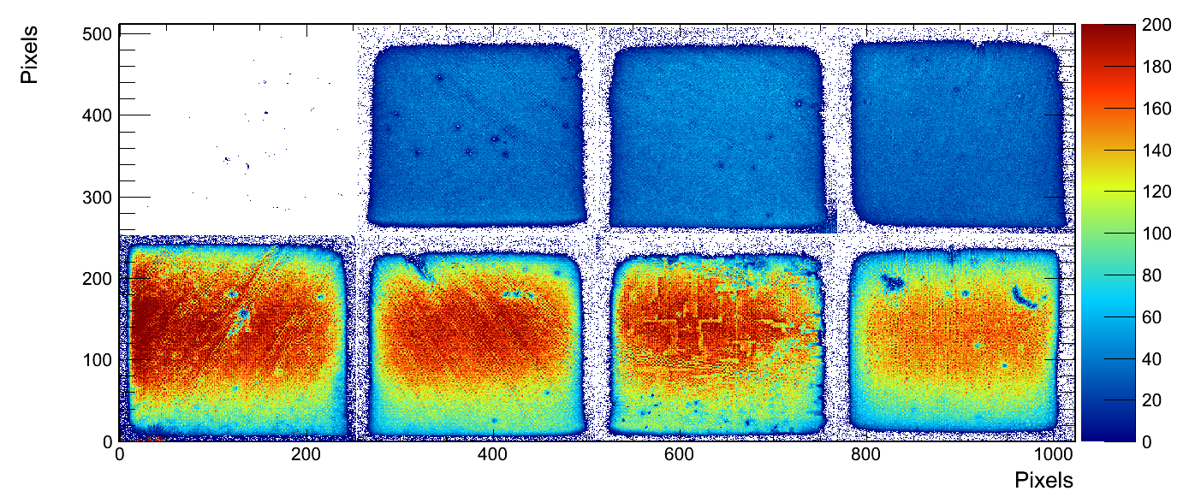
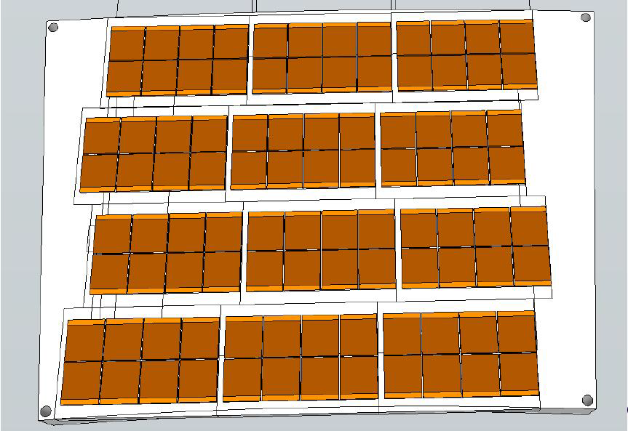
Technology Development Highlights
Pixel Readout Integration
Octoboards
Results of the tests of the GridPix type detector with TimePix chip readout with RD51 SRS mounted in LP TPC prototype for LC TPC application
9

Slide 10




Detector Assembly Optimization
Industrialization and Cost Reduction
Simplified Bulk MicroMegas & GEM NS2
ATLAS muon system MicroMegas upgrade assembly
CMS high eta project triple GEM detector assembled using self-stretching method
10

Slide 11







Quality Control
Electrical rigidity
Hole diameter uniformity in GEM
Gap uniformity in MicroMegas
THGEM thickness uniformity
Final detector calibration and characterization protocols and infrastructure
11

Slide 12



Long Term Stability
Classical gas detectors ageing detector
Radiation hardness and activation of detector components
Sustainability to neutrons and heavily ionizing particles induced discharges
Exposure to X-Ray, Gamma, Neutron and Alpha Sources
Monitoring infrastructure
Portable gas monitoring system for detector stability studies; to be used by LHCb and CMS upgrade of the muon system
Resistive MicroMegas stability performance under X-Ray irradiation
Discharge studies of the triple GEM detector exposed to the low energy neutron flux

Slide 13




New Developments Examples
Piggy Back, Light Beam Monitors, Glass GEM
Light ( 0.4 % X₀ ) 2D GEM detector for low energy antiproton beam monitoring
Glass GEM for sealed photon large area detector
Piggy Back – a novel method of the readout of the MPGD detectors using pixel chips; Electronics is completely separated from the detector volume
13

Slide 14






Development of Scalable Readout System (SRS) for MPGDs
Development of a portable multi-channel readout system (2009-2012):
Scalable readout architecture: a few hundreds channels up to very large LHC systems (> 100 k ch.)
Project specific part (ASIC) + common acquisition hardware and software
Physical Overview of SRS:
Scalability from small to large system
Common interface for replacing the chip
frontend
Integration of proven and commercial
solutions for a minimum of development
Default availability of a very robust and
supported DAQ software package
ADC frontend adapter
for APV and Beetle chips
ADC plugs into FEC to make a
6U readout unit for up to 2048
channels
FEC cards (common):
Virtex-5 FPGA, Gb-Ethernet, DDR buffer, NIM and LVDS pulse I/O, High speed Interface connectors to frontend adapter cards
Frontend hybrids:
based on
APV25, VFAT, Beetle, VMMx and Timepix chips
14

Slide 15


SRS Users Status
Produced by PRISMA Company (Greece), sold via the CERN store
ALICE EMCal Calorimeter upgrade, ORNL, SRS readout backend via DTCC links and 24 SRU’s , DATE Online system, being installed
ATLAS upgrade CERN, MAMMA project NSW , µMEGAS , APV frontend SRS Eurocrates-SRU, MMDAQ Online, installed
ATLAS upgrade Mainz, µMEGAS for MBTS, APV frontend- SRS Eurocrate, MMDAQ Online, waiting delivery
ATLAS Muon upgrade R&D, INFN Rome, APV frontend SRS Eurocrate, MMDAQ Online, delivered
ATLAS Saclay, µMEGAS R&D, APV frontend SRS Minicrate, MMDAQ Online, delivered
NA62 CERN straw tracker upgrade with µMEGAS, APV frontend with SRS Minicrate, MMDAQ Online, delivered
CMS upgrade CMS GEM collaboration CERN, Muon Endcaps, design of VFAT frontend digital readout SRS, ongoing with IFIN-HH
TOTEM upgrade GEMs Baris testlab, OPTO-Rx card design, Minicrate,Eurocrate, SRU, DATE Online, delivered
BNL GEM detectors, APV frontend-SRS Minicrate, RCDAQ Online, delivered
Stony Brook GEM detector R&D, APV frontend SRS Minicrate, RCDAQ Online, delivered
Bonn Phys. Inst. R&D for ILC, T24 DESY testbeam, Timepix Array Ingrid Module adapter for SRS , Eurocrate, Online unknown, ongoing
Florida Inst Tech GEMs, Muon Tomografy for Homeland security, 15k channel SRS prototype Eurocrate, DATE Online, delivered
Géosciences Azur-CNRS-UNSA, Muon Tomography w.µMEGAS for geology, APV frontend SRS Eurocrate, Date Online, delivered
GDD lab RD51, CERN, R&D for GEM and µMEGAS, APV frontend SRS Euro and Minicrates, DATE, Labview MMDAQ, delivered
HIP, HELSINKI, characterization MPGAD detactors, APV frontend SRS Eurocrate, DATE and Labview, delivered
INFN Napoli, ATLAS. Development of SRS Hardware and Firmware, Labview, delivered
Jefferson Lab, Virginia UVa upgrade GEM readout system, APV frontend SRS Eurocrate, DATE online, partially delivered
Yale University , GEM development ALICE, APV frontend SRS Eurocrate, DATE Online, delivered
NEXT Coll. small Xenon TPC with PM and Si PMs, SRS readout electronics co-development, SRS Eurocrate and SRU, DATE, delivered
UNAM, MEXICO, MX , R&D on THGEM, APV frontend SRS Minicrate, DATE Online, delivered
Radiation Laboratory, Nishina Center, RIKEN , APV frontend SRS Eurocrate, Online unknown, delivered
J-PARC /E16 experiment, GEM based tracking, APV frontend SRS Minicrate, Online Unknown, partially delivered
Jefferson Lab SHM spectrometer triple GEM, APV frontend SRS Eurocrate, DATE Online, waiting
Harward Univ. Physics, APV frontend SRS Minicrate, Online unknown, waiting
Tokyo Univ. ATLAS, APV frontend SRS Eurocrate, Online unknown, waiting
WIS and Aveiro Univ. GEM validation, APV Frontend SRS Eurocrate, MMDAQ and Labview, being delivered
East Carolina University, Health Physics, APV frontend, SRS Eurocrate, Labview, waiting
Munich LMU / ATLAS µMEGAS, APV frontend SRS Eurocrate –SRU, MMDAQ Online, partially delivered
NCSR Democritos ATHENS, APV frontend SRS Minicrate, Online unknown, waiting
IFIN-HH-Bucharest new Detector lab, APV and VFAT frontend, SRS Eurocrate and SRU, Labview, delivered
ATLAS NSW CERN, SRS-ATCA pilot system, MMDAQ Online, waiting
ALICE FOCAL ORNL, SRS-ATCA pilot system, DATE Online, waiting
NEXT Collaboration, SRS-ATCA pilot system, DATE Online, waiting
Lunds Univ, ILC TPC, SRU for 24 channel DTCC link readout, Online unknown, delivered
15

Slide 16
Potential New SRS Users
LAPP, Annecy, SRS hybrid with MicroROC chip for ATLAS , no news
Pacific Northwest National Laboratory, Radiation detection and Nucl. Sci, interest in APV SRS system, no CERN team account
Radcore LTD Republic of Korea, GEM production , small SRS system , no team account
Newflex GEM production, South Korea , small SRS system , enquiry status
GIF++ team CERN, interested in SRS as GIF++ base installation with DATE Online system , ongoing discussions, waiting
Budker INP, Novosibirsk, Deuteron Exp. @ VEPP-3 , APV readout SRS , APV order impossible, radhard export restriction
Tsinghua Univ. China , R&D on GEM Imaging detectors, APV readout SRS , APV order impossible, radhard export restriction
SAHA Inst Nucl Phys,KOLKATA, IN , Laboratory for characterization of MPGDs , APV order impossible, radhard export restriction
USTC Shanghai, CN , characterization of GEM and MicroMega with SRS , APV order impossible, radhard export restriction
Univ . Texas, DOE proposal with 18 GEMs , no news
National Univ. of Colombia, Dosimetry for mediical appl, no team account, no news
BNL Phenix upgrade, small SRS systems already delivered , no news
Helsinki University, Totem , no news
Freiburg University, verbal enquiry for SRS system, no news
Univ Calabria It, email enquiry for SRS, no news
Uni. Kobe, JP J-PARC /E16 upgrade , large SRS system, prelim offer sent
ALICE ITS, SRS 16 ch. ADC card for test of ITS chips , enquiry
NEOHM Italy, SRS system for test of hybrid production for CERN store, sending offer
Geoazur-CNRS-UNSA, Valbonne, FR, upgrade of existing SRS uMega readout systrem, APV readout Eurocrates ,waiting for news
A main feature of SRS, apart from its scalability, portability and affordable cost
(< 2 EUR/ channel), possible choice of the frontend ASIC (APV, VFAT, Beetle, VMMx, Timepix).
System was used for R&D for upgrades in ATLAS, CMS, ALICE ECAL and for SiPM readout
16

Slide 17


Large SRS Systems in ATCA Technology
ELMA and EicSys GmbH, Germany started to rework the “SRS classic” system into the industry Advanced xTCA standard (ATCA), targeting larger experiments and commercial applications.
SRS ATCA*- fully commercial SRS in certified ATCA Crates
1.) higher channel integration => reduce cost/channel for large systems
2.) certified crate standard 3.) replace DTCC cables by ATCA backplane
4.) start with 2-slot ATCA crate that can be read out via SRU
Delivery of the first ATCA SRS expected in June – July 2013
17

Slide 18





Towards a Complete SRS-Lab Equipment for MPGDs
AVD box : active Voltage Divider with monitoring for GEMs (under test )
Remote I2C readout of AVD and CM via SRS (in progress)
CM box: Current monitoring range 10 pA -100 μA ( design status )
QSA frontend: quad signal amplifier 2 GHz, factor 20, for MPGD’s (tb revised)
TPB trigger pickup box: generates triggers from Meshes ( working in several places)
I-GEM: Anode current summing hybrid for GEMs (planned)
Shaper-Discriminator: SRS card 50 OHM triggers from TPB (planned )
HGM: SRS card , programmable High Voltage for mesh grounded MM ( design status)
Active Voltage Divider
for GEM’s
High Voltage Monitoring
Readout pAmmeter
High Voltage pAmmeter
Hans Muller (CERN) et al.,
18

Slide 19
MPGD Simulation Tools
Focus on providing techniques for calculating electron transport in small-scale structures
The main difference with traditional gas-based detectors is that the electrode scale (~ 10 μm) is comparable to the mean free path between collisions
Development and Maintenance of Garfield++:
Garfield++ is a collection of classes for the detailed simulation of small-scale detectors.
Garfield++ contains:
- electron and photon transport using cross sections provided by Magboltz
- ionization processes in gases, provided by Heed and MIP
- ionization and electron transport in semi-conductors
- field calculations from finite elements, boundary elements, analytic methods
Simulation Improvements:
Transport:
- ion mobility and diffusion, measurement and modelling
- ongoing update of electron cross sections
- e-ion recombination process in Xe
- thermal motion
Photons:
- update in UV emission
- inclusion of IR production
- photon trapping and resulting excitation transport
- photon absorption in the gas (gas feedback)
- photon absorption in and electron emission from walls (feedback)
- photo cathodes
19

Slide 20



MPGD Simulation Tools
Applications:
TPC GEM: ion backflow
GEM: multiplication process and polyimide properties; charging up
MicroMegas: timing and effects of resistive layers
ALICE TPC end-cap upgrade studies of rate dependence of the Ion Back Flow in GEM. Left: measurement; Right: Garfield++ simulation results

Slide 21




Demand for the Micro-Pattern Gas Detectors – LHC Upgrades
Atlas MM 1200 m²
CMS GEM 1000 m²
Alice GEM 130 m²
LHCb GEM 57 m²

Slide 22


RD51– MPGD Production
Currently CERN-MPGD workshop is the UNIQUE MPGD production facility
(generic R&D, detector components production, quality control)
2008 RD51 Collaboration Survey:
GEM:
Continuous polyimide etcher
Cu electroetch line
MicroMegas:
Large laminator
Large Cu etcher
Large UV exposure unit
Large resist developer
Large resist stripper
Large oven
Large dryer
Construction of the new workshop’s building
Start : beginning 2012
Completion: October 2013
Upgrade of the workshop approved by CERN management (Nov. 2009):
Installation of the new infrastructure to fabricate 2x1m² Bulk MM and 2x0.5m² GEM COMPLETED
22

Slide 23




MPGD Technology Industrialization
Technology Industrialization → transfer “know-how” from CERN workshop to
Industrial partners for MASS PRODUCTION
THGEM Technology – ELTOS S.p.A. (Italy), PRINT ELECTRONICS
GEM Technology
Mecharonix (Korea, Seoul)
New Flex (Korea, Seoul)
Tech-ETCH (USA, Boston)
Scienergy (Japan, Tokyo)
TECHTRA (Poland, Wroclaw)
MicroMegas Technology
ELTOS S.p.A. (Italy)
TRIANGLE LABS (USA, Nevada)
SOMACIS (Italy, Castelfidarco)
ELVIA (France, CHOLET)
GEM Licenses signed by:
-Mecharonics, 21/05/2013
-TECH-Etch, 06/03/2013
-China IAE, 10/01/2012
- SciEnergy, 06/04/2009
- Techtra, 09/02/2009
- CDT, 25/08/2008
- PGE, 09/07/2007
2012-2013: Industrial test runs for GEM and MM in companies (Techtra, ELTOS, ELVIA)
2013: Two large area MMs (1*0.5 m²) are ordered in ELVIA for GEOAZUR Project (Tomography Densitometric Meas.); 4 more det. to be produced at CERN
23

Slide 24






RD51 Test Beam Facility at H4 SPS
Common RD51 infrastructure: 3 beam telescopes, services, DAQ, FEE
GEM-TRT 1-period
CALICE-umegas 1 period
JLAB-GEM 1-period
CMS-GEM 3-periods
TOTEM-GEM 3-periods
RD51-umegas-telescope
RD51-GEM-telescope
~ 25 m
2008-2013: > 20 RD51 groups participated;
3-beam telescopes
1 Bulk MM, 1 resistive MM and 1 triple-GEM with SRS readout
DT GDD lab infrastructure
DHCAL-THGEM 1 period
COMPASS-THGEM 2 periods
24

Slide 25
RD51 Future – beyond 2013
Continuation of the R&D support for the experiments and LHC upgrades WG1
Generic R&D (new structures, ideas, detector physics) – RD51 Common Projects WG2 Development of new structures and consolidation of the existing structures
Applications - organization of series of specialized workshops disseminating MPGD applications beyond fundamental physics – RD51, potential users and industry (e.g. dosimetry, neutron detection, medical physics, …) WG3
Development and Maintenance of Software & Simulation Tools; basic studies & software support for the RD51 community WG4
Development and Maintenance of the SRS Electronics; An extended support for the SRS including new developments and implementations of additional features WG5
MPGD Industrialization and QA Control - GEM, MicroMegas, Thick GEM; Completion of the industrialization of main technologies WG6
Maintenance and extension of the RD51 Lab and Test-Beam Infrastructure WG7
MPGD Education and Training : organization of schools for students and newcomers & academic training NEW WG

Slide 26
RD51 Future – beyond 2013
In 2008 RD51 Collaboration was Approved for the 5-years term (MoU)
The Collaboration would like to ask LHCC for extension for the next 5 years and for continuation of limited support :
• Access to test beam facility (including the possibility to keep “semi permanent” setup)
• Access to CERN TE MPE Printed Circuit Workshop (similar to present availability level)
• Access to Silicon Bonding Laboratory
• Access to central computing resources for MPGD simulations.
• Limited amount of office space
26

Slide 27
SPARES

Slide 28

RD51 Collaboration – Working Groups
“Transverse organization” of MPGD activities in 7 Working Groups
28

Slide 29
RD51 Collaboration Organization
RD51 Collaboration Organization
Consolidation around common projects: large area MPGD R&D, CERN/MPGD
production facility, common electronics developments, software tools, beam tests
WG1: large area Micromegas, GEM; THGEM R&D; MM resistive anode readout (discharge protection); design and detector assembly optimization; large area readout electrodes and electronics interface
WG2: double phase operation, radiation tolerance, discharge protection, rate effects, single-electron response, avalanche fluctuations, photo detection with THGEM and GridPix
WG3: applications beyond HEP, industrial applications (X-ray diffraction, homeland security)
WG4: development of the software tools; microtracking; neBEM field solver, electroluminescence simulation tool, Penning transfers, GEM charging up; MM transparency and signal development, MM discharges
WG5: scalable readout system; Timepix multi-chip MPGD readout
WG6: CERN MPGD Production Facility; industrialisation; TT Network (HEPTech)
WG7: RD51 test beam facility and GDD lab
29

Slide 30
RD51 Collaboration Notes
https://espace.cern.ch/test-RD51/RD51%20internal%20notes/Forms/AllItems.aspx
RD51 Notes: 6 in 2013
12 in 2012
17 in 2011
9 in 2010
7 in 2009

Slide 31
RD51 Collaboration Supported Projects
2012:
R&D on large area GEMs for the ALICE TPC upgrade (GSI/ Tokyo / UNAM)
High resolution UV scanner for MPGD applications (Wigner FCP/INFN Trieste/ INFN Bari )
Large-area THGEM detector evaluation with SRS electronics (Weizmann/Coimbra/Aveiro)
2011:
Thin and high-pitch laser-etched mesh manufacturing and bulking (Saclay / CERN / Bari)
Development of innovative resistive GEM alpha detectors for earthquakes prediction and homeland security (INFN Bari / UNAM, Mexico / INFN Padova / INFN Frascati)
MPGDs technology laboratory for training, development, fabrication, applications and innovation (Universidad Antonio Nariño, Columbia / Brookhaven National Laboratory/ Helsinki Institute of Physics / HEPTech / GSI Helmholtzzentrum)
A low mass microbulk with real XY strips structure (NCSR Demokritos / Saclay/ Laboratorio de Física Nuclear y Astropartículas, Universidad de Zaragoza / CERN )

Slide 32
Demand for the Micro-Pattern Gas Detectors
MPGD are mostly used/proposed for high-rate tracking and photodetectors
COMPASS Upgrade:
Micromegas and GEM detectors for high-rate tracking
Photon Detectors Using THGEM technology for RICH 1
KLOE2 Upgrade:
Large-area cylindrical GEMs for Inner Tracker
RHIC Upgrades:
GEM Tracking for STAR Experiment
GEM Tracking for PHENIX Experiment(+ drift micro-TPC);
development of Ring Imaging version of HBD for particle ID
Future JLAB Projects:
Thin-Curved Micromegas for JLAB/CLAS12
GEM Tracker for JLAB/Hall A High Luminosity (SBS) experiments
Future FAIR Facility:
GEM Tracker PANDA Experiment
GEM/Micromegas tracking in CBM Muon Chamber (MUCH)
Future Electron - Ion Collider Facility:
Tracking and particle ID detectors based on MPGD-technology

Slide 33




33

Slide 34




34

