Slide 1
ATLAS – CMS RD collaboration:
Pixel readout integrated circuits for extreme rate and radiation
The “pixel 65” collaboration

Slide 2
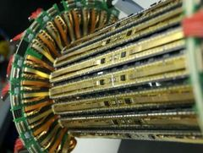
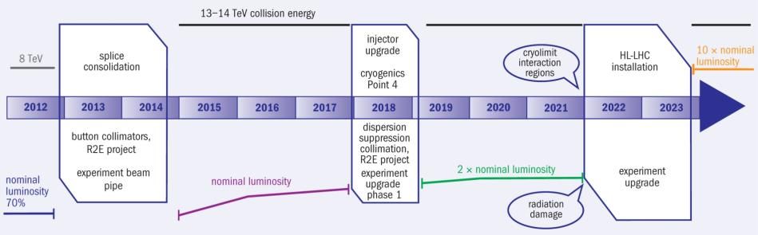
Pixel upgrades
Current LHC pixel detectors have clearly demonstrated the feasibility and power of pixel detectors for tracking in high rate environments
Phase1 upgrades: Additional pixel layer, ~4 x hit rates
  ATLAS: Addition of inner B layer with new 130nm pixel ASIC (FEI4)
  CMS: New pixel detector with modified 250nm pixel ASIC (PSI46DIG)
Phase2 upgrades: ~16 x hit rates, 2-4 x better resolution, 10 x readout rates,
16 x radiation tolerance, Increased forward coverage, less material, , ,
  Installation: ~ 2022
  Relies fully on significantly improved performance from next generation pixel chips.
ATLAS Pixel IBL
CMS & ATLAS phase 2 pixel upgrades
CMS Pixel phase1
100MHz/cm²
400MHz/cm²
1-2GHz/cm²

Slide 3
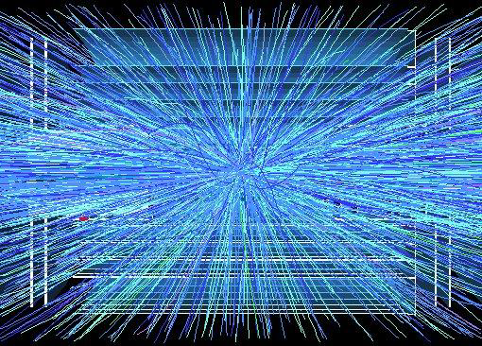
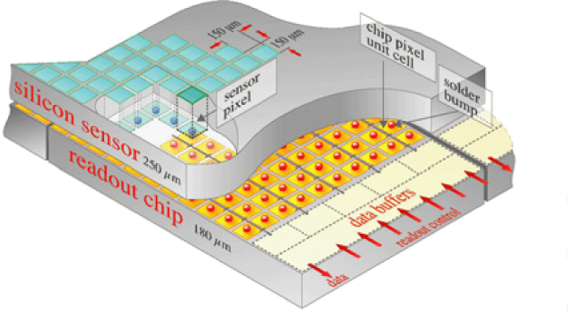
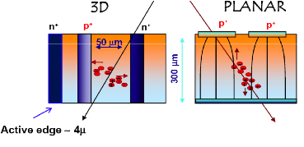
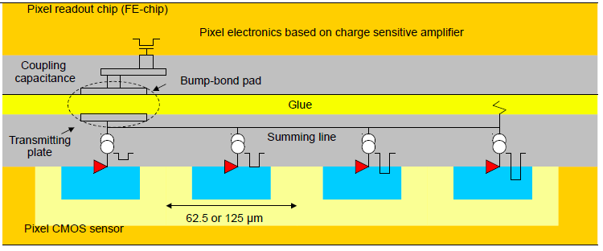
Phase 2 pixel challenges
ATLAS and CMS phase 2 pixel upgrades very challenging
  Very high particle rates: 500MHz/cm²
    Hit rates: 1-2 GHz/cm² (factor 16 higher than current pixel detectors)
  Smaller pixels: ¼ - ½ (25 – 50 um x 100um)
    Increased resolution
    Improved two track separation (jets)
  Participation in first/second level trigger ?
    40MHz extracted clusters and shape (outer layers) ?
    Region of interest readout for second level trigger ?
  Increased readout rates: 100kHz -> 1MHz
  Low mass -> Low power
  Very similar requirements (and uncertainties) for ATLAS & CMS
Unprecedented hostile radiation: 10MGy(1Grad), 10¹⁶ Neu/cm²
  Hybrid pixel detector with separate readout chip and sensor.
  Phase2 pixel will get in 1 year what we now get in 10 years
Pixel sensor(s) not yet determined
  Planar, 3D, Diamond, HV CMOS, , ,
  Possibility of using different sensors in different layers
  Final sensor decision may come relatively late.
Very complex, high rate and radiation hard pixel readout chips required
ATLAS HVCMOS program

Slide 4
Pixel chip
Pixel readout chips critical for schedule to be ready for phase 2 upgrades
  Technology: Radiation qualification
  Building blocks: Design, prototyping and test
  Architecture definition/optimization/verification
  Chip prototyping, iterations, test, qualification and production
  System integration
    System integration tests and test-beams
  Production and final system integration, test and commissioning
Phase 2 pixel chip very challenging
  Radiation
  Reliability: Several storage nodes will have SEUs every second per chip.
  High rates
  Mixed signal with very tight integration of analog and digital
  Complex: ~256k channel DAQ system on a single chip
  Large chip: ~2cm x 2cm, ½ - 1 Billion transistors.
  Very low power: Low power design and on-chip power conversion
Both experiments have evolved to have similar pixel chip architectures and plans to use same technology for its implementation.
Experienced chip designers for complex ICs in modern technologies that most work in a extremely harsh radiation environment is a scarce and distributed “resource” in HEP.

Slide 5
Pixel chip generations
Generation | Current FEI3, PSI46 | Phase 1 FEI4, PSI46DIG | Phase 2
Pixel size | 100x150um² (CMS) 50x400um² (ATLAS) | 100x150um² (CMS) 50x250um² (ATLAS) | 25x100um² ?
Sensor | 2D, ~300um | 2D+3D (ATLAS) 2D (CMS) | 2D, 3D, Diamond, MAPS ?
Chip size | 7.5x10.5mm² (ATLAS) 8x10mm² (CMS) | 20x20mm² (ATLAS) 8x10mm² (CMS) | > 20 x 20mm²
Transistors | 1.3M (CMS) 3.5M (ATLAS) | 87M (ATLAS) | ~1G
Hit rate | 100MHz/cm² | 400MHz/cm² | 1-2 GHz/cm²
Hit memory per chip | 0.1Mb | 1Mb | ~16Mb
Trigger rate | 100kHz | 100KHz | 200kHz - 1MHz
Trigger latency | 2.5us (ATLAS) 3.2us (CMS) | 2.5us (ATLAS) 3.2us (CMS) | 6 - 20us
Readout rate | 40Mb/s | 320Mb/s | 1-3Gb/s
Radiation | 1MGy (100Mrad) | 3.5MGy (350Mrad) | 10MGy (1Grad)
Technology | 250nm | 130nm (ATLAS) 250 nm (CMS) | 65nm
Architecture | Digital (ATLAS) Analog (CMS) | Digital (ATLAS) Analog (CMS) | Digital
Buffer location | EOC | Pixel (ATLAS) EOC (CMS) | Pixel
Power | ~1/4 W/cm² | ~1/4 W/cm² | ~1/4 W/cm²

Slide 6
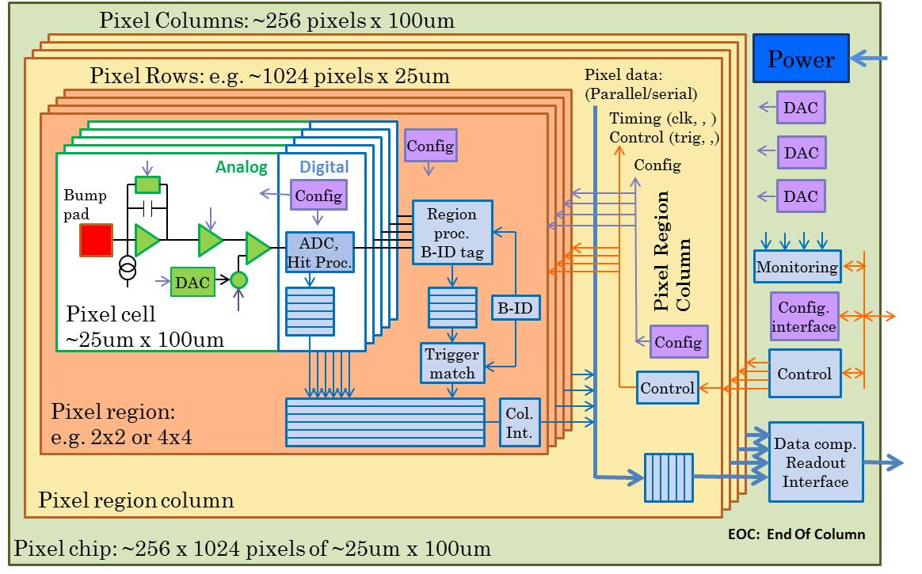
3rd generation pixel architecture
95% digital (as FEI4)
Charge digitization
~256k pixel channels per chip
Pixel regions with buffering
Data compression in End Of Column

Slide 7
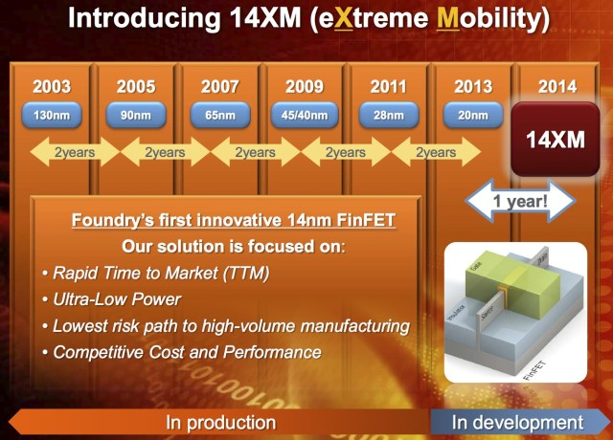
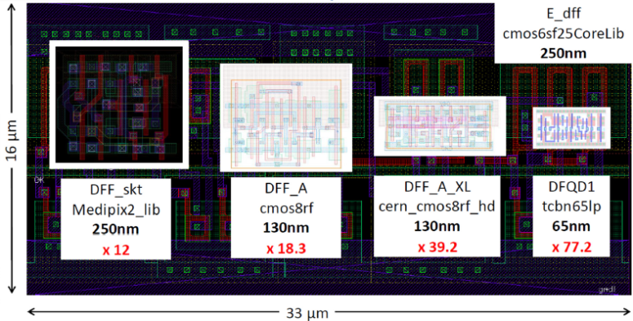
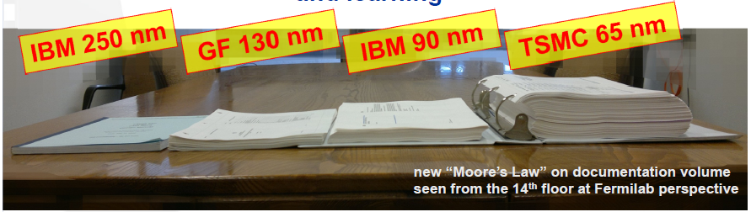
Why 65nm Technology
Mature technology:
  Available since ~2007
High density and low power
Long term availability
  Strong technology node used extensively for industrial/automotive
Access
  CERN frame-contract with TSMC and IMEC
    Design tool set
    Shared MPW runs
    Libraries
    Design exchange within HEP community
Affordable (MPW from foundry and Europractice, ~1M NRE for full final chips)
Significantly increased density, speed, , ,
and complexity !
X. Llopart CERN
G. Deptuch, Fermilab

Slide 8
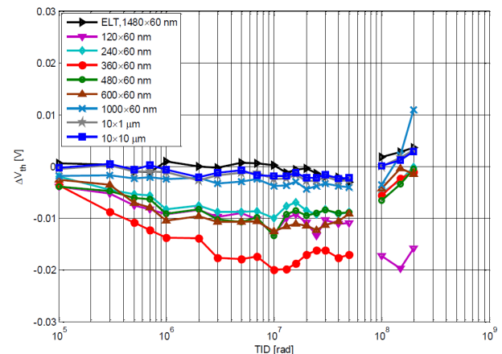
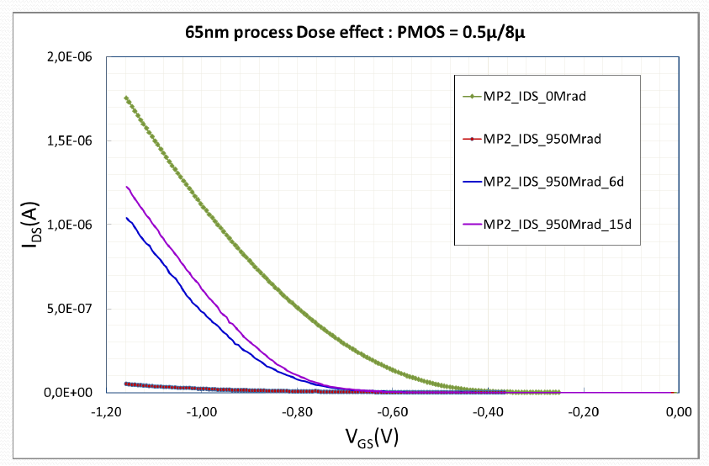
65nm Technology
Radiation hardness
  Uses thin gate oxide
    Radiation induced trapped charges removed by tunneling
    More modern technologies use thick High K gate “oxide” with reduced tunneling/leakage.
  Verified for up to 200Mrad
  To be confirmed for 1Grad
    PMOS transistor drive degradation, Annealing ?
    If significant degradation then other technologies must be evaluated and/or a replacement strategy must be used for inner pixel layers
  CMOS normally not affect by NIEL
    To be confirmed for 10¹⁶ Neu/cm²
    Certain circuits using “parasitic” bipolars to be redesigned ?
  SEU tolerance to be build in (as in 130 and 250nm)
    SEU cross-section reduced with size of storage element, but we will put a lot more per chip
  All circuits must be designed for radiation environment ( e.g. Modified RAM)
S. Bonacini, P. Valerio CERN
No radiation
after annealing
950Mrad
M. Menouni, CPPM

Slide 9
ATLAS – CMS RD collaboration
Similar requirements, same technology choice and limited availability of rad hard IC design experts in HEP makes this ideal for a close CMS – ATLAS RD collaboration
  Even if we do not make a common pixel chip
Initial 2day workshop between communities confirmed this.
  Workshop: http://indico.cern.ch/conferenceDisplay.py?confId=208595
Forming a RD collaboration has attracted additional groups and collaborators
  Synergy with CLIC pixel (and others): Technology, Rad tol, Tools, etc.
Institutes: 17
  ATLAS: Bonn, CERN, CPPM, LBNL, LPNHE Paris, NIKHEF, New Mexico, RAL,
  UC Santa Cruz.
  CMS: Bari, Bergamo-Pavia, CERN, Fermilab, Padova, Perugia, Pisa, PSI, RAL, Torino.
Collaborators: 99, ~50% chip designers
Collaboration organized by Institute Board (IB) with technical work done in specialized Working Groups (WG)
Initial work program covers ~3 years to make foundation for final pixel chips
  Will be extended if appropriate:
    Common design ?,
    Support to experiment specific designs

Slide 10
Working groups
WG | Domain
WG1 | Radiation test/qualification
Qualification of technology to 10 MGy TID, 10¹⁶ n.eq./cm². Transistor simulation models after irradiation. Evaluation of logic cell libraries after irradiation. Expertise on radiation effects in 65nm
WG2 | Top level design
Design methodology, verification and test of ~5 × 10⁸ transistor IC. Analog integration in large digital chip. Power distribution Synthesis constraints. Clock distribution and optimization
WG3 | Simulation and verification test bench
System Verilog simulation and Verification framework. Optimization of global architecture/pixel regions/pixel External system and external physics data. Verification of test chips and evolving designs
WG4 | I/O
Definition of readout and control interfaces (e.g. LPGBT). Definition of standardized I/O protocols and performance Implementation of readout and control interface blocks. Standardized interfaces: Control, Readout, etc.
WG5 | Analog design
Evaluate and compare alternate amplifier designs. Evaluate and compare charge ADC techniques vs. number of bits (TOT, shared ADC, etc.)
WG6 | IP blocks
Define common requirements for IP block design. Evaluate, document, and keep library of IP blocks Generate overview and recommendations. Each block will have its own prototyping milestones

Slide 11
Participation matrix
Institute | WG1 Radiation | WG2 Top level | WG3 Sim./Ver | WG4 I/O | WG5 Analog | WG6 IPs
Bari | C |  | A |  |  | A
Bergamo-Pavia | A |  |  | C | A | B
Bonn | C | A | A | B | B | A
CERN | B^{(*)} | ^{(*)} | A | C^{(*)} | A | B^{(*)}
CPPM | A | B | C | C | B | A
Fermilab | A | B |  |  | A
LBNL | B | A | B | B | A | A
LPNHE Paris | A | B | A |  |  | A
NIKHEF |  | A | A |  |  | A
New Mexico | A
Padova | A |  |  |  | A
Perugia | B |  | A |  |  | B
Pisa |  | B | A | A |  | A
PSI | B | A |  | C | A | A
RAL |  | B | B |  | A | C
Torino | C | B | C | B | A | A
UCSC | C | B | C |  |  | A
A: Core competency, B: High interest, C: Ability to help
(*): General CERN support for 65nm

Slide 12
Summary
Highly focused ATLAS - CMS RD collaboration to develop/qualify technology, tools, architecture and building blocks required to develop phase 2 pixel readout chips
Synergy with other pixel projects: CLIC, ?
Centered on well defined working groups
Baseline technology: 65nm
17 Institutes, 100 Collaborators
Initial work program of 3 years

