Slide 1
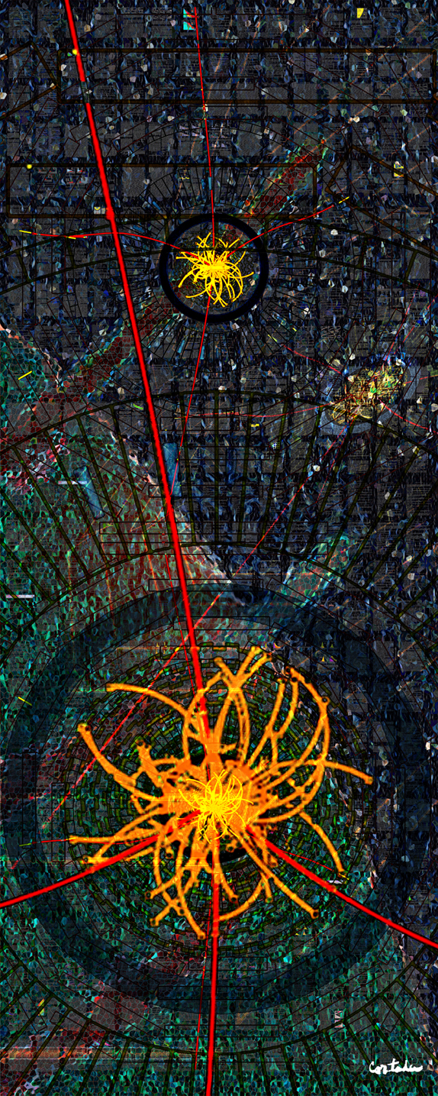
CMS
Highlights from Spring 2013
LHCC open session
June 12, 2013
Jeffrey Berryhill (Fermilab)
On behalf of the CMS collaboration
Digital art courtesy of Xavier Cortada (with the participation of physicist Pete Markowitz) "In search of the Higgs boson: H -> ZZ"

Slide 2
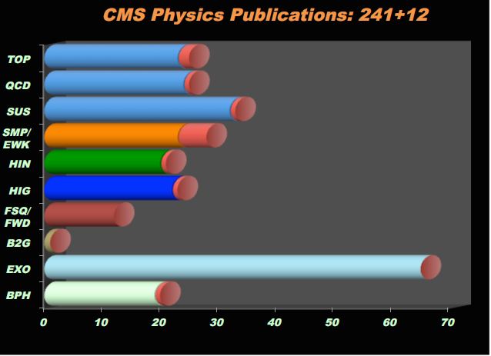
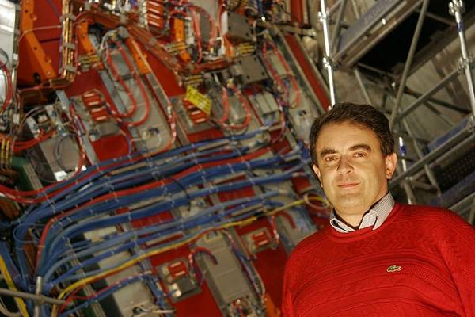
CMS Collaboration status
241+ physics publications with collision data; Higgs discovery paper has nearly 1200 citations
33 new physics results since Moriond 2013, including new Higgs combination
Manpower shifting to upgrades/LS1 activities as Run 1 analysis is completed
Welcoming new spokesperson-elect Tiziano Camporesi in 2014.

Slide 3
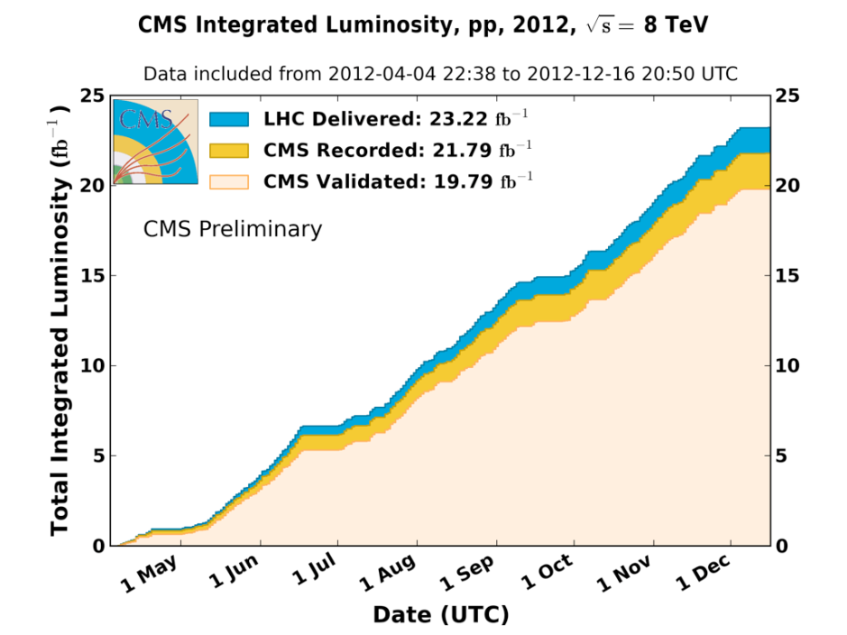
CMS Collaboration status
2012 data and MC reprocessing with final calibrations and alignments is complete!
  (Core + Parked) with improved conditions has been delivered!
  This is the legacy 2012 dataset
And fully certified!
  Golden: 19.79 /fb (91% of recorded)
  Muon: 20.65 /fb (95% of recorded)
    Jet Energy Corrections and Btag scale factors based on new reprocessing signed of and available to analyzers since June 7th
  Improved MC for H->γγ (with run dependent ECAL conditions)

Slide 4
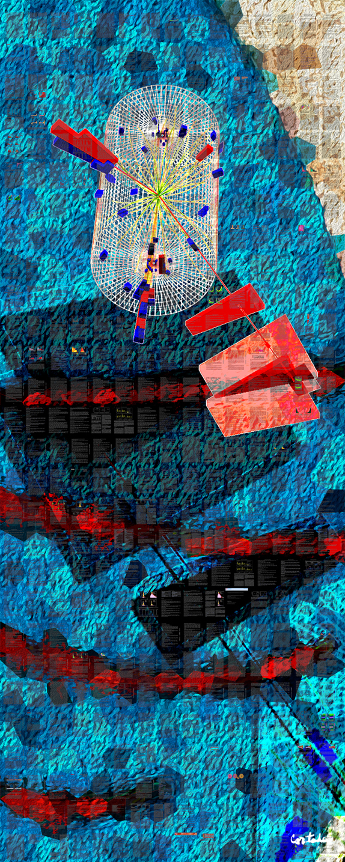
Heavy Ion and Standard Model Results
Digital art courtesy of Xavier Cortada (with the participation of physicist Pete Markowitz) "In search of the Higgs boson: H -> tautau"

Slide 5
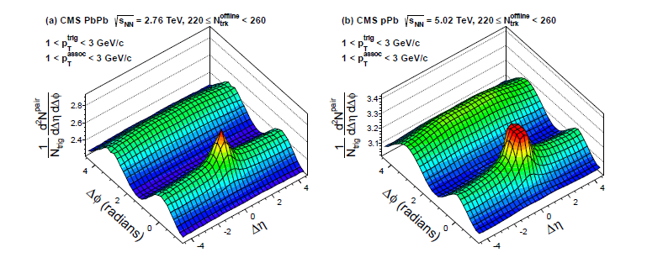
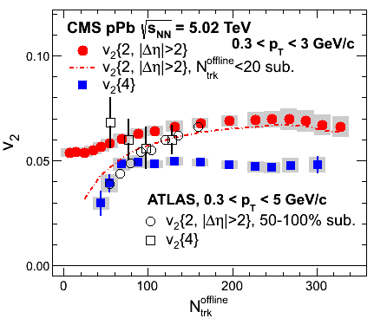
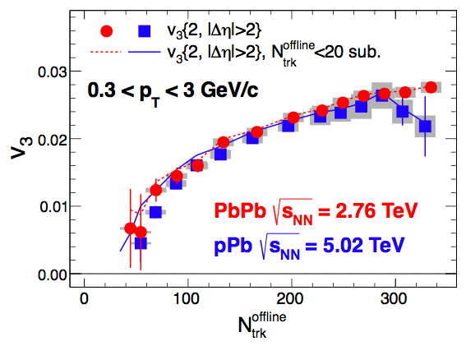
p-Pb results: 2013 ridge analysis
Submitted to PLB
arXiv:1305.0609
31/nb of 2013 pPb collisions, a comprehensive follow-up on 1/μb 2012 observation of near-side long-range correlations in pPb
PbPb ridge
pPb ridge
Ridge phenomena can now be compared with PbPb at similar multiplicity (> 200), as well as 4-particle correlations and multipole harmonics (v2, v3)

Slide 6
p-Pb results: 2013 ridge analysis
Submitted to PLB
arXiv:1305.0609
31/nb of 2013 pPb collisions, a comprehensive follow-up on 1/μb 2012 observation of near-side long-range correlations in pPb
Hydrodynamic expansion of a strongly coupled medium presently the only theory that explains all CMS observations
PbPb ridge
pPb ridge
Ridge phenomena can now be compared with PbPb at similar multiplicity (> 200), as well as 4-particle correlations and multipole harmonics (v2, v3)

Slide 7
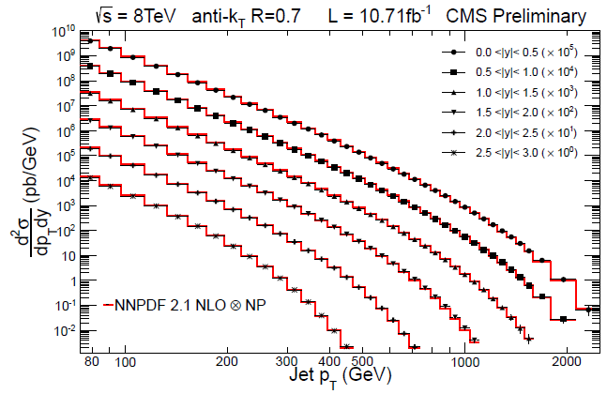
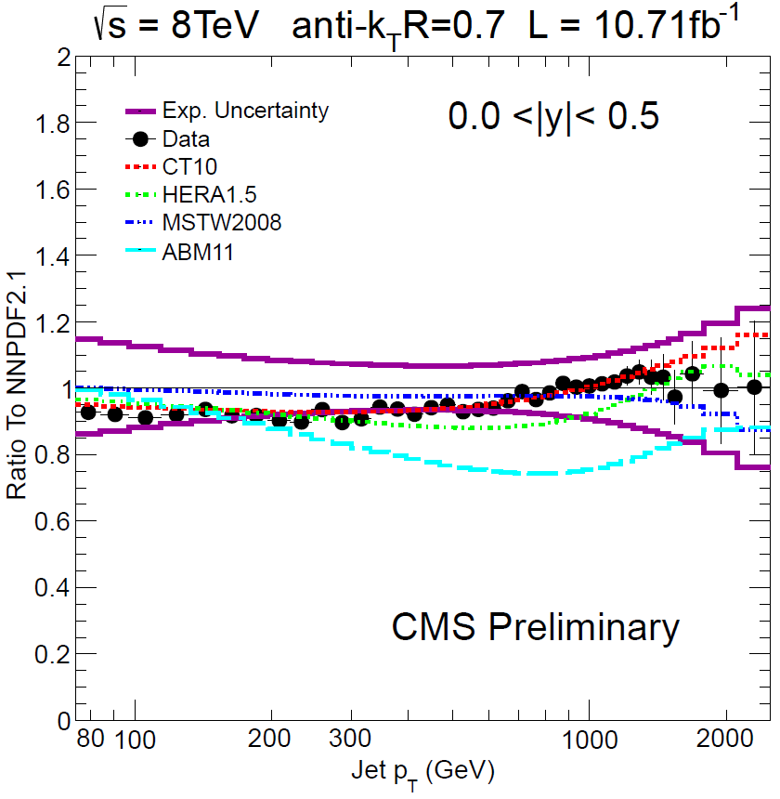
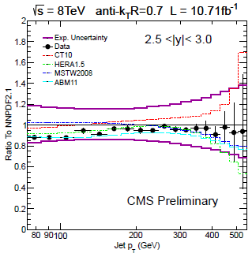
Standard Model: 8 TeV inclusive jets
CMS-PAS-SMP-12-012
Double-differential inclusive jet cross section obtained with 11/fb at 8 TeV
Agreement with NLO QCD over 11 orders of magnitude, with sensitivity beyond 2 TeV
2-5% jet energy scale uncertainty for PF jets
4-8% jet energy resolution
10-30% cross section uncertainty per bin
Improvement to high x q/g PDF expected

Slide 8
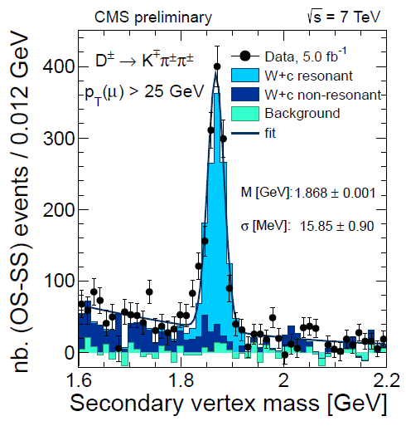
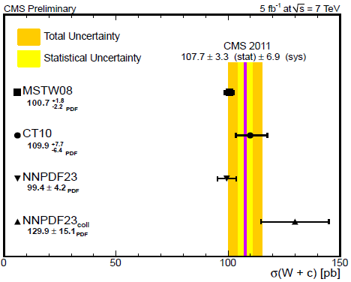
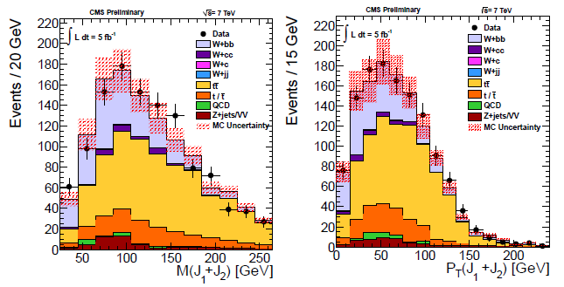
Standard Model: W+heavy flavor studies
CMS-PAS-SMP-12-002
Large W+c rate exploited for a high-purity W+c cross section measurement at 7 TeV.
Sensitivity to strange PDF now an interesting alternative to fixed target neutrino data.
CMS-PAS-SMP-12-026
W+bb exclusive final state extracted for the first time at 7 TeV
Rate and production dynamics consistent with MadGraph and NLO QCD (MCFM) within errors (22%)

Slide 9
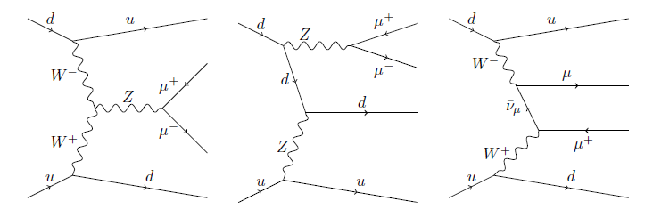
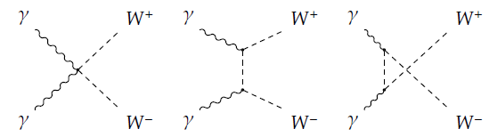
“Forward” Physics: VBF Z and WW aQGC
Submitted to JHEP, arXiv:1305.7389
Purely electroweak
Z + 2 jets (interfering)
Comprehensive study of Z+forward dijet production at 7 TeV.
VBF Z one of the interfering amplitudes
Submitted to JHEP, arXiv:1305.5596
First search for photon-photon scattering production of WW
WWγγ quartic gauge coupling one of the amplitudes
Two photon production
of WW (s, t, and u channel)

Slide 10
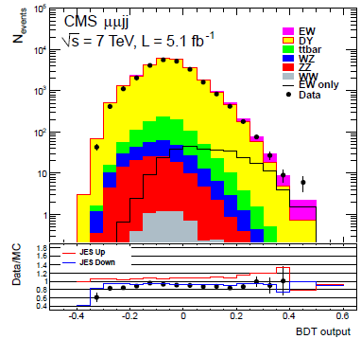
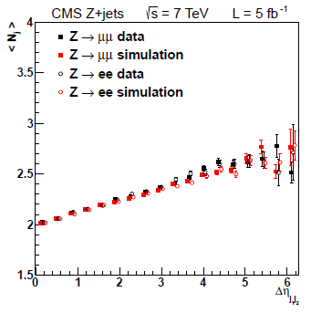
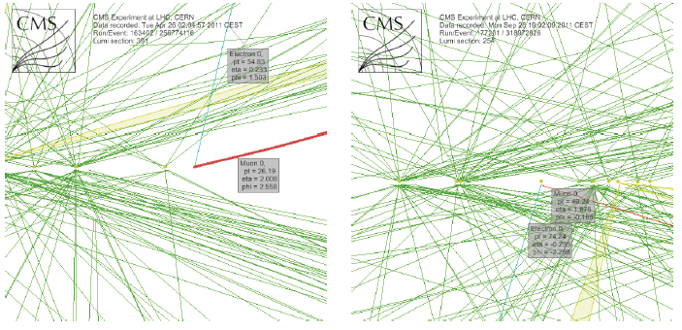
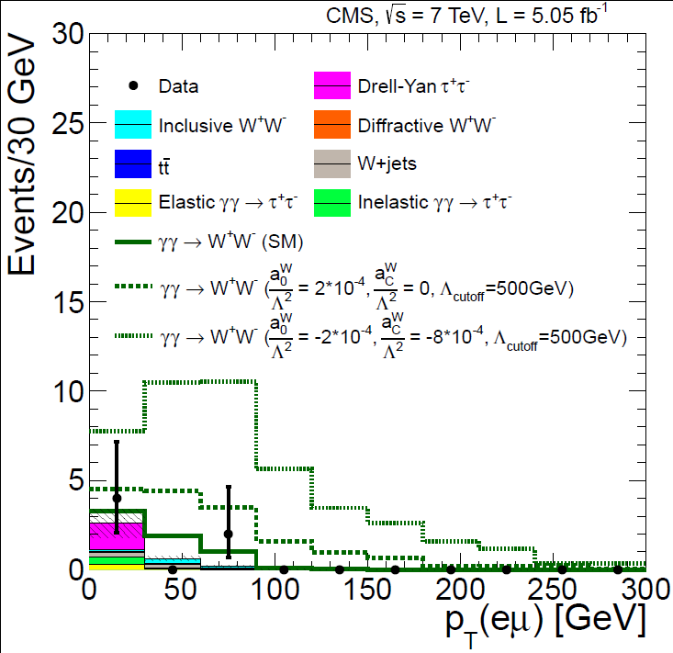
“Forward” Physics: VBF Z and WW aQGC
Submitted to JHEP, arXiv:1305.7389
Comprehensive study of Z+forward dijet production at 7 TeV. Electroweak component has 2.6 sigma significance.
Forward dijet dynamics in agreement with MadGraph
Submitted to JHEP, arXiv:1305.5596
Two eμ events observed with no UE present
First quartic gauge coupling limits at LHC; WWγγ limit two orders better than LEP or Tevatron!

Slide 11
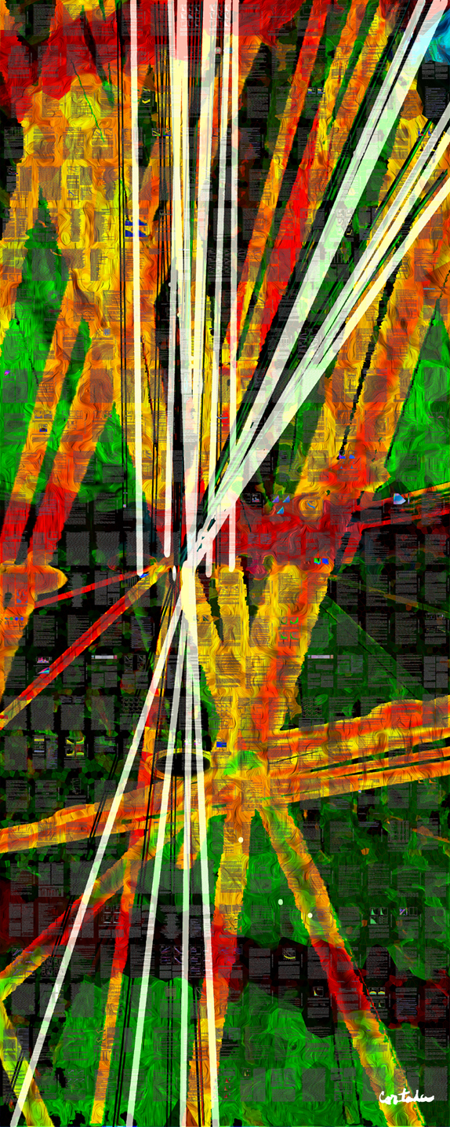
Higgs Results
Digital art courtesy of Xavier Cortada (with the participation of physicist Pete Markowitz) "In search of the Higgs boson: H -> bottom bottom"

Slide 12
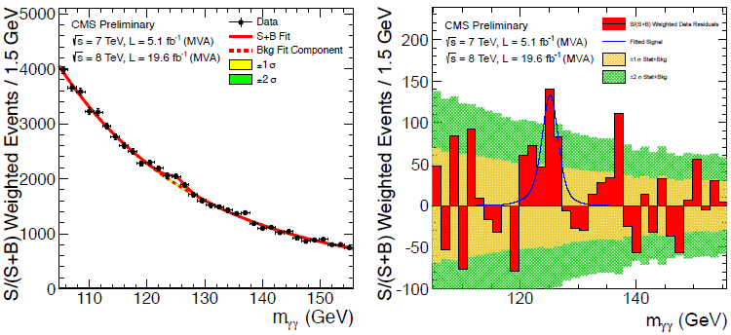
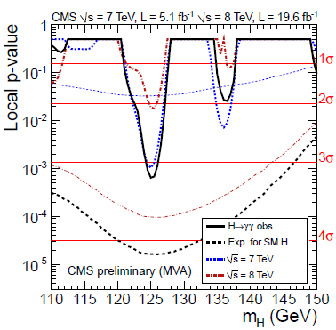
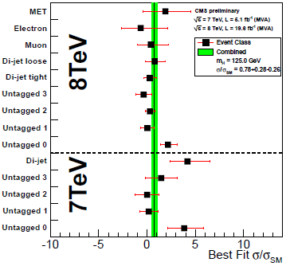
H → γγ : Full Run 1 result
CMS-PAS-HIG-13-001
Most sensitive MVA-based analysis finds an excess with local significance of 3.2 σ at 125 GeV mass (4.2 σ expected).
Signal strength μ= 0.78±0.27 consistent with SM Higgs and consistent across categories
Alternative cut-based analysis has significance of 3.9 σ (3.5 expected)
Different analyses compatible with each other at 1.5 σ level, including correlations.

Slide 13
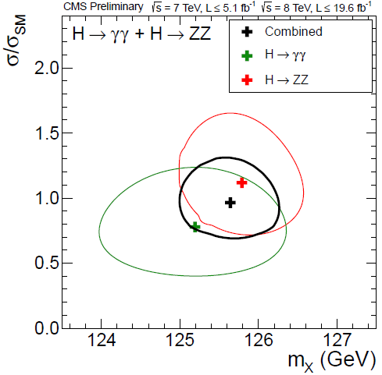
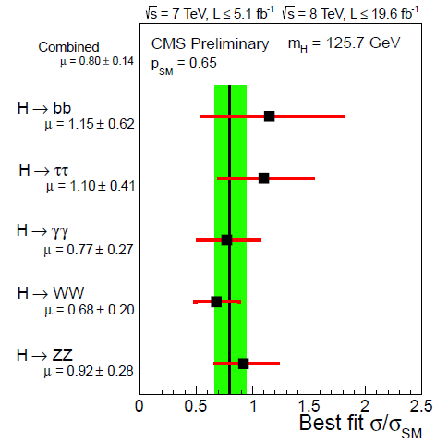
Moriond 2013 combination
CMS-PAS-HIG-13-005
A consistent mass is measured for ZZ* and γγ: 125.7±0.3±0.3 GeV
A consistent signal strength is measured for 5 decay modes
μ = 0.80±0.14
A consistent signal strength is measured w.r.t production mode, fermion vs. boson couplings, and custodial symmetry
JCP 2++/0-+ disfavored at 2.8/3.3 σ level

Slide 14
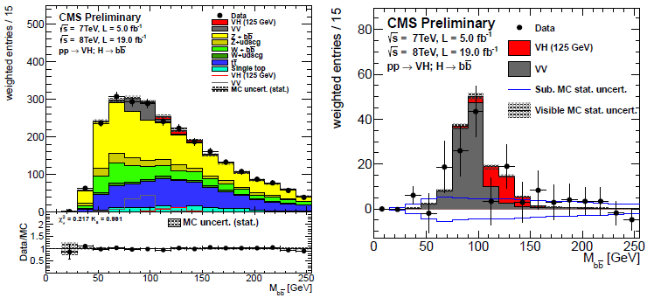
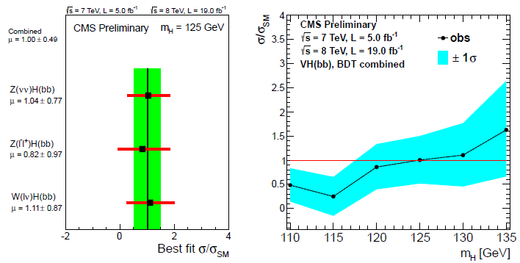
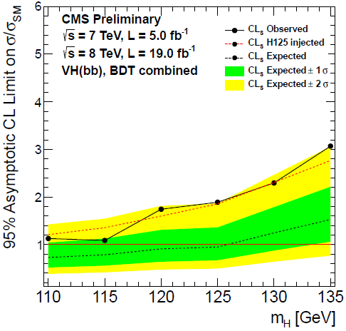
V+H, H→bb: Full Run 1 result
CMS-PAS-HIG-13-012
125 GeV
BDT shape-based analysis finds an excess with local significance of 2.1 σ at 125 GeV mass (2.1 σ expected).
VZ diboson peak clearly visible (7.5σ), consistent with SM rate
Signal strength μ= 1.0±0.50 consistent with SM Higgs and consistent across V modes

Slide 15
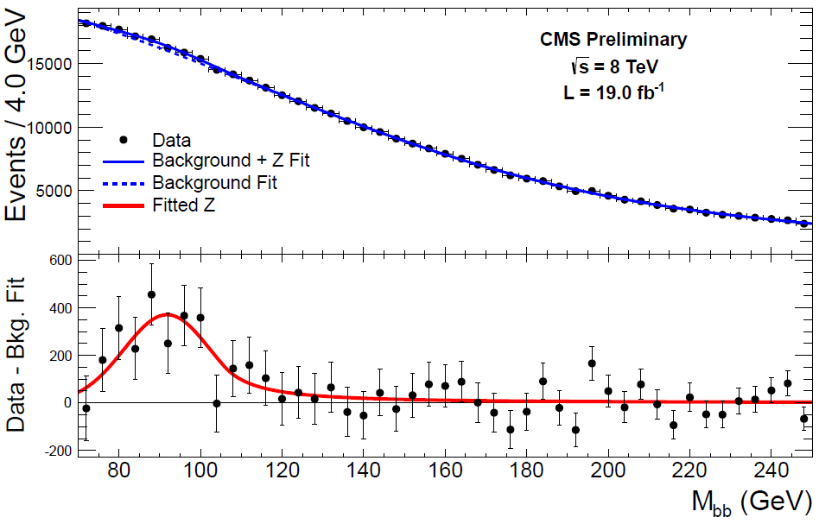
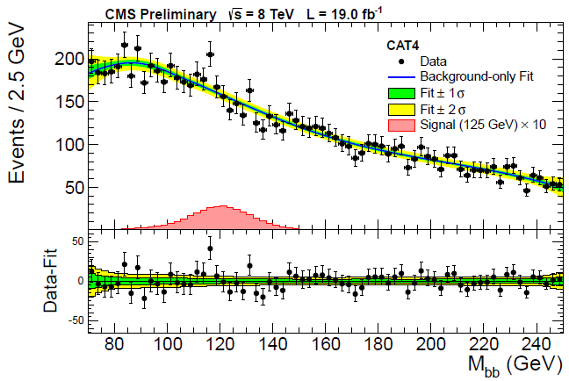
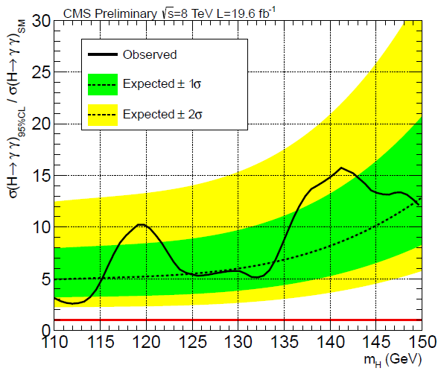
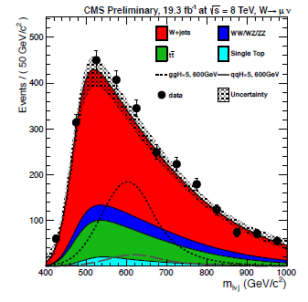
Higgs newcomers since Moriond:
CMS-PAS-HIG-13-011
First search for VBF H→bb.
Z→bb peak clearly visible (8 σ, 6.8 σ exp.)
bb Mass fit in MVA categories
At 125 GeV μ= 0.7±1.4, 95% CL UL of 3.6 (3.0 exp.)
CMS-PAS-HIG-13-015, HIG-13-008
ttH now extended to γγ decay mode. At 125 GeV, μ < 5.4 (95% CL, 5.3 expected)
H →WW →lνJ search. First Higgs search to include merged dijet W-tagging (pruned CA8 with n-subjettiness cut).
H→WW
→lνJ
ttH, H→γγ

Slide 16
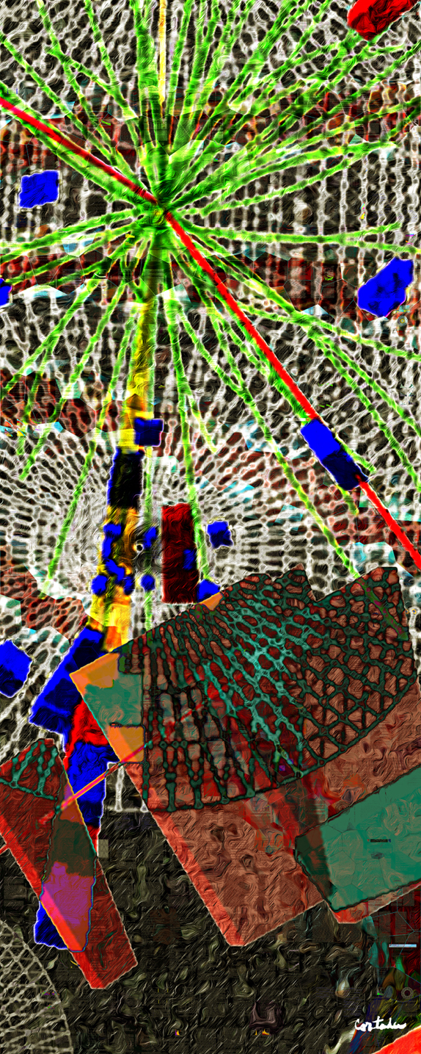
Beyond Standard Model Search Results
Digital art courtesy of Xavier Cortada (with the participation of physicist Pete Markowitz) "In search of the Higgs boson: H -> gamma gamma"

Slide 17
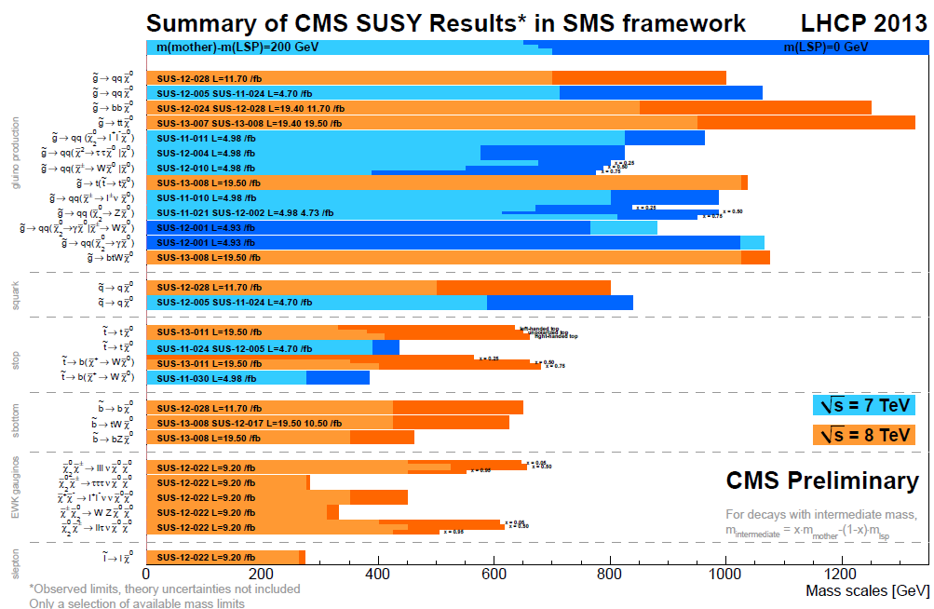
SUSY: Remaining strategies for Run 1
Natural R-parity-conserving SUSY offered possibility of light squark/gluino discovery. Exclusions up to 800-1300 GeV mass complete.
Now searching for more general realizations of natural SUSY:
  R-parity violation
  Electroweak gaugino production
  Light stop/sbottom
  Compressed spectra
800 GeV
squark
TeV gluino
650 GeV
Stop or EWKinos

Slide 18
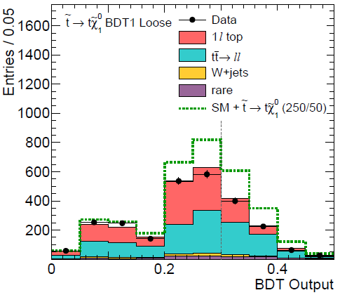
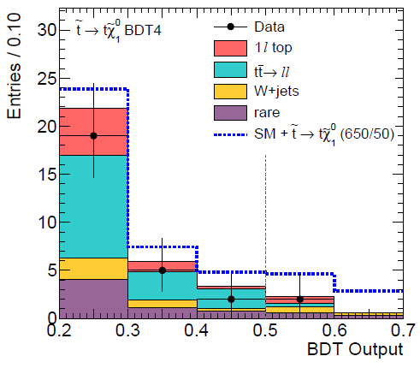
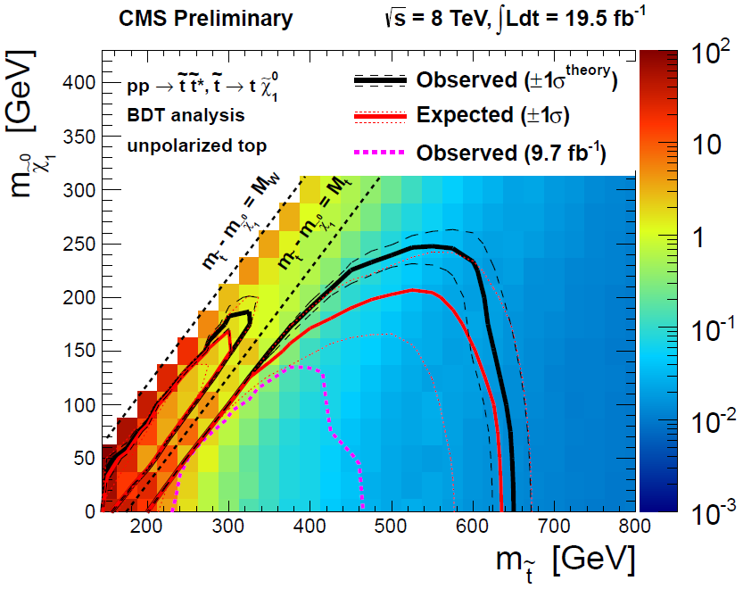
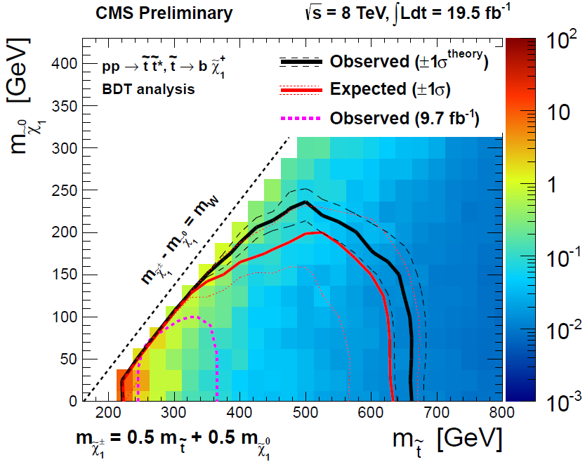
SUSY: stop search in lepton+jets
CMS-PAS-SUS-13-011
Stop pair search in stop →top + LSP and b+W+LSP decays . Signature is semileptonic tt candidates with large MET. Kinematic BDT identifies loose (tight) selection for light (heavy) stop
Stop mass limits obtained 150- 650 GeV in mass, including the off-shell top sector

Slide 19
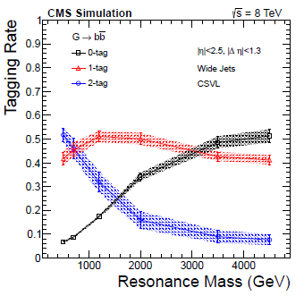
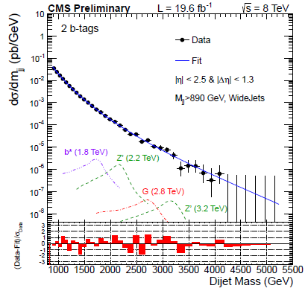
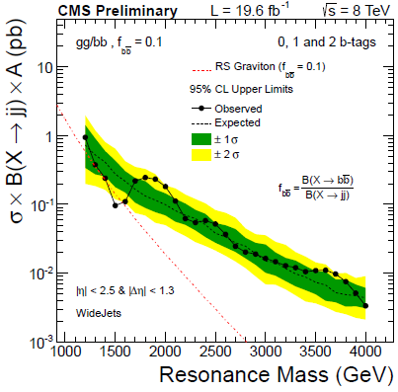
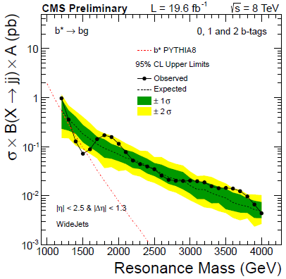
BSM: bb resonances
CMS-PAS-EXO-12-023
bb and bg resonance search
Wide central (η< 2.5) jets of radius 1.1 reconstructed from anti-kt jets of radius 0.5, |Δη| < 1.3
0, 1, and 2 b-tagged jet categories analyzed to maximize efficiency at high mass
Data consistent with smooth background
RS graviton bounds
> 1.42-1.57 TeV
Narrow topcolor Z’
> 1.20-1.68 TeV
Excited b*→bg
> 1.34-1.54 TeV
RS graviton
limits
b* limits

Slide 20
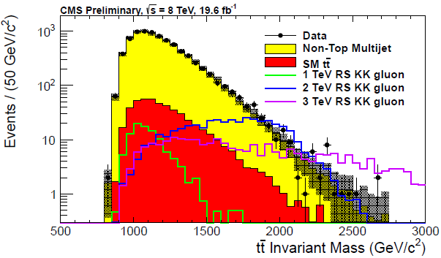
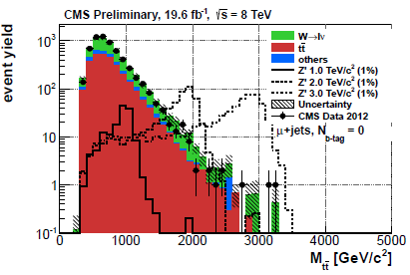
BSM: tt resonances
CMS-PAS-B2G-12-005
tt resonance search in the all-hadronic state
400 GeV CA8 dijets selected for 3-jet, top-like substructure (JHUTopTagger)
Top tagger performance calibrated with tt control samples
RS KK gluon bounds > 1.8 TeV
Narrow topcolor Z’ > 1.65 TeV
CMS-PAS-B2G-12-006
tt resonance search in the lepton+jets state
Threshold ,low mass selection: isolated lepton + 4 jets
Boosted, high mass selection:
non- or isolated lepton + 2 jets
Both 0 and 1 b-tagged categories examined
RS KK gluon bounds > 2.5 TeV
Narrow topcolor Z’ > 2.1 TeV

Slide 21
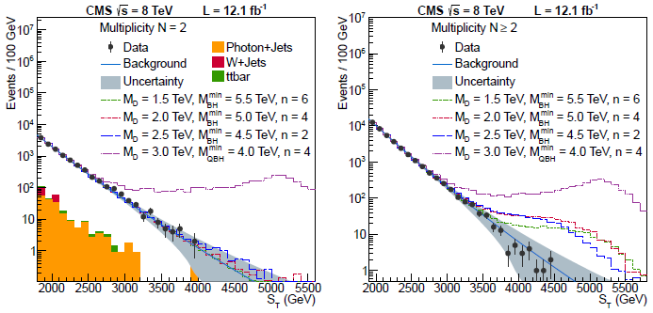
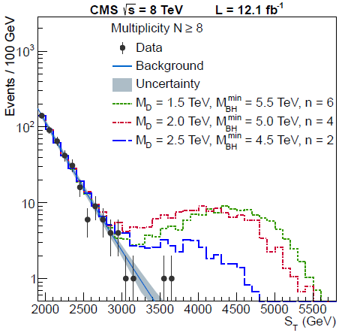
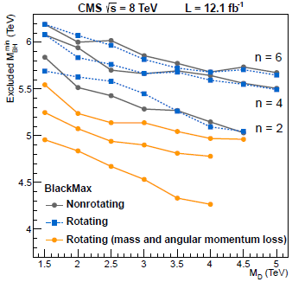
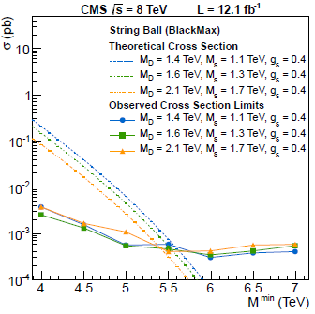
BSM: black holes
Submitted to JHEP, arXiv:1303.5338
Microscopic black hole or string-ball production results in high-multiplicity, high sum-ET events
Select 2 jets + X events, count N physics objects with ET > 50 GeV and compute their scalar sum-ET, ST for N=2-10
N=2 control sample for ST background shape
ST 1.9-2.3 TeV sideband for background norm vs. N
Semi-classical BH bounds from 4.3-6.2 TeV
Minimum string ball bounds ~5.5 TeV
+model-independent xsec limits
Final result for Run 1

Slide 22
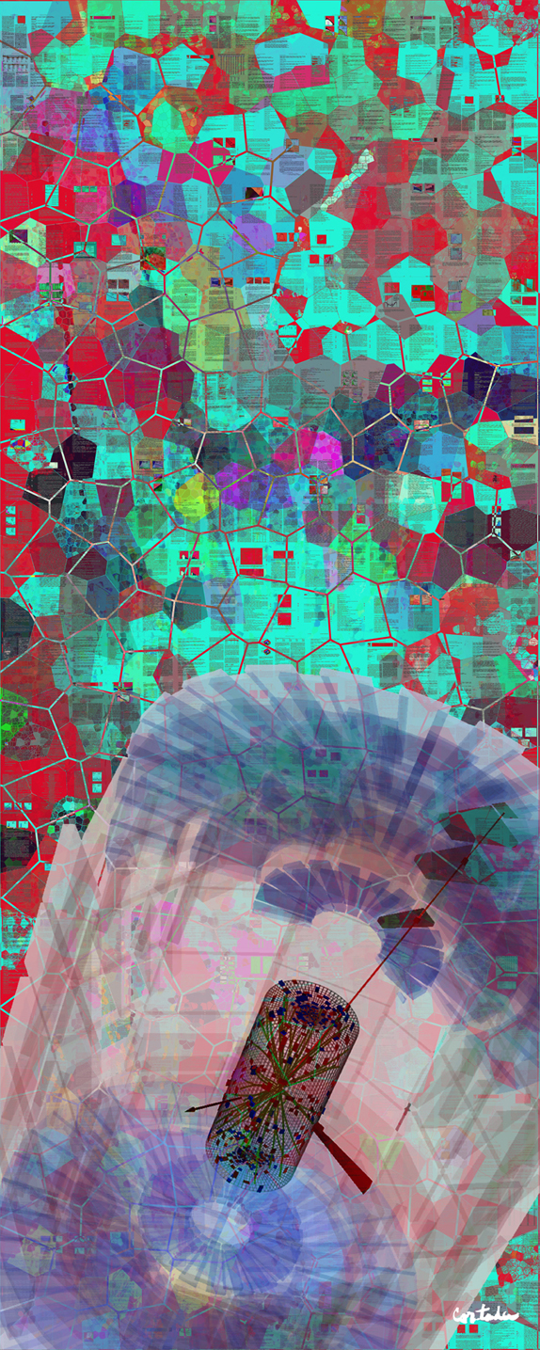
Shutdown and Upgrade Activities
Digital art courtesy of Xavier Cortada (with the participation of physicist Pete Markowitz) "In search of the Higgs boson: H -> WW"

Slide 23



Current CMS detector status
Beam pipe HF/CT2, and endcap sections removed at both ends
Barrel and forward pixels have been removed to cold lab
ME1/1 chamber removal begun
Water cooling has returned, power to racks soon to follow

Slide 24


Near term plans for LS1
ME 1/1 chambers
Full ME1/1 chamber removal to surface for electronics refurbishing
HO SiPM, HF PMT testing and installation at Pt 5 test-stand
Strip tracker "Going Cold" activities in full swing; recommissioning cold in September
CSC and RPC chambers in layer 4, installation in Oct. and Feb.
Global run planned for end October
ME 4/2 production

Slide 25

LS1: Surface Facilities
ME1/1 revision
Drift tube active stoarge
Sensor repair lab
Shielding/T1 bunker
Pixel cold lab
RP workshop
CASTOR
bunker
ME 4/2 production
beampipe

Slide 26



Longer term
LHCC this week: L1 Trigger Upgrade TDR Asking for approval at this meeting
With approval this joins the Pixel and HCAL Upgrade TDRs for Phase 1
CMS held an upgrade workshop last week at DESY, focused on the upgrade scenarios and R&D for Phase 2
Preparing for Snowmass, End of June (Seattle), Start of August (Minneapolis): Variety of physics studies for HL‐LHC
And for ECFA HL-LHC Workshop, Oct 1-3
Developing upgrade scenarios with cost scale for Phase 2 (HL-LHC) based on physics performance and detector longevity requirements – by October
Phase 2 Technical Proposal planned in 2014
L1 Trigger Upgrade
Ready for physics in 2016

Slide 27
Summary
Run 1 pp, pPb, PbPb data being successfully exploited for novel insights into heavy ion and SM physics.
2013 Run 1 Higgs results validate and improve upon the 2012 Higgs-like boson discovery. SM Higgs hypothesis is holding up well; now on the offensive in new SM and BSM modes.
BSM search data continue to confront TeV scale physics (and beyond). New avenues in natural SUSY under exploration.
LS1 improvements proceed on schedule. Phase 1 projects are underway. Converging on plans for Phase 2 Technical Proposal.

Slide 28
Backups

Slide 29



H → γγ : Full Run 1 result
Signal strength by analysis and year

Slide 30

H → γγ : Full Run 1 result
The correlation coefficient between the MVA and cut-based signal strength measurements is found to be r=0.76 (estimated using jackknife techniques).
Taking account of the correlation, the compatibility between the MVA and cut-based analysis measurements of the signal strength is found to be within 1.5σ for the combined 7 and 8 TeV measurement, and within 1.8σ for the 8 TeV measurement alone.

Slide 31
CMS Upgrade: L1 trigger TDR for LS1
EM and muon object isolation using calorimeter energy with pile-up subtraction.
Improved jet finding with pile-up subtraction.
Improved hadronic tau ID with a much narrower cone.
Improved muon pT resolution.
Improved global Level-1 trigger menu with larger capacity and more complex object combination
Realized with new high-bandwidth optical links (μTCA) and large FPGAs (Xilinx Virtex 7)
Commissioning system in 2015
Complete system ready for physics in 2016

