Slide 1
Dim8 Status for SnowMass EWK
Shu Li
Duke University

Slide 2
Status
Converged with Jessica in dim6 mg5 cross check
First shape results of WZjj w/ dim8
producing zzjj and wzjj distributions
  Still have a problem generating WZjj events, Olivier and Oscar are investigating. Temporary fix is now proposed! (See mailing list)
  ZZjj processes have unexpected number of events produced. Needs investigation

Slide 3
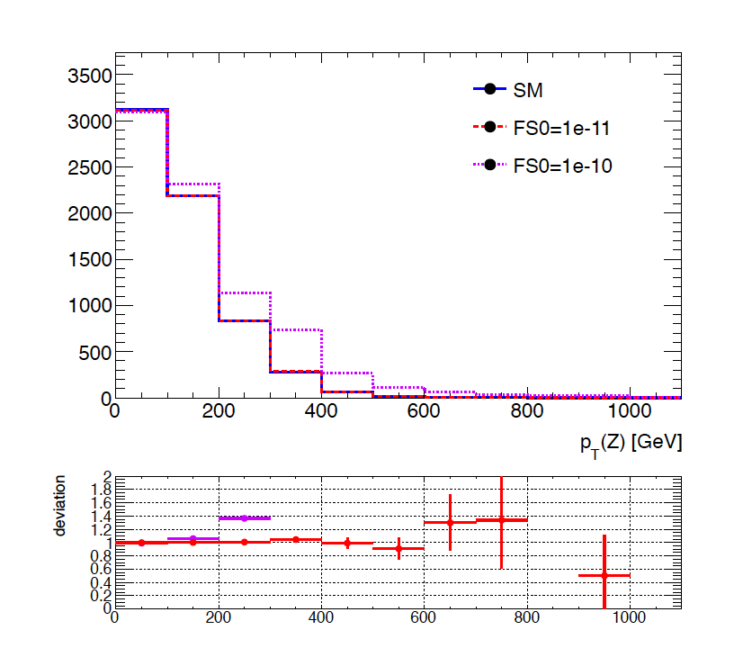
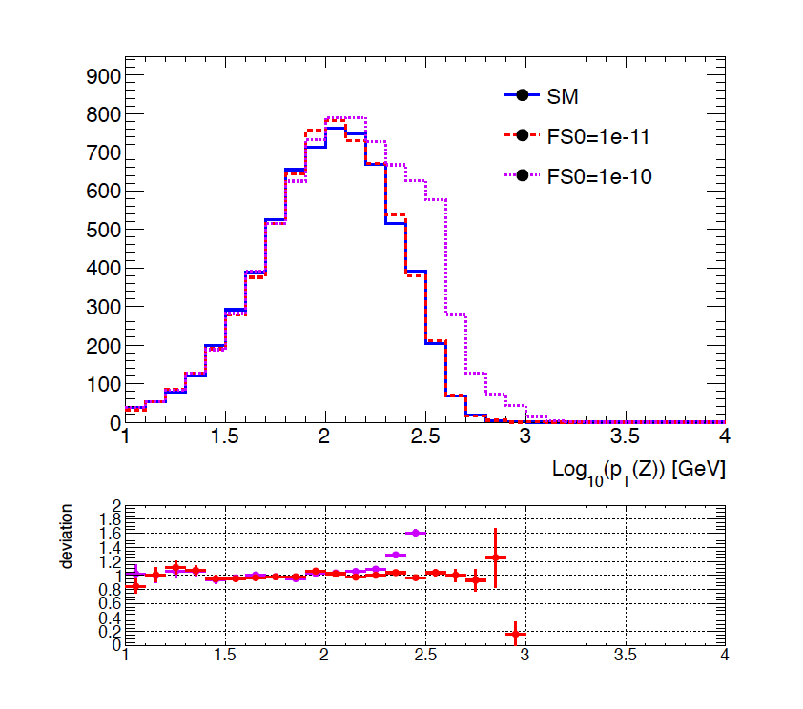
pT(Z) distribution of WZjj w/ FS0 variation

Slide 4
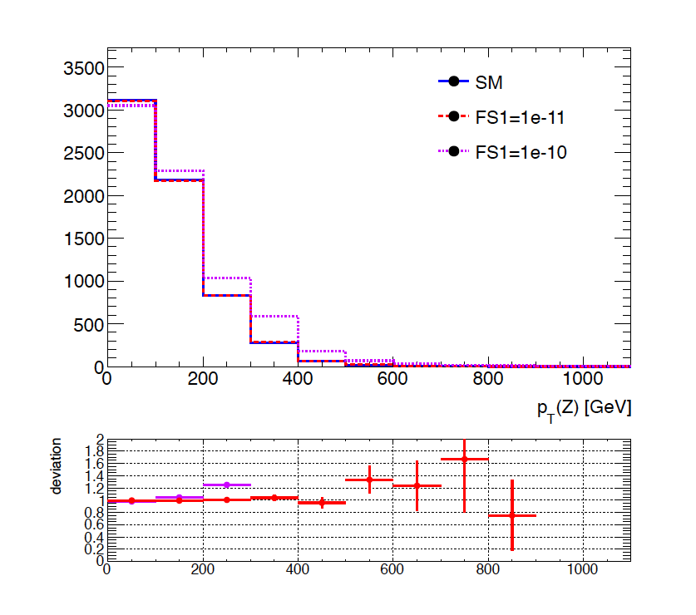
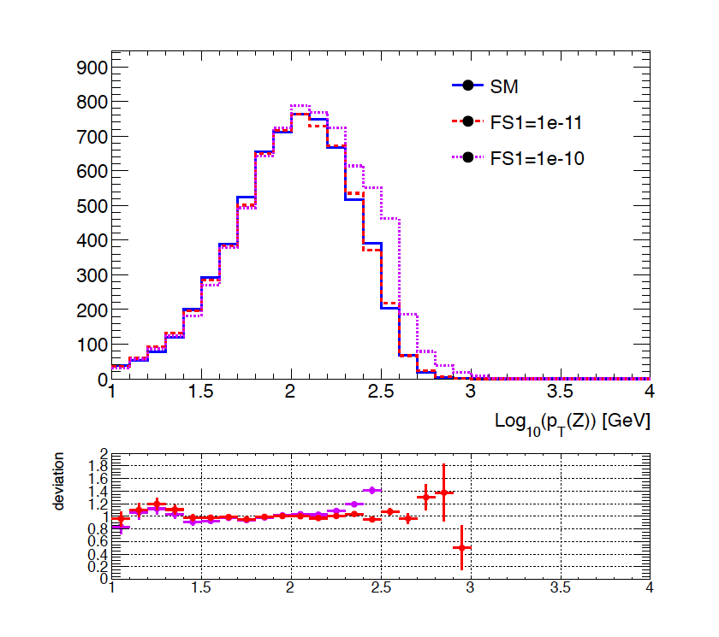
pT(Z) distribution of WZjj w/ FS1 variation

Slide 5
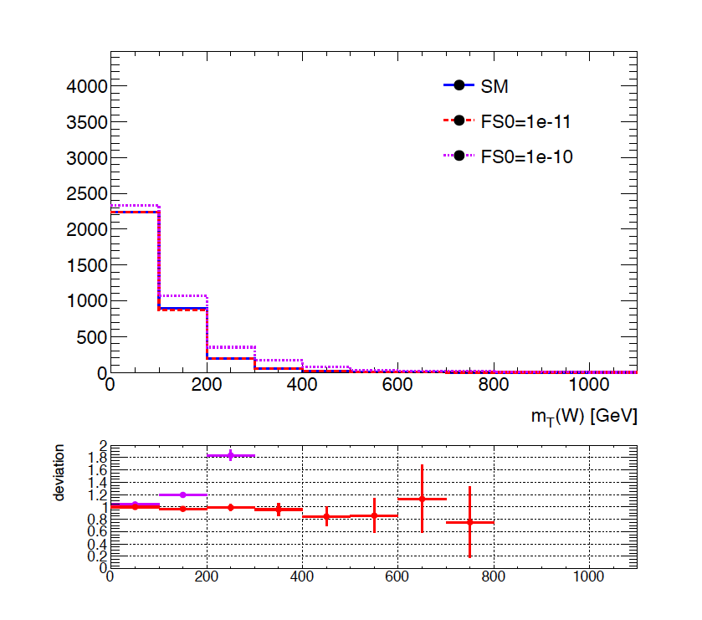
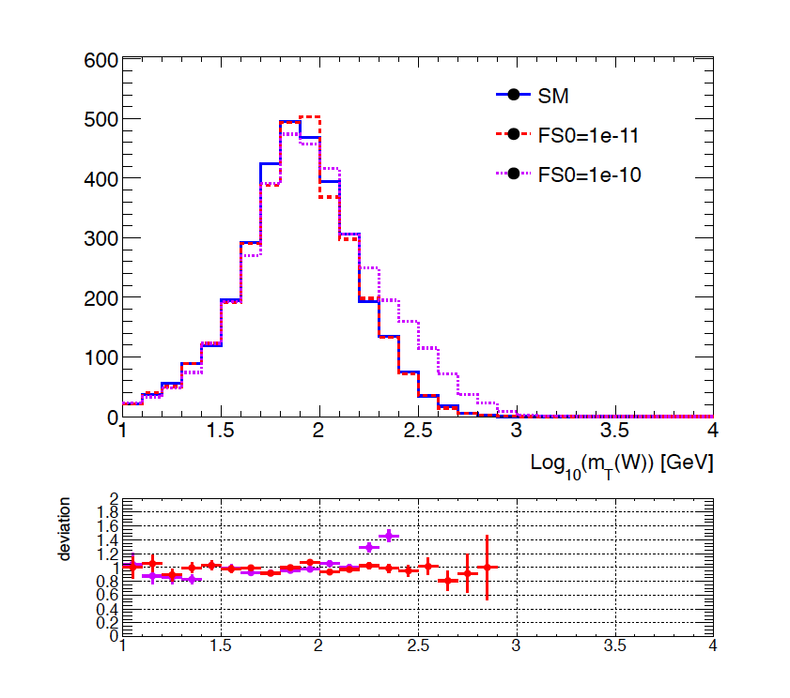
mT(W) distribution of WZjj w/ FS0 variation

Slide 6
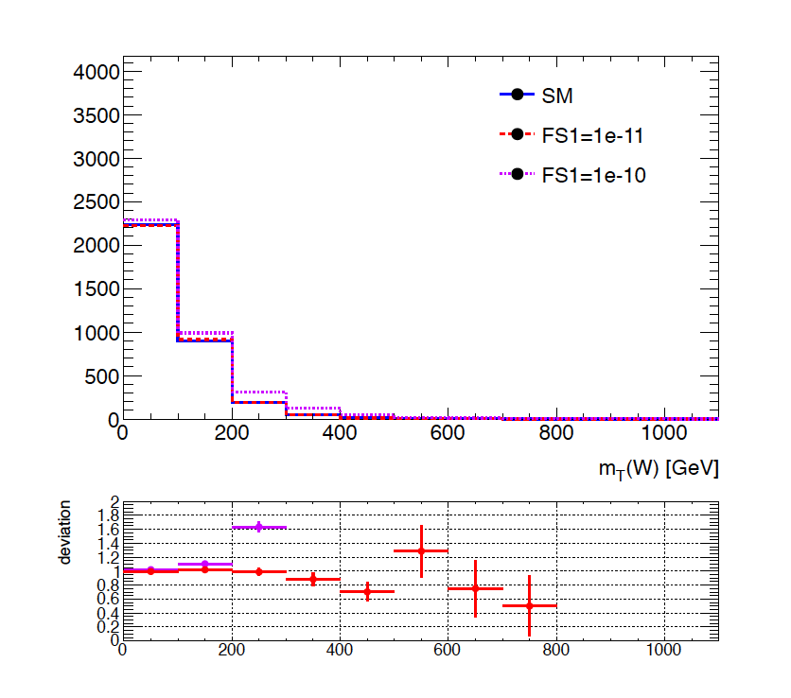
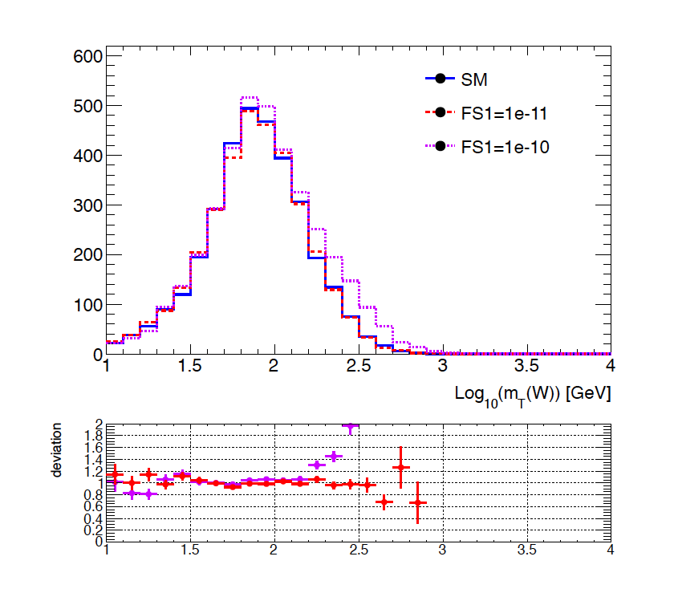
mT(W) distribution of WZjj w/ FS1 variation

Slide 7
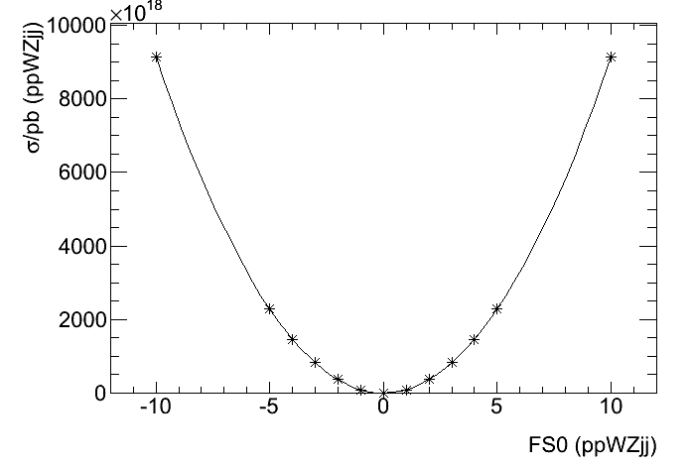
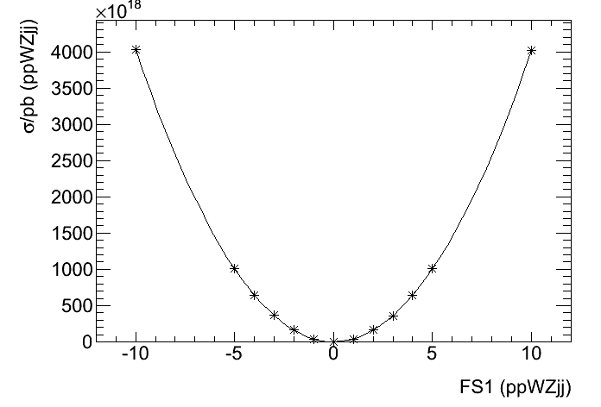
First look at the dim8 operators in WZjj
FS0
FS1

Slide 8
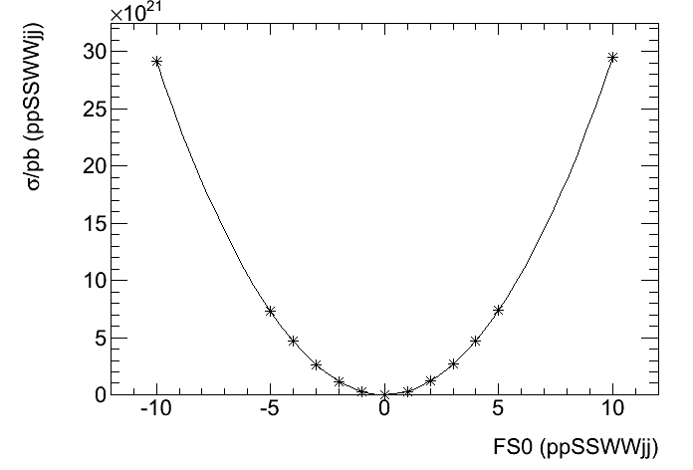
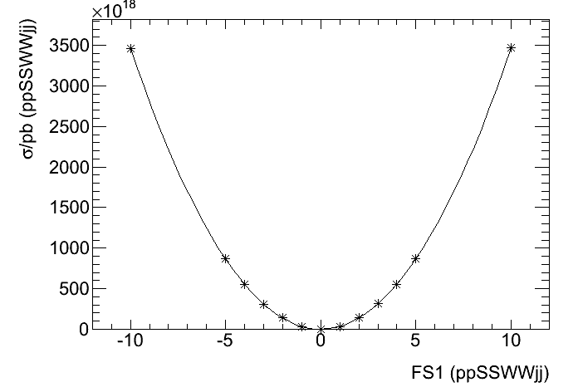
First look at the dim8 operators in SS WWjj
FS0
FS1

Slide 9


