Slide 1
HL-LHC Experiment ECFA Workshop, Aix-les-Bains Oct 1-3 2013
Preparatory group meeting May 22nd 2013
P. Allport, D. Contardo
Workshop organization matters
Plan’s from Preparatory Groups
Steering committee of the workshop (* Chairs):
ALICE: P. Giubellino (SpokesPerson), Hannes Wessels (Deputy SP)
ATLAS: Phil Allport* (Upgrades Coord.), D. Charlton (SP), Beniamino Di Girolamo (Tech. Coord.)
CMS: Austin Ball (Tech. Coord.) and Didier Contardo* (Upgrades Coord.), J. Incandela (SP)
LHCb: P. Campana (SP) Burkhard Schmidt (Deputy SP)
Sergio Bertolucci (CERN Dir. Research), Manfred Krammer (ECFA Chair), Peter Jenni (ATLAS), Michelangelo Mangano (LPCC), Steve Myers (Dir. Accelerators), Jim Virdee (CMS)

Slide 2
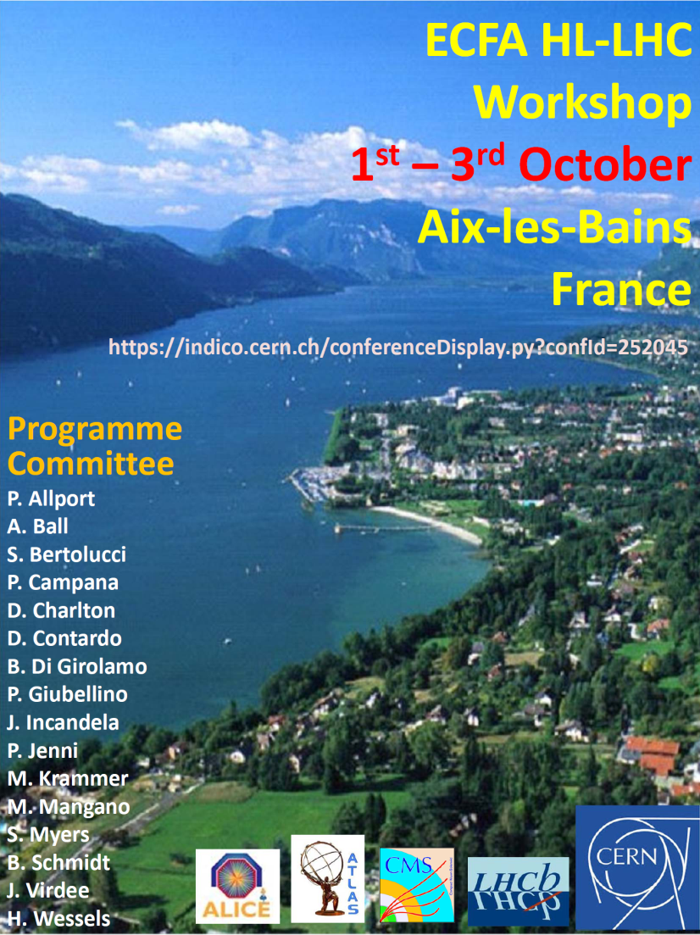
Workshop organization
Start putting information into conference web pages and define registration process and accommodation detailshttps://indico.cern.ch/conferenceDisplay.py?confId=252045
Dawn Hudson (CMS) and Connie Potter (ATLAS) are the contact persons
Dawn visited the congress center in Aix-Les-Bains
  Working out technical details
  Proceeding with price offers
  And setting up a CERN account for the fees
  Fees including room booking, break and
  buffet lunch at the congress center and
  dinner in casino d’Aix-Les Bains should
  be around 180Euros (assuming 500 participants)
Goal to finalize the web page and fees estimate
by the end of the month for workshop wide
announce
Please comment the workshop poster
  Title, “ECFA HL-LHC workshop” or
  “HL-LHC Experiment ECFA workshop” ?
  …
DRAFT POSTER

Slide 3
Next meetings
June preparatory session
  Open to working group proponents and SC (about 90 people) plus few invited people?
  Booked Main Auditorium from 10:30 on (only available room on June 10)
  Presentation from the PGs 30’ plus 10 ‘ discussion
    Proposed agenda
    Detailed outline of the presentations
    Status of availability of the required material and next steps
  Consider overlap between groups and topical common presentations
Sept. preview of the workshop session content
  Chairs report to the workshop SC

Slide 4
Slides from last meeting including update of PG membership

Slide 5
Goals and topics for the Workshop
The HL-LHC Experiment ECFA workshop will be a meeting for the HL-LHC community to discuss the HL-LHC Upgrade programmes
It will address Physics goals, Detector Upgrade requirements and subsequent Technology R&Ds, to develop common approach and to identify synergies, and further possible effort to collaborate in areas of common interest
The four LHC experiments, ALICE, ATLAS, CMS and LHCb contribute to the workshop
The areas to be covered at the workshop include:
  Physics goals, theoretical developments and performance reach
  Tracking devices and associated electronics and readout
  Calorimetry and associated electronics and readout
  Muon systems and associated electronics and readout
  Trigger/DAQ/Offline/Computing
  Electronics and read-out systems
  Long Shutdown constraints and radiation and activation effects
  Accelerator and Experiment interface

Slide 6
Preparatory Groups: Charge
The workshop will be organized with plenary sessions dedicated to each of the areas outlined above
Preparatory groups are formed to identify the key topics to be discussed and to organize the session of the workshop.
They will propose the agenda and the speakers to the workshop Steering Committee
Chairs of the PGs will write a document of few pages to discuss at the workshop which can be used as a basis for summarizing the main outcomes and proposing further steps in each area

Slide 7
Preparatory Groups: Membership (chairs in bold)
  Physics goals and performance reach
    CERN Theory: G.Salam
    ALICE: Peter Braun Munzinger, Andrea Dainese
    ATLAS: Leandro Nisati, Pippa Wells, Bill Murray
    CMS: Chris Hill, Markus Klute, Isabell Melzer-Pellmann
    LHCb: Tim Gershon, Guy Wilkinson
  Tracking devices and associated electronics and readout
    ALICE: Vito Manzari, Werner Riegler
    ATLAS: Ingrid Gregor, Didier Ferrere, Craig Buttar
    CMS: Duccio Abbaneo, Francois Vasey, Stefano Mersi
    LHCb: Massimiliano Ferro-Luzzi
  Calorimetry and associated electronics and readout
    ALICE: David Silvermyr
    ATLAS: Francesco Lanni, Alberto Valero
    CMS: Dave Barney, Pawel. De Barbaro, Marcello Mannelli
    LHCb: Frederic Machefert
  Muon Systems and associated electronics and readout
    ALICE: Pascal Dupieux
    ATLAS: Christoph Amelung, Oliver Kortner, Stefano Veneziano
    CMS: Marcello Abbrescia, Kerstin Hoepfner, Alexei Safonov
    LHCb: Alessandro Cardini

Slide 8
Preparatory Groups: Membership (chairs in bold)
  Trigger/DAQ/Offline/Computing
    ALICE: Pierre Vande Vyvre, Thorsten Kollegger, Predrag Buncic
    ATLAS: David Rousseau, Benedetto Gorini, Nikos Konstantinidis
    CMS: Wesley Smith, Christoph Schwick, Ian Fisk, Peter Elmer
    LHCb: Renaud Legac, Niko Neufeld
  Electronics and read-out systems
    ALICE: Alex Kluge
    ATLAS: Philippe Farthouat, Maurice Garcia-Sciveres, Tony Weidberg
    CMS: Magnus Hansen, Jorgen Christiansen
    LHCb: Ken Wyllie
  Long Shutdown constraints and radiation and activation effects
    ALICE: Werner Riegler
    ATLAS: Olga Beltramello, Beniamino Di Girolamo
    CMS: Wolfram Zeuner, Christoph Schaefer
    LHCb: Rolf Lindner
  Accelerator and Experiment interface
    CERN Accelerator: L. Rossi, O. Bruning
    ALICE: Hannes Wessels
    ATLAS: Christoph Rembser, Beniamino Di Girolamo, Antonio Sbrizzi
    CMS: Wolfram Zeuner, Maria Chamizo Llatas (CMS)
    LHCb: Burkhard Schmidt

Slide 9
Preparatory Groups: Modus Operandi
The chairs of PGs organize meetings with proponents to fulfil the objectives outlined above.
It is proposed to set-up a common TWIKI page ( need volunteer)
to collect and circulate information and progress of each group.
The meetings of the groups will be open to members of other groups, especially to cover cross-aspects (eg specific detector physics aspects, electronics systems…),
Experts outside the group can also be invited by the chairs. The chairs of the groups will report plans and progress to the workshop Steering committee.
E-mail list of the group members: PGMembers-HL-LHC-ECFA@cern.ch

Slide 10
Agenda session scheme for discussion (length/order of session indicative)
  Tuesday 1 morning 9:20 - 13:00
    Registration 8:30 - 9:30
    Introduction by ECFA 30’
    Introduction by CERN Management 30’
    Break 30 ’
    Theory overview 1 h
    LHC upgrade overview 1h
  Wednesday 2 morning 9:00 - 13:00
    Tracking devices and associated electronics and readout 1h45’
    Break 30’
    Calorimetry and associated electronics and readout 1h45’
  Thursday 3 morning 9:00 - 13:00
    Electronics and read-out systems 1h45’
    Break 30’
    Accelerator and Experiment interface 1h:45
Lunch 13:00-14:00
Tuesday 1 Afternoon 14:00 - 18:30
  Experiment Upgrade 2h (4 experiments)
  Break 30’
  Physics goals and performance reach 2h
  Reception 19:00
Lunch 13:00-14:00
Wednesday 2 Afternoon 14:00 - 18:30
  Muon Systems and associated electronics and readout 1h45’
  Break 30’
  Trigger/DAQ/Offline/Computing 1h45’
  Diner 20:00
Lunch 13:00-14:00
Thursday 3 Afternoon 14:00 - 16:30
  Long Shutdown constraints and radiation and activation effects 1h45’
  Concluding remarks Next steps - proposed future ECFA Workshops 30’
  End of the workshop
Note: 2-3 topical presentations per session common to 4 experiments (eg. detector systems 1) motivation/concepts 2) R&Ds …)

