Slide 1




jAliEn Java AliEn middleware
A. Grigoras, C. Grigoras, M. Pedreira
P Saiz, S. Schreiner
ALICE Offline Week – June 2013

Slide 2
AliEn2 – Current status
TASKQUEUE
Site 1
All components to create a GRID
File Catalogue
UNIX-like file system
Mapping to physical files
Metadata information
SE discovery
Transfer Model
With different plugins
TaskQueue
Job Agent & pull model
Automatic installation of software packages
Simulation, reconstruction, analysis...
xrootd
CE
CREAMCE
Job
Optimizer
JA
MonALISA
Job
Manager
Site 2
Job
Job
Broker
Job
xrootd
Job
CE
File catalogue
CREAMCE
JA
MonALISA
LFN
GUID
Meta
data
Perl, C/C++, Bash scripting
~ 150 packages to maintain

Slide 3
Why jAliEn
ALICE uses MonALISA for monitoring
Jobs, transfers, site services, central services, real-time and accounting data, network topology discovery, storage elements functional tests and many more
Based on the monitoring information a framework was developed to steer in an automatic way central productions, data registration and replication
Gradually this framework grew in a full implementation of the AliEn objects and interactions with the central databases
File Catalogue: LFN, GUID, PFN, SE, booking table
Job, JDL and TaskQueue interactions
Users, quotas
gLite packages for proxy­based authentication
Support for signed JDLs by all parties involved
Access envelope generation, storage management, transfer methods
Parallel replica uploads and downloads for efficient end-user interaction with the federated SE space
and the rest of supporting objects and methods in AliEn

Slide 4
Why jAliEn
Next step is to provide a full end-to-end Java implementation of AliEn
More efficient communication infrastructure
Persistent, compressed, SSL channels
Exchanging Java serialized objects
Multi­layered channel multiplexing and object caching
Logging and error propagation
No tokens for authentication, simply use the Grid certificate
Better real­time monitoring of all components
Platform­independent, easily maintainable code

Slide 5
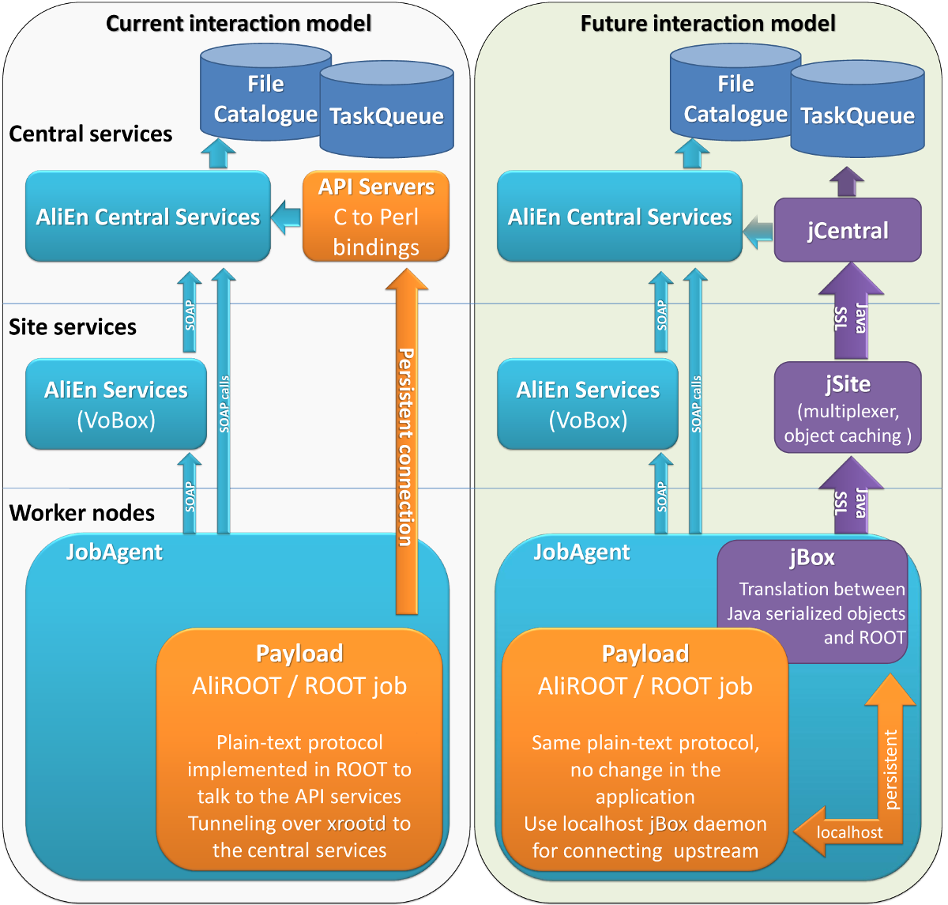
AliEn2 vs jAliEn

Slide 6
JCentral
Implement all AliEn objects in Java (LFN, PFN, GUID, Job, SE, access envelopes, users etc)
Direct connections to the DBs for all operations
Only kill is handed out to AliEn
Delegates presentation to the end client
Implement the minimal set of commands as API calls via serializable objects
Encapsulating requester identity
A single entity provides all functionality required by the clients, trivial to scale out

Slide 7
JSite
Trusted entities that multiplex requests to the central services
Some of the objects are cacheable and can be quickly returned to the requester
For example OCDB file locations, SE status, Grid status …
Can be cascaded indefinitely in order to reduce the number of sockets per server to a reasonable number
Or can be missing altogether, for small sites or opportunistic resources
Running as another AliEn service on the site VoBox

Slide 8
JBox
Authentication and authorization
No more proxies for the users
Communication
Listing, opening and writing files
Submitting and accessing job information
Components
Java daemon responsible for authentication/authorization and communication between user applications and central services
Java shell client – same aspect and functionality as previous client
Commands implemented as classes using introspection
ROOT implementation of TGrid functionality

Slide 9
Current status
ALICE MonALISA uses it fully
LPM and user job management and accounting
Catalogue browser, file editing, quotas, collections...
Storage cleanup, all scheduled file transfers
Communication channels working fine
Many end­user commands are implemented in JBox
cat, cp, mv, rm, rmdir, find, ls, cd, pwd, mkdir, guid2lfn, lfn2guid, ps, masterjob, packages, submit, kill, whereis, w, uptime, type, time, role, access, commit
ROOT implementation of the new plugin is next
Missing commands & options, polishing, packaging …

Slide 10

Conclusions
jAliEn is the next version of AliEn Grid middleware
The transition will be done step by step until all services are replaced by jAliEn services

Slide 11
Feedback is very welcome
$ svn co http://jalien.cern.ch/svn/alien-java/trunk alien-java
$ cd alien-java
$ ./compile.sh
$ ./jalien setup
$ ./jalien

